Slide 1
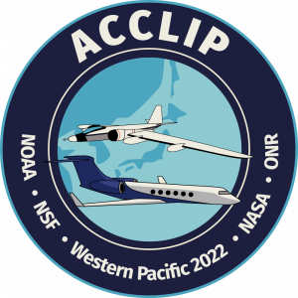

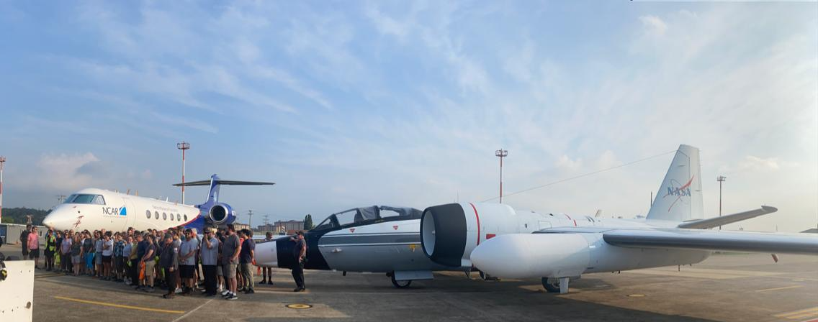
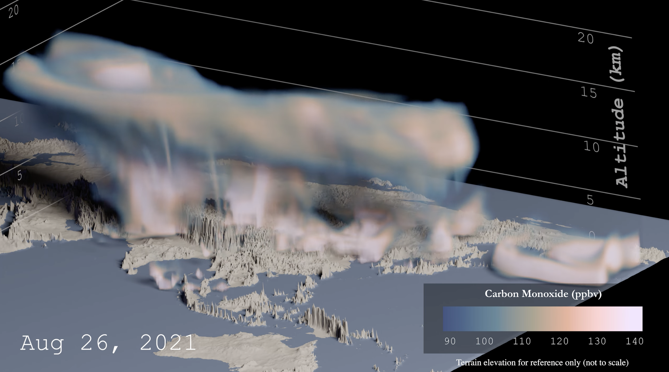
ACCLIP: Asian Summer Monsoon Chemical and Climate Impact Project
ACCLIP is an interagency effort to investigate the transport of pollutants and other gases from the Asian Summer Monsoon (ASM) region to the global atmosphere. Two aircraft (NASA WB-57 and NCAR G-V) were deployed together in South Korea from late July through early September 2022 to obtain a comprehensive suite of dynamical, chemical and microphysical measurements in the ASM outflow. A key objective was to determine the impact of ASM uplifted air on stratospheric ozone chemistry and global climate.
Ames played leadership roles in forecasting and flight planning, operation of two major instrument payloads, and project management.
Early Findings. NASA WB-57 successfully completed 15 science flights to sample ASM air that was transported eastward into the Korean and Japanese airspace. The outflow from strong monsoon convection over the most polluted boundary layer on Earth appears to have distinct chemical signatures in the upper troposphere and lower stratosphere that reflects the combination of surface sources, convective pumping, and subsequent photochemical processing. These measurements will be critical for determining the radiative impact of ASM air and for improving chemistry-climate interactions in global climate models.
Next Steps. Data from this summer’s deployment is currently being calibrated and quality controlled for public archival. Science team meeting is scheduled this November to discuss preliminary findings and analysis ideas.
For more info: https://espo.nasa.gov/acclip
ACCLIP operations at South Korea
Top: Team photo in front of NASA WB-57 (right) and NCAR G-V (left) at Osan Air Base, South Korea.
Bottom: 3-D depiction of a cloud of carbon monoxide, a key pollutant measured by Ames instrument, being uplifted by Asian monsoon convection and transported eastward over our flight domain. (NCAR/CISL)

Slide 2
