Slide 1
Met Brief, 20130820
Lenny Pfister
Nick Heath

Slide 2
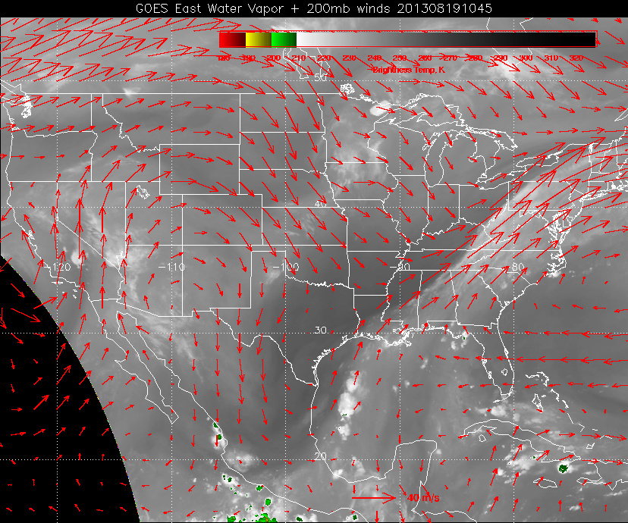

Slide 3
Outline
Tomorrow’s flight
Convection
Surface temperatures
Convective outflow
Friday’s flight
East Coast trough and frontal approach
Upper level flow
Ellington Weather

Slide 4
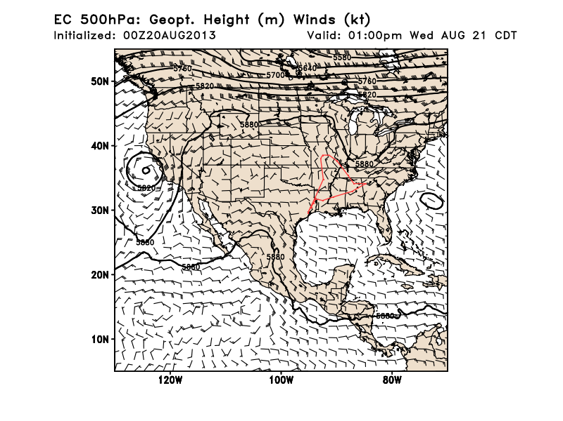
500mb pattern tomorrow. Most of the flow is near Canadian border. With moisture supply at
low levels from the Gulf, big convective systems are propagating west-east in
southern Canada.
Trough retracting somewhat, but SW-NE flow is still expected to play a role in organizing the
convection in SE.

Slide 5
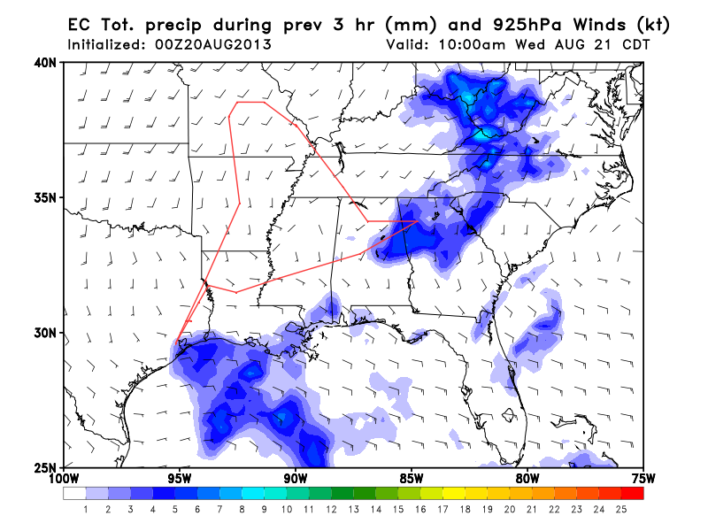
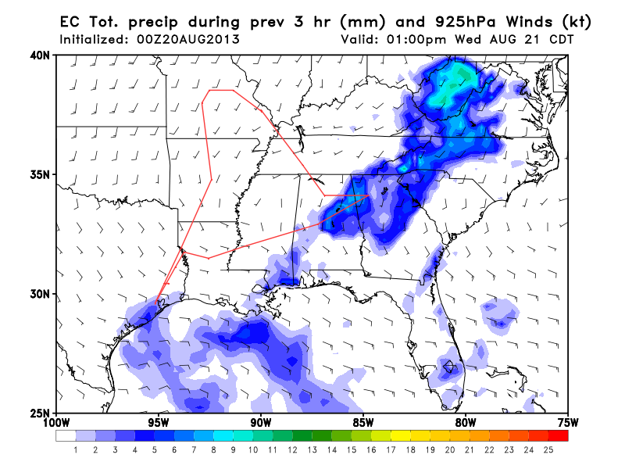
10 AM
Morning convection off the coast
expected. In the afternoon, expect
convection in Northern AL.
This model is displacing convection
further east than the others. Still, expect
no rain over Arkansas.
1 PM

Slide 6
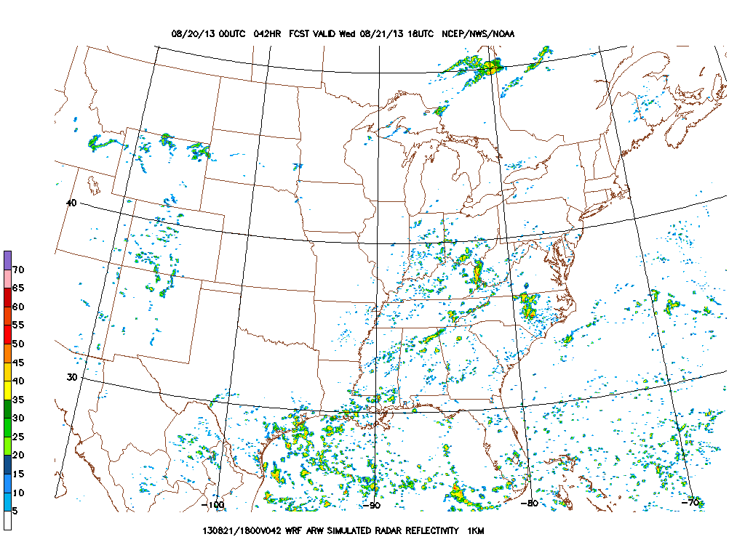
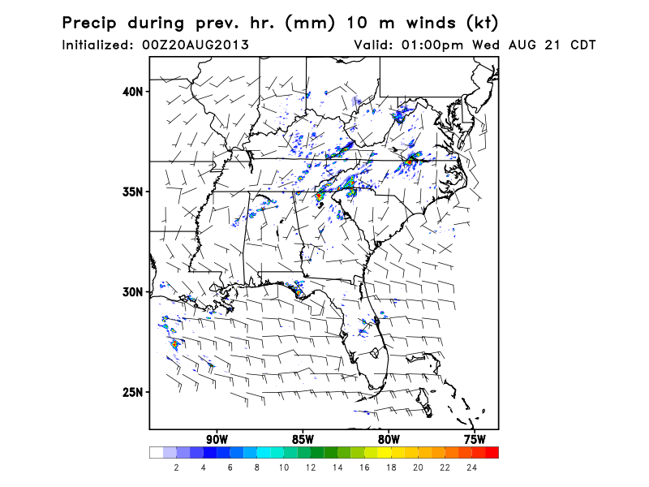
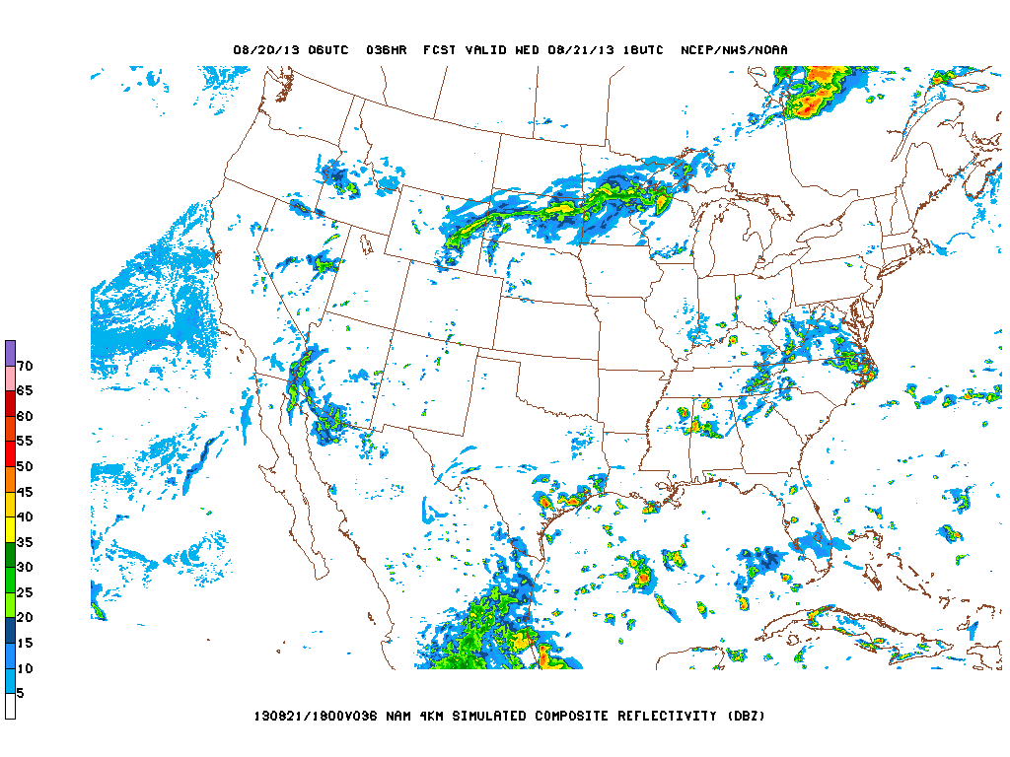
WRF-ARW
1 PM convection
NAM-hires
High resolution models have variations,
but all show similar SW-NE organization.
Very little west of the Mississippi
Very little over the coast at this time.

Slide 7
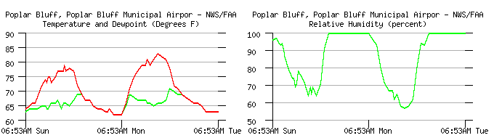
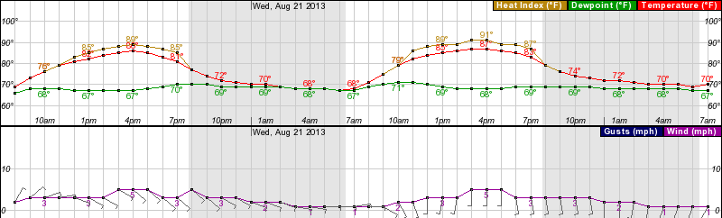
Surface Temperature
Poplar Bluff (SE MO)

Slide 8
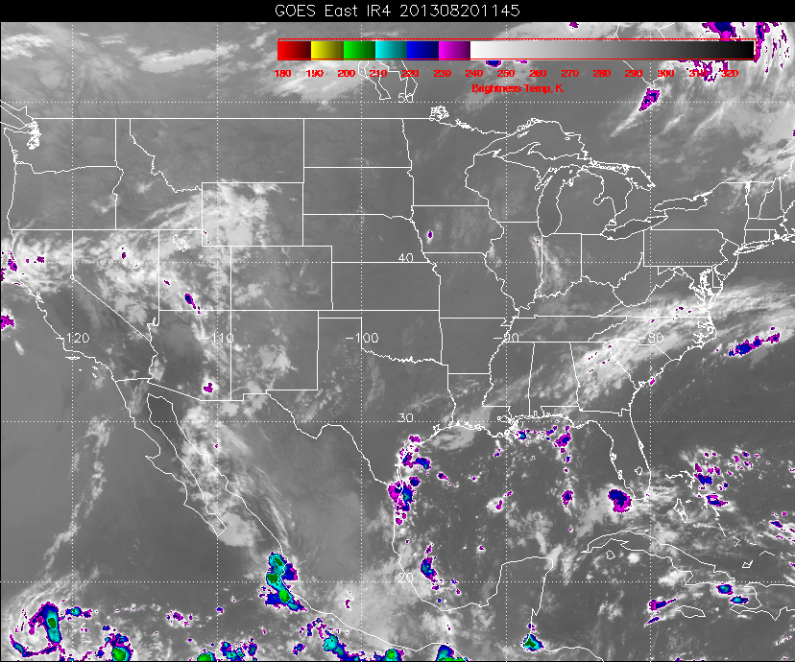
Convective outflow for tomorrow (recent)

Slide 9
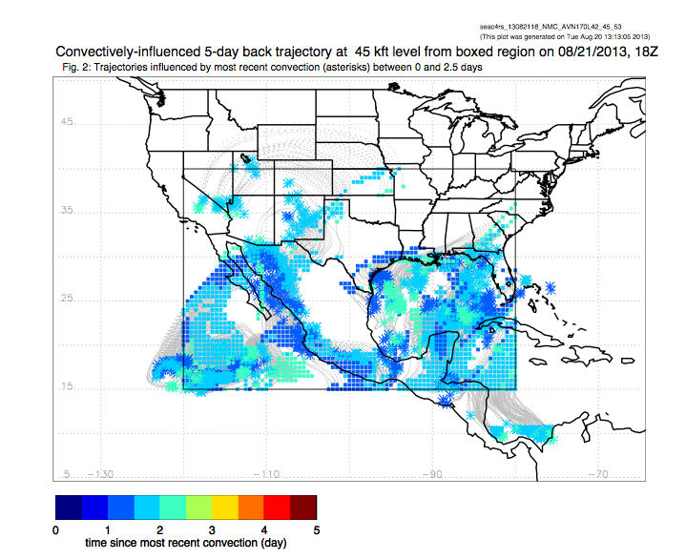

Slide 10
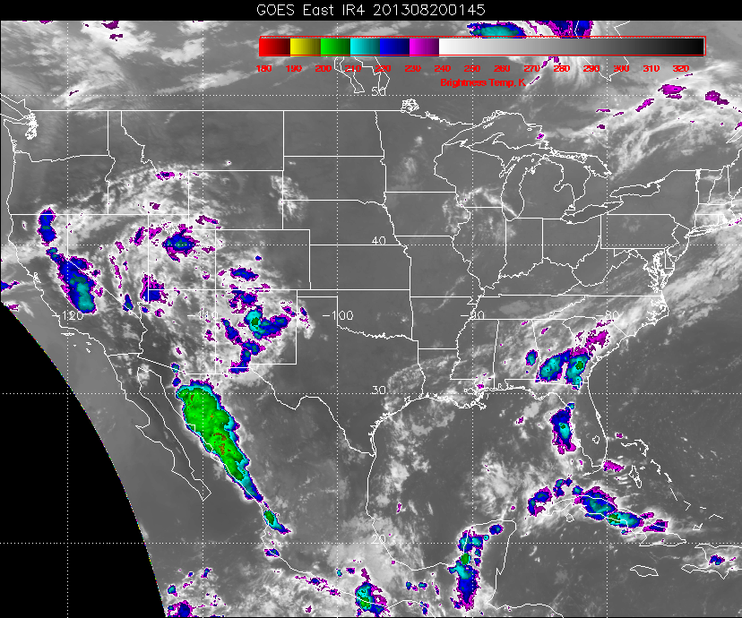
Convection in the West and in Northern Mexico

Slide 11
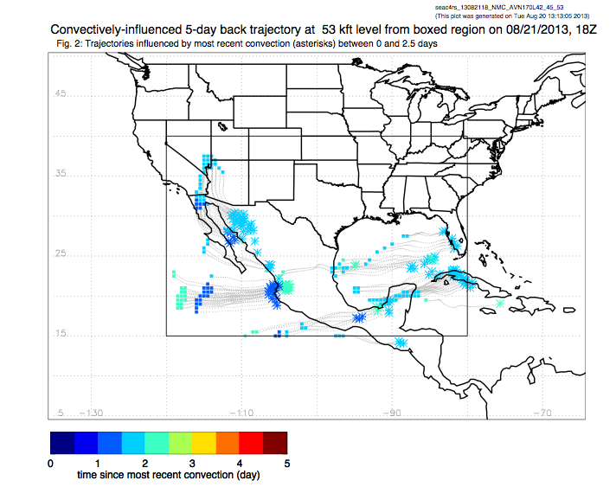
Outflow from Mexican convection at 100mb going around anticyclone into US.

Slide 12
Friday
500mb pattern shows current trough lifting and moving, and then replaced by
a longer and deeper trough. This is accompanied by a front, which will penetrate
beyond the Ohio valley and affect SEUS, especially east of the Mississippi.

Slide 13
Short wave, “old” trough that has been over us, retracted to Ohio valley on Wed

Slide 14
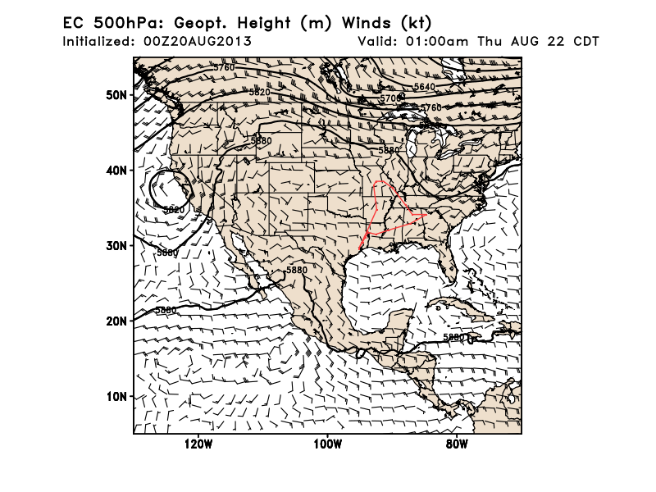
Trough retracting further and moving east, Note stronger trough rotating around HB low

Slide 15
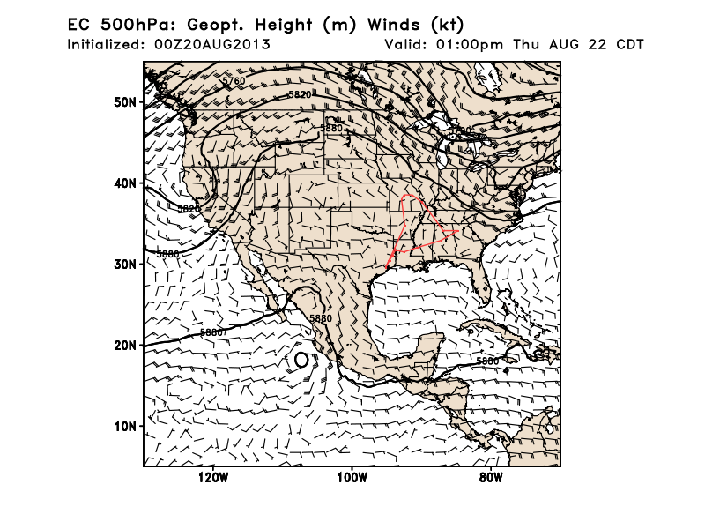
Trough amplifies

Slide 16
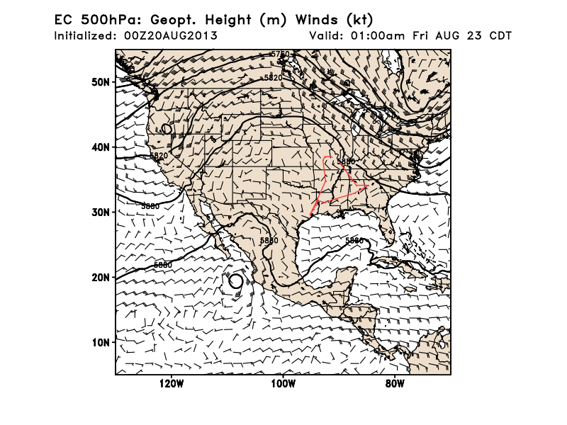

Slide 17
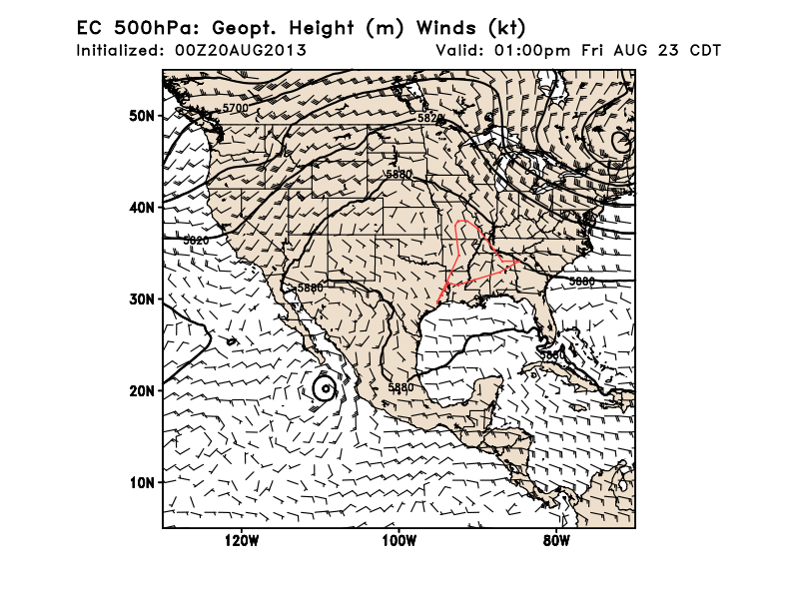
Further amplification

Slide 18
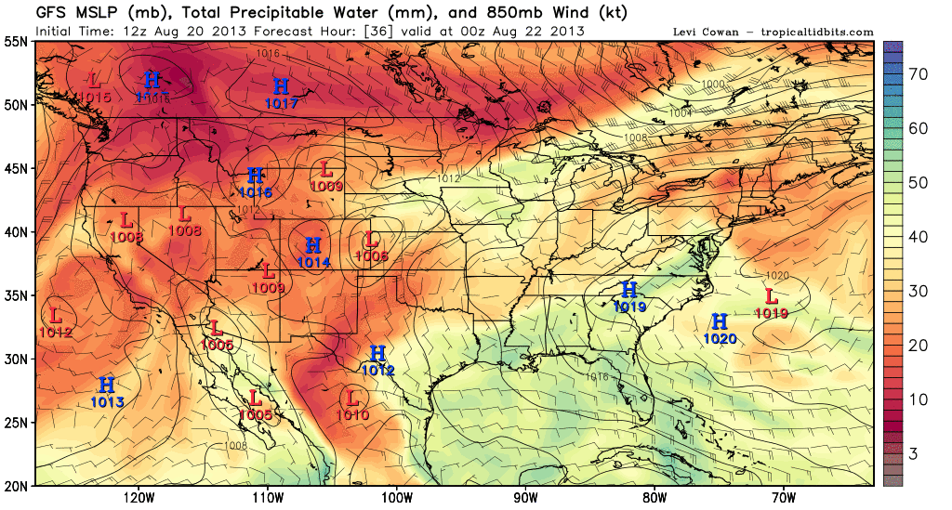
Wednesday 7 PM – Friday 7 PM: Precipitable water, MSLP, and 850 hPa winds
Surface features as east coast trough amplifies.
Interpretation: Wind does shift to northerlies in Alabama, but basic air mass does not
change much. Not ideal “stagnant” situation, but temps in AR and AL will still be high

Slide 19
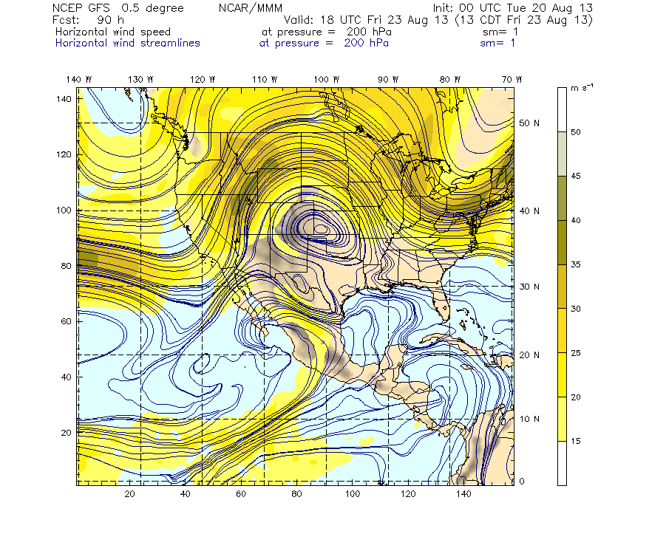
200mb streamlines for Friday. This looks very favorable for a flight into the
anticyclone. Also, western convection (US and Mexico) has been very
active.

Slide 20
Next Monday

Slide 21
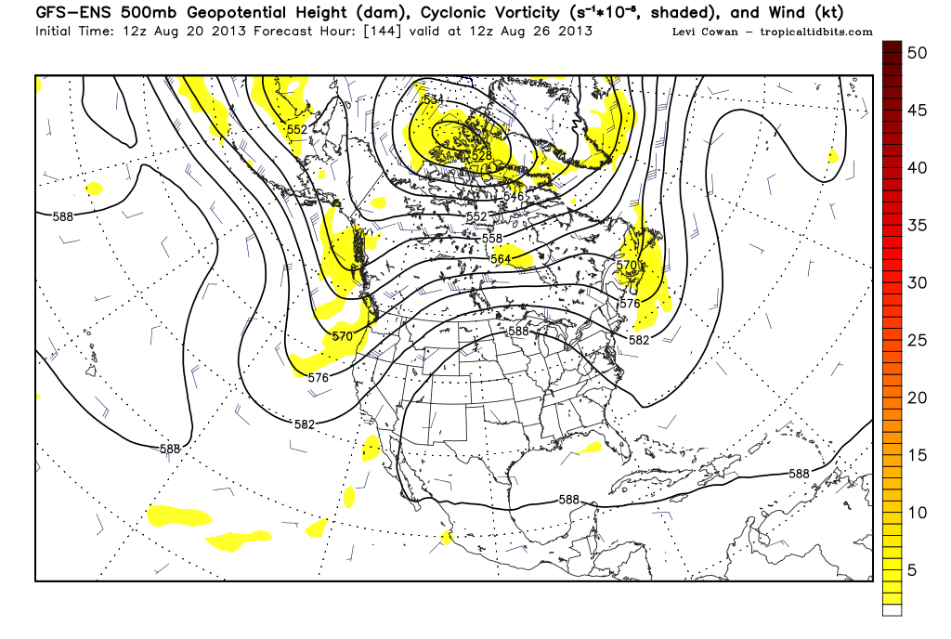
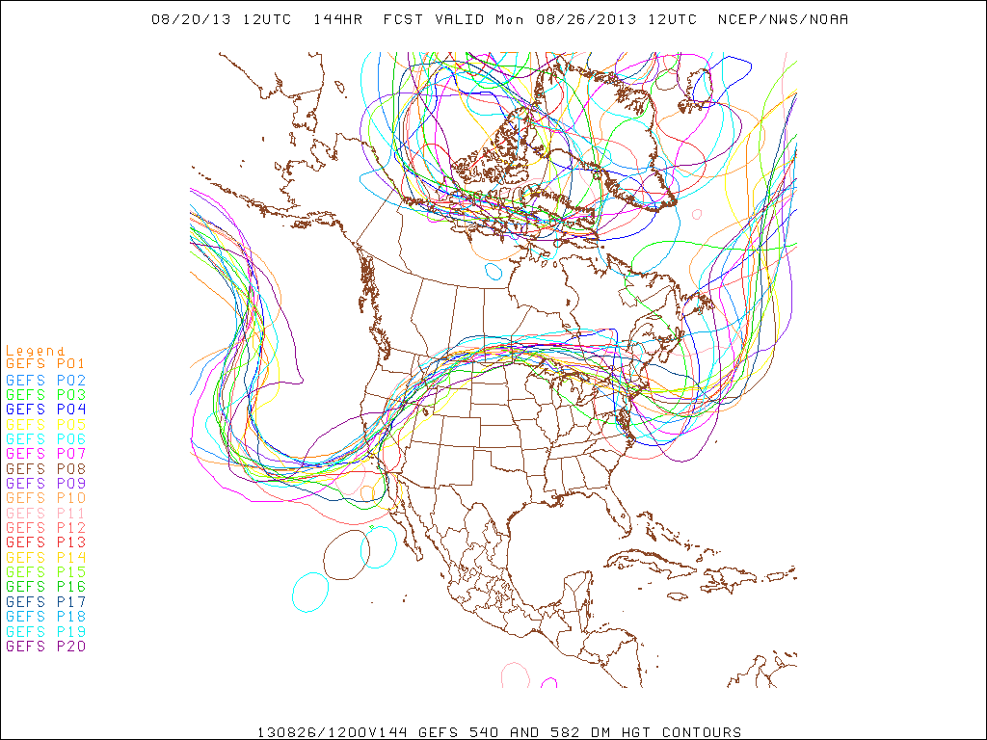
Long range forecast. Ridge
over central US, displaced
eastward relative to climo.
Suggests diurnal convection
in our region, fairly stagnant
conditions. Smoke might
be hard to get to

Slide 22
Landing/TO

Slide 23
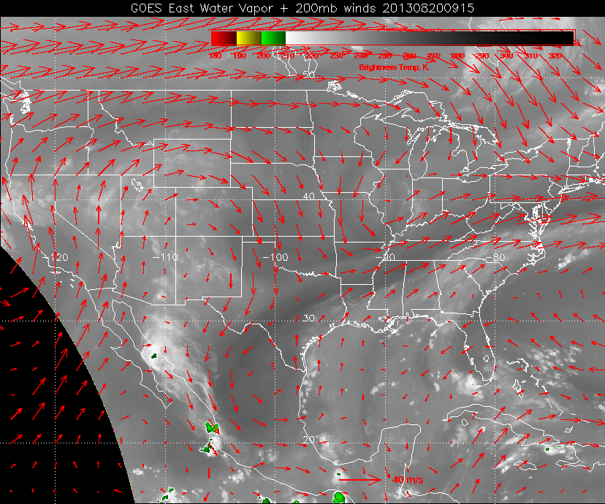
Note surge of moisture approaching hitting us now. Expect dry slot to be over us
sometime tomorrow. Then following moist area on Thursday. Houston office
raises chances of precip on Thursday, probably because of this.

Slide 24
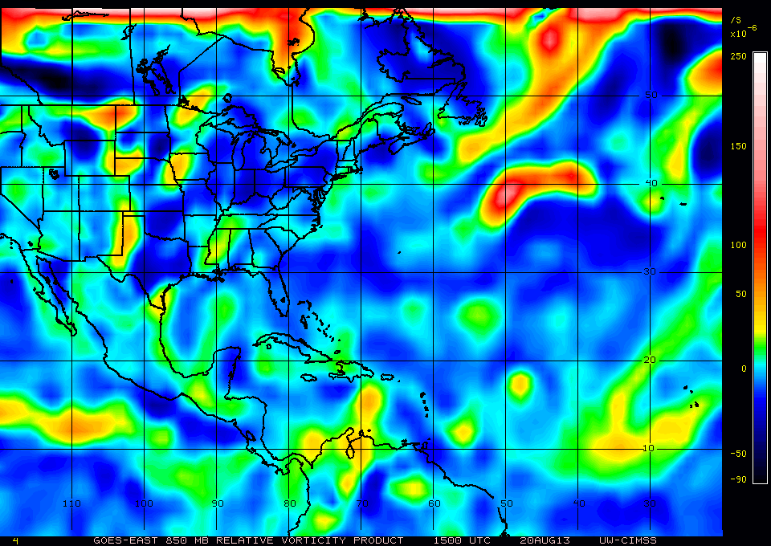
850 hPa relative vorticity at 10 AM CDT this morning
May affect us Wed night and Thurs
Affecting us now

Slide 25
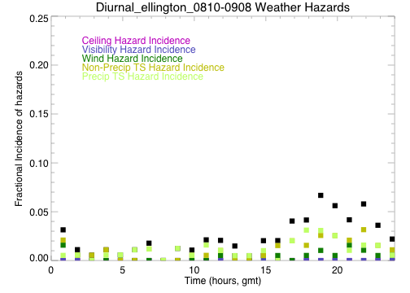
Landing/TO
Forecast points to an upcoming wet period
Today, an EFD lightning warning occurred about an hour ago.
Enhanced moisture will amplify the typical diurnal cycle of weather hazards
Weak tropical waves can interfere with this (e.g., showers south of us today)

Slide 26
Summary
Northern AL looks reasonable for convective development tomorrow afternoon.
Expect AR surface temps to be around 87-88 tomorrow.
Convective outflow (fresh) at 45kft expected off the Gulf Coast tomorrow afternoon.
Trough development off US east coast for Friday. Will affect our weather – AR and AL still warm. AL has weak winds, but not stagnant.
NAM conditions favorable for Friday
Long range forecast (Monday) indicates ridge over central US, east of climo position.
We are in for a wet period in Houston for the next 5 days. Expect amplification of the diurnal cycle of T-storms

