Slide 1


Weather Brief
05 September 2013
Nick Heath
Lenny Pfister
Tristan Hall
Jim Bresch

Slide 2
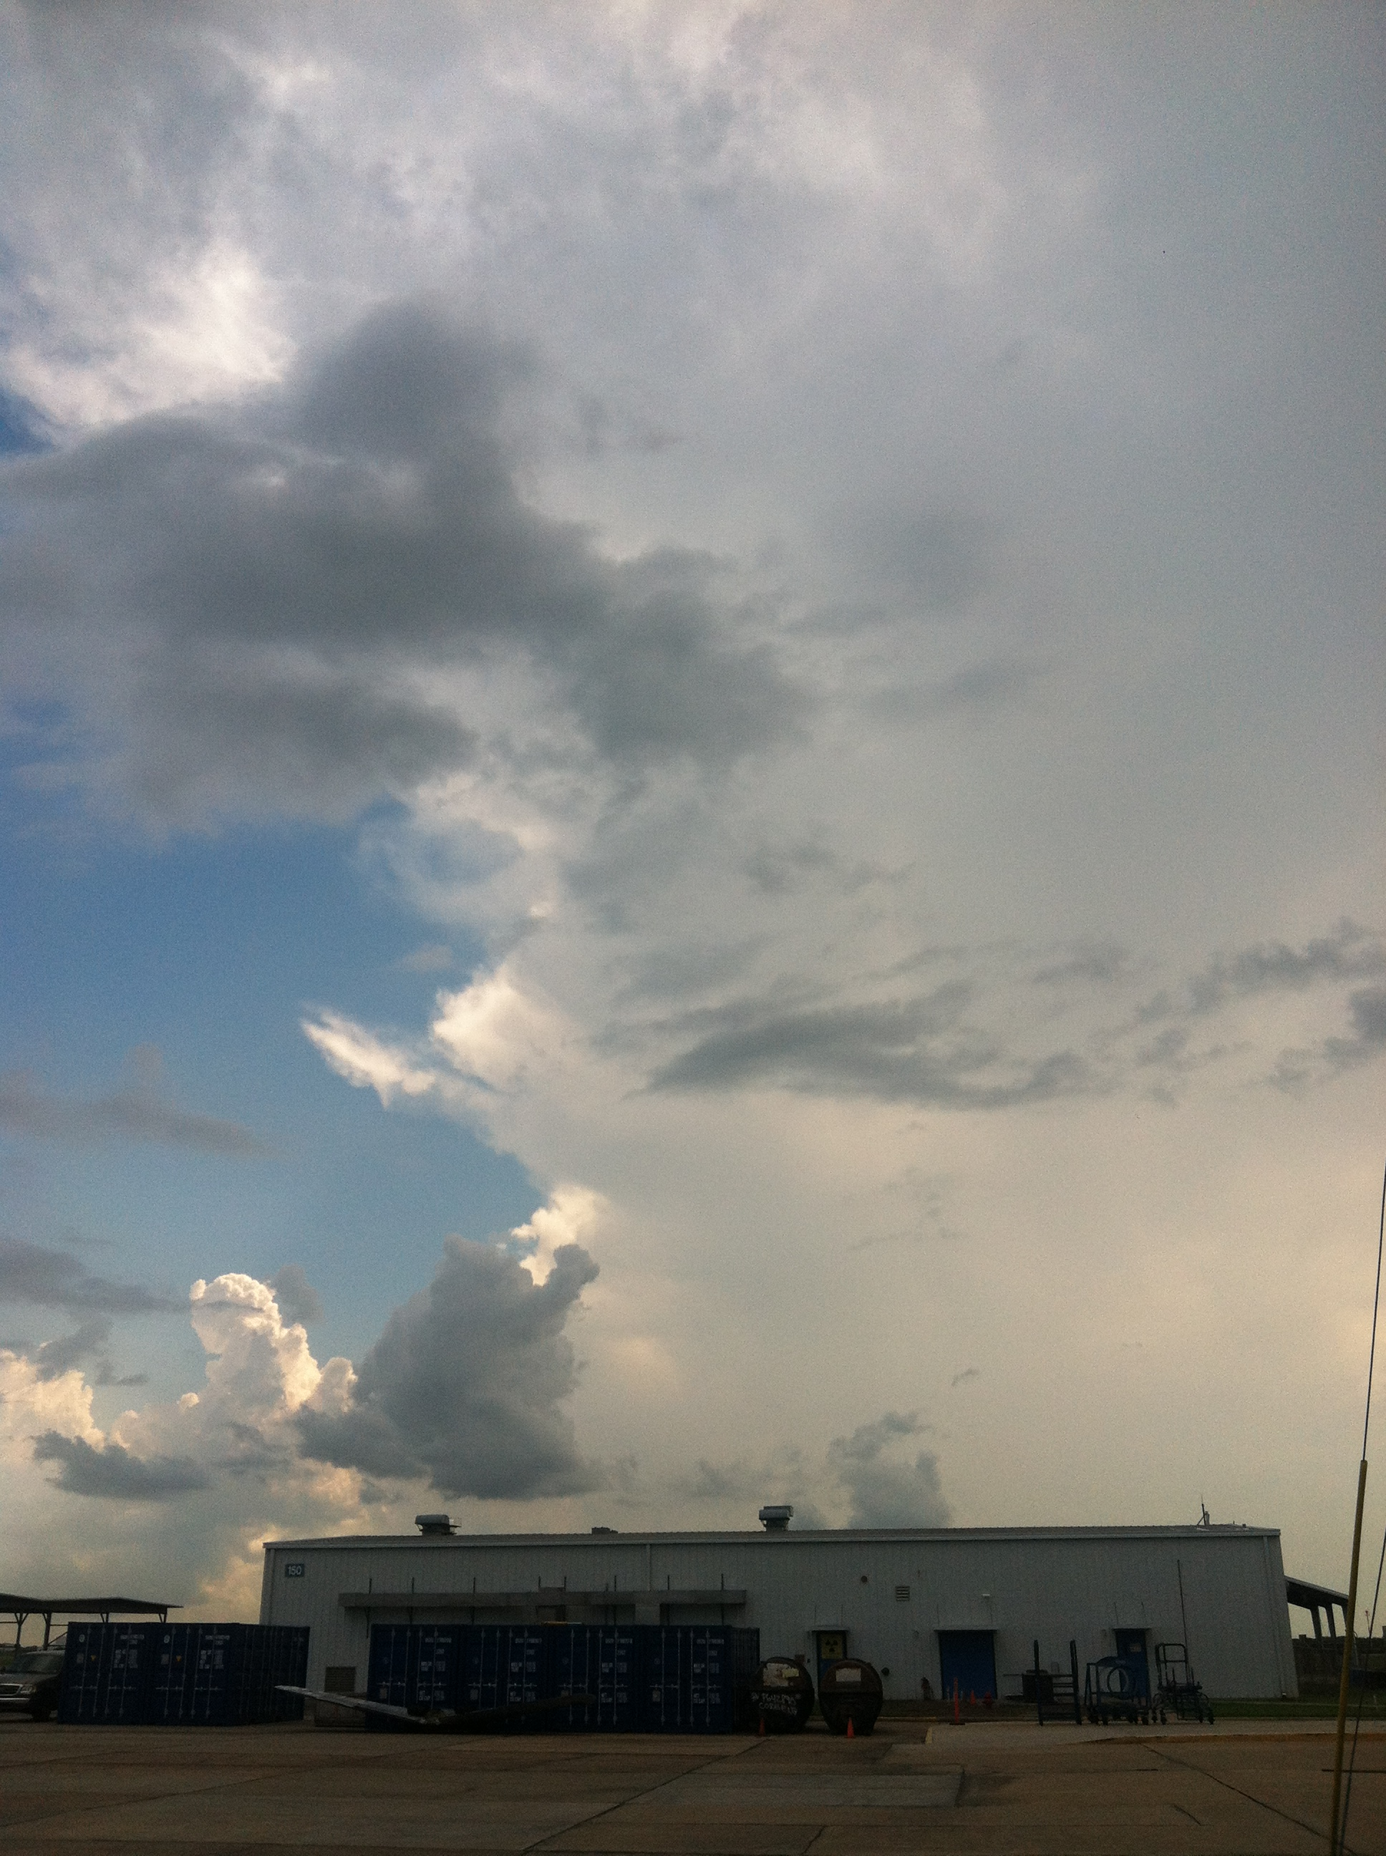
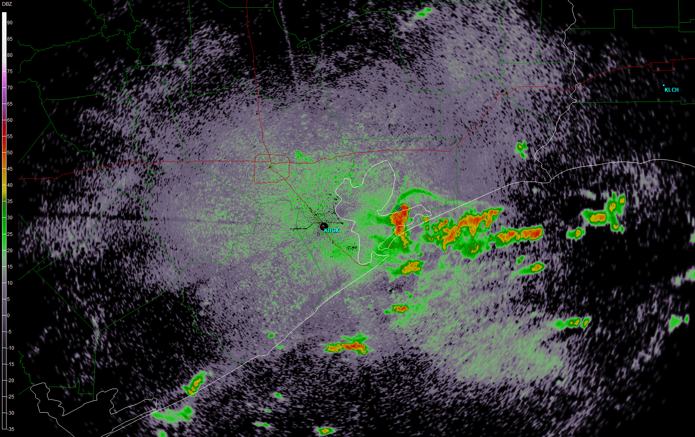
Anvil “shield”
10:00 AM

Slide 3
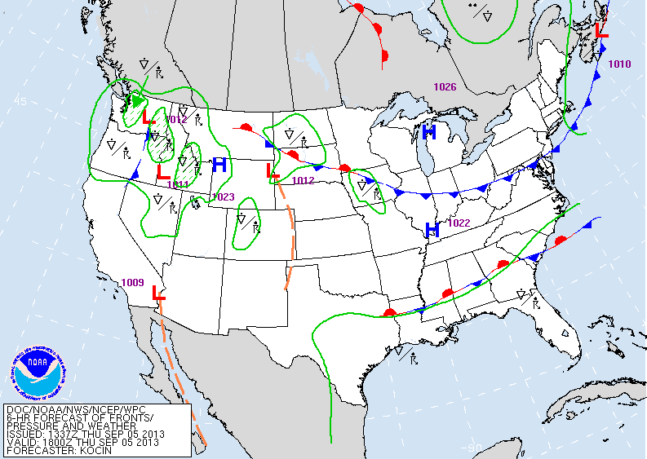
Current Surface Analysis

Slide 4
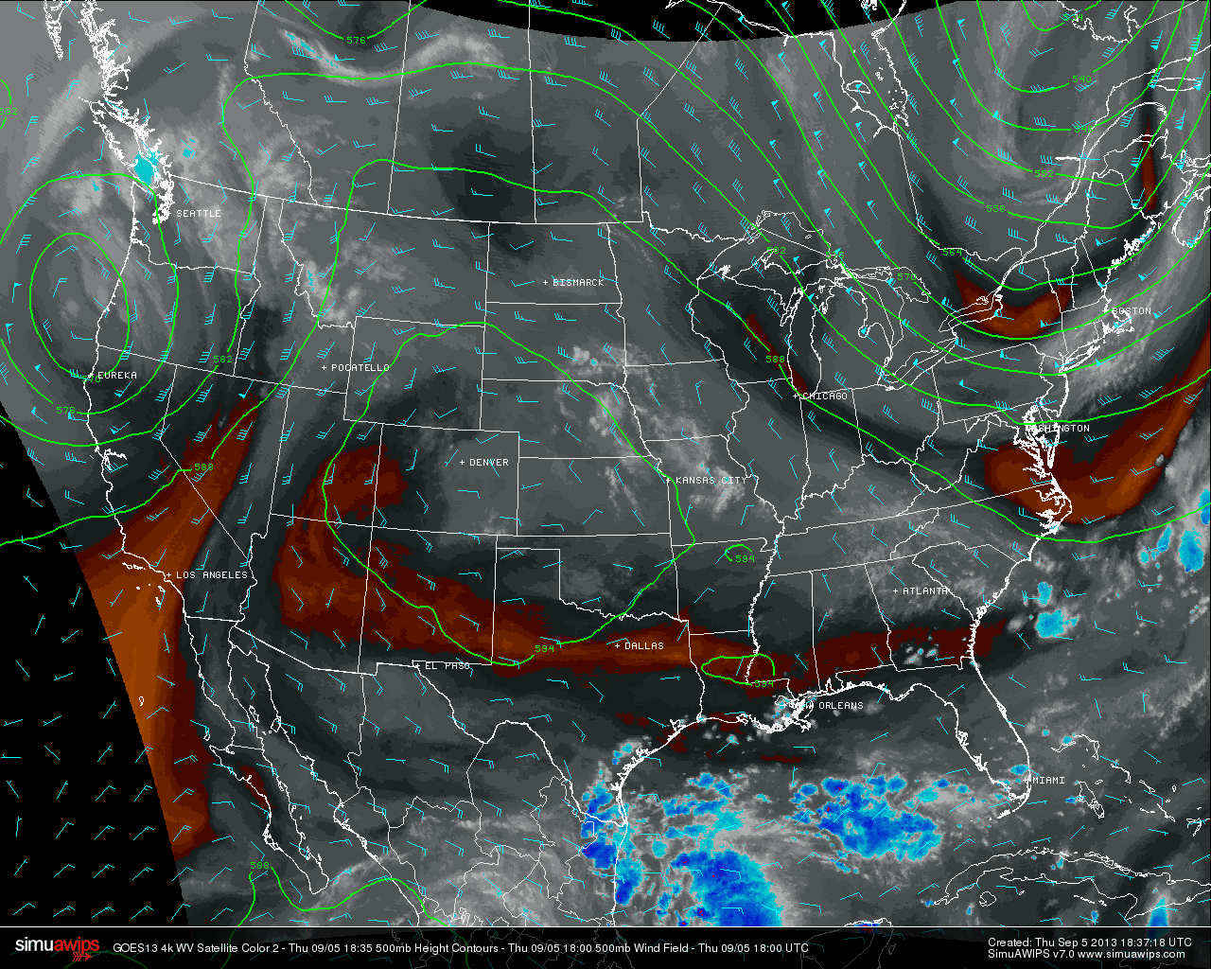
Current Analysis: 500 hPa and water vapor

Slide 5
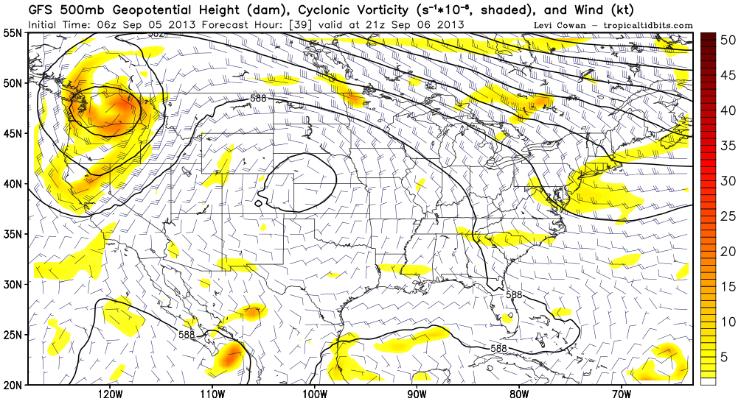
Evolution at 500 hPa: 4 PM Friday

Slide 6
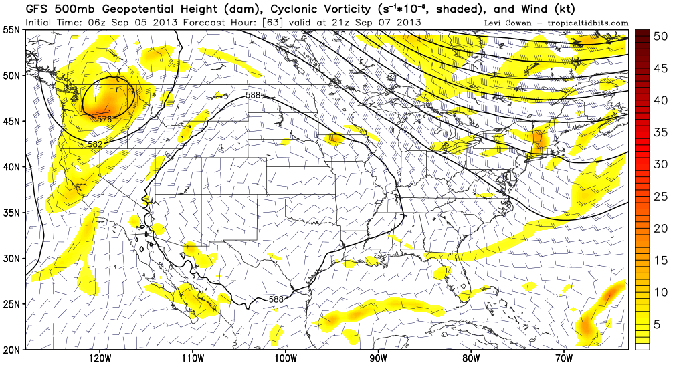
Evolution at 500 hPa: 4 PM Saturday

Slide 7
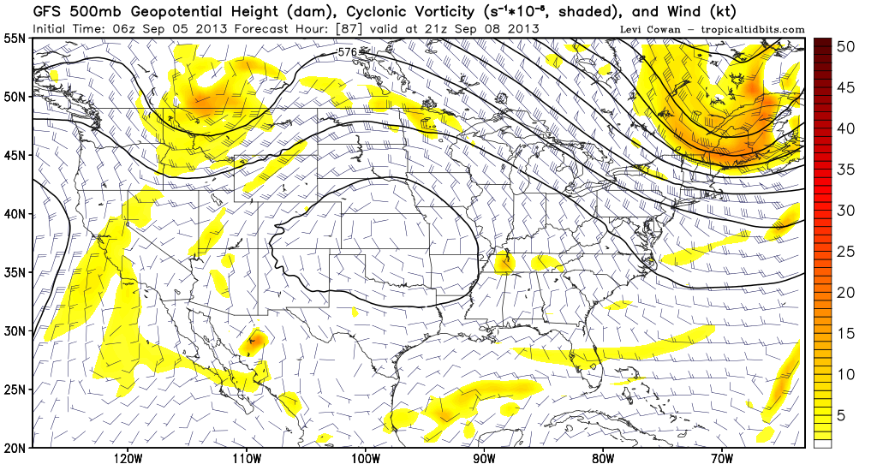
Evolution at 500 hPa: 4 PM Sunday

Slide 8
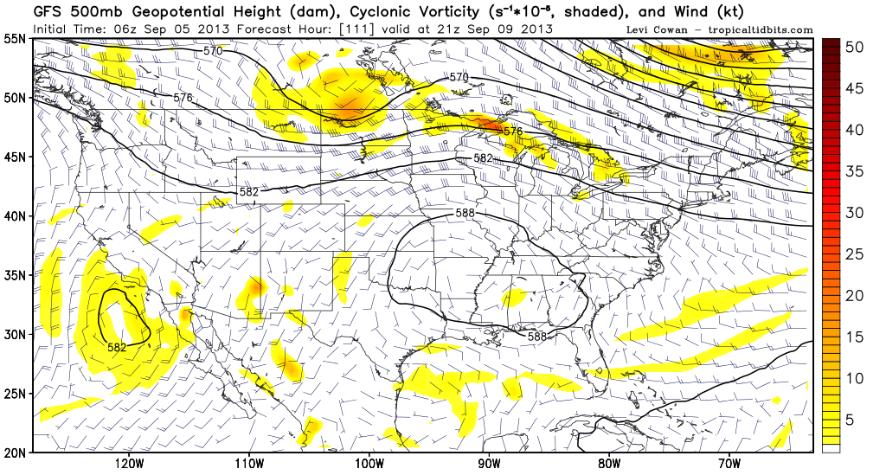
Evolution at 500 hPa: 4 PM Monday

Slide 9
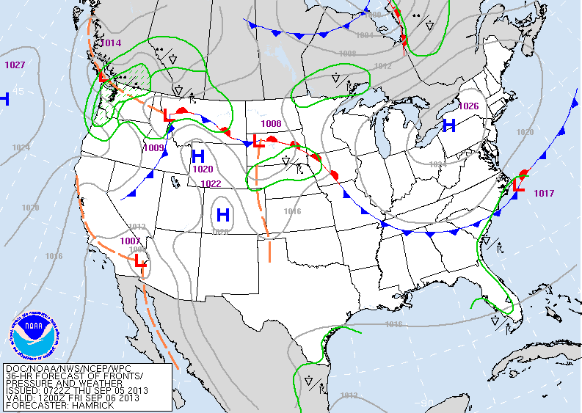
Evolution at the surface: 7 AM Friday

Slide 10
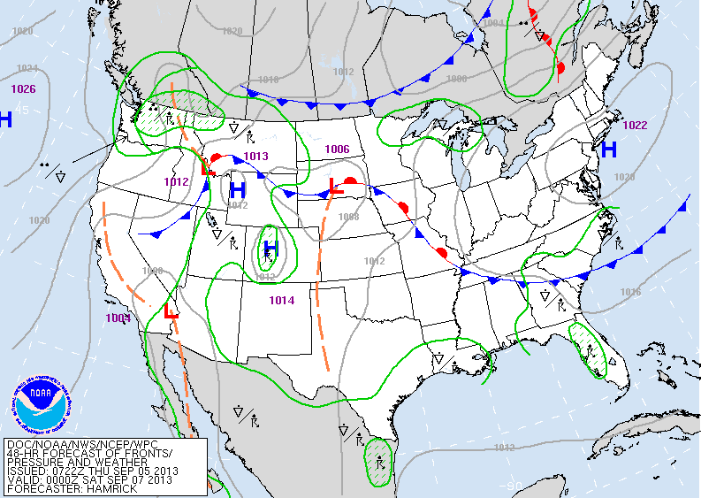
Evolution at the surface: 7 PM Friday

Slide 11
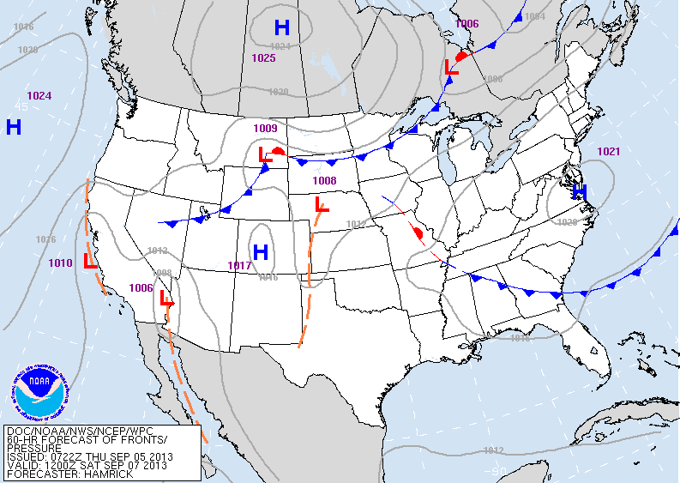
Evolution at the surface: 7 AM Saturday

Slide 12
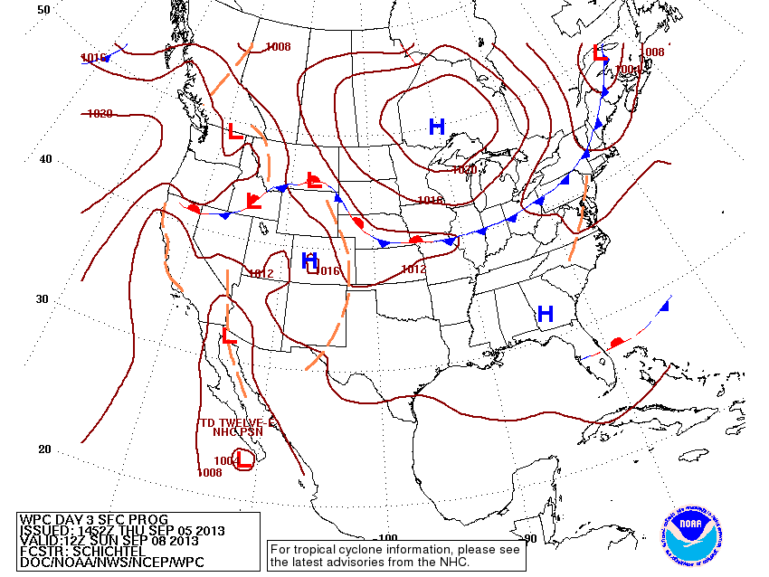
Evolution at the surface: 7 AM Sunday

Slide 13
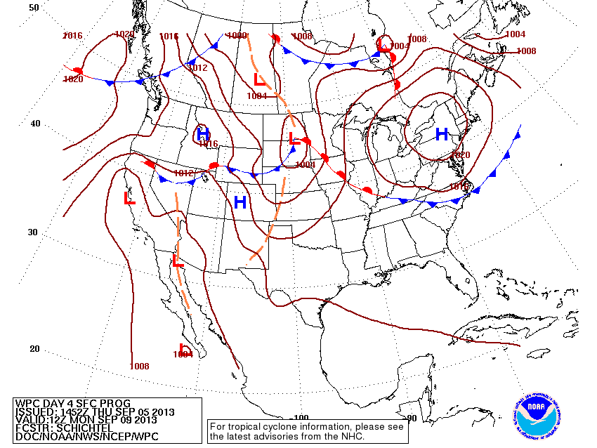
Evolution at the surface: 7 AM Monday

Slide 14
Tomorrow’s Flight

Slide 15
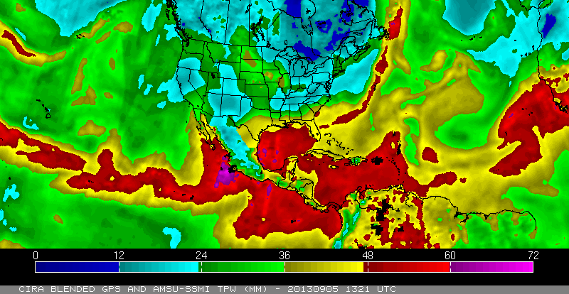
Friday’s Flight: Takeoff

Slide 16
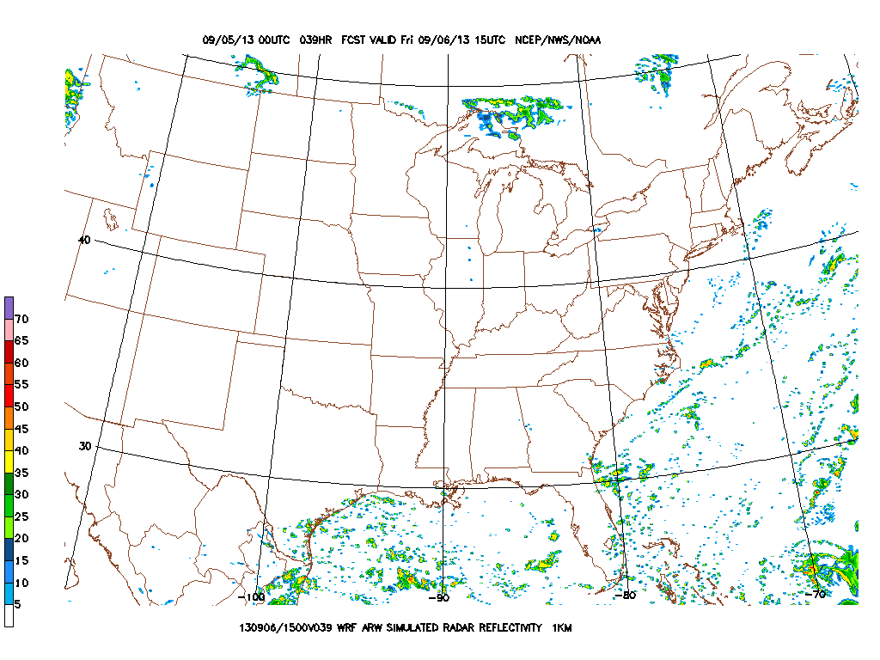
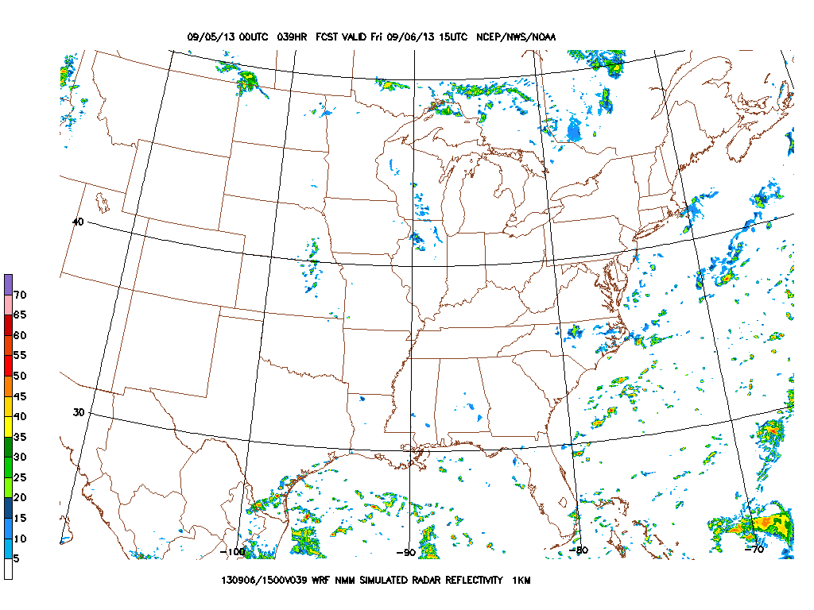
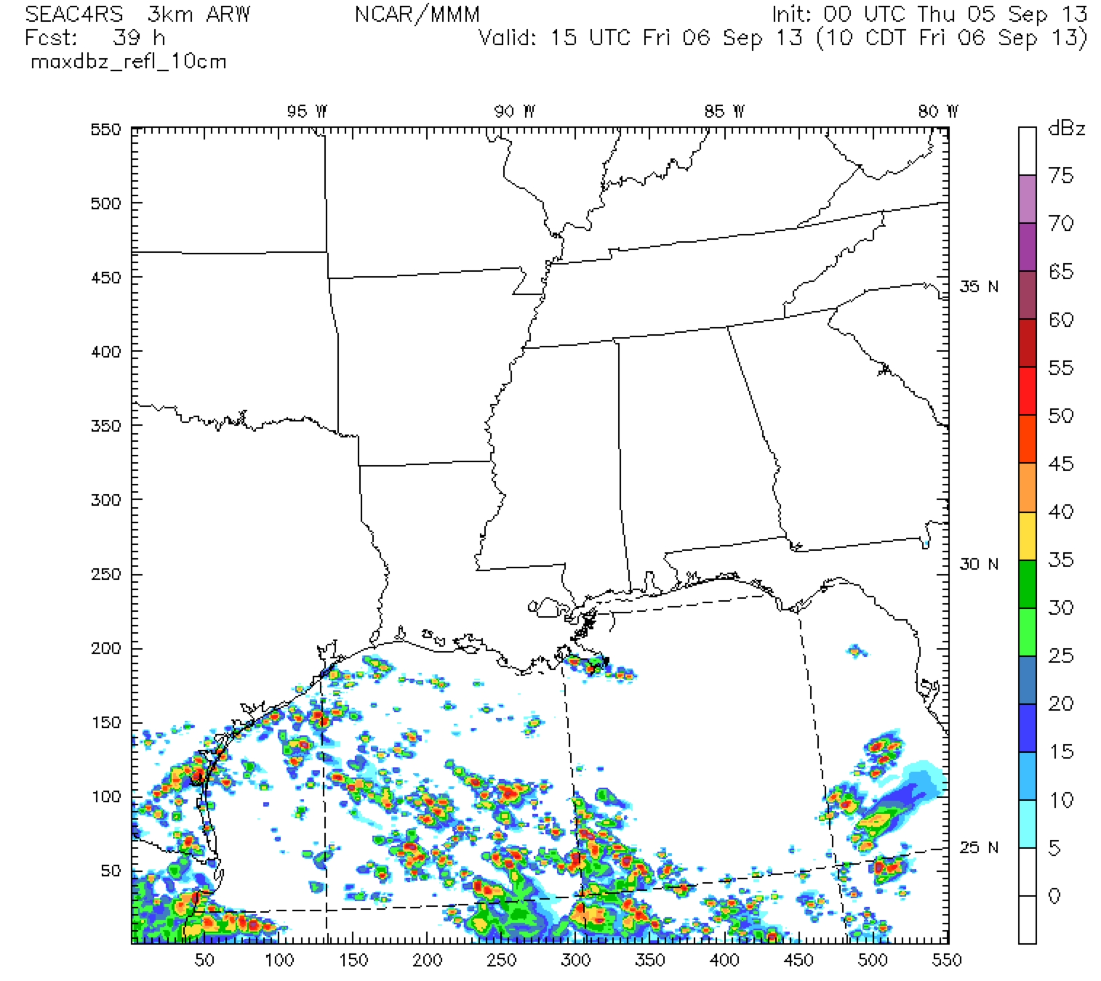
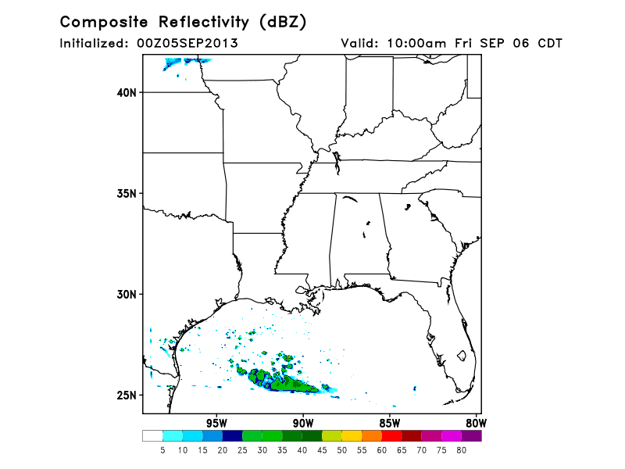
NCEP ARW
NCEP NMM
NCAR WRF
FSU WRF

Slide 17
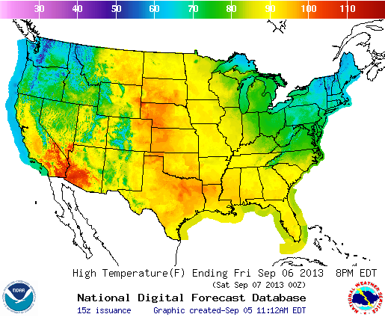
In-flight: upper 80s/lower 90s over SEUS

Slide 18
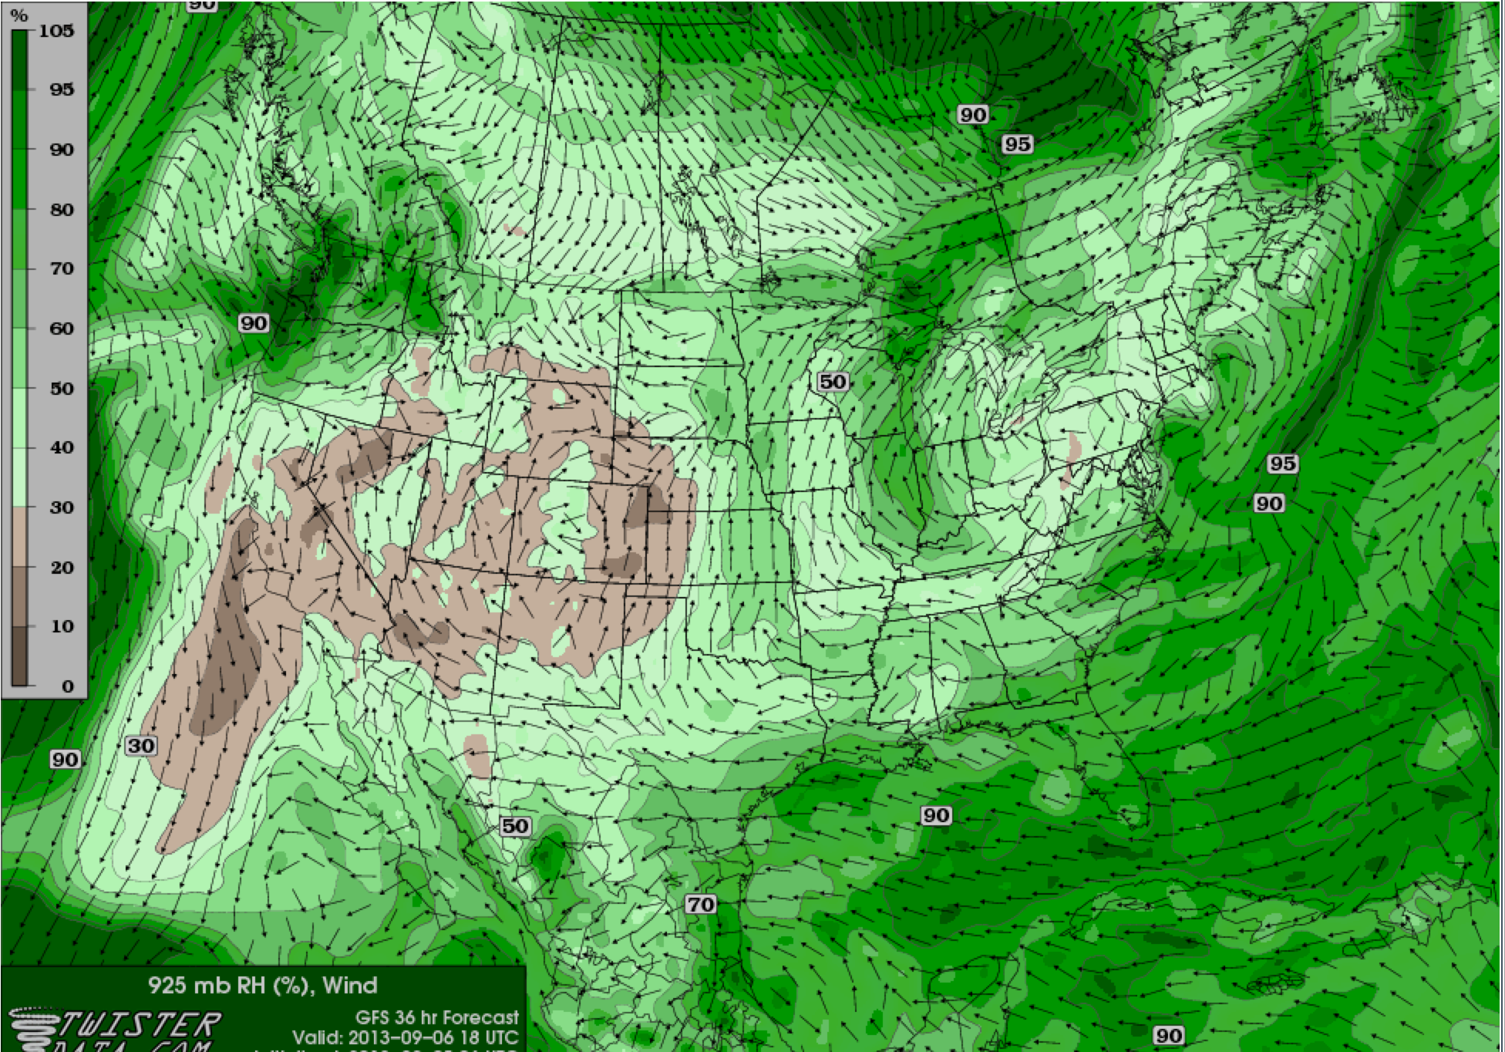
925 RH and Winds 1 PM Fri: Moister regions generally have more low-level CU

Slide 19
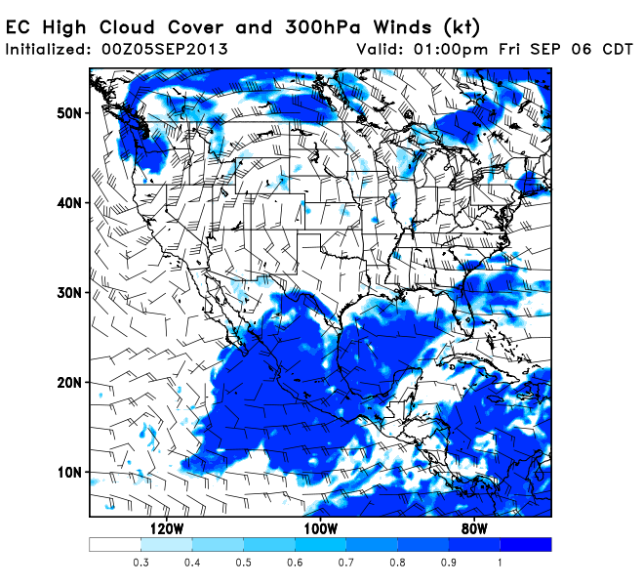
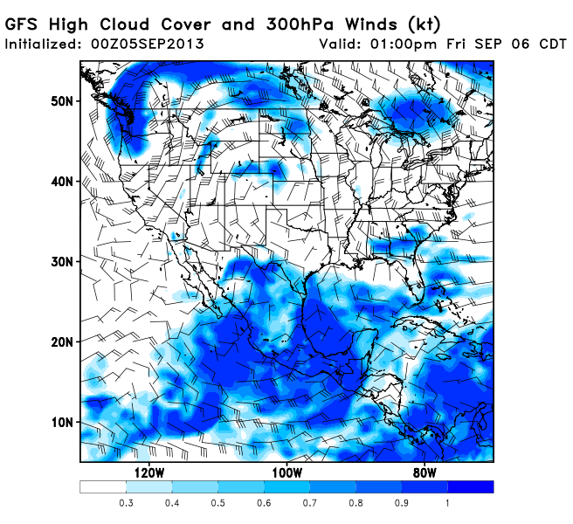
Few high clouds over region of interest

Slide 20
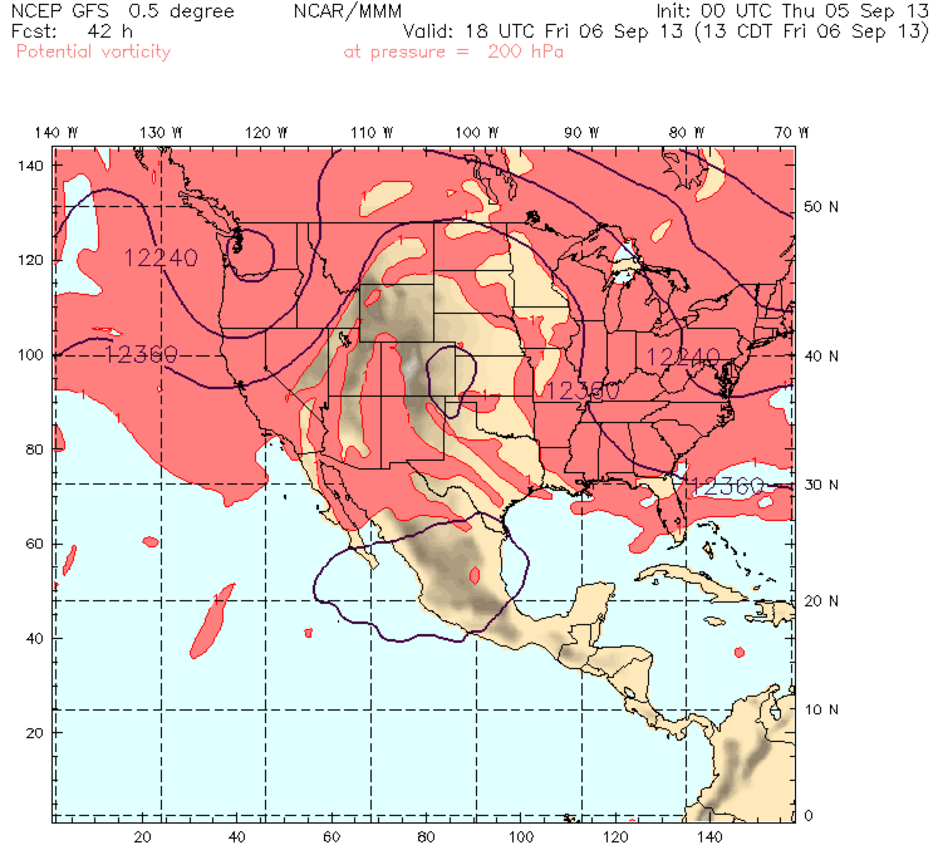
NAM Sampling: 200 hPa Potential Vorticity

Slide 21
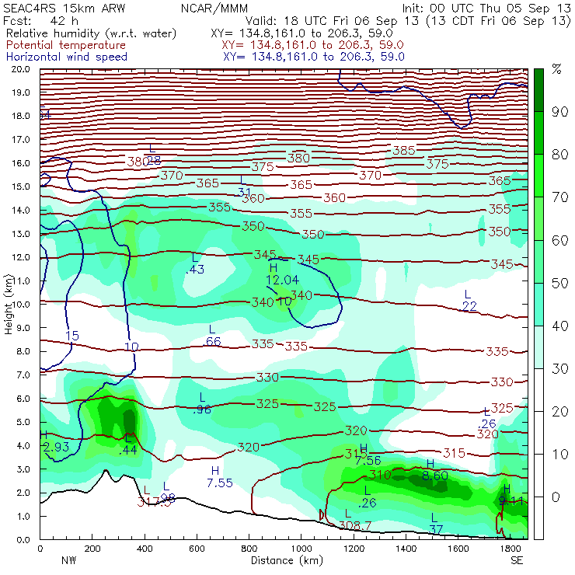
NAM moisture reaching up to ~17 km

Slide 22
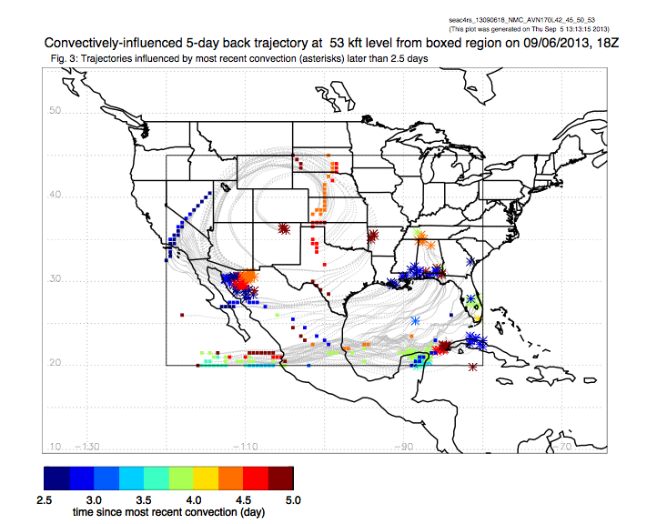

Slide 23
Landing Weather
20% chance of scattered storms with daytime heating and added moisture from tropical wave to the south

Slide 24
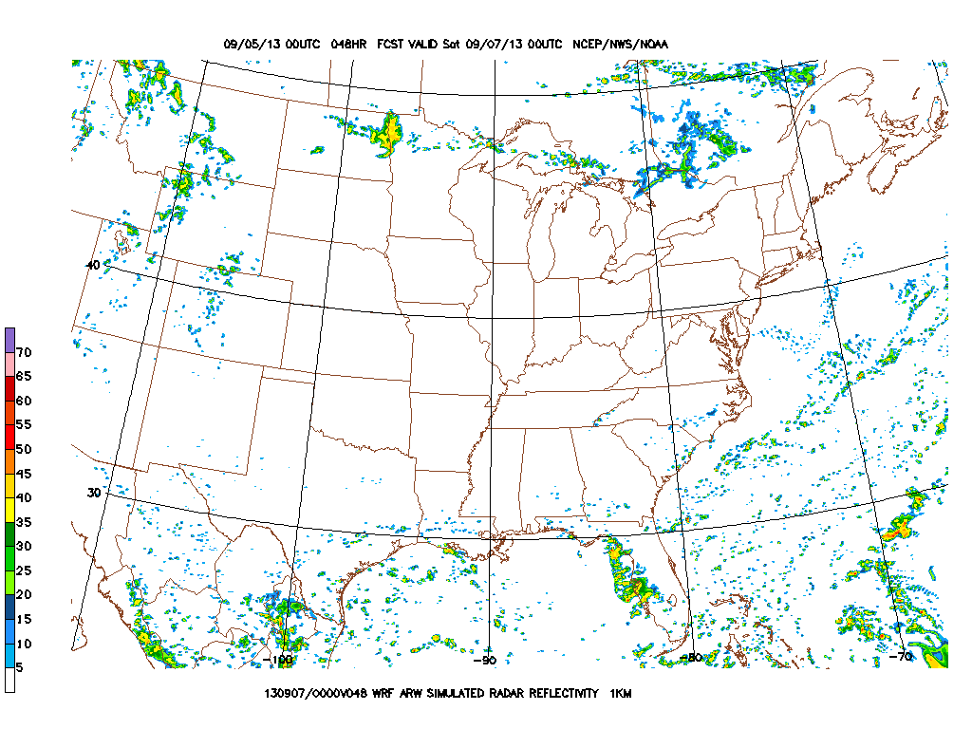
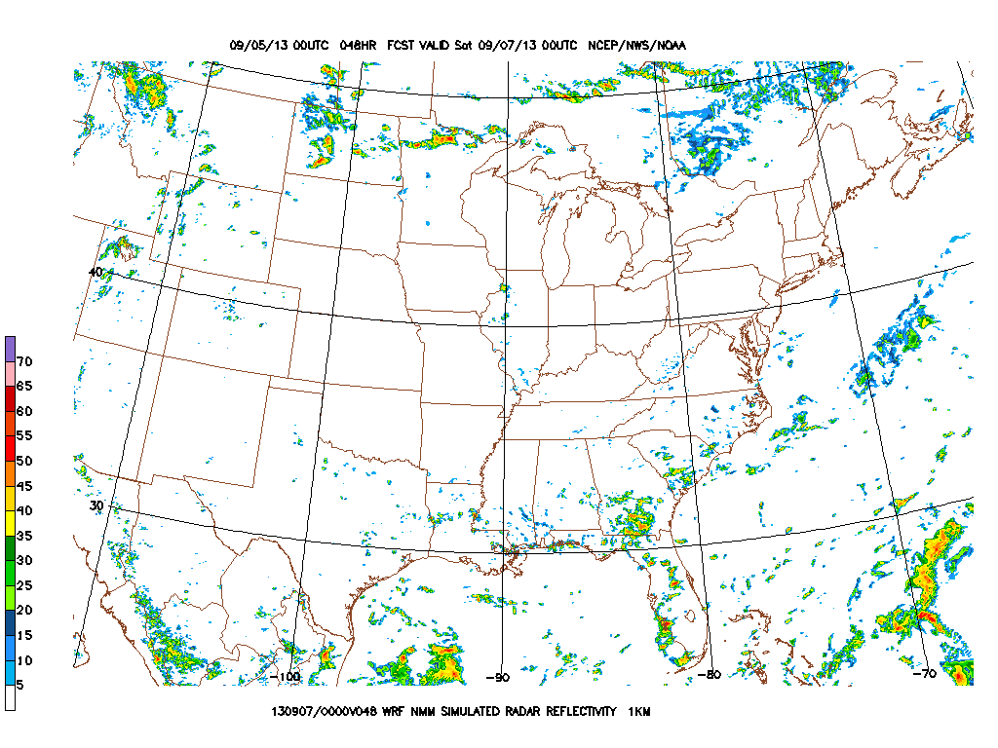
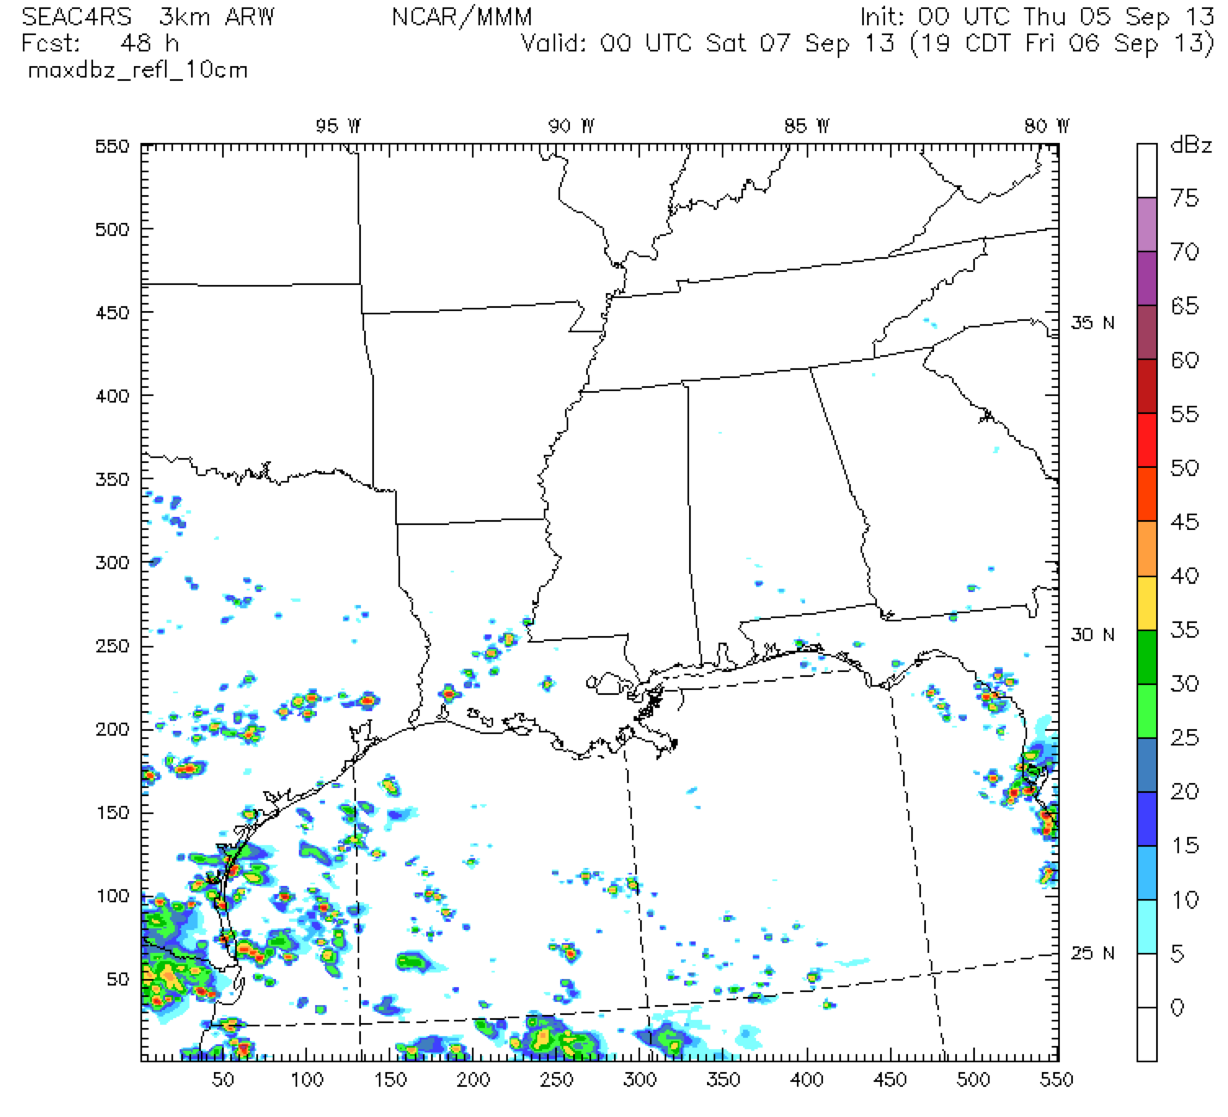
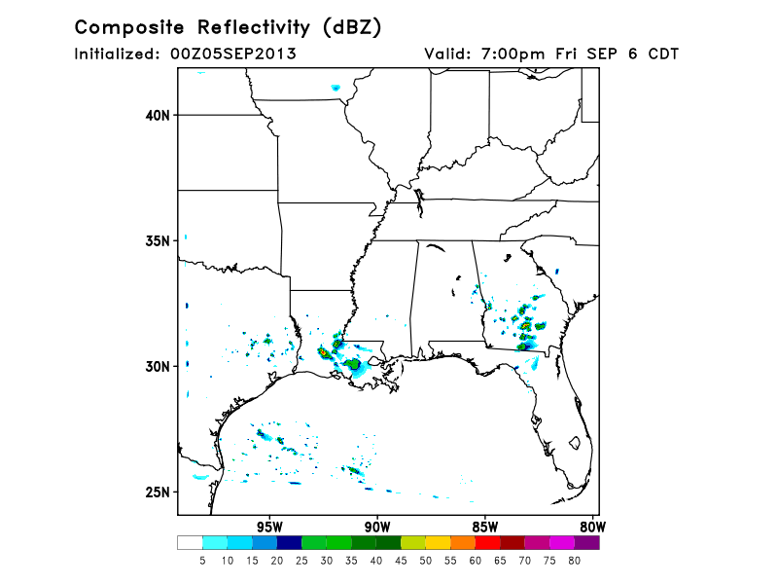
NCEP ARW
NCEP NMM
NCAR WRF
FSU WRF

Slide 25
Looking ahead to Monday

Slide 26
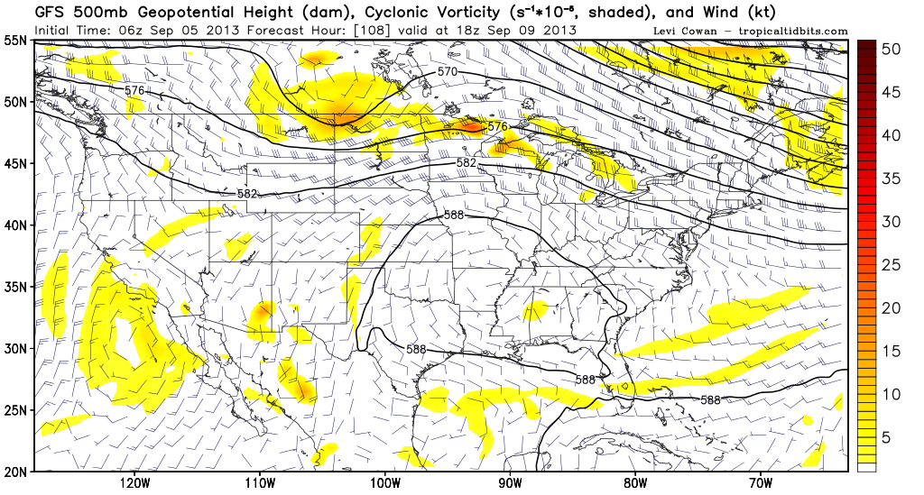
Anticyclone shifted southeast

Slide 27
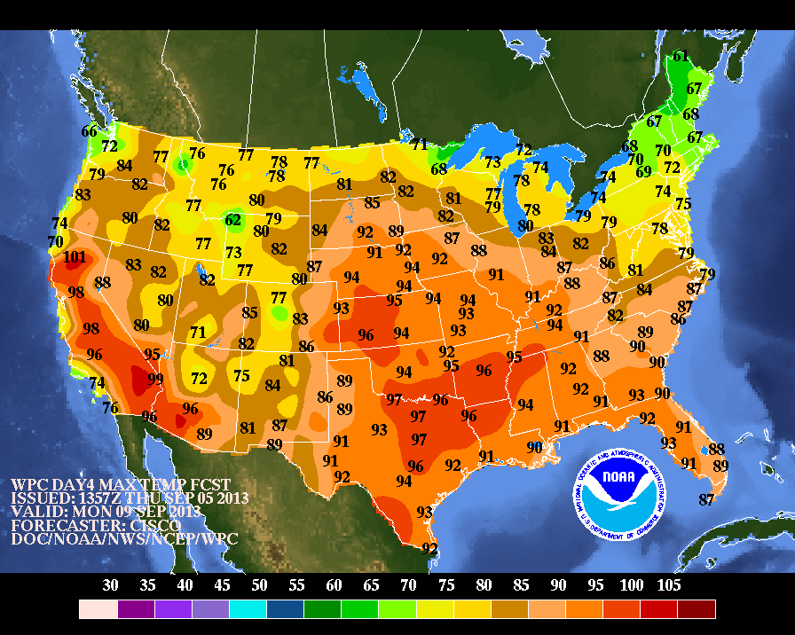
Still hot in the southeast with UL anticyclone in place

Slide 28
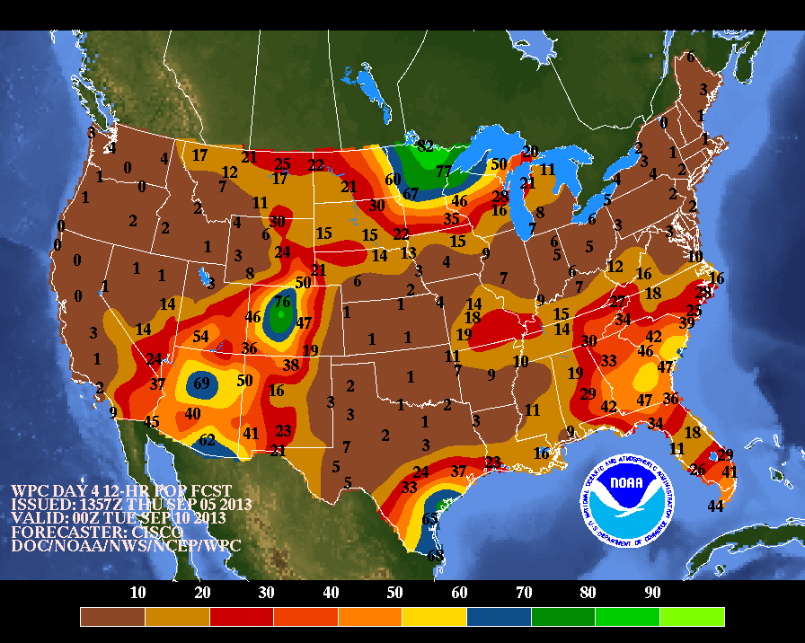
12 h POPs for Monday

Slide 29
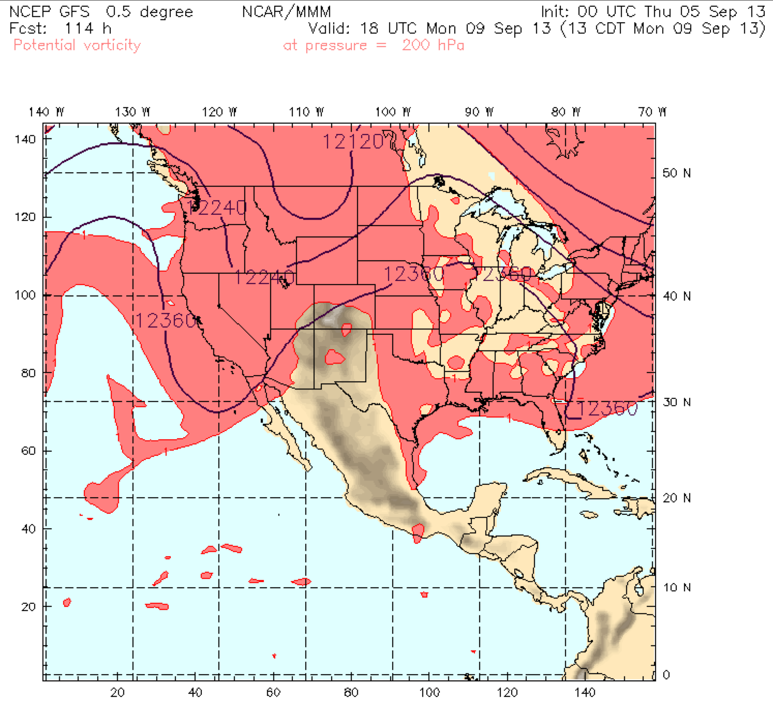
NAM destroyed by Monday

Slide 30
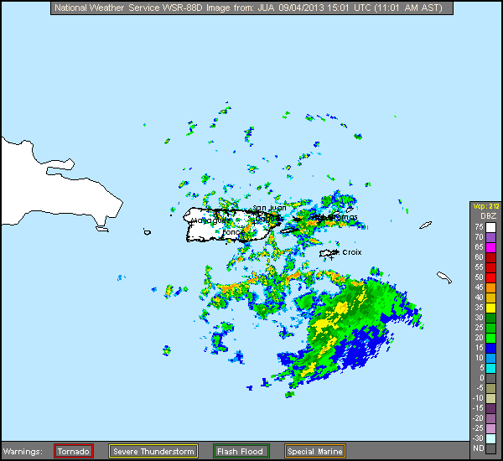
Tropical Depression Gabrielle

Slide 31
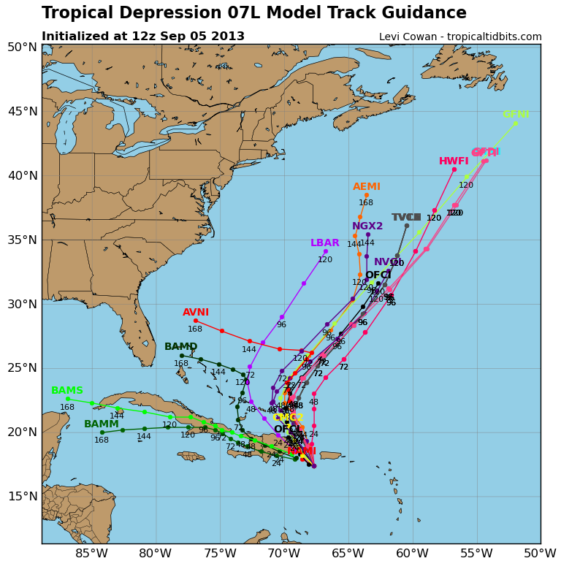

Slide 32
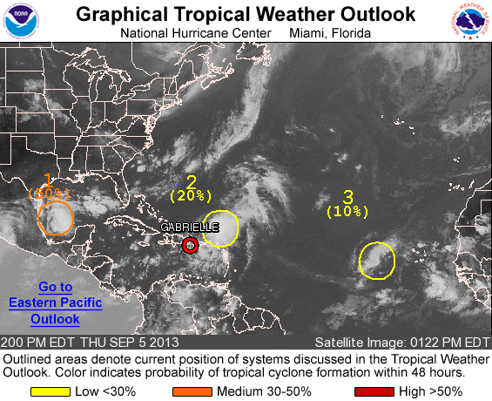
We’re not giving up yet, Lenny!

Slide 33
Summary
Chance of storms for both takeoff and landing tomorrow
Southeast is hot, and remains hot through Monday
NAM anticyclone looks to breakdown by Monday
Tropics becoming a little more active

