Slide 1
SEAC4RS Met Overview
Lenny Pfister (NASA), Karen Rosenlof (NOAA), Rei Ueyama (NASA), and Nick Heath(FSU)

Slide 2
Outline
Circulation, rainfall and convective statistics during the experiment, and comparison with climo.
Some remarks about SEUS air quality
SEUS surface temperatures
Air origins (back trajectories) in the UT and UTLS during SEAC4RS.
Satellite movie of the experimental period

Slide 3
Circulation statistics – discussion structure
Divided SEAC4RS into 3 ~2 week periods
Examine how the summer-fall transition transpired in 2013 vs a 15 year average.
Upper (100mb), middle (500mb), and lower (925 – top of BL) levels.
Compare both circulation and regional (sector) rainfall/convection.
NCEP Reanalysis data
CMORPH 3-hourly quarter degree precip
GSFC global 4 km 3-hourly geostationary IR brightness temperature

Slide 4
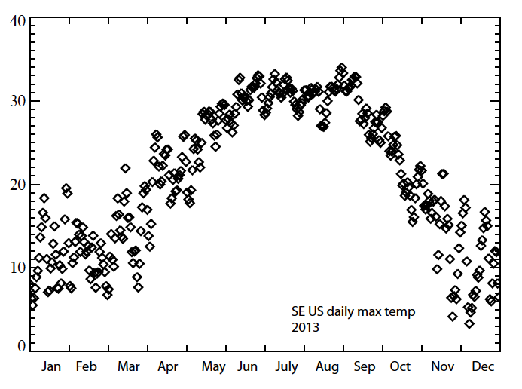
A basic point: transition
to fall is retarded to mid-
September this year, as
shown by the shelf in max
T. Can actually see this in
other aspects of the circulation.

Slide 5
100mb

Slide 6
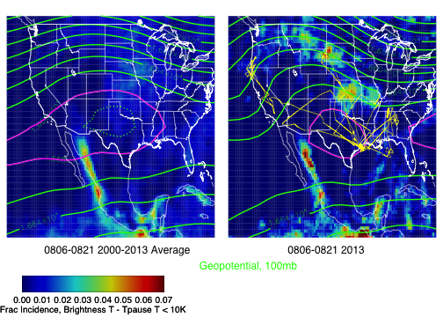
Shorter wave pattern, weaker anticyclone,
displaced eastward.

Slide 7
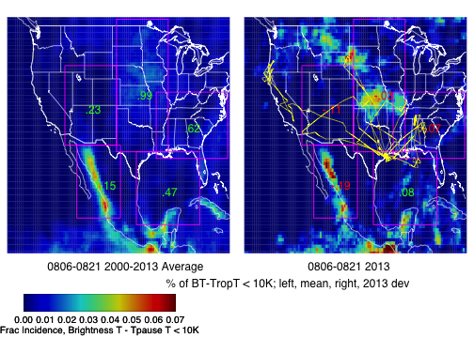
Statistic is crude indicator of convective injection
into stratosphere. Except in Gulf, deepest
convection is suppressed relative to climo (red nos),
significantly so in the west.

Slide 8
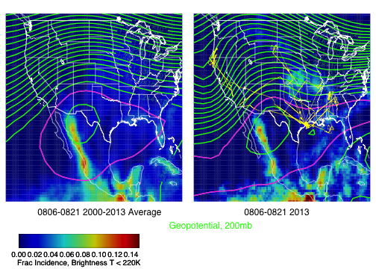
Basic picture at 200mb (“classical” altitude for
the NAM anticyclone) is broadly similar

Slide 9
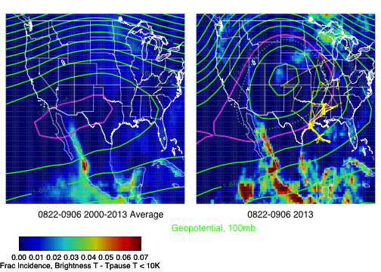
Climo (left) shows the weakened anticyclone and
reduced convection in the west for the second
2 wk period of SEAC4RS. Strongly amplified
pattern, displaced eastward is apparent in 2013

Slide 10
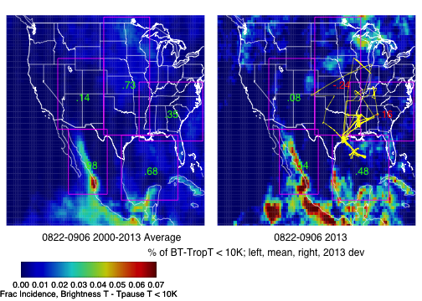
Climo penetrative convection weakens (except
Gulf) relative to earlier period.
Enhancement in west and Gulf relative to climo,
suppression in SE and MCC region. Note Pac TCs

Slide 11
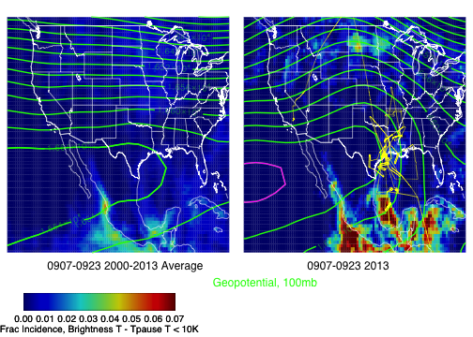
Residual ridge in 2013. Note strong enhancement
associated with two TCs. Not much over NE CO,
floods were not a deep convective event.

Slide 12
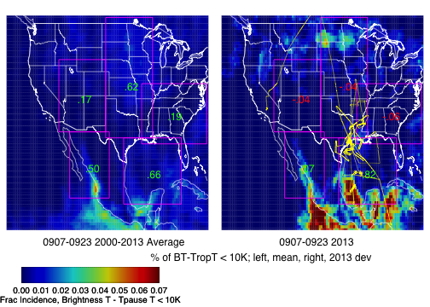
Climo convection decreases everywhere (even slightly
in Gulf). Gulf and Mexico enhanced in 2013, due to
two TCs (Ingrid and Manuel)

Slide 13
500mb, use BT < 220K (measure of convection reaching the UT)

Slide 14
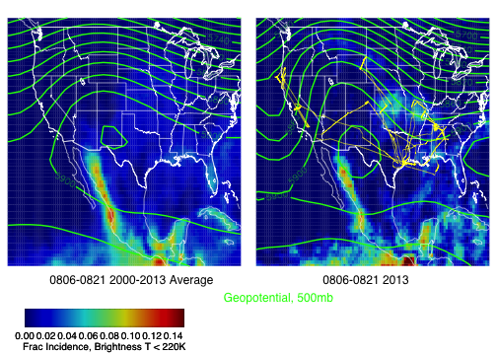
Strong Pacific and east central US trough more apparent
in these first two weeks (relative to climo). Clearly
period of enhanced convection getting to upper trop in
SE, and Gulf, suppressed in Mexico and American West

Slide 15
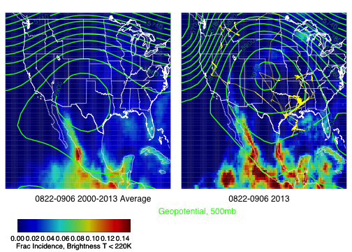
Pacific trough (enhanced) still present, but eastern
trough is pushed eastward, suppressing convection
in SE US. Can see enhancement in convection in
Gulf, Mexico, Western US.

Slide 16
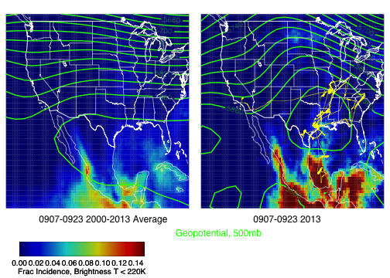
Zonal flow in climo, with anomalous ridge over central
US in 2013.

Slide 17
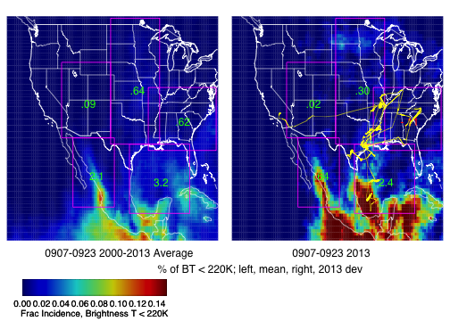
Notably, enhanced UT convection in all sectors
except SE, which is under the lee side of the mean
enhanced ridge. Note two TCs in Gulf and Pacific.

Slide 18
925mb (Use rainfall from CMORPH)

Slide 19
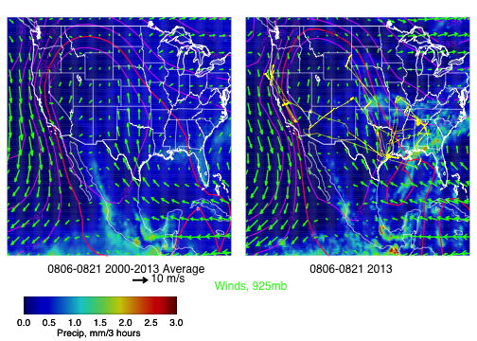
Rain clearly enhanced in SE US relative to climo,
temperatures at low levels suppressed, associated
with anomalous eastern trough (see 500mb).
Enhanced northward flow into SEUS relative to climo

Slide 20
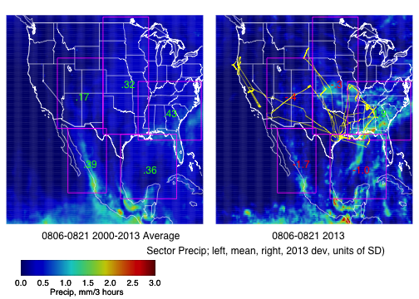
All sectors suppressed (in rainfall), except SEUS, with
precip almost 2 SD above mean.

Slide 21
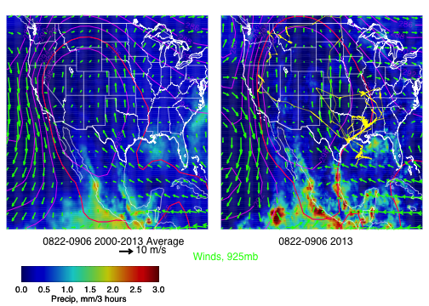
Note stronger northward flow – more rainfall in
northern tier. Ridge suppresses rainfall in SEUS, and T
is warmer than normal. Rainfall enhancement in
west and Mexico consistent with conv stats.

Slide 22
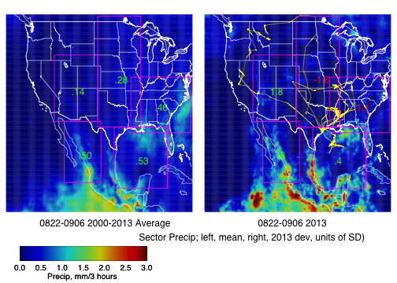
MCC and SEUS region have much weaker rainfall,
NAM convective driver regions substantially enhanced.

Slide 23
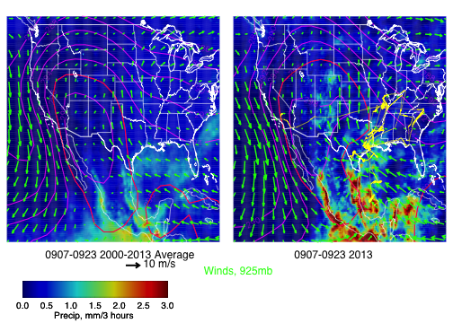
T cools relative to previous period, but warmer than climo
in 2013. More moisture flow off the Gulf at the lowest
levels.

Slide 24
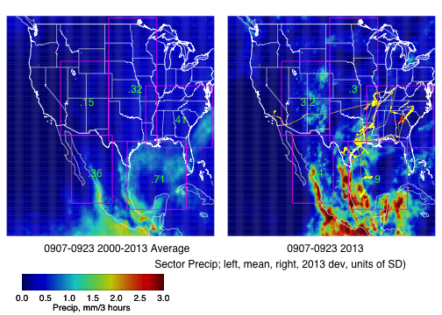
Rain suppressed in SEUS due to ridge, but note
3 SD above mean enhancement in western US,
including NE CO bullseye. Manuel and Ingrid enhance
rain in Gulf and Mexico.

Slide 25
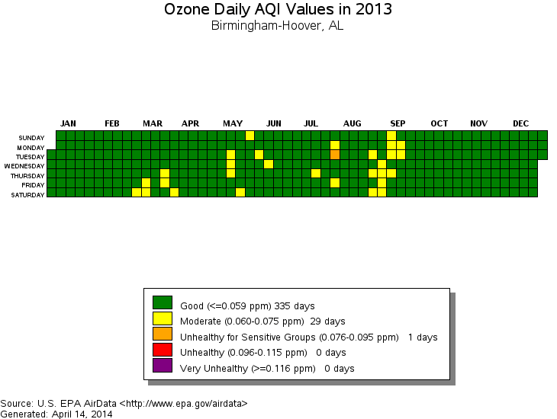

Slide 26
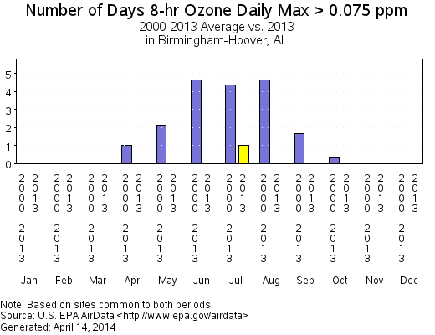
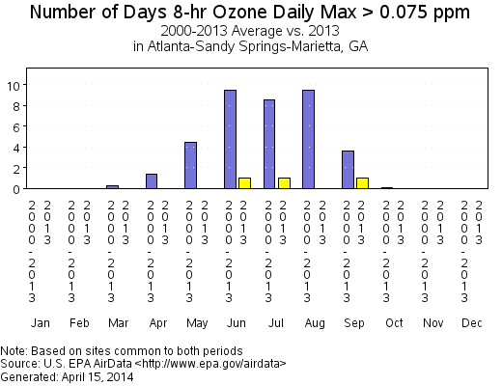
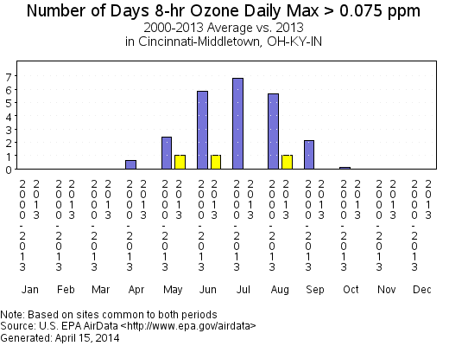
Birmingham (above), Atlanta (abv right)
and Ohio Valley (right) all show lower
than average pollution levels.
(This is probably not just meteorological)

Slide 27
SEUS Surface temperature

Slide 29
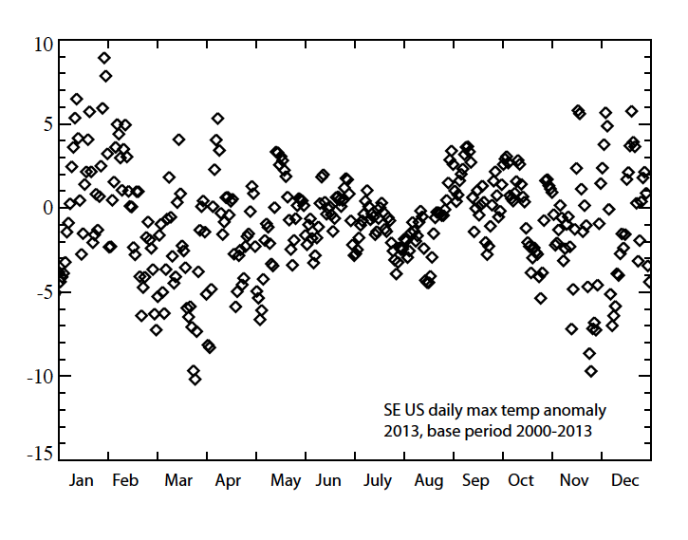

Slide 30
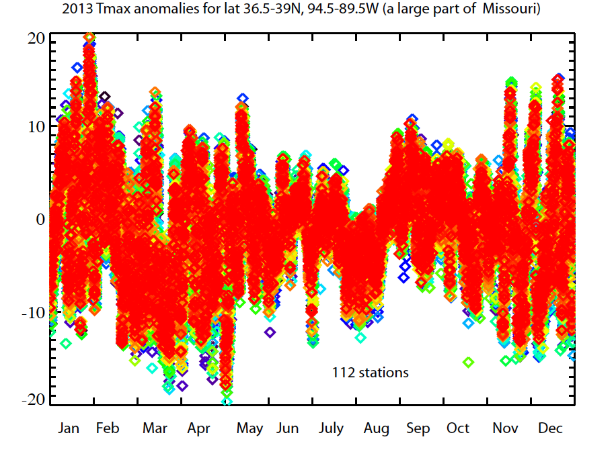

Slide 31
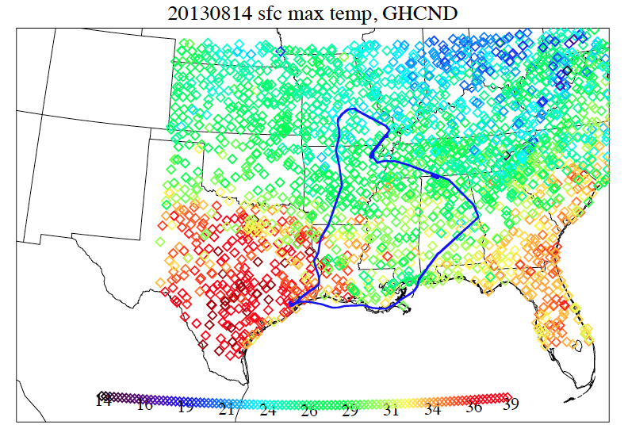

Slide 32
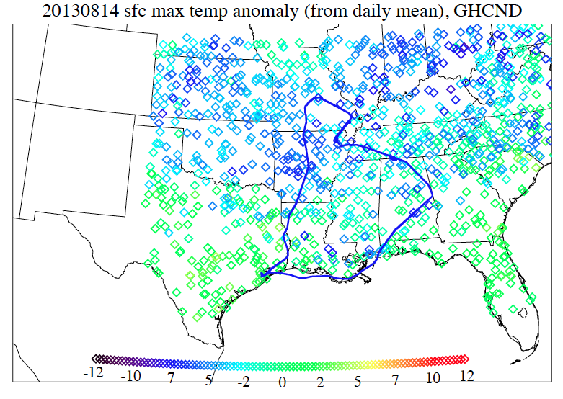

Slide 33
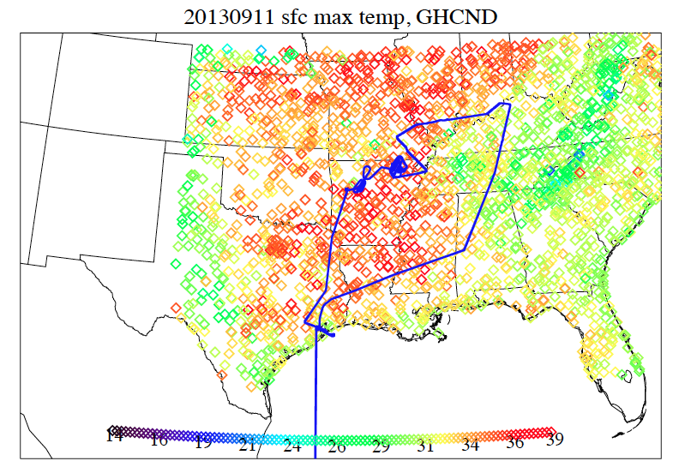

Slide 34
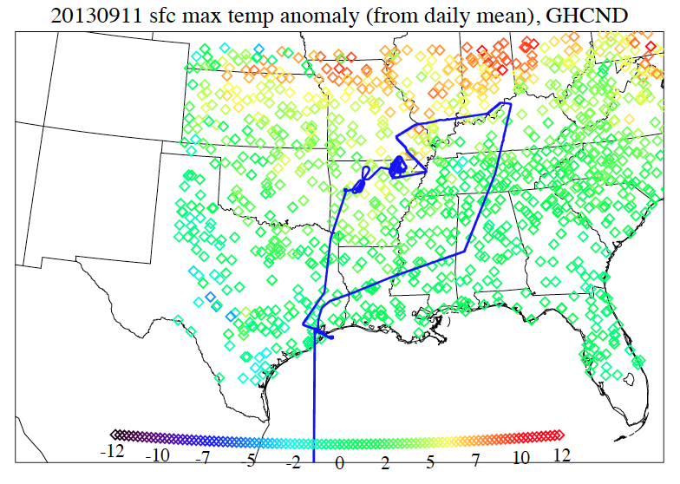

Slide 35
Air Origins SEUS UT
Look at 10 day Kinematic Back Trajectories from 300mb in the SEUS. Ask where (and how much) of the air can be traced to the Boundary Layer

Slide 36
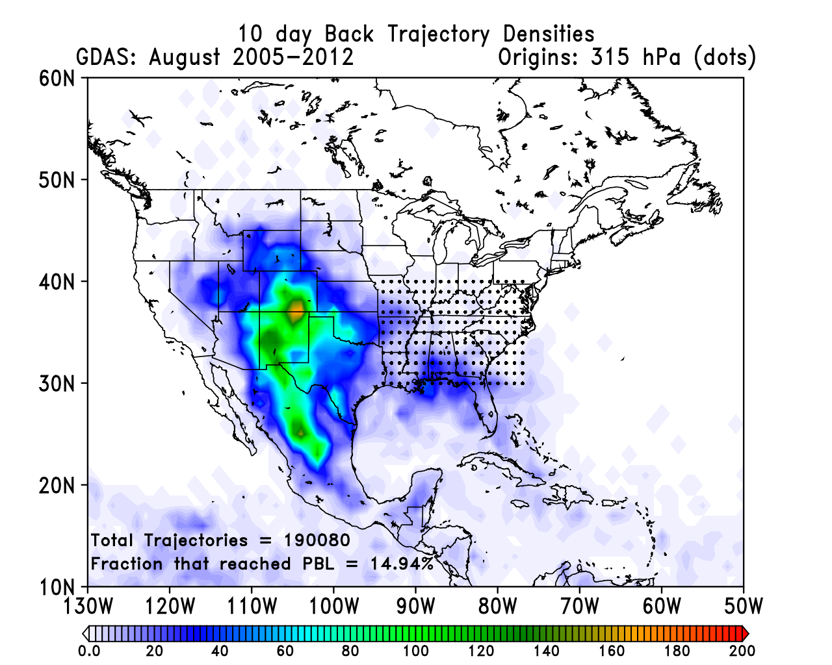
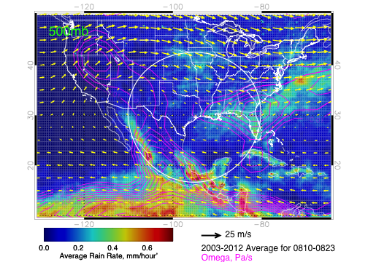
10 day kinematic Back trajectories from
315mb in the US (dotted points)
Vertical velocity (upward) concentrated
in western US, with SEUS downstream

Slide 37
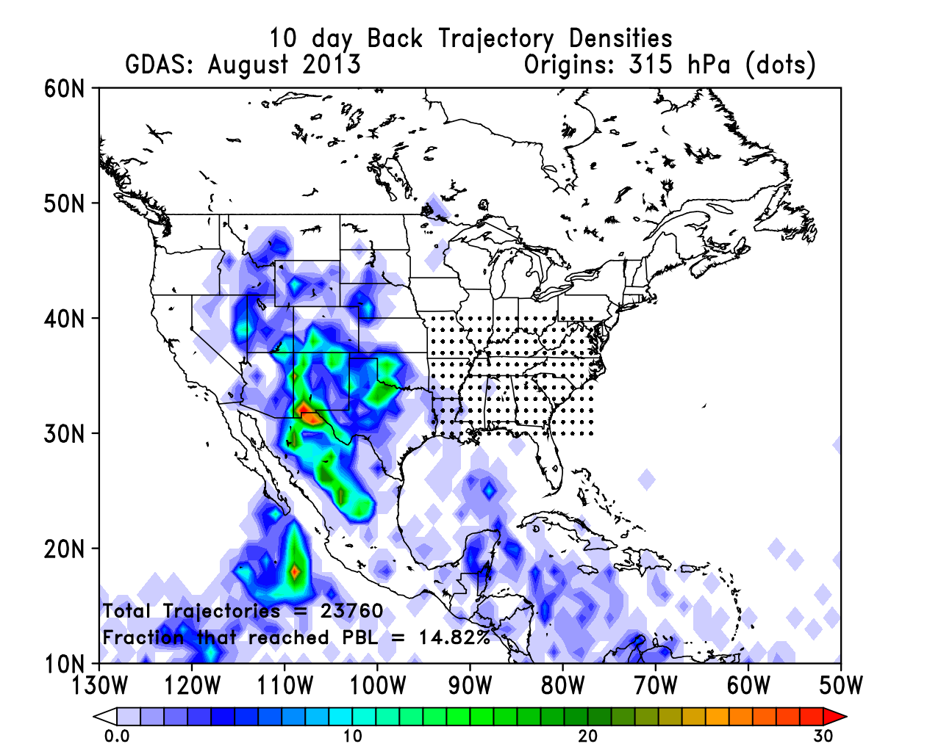
10 day kinematic Back trajectories from
315mb in the US (dotted points)
Pacific TCs play a more important role in
August, 2013

Slide 38
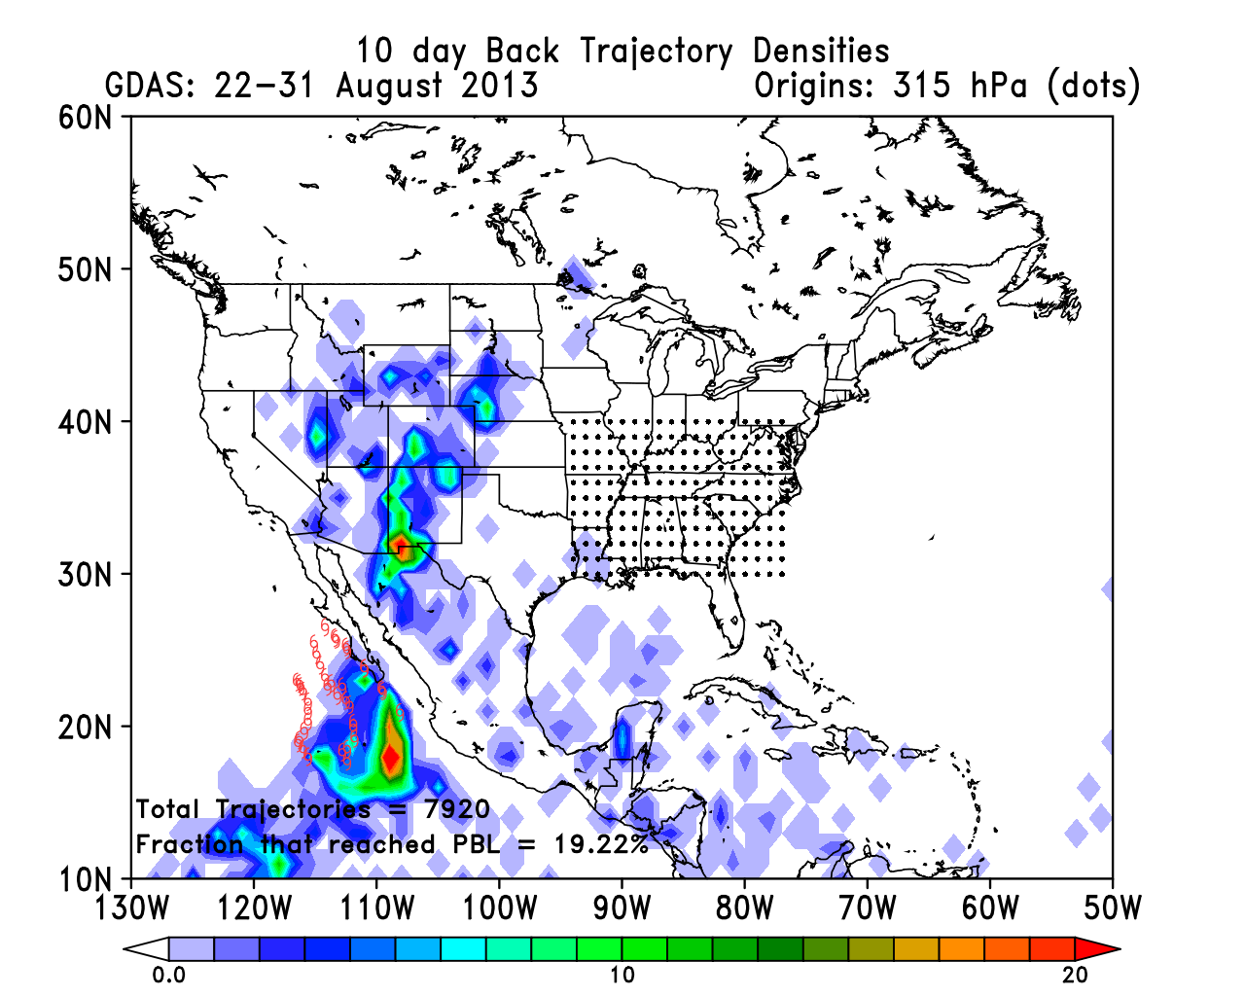
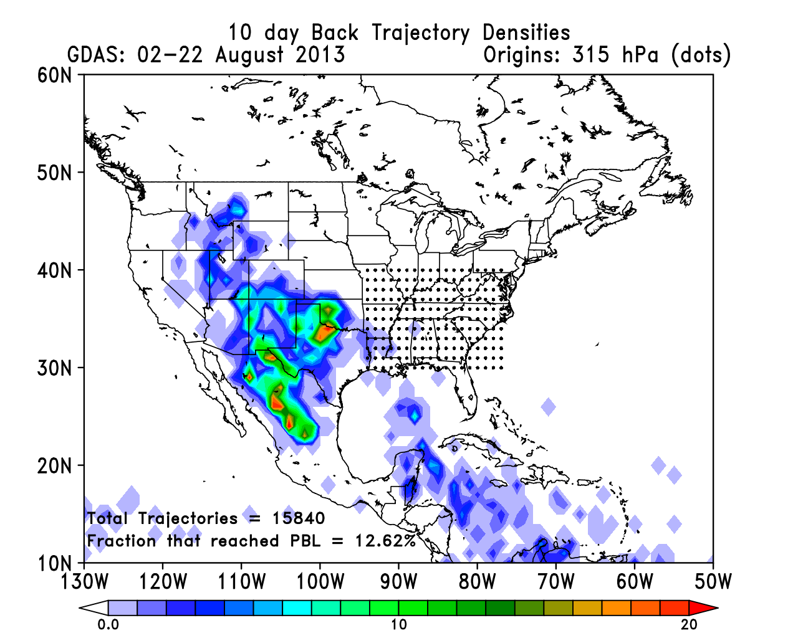
Three TCs (Ivo, Juliette, Kiko) in
late August responsible for August
tropical eastern Pacific enhancement

Slide 39
UTLS Air Origins
Examine air origins over entire US at 150mb (45kft) and 100mb (53kft) using back trajectories to 3 hourly satellite imagery.

Slide 40
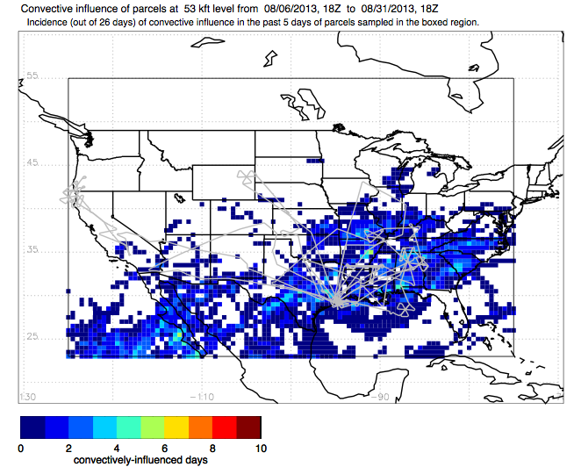

Slide 41
Shorter wave pattern, weaker anticyclone,
displaced eastward.

Slide 42
Climo (left) shows the weakened anticyclone and
reduced convection in the west for the second
2 wk period of SEAC4RS. Strongly amplified
pattern, displaced eastward is apparent in 2013

Slide 43
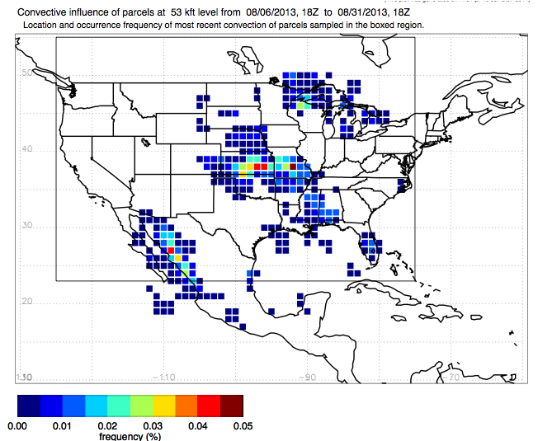

Slide 44
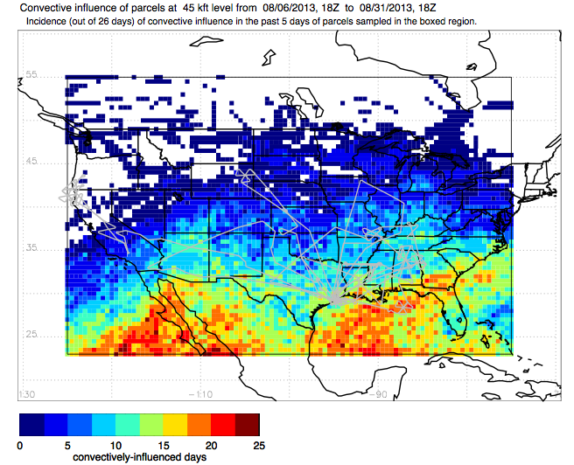

Slide 45
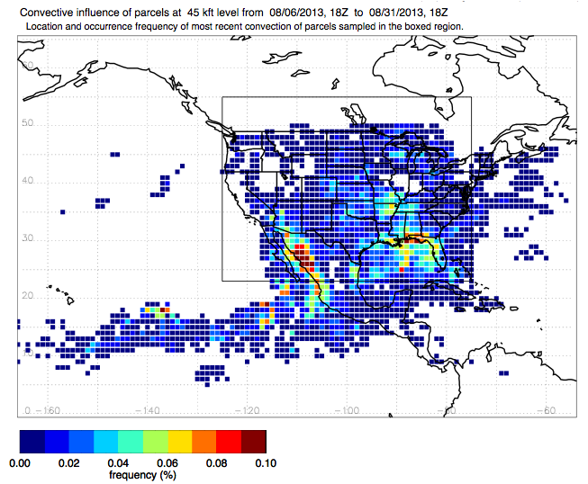

Slide 46
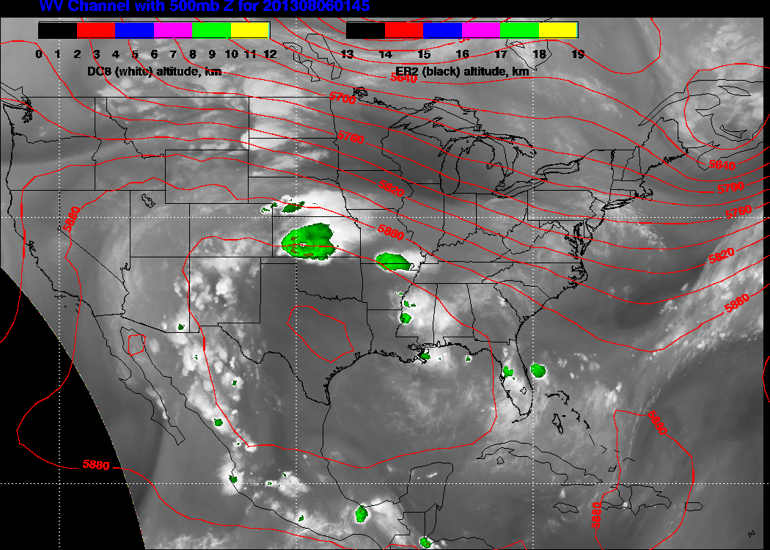

Slide 47
Summary
2013 a year where summer to fall transition was “delayed”, and fairly abrupt in mid to late September.
Late August/early September “surge” in strong ridge development, in contrast to weaker ridge and bracketing troughs in most of August.
Probable role of Pacific tropical cyclones in Upper Tropospheric venting.
Convective venting at high levels (100) dominated by MCS’s and Mexican convection.
At 150mb, Gulf and SEUS convection is important in convective venting.

Slide 48
Backup

Slide 49
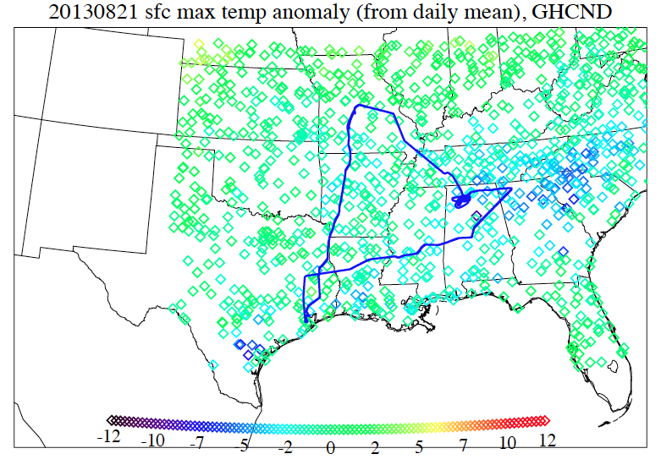

Slide 50
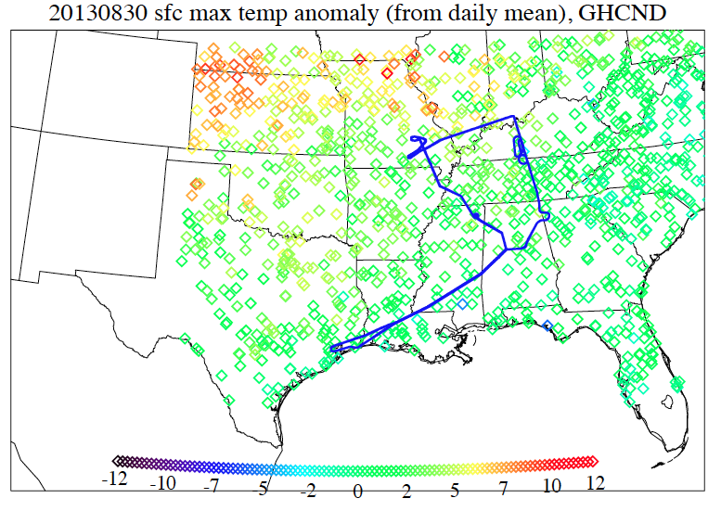

Slide 51
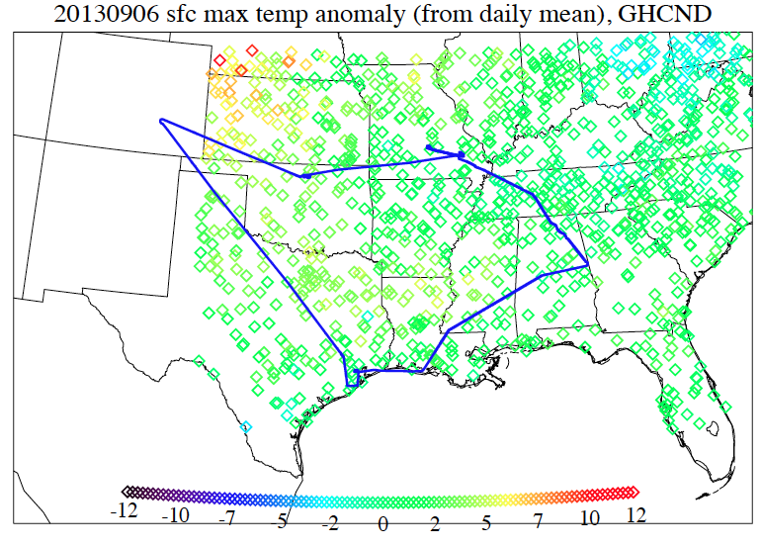

Slide 52
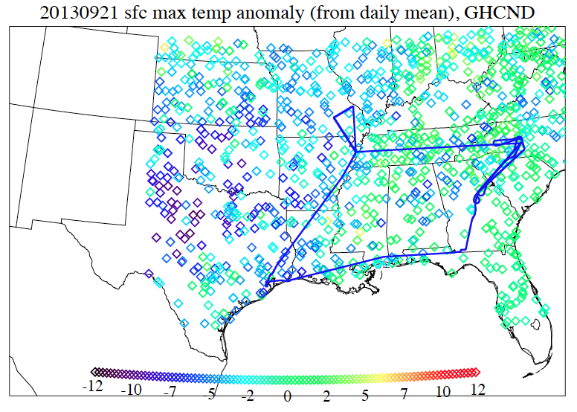

Slide 53
