Slide 1
Met Briefing, 20130831
Lenny Pfister
Henry Fuelberg
Tristan Hall

Slide 2
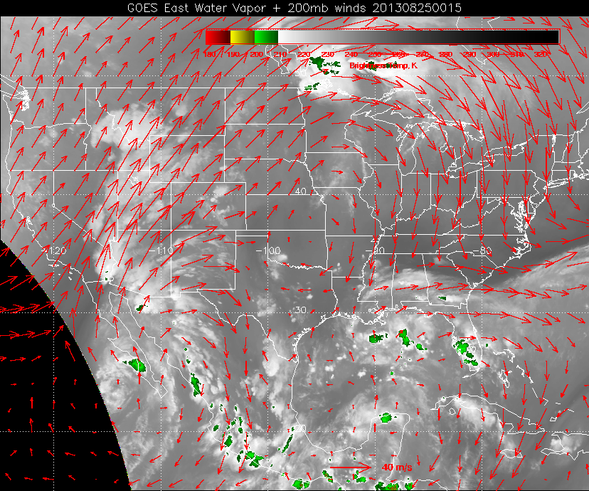

Slide 3
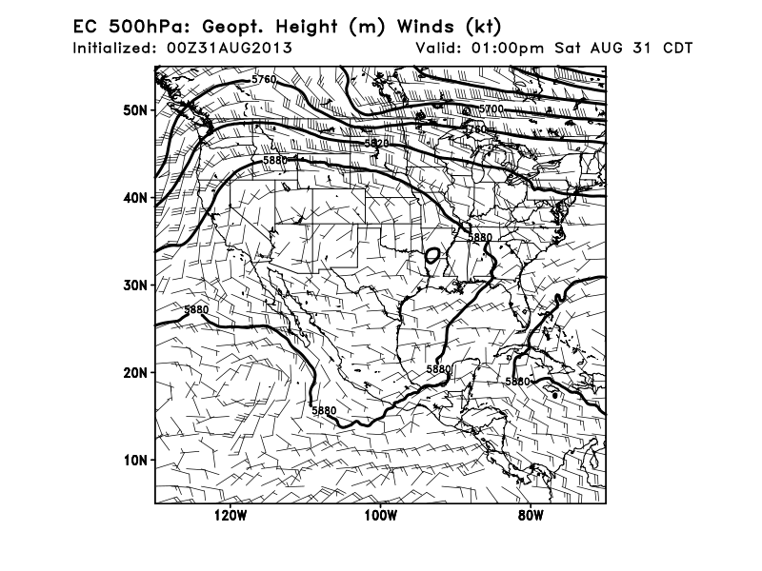

Slide 4
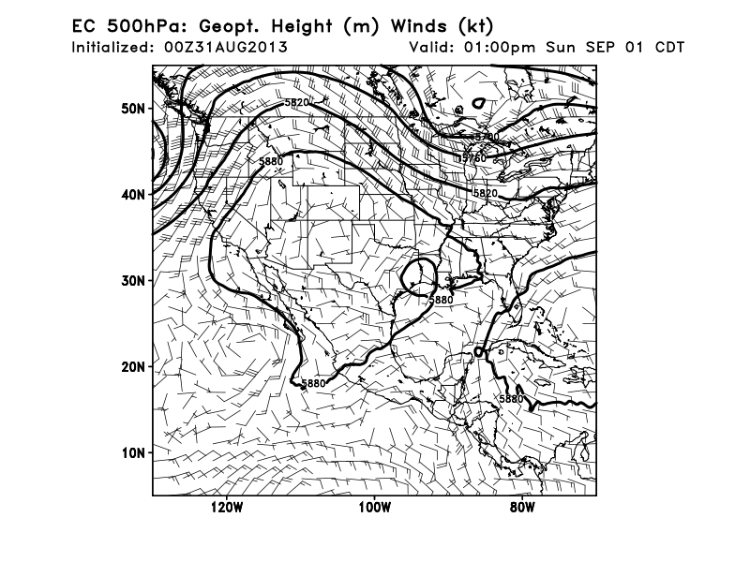

Slide 5
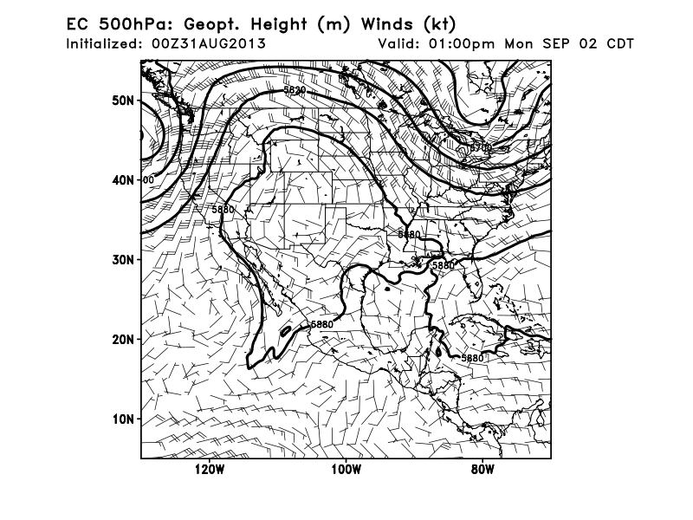

Slide 6
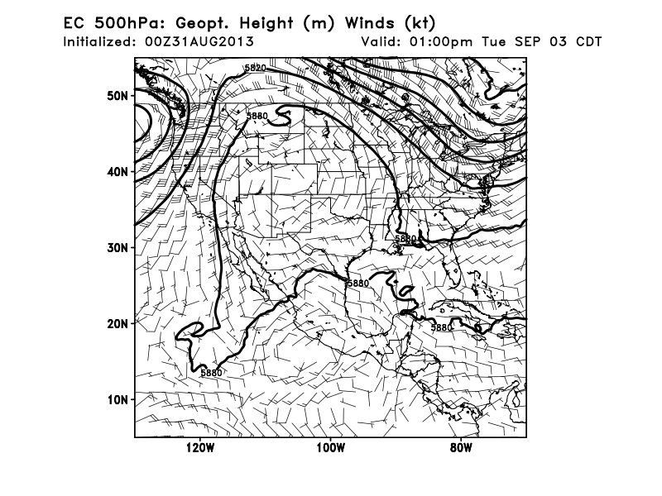

Slide 7
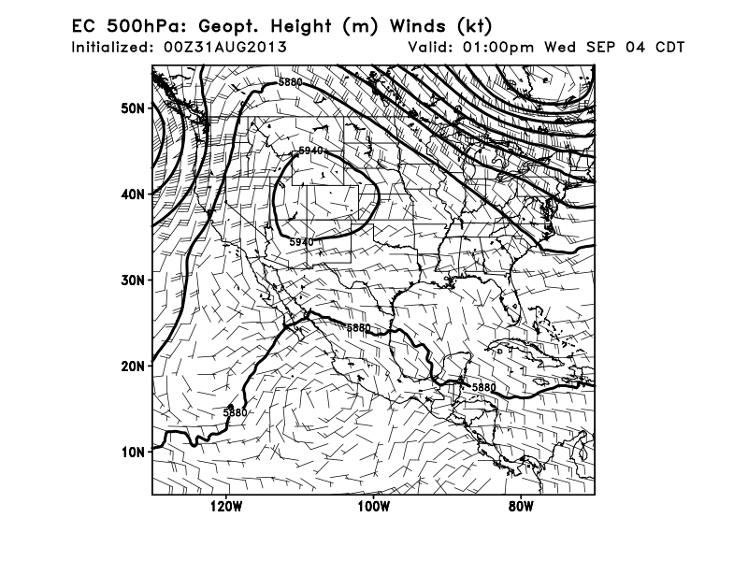

Slide 8
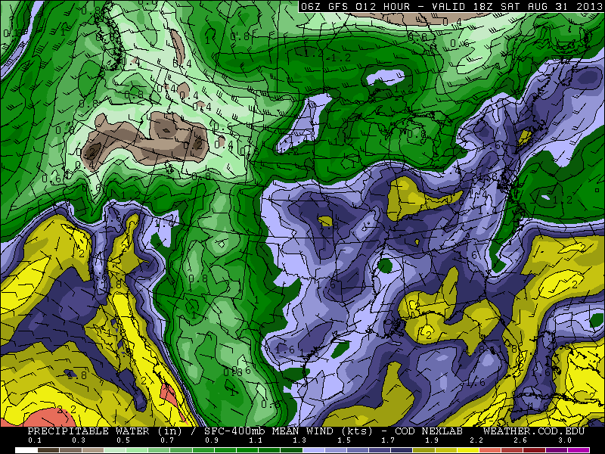

Slide 9
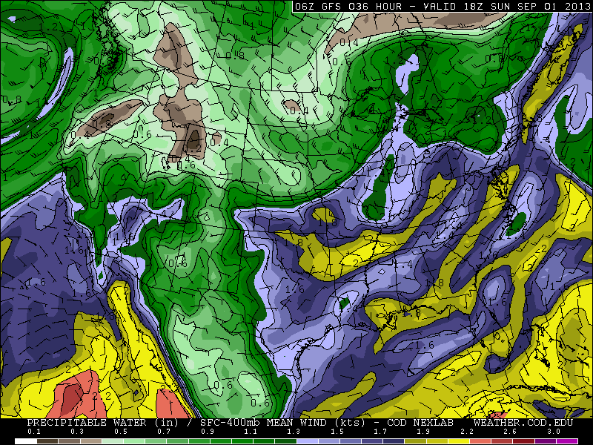

Slide 10
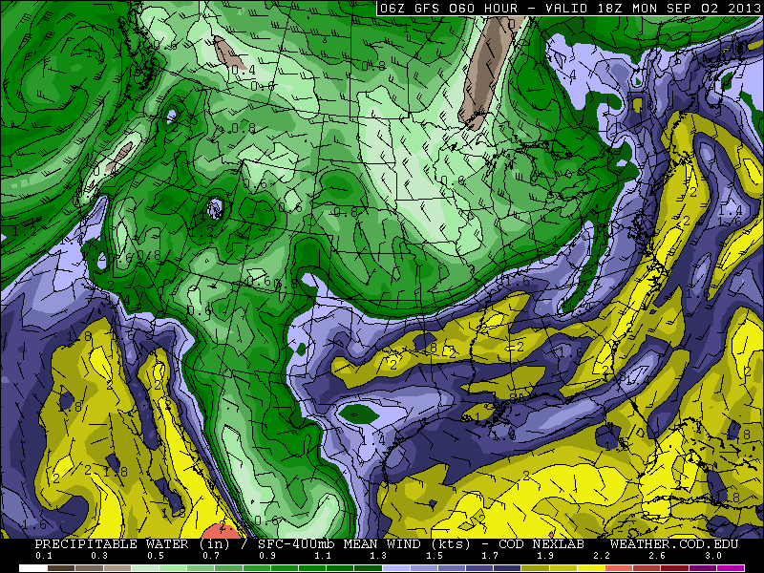

Slide 11
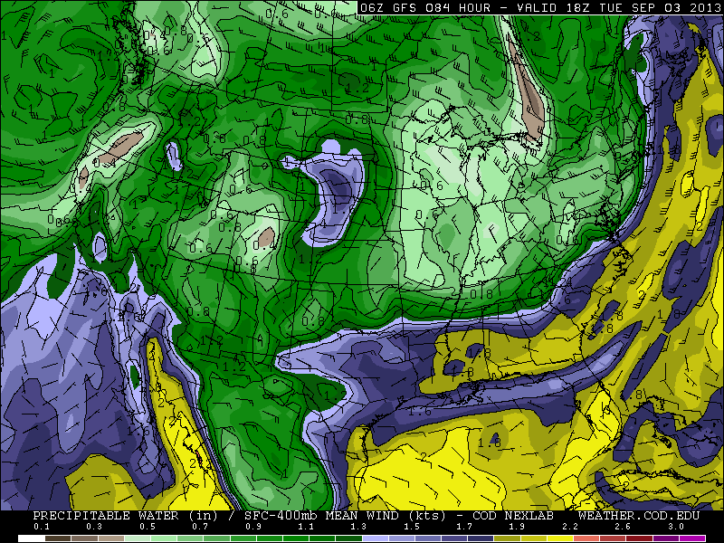

Slide 12
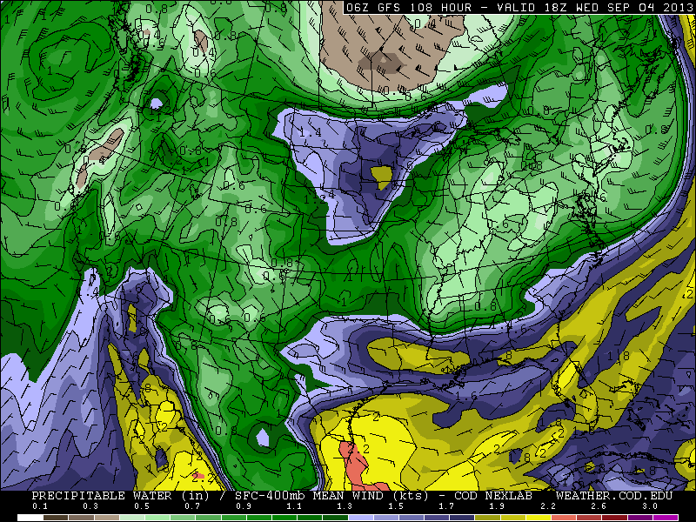

Slide 13
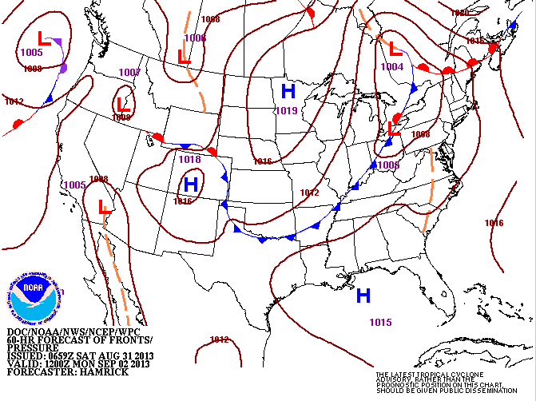
Implications for Monday Wx
As suggested by previous precipitable water plot, a front is located from OK to Lake Erie

Slide 14
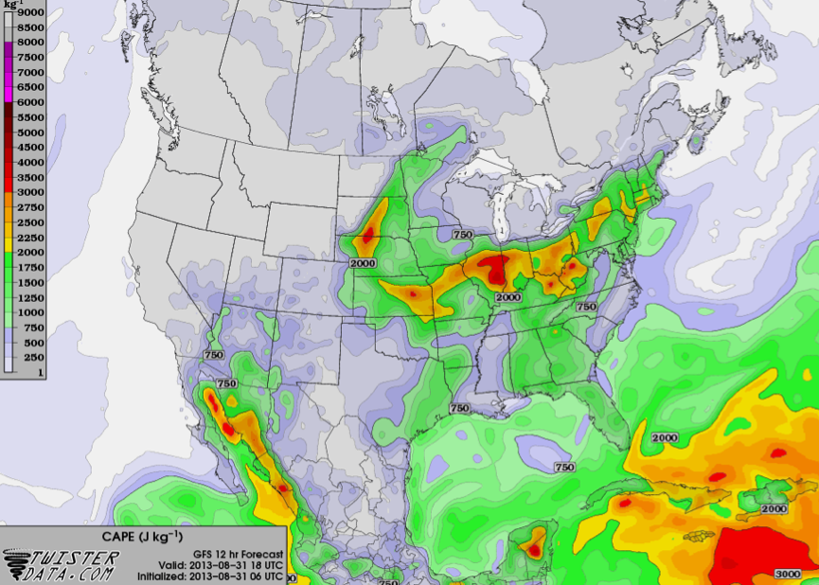
Today’s instability. Not much in northern Gulf. Some in AL, GA. Some over us associated with
rotating trough – probably won’t amount to much do to capping inversion.

Slide 15
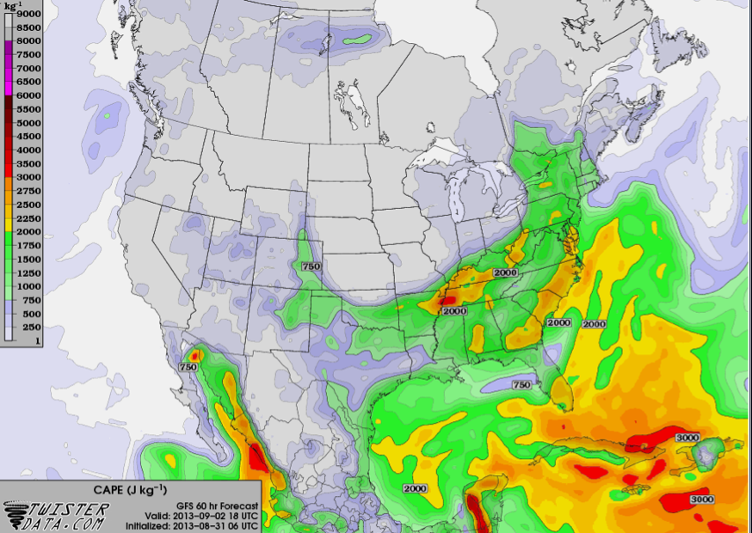
In contrast to today, Monday’s unstable conditions lead to high precip probabilities, and
significant convective storms ahead of front. Gulf a bit more unstable, especially near south
TX coast. In our area, some chance of diurnal T-storms

Slide 16
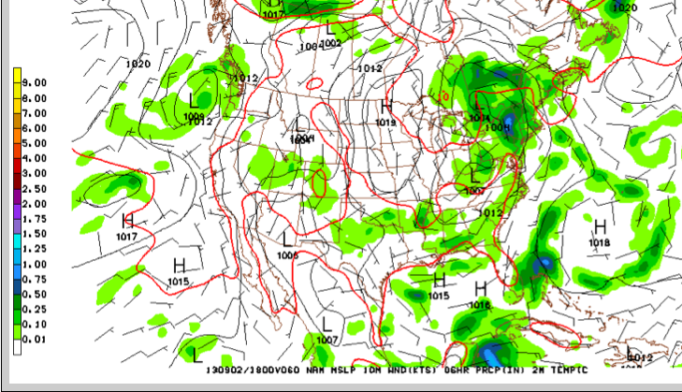
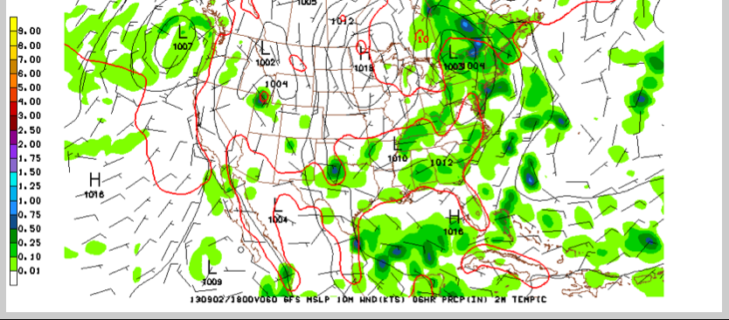
NAM, 18Z Monday
Both models place precip along
or ahead of front
Parts of LA and our area are
“spared”
Systems near front likely to be
big, systems in southern AL, GA
likely to be smaller.
Frnt wkr in west, some isolated strms
Southern Gulf coast in TX could
be active, as could be LA,MS coast
Vort max from yesterday’s Mingo storm
propagates to S TX
GFS, 18Z
Monday

Slide 17
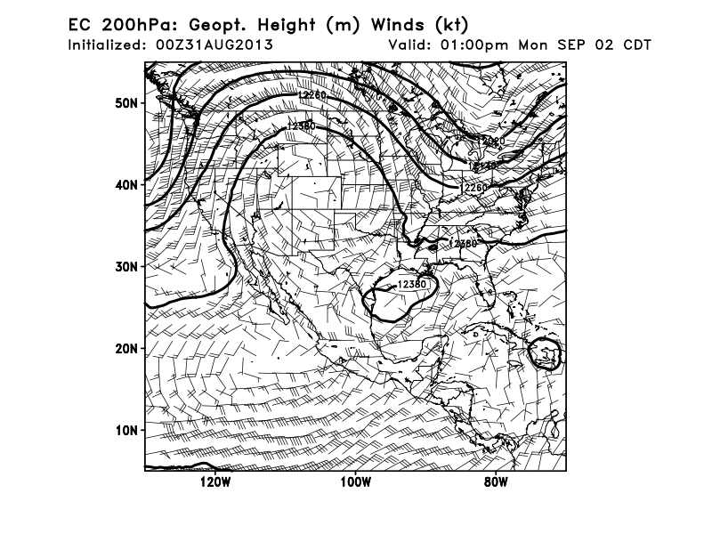
Outflow directions – to the SW over South TX coast and OK, to the east over central Gulf and AL

Slide 18
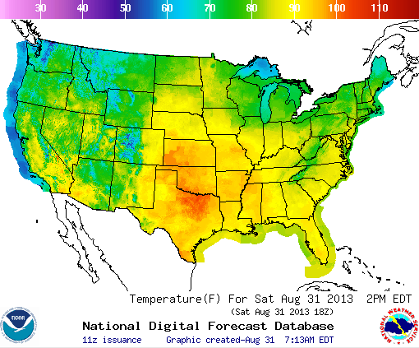
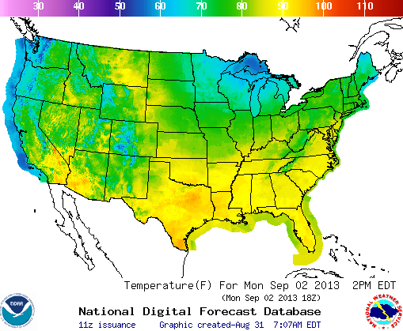
Today
Monday
No surprise, temps go down except in northern Louisiana.

Slide 19
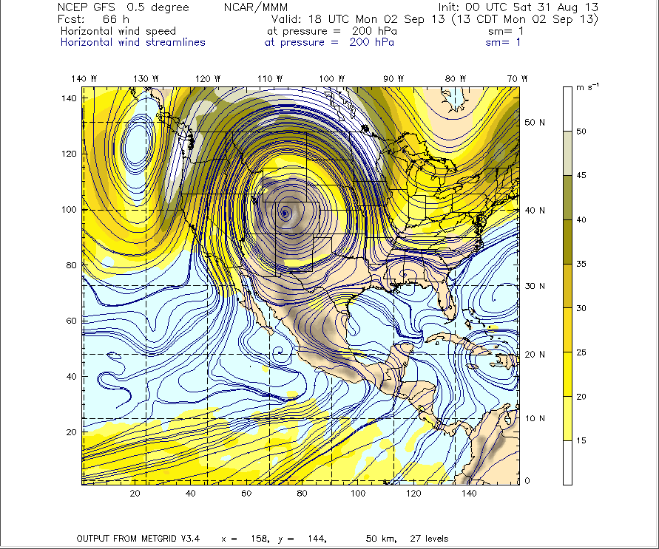
Well formed anticyclone, but well to the west. Have had, and will continue to have, monsoon
moisture in the west producing showers in the southern Rockies. Note that yesterday even
dry places like Blythe CA and Las Vegas had rain.

Slide 20
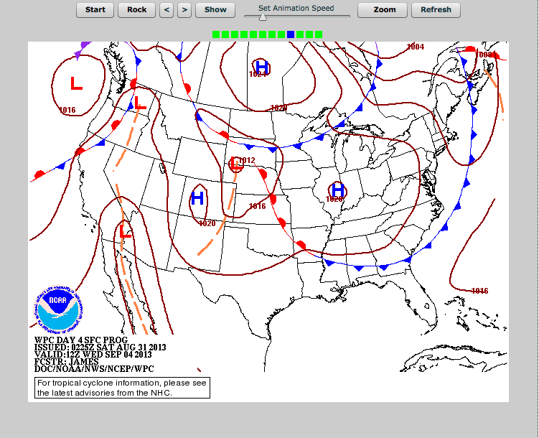
Implications for Wednesday Wx

Slide 21
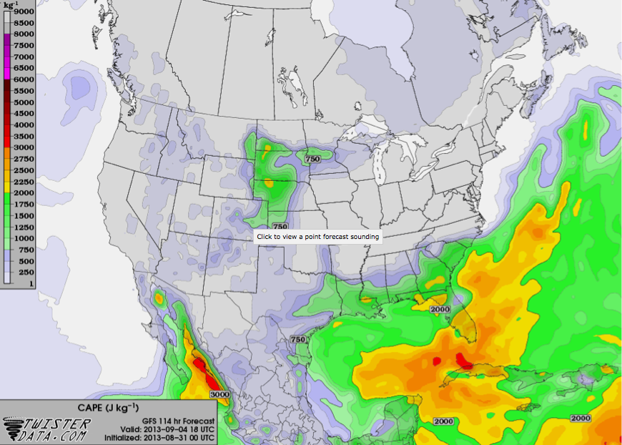
Instability higher in Gulf, less on land, PW in Gulf is higher. Note that the low level southerly moist flow
from the Gulf to the northern plains reestablishes itself, producing instability (and PW, next slide).

Slide 23
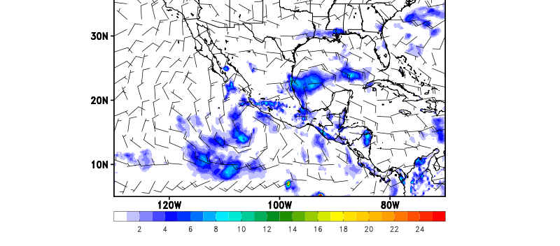
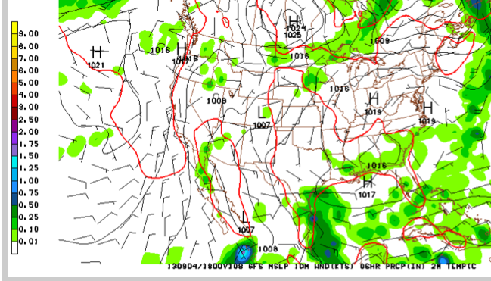
EC, 18Z Wednesday
EC seems to underdo precip
at long forecast hours.
Still, two models get most
features right, though S
TX coast precip missing in EC
Based on PW and instab, my
opinion is we should get precip
off S TX coast Wed
Note that we see no obvious
wave that would enhance
precip as happened on Monday
GFS, 18Z
Wednesday

Slide 24
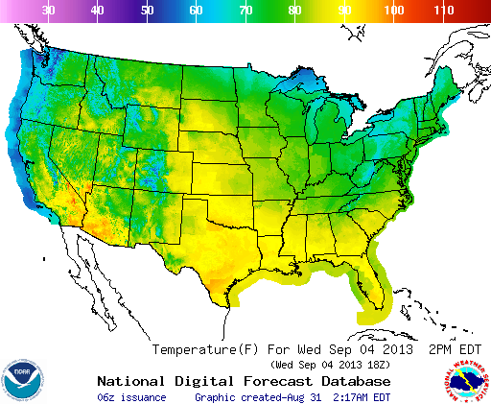
Monday
Wednesday
More cooling

Slide 25
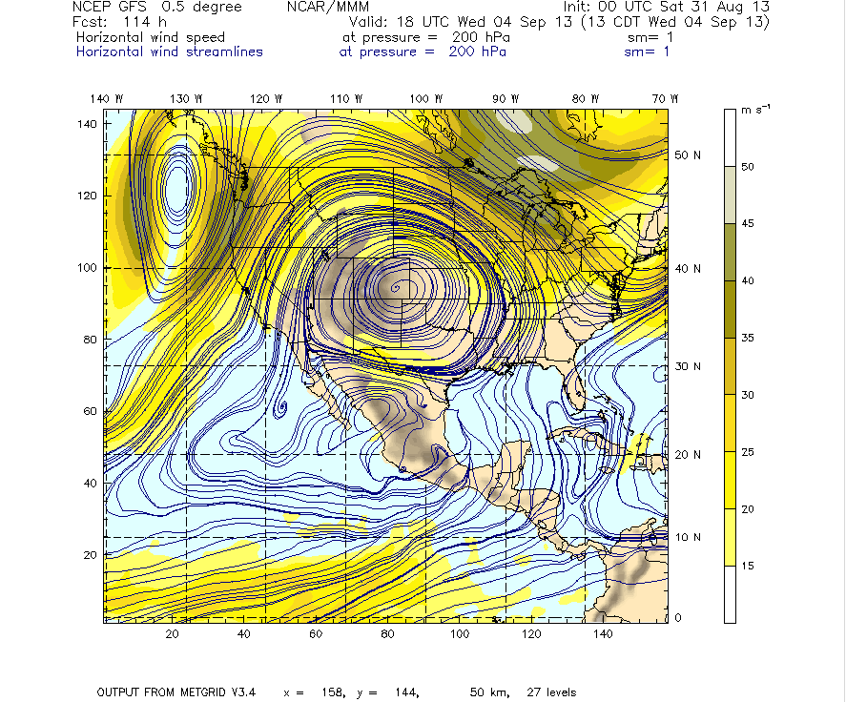
Anticyclone slightly east of Monday’s position, but still very well formed. Monsoon moisture
is going from the elevated levels we saw with the moisture surge earlier this week to more
typical levels.

Slide 26
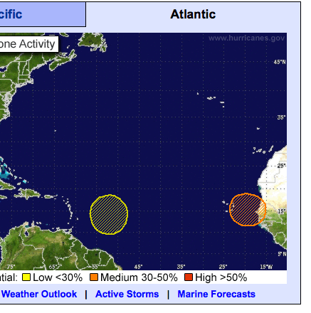
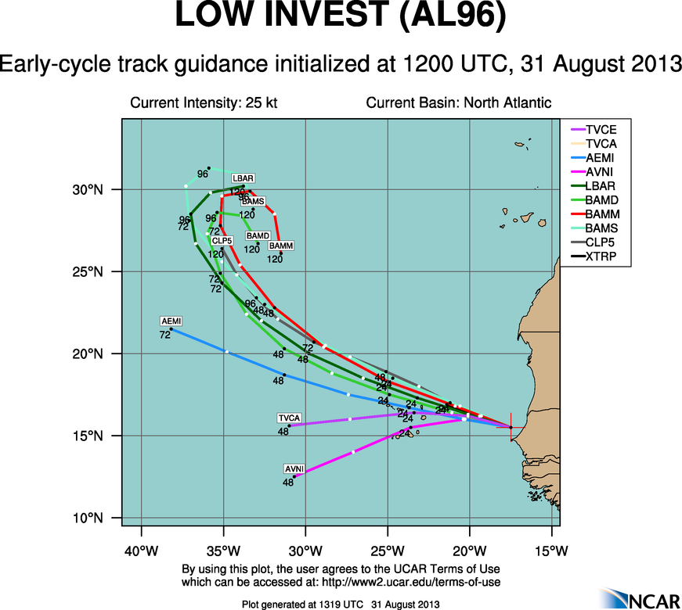
Tropical wx only worth one depressing
slide. As HS3 forecasters thought two
days ago, the disturbance off the African
coast will probably not amount to anything.
NHC has downgraded its likelihood of
forming a TC in the next 5 days from 60
to 40%.

Slide 27
Friday

Slide 28
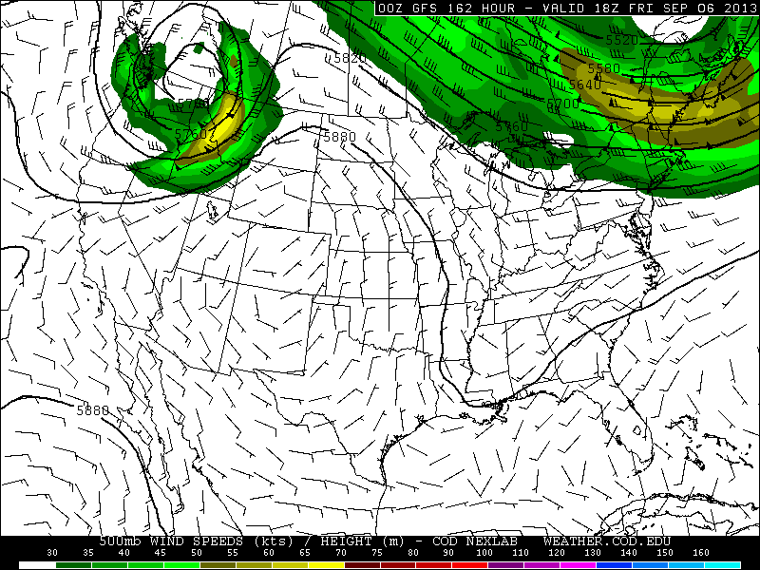
Trough continues to dig in on Friday, implying continued cooler and drier conditions in
SEUS

Slide 29
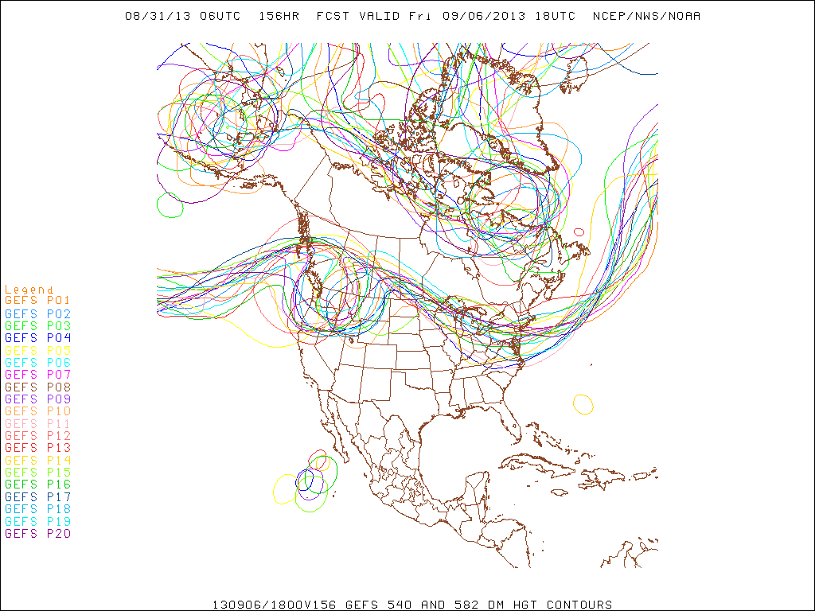
Ensemble forecasts are in reasonable agreement, except possibly for position of Pacific
trough moving in.

Slide 30
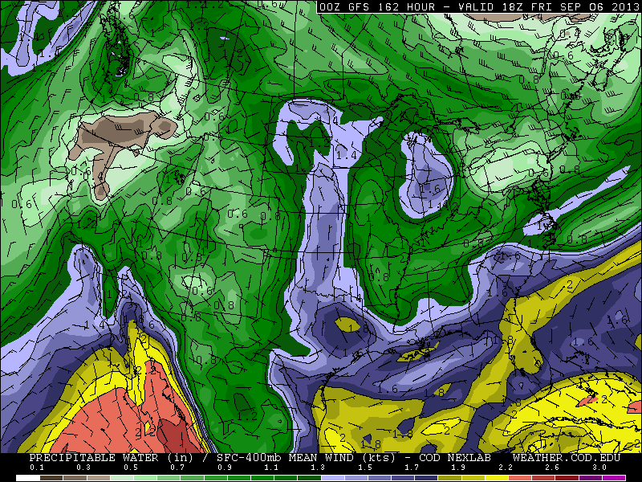
PW a bit less in the Gulf – note moisture plume to north is clearly reestablished.

Slide 31
Local wx
Starting Monday, expect some diurnal sea breeze convection late Monday through Friday.
Front mentioned earlier may provide some focus for convection, but chances are no more than 20%.
Low level flow is from the ESE starting Wednesday, so the Galveston Bay effect (storms dying as they cross the bay) will help reduce chances.
Expect no TO/landing issues.

Slide 32
Summary
Strong front moving southeastward affecting our region on Monday. Expect strong convection along front from AR east, scattered convection toward the west. Also scattered convection ahead of front in unstable air in MS, AL, and GA
Gulf moistens in the forecast period, producing better chances of coastal convection Monday and Wednesday (Wednesday may be better)
Friday conditions continued cooler and drier except near the SEUS coast. Gulf convection may be less favorable on Friday (emphasis on may)
NAM is strong, though fairly far west, both Monday and Wednesday. Starts to break down on Friday.
Model forecasts on large scale flow are very consistent through next Friday – not always the case
Tropics are depressing

