Slide 1
Met Brief, 20130904
Lenny Pfister, Nick Heath, and SEAC4RS met team

Slide 2
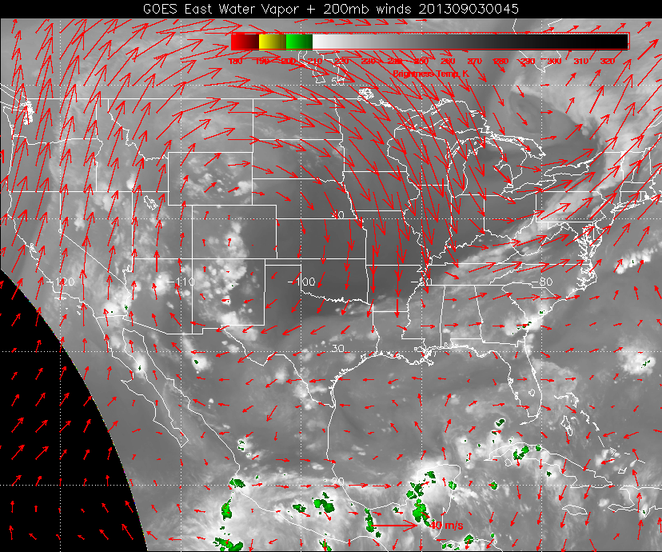

Slide 3
Evolution at 500mb

Slide 4
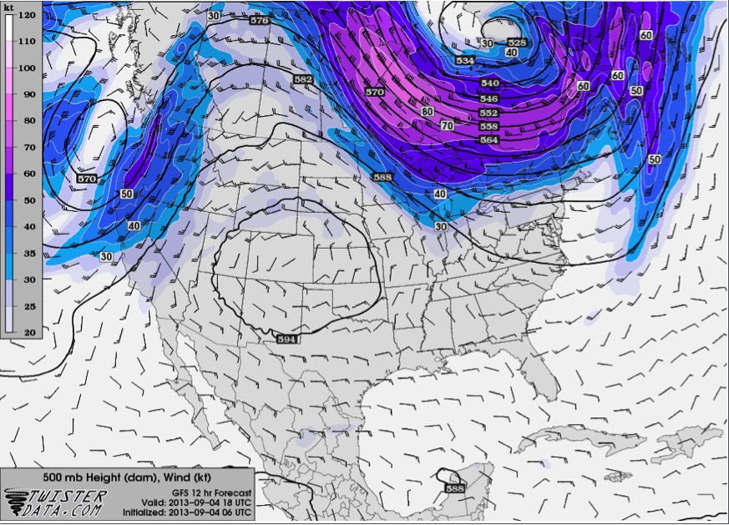

Slide 5
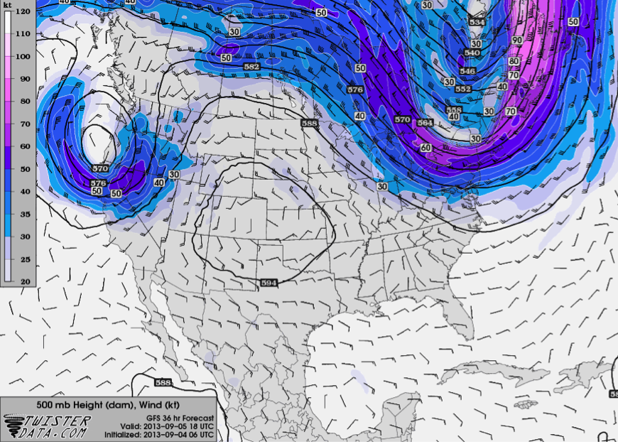

Slide 6
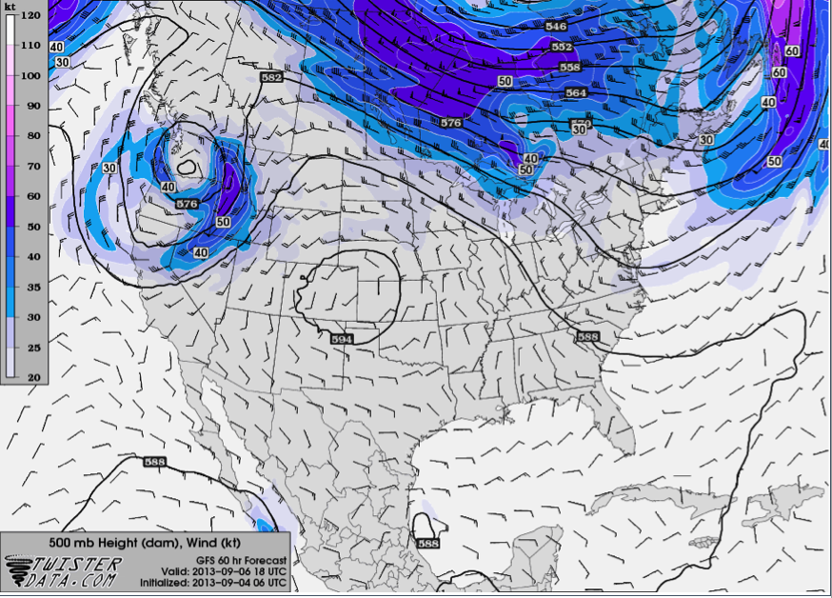

Slide 7
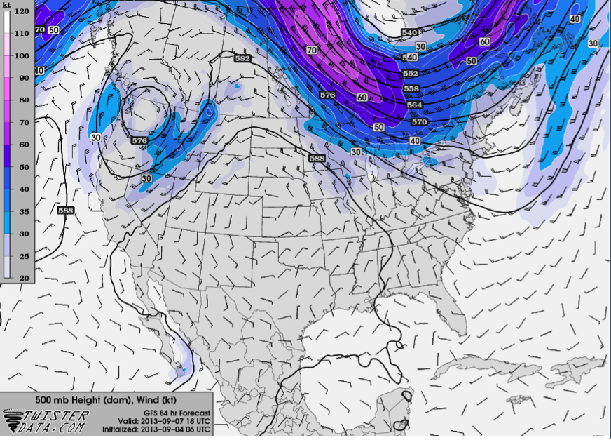

Slide 8
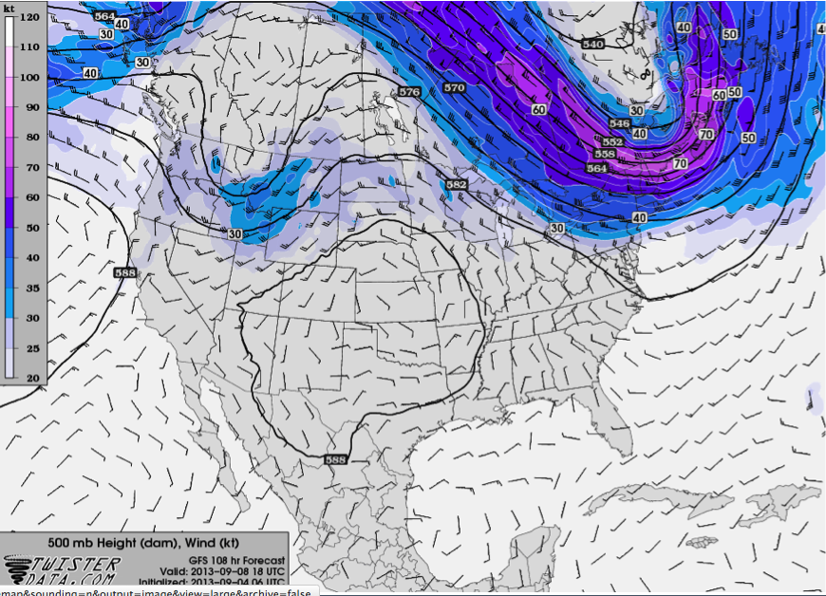

Slide 9
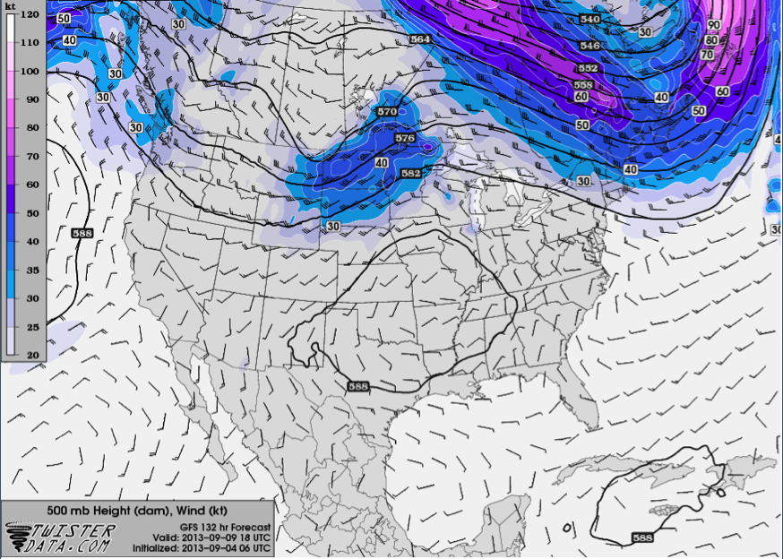

Slide 10
Evolution at the surface

Slide 11
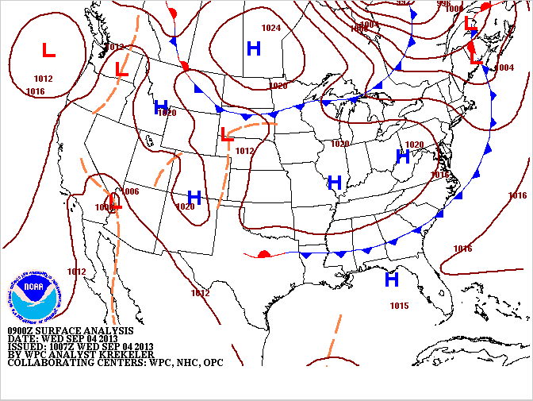

Slide 12
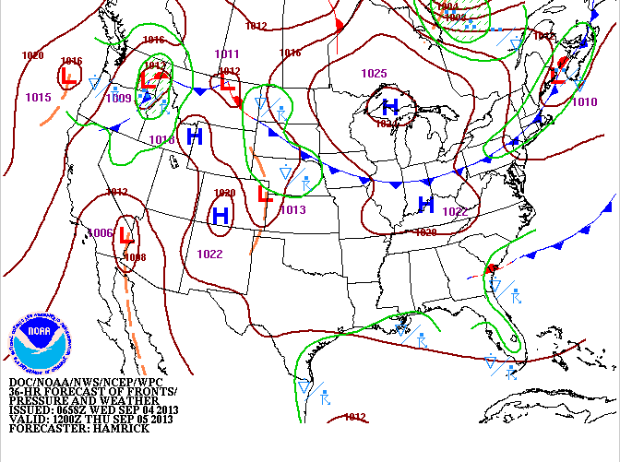

Slide 13
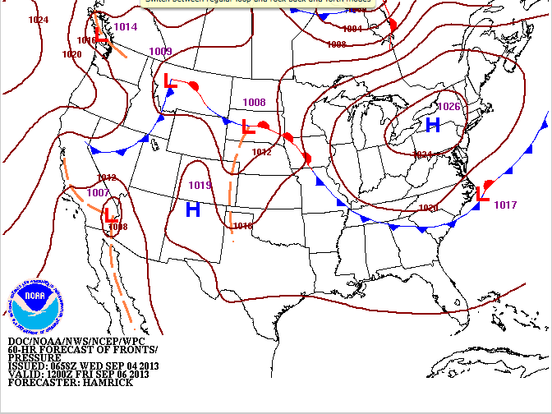

Slide 14
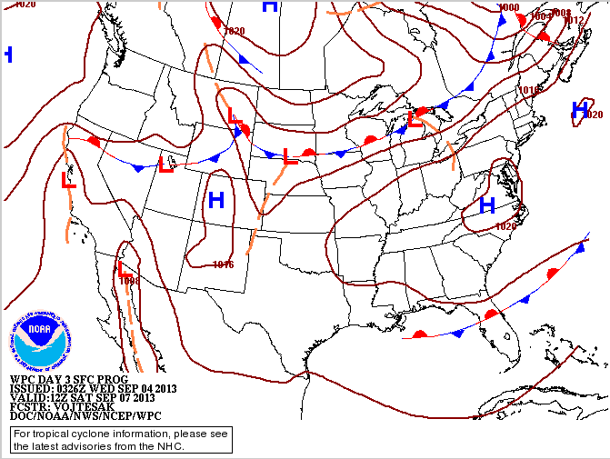

Slide 15
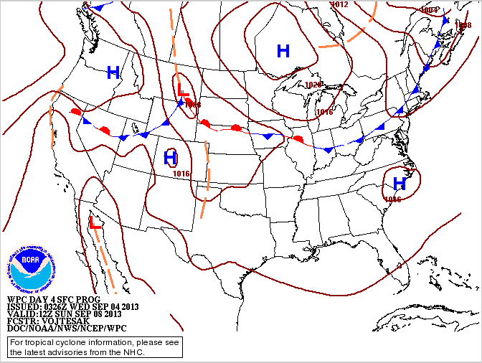

Slide 16
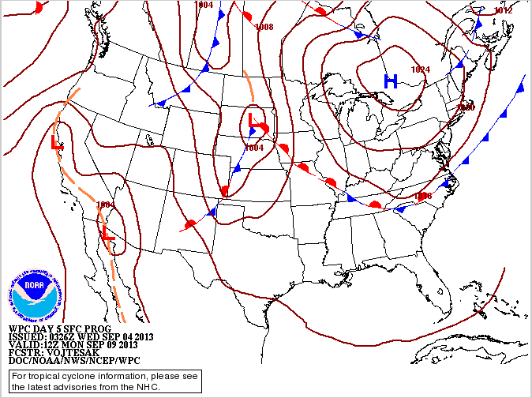

Slide 17
T/O,Landing for Friday, Monday
Winds are progged to be southerly to easterly, always less than 10 knots,
T-storms excepted.

Slide 18
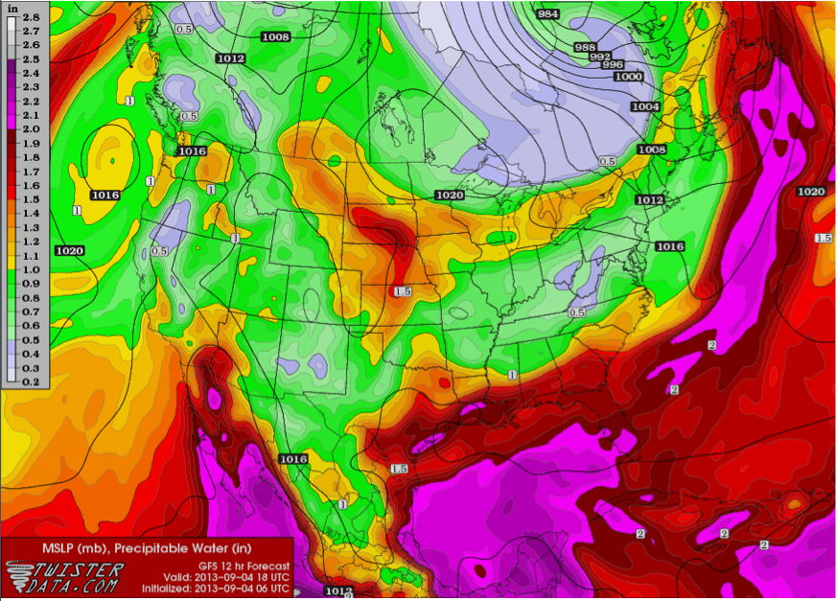
Precipitable Water, This Afternoon
Today, easterly wave is approaching Mexican coast, have 30% chance of T-storms this PM.
In fact, have convection east of us, slowly moving in our direction right now.

Slide 19
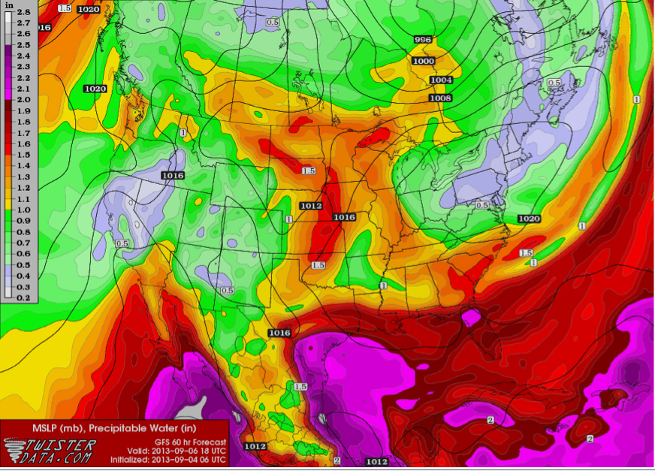
Friday, easterly wave comes ashore. Probably OK because of high above us. 20% chance

Slide 20
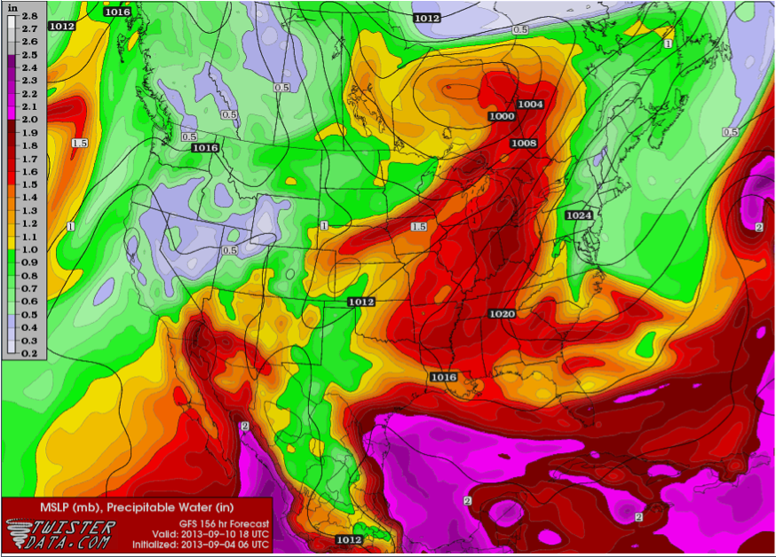
Another easterly wave comes in next Tuesday. Timing is tough this far out, but these models
are usually fast. Should be OK for Monday– 20% chance.

Slide 21
Implications for Friday

Slide 22
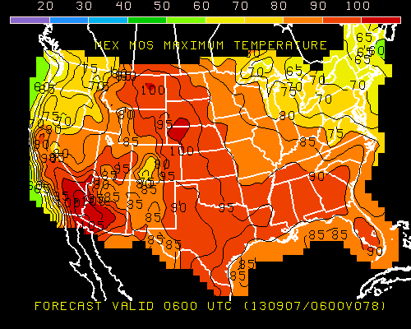
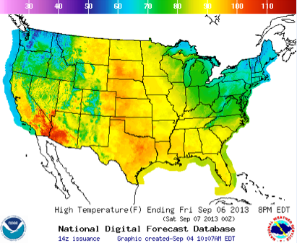
Max Temperature

Slide 23
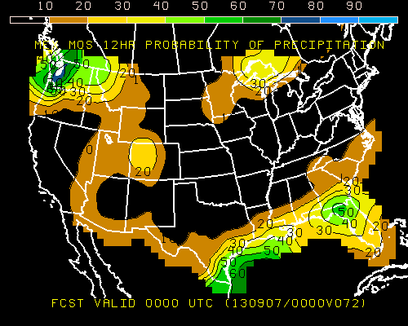
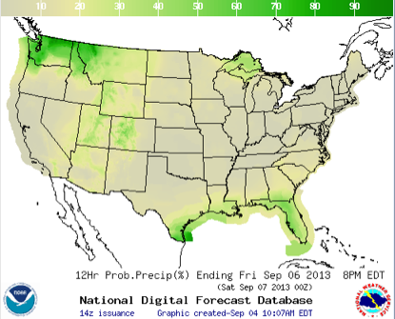
Precip

Slide 24
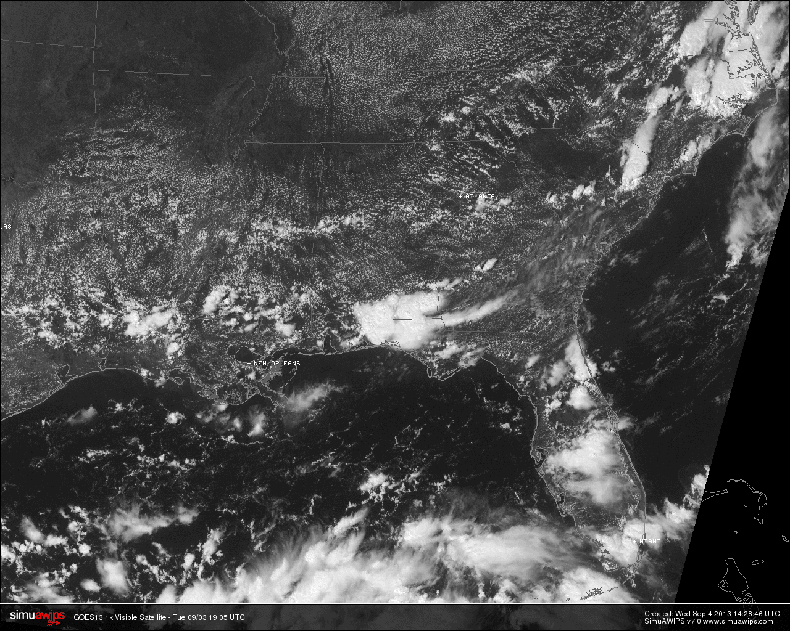
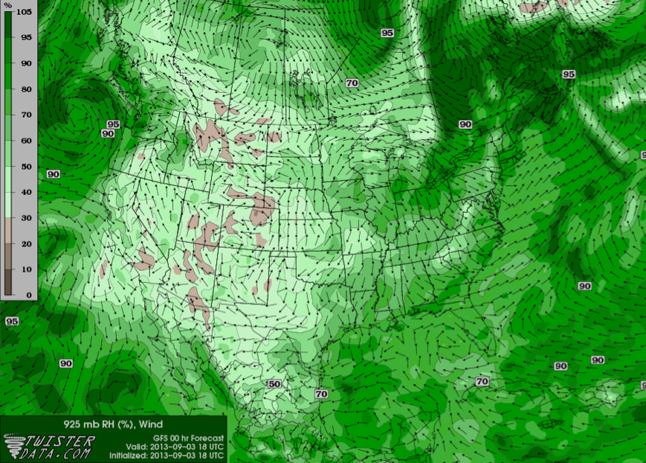
Low clouds
Yesterday, 2:15 PM
Generally moister regions at 925 mb have more
low level cu
Low level RH yesterday

Slide 25
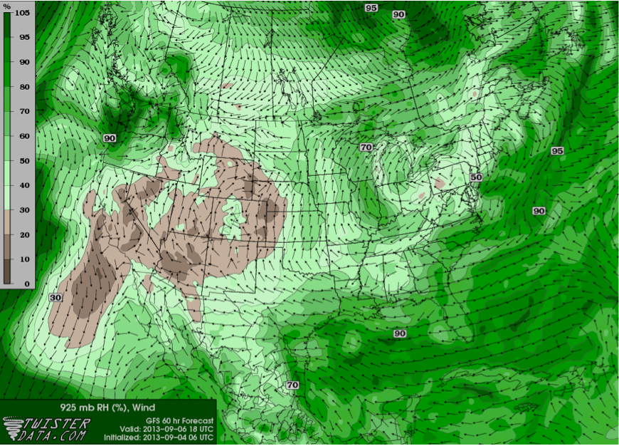
Sorry, no satellite image available for Friday, but things are
drier (or similar to yesterday) in SEUS; winds shifted to easterly
and southerly around high moving to east.
Friday, low level RH

Slide 26
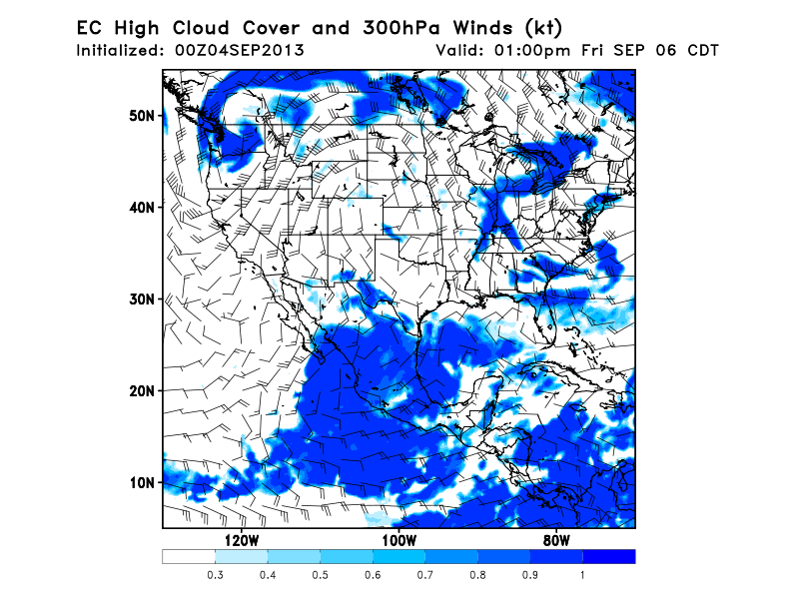

Slide 27
Implications for NAM on Friday

Slide 28
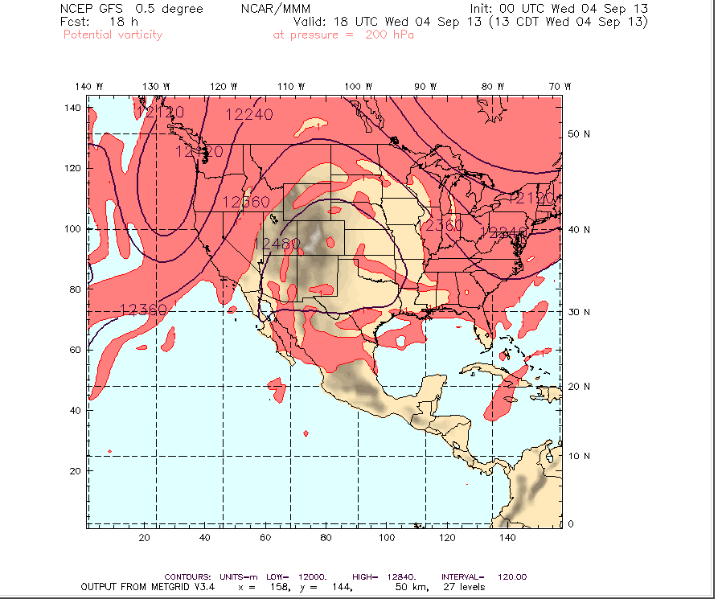
Wednesday

Slide 29
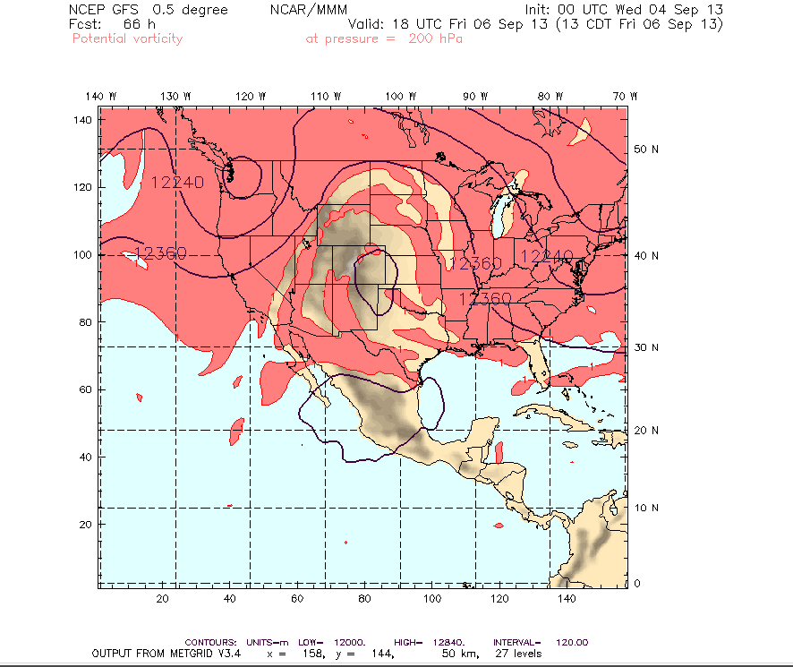
Friday
High has shrunk,
moved slightly
east. Would have
to go to central KS
to be assured of
getting NAM air
mass at low levels

Slide 30
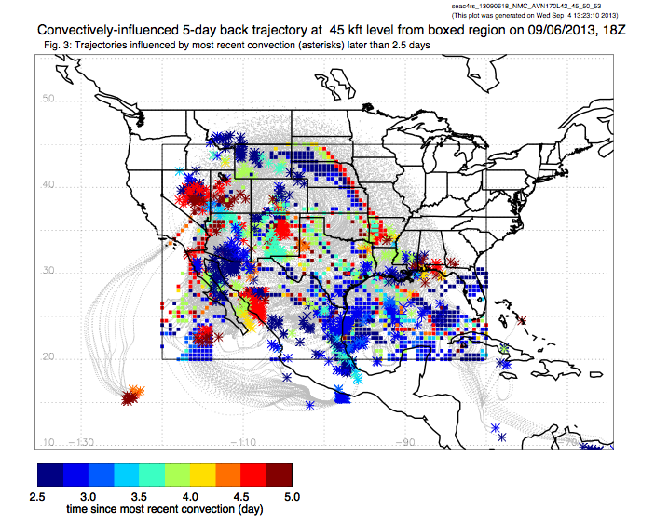
This air lofted by convection in the Rockies and Mexico

Slide 31
Implications for Monday
NOTE: These are long term forecasts (almost 6 days).

Slide 32
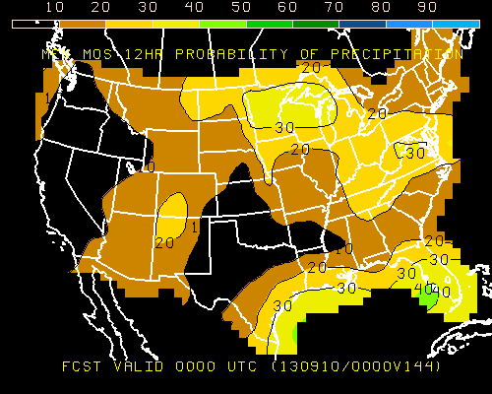
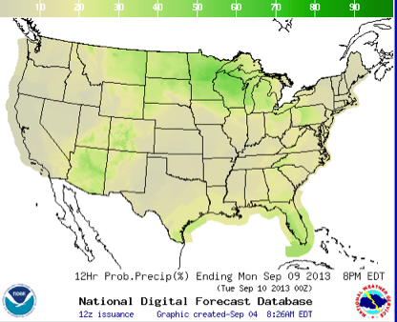

Slide 33
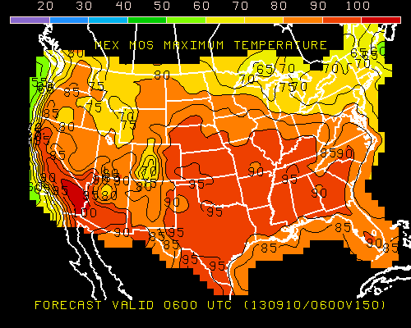
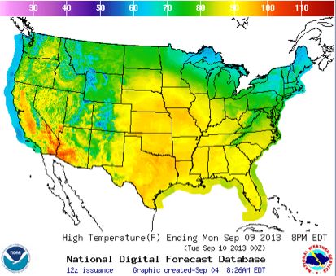

Slide 34
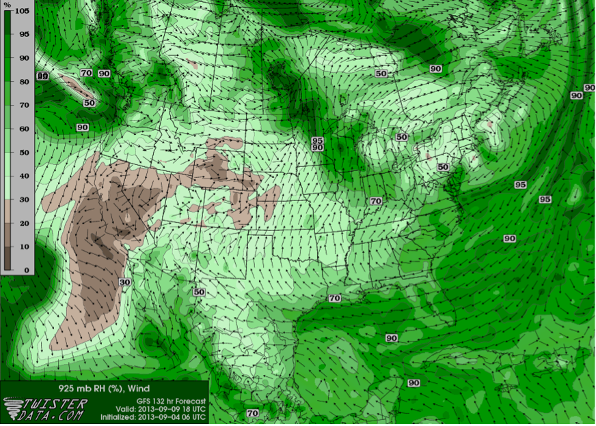
Still looks reasonably dry on Monday

Slide 35
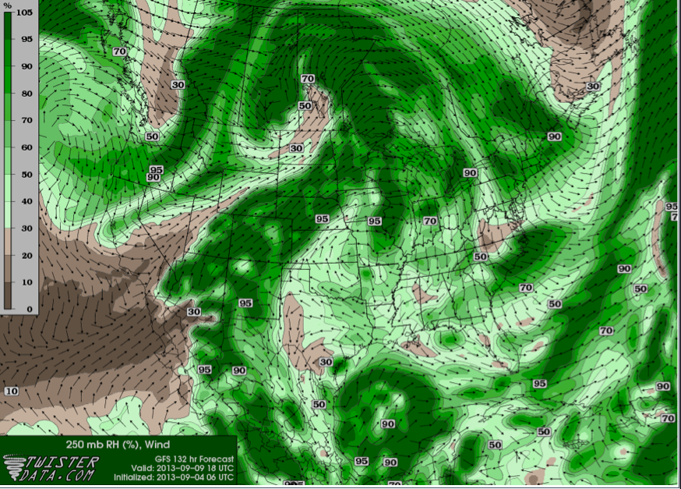
Forecast indicates minimal high clouds (though more than Friday) in SEUSCHEM target area

Slide 36
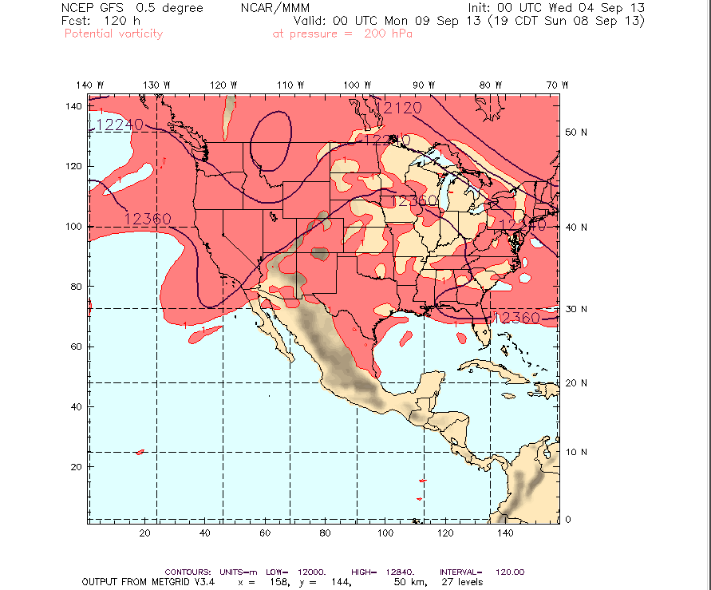
This is Sunday
night, but as
shown by 500mb
chart, NAM is
totally destroyed
by now.

