Slide 1
Met Brief, 20130820
Lenny Pfister
Nick Heath

Slide 2
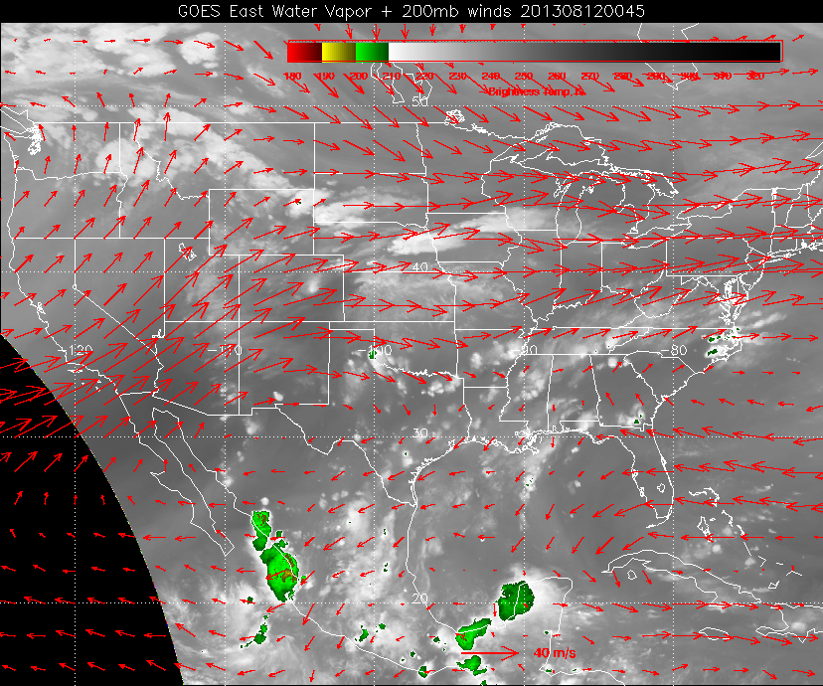

Slide 3
Forecast Issues for 20130821
Location and intensity of convection (Lear/DC8 interaction)
Surface temps and conditions in the Ozarks
Convective outflow
Ellington wx

Slide 4
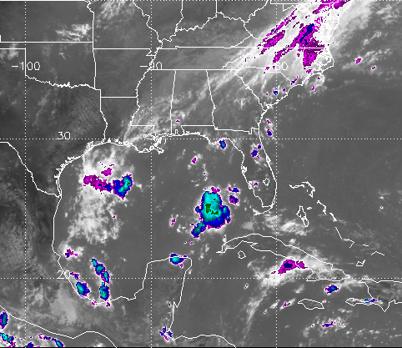
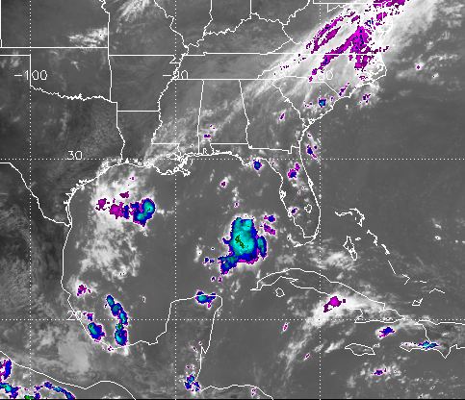
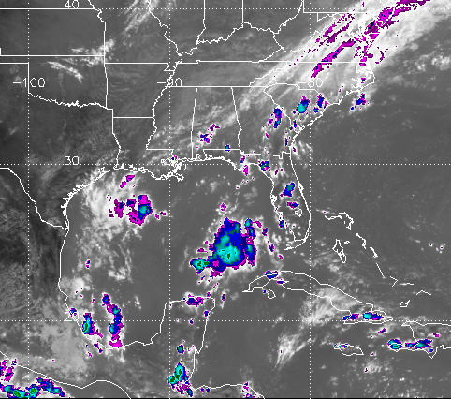
1715
1745
Indications from yesterday are that systems are developing around noon. Radar shows
returns even earlier. This is near the coast,
though. For the further inland systems I
expect, 1 PM should be OK (no later than
that).
1915

Slide 5
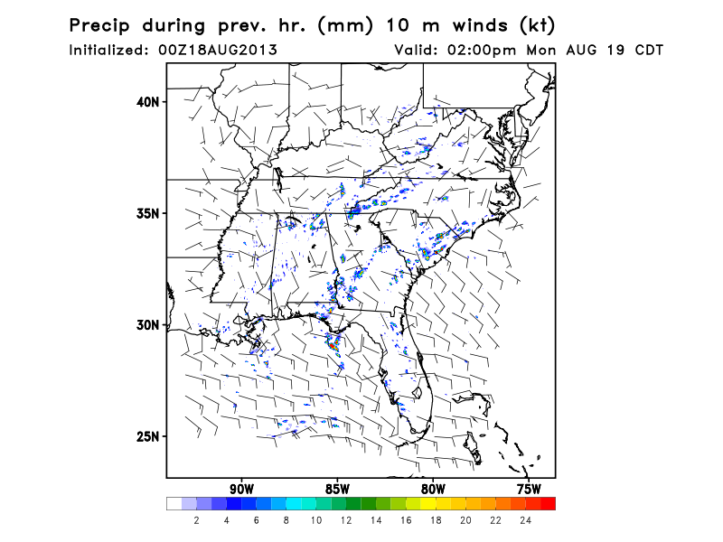
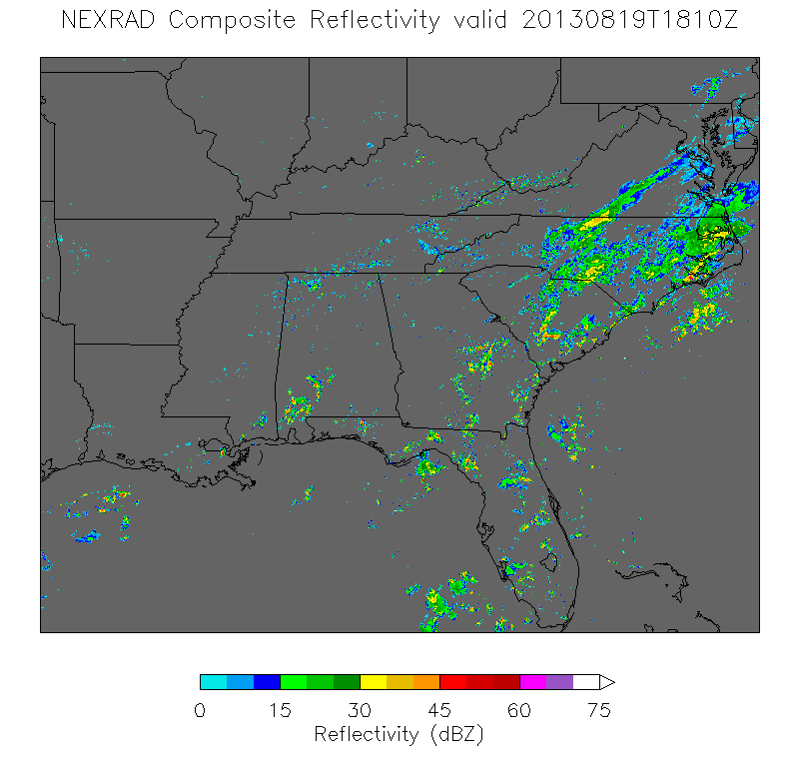
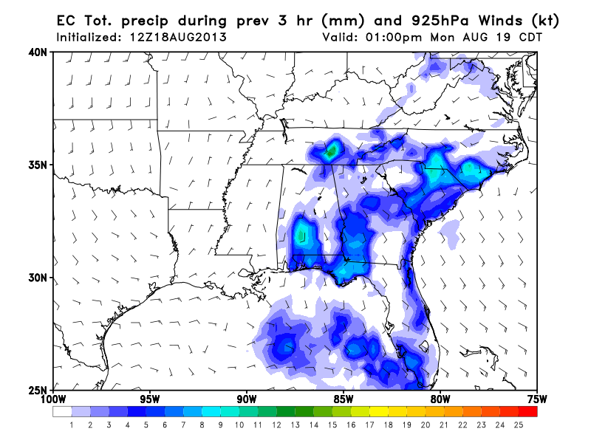
Yesterday’s precip/models
Not too bad. EC distributions do not extend
far enough west, FSU perhaps too much.
radar
EC
EC

Slide 6
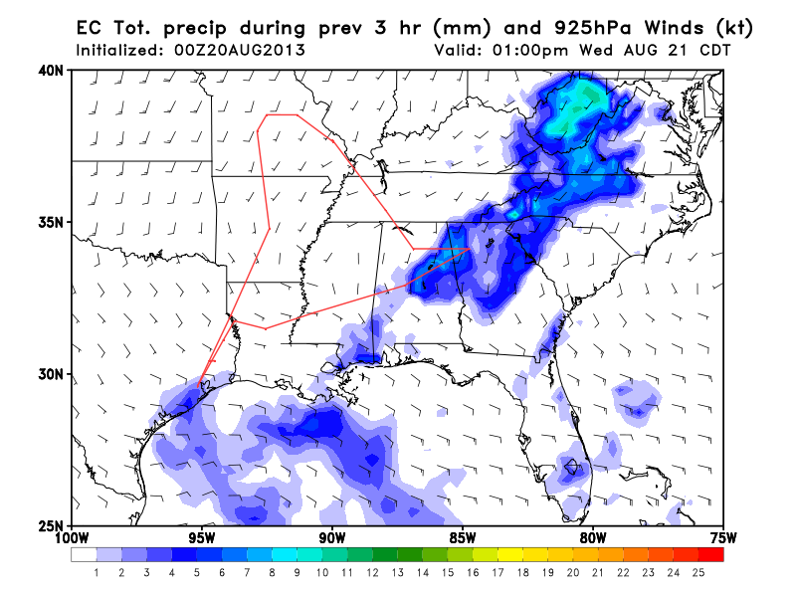
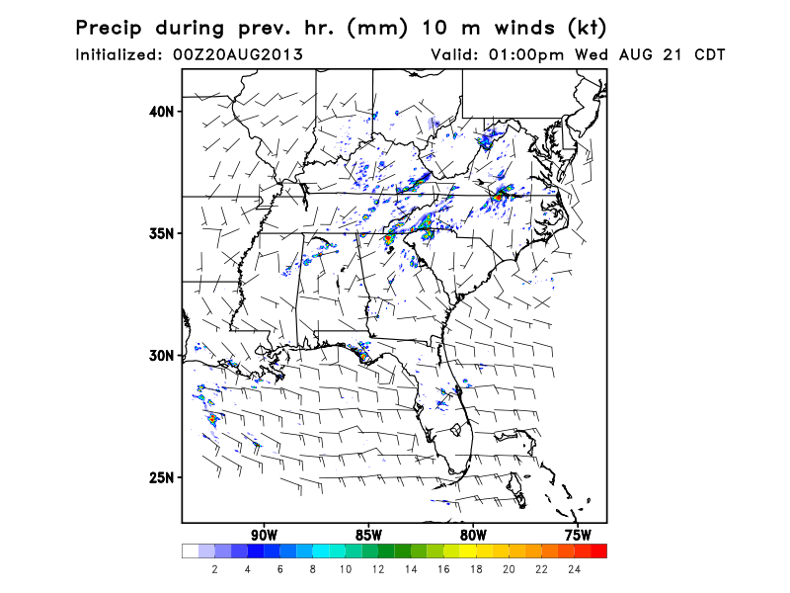
Model simulations
EC (15 km)
FSU WRF (3 km)
NCAR model no longer forecasting rain for AR.

Slide 7
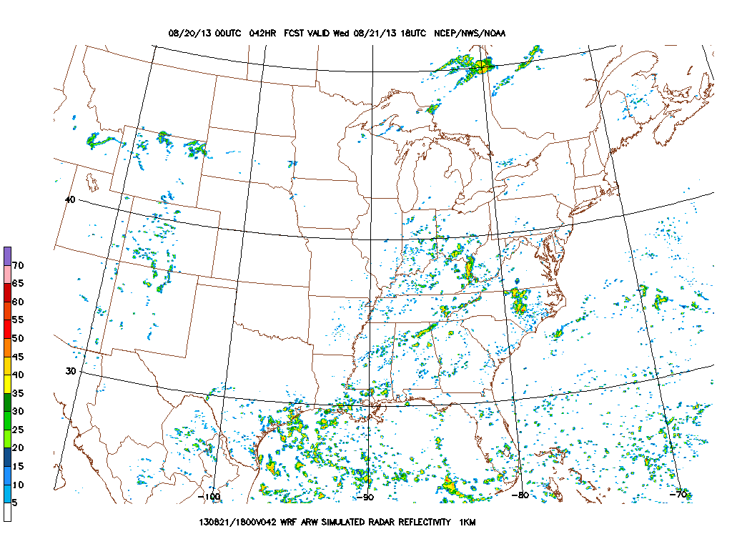
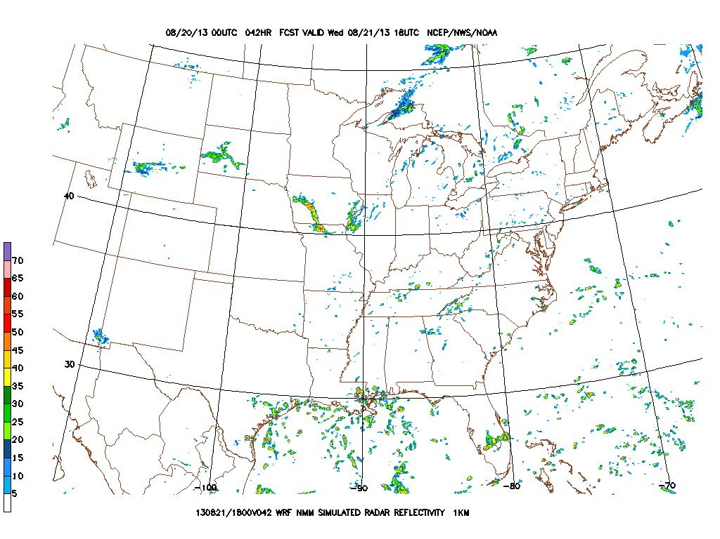
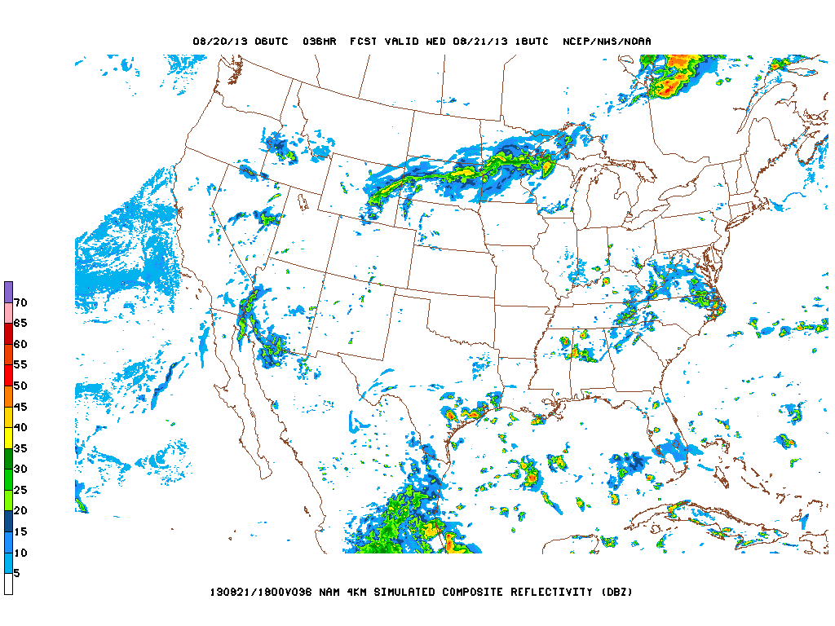
Wednesday’s Convection
1 PM CDT
WRF-ARW
Conclusion: Don’t see a lot of convection
near the coast in the PM. Expect
development in north-central AL in
the afternoon. At or somewhat before
1 PM is preferable.
WRF-NMM
NAM-hires

Slide 8
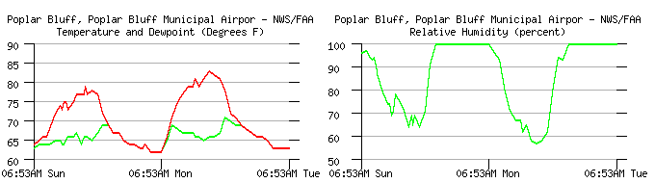
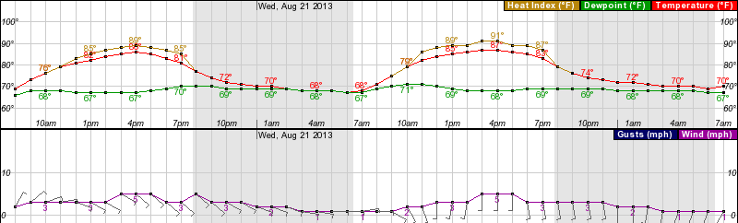
Surface Temperature
Poplar Bluff (SE MO)

Slide 9
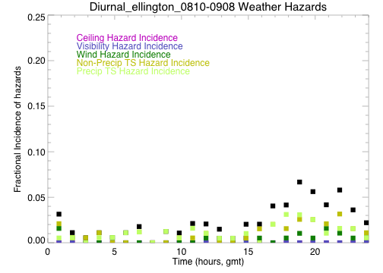
Landing/TO
Forecast points to an upcoming wet period. Precipitable water has
definite westward moving “surges.”
One of these comes ashore on Thursday, leading to increased chances
of showers. TS/rain risk peaks at 2 PM, with a secondary peak at 5 PM.
(climo). With enhanced precipitable water come stronger systems than
normal and possibility of wind gusts. Again, nothing like we had last week
where airports were closed. Aircraft will need to have reserve time.

Slide 10
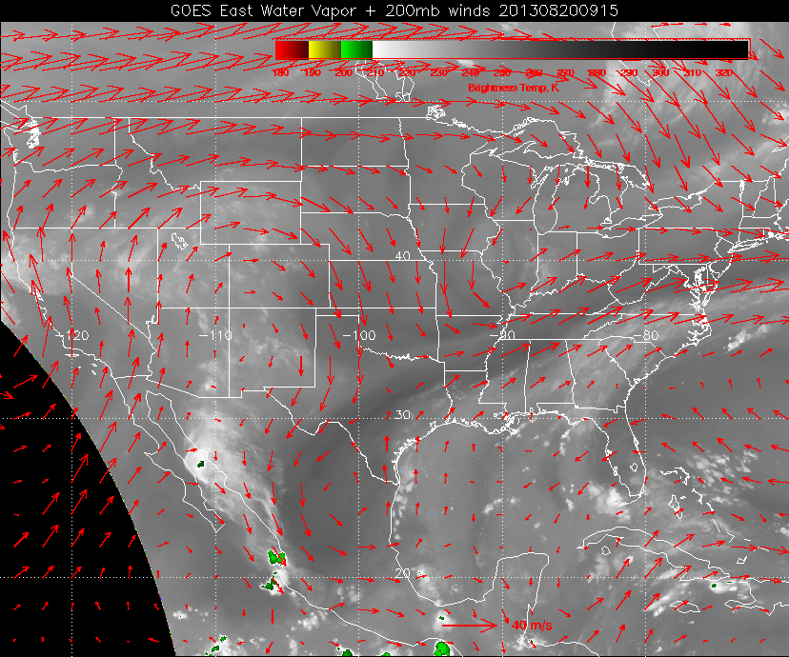
Note surge of moisture approaching hitting us now. Expect dry slot to be over us
sometime tomorrow. Then following moist area on Thursday. Houston office
raises chances of precip on Thursday, probably because of this. We may get lucky,
again.

Slide 11
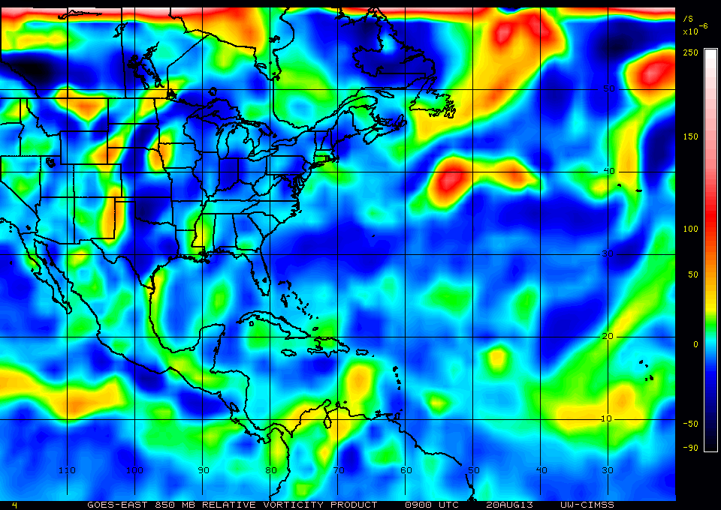
850 hPa relative vorticity at 09 UTC this morning…another easterly wave north of Yucatan…timing of this wave could affect our precip chances.

Slide 12
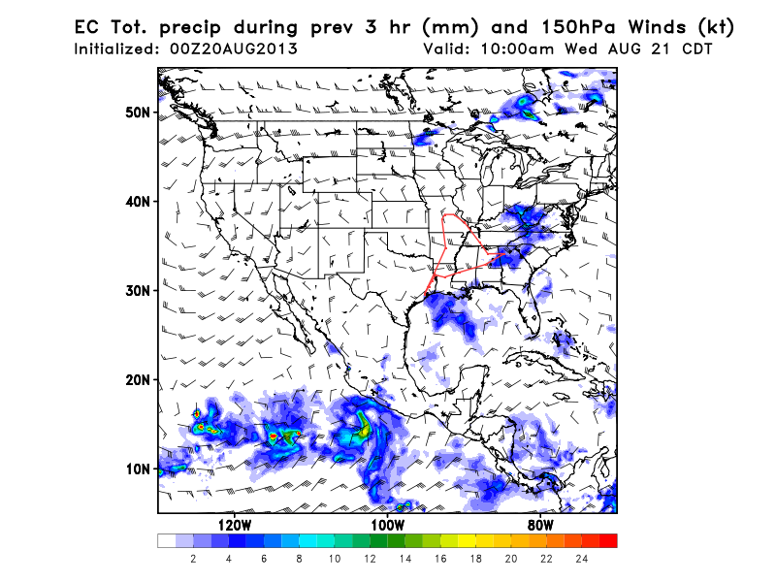
Convective Outflow
No obvious outflow pattern from morning convection off the coast. Daytime convection
is blown Neward.

Slide 13
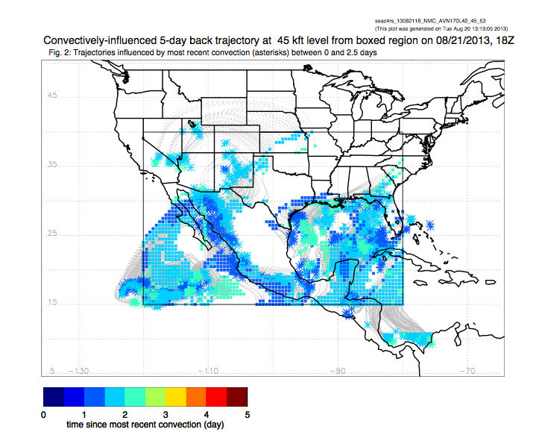

Slide 14
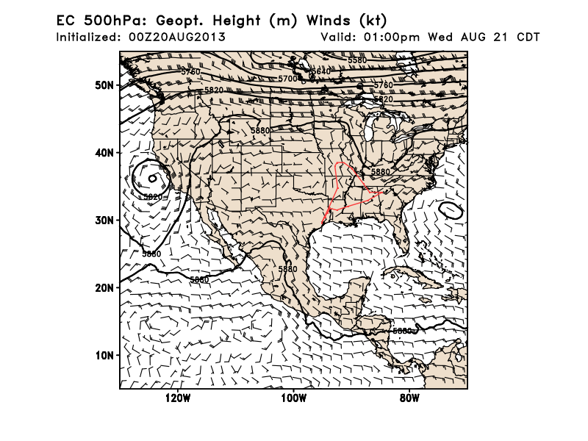
500mb pattern similar to yesterday’s run, with Ohio valley trough somewhat advanced
from yesterday’s run, and not quite as deep (CA closed low not advanced as much,
such a surprise!). Implications for immediate area are limited.

Slide 15
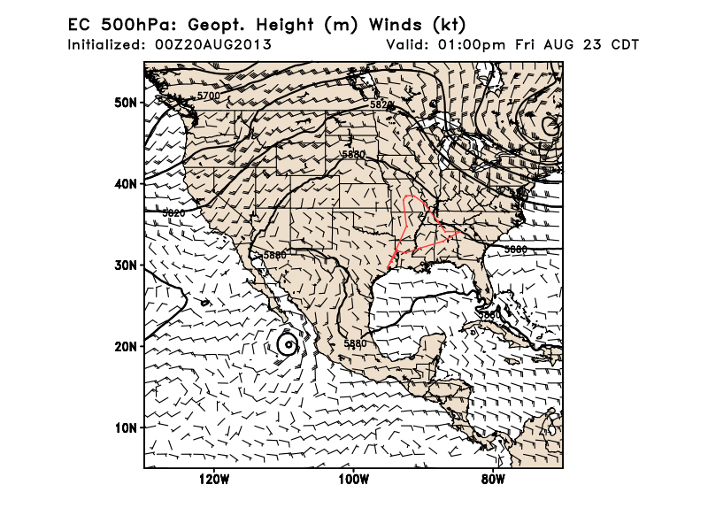
Both EC and GFS are much more aggressive with offshore trough development by Friday.
Daniel’s fear of clearing out pollution is now much more likely to be realized, as the front
expected to be over KY now pushes through, reversing winds in AL (surf) to the north.

Slide 16
Summary
Northern AL looks reasonable for convective development tomorrow afternoon. Suggest being there no later than 1 PM, sooner if possible.
Expect AR surface temps to be around 87-88 tomorrow. Increasing trend, as forecast, though absolute values are not as high as indicated yesterday.
Convective outflow (fresh) at 45kft expected off the Gulf Coast tomorrow afternoon.
Trough development off US east coast much more aggressive than previous forecast. Wind direction changes at Birmingham and are likely to sweep pollution away.

