Slide 1
Met Brief, 20130819
Lenny Pfister
Nick Heath

Slide 2
Weather today/yesterday

Slide 3
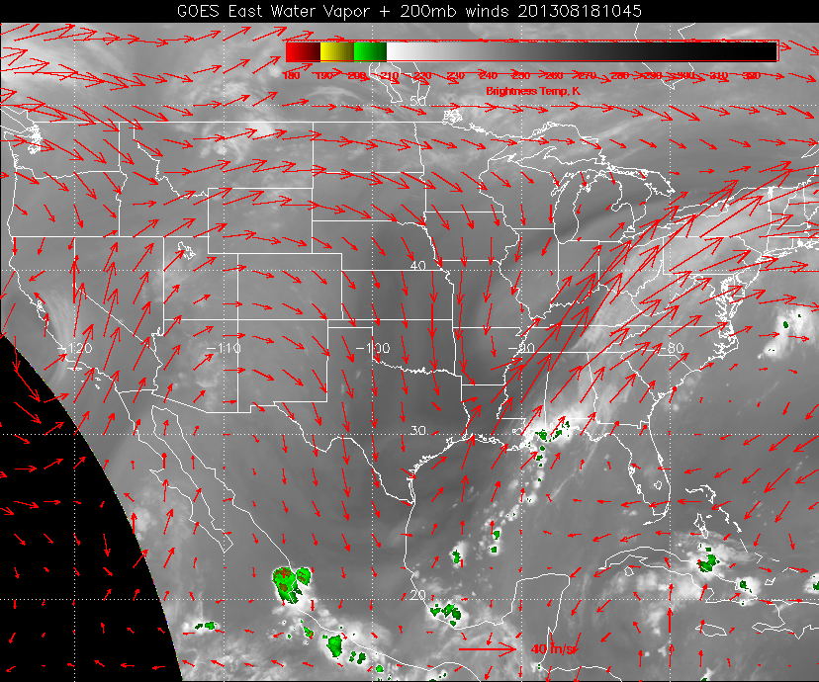

Slide 4
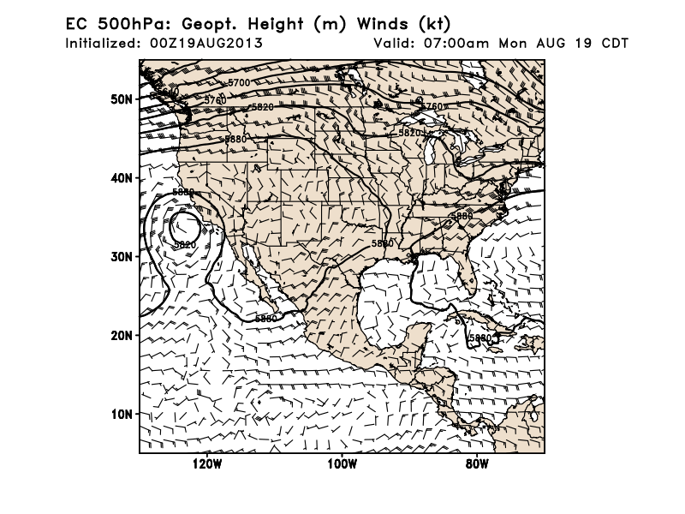
Trough in northern great plains generated string of MCSs across southern CA
500mb ridge in west is typical, but northern position of closed circulation is not.

Slide 5
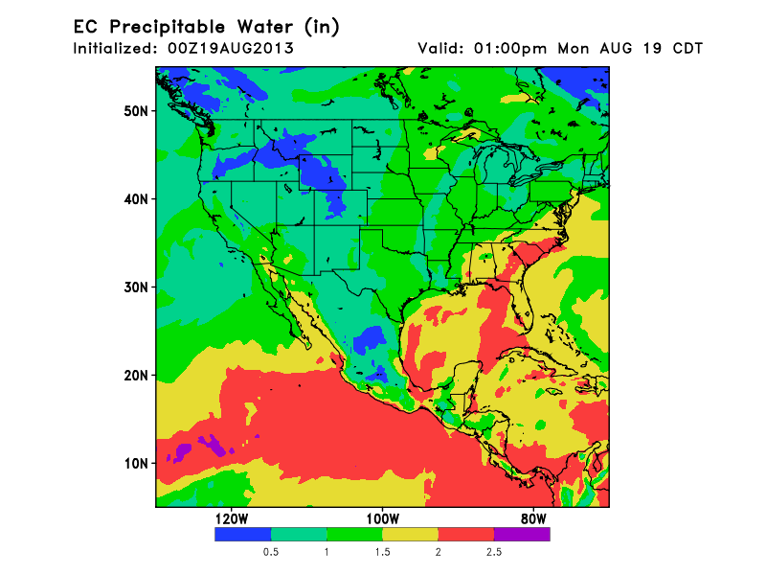
Dry trough keeps Gulf moisture away for today.
Core of precipitable water is in eastern Gulf.

Slide 6
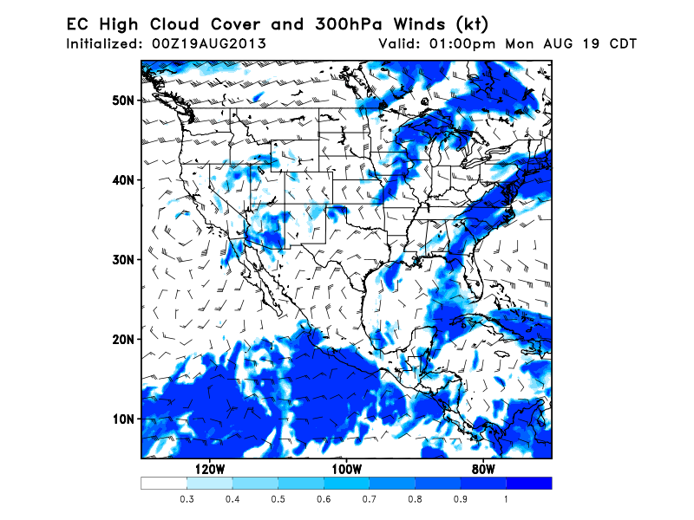
Forecast for this PM holding as clearing occurs behind the upper level trough that generated
MCS in the north yesterday and this morning.

Slide 7
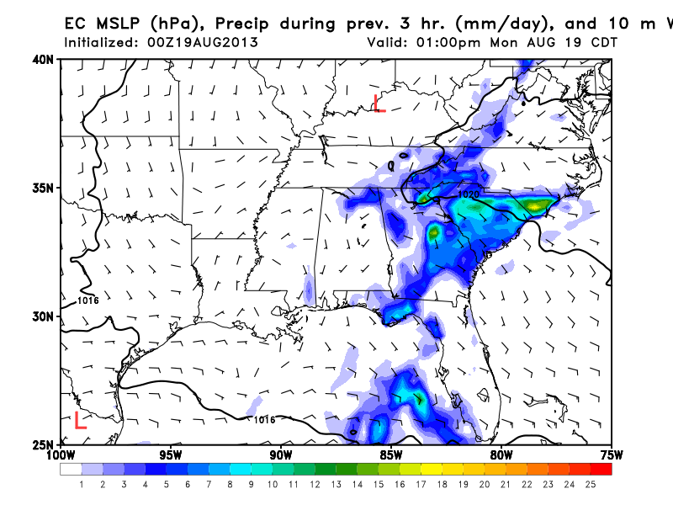
Today, expect precip to be concentrated in eastern portion of SEUS. Note very weak
flow, high is offshore (925 mb winds also light and variable).

Slide 8
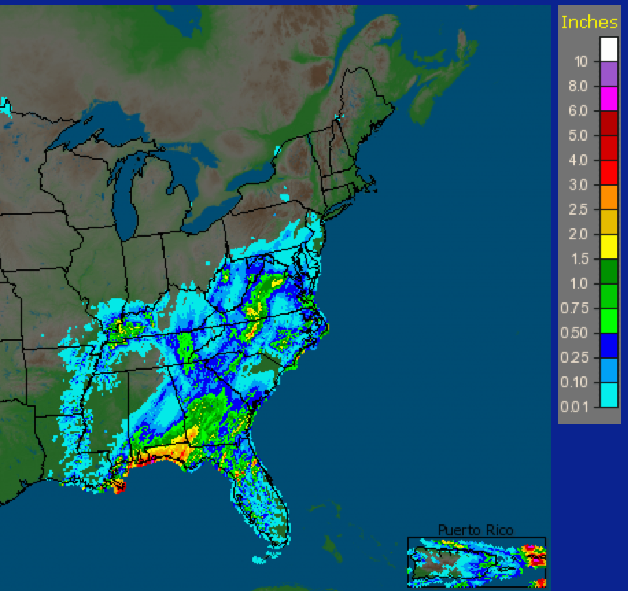
Precip over past few days. Ground is moist, any heating will at least generate
puffy clouds. Chemistry impact?

Slide 9
Weather Wednesday

Slide 10
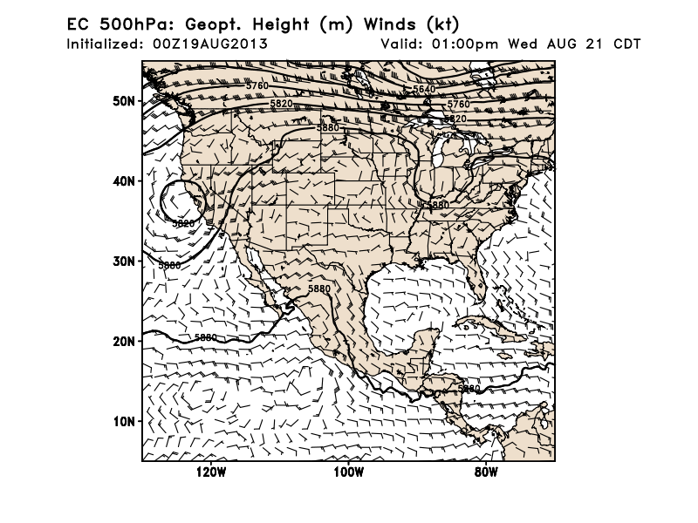
By Wednesday, 500mb trough has lifted somewhat, a low (upper level and surface) has
developed near Hudson’s bay, and a front is extending from the upper old northwest
through SD/Iowa. Closed anticyclonic circulation has weakened with lifting trough, but
No MCSs expected except along the frontal boundary. Closed low off Pacific coast starting
to move in. Expect T-storms in CA about this time.

Slide 11
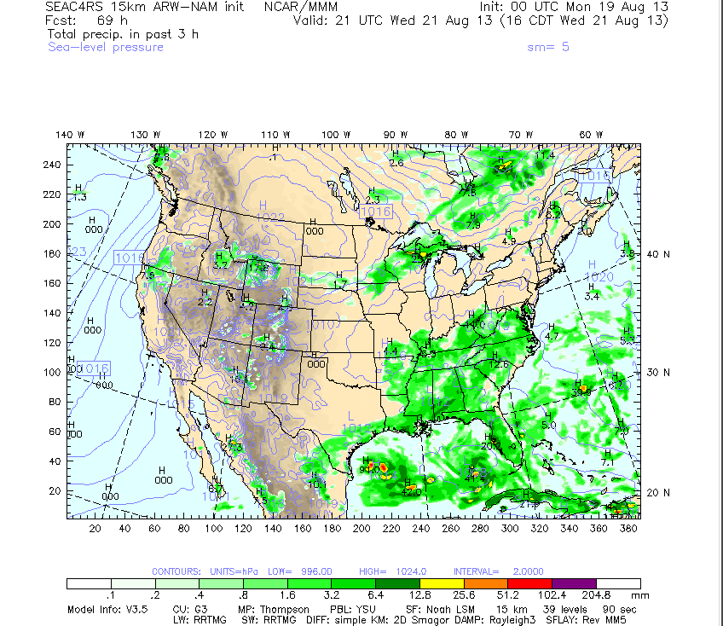
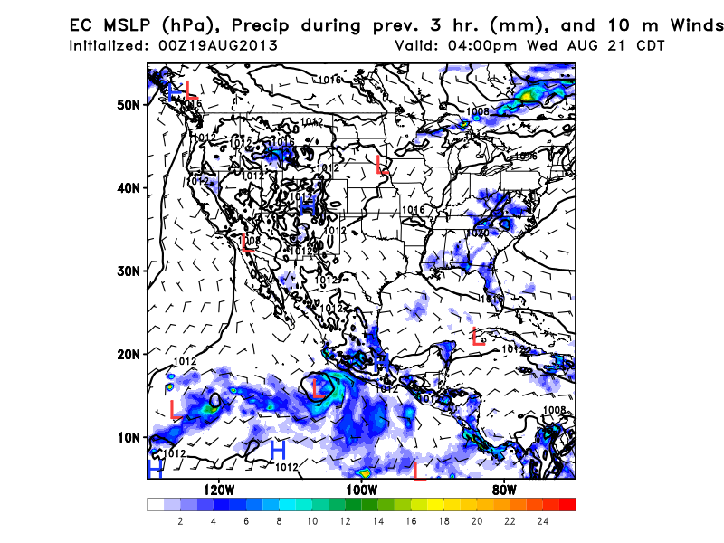
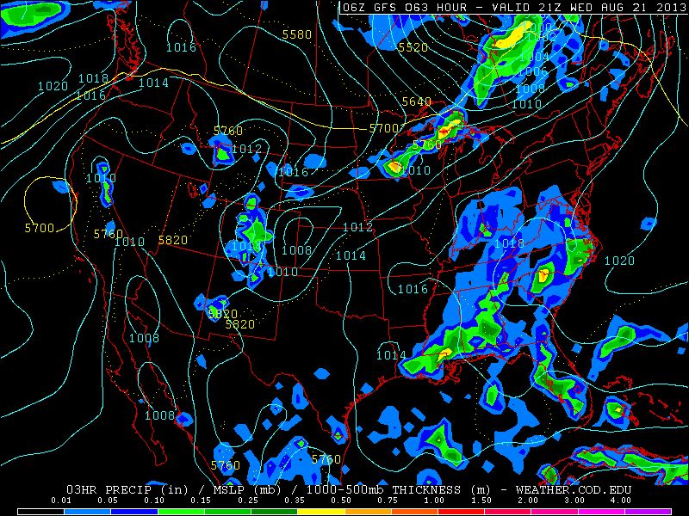
Similar basic rain pattern for NCAR WRF
(above), GFS (below right), and EC
(above right). Bottom line – precip and
convection further west (slightly) in
SEUS. Do not expect rain over AR.
EC underdoes, WRF overdoes the precip.

Slide 12
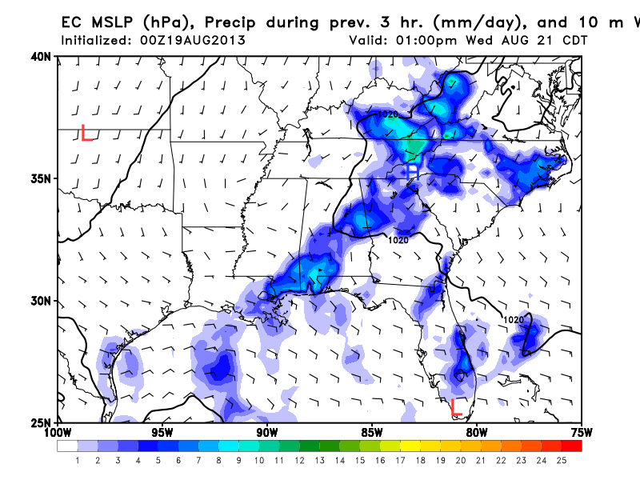
Detail on precip pattern and flow in SEUS Precip shifted westward relative to today.
Weak flow at the surface. This model shows development in NE TN, probably related
to dynamics of retreating trough.

Slide 13
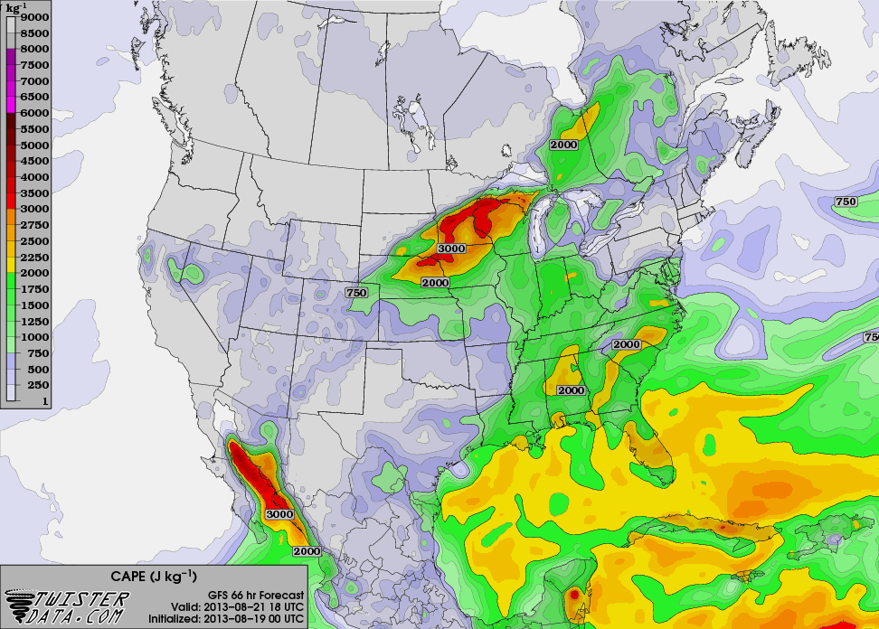
Ample CAPE (Convective available potential energy) over SEUS, also the Gulf.
Forcing may be stronger in the north (associated with retracting trough), so big systems
north of Huntsville are possible. Coastal convection before noon is expected on Wednesday.

Slide 14
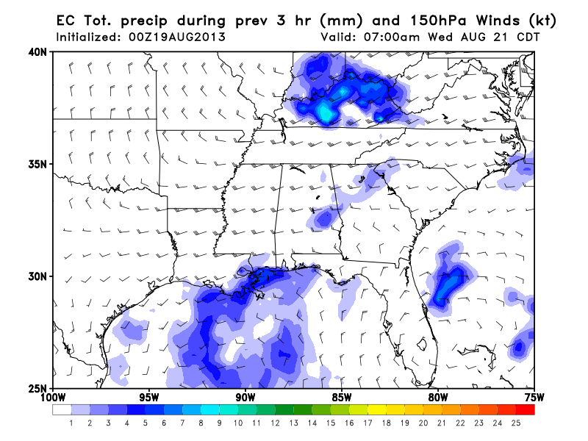
Convectively active Gulf on Wednesday. Substantial CAPE. No obvious strong waves
present, so expect diurnal pattern, maximizing before noon. There should be
convective outflow to sample.

Slide 15
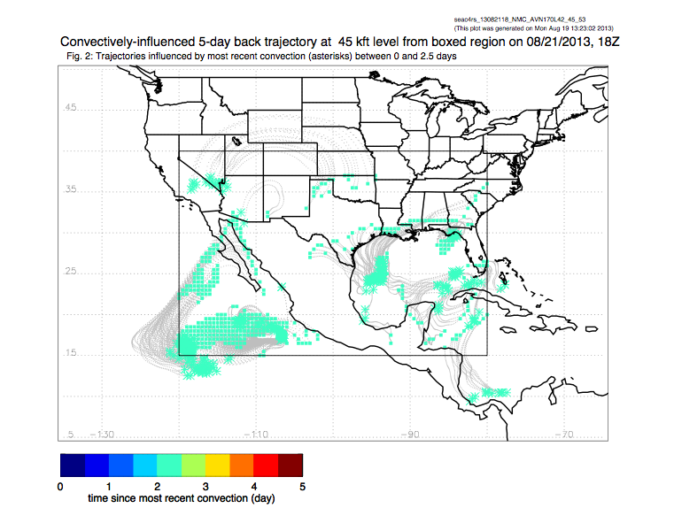
Outflow from recent convection in the Gulf over SEUS region.

Slide 16
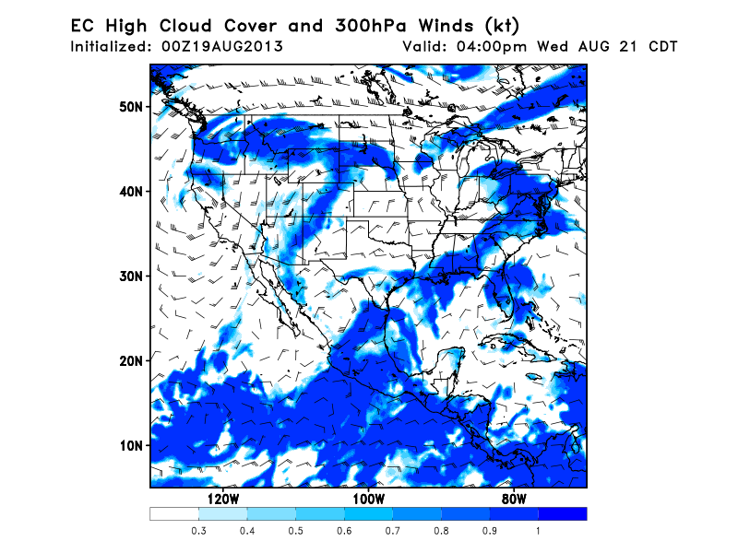
Ample high clouds along trailing trough/front associated with HB low. High clouds
associated with active convection in Gulf and SEUS. Expect AR to be clear.

Slide 17
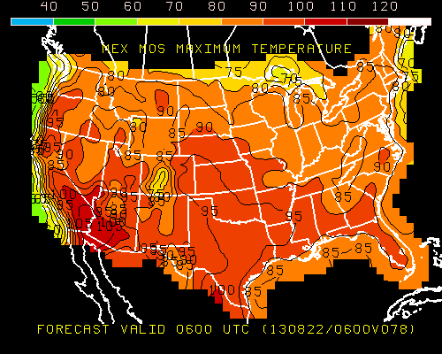
Wednesday max temp

Slide 18
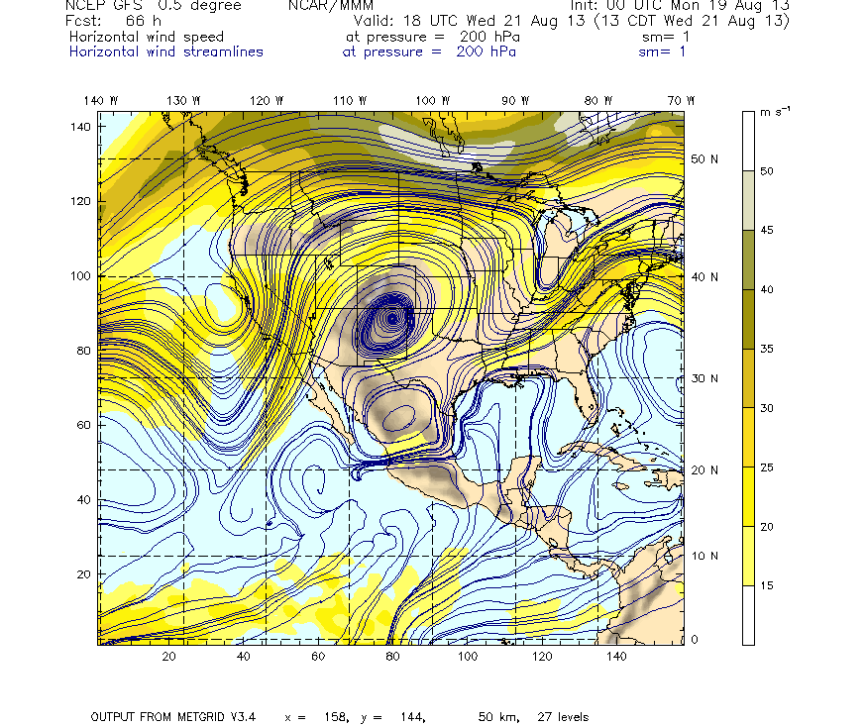
Anticyclone well developed and displaced eastward on Sunday. Have had substantial
convection over Rockies (and yesterday over Mexico as well).

Slide 19
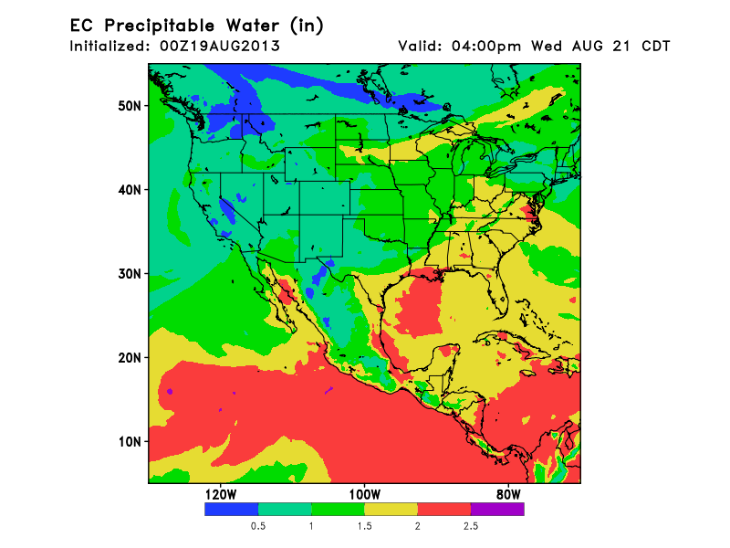
Slightly westward movement of PW over SEUS. Clear westward propagation
of Gulf moisture. The dry air (that has been shutting down the rain
here in last few days) retreats with the lifting trough. Expect diurnal type showers
on Wednesday. (Peak T-storms probably 2-3 PM based on climo).

Slide 20
Friday

Slide 21
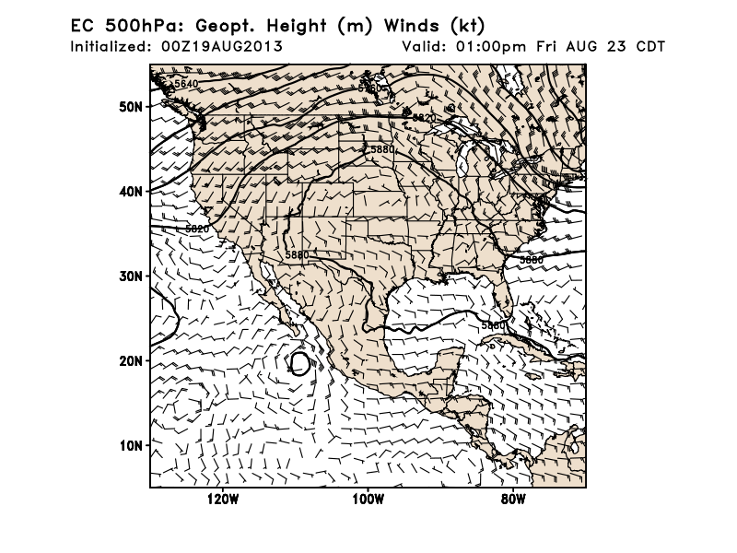
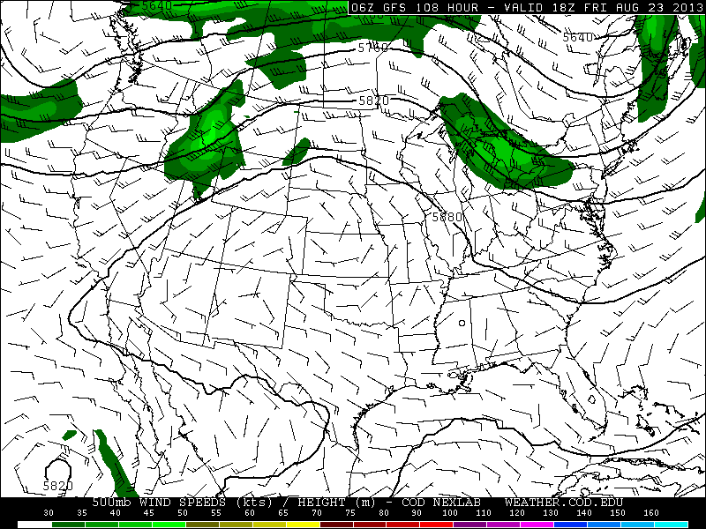
Long term 500mb forecast. Similar
pattern in both GFS and EC. Ridge
moves eastward – ridge east of
climo position. GFS slower in moving
CA closed low eastward, but EC has
new trough coming into West Coast.
Both models develop a TC, related
to a current disturbance (20%)
near (107,13)

Slide 22
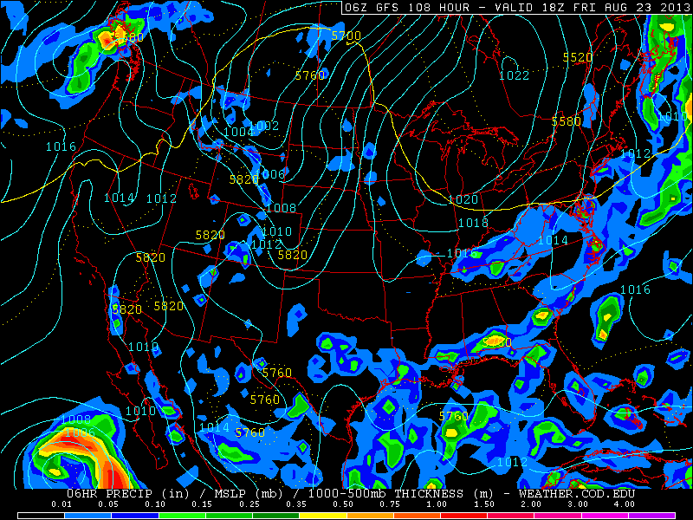
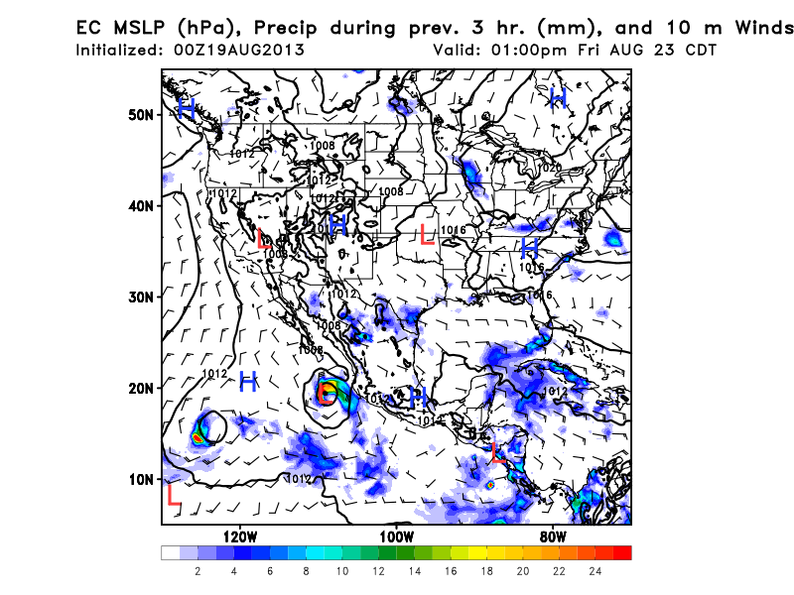
Both models generate a strong
low-high pattern over the northern
tier. Major effect on SEUS is convection
ahead of the front in northern TN. Cannot
count on that detail being correct (!) Flow
south of that very weak. AR region likely
in the clear.

Slide 23
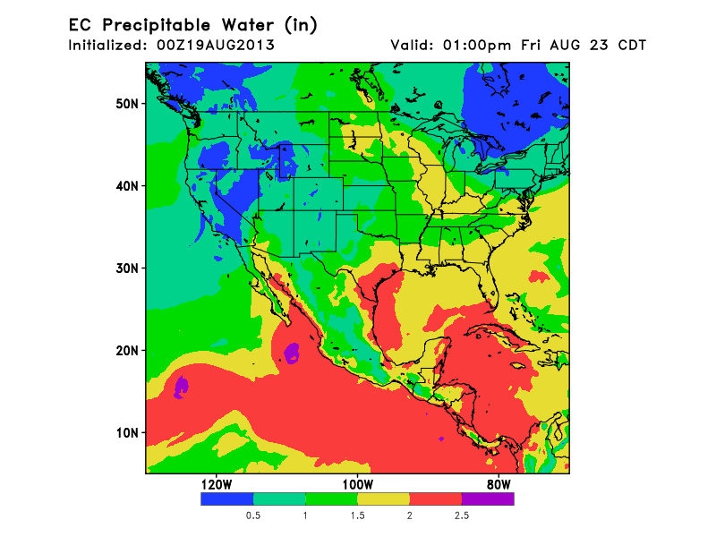
Incoming trough reduces monsoonal moisture in western part of Great
Basin, rockies. Still expect ample convection in eastern Rockies.
PW is moving into TX. Expect 30% chance of diurnal T-storms,
peak around 2-3 PM (though not a sharp peak)

Slide 25
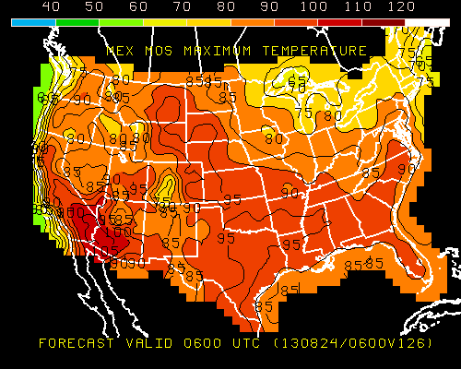
Friday Max Temps

Slide 26
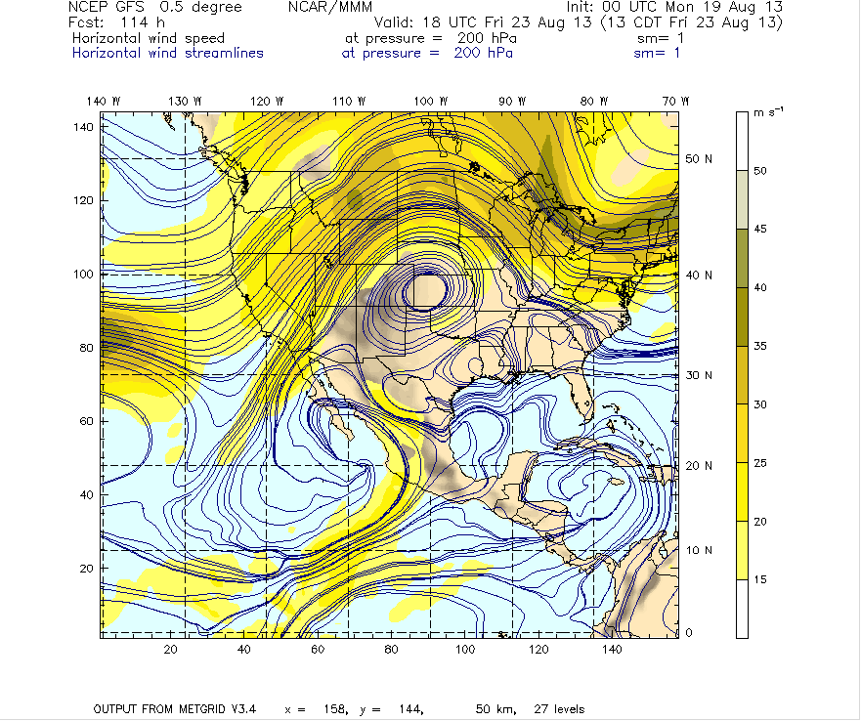
Good pattern for NAM on Friday. Accessible, pronounced closed circulation. There has
been active convection in the Rockies over the week, so this is a real possibility

Slide 27
And Beyond

Slide 28
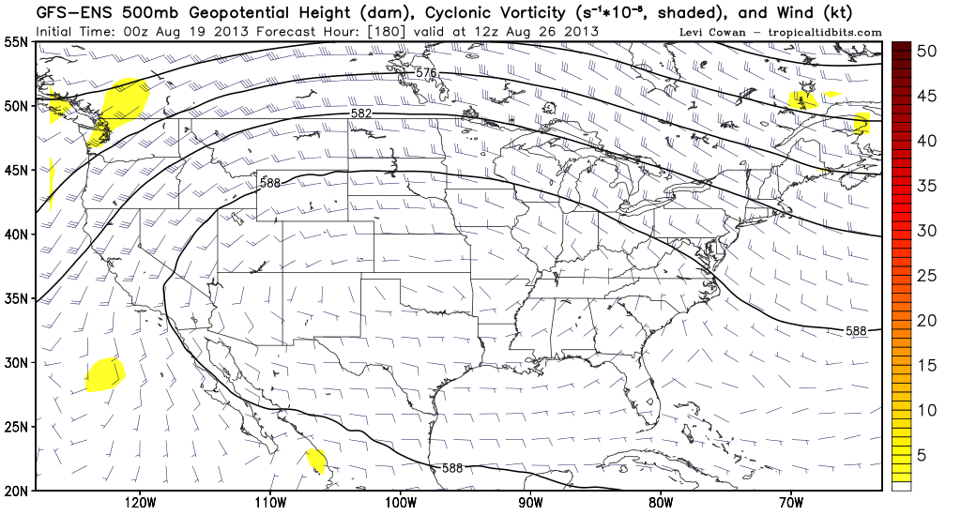

Slide 29
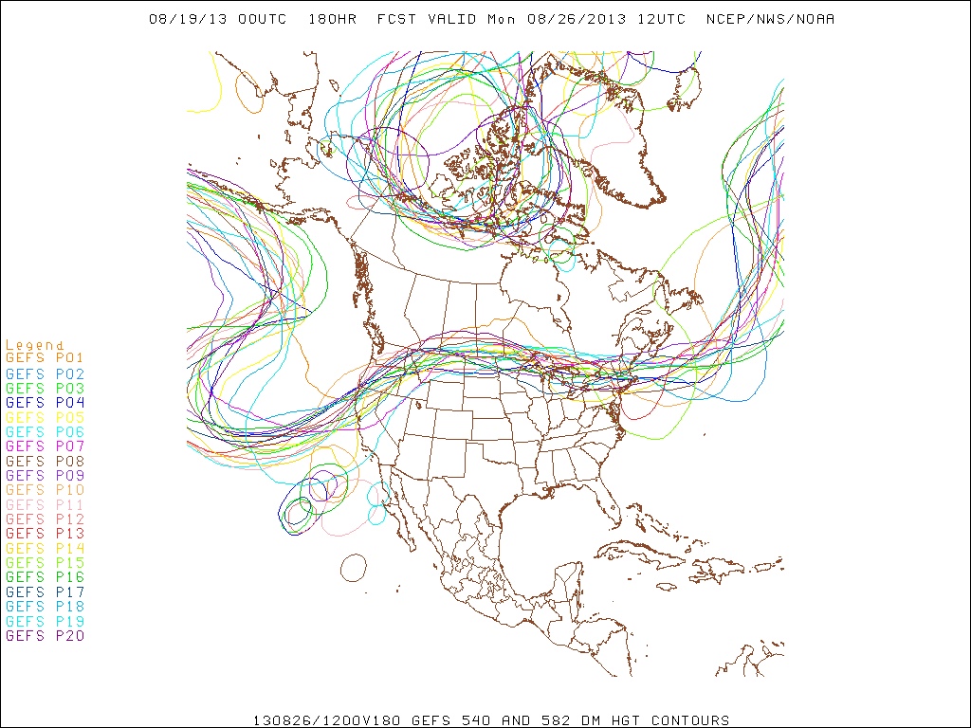

Slide 30
Summary
T/O weather to be similar to climo, with 20-30% chance of showers, peaking 2-3 PM both Wednesday and Friday
Precip pattern moving further west in SEUS on Wednesday than today, though expect AR/MO to still be free of precip and clear. Low puffy clouds are expected.
Upper trough weakens on Wednesday, though still expect southward flow advection into northern part of SEUS
Friday trough retracts further and moves east. Expect rain in SEUS in northern TN and near coast (mostly). Advection from northern smoke largely shut off
NAM conditions are good for both Wednesday and Friday.
Expect ridge to persist and move eastward and persist early next week.

Slide 31
WPC Analyses -- backup

Slide 32
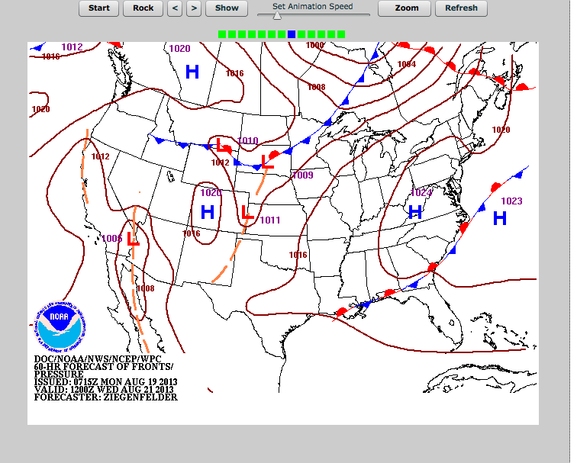

Slide 33
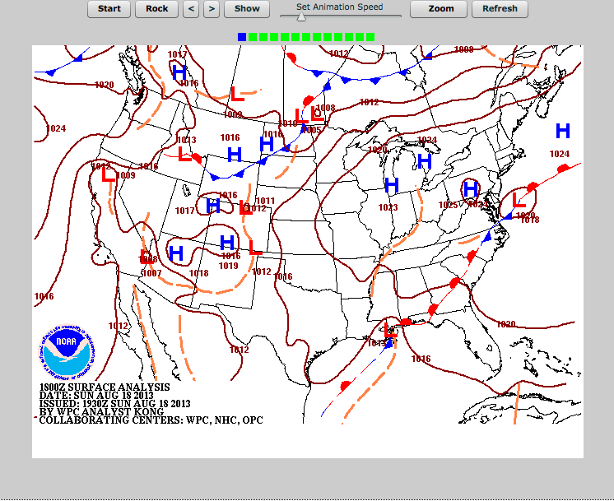

Slide 34
