Slide 1
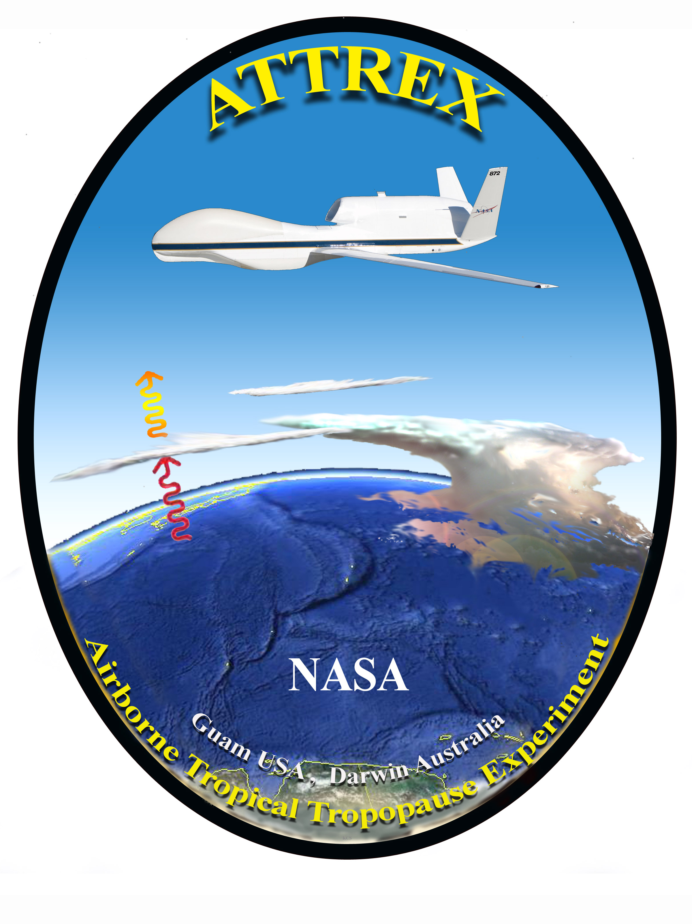
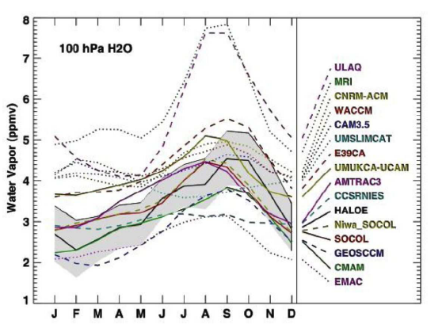
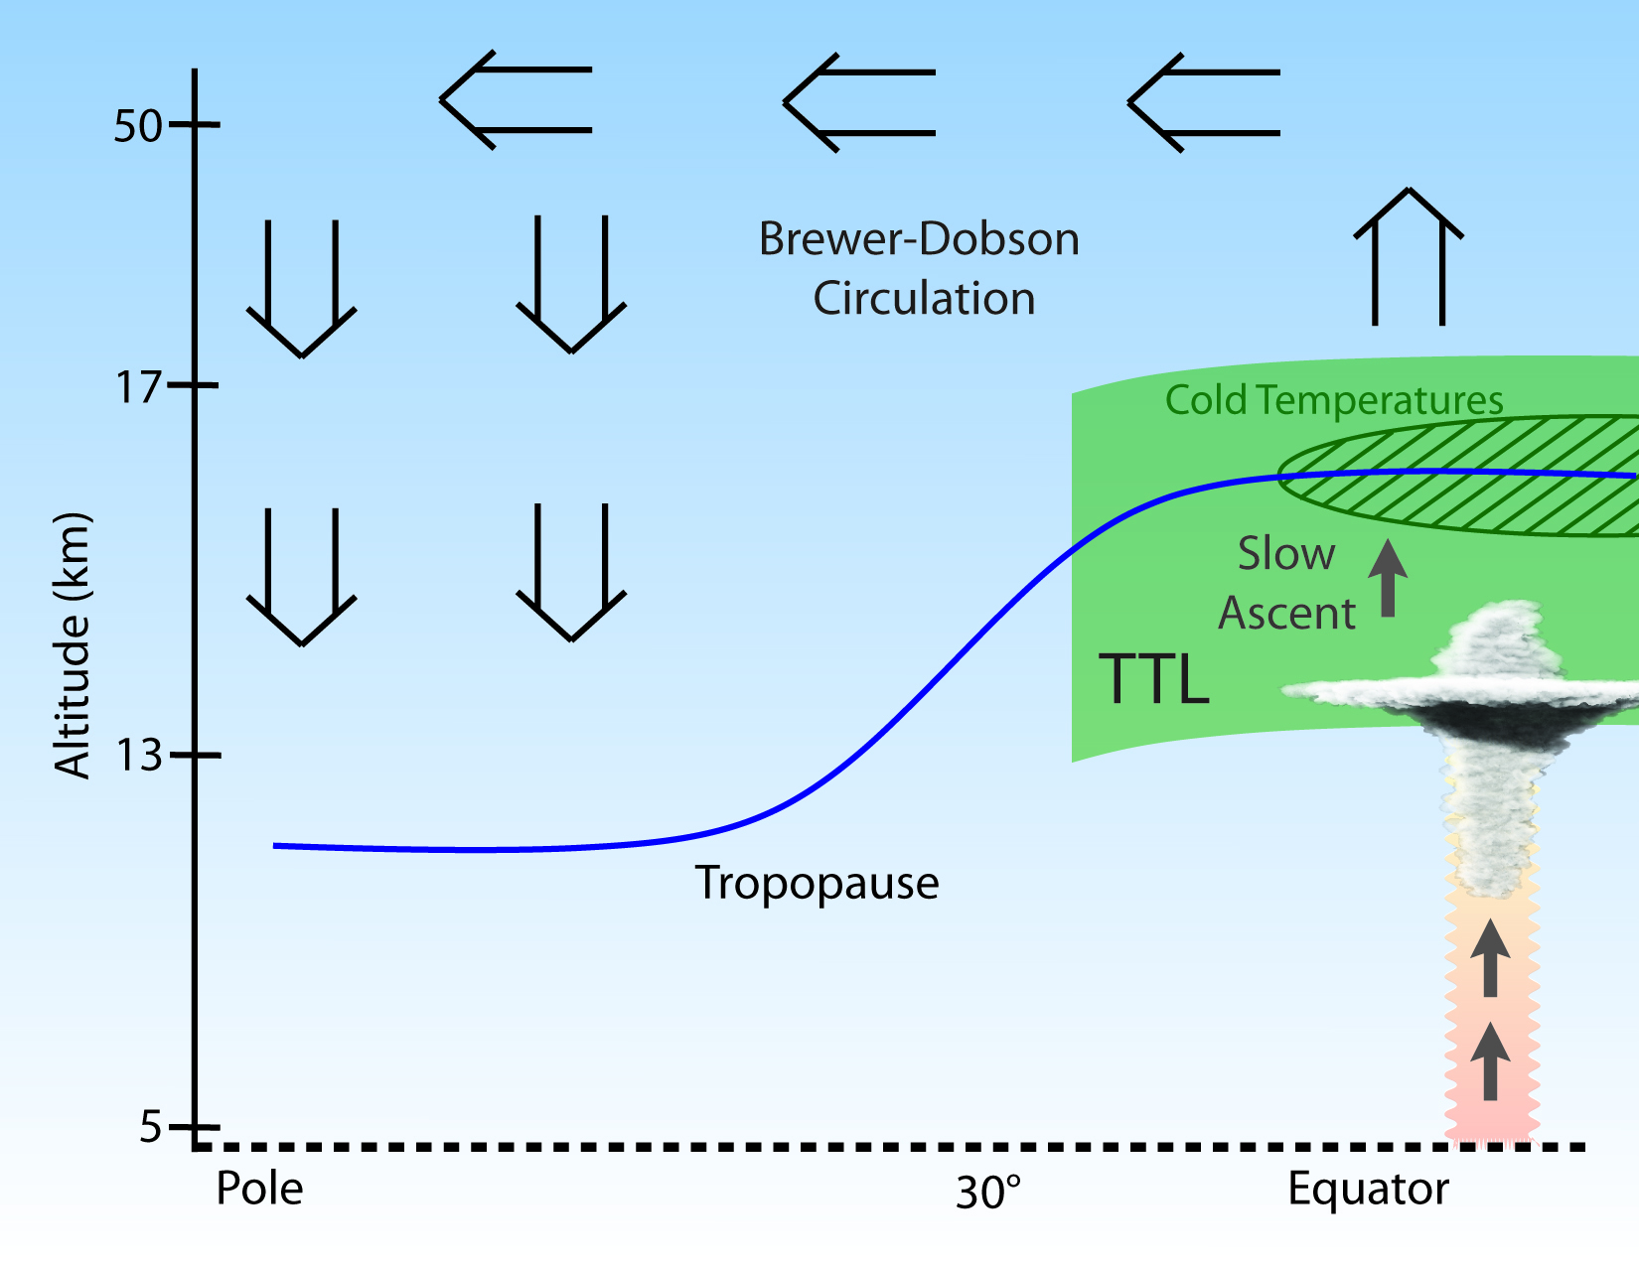
a
b
Water Vapor in the stratosphere (SWV) is important for ozone depletion and climate warming
It is driven by ascent in the tropics through one of the coldest parts of the atmosphere. (a)
Our climate models have great difficulty getting stratospheric water correctly. (b)
I
Notes:
Water Vapor in the Stratosphere is important for climate change and ozone
depletion. Need stratospheric water to better than 1 ppmv.
Our understanding is poor – we cannot model it to the required accuracy
Aircraft are needed because satellites have only a few points in the thin
TTL (4 km), and satellites cannot measure some important quantities (ice
crystal concentrations)

Slide 2
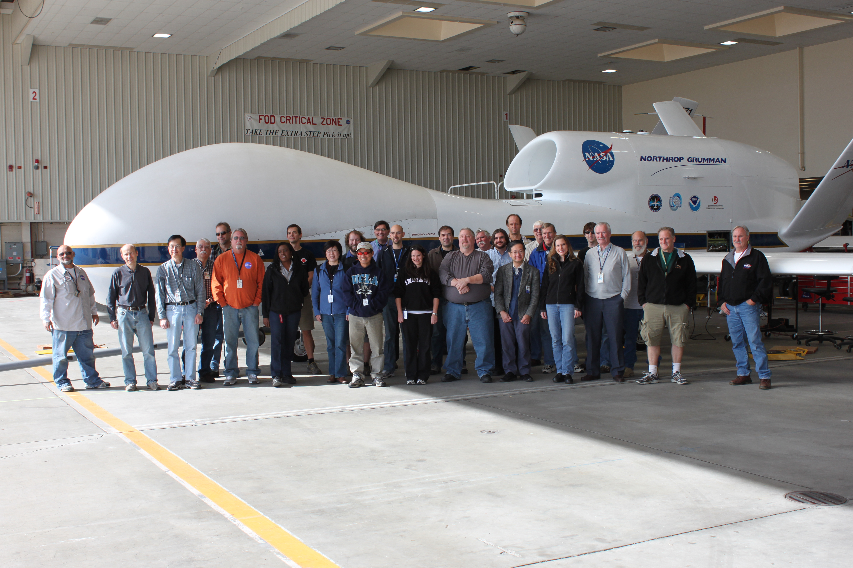
ATTREX spans the Pacific with a long
duration UAV (24 hours flights) and
bases in California and Guam
Notes:
Already have latest results.
Clouds are the vehicle for controlling water vapor, and we can see them and get some useful information from satellites (left)
But, ice number densities and detailed distributions are not possible.
Aircraft data shows this. These are new results. For the first time we are seeing high ice crystal number densities at the top of the tropical troposphere. This is the dehydration mechanism in action.

Slide 3
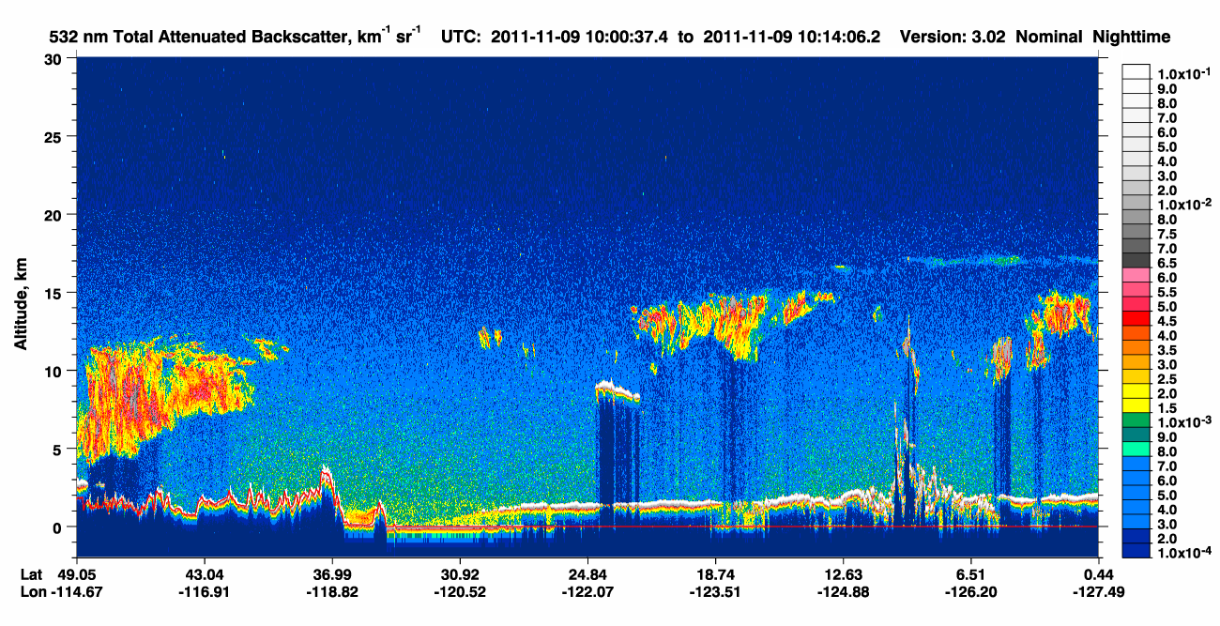
CALIOP Lidar (satellite)
Aircraft obtains data (water and ice particles) in thin
cloud layers that dehydrate air as it enters the
stratosphere. Cannot get this vertical resolution or
the ice particle data from satellites. A key new finding
is the presence of supersaturated air (black curve)
with small numbers of ice particles (red) – implying
additional water “leaking” through the tropopause.
Notes:
Already have latest results.
Clouds are the vehicle for controlling water vapor, and we can see them and get some useful information from satellites (left)
But, ice number densities and detailed distributions are not possible.
Aircraft data shows this. These are new results. For the first time we are seeing high ice crystal number densities at the top of the tropical troposphere. This is the dehydration mechanism in action.

