Slide 1
Briefing, 20130813
Local wx in Houston for tomorrow, Friday
Pattern of convection tomorrow
High cloud forecast for tomorrow

Slide 2
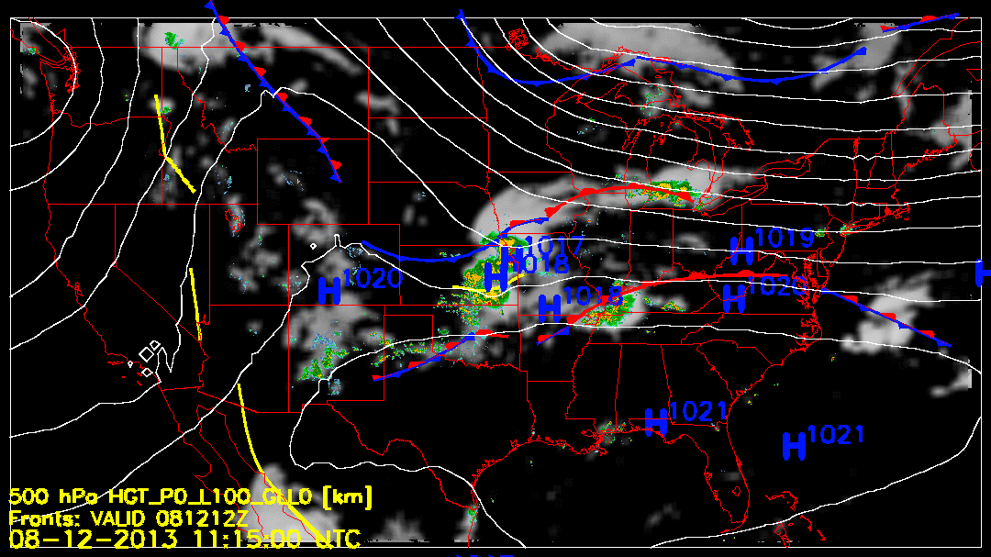

Slide 3
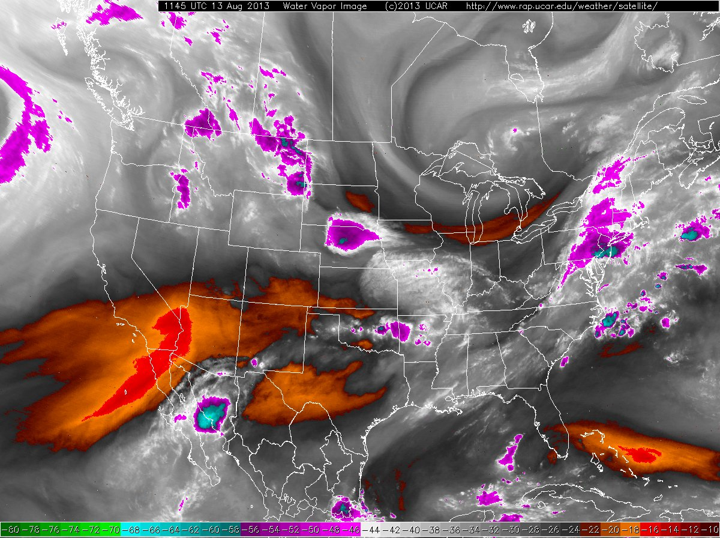

Slide 4
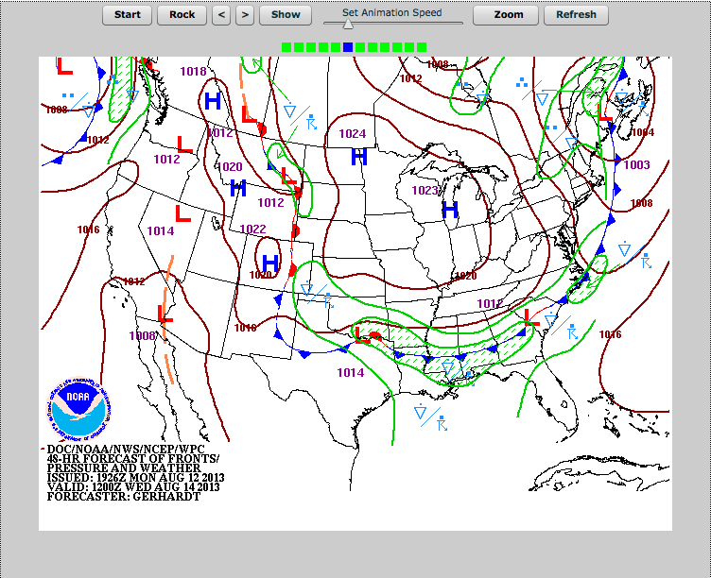

Slide 5
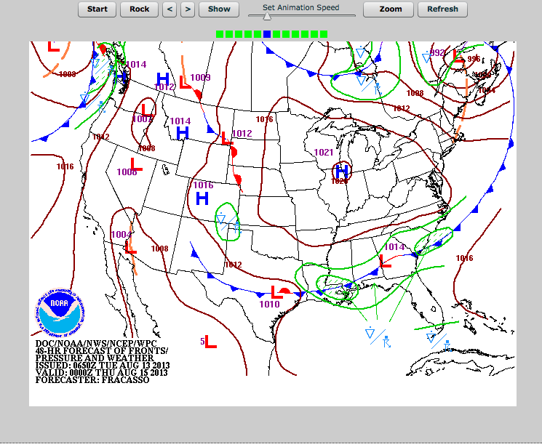
Front moving south faster than previously forecast (this was apparent in some
12Z models yesterday), leading to 20% chance of T-showers tomorrow. This
will be concentrated late (post 4 PM) in the day.

Slide 6
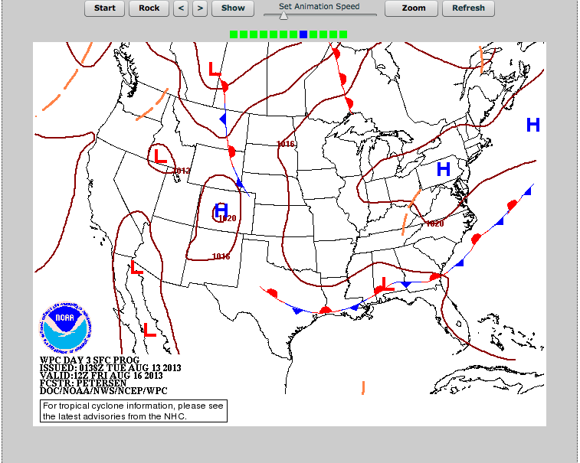
Front is still present over us on Friday, 20% chance of T-storms.

Slide 7
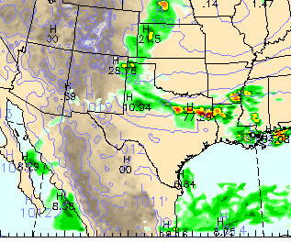
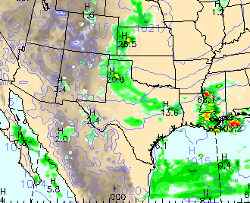
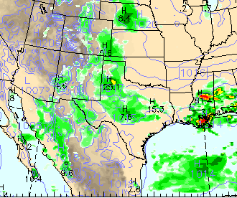
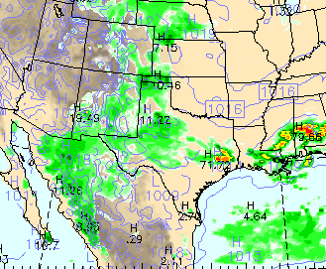
12Z Wed (7 AM)
18Z
21 Z
0Z Th

Slide 8
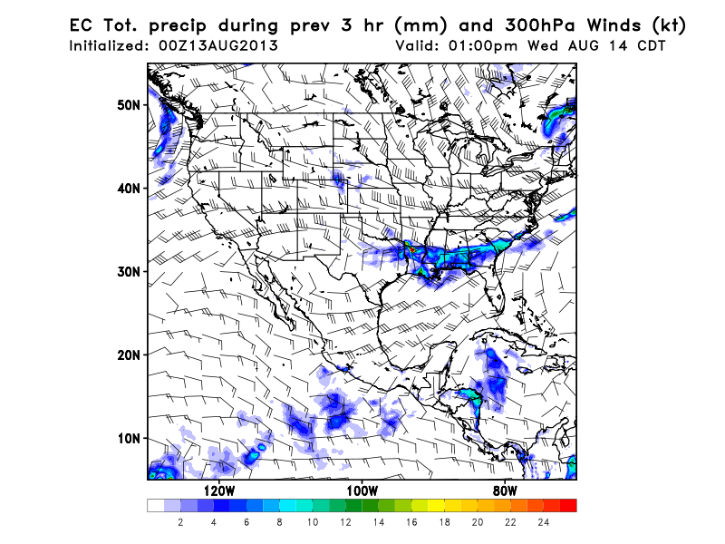
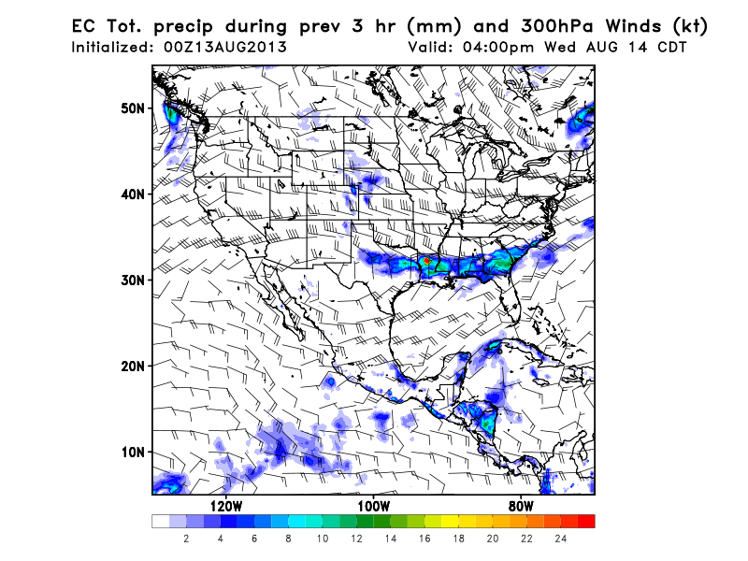
Convection on Wednesday
Emphasis on precip is over LA/AR, but some to the east along front. Previous times
do show the “bending” of the region of precip in vicinity of developing low over NE TX.
Following charts show convection in NCAR WRF through the day. Note that all the models
I looked at (NCAR WRF, FSU WRF, GFS, EC, and NAM) initialize precipitation quite well (12 hr
forecast)

Slide 9
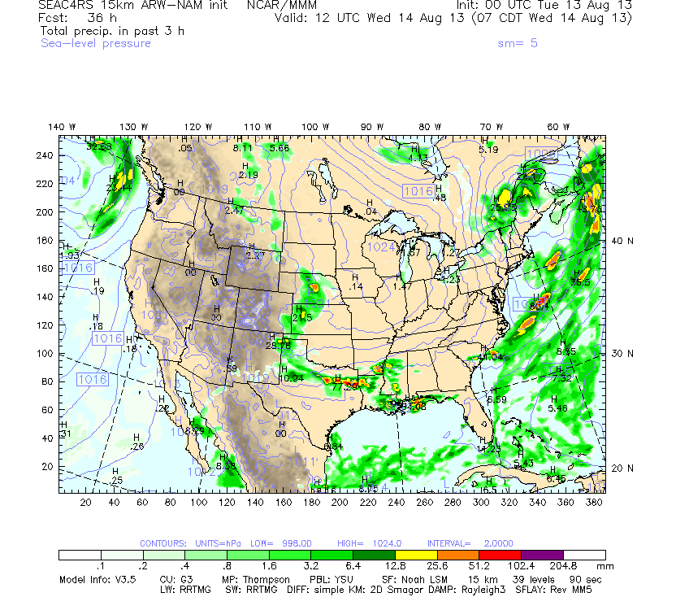

Slide 10
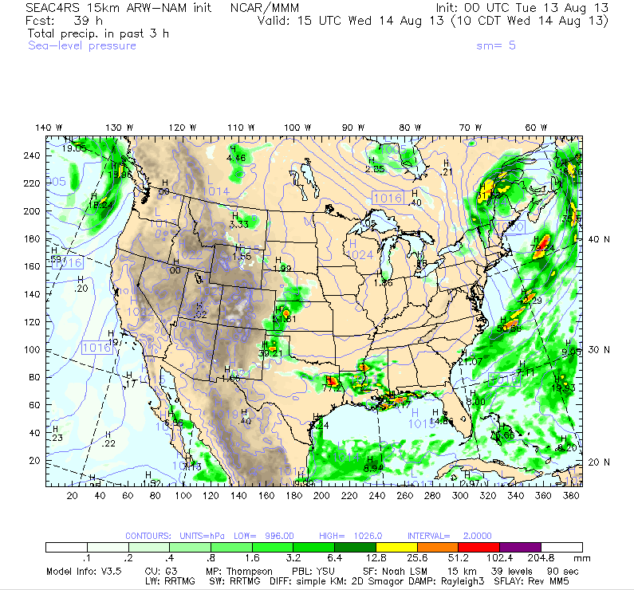

Slide 11
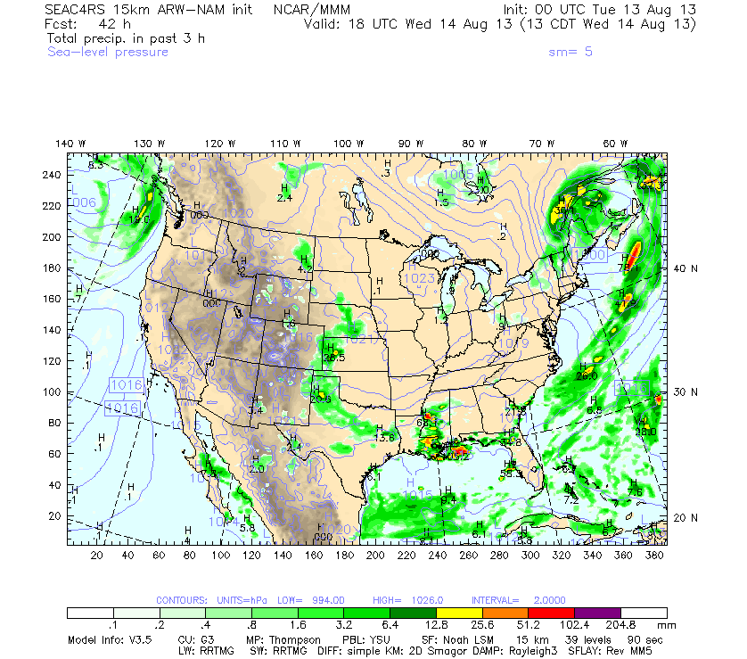

Slide 12
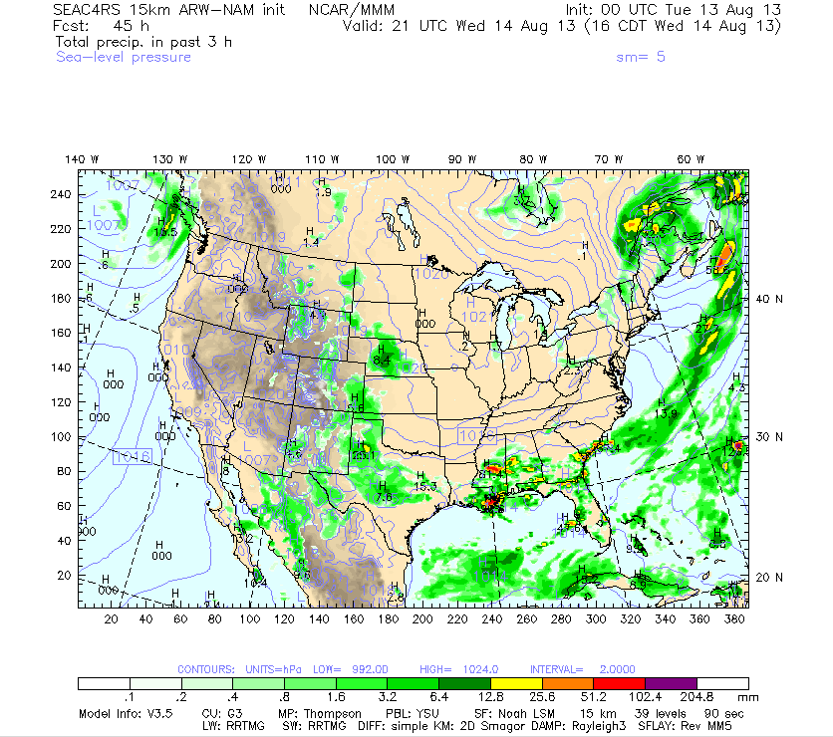
Precip spreads east of MS by 4 PM. Note the strong high

Slide 13
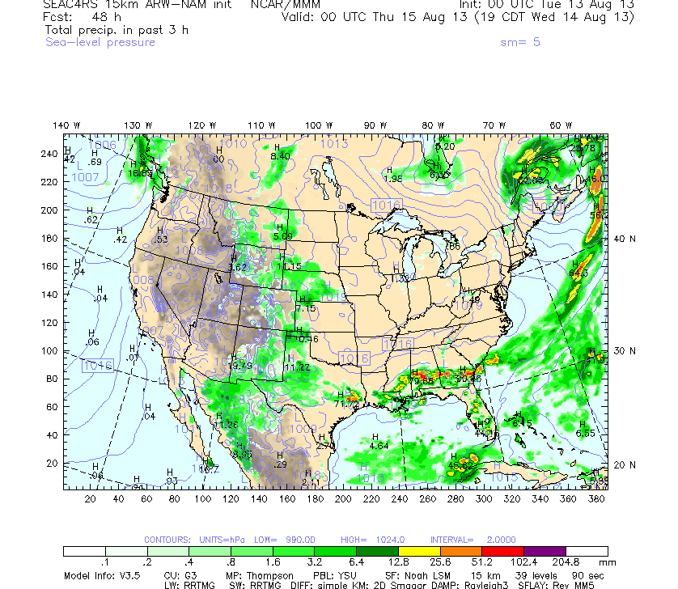

Slide 14
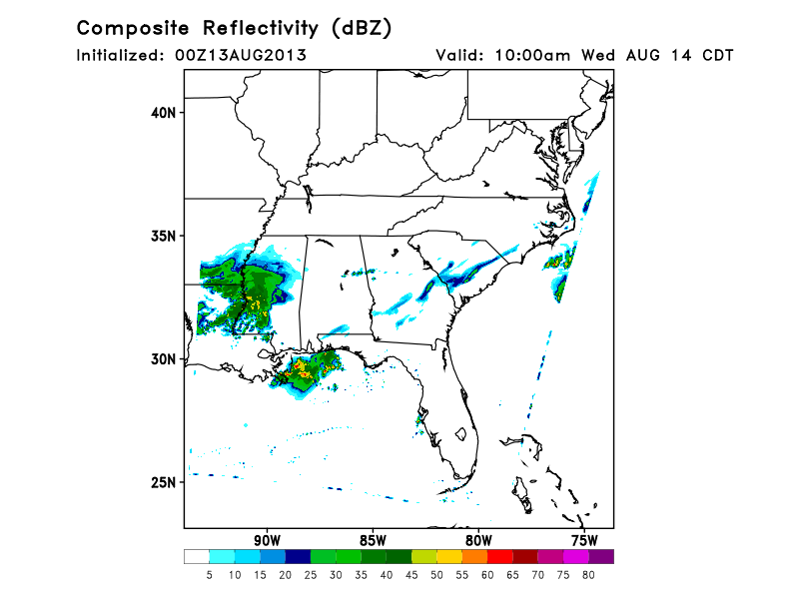
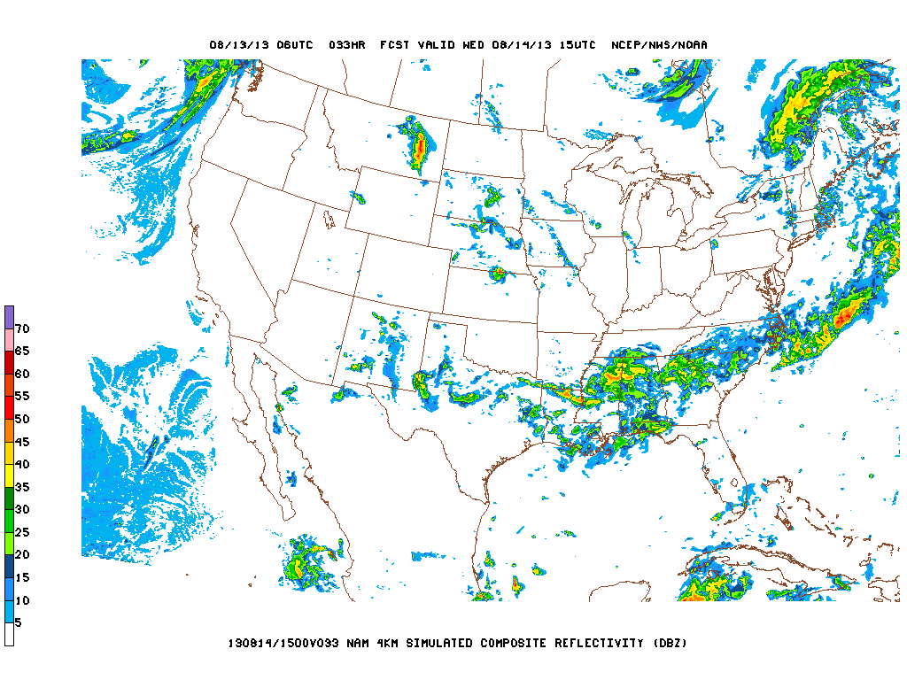
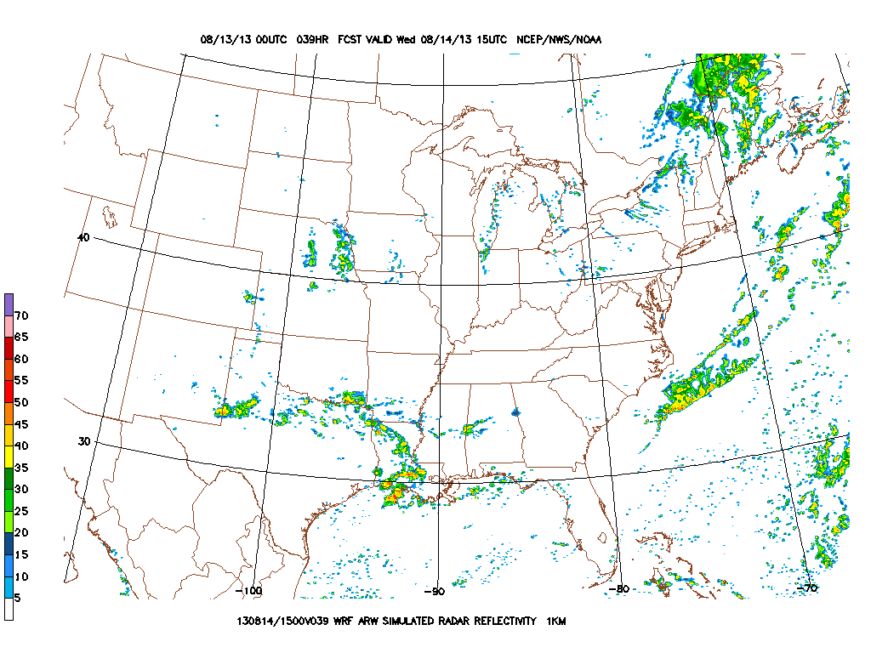
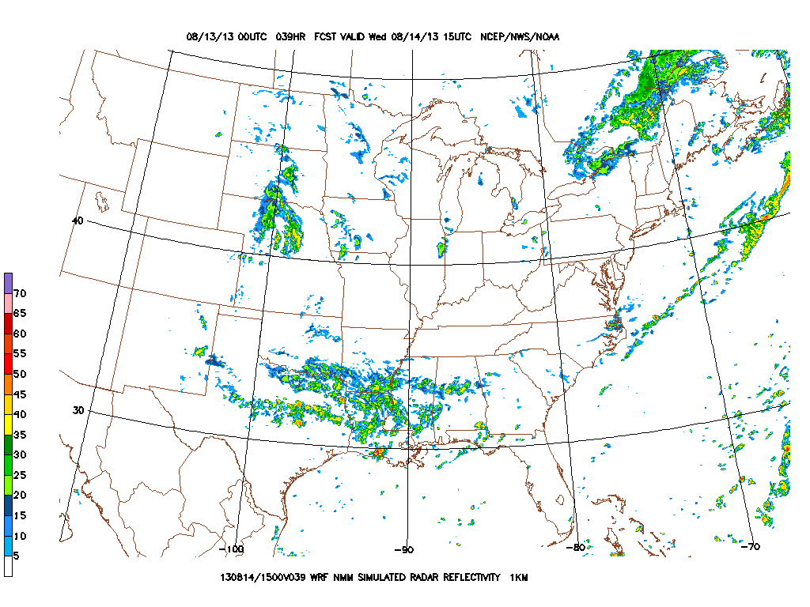
These are all consistent,
except for NAM HIRES
NAM Hi-Res
FSU WRF
High-Res Models: 10 AM CDT
NCEP WRF-ARW
NCEP WRF-NMM

Slide 15
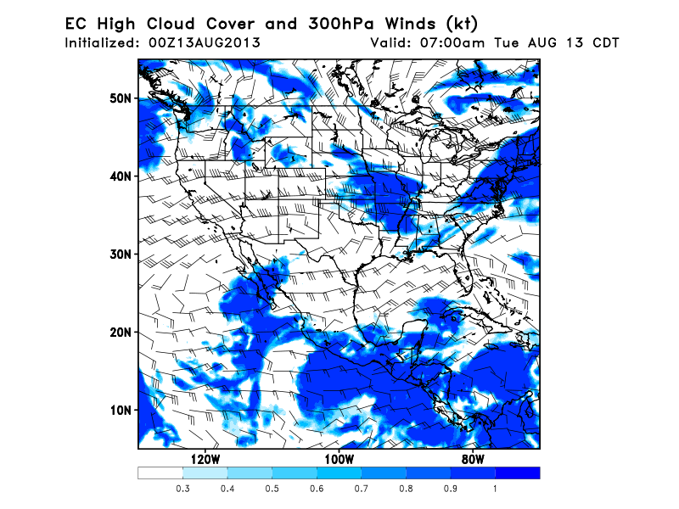
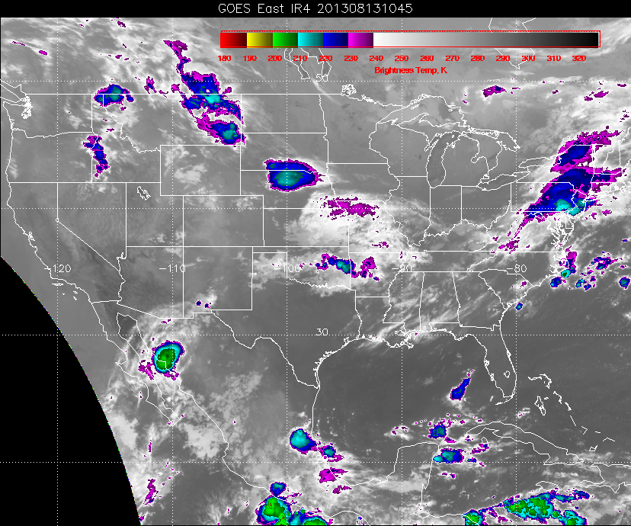
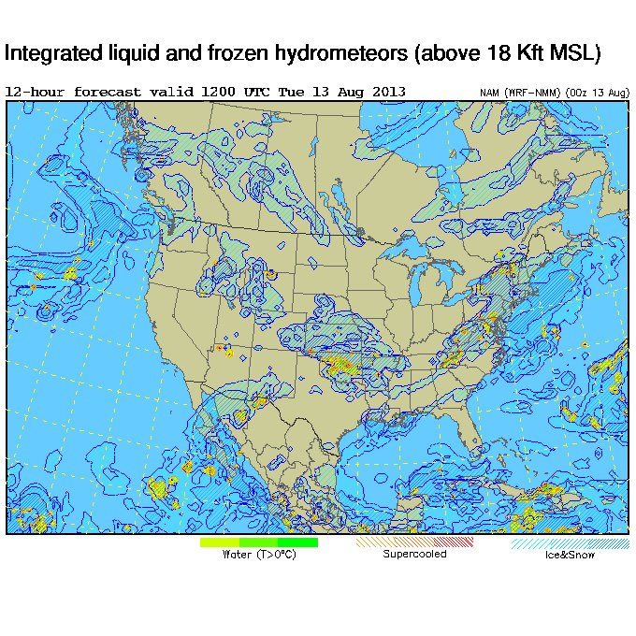
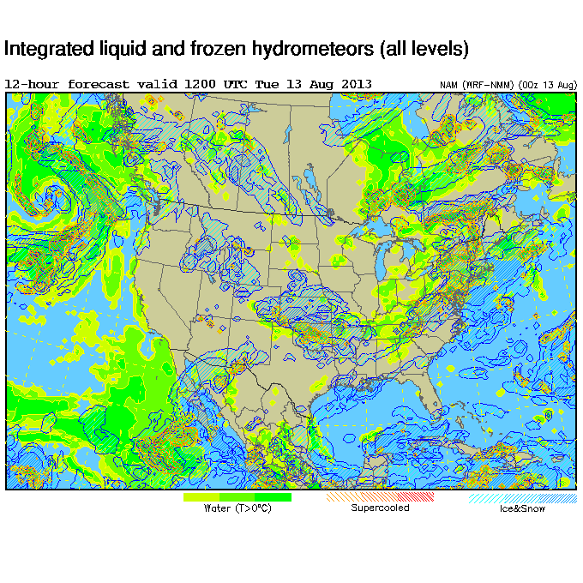
EC is underpredicting thin stuff
Conclusion: Models UNDERpredict, except GFS in the tropics; WRF models seem to have the most trouble

Slide 16
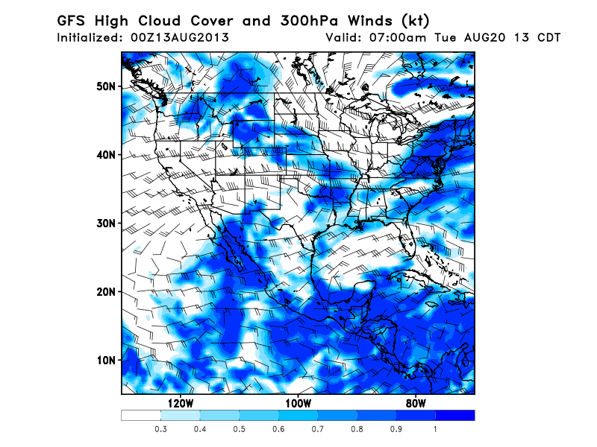
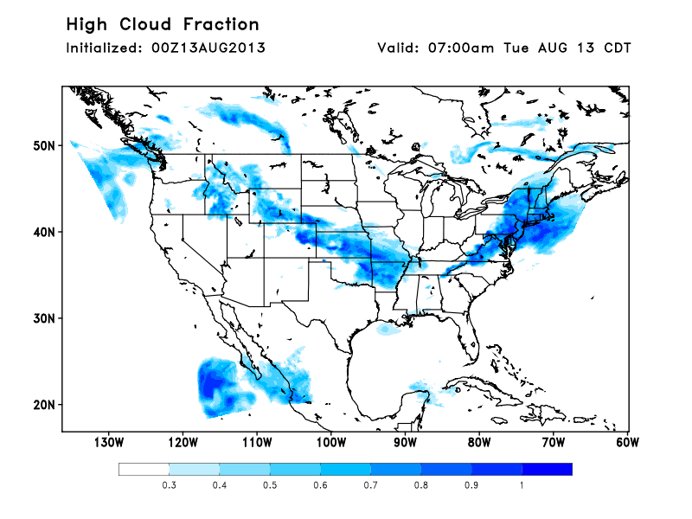
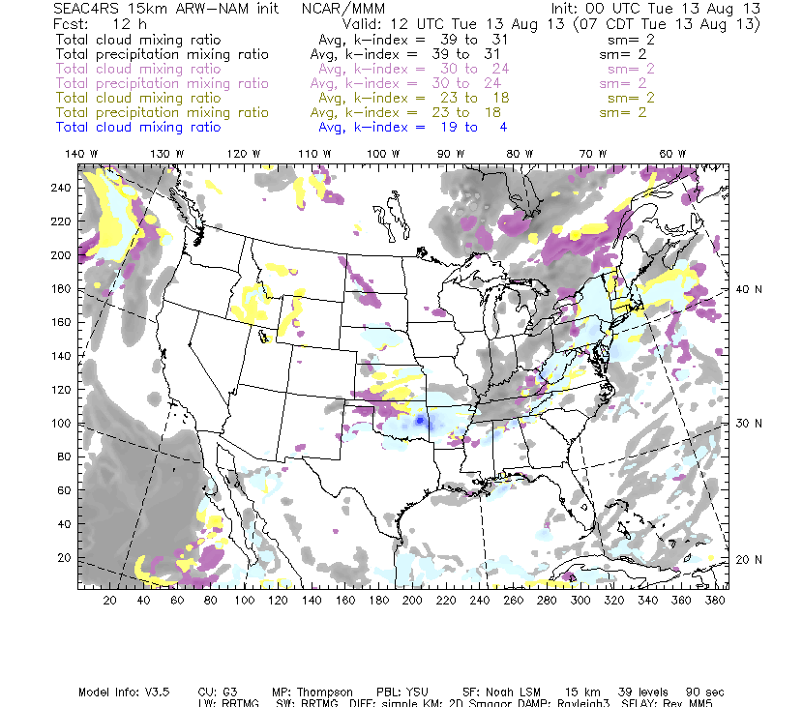

Slide 17
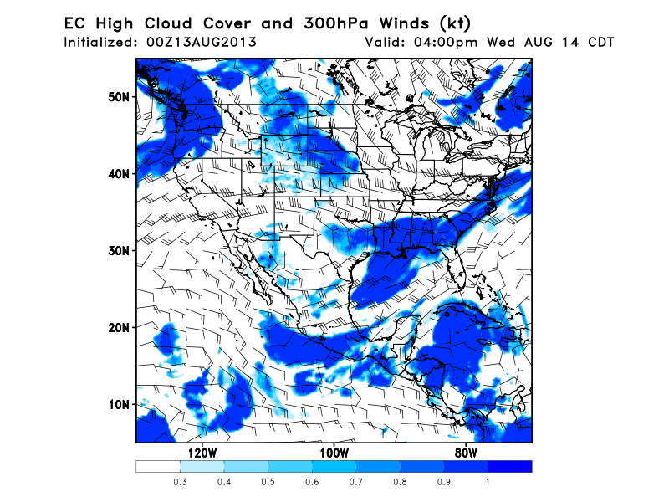
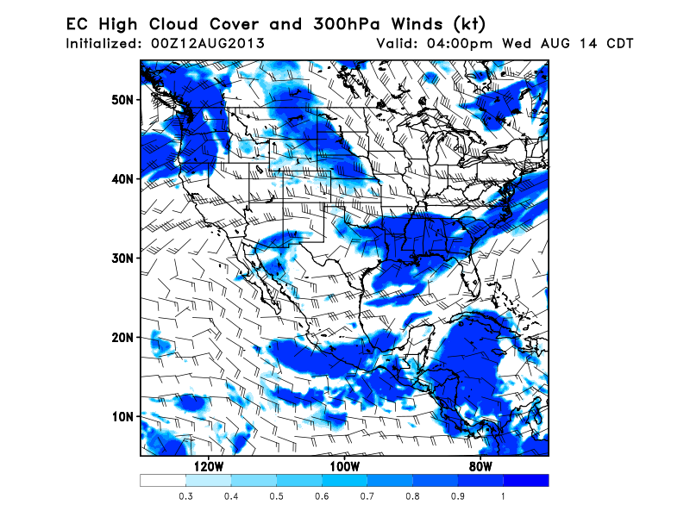
Today’s forecast (above), yesterday’s (right).
More southward movement of front leads to
reduced chances of high cloud. Note MCS’s
that can occur upstream may create cirrus
streamers.

Slide 18
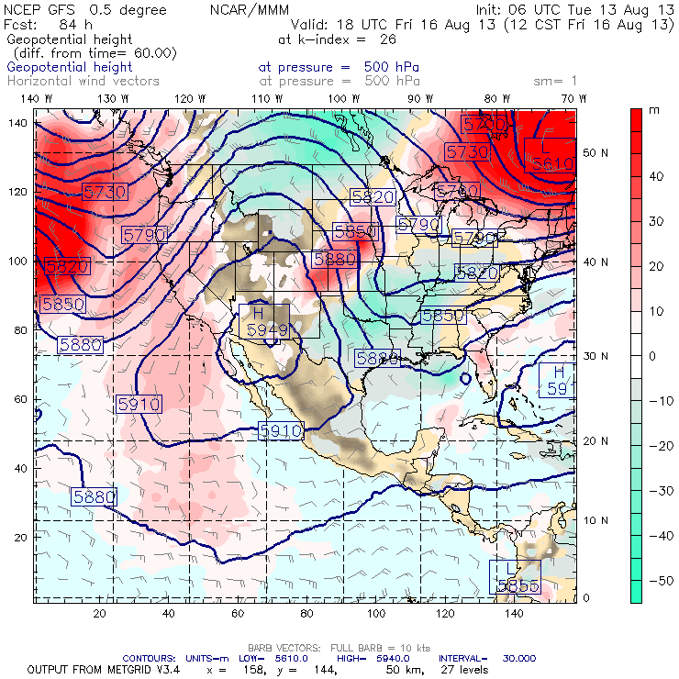

Slide 19
Backup

Slide 20
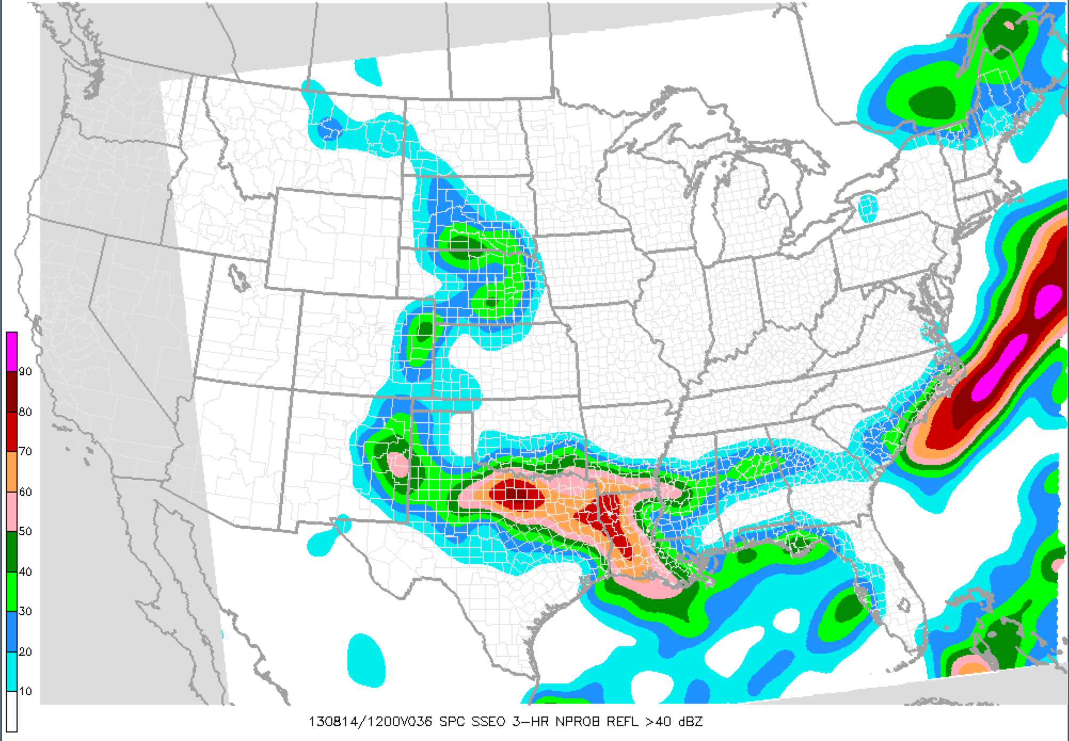
High-res ensemble: Probability of seeing 40 dBZ reflectivity at 7 AM CDT

Slide 21
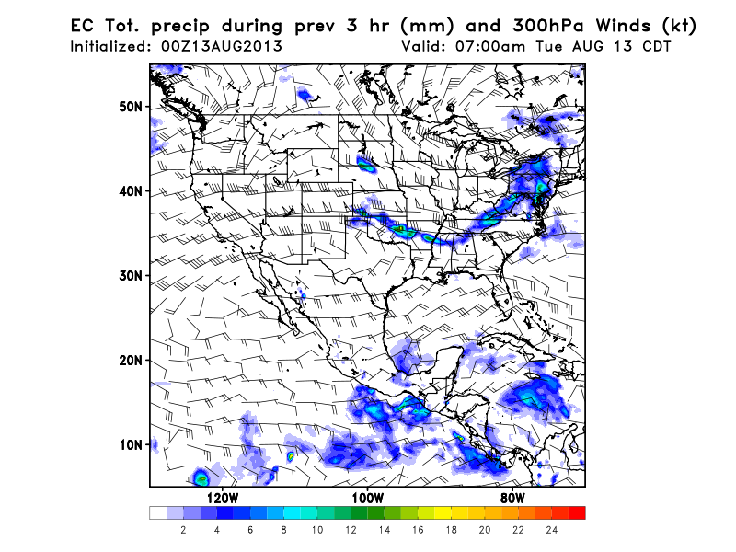
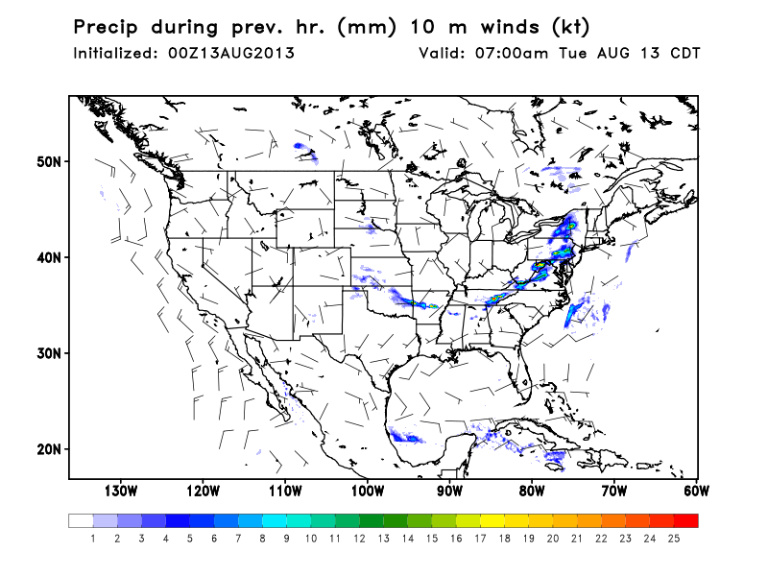
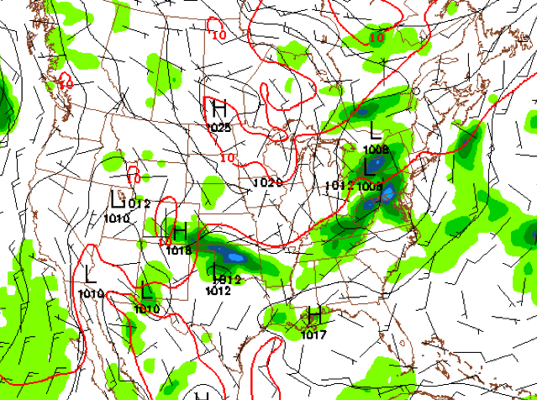
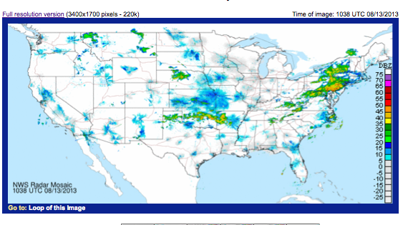
FSU WRF
Current precip (12Z) and 0Z forecast models
NAM

Slide 22
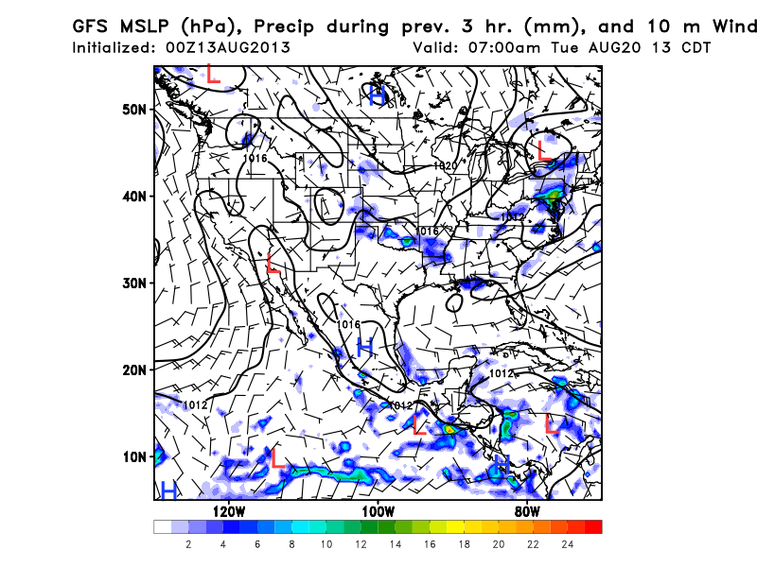
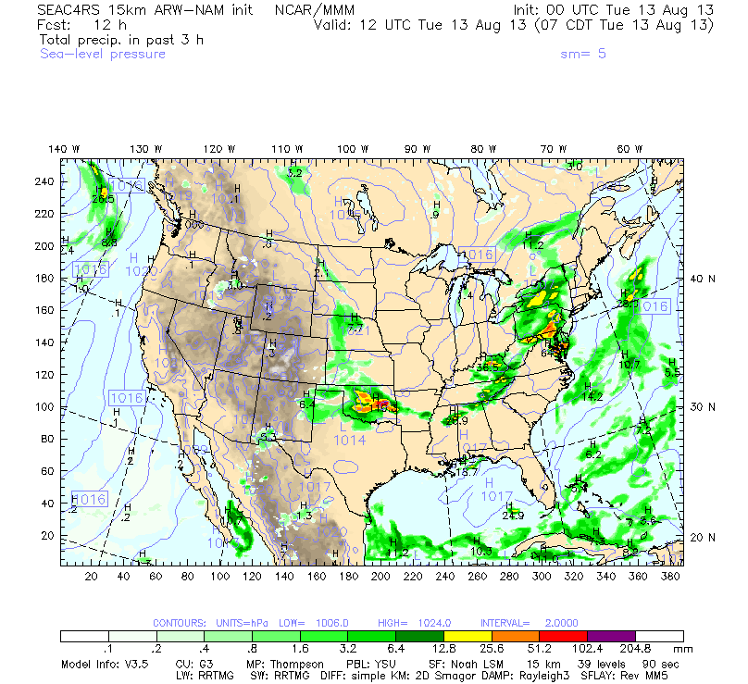
0Z models predict 12 Z
precip well.

