Slide 1
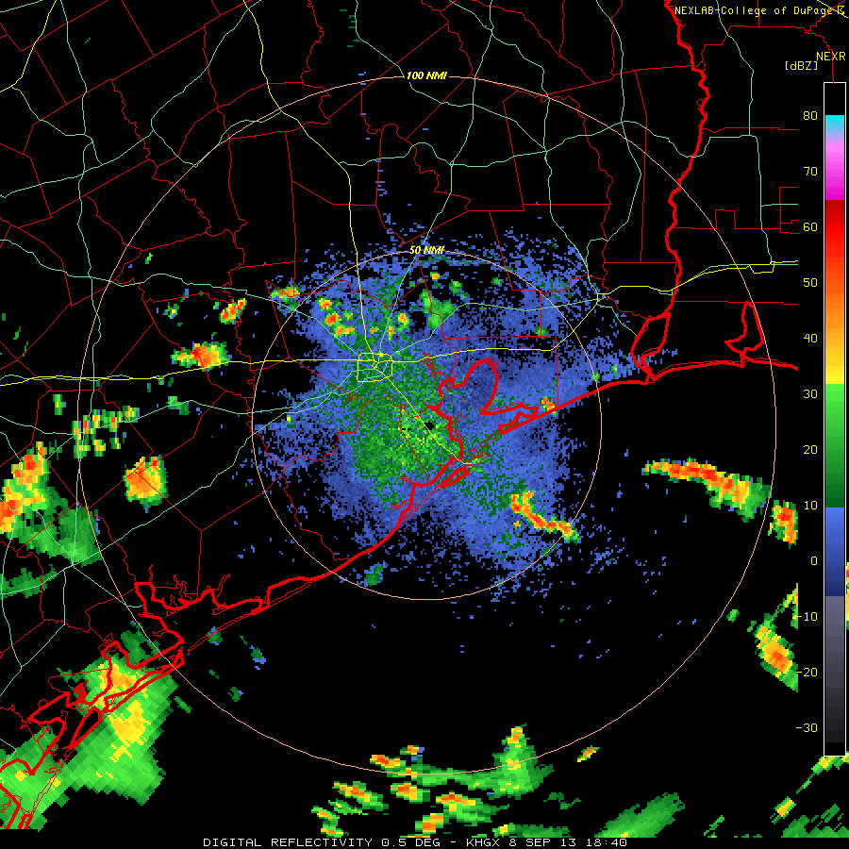

Slide 2
Weather discussion
8 September 2013
Jim Bresch NCAR/MMM
and the SEAC4RS Met team
Overview: Dominant ridge moves eastward while northern stream becomes active and eastern trough hangs tough.
Forecast issues are:
Clouds, temperatures, and precip over SEUS.
Gulf convection
Weather at Ellington
Extended outlook

Slide 3
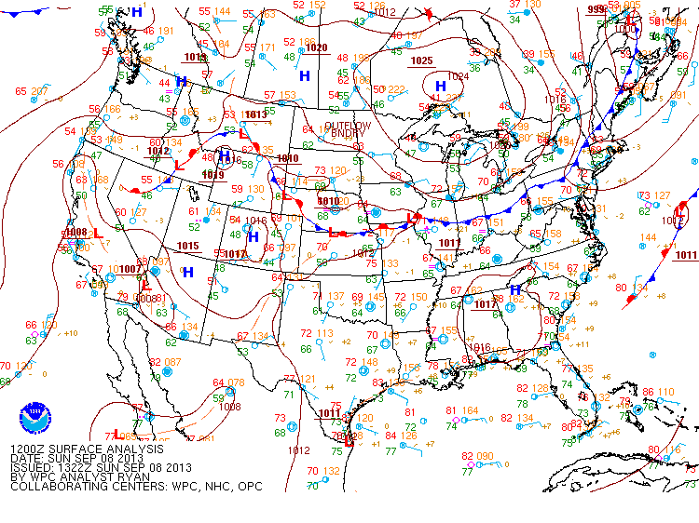

Slide 4
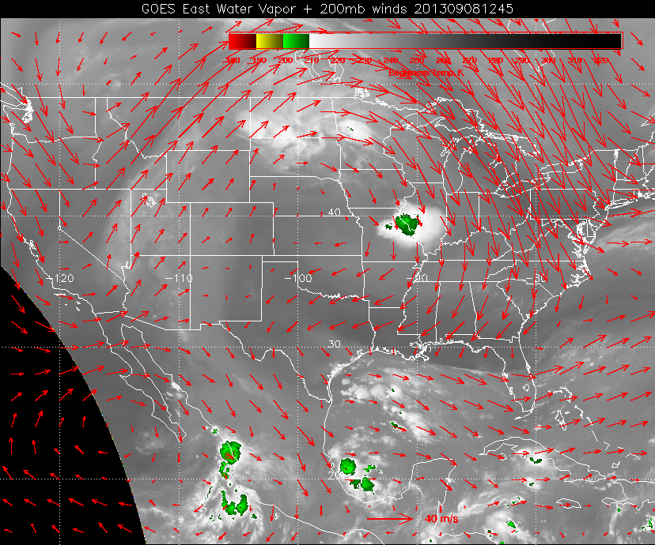

Slide 5
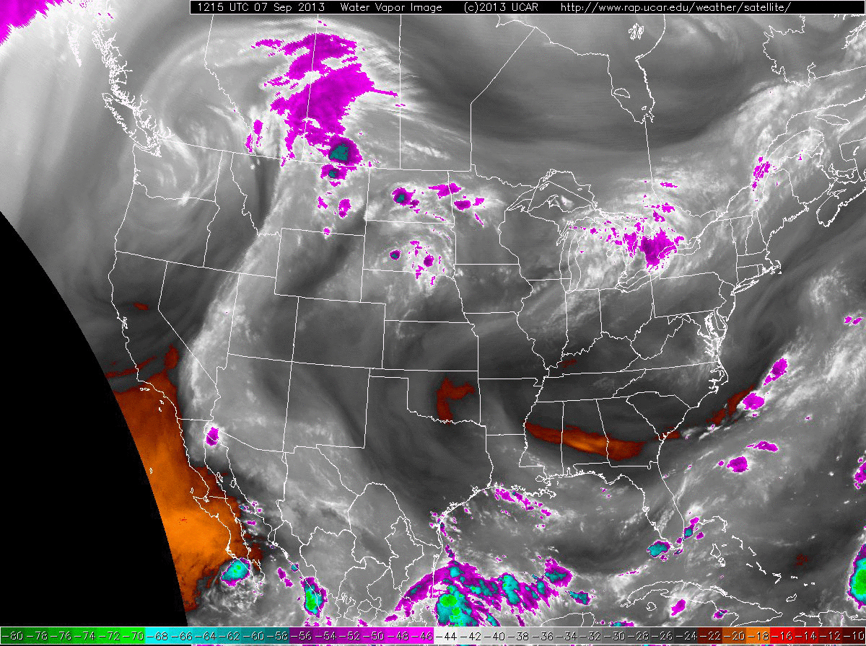

Slide 6
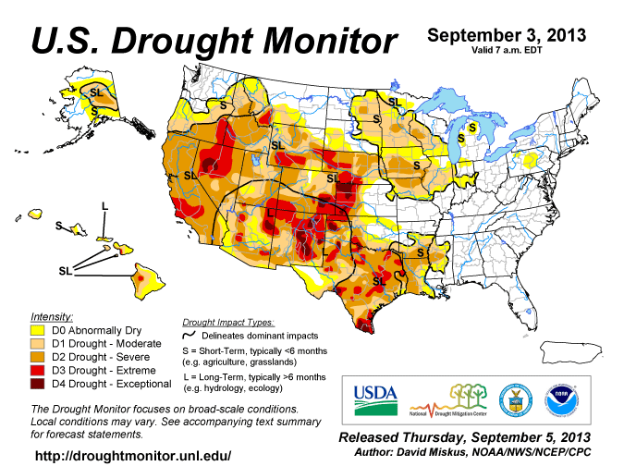

Slide 7
Monday forecast

Slide 8
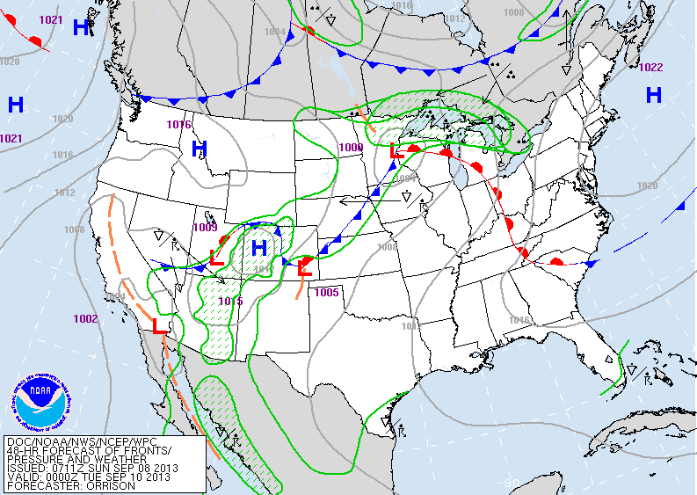
Notes:
Front races north across MO on monday

Slide 9
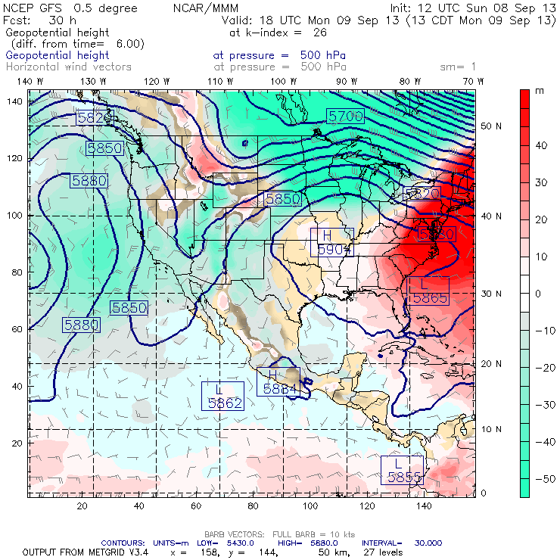
500 mb height

Slide 10
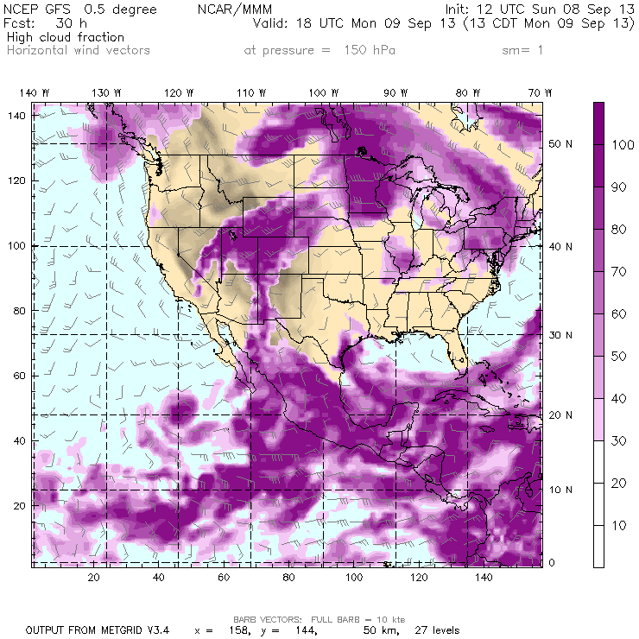

Slide 11
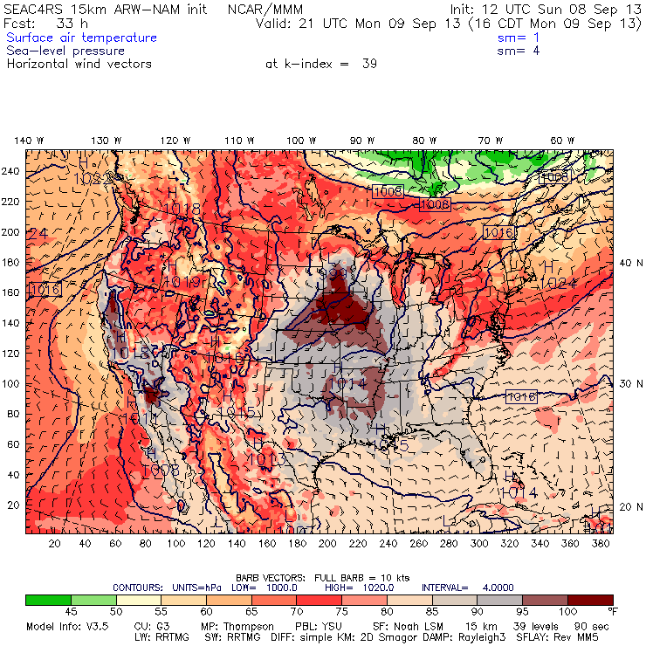

Slide 12
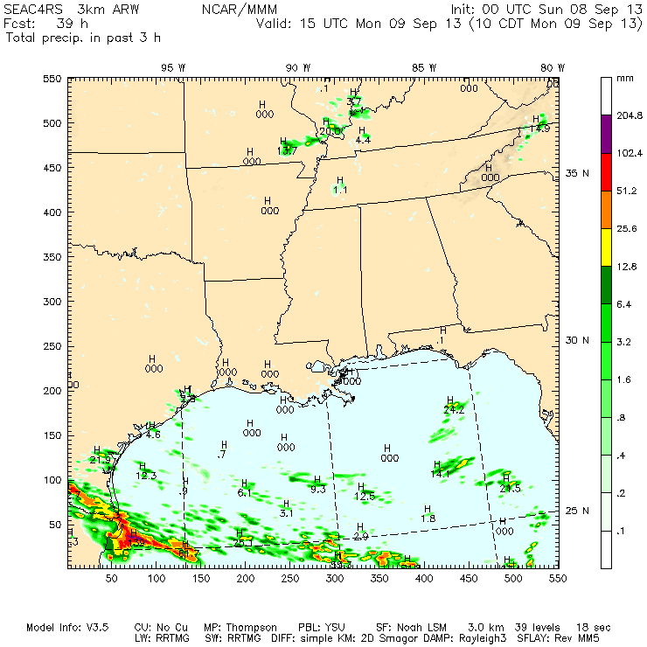
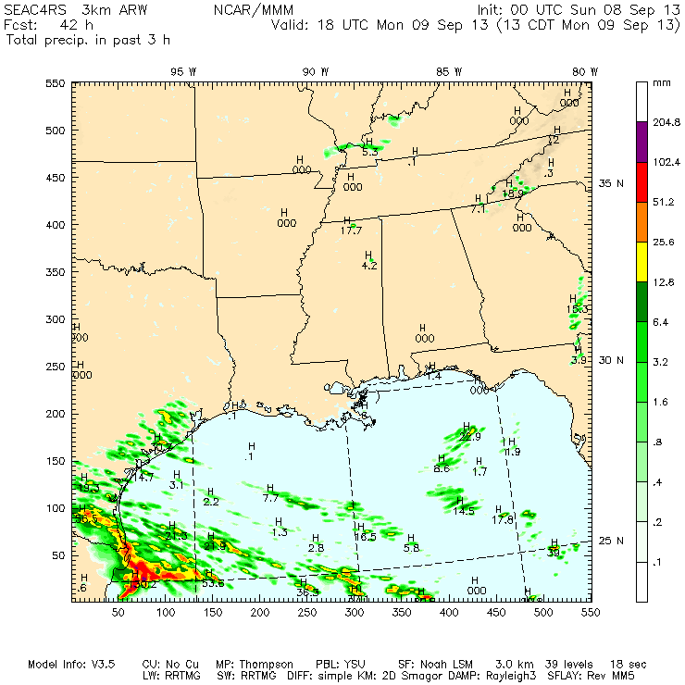
3-km NCAR WRF-ARW shows convective rain from Galveston Bay southwestward to Brownsville.

Slide 13
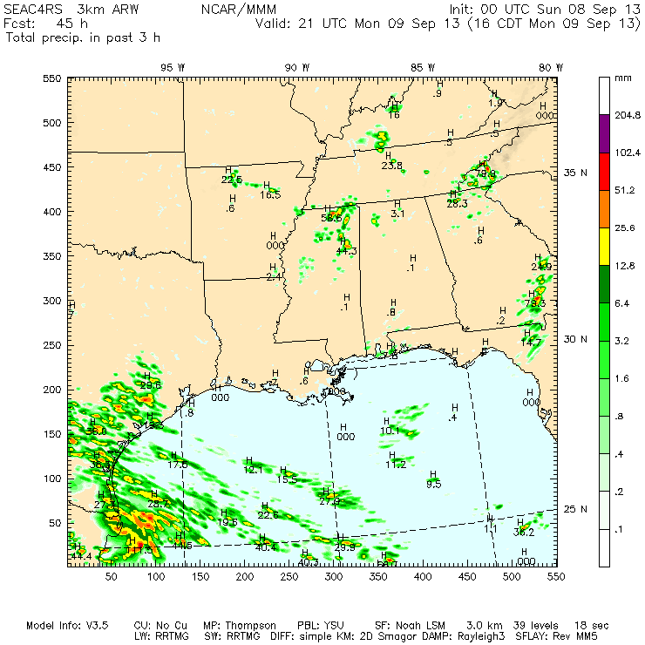
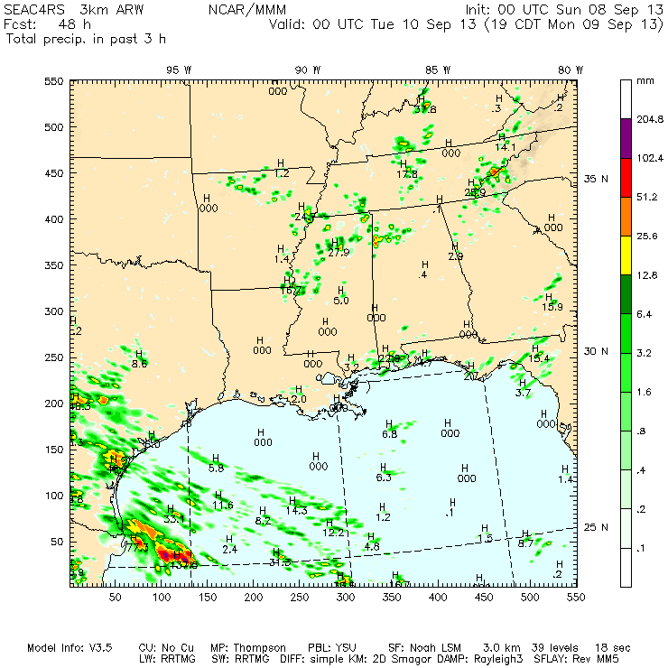
Bands of convection continue over the southwestern Gulf during the afternoon. (No cyclonic curvature noticeable)

Slide 14
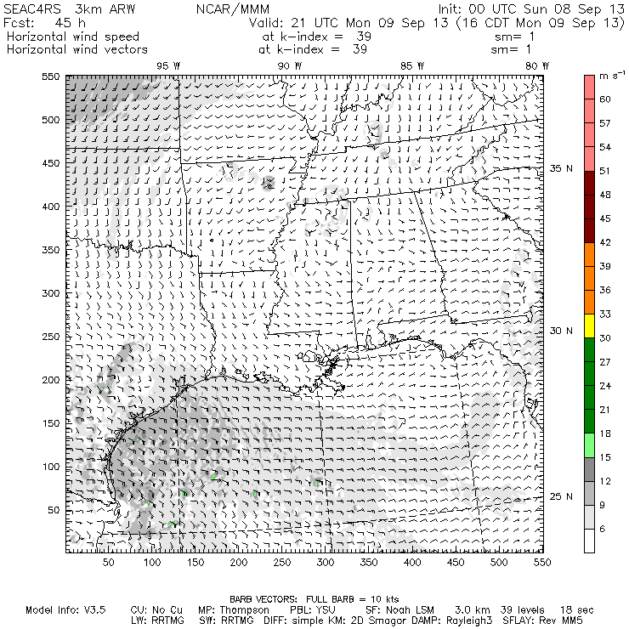
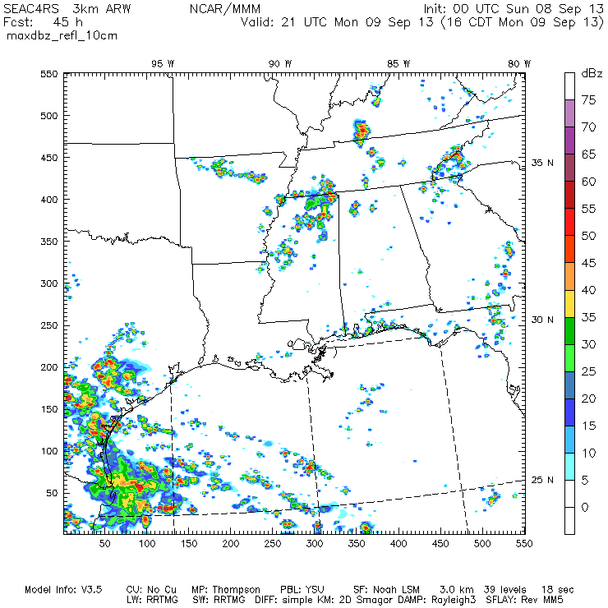
Surface winds Reflectivity

Slide 15
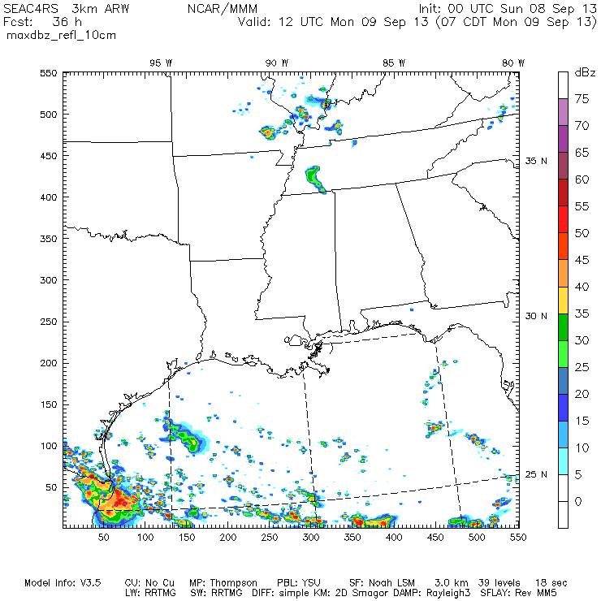

Slide 16
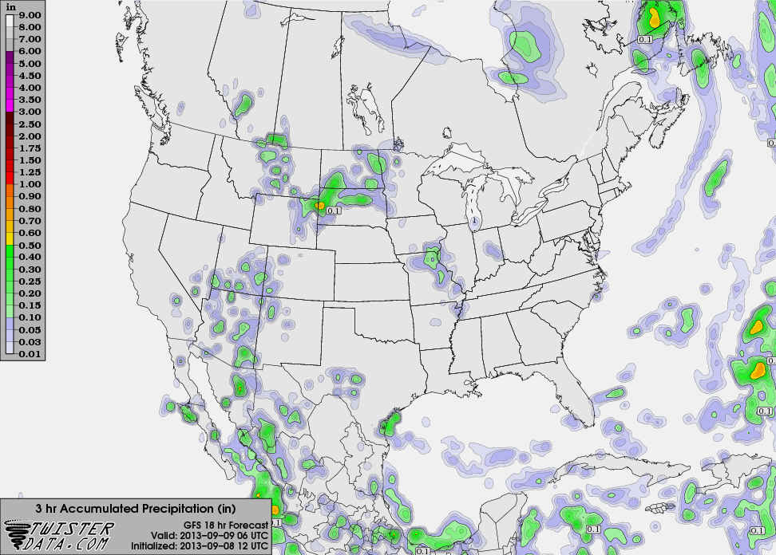
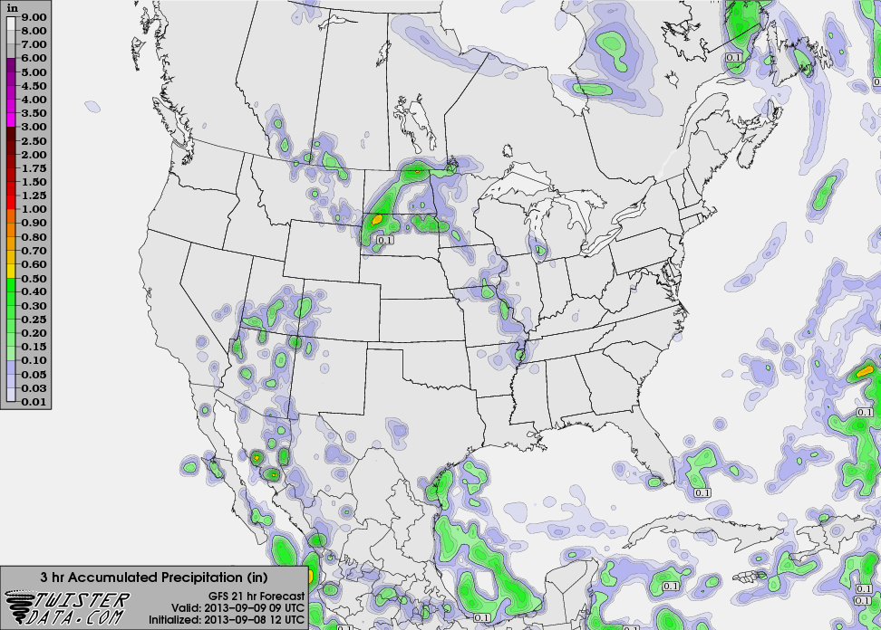
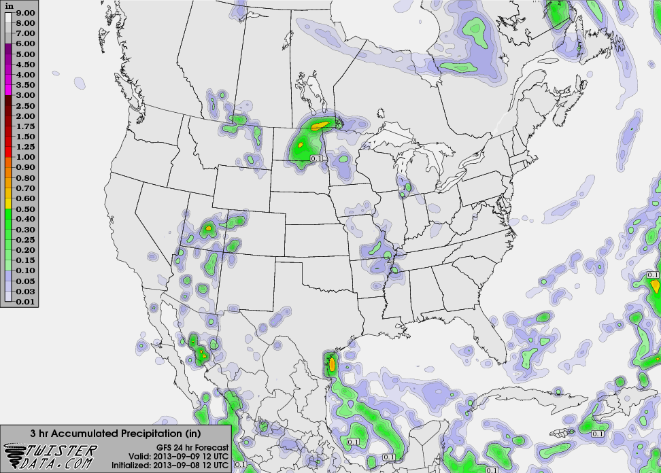
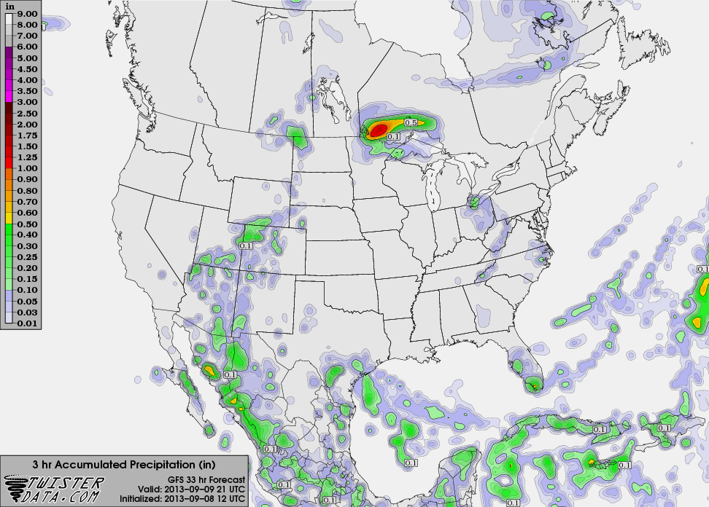
1 AM CDT
4 AM CDT
12 UTC GFS
7 AM CDT
4 PM CDT

Slide 17
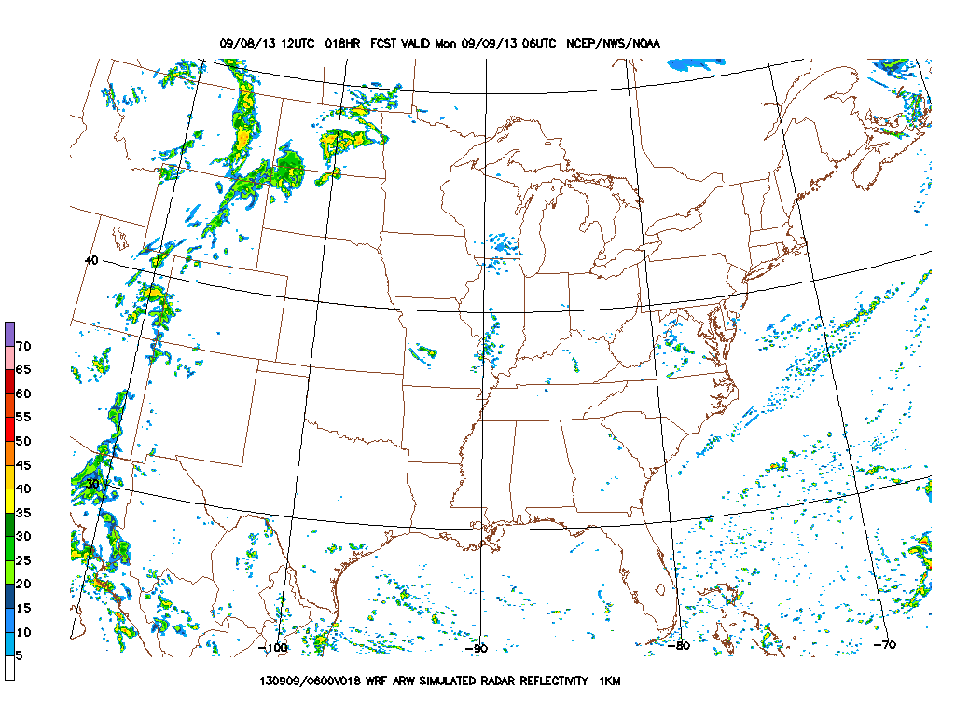
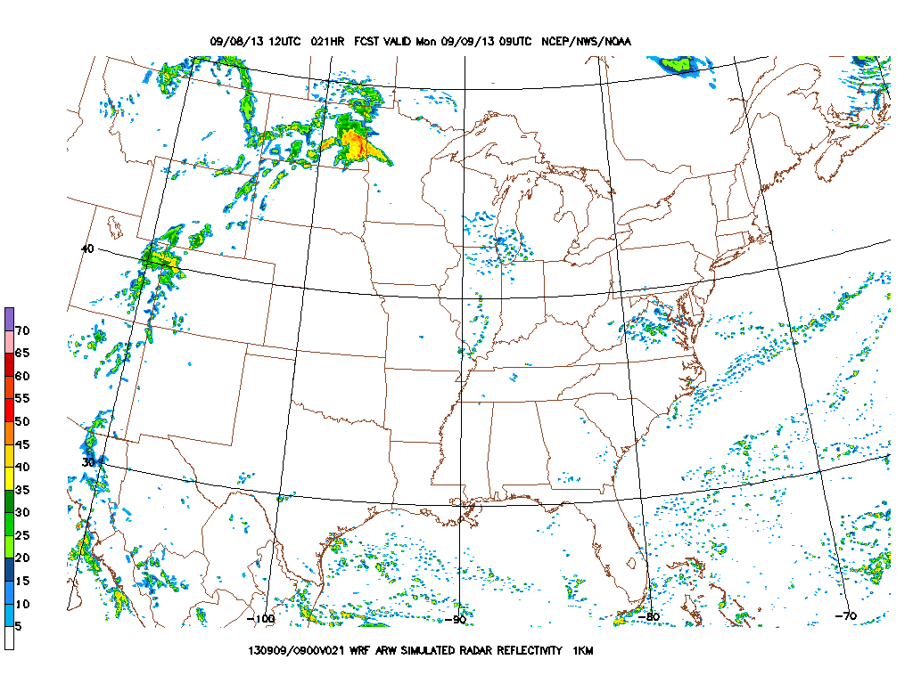
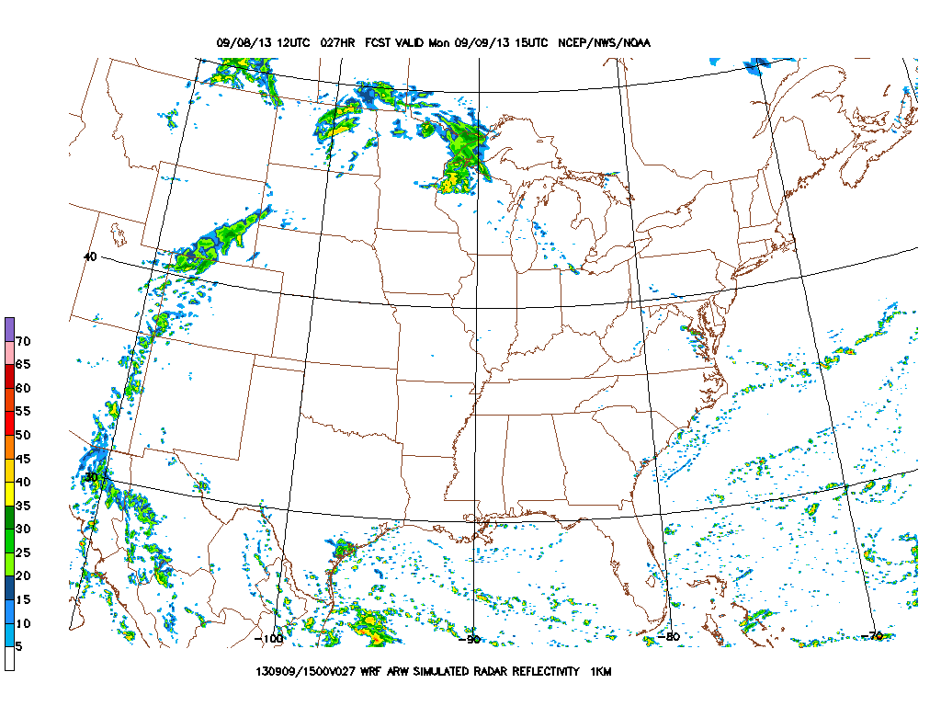
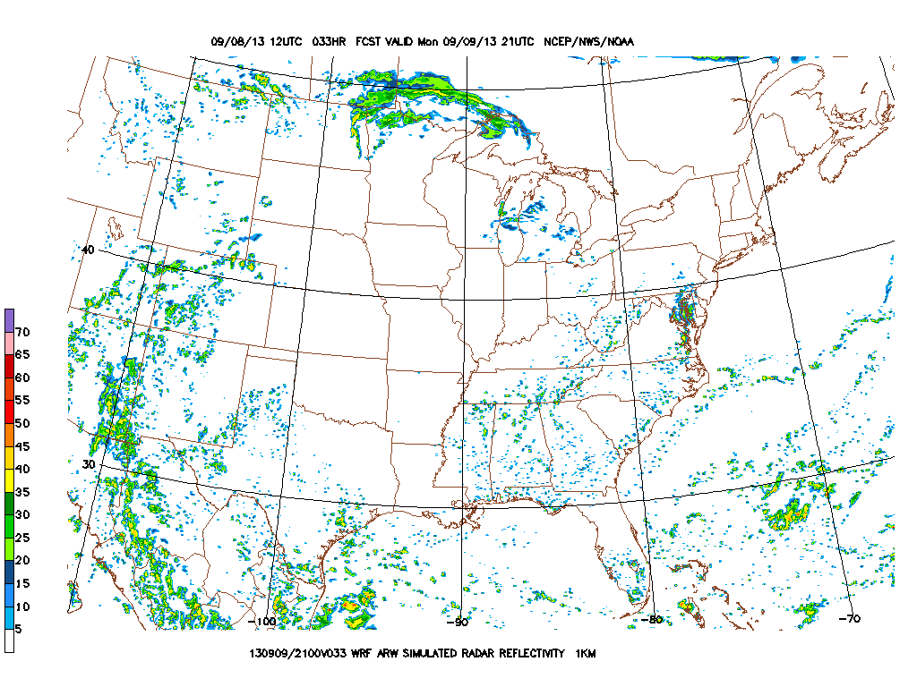
1 AM CDT
4 AM CDT
12 UTC WRF ARW
7 AM CDT
4 PM CDT

Slide 18
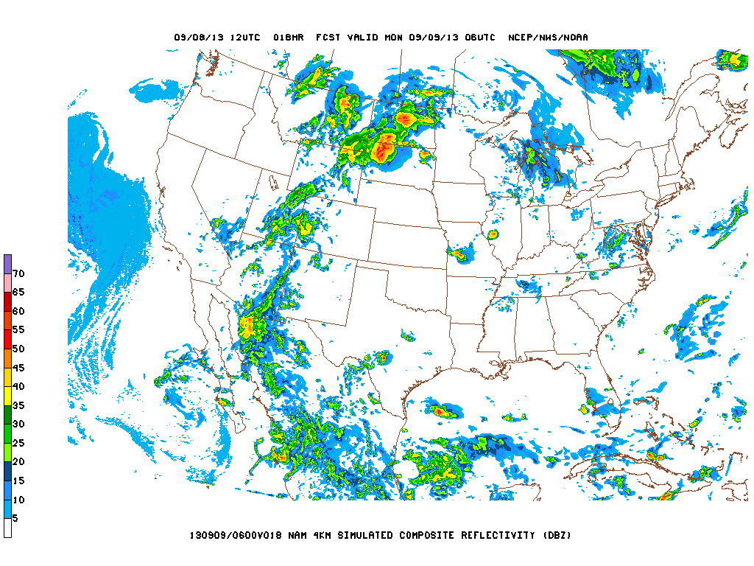
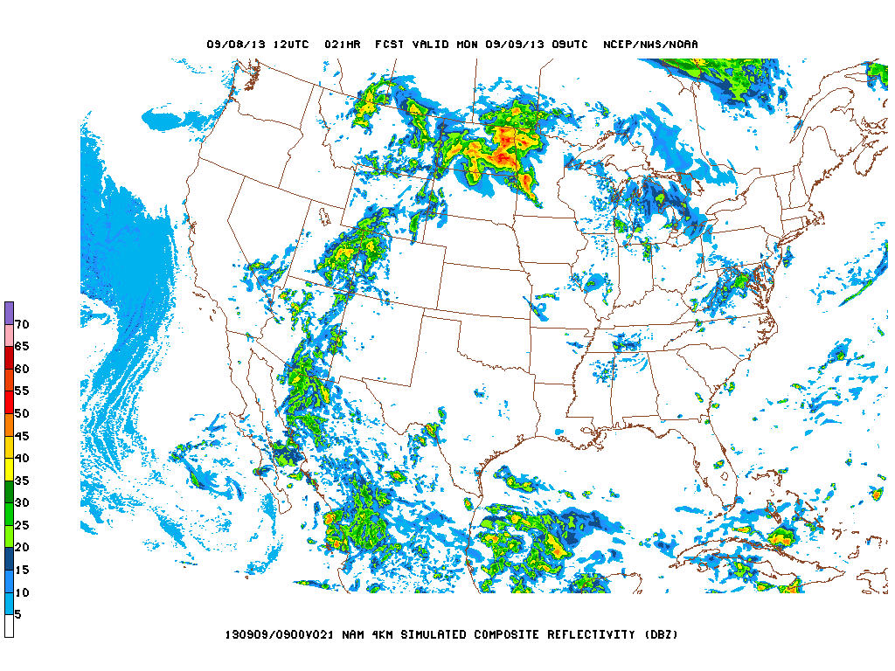
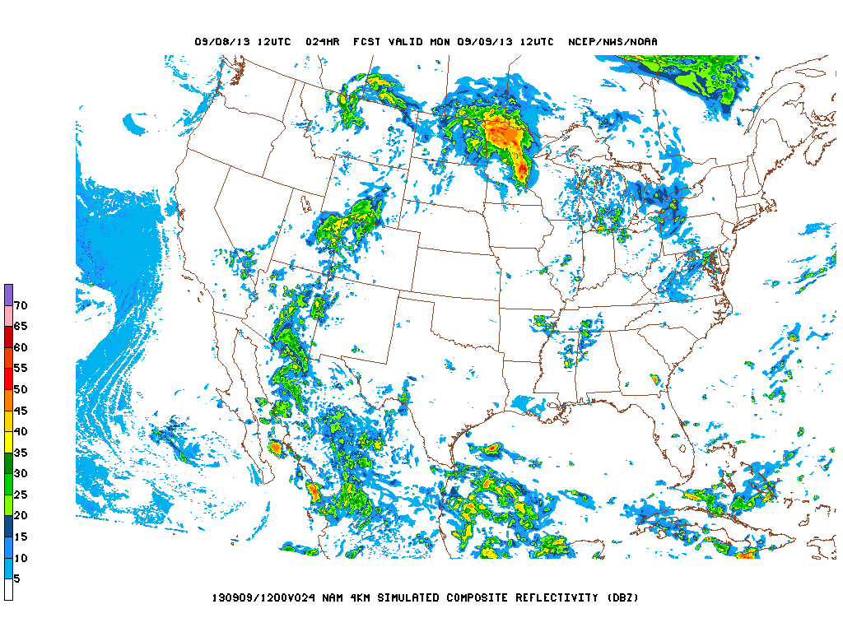
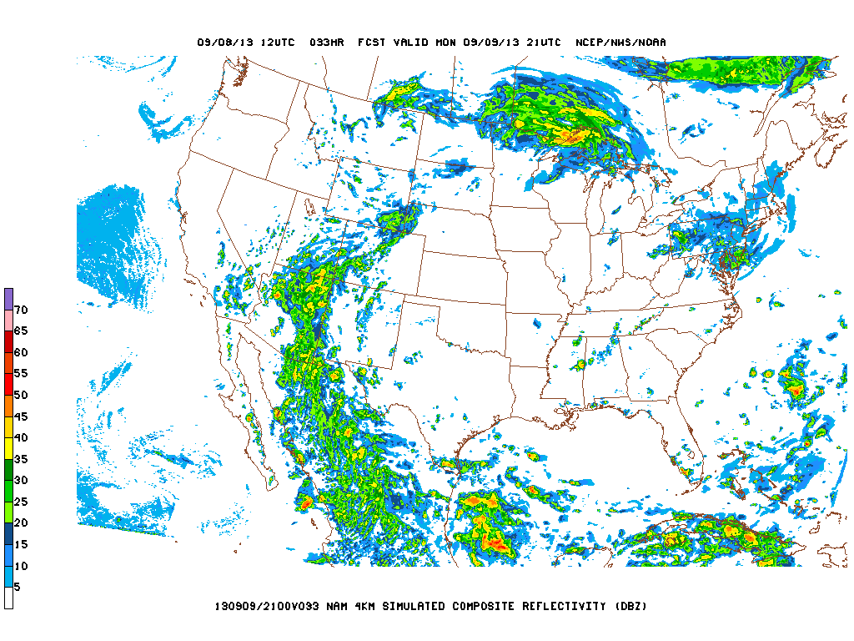
1 AM CDT
4 AM CDT
12 UTC NAM hires
7 AM CDT
4 PM CDT

Slide 19
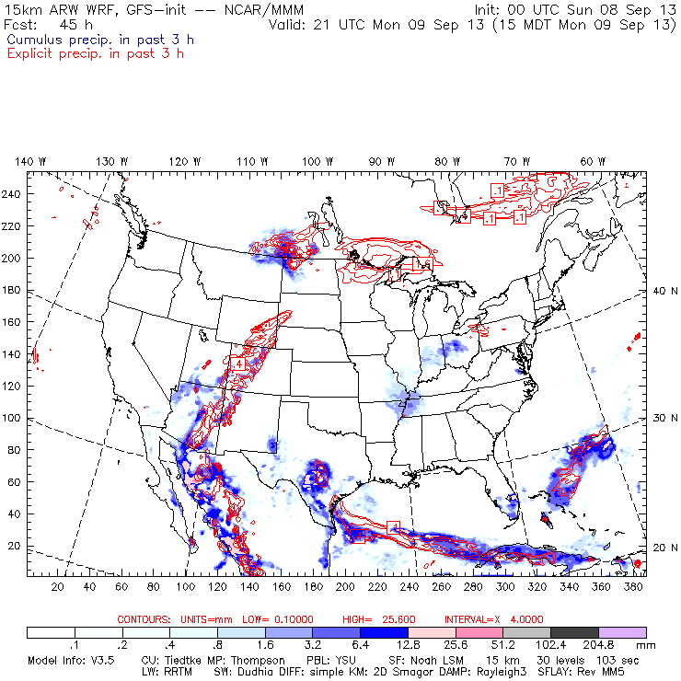

Slide 20
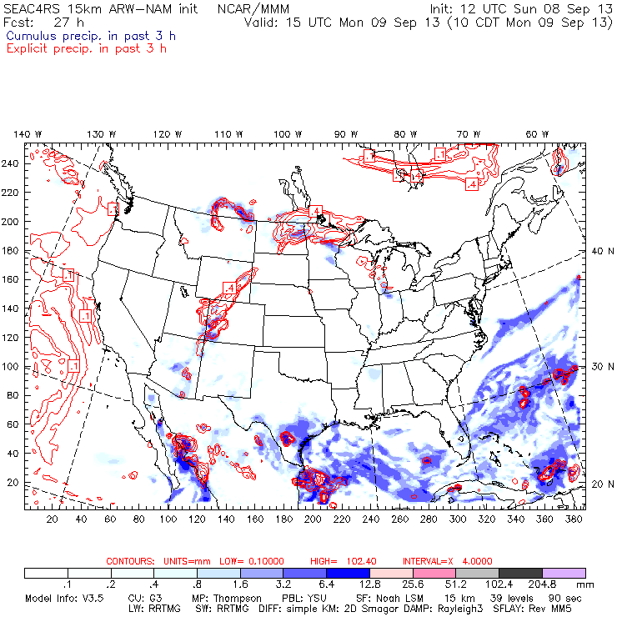

Slide 21
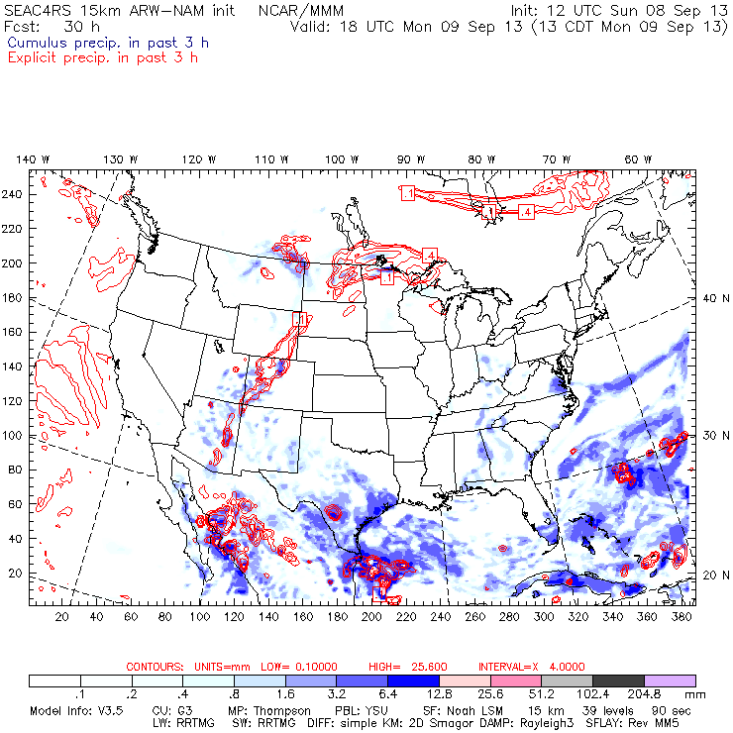

Slide 22
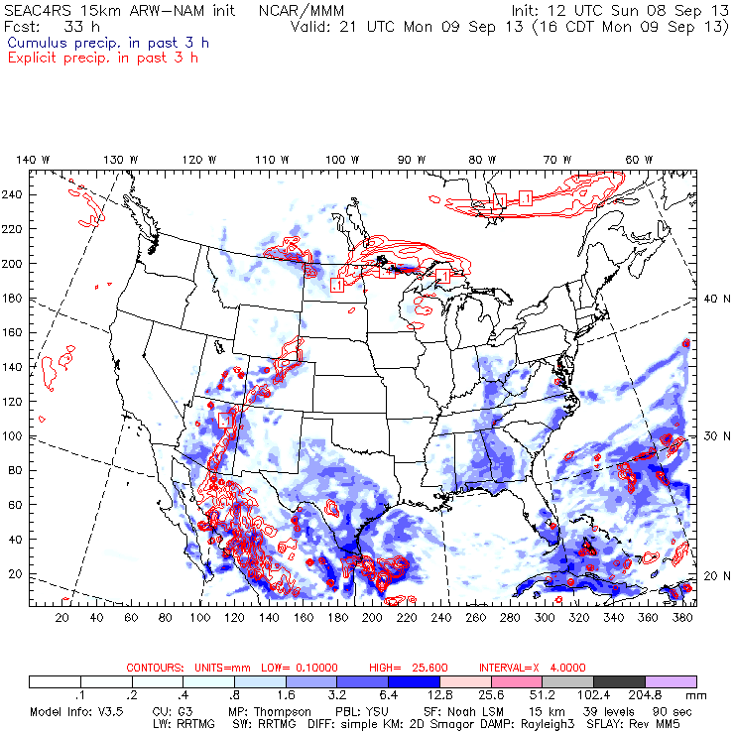

Slide 23
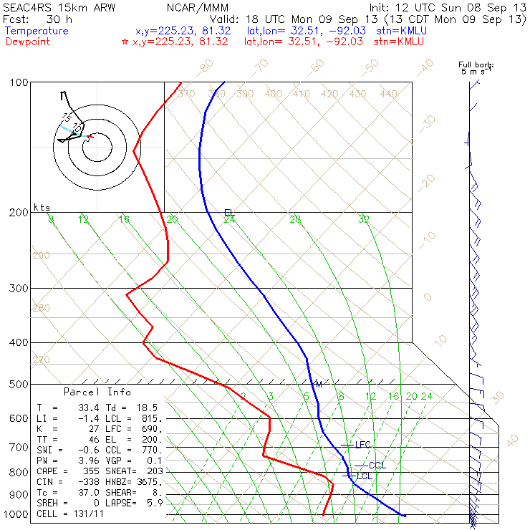
Monroe, LA
18 Z

Slide 24
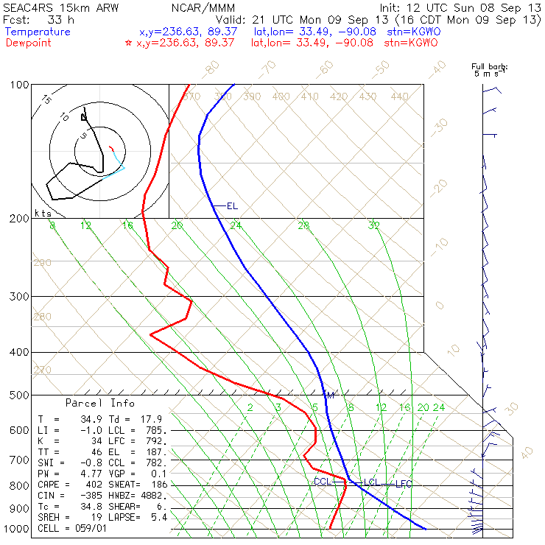
Greenwood, MS 21Z

Slide 25
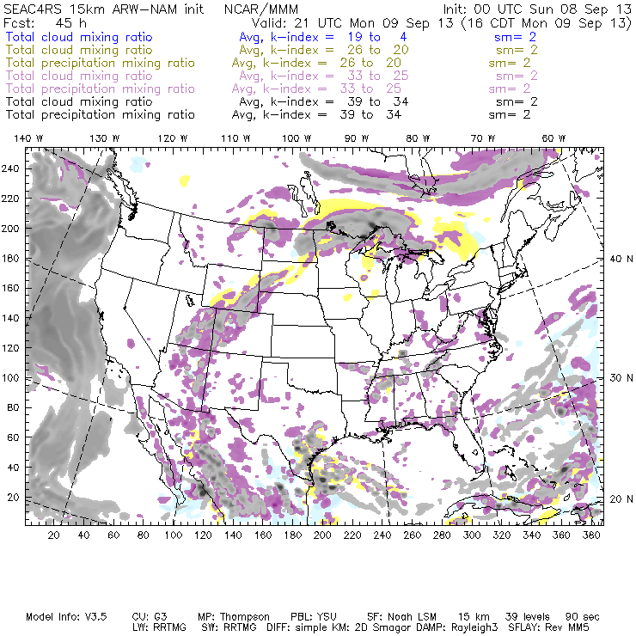

Slide 26
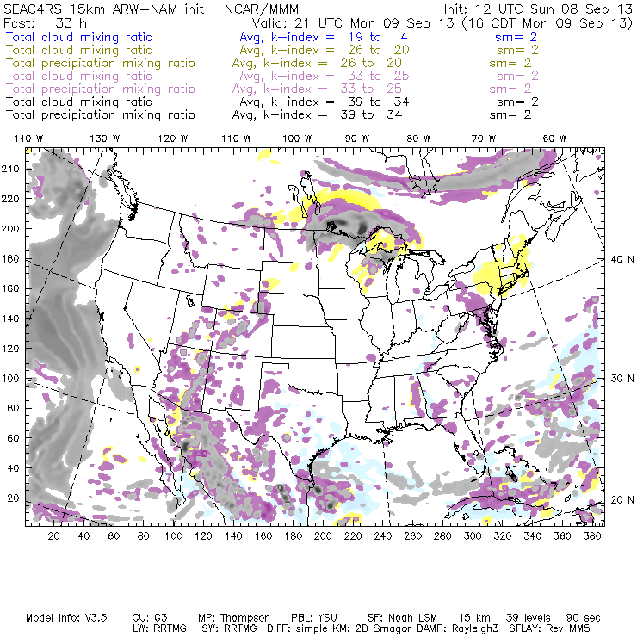

Slide 27
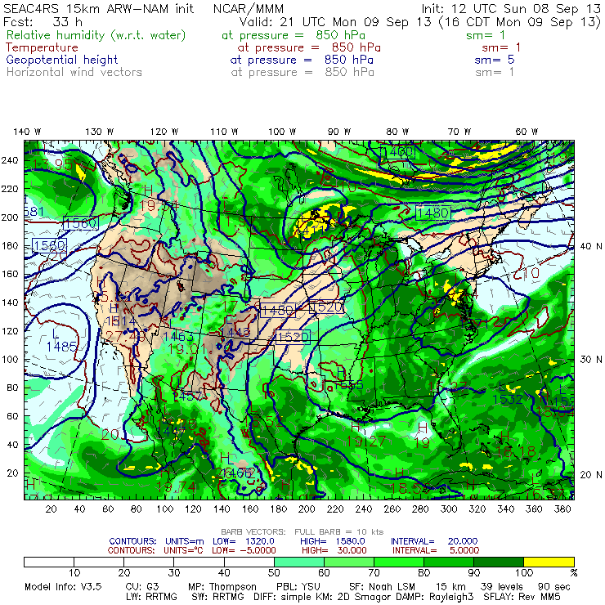

Slide 28
Wednesday

Slide 29
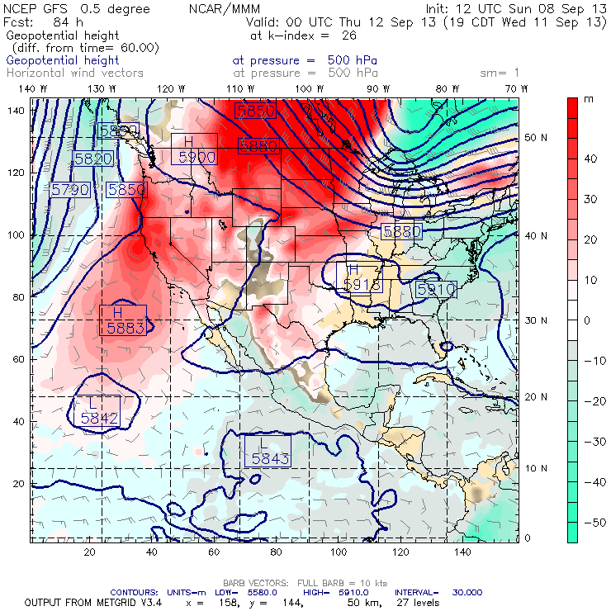
Ridge builds back westward.

Slide 30
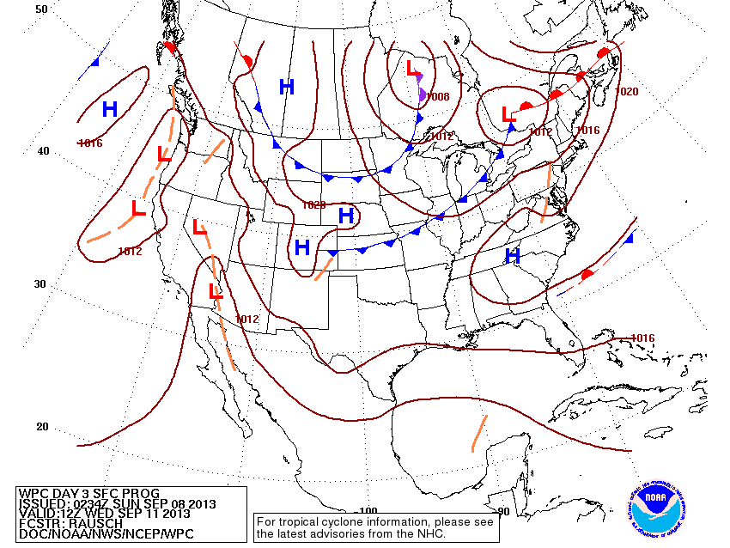

Slide 31
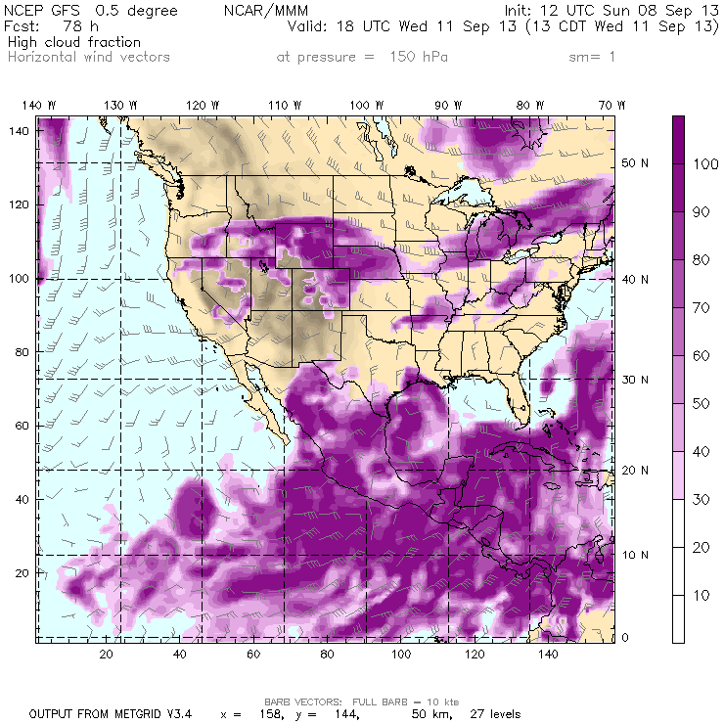
Wednesday afternoon

Slide 32
The tropics:

Slide 33
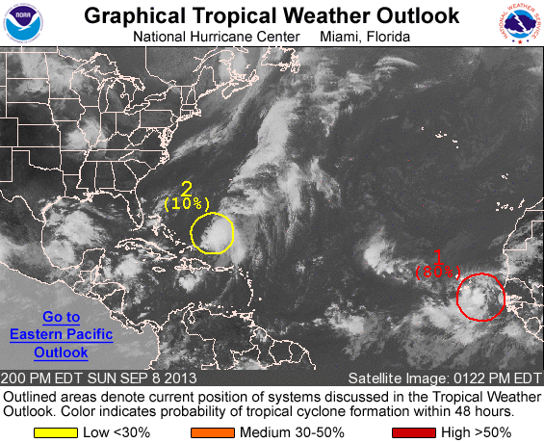

Slide 34
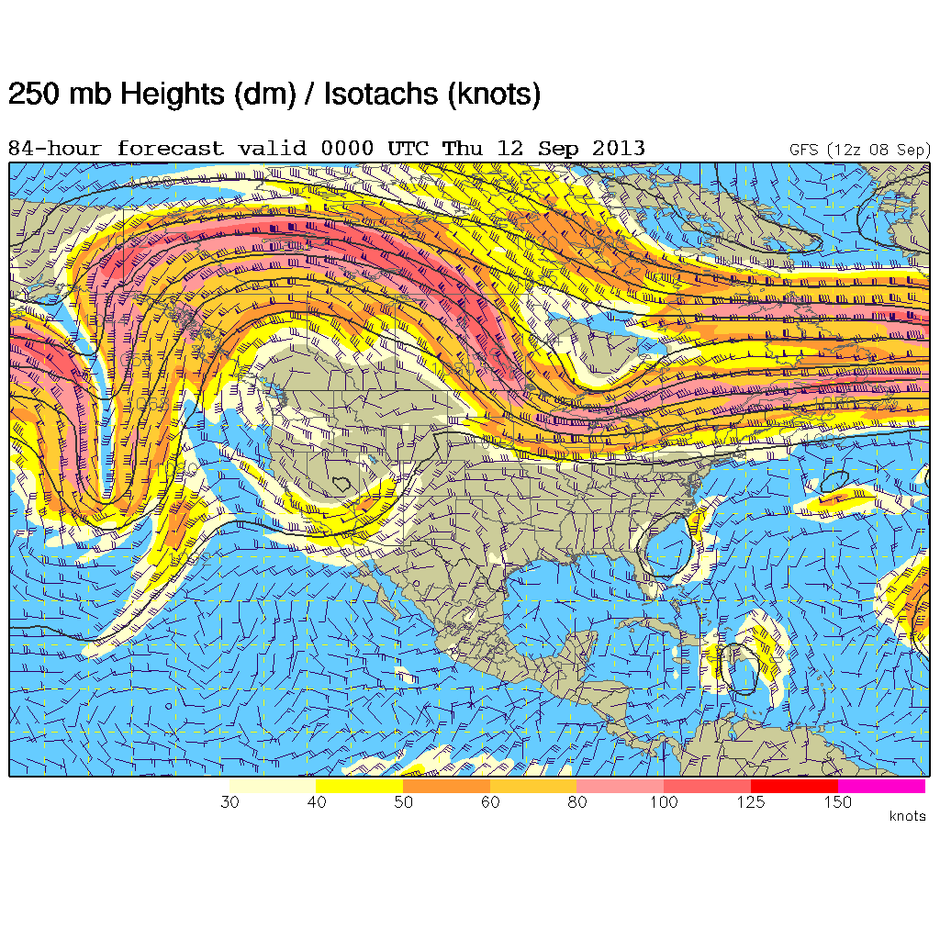

Slide 35
Friday the 13th

Slide 36
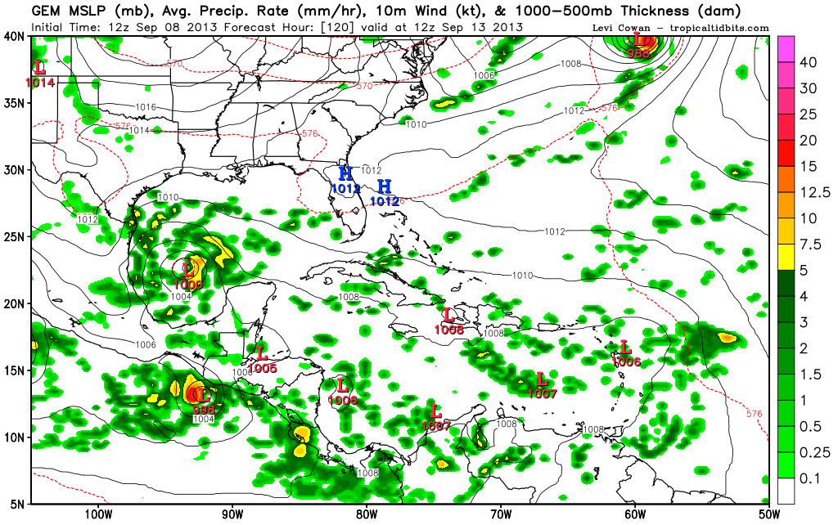

Slide 37
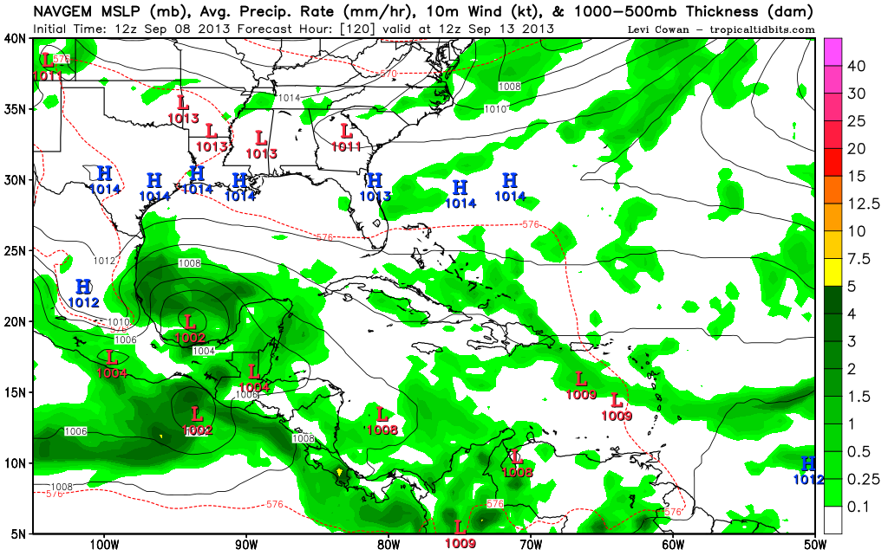

Slide 38
Ellington forecast

Slide 39
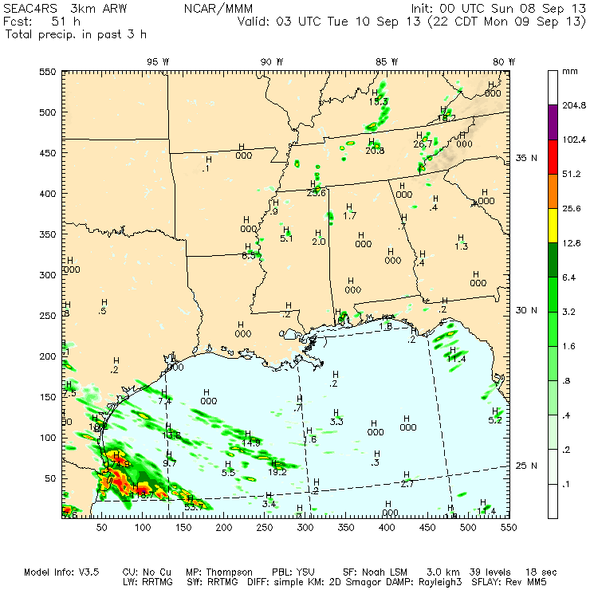
3-km NCAR WRF-ARW shows precip in the Gulf generally southwest of EFD at takeoff. No weather issues at landing.

Slide 40
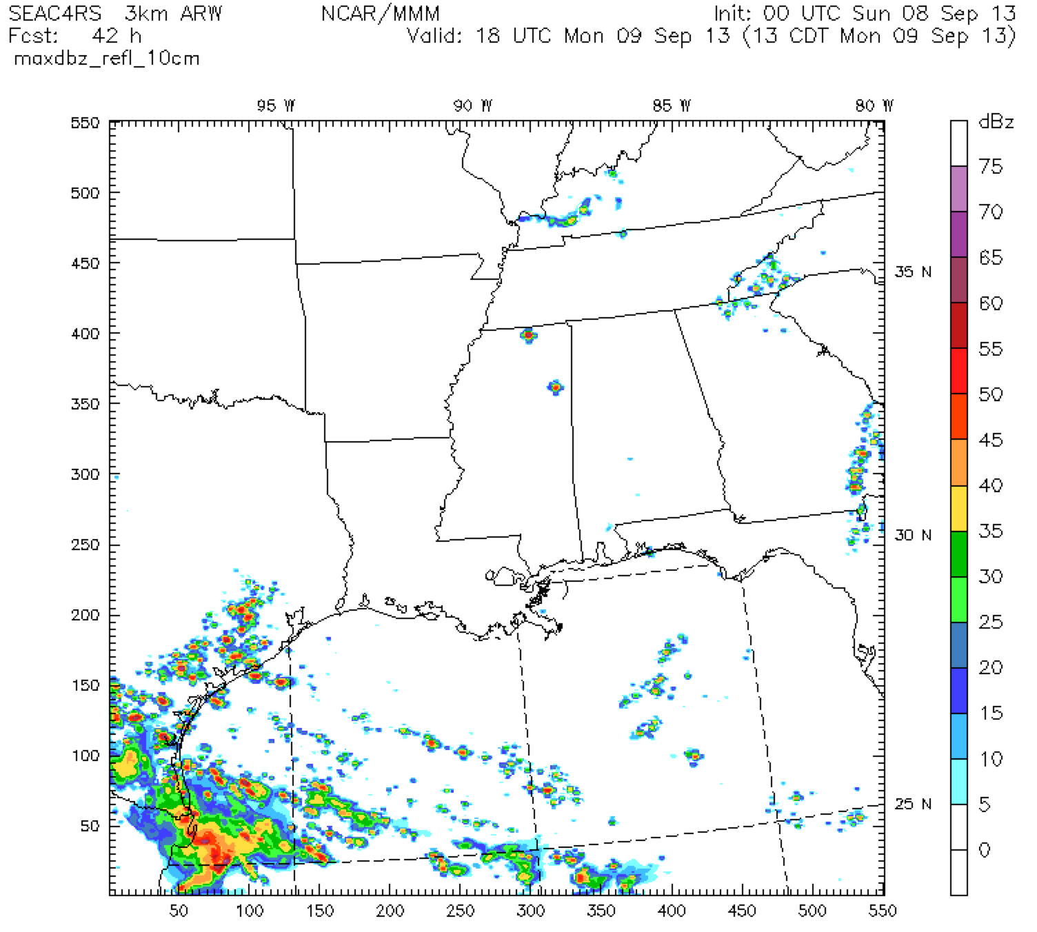
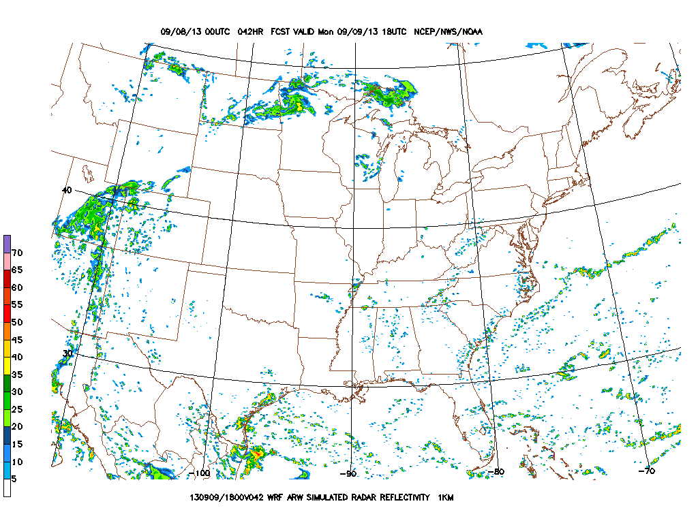
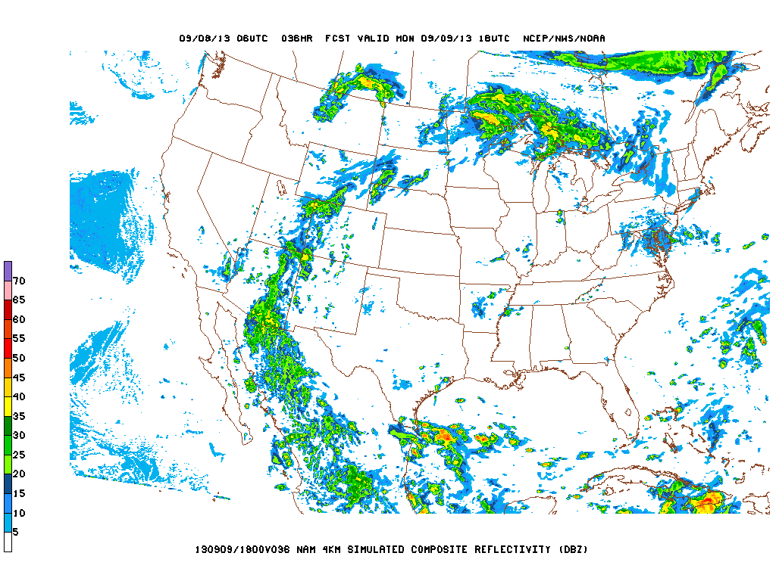
NCAR WRF
NCEP WRF ARW
NCEP NAM High-res

Slide 41
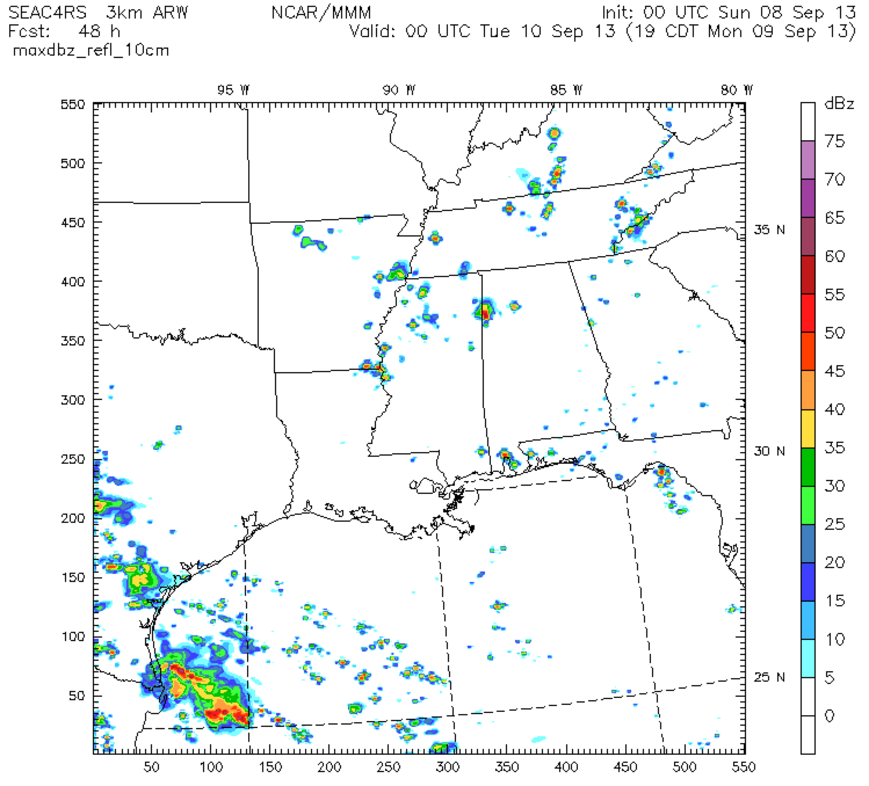
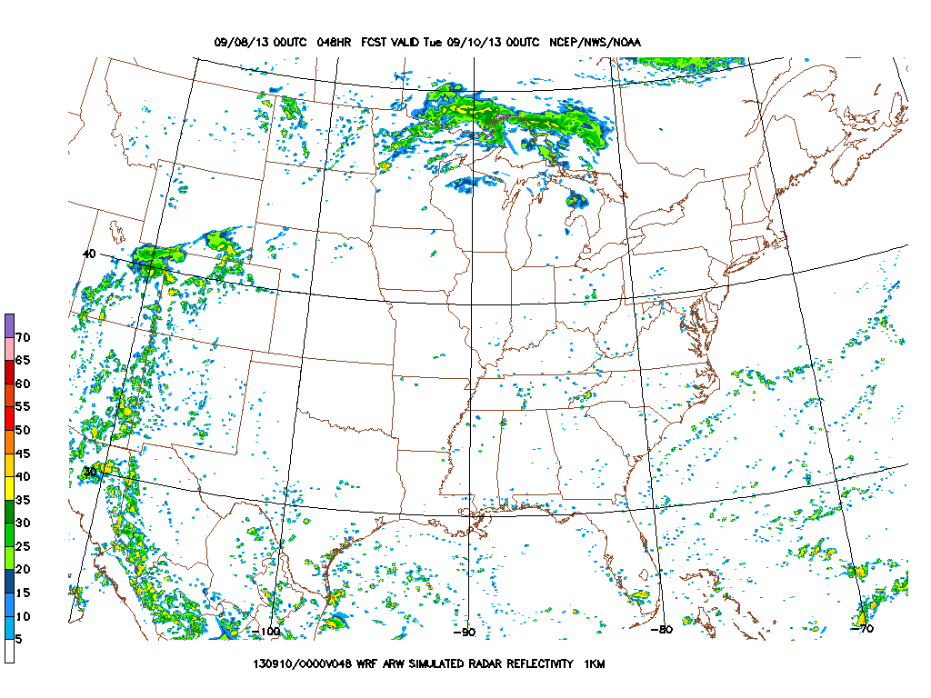

NCAR WRF
NCEP WRF ARW
NCEP NAM High-res

Slide 42
Notes:
Init 6z gfs

Slide 43

Notes:
Init 6z gfs

Slide 44
Summary
Ridge moving eastward to the SEUS on Monday
W LA / E TX has highes chances of clear skies
Gulf convection persists over the western Gulf.
Takeoff weather has a 30% chance of showers, decreasing as the day goes on. Landing weather should be fine.

