Slide 1
Weather discussion
3 September 2013
Jim Bresch NCAR/MMM
and the SEAC4RS Met team
Overview: The large-scale weather pattern remains stable over most of the U.S. with weak forcing and flow over the southern states.
Forecast issues are:
Existence, timing, and location of Gulf convection
Convective prospects over the SEUS
Weather at Ellington
Friday outlook

Slide 2
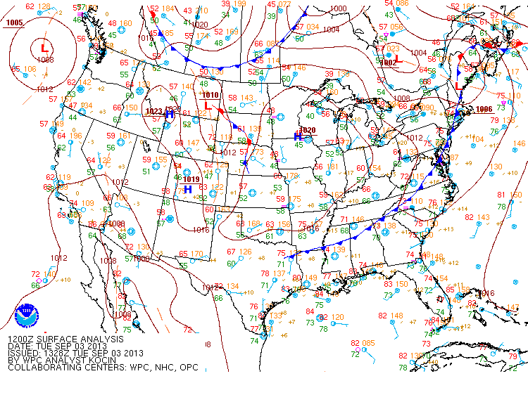
Notes:
Surface cold front triggering convection ahead of it from central TX to northern GA. Generally southerly anti-cyclonic sfc flow over the Gulf.

Slide 3
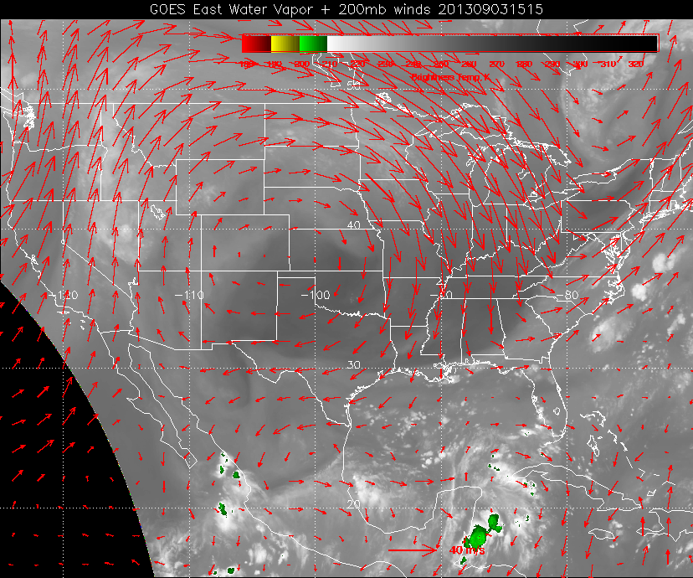
Notes:
Upper high is anchored over Colorado. Trough across the E US. 200 mb flow is weak and divergent over the Gulf. No strong convection.

Slide 4
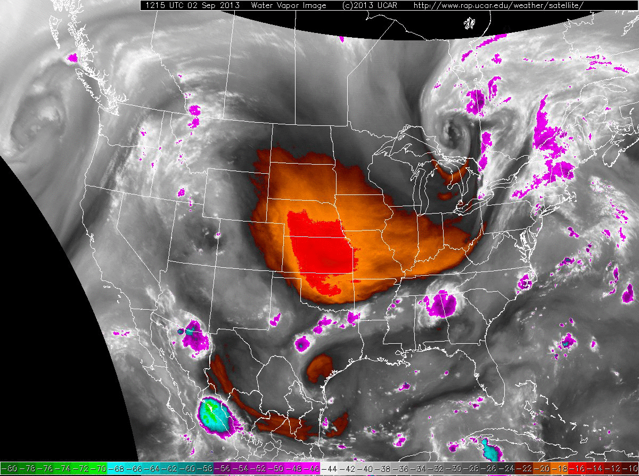
Notes:
Strong mid-level drying in central plains. Note convection develops in the dry air (due to sfc moisture). Deformation zone pushes south to near the coast. Cyclonic circulation over the central/southern Gulf.

Slide 5
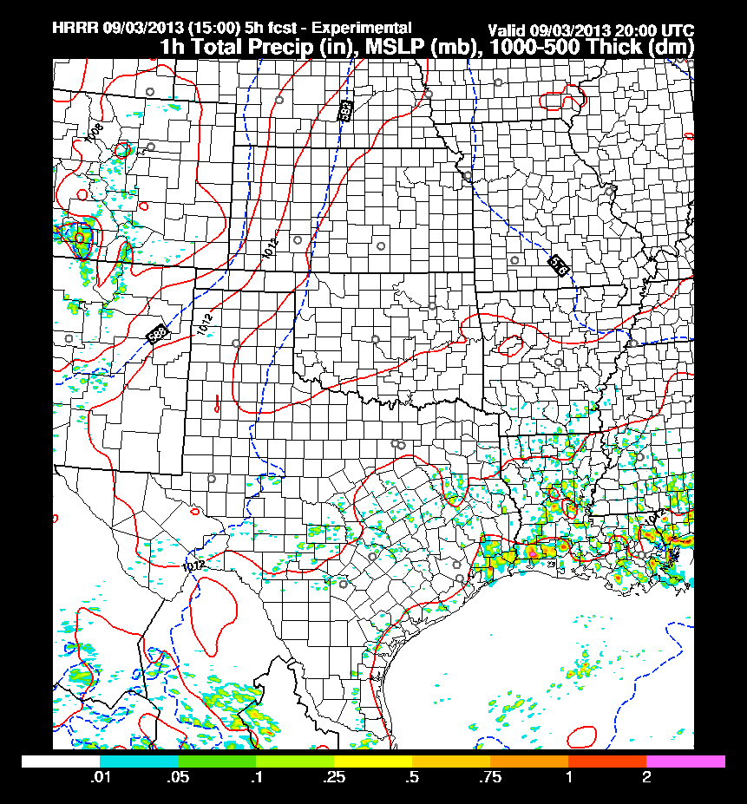
High-Resolution Rapid Refresh (3-km WRF-ARW).
Rain developing near Galveston Bay after just about now.

Slide 6
Wednesday forecast

Slide 7
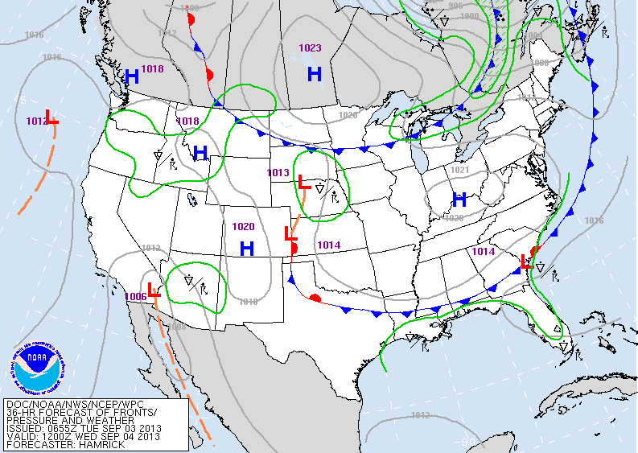
Notes:
Weak sfc front is expected to move slowly across the SE approaching the Gulf coast Wednesday morning.

Slide 8
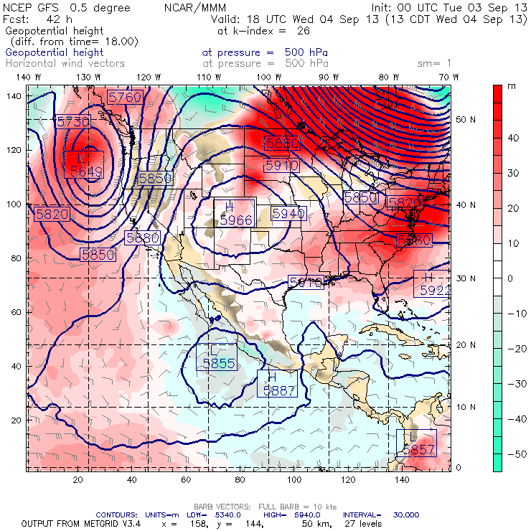
By 18z Wednesday the 500 mb high is anchored over Colorado with easterly flow over the western Gulf.
Red: 24-h height rises
Green: 24-h height falls

Slide 9
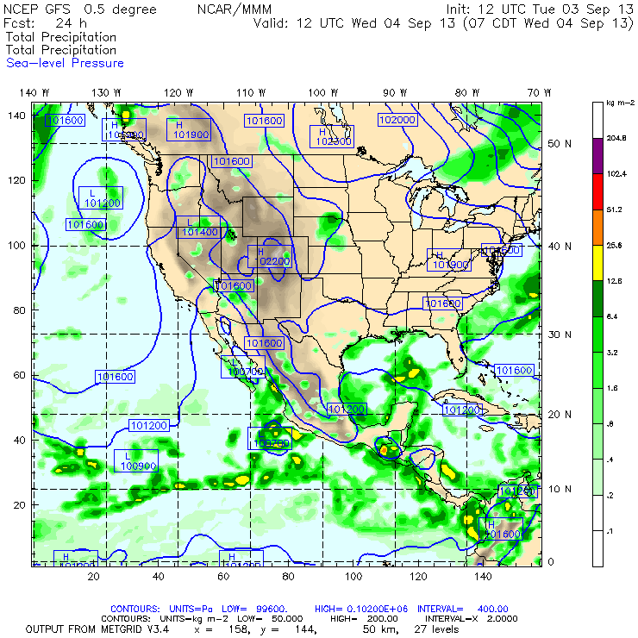
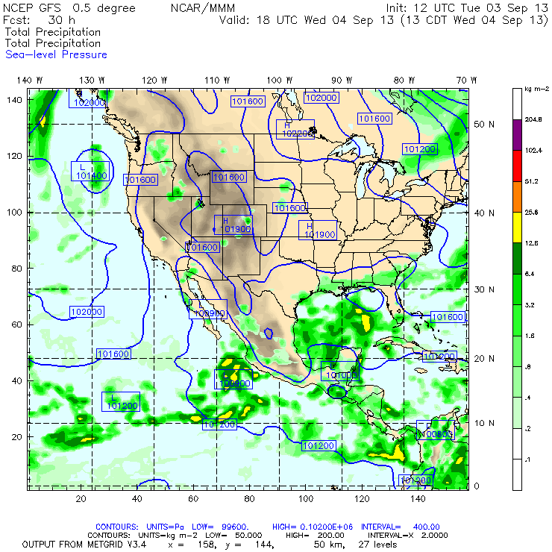
The GFS has a band of rain along the TX coast early Wednesday, decaying slightly during the late morning while central Gulf convection intensifies.

Slide 10
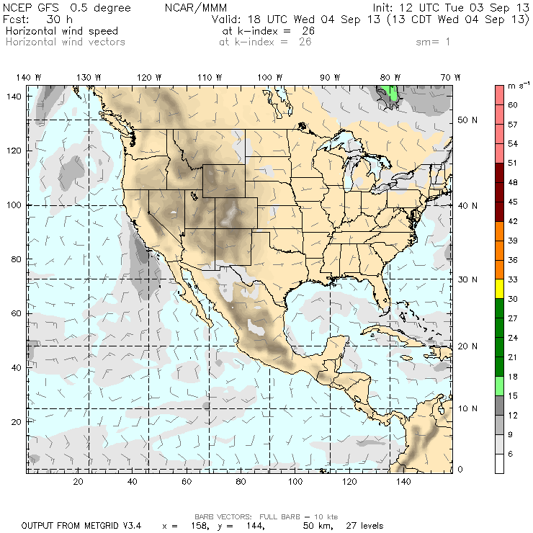
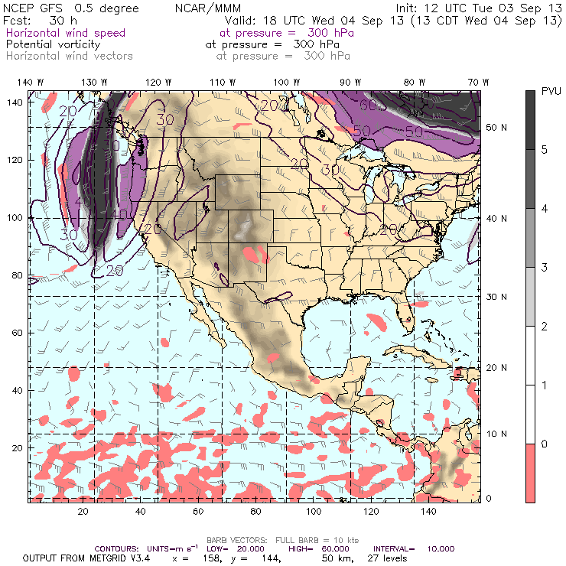
Surface winds (left panel) are easterly at about 15 kts in the northern Gulf. At 300 mb winds are easterly north of a weak cyclone NW of Yucatan.

Slide 11
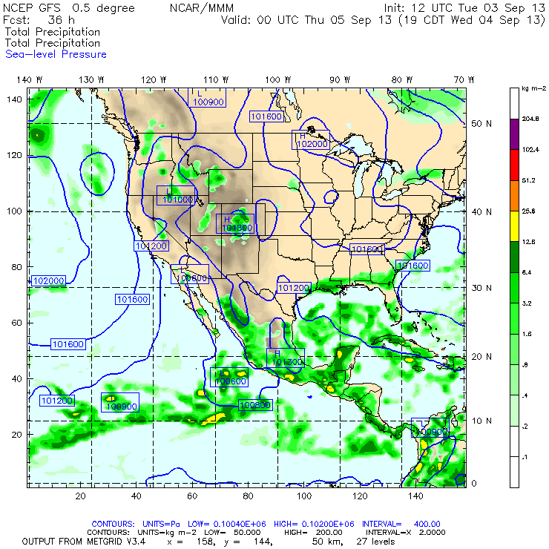
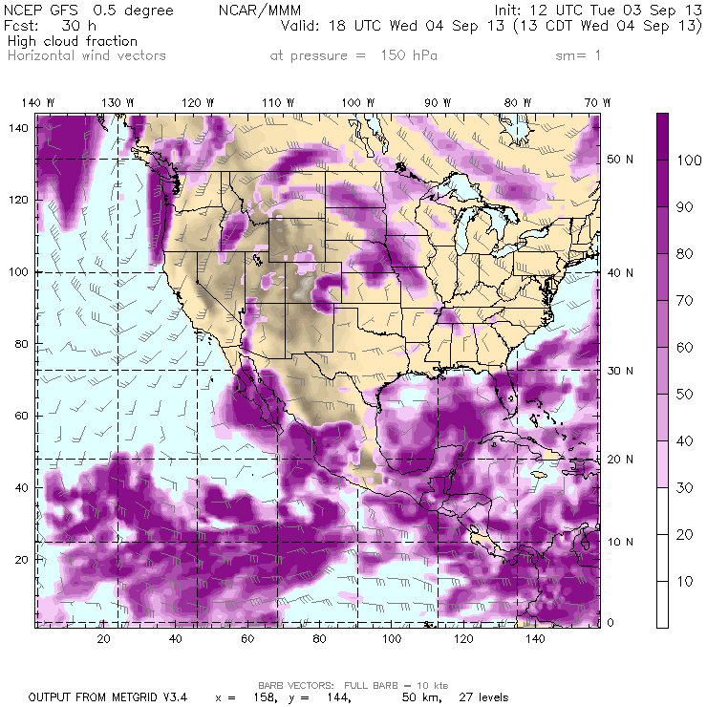
GFS convection decays during the afternoon, but exists along TX coast from EFD eastward. Cirrus is associated with the convective areas over the Gulf.

Slide 12
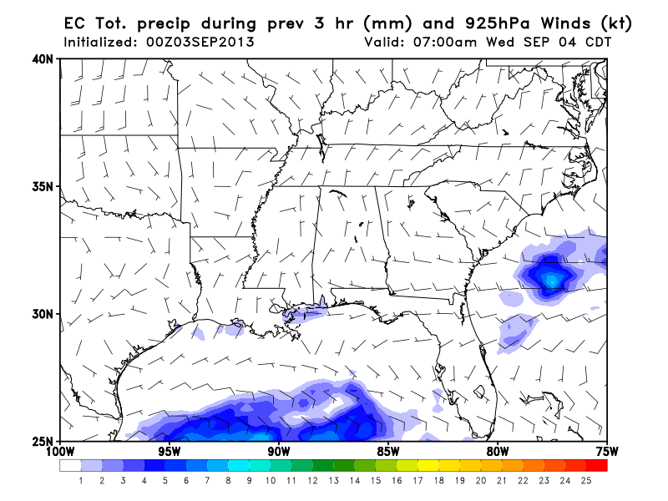
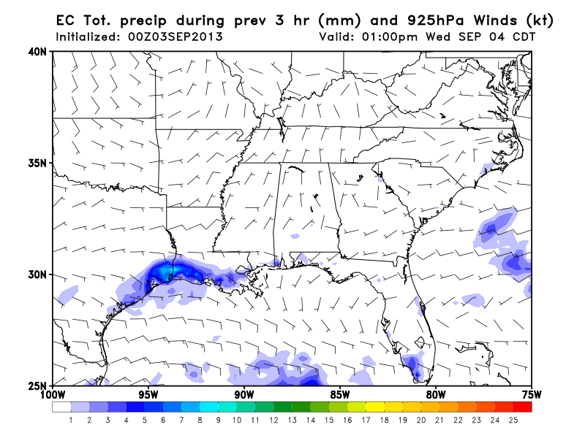
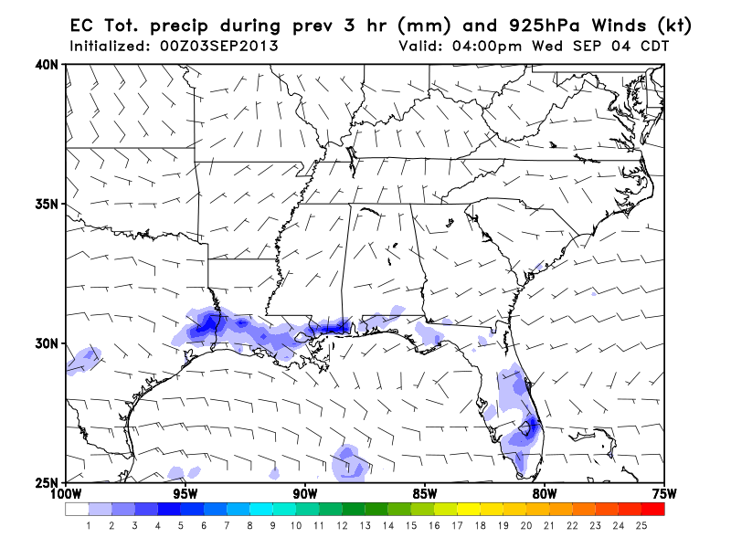
7 AM
1 PM
4 PM
EC Precip

Slide 13
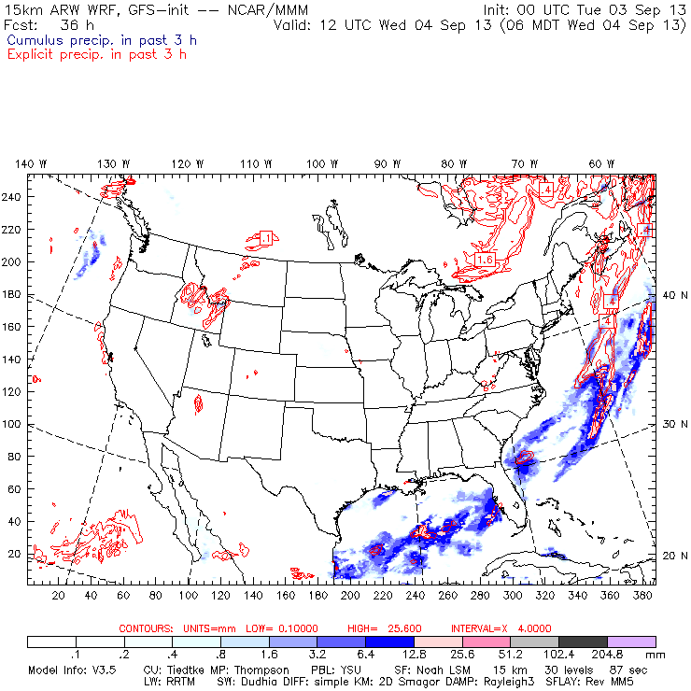
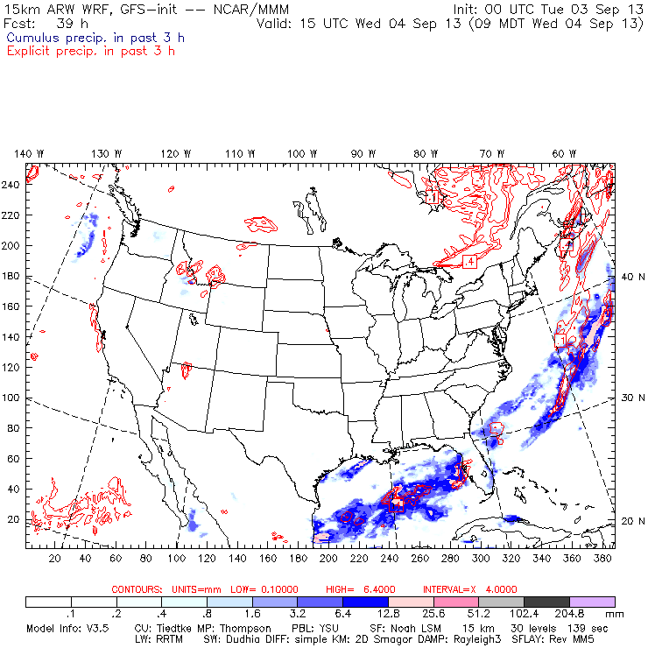
WRF-GFS shows convection in the central/southern Gulf and develops a band of convection from off Galveston to south of Lake Charles.
Blue: convective
Red: grid-resolved

Slide 14
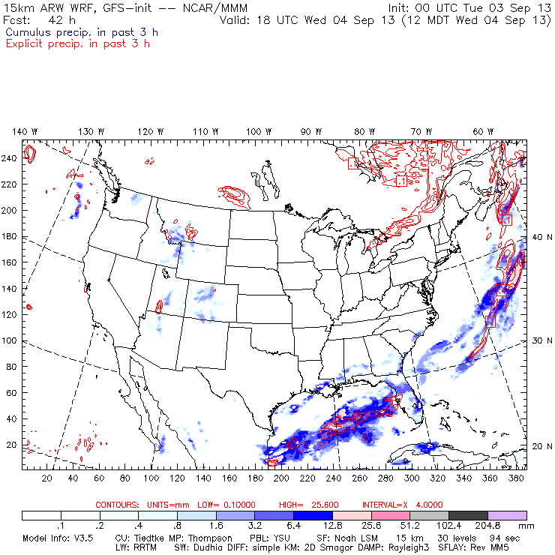
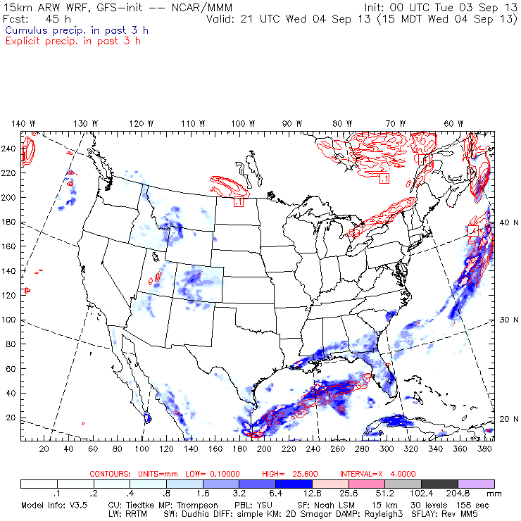
By afternoon WRF-GFS shows the convective band in the northern Gulf dissipating while the central Gulf convection weakens, but persists. Little to none is progged near EFD.
Blue: convective
Red: grid-resolved

Slide 15
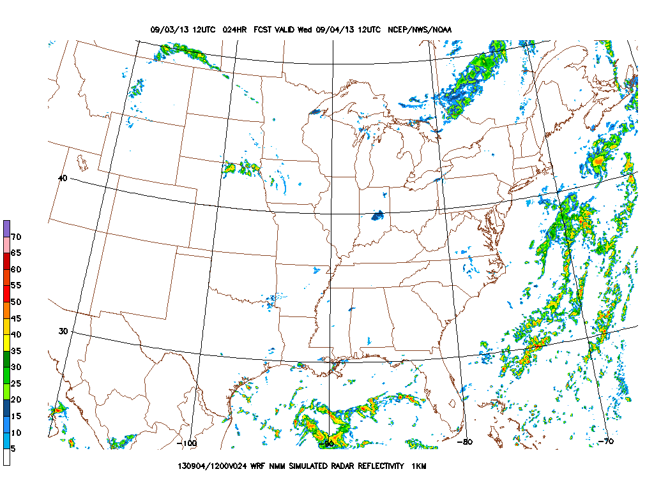
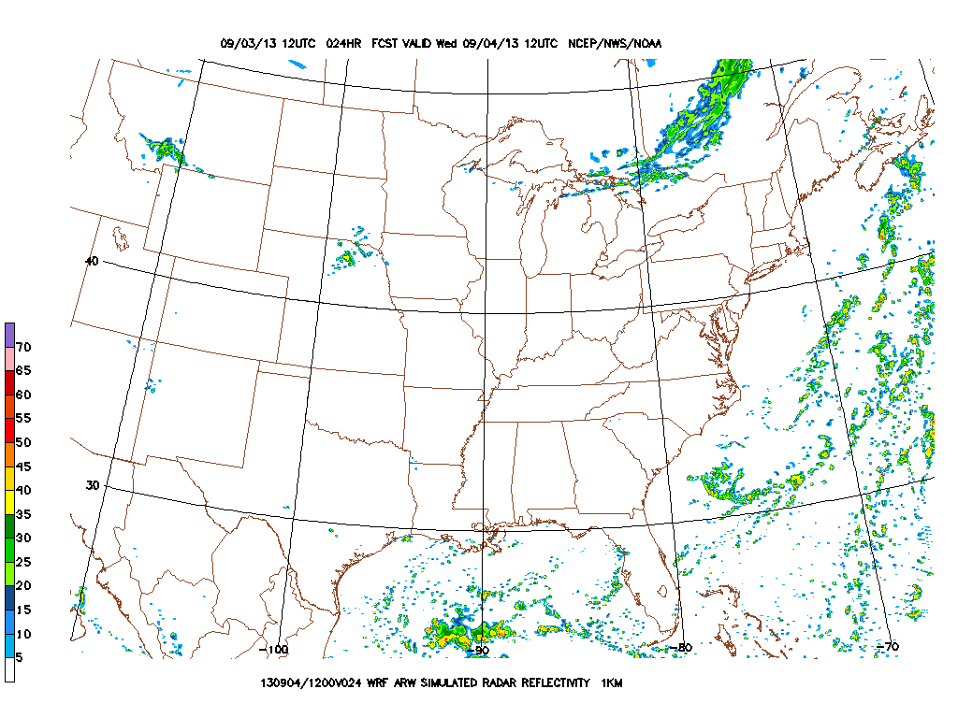
NMM
7 AM CDT Wednesday
ARW

Slide 16
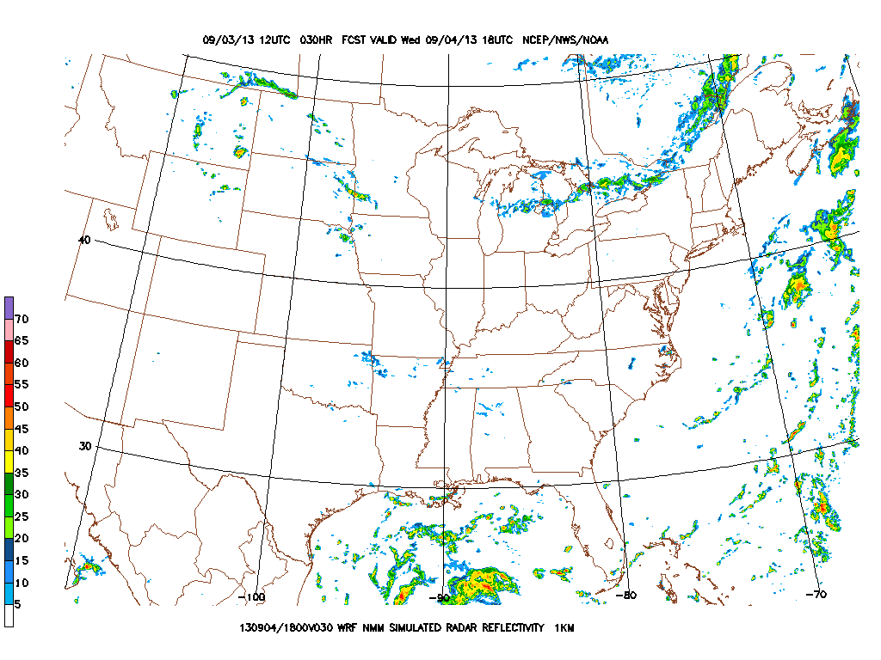
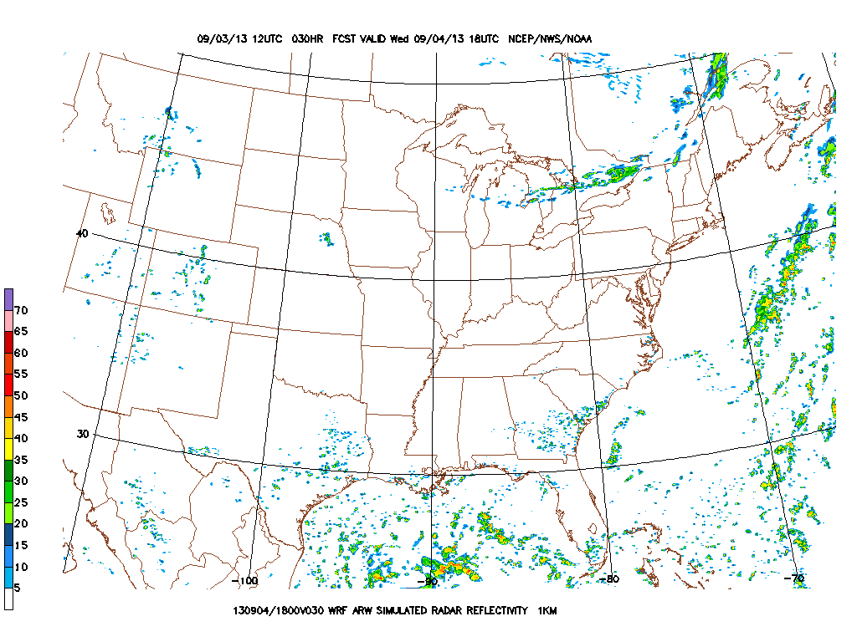
NMM
1 PM CDT Wednesday
ARW

Slide 17
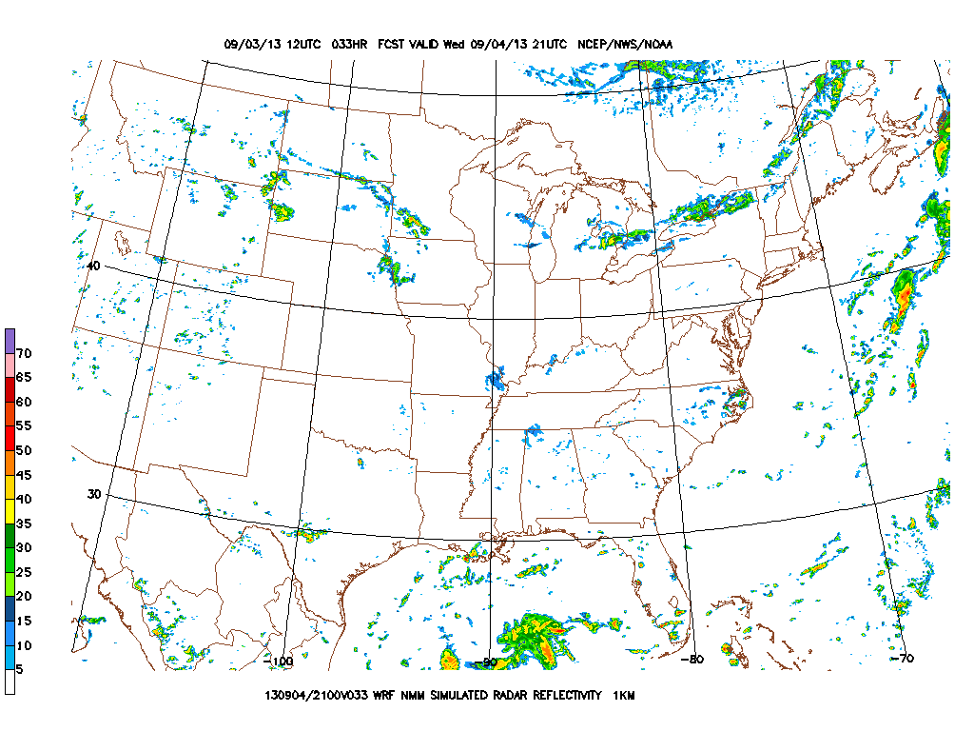
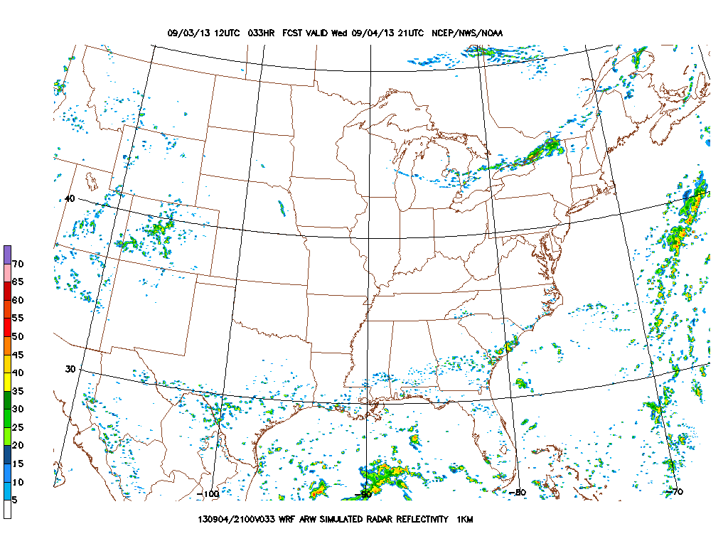
NMM
4 PM CDT Wednesday
ARW

Slide 18
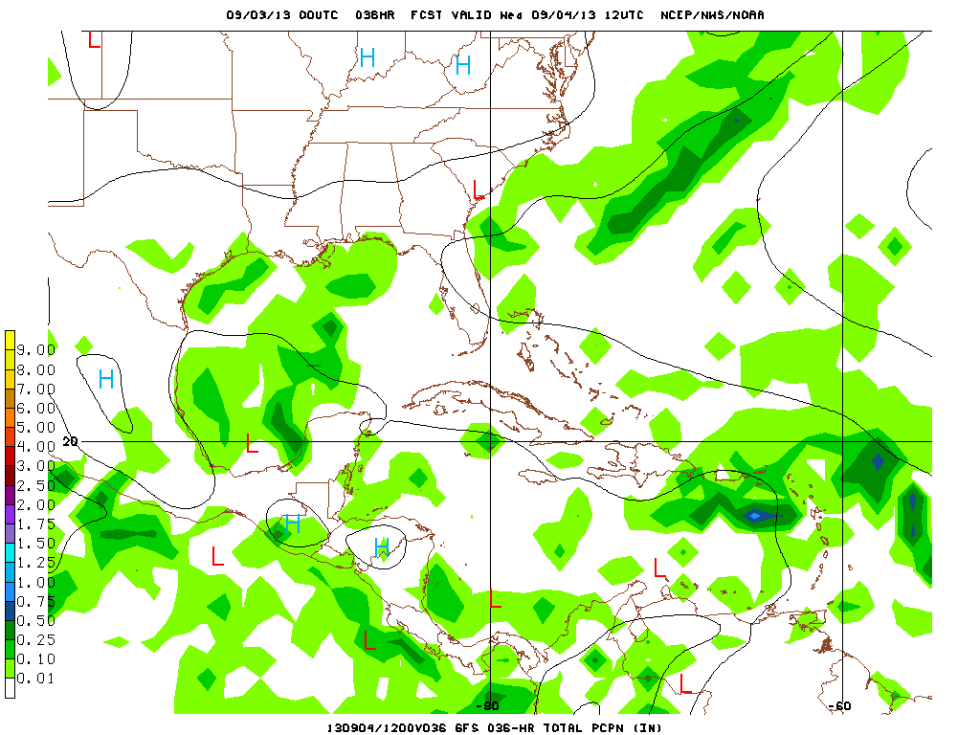
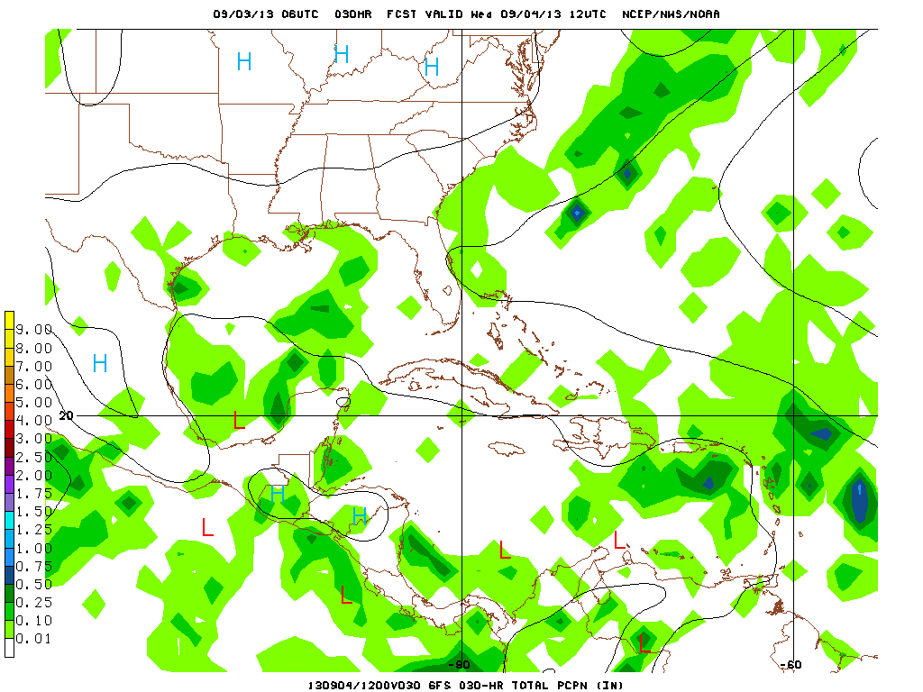
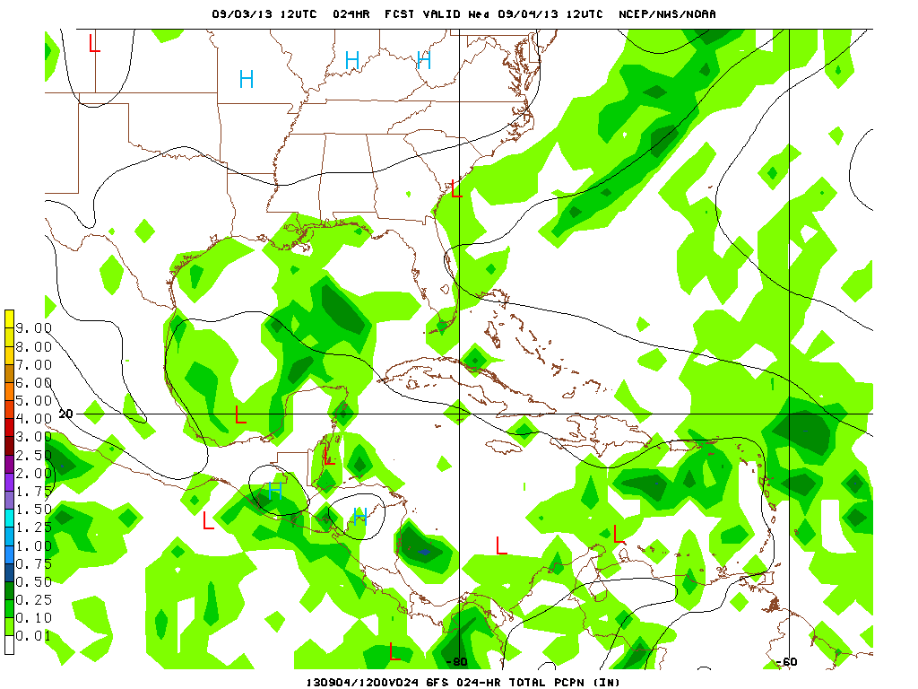
00z Initialization
06z Initialization
12z Initialization
Takeoff-7 AM CDT
GFS 3 h Precip

Slide 19
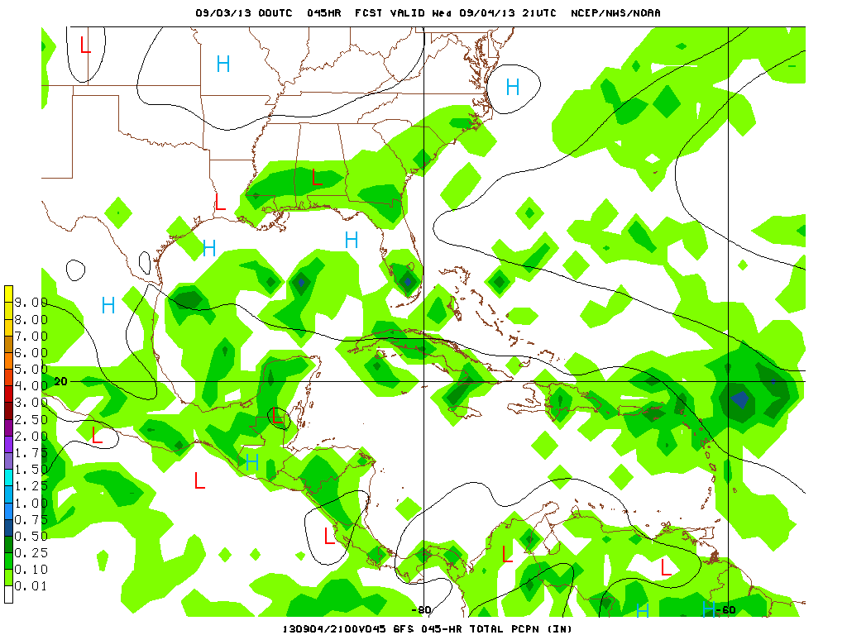
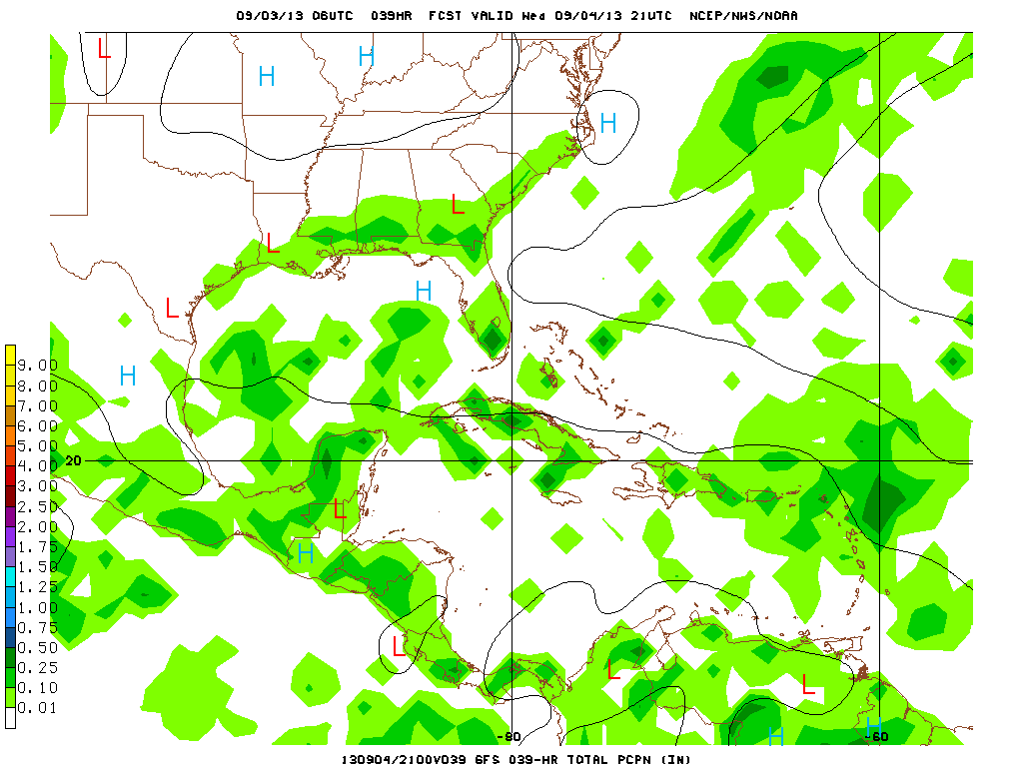
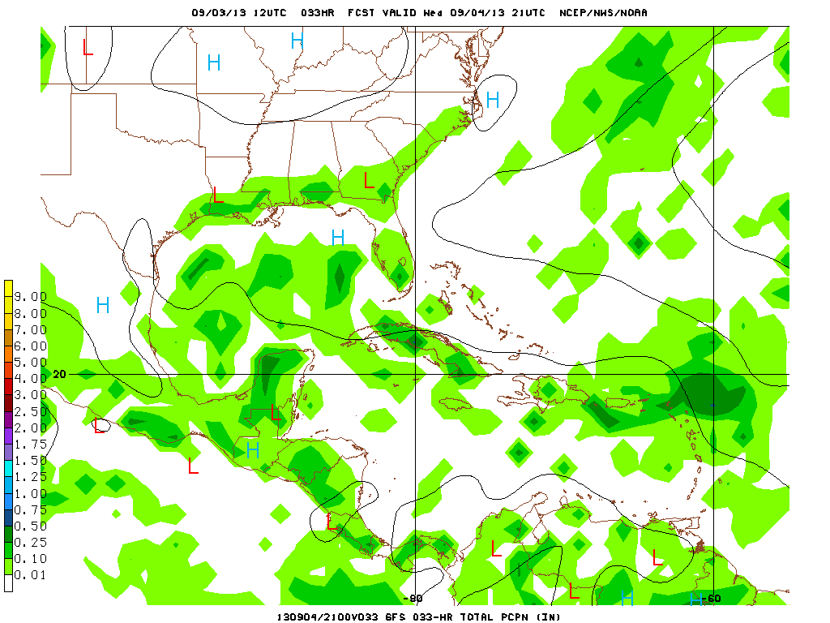
00z Initialization
06z Initialization
12z Initialization
Landing-4 PM CDT
GFS 3 h Precip

Slide 20
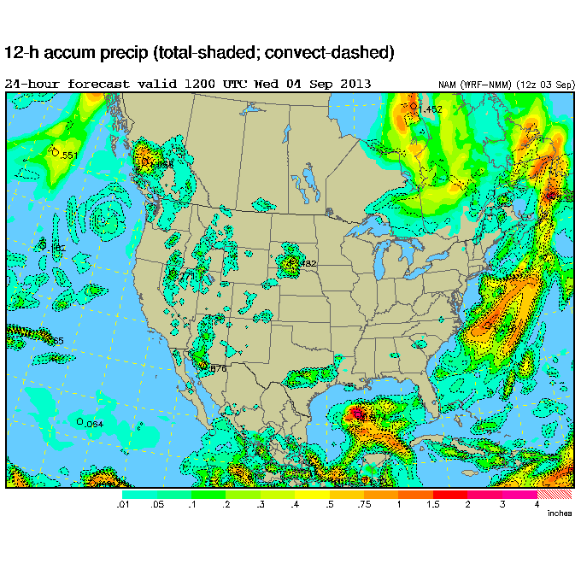
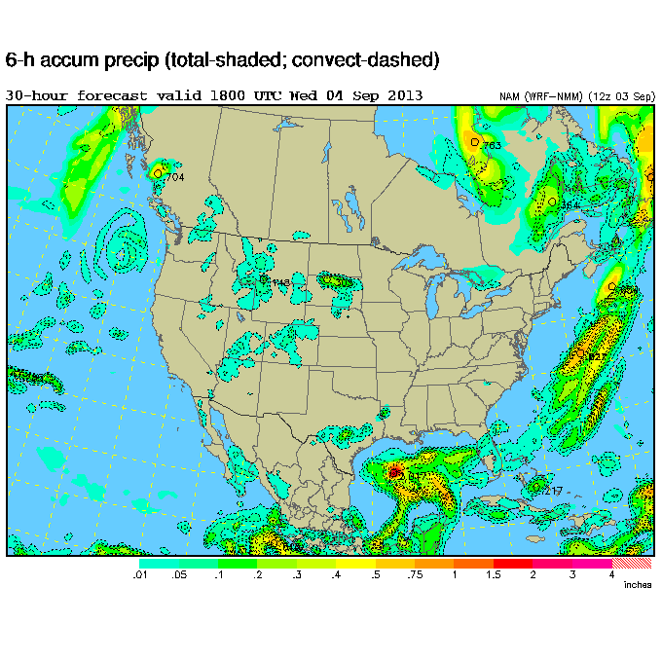
The NAM is fairly aggressive with convection in the central Gulf. It has a band of rain north of Houston, but none along the coast.

Slide 21
So what does it all mean?

Slide 22
So what does it all mean?
The numerical models have difficulty predicting weakly-forced convection in a region of conditional instability and few observations.
Proper modeling of this situation would require very high resolution (grid spacing of 1 km or smaller) to produce the outflow boundaries, gravity waves that kick off new convection.

Slide 23
So what does it all mean?
The numerical models have difficulty predicting weakly-forced convection in a region of conditional instability and few observations.
Proper modeling of this situation would require very high resolution (grid spacing of 1 km or smaller) to produce the outflow boundaries, gravity waves that kick off new convection.
Model consensus indicates high probability of convection in the central Gulf.

Slide 24
Friday Outlook

Slide 25
NAM (the other NAM) prospects

Slide 26
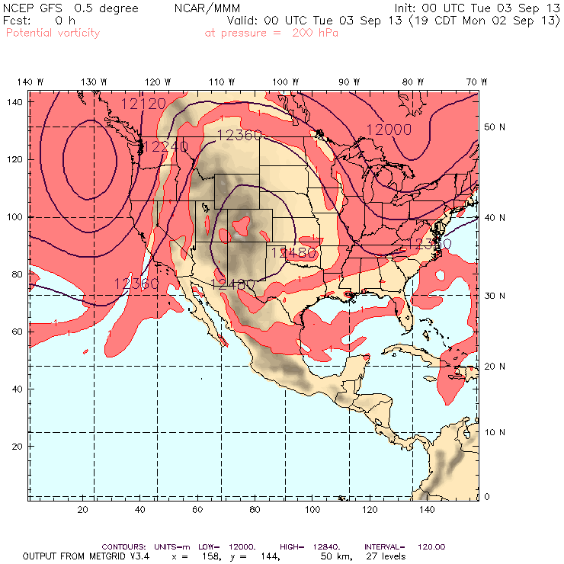
The anticyclone’s extent is peaking today before the trough begins to erode the northern periphery.

Slide 27
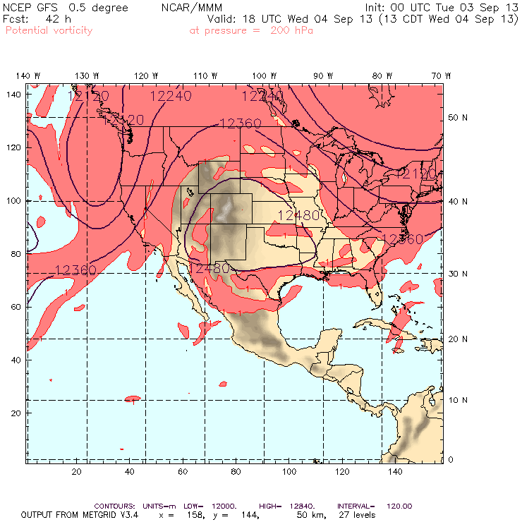
By Wednesday the northern edge of the a-c has moved south.
The southern edge of the circulation is overhead EFD.

Slide 28
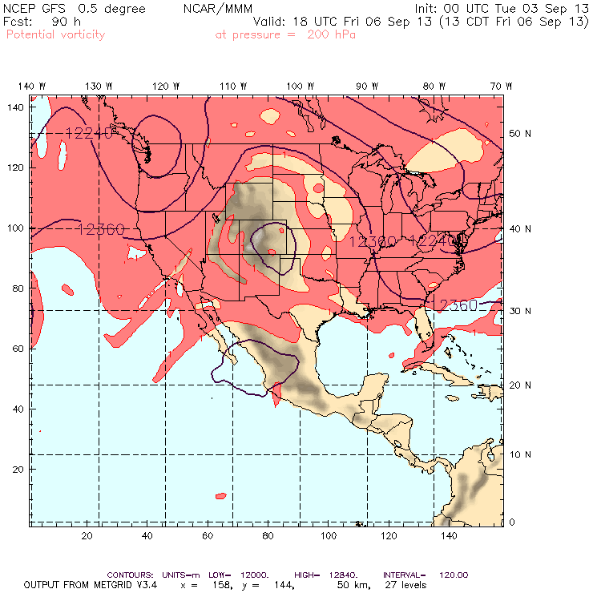
By Friday, the anticyclone continues to decay as troughs attack the western and eastern sides.

Slide 29
SEUS Chemistry prospects

Slide 30
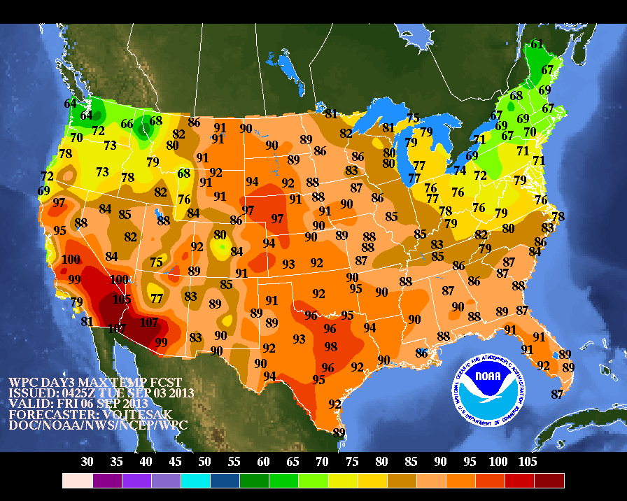
Notes:
Friday max temps.

Slide 31
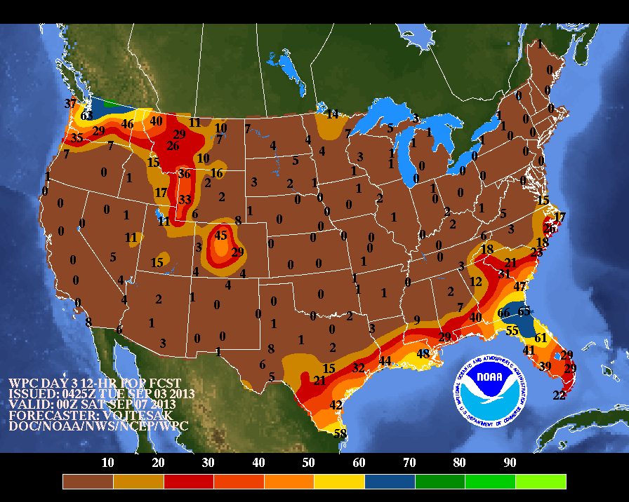
Notes:
Friday max temps.

Slide 32
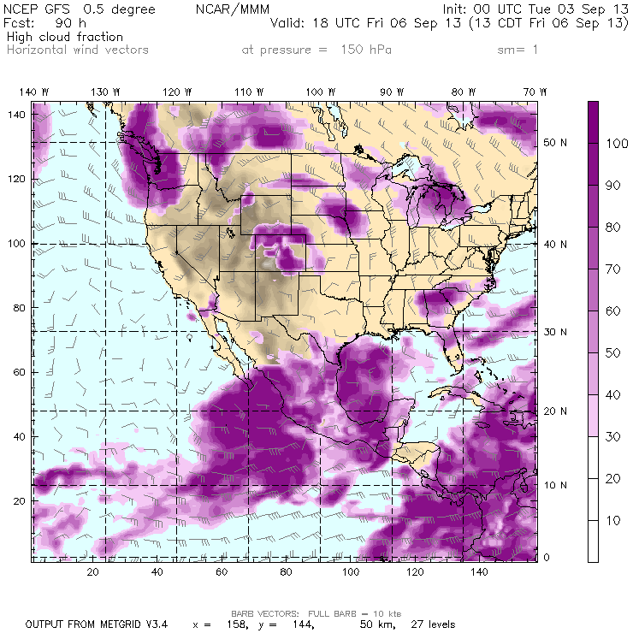
GFS high cloud fraction shows less than 30% coverage over the Mississippi Valley.
High clouds likely over the western Gulf and GA.
Notes:
Friday max temps.

Slide 33
MCS prospects:
Nil south of Nebraska

Slide 34
The tropics:

Slide 35
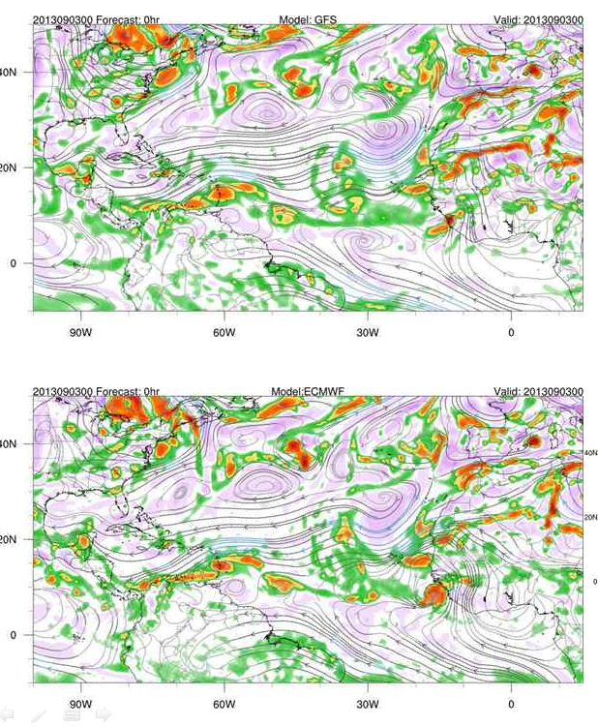
00Z Tuesday 3 Sept.
Initialization of GFS (top) and EC
(bottom) for 850mb streamlines
and 850mb vorticity.
GFS
NHC gives this system a 50% chance of becoming a TC in the next 5 days (recently upgraded).
NHC also watching a system over
the Yucatan and off the coast
of Africa. Models discard both
of these systems.
EC

Slide 36
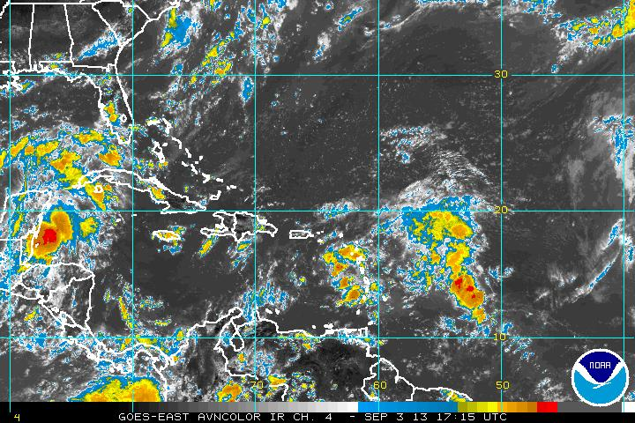
System of interest has significant convection, but is quite diffuse

Slide 37
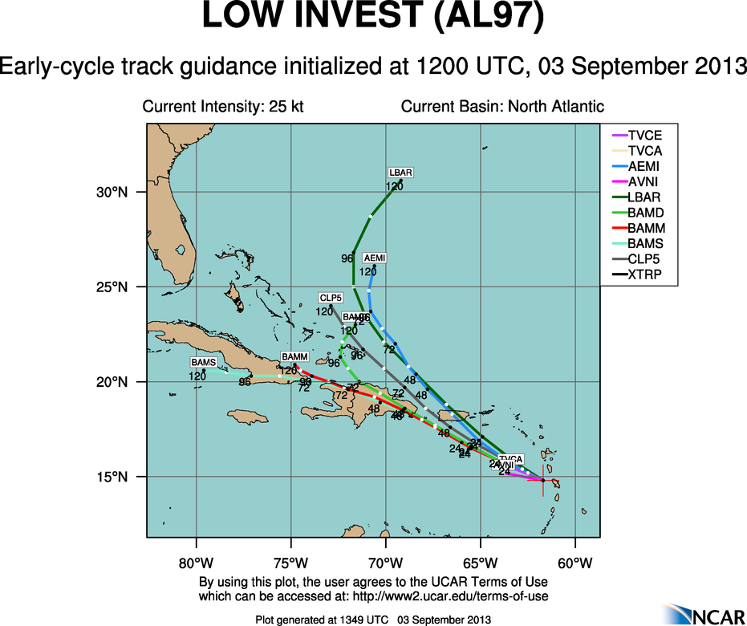
Path of windward islands system suggests that it is likely to be out of range (but not certainly)

Slide 38
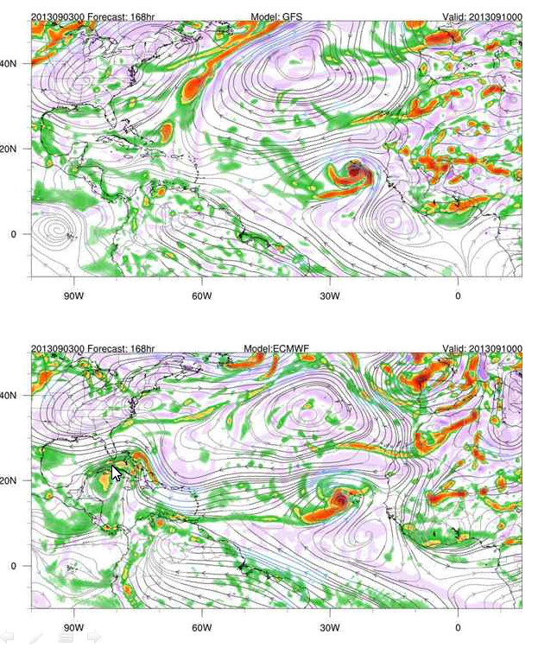
Monday, 7 PM
168 hour forecast (!). Yucatan
system is gone, system of current
interest is a wave (looking quite
different in the two models).
Previous African system is long
gone, replaced by a new one that
both models seem to want to
develop into a TC.
GFS
EC

Slide 39
Ellington forecast

Slide 40
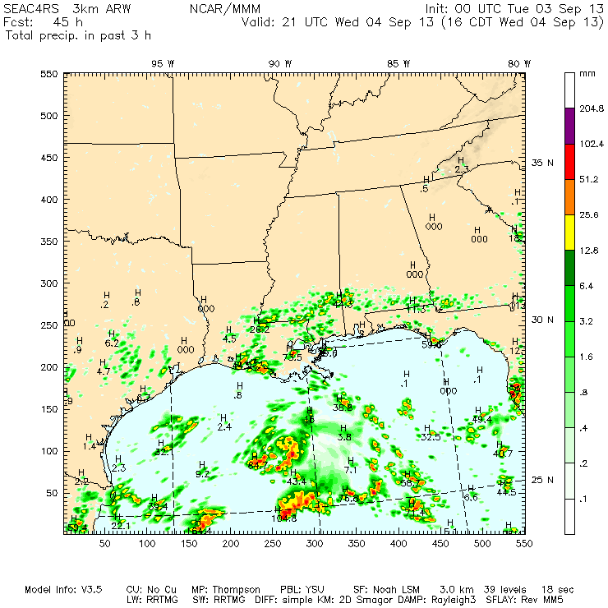
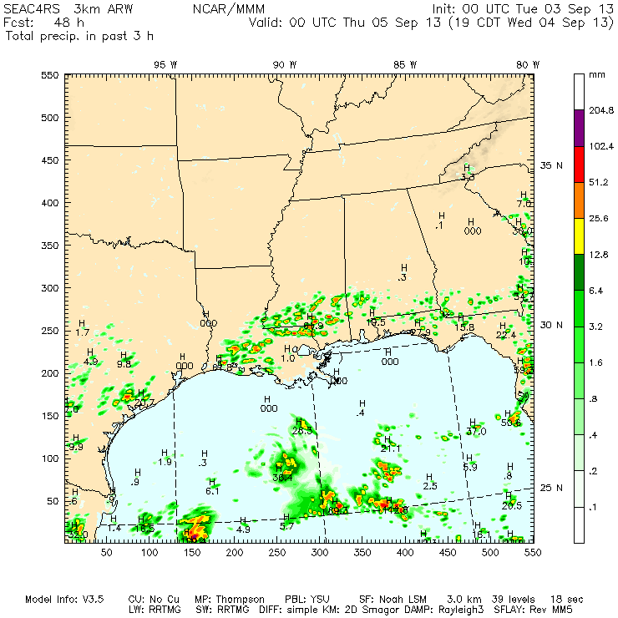
3-km WRF shows some precip developing near EFD before 4 PM Wednesday, but not lasting long

Slide 41
Summary
The stable large-scale pattern over the CONUS begins to decay later this weak.
Anti-cyclone remains over Colorado, but weakens by Friday.
Gulf convection is likely with highest prospects along 89-90 W.
Surface front will act as focus for convection over SEUS.
Some concern for showers in the EFD area for takeoff and landing – say 20%.

