Slide 1
Weather discussion
3 September 2013
Jim Bresch NCAR/MMM
and the SEAC4RS Met team
Overview: The large-scale weather pattern remains stable over most of the U.S. with weak forcing and flow over the southern states.
Forecast issues are:
Existence, timing, and location of Gulf convection
Convective prospects over the SEUS
Weather at Ellington
Friday outlook

Slide 2
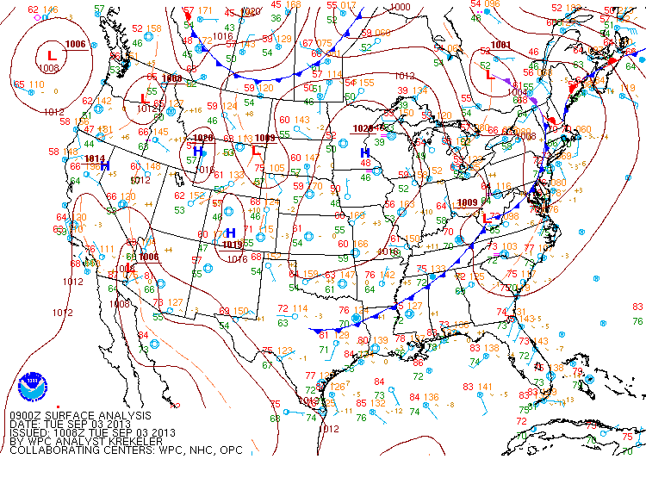
Notes:
Surface cold front triggering convection ahead of it from central TX to northern GA. Generally southerly anti-cyclonic sfc flow over the Gulf.

Slide 3
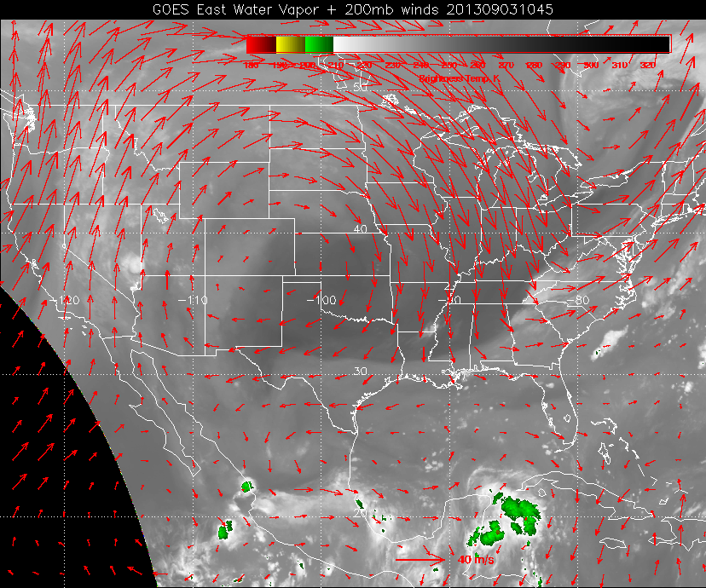
Notes:
Upper high is anchored over Colorado. Trough across the E US. 200 mb flow is weak and divergent over the Gulf. No strong convection.

Slide 4
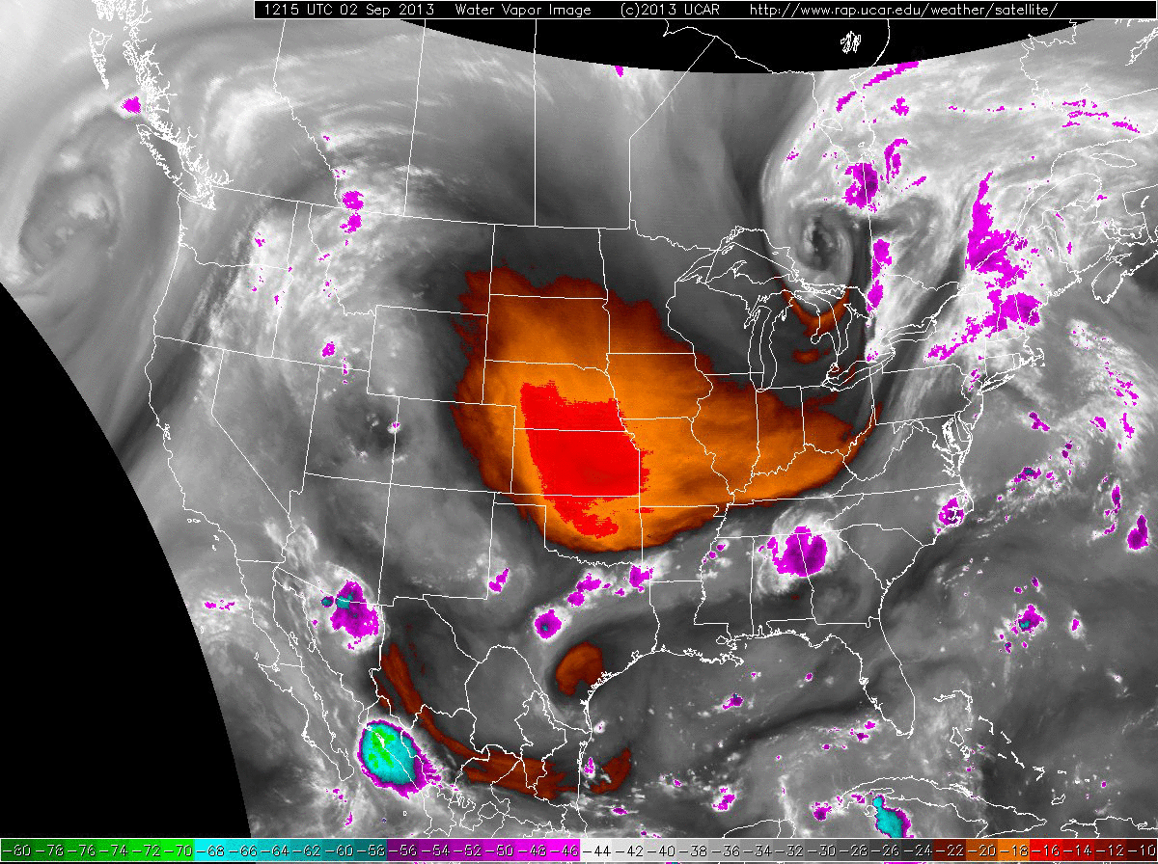
Notes:
Strong mid-level drying in central plains. Note convection develops in the dry air (due to sfc moisture). Deformation zone pushes south to near the coast. Cyclonic circulation over the central/southern Gulf.

Slide 5
Gulf forecast

Slide 6
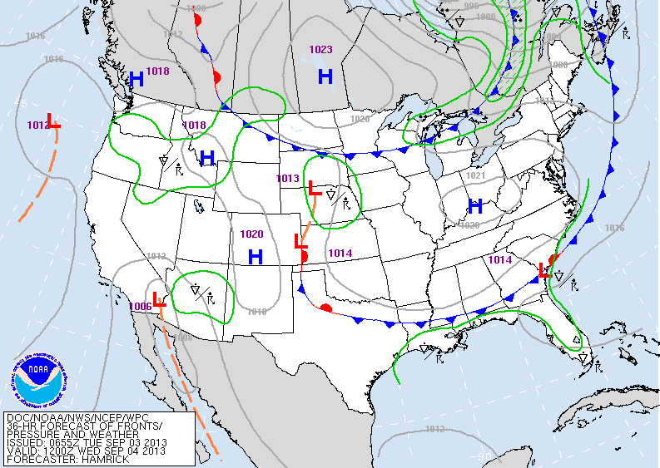
Notes:
Weak sfc front is expected to move slowly across the SE approaching the Gulf coast Wednesday morning.

Slide 7
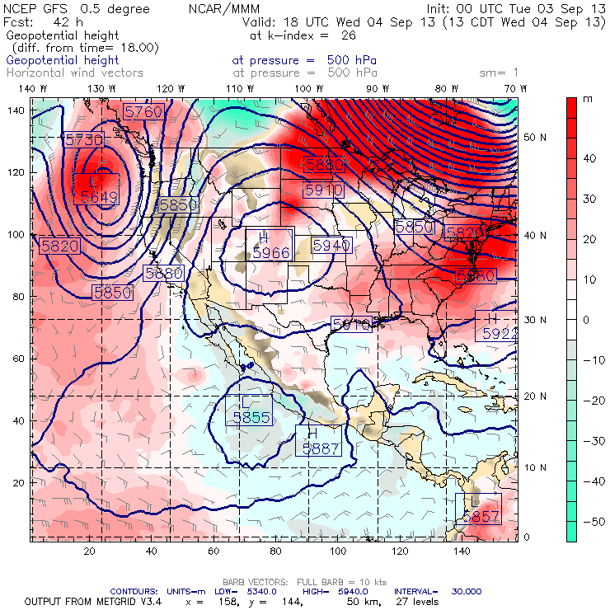
By 18z Wednesday the 500 mb high is anchored over Colorado with easterly flow over the western Gulf.
Red: 24-h height rises
Green: 24-h height falls

Slide 8
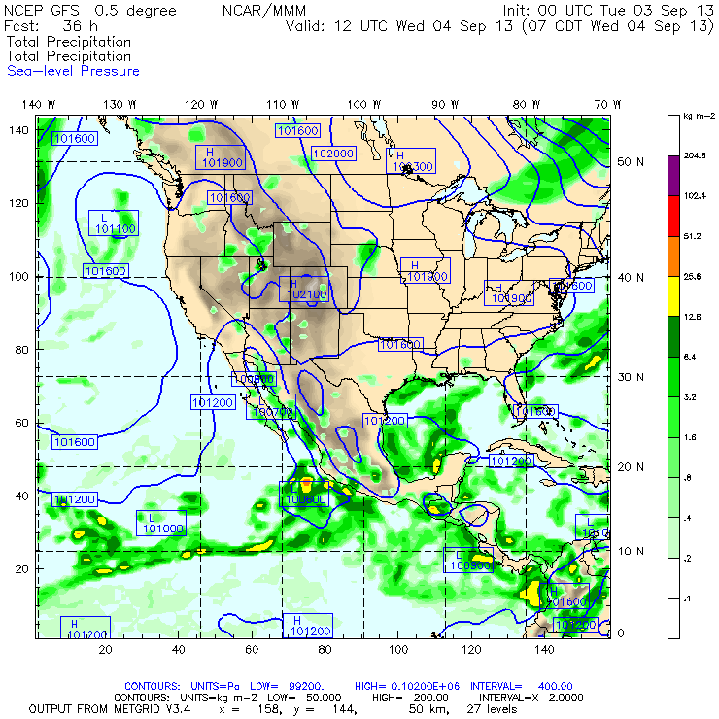
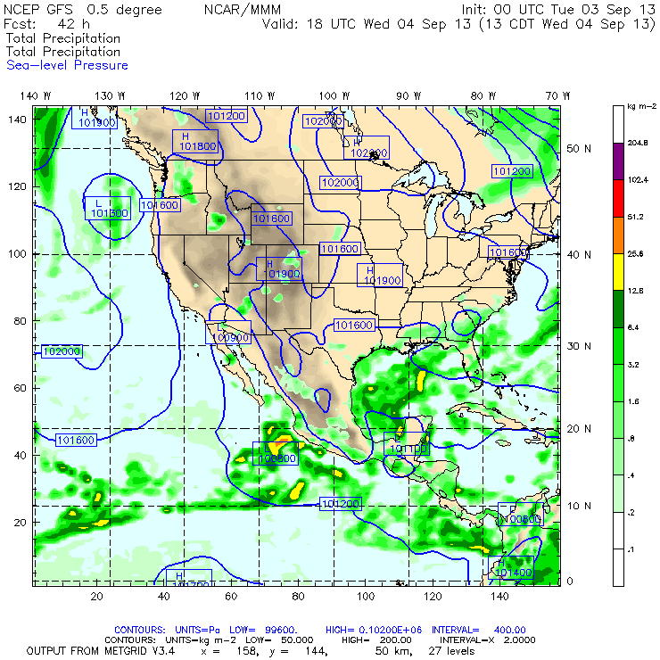
The GFS has a band of rain along the TX coast early Wednesday, decaying during the late morning while central Gulf convection intensifies.

Slide 9
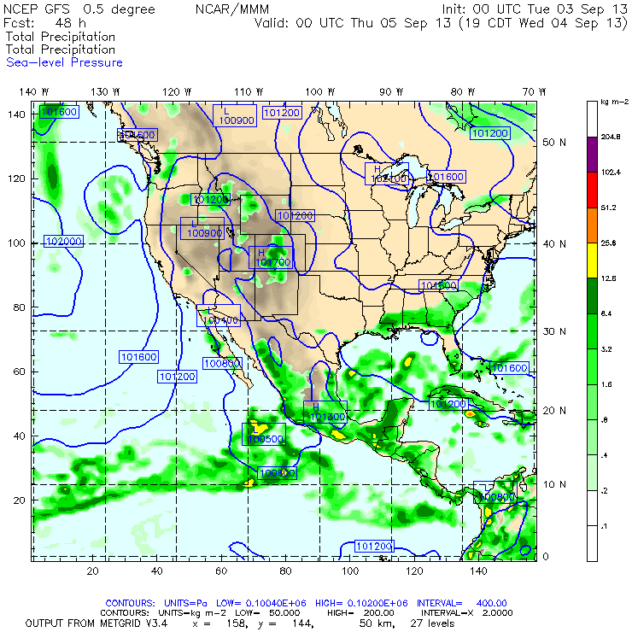
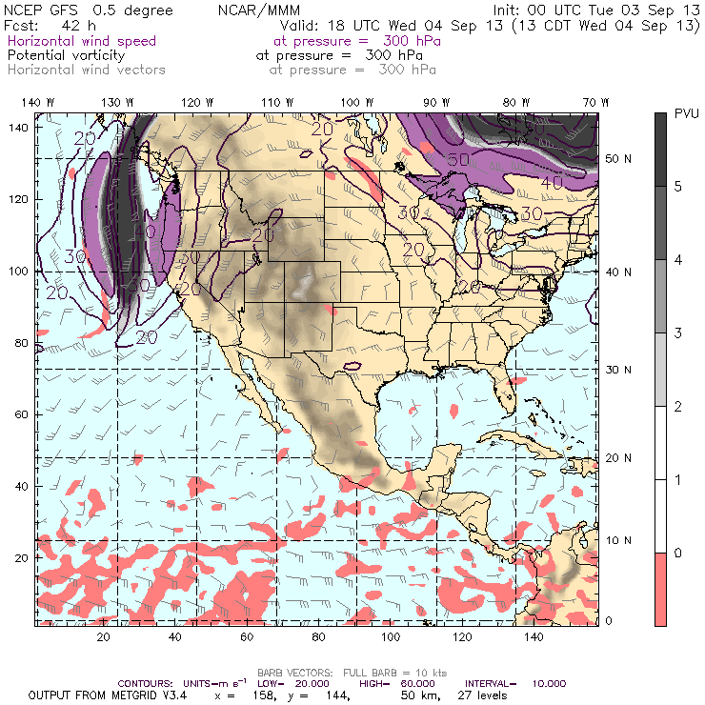
GFS convection decays during the afternoon. Upper tropospheric winds are easterly along the coast and variable across the central and southern Gulf with a cyclonic circulation in the SW Gulf.

Slide 10
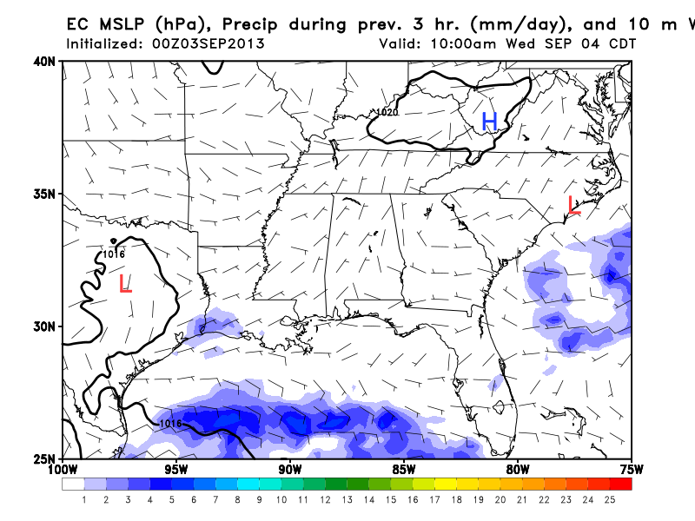
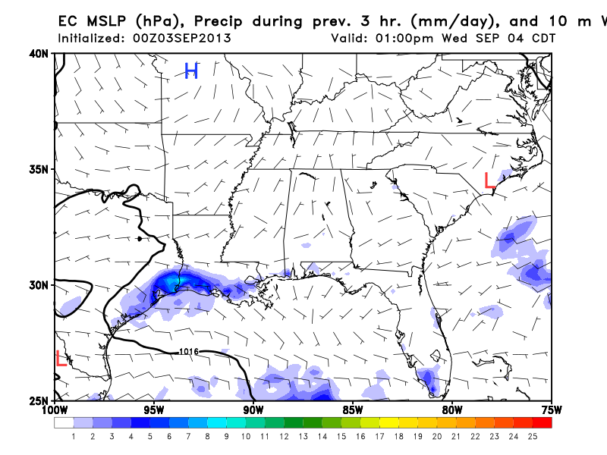
The EC places rain along the coast, mostly inland, concentrated along the TX/LA border.

Slide 11
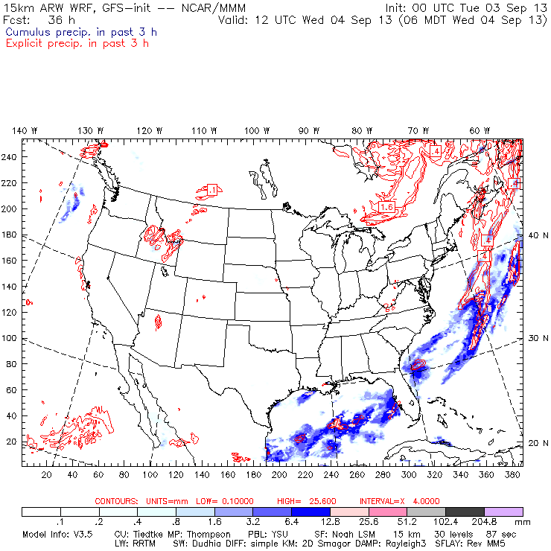
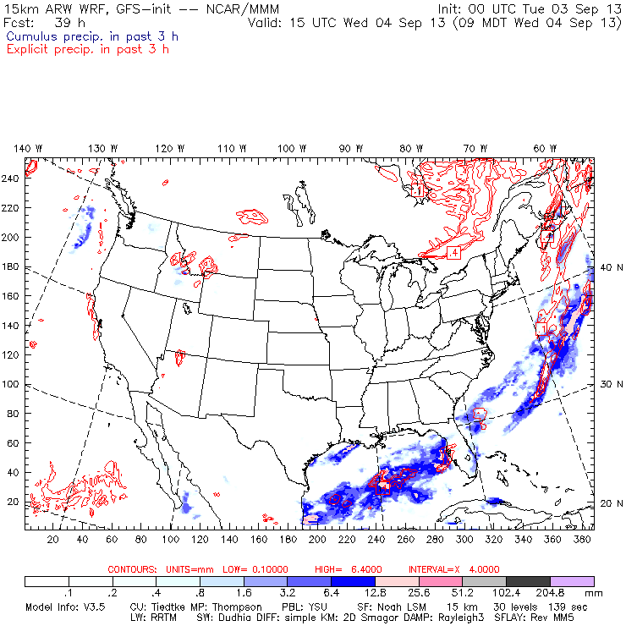
WRF-GFS shows convection in the central/southern Gulf and develops a band of convection from off Galveston to south of Lake Charles.
Blue: convective
Red: grid-resolved

Slide 12
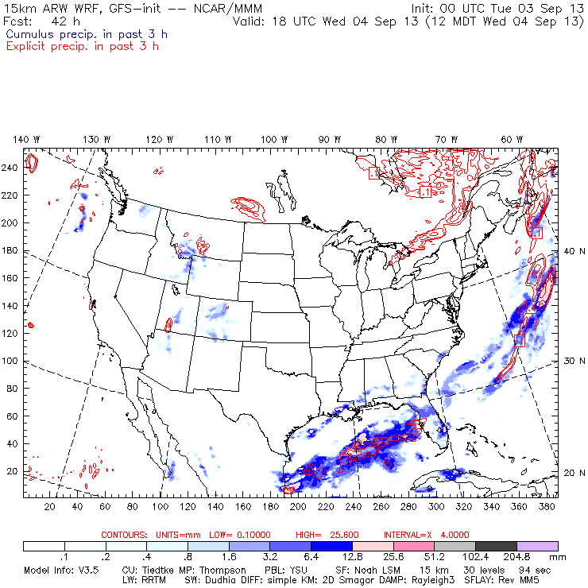
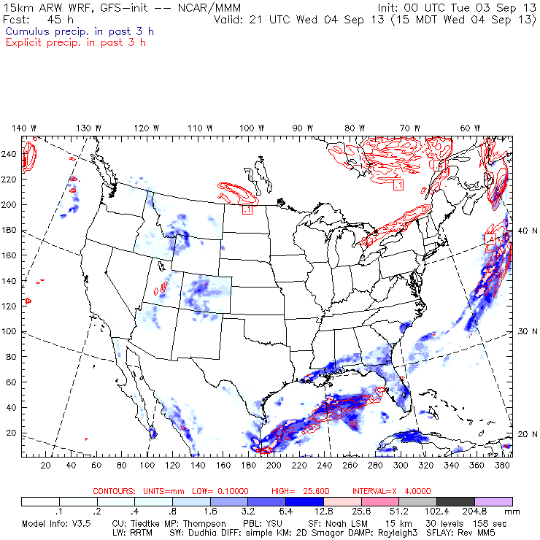
By afternoon WRF-GFS shows the convective band in the northern Gulf dissipating while the central Gulf convection weakens, but persists. Little to none is progged near EFD.
Blue: convective
Red: grid-resolved

Slide 13
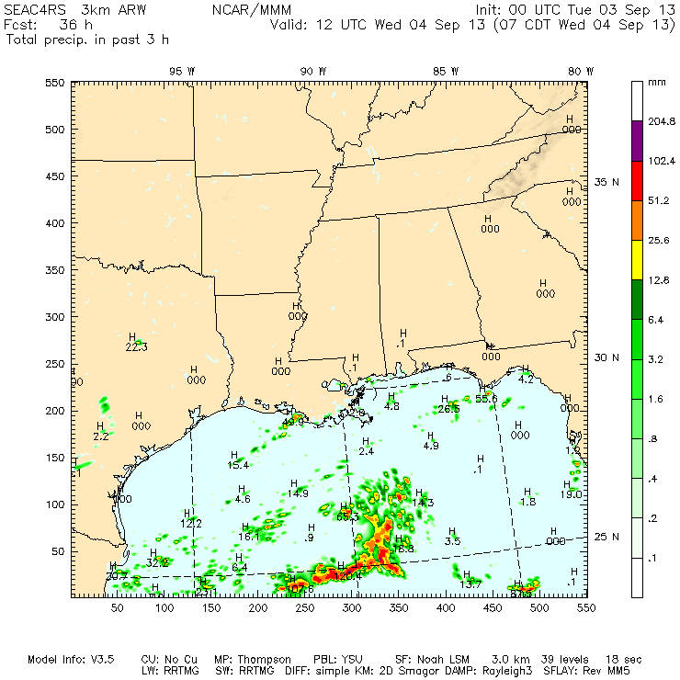
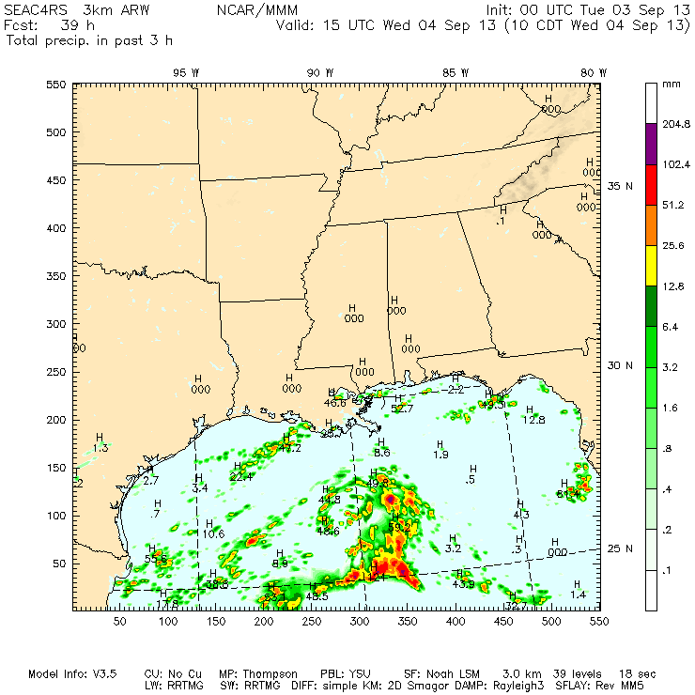
The 3-km WRF-NAM also develops a band of convection in the northern Gulf. More substantial precip is along 89 W.
Blue: convective
Red: grid-resolved

Slide 14
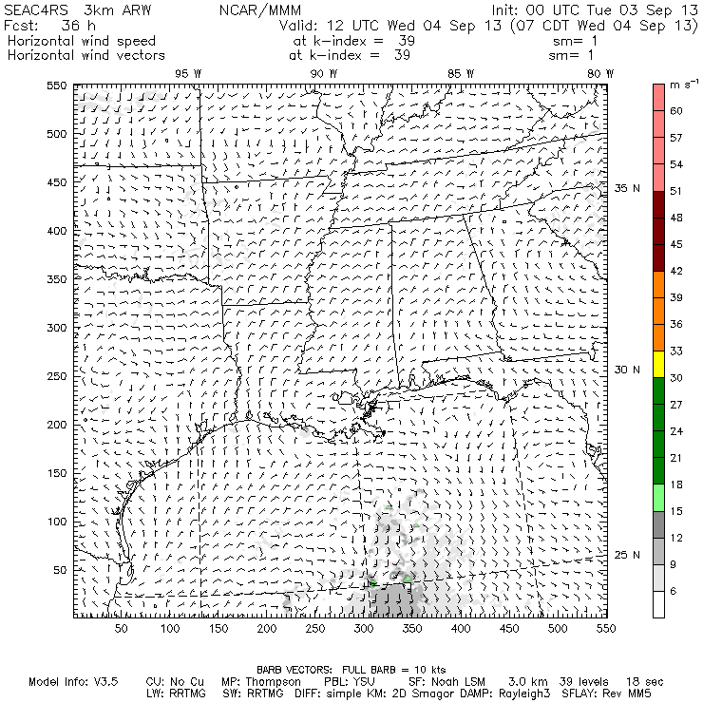
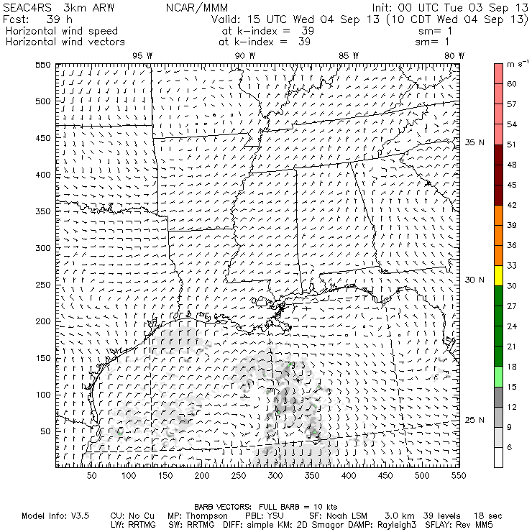
The convection develops along a convergence line where offshore northerlies collide with easterlies over the central Gulf.
Blue: convective
Red: grid-resolved

Slide 15
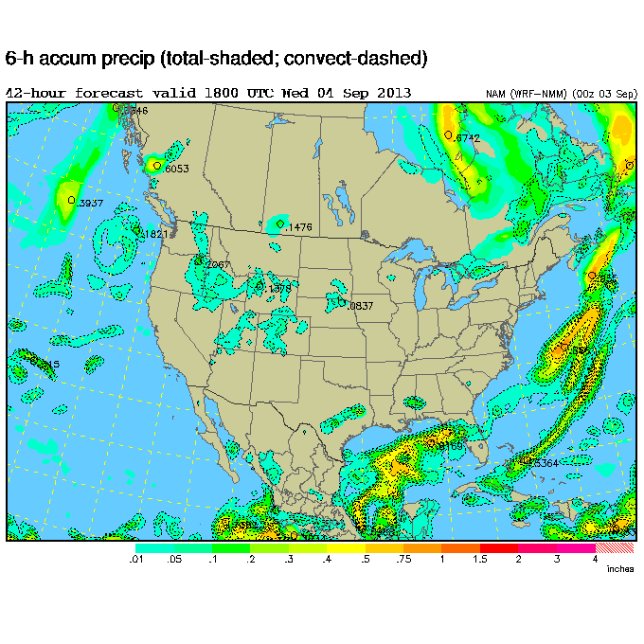
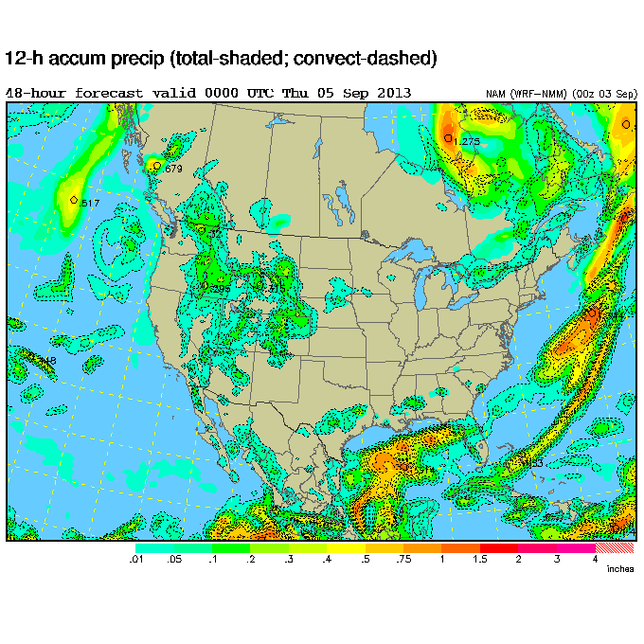
NAM is outlier, not producing a northern Gulf rainband Wednesday morning. It has considerable convection in the central Gulf and south of Grand Isle. Convection is progged across inland Texas with none near EFD.

Slide 16
NAM (the other NAM) prospects

Slide 17
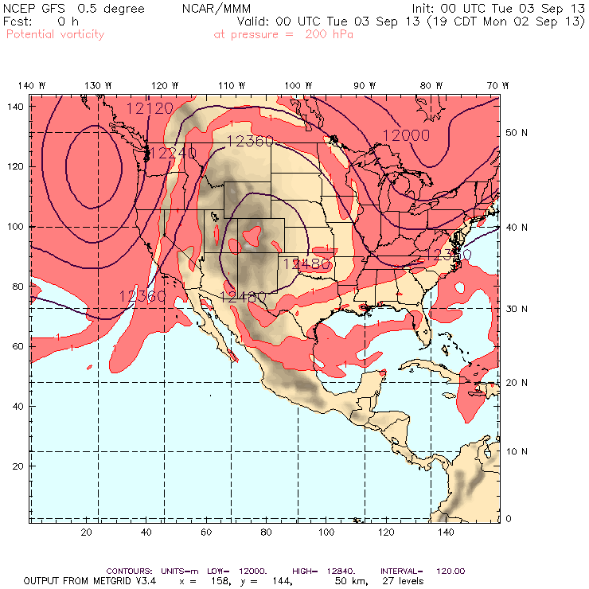
The anticyclone’s extent is peaking today before the trough begins to erode the northern periphery.

Slide 18
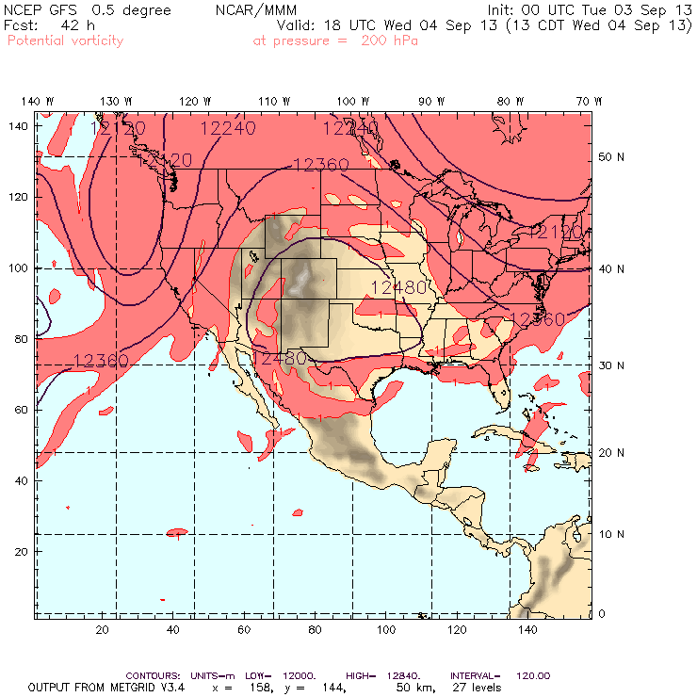
By Wednesday the northern edge of the a-c has moved south.
The southern edge of the circulation is overhead EFD and the northern edge is reachable in eastern Nebraska.

Slide 19
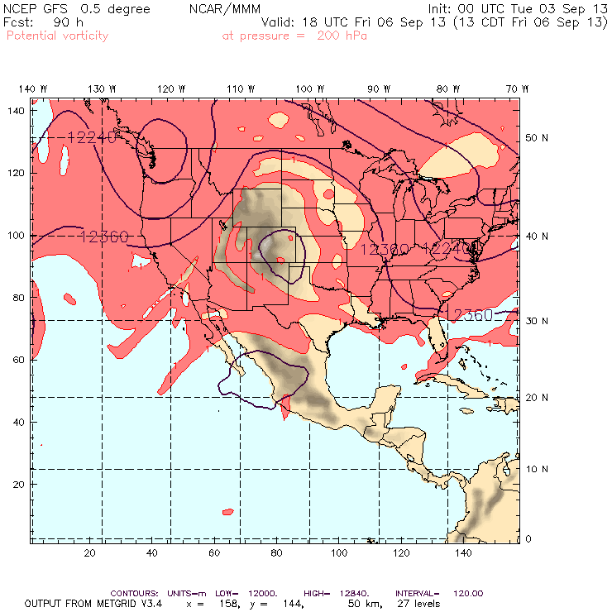
By Friday, the anticyclone continues to decay as troughs attack the western and eastern sides.

Slide 20
SEUS Chemistry prospects

Slide 21
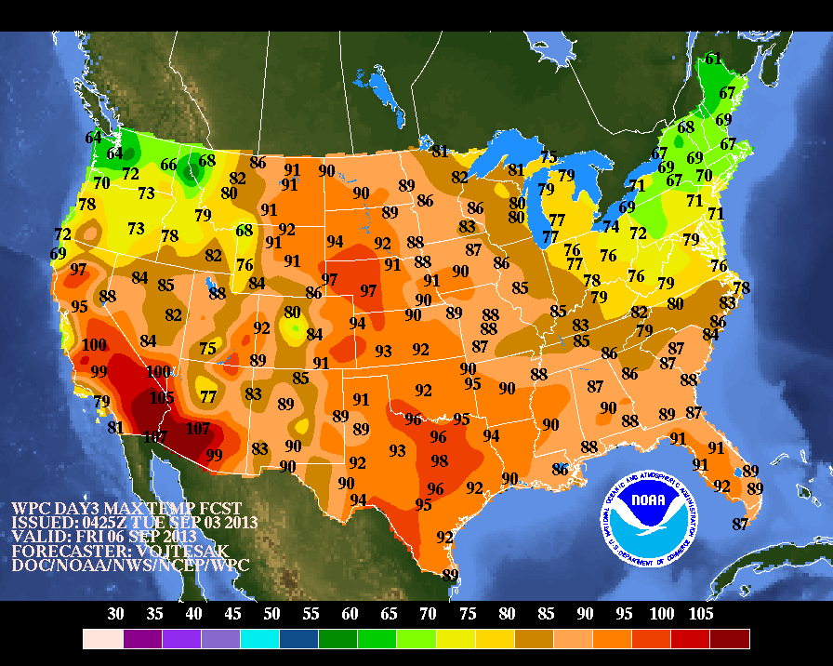
Notes:
Friday max temps.

Slide 22
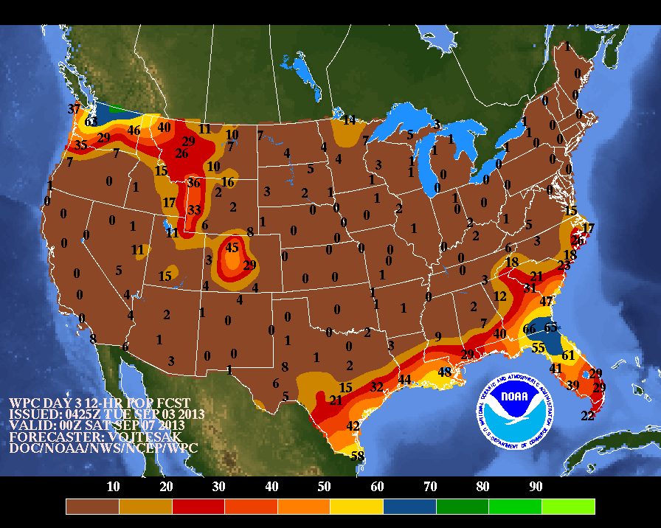
Notes:
Friday max temps.

Slide 23
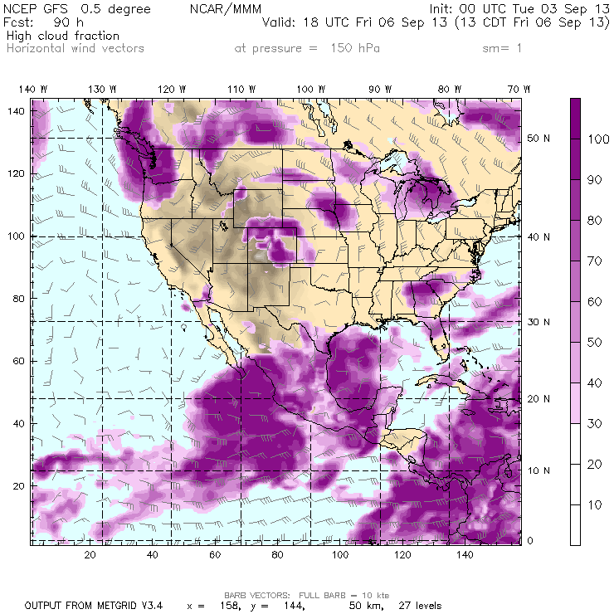
GFS high cloud fraction shows less than 30% coverage over the Mississippi Valley.
High clouds likely over the western Gulf and GA.
Notes:
Friday max temps.

Slide 24
MCS prospects:
Nil south of Nebraska

Slide 25
Ellington forecast

Slide 26
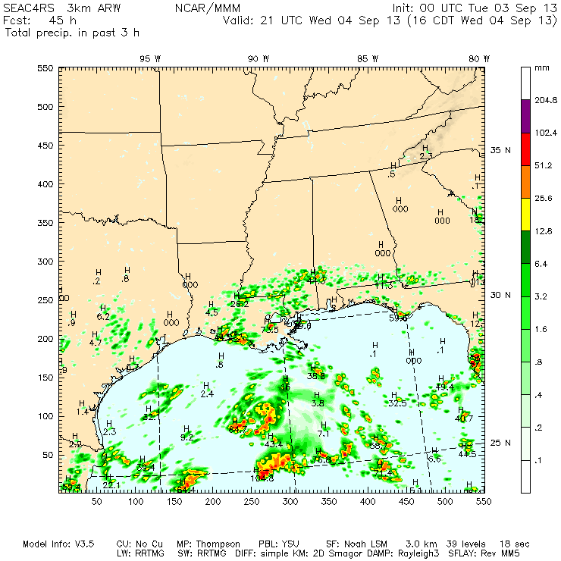
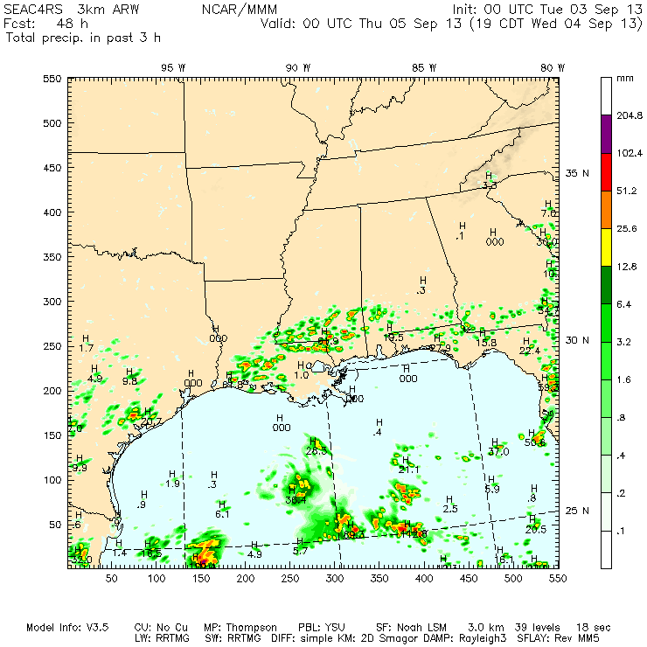
3-km WRF shows some precip developing near EFD before 4 PM Wednesday, but not lasting long. It would be prudent to avoid landing during a 3:30 to 6:00 PM window.

Slide 27
Summary
The stable large-scale pattern over the CONUS begins to decay later this weak.
Anti-cyclone remains over Colorado, but weakens by Friday.
Gulf convection is likely with highest prospects along 89 W.
Surface front will act as focus for convection over SEUS.

