Slide 1
Weather discussion
2 September 2013
Jim Bresch NCAR/MMM
and the SEAC4RS Met team
Overview: The large-scale weather pattern remains stable over most of the U.S. with weak forcing and flow over the southern states.
Forecast issues are:
Existence, timing, and location of Gulf convection
Convective prospects over the SEUS
Weather at Ellington
Friday outlook

Slide 2
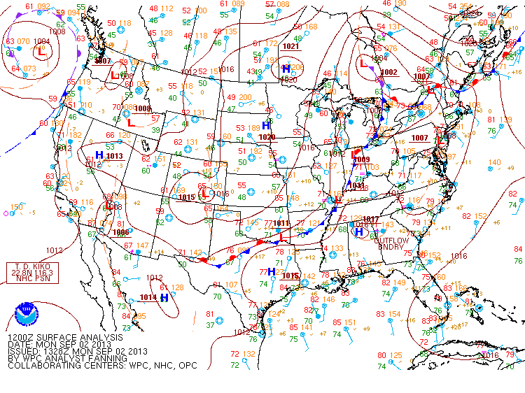
Notes:
Surface cold front triggering convection ahead of it from central TX to northern GA. Generally southerly anti-cyclonic sfc flow over the Gulf.

Slide 3
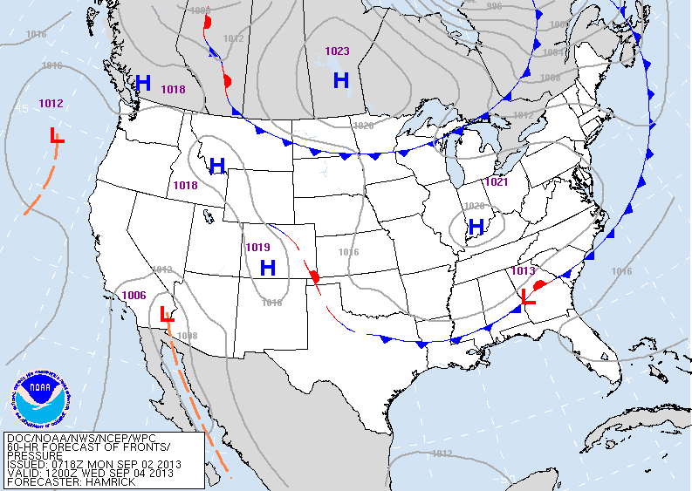
Notes:
Weak sfc front is expected to move slowly across the SE approaching the Gulf coast Wednesday morning.

Slide 4
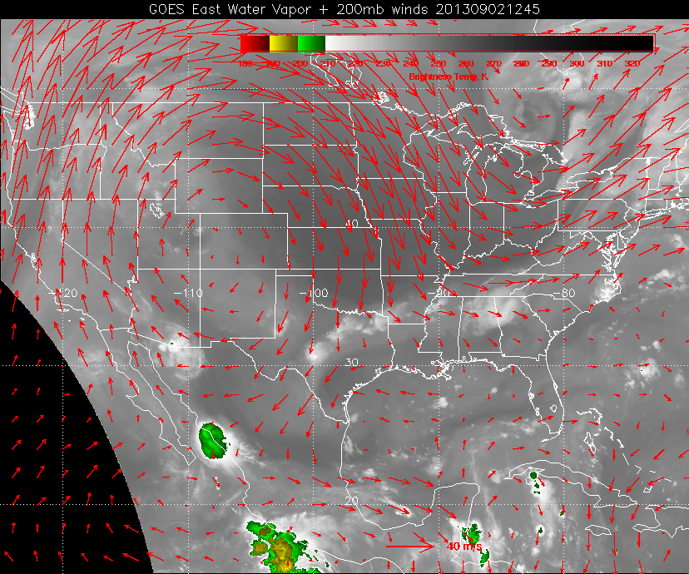
Notes:
Upper high is anchored over Colorado. Trough across great lakes is pushing the cold front across the E US. 200 mb flow is weak and divergent over the SEUS. Weak flow over the gulf.

Slide 5
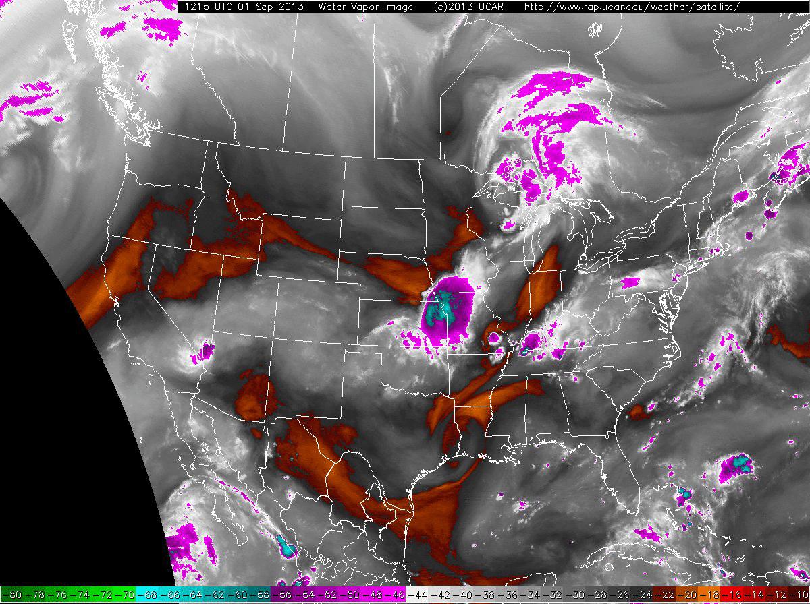

Slide 6
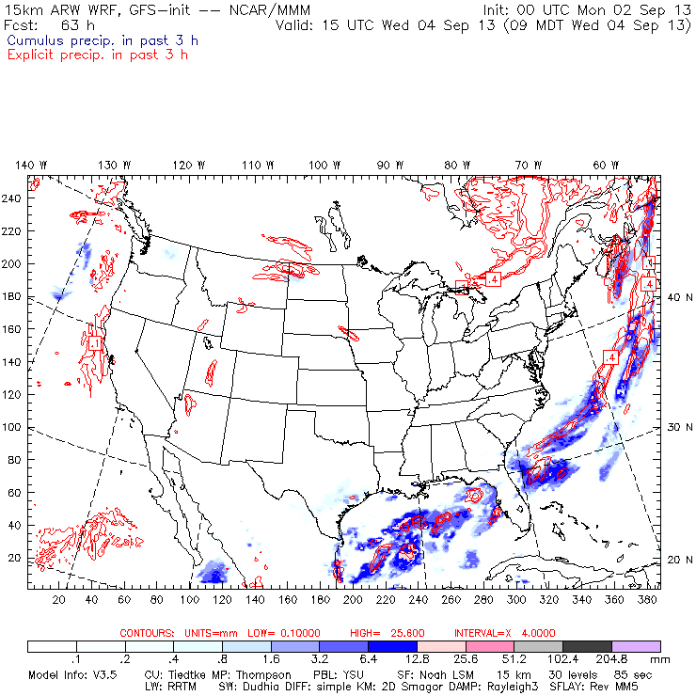
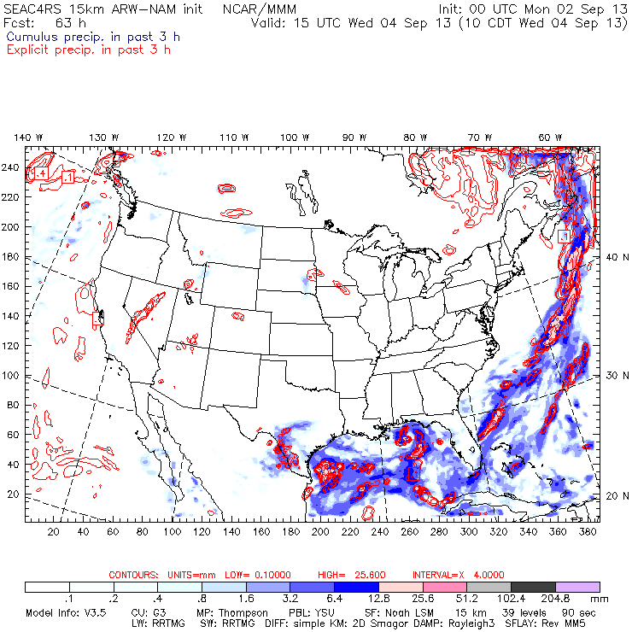
Mesoscale models show good potential for Gulf convection Wednesday morning, although location is inconsistent.
Blue: convective
Red: grid-resolved

Slide 7
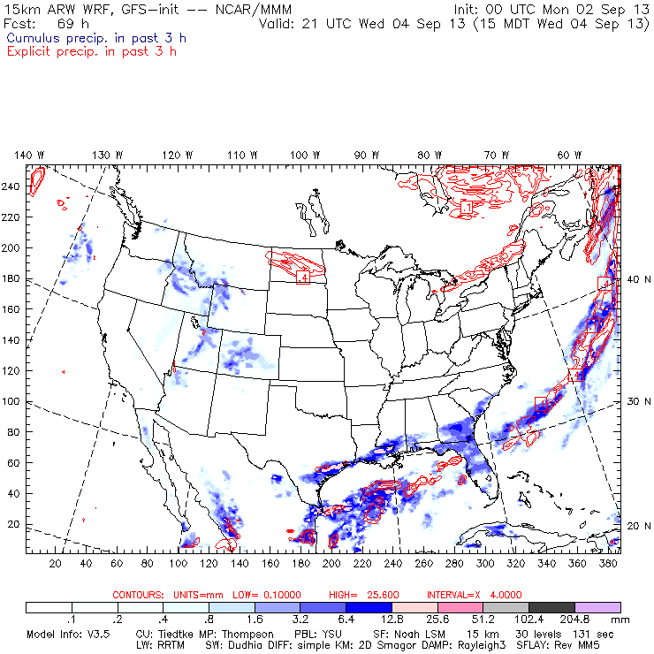
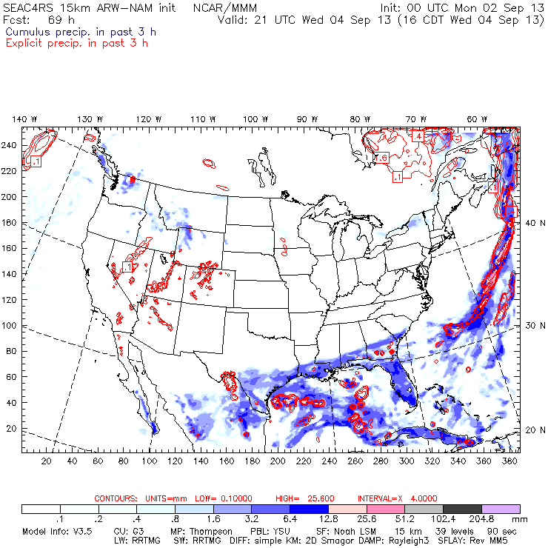
By Wed. afternoon both WRF runs show convection developing along the front near EFD. Again, the NAM-init places Gulf convection farther north.
Blue: convective
Red: grid-resolved

Slide 8
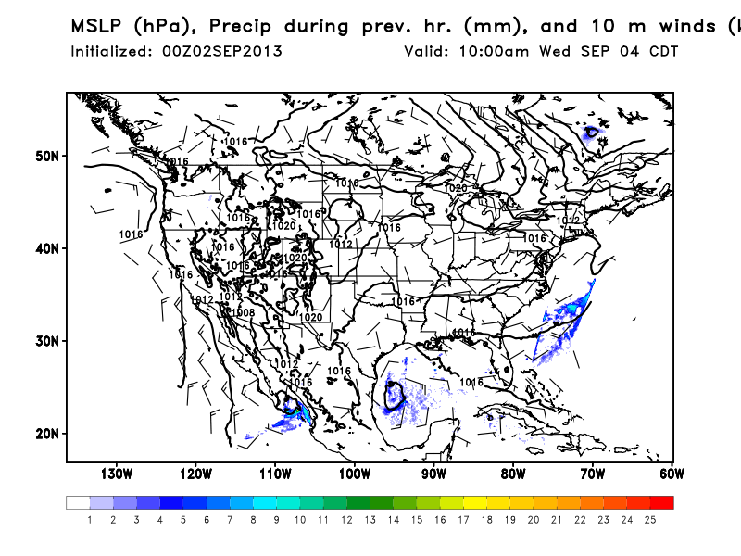
FSU WRF even spins up a surface circulation by Wed. morning in the western Gulf.

Slide 9
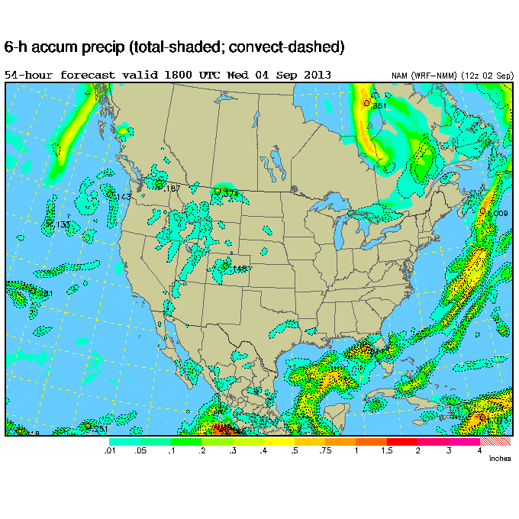
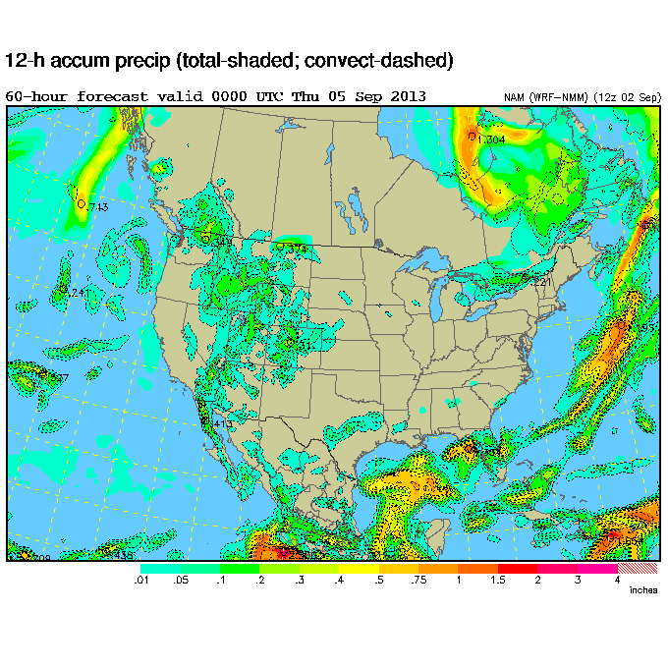
NAM produces convection over the central Gulf with EFD precip-free.

Slide 10
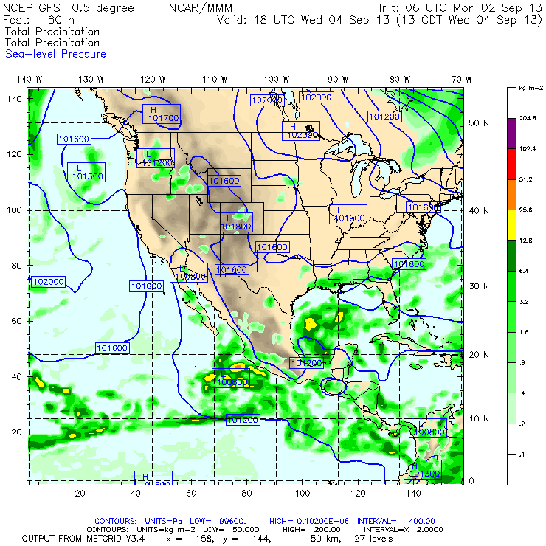
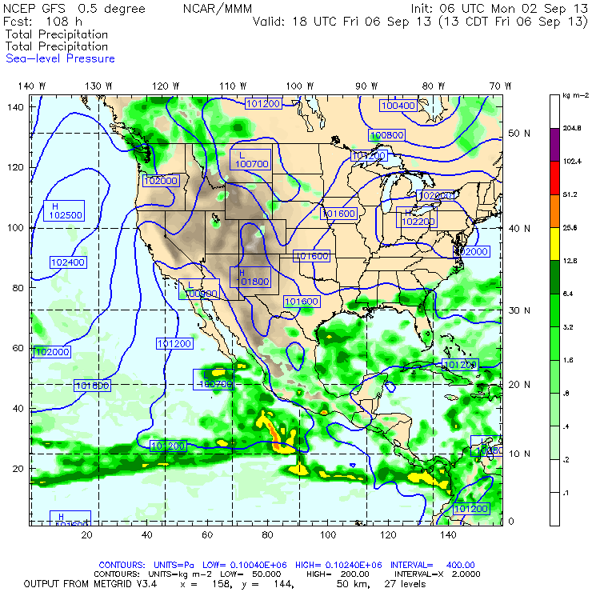
GFS shows precip further offshore on Wednesday (left) than on Friday (right).

Slide 11
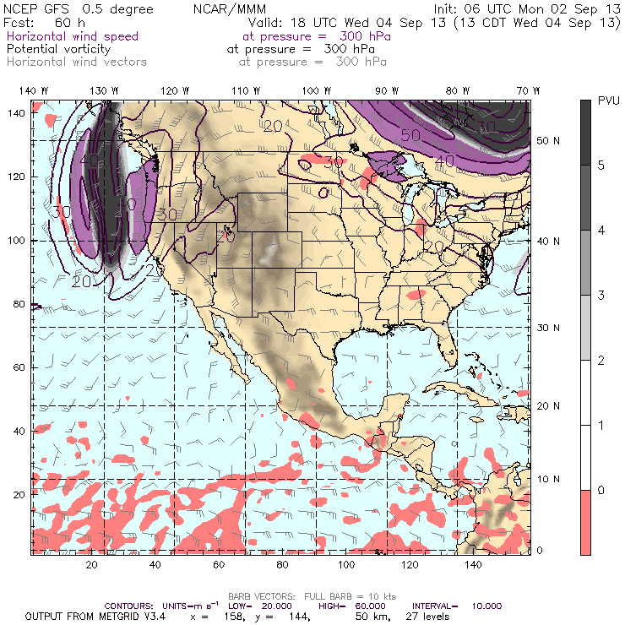
Surface winds in the Gulf will be easterly at about 10 kts with very little vertical shear. 300 mb flow is only 15 kts suggesting very little anvil propagation.

Slide 12
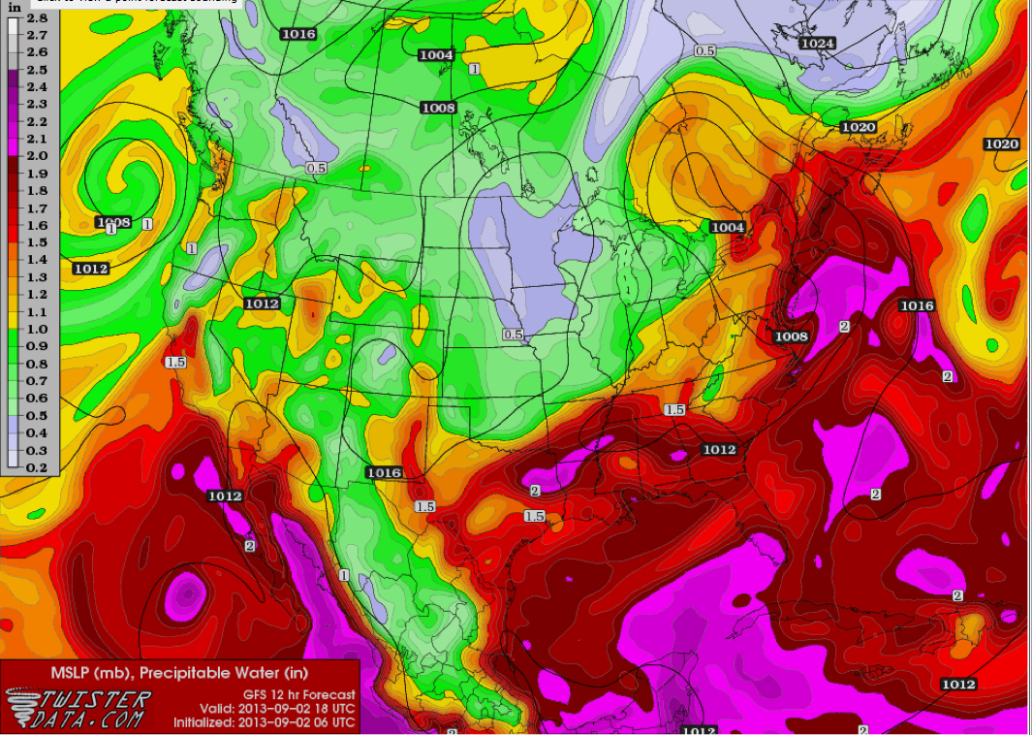

Slide 13
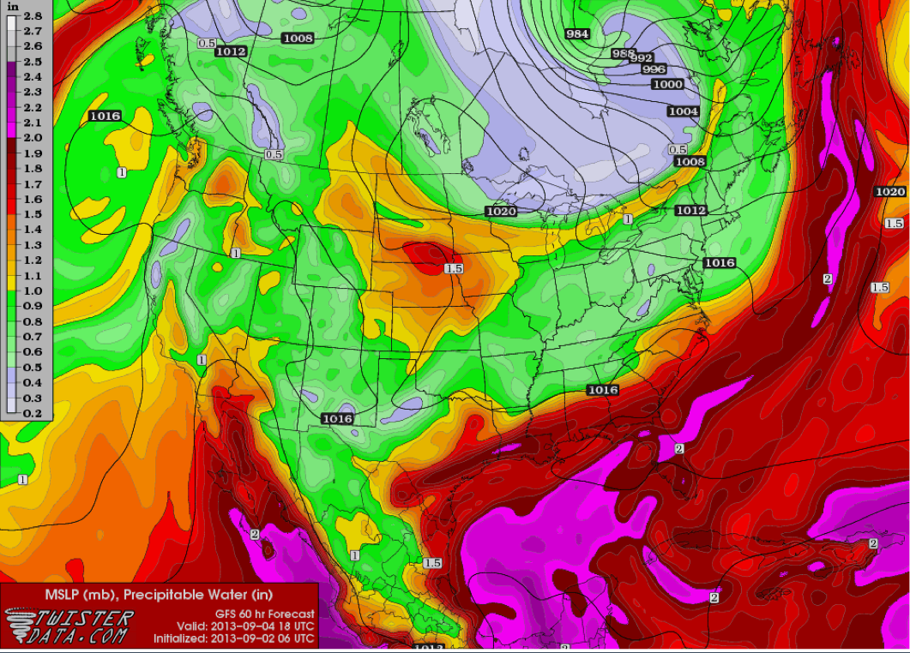

Slide 14
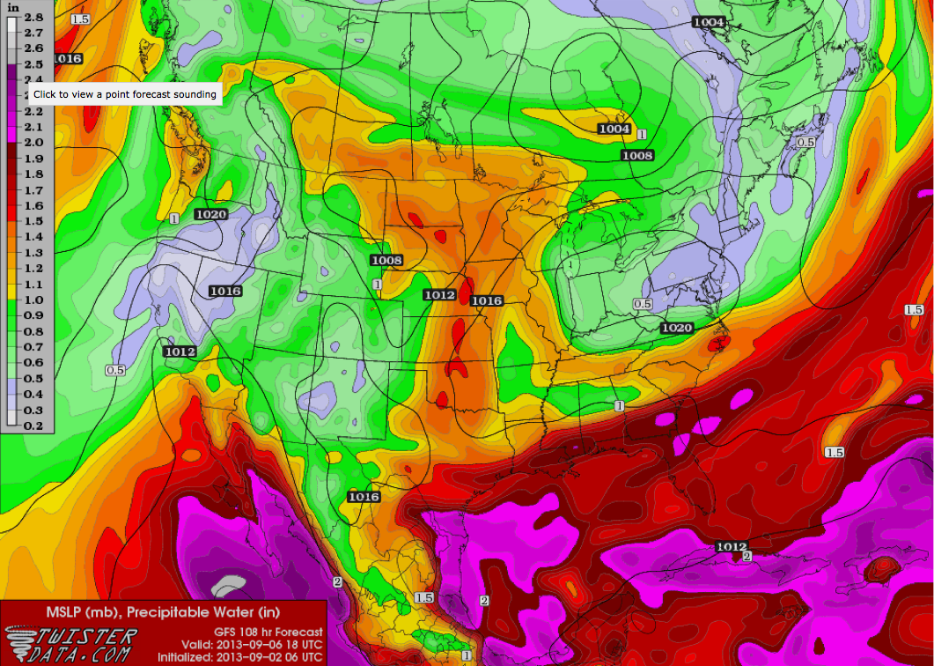

Slide 15
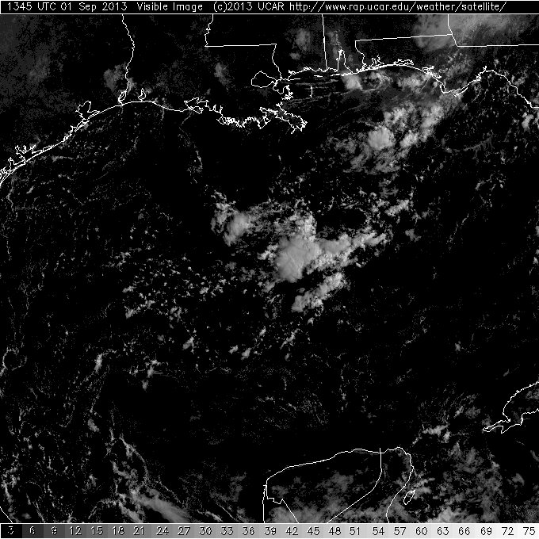
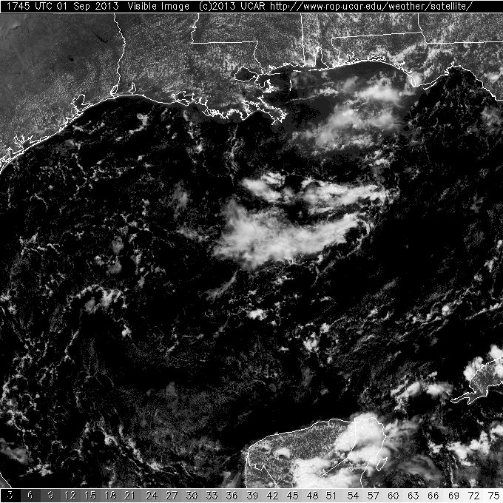
14z
18z
Convection on Sunday was located over the central Gulf with small, isolated cells south of Lake Charles.

Slide 16
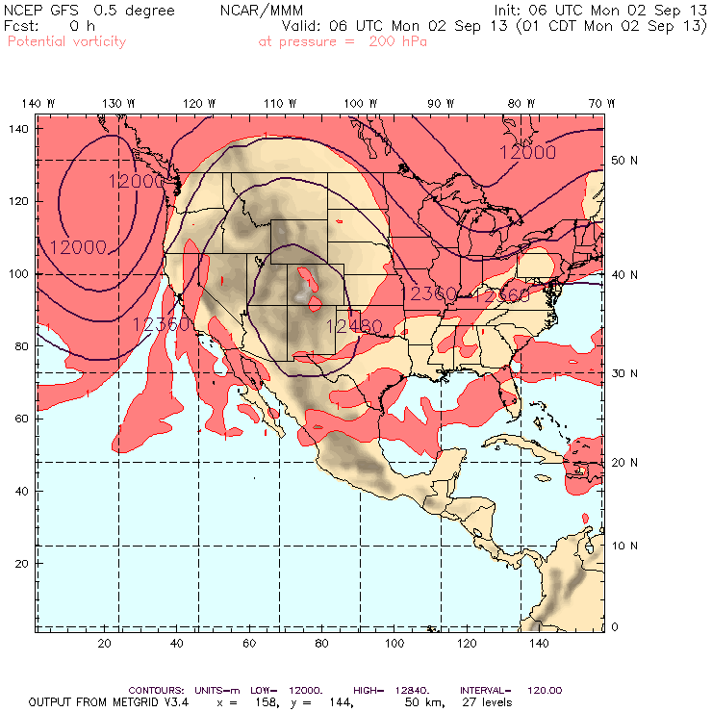
The anticyclone is currently well-established, extending into southern Canada.

Slide 17
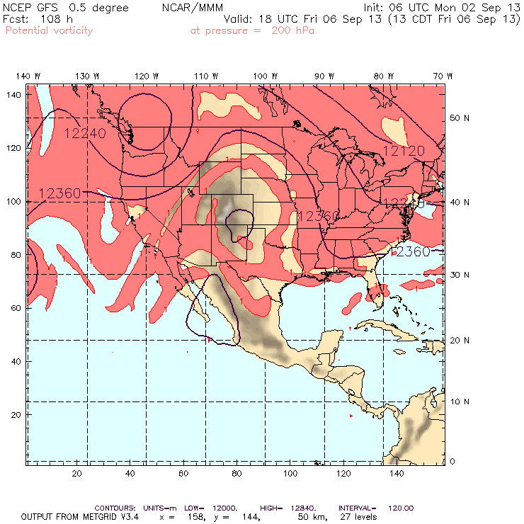
By Friday, the anticyclone has weakened.

Slide 18
Ellington forecast

Slide 19
By Wed. afternoon both WRF runs show convection developing along the front near EFD. Again, the NAM-init places Gulf convection farther north.
Blue: convective
Red: grid-resolved

Slide 20
Summary
Stable large-scale pattern over CONUS is expected to continue this week.
Anti-cyclone remains over Colorado, but weakens by Friday.
No strong forcing over the Gulf.
Surface front will act as focus for convection over SEUS
Placement of front will affect EFD weather.

