Slide 1
Weather discussion
15 August 2013
Jim Bresch NCAR/MMM
and the SEAC4RS Met team
Overview: Anticyclone over extreme southern Arizona is progged to wobble around the desert. Evening convection over MX and AZ detrains over southern AZ, NM, and west TX.
Forecast issues are:
Anti-cyclone and U-T flow over western U.S.
High cloudiness over OK
Potential for severe convection near flight track
Ellington weather
Tropical depression

Slide 2
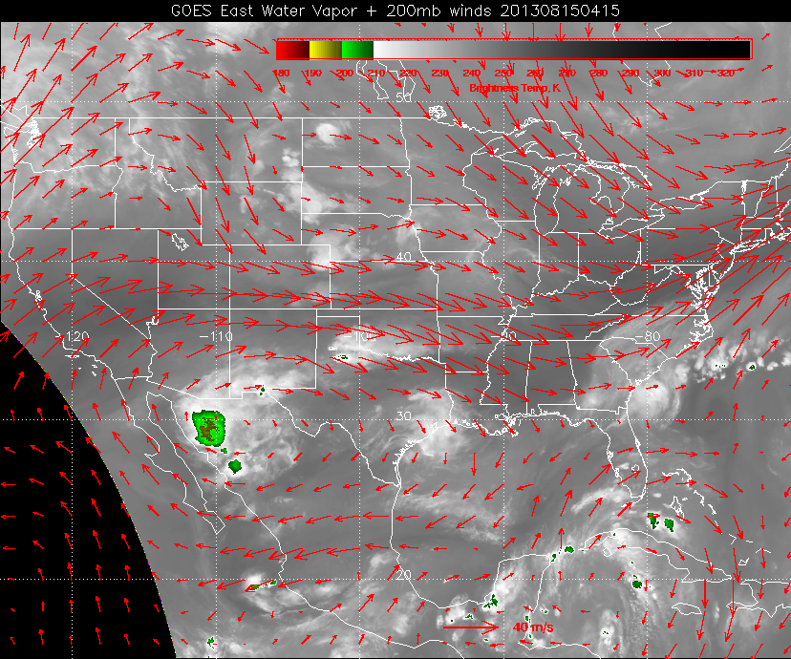

Slide 3
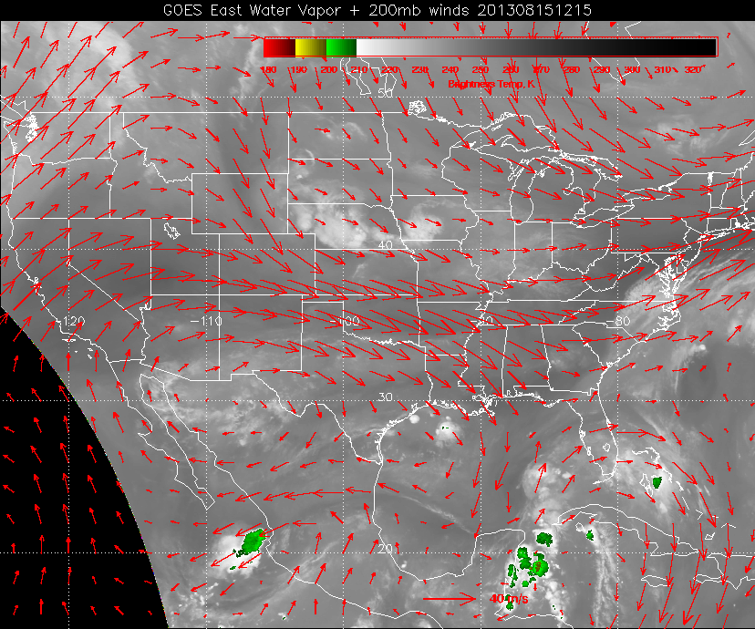

Slide 4
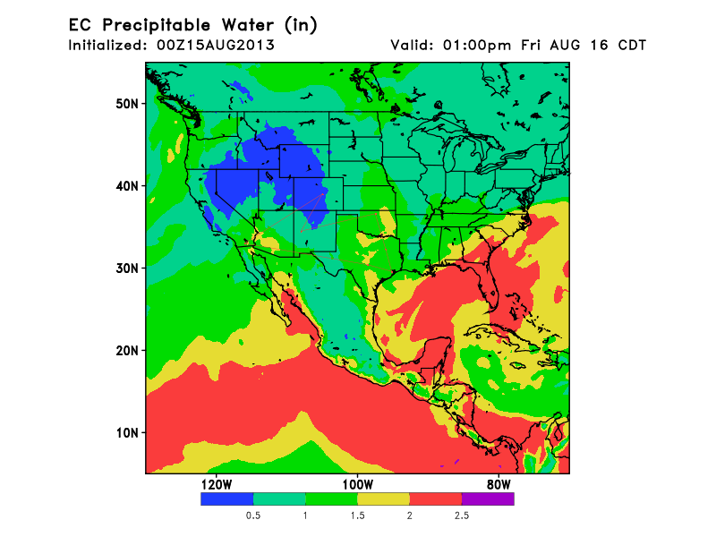

Slide 5
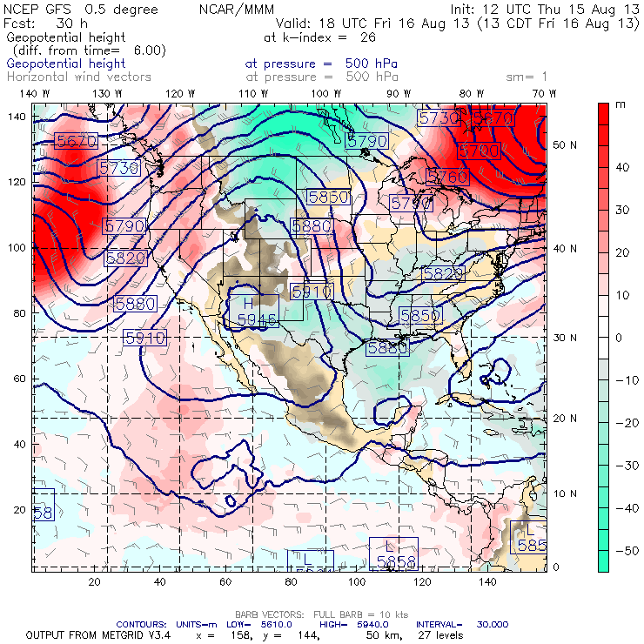
500 hPa anticyclone over AZ with a sharp trough off the west coast and a short wave moving south across the Great Plains.
A closed circulation emerges off the west coast of Yucatan.

Slide 6
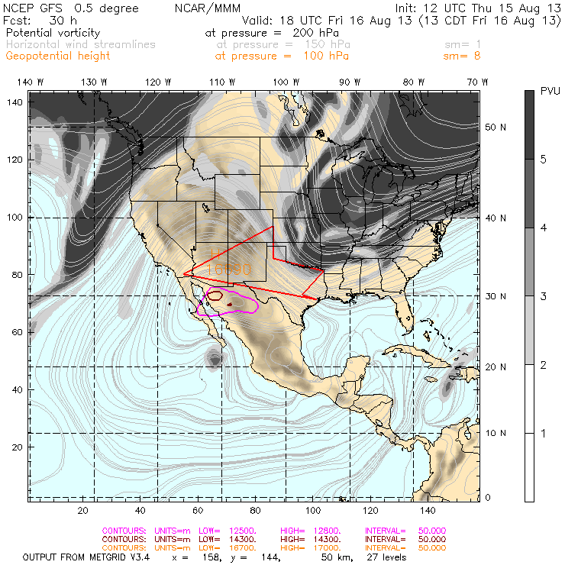
200 mb PV
150 mb streamlines
A-C centered south of Tucson, AZ. Monsoon outflow confined over a very small area mostly over Mexico, but also over southern AZ, NM and west TX.

Slide 7
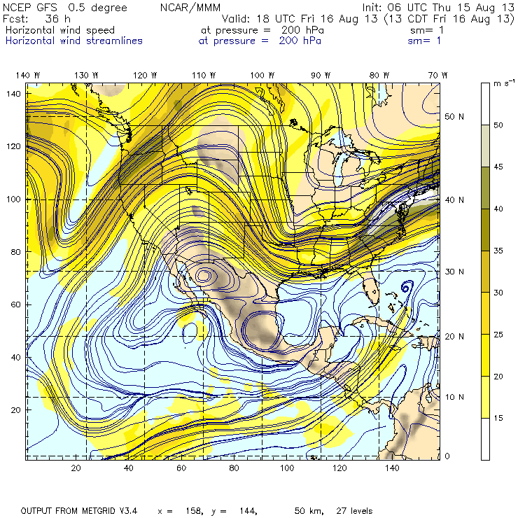
200 mb circulation center over northern MX. Closed circulation is quite confined.

Slide 8
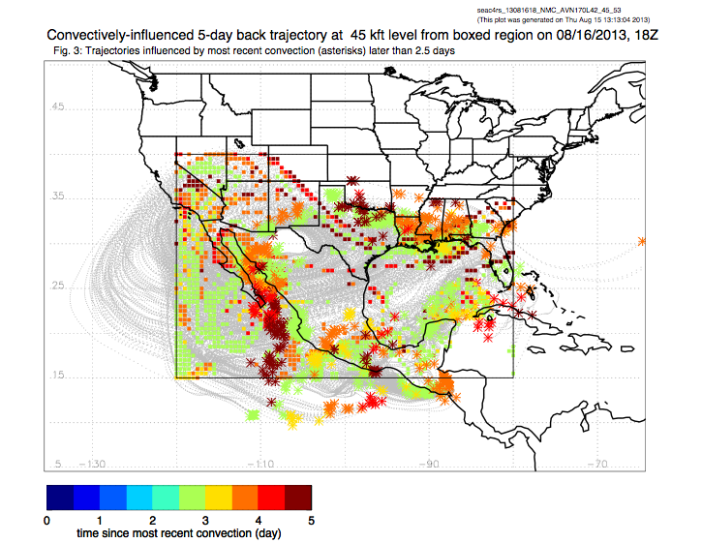

Slide 9
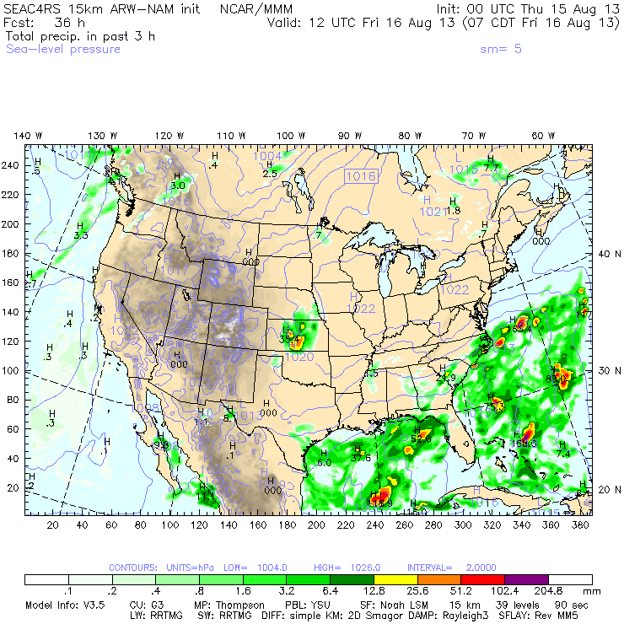
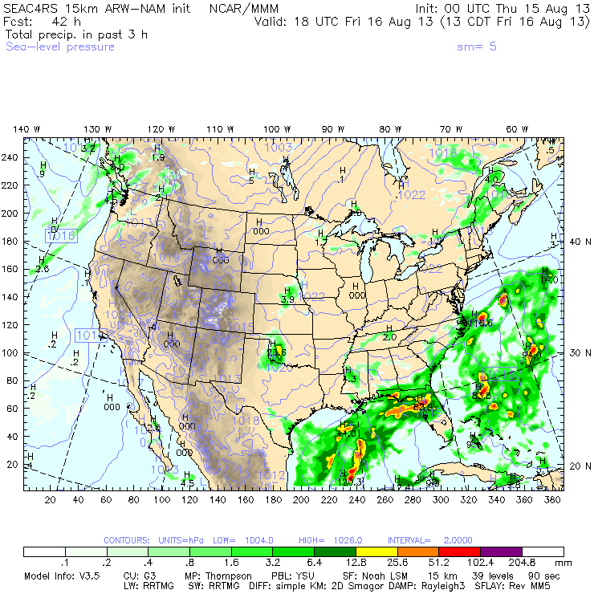
Overnight MCS moves south across KS/OK during day on Friday. NAM predicts clearing by 00z. SPC expects convection to regenerate during Friday afternoon. Possible severe storms over E NM/ W TX.

Slide 10
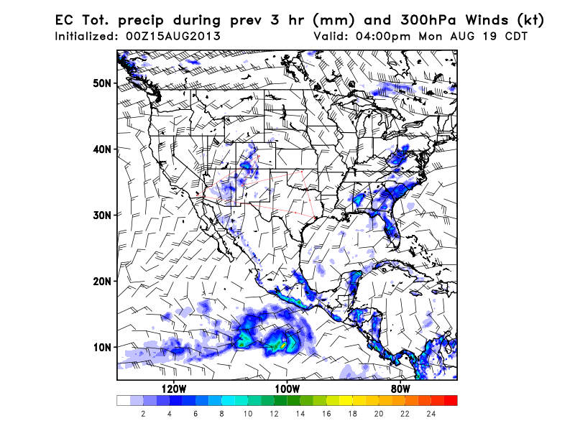
For Monday, the EC maintains ridge over central U.S. and trough in the east. Monsoon convection over the plateau and rains in the SEUS.

Slide 11
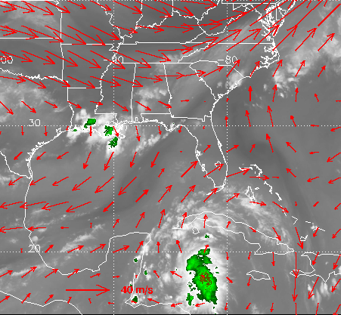
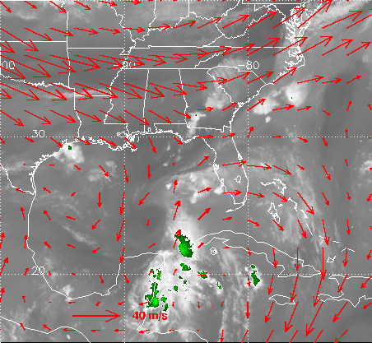
Yesterday, 1 PM
Today, noon
Convection has declined as the system as interacted with the Yucatan peninsula. Disturbance forming along shear line in east central Gulf. Vertical shear will increase as the system enters the Gulf of Mexico late tomorrow.

Slide 12
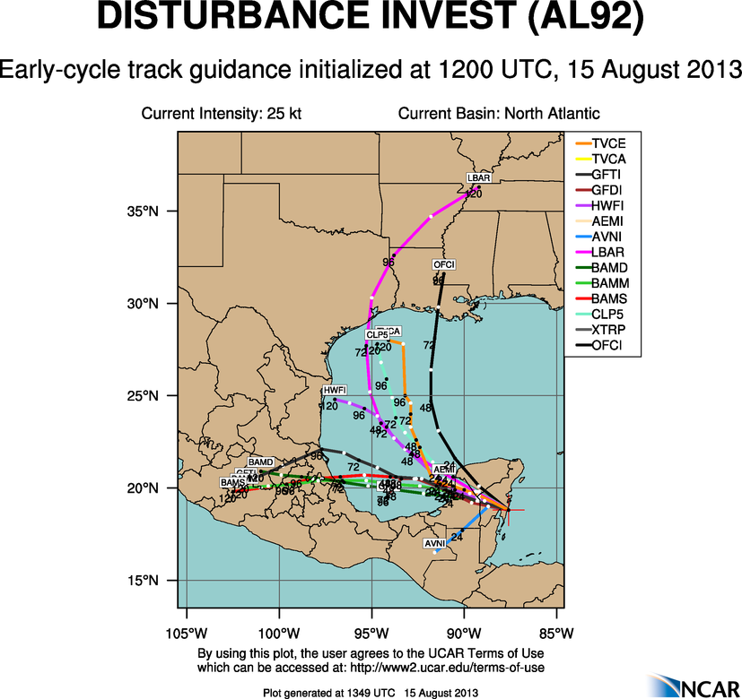
Majority of tracks head into Mexico before Monday. One makes a bee-line to Ellington. Large spread.

Slide 13
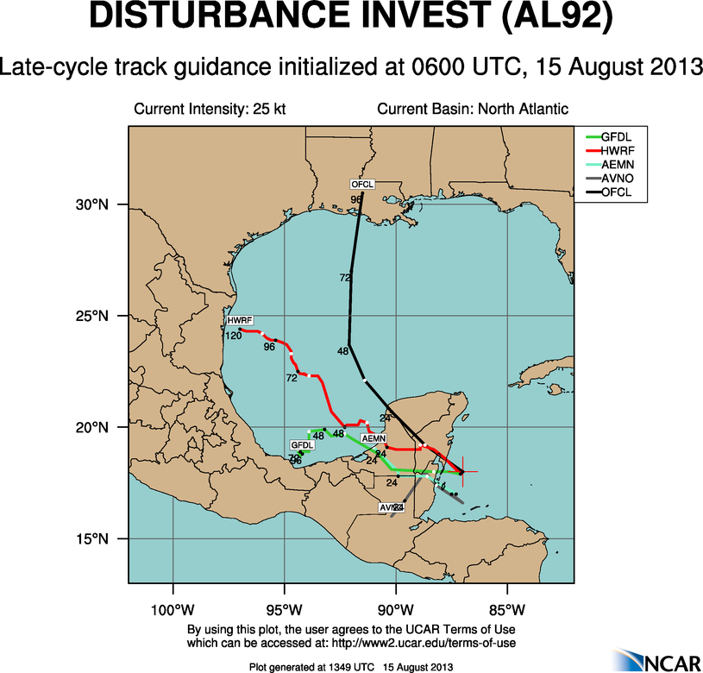

Slide 14
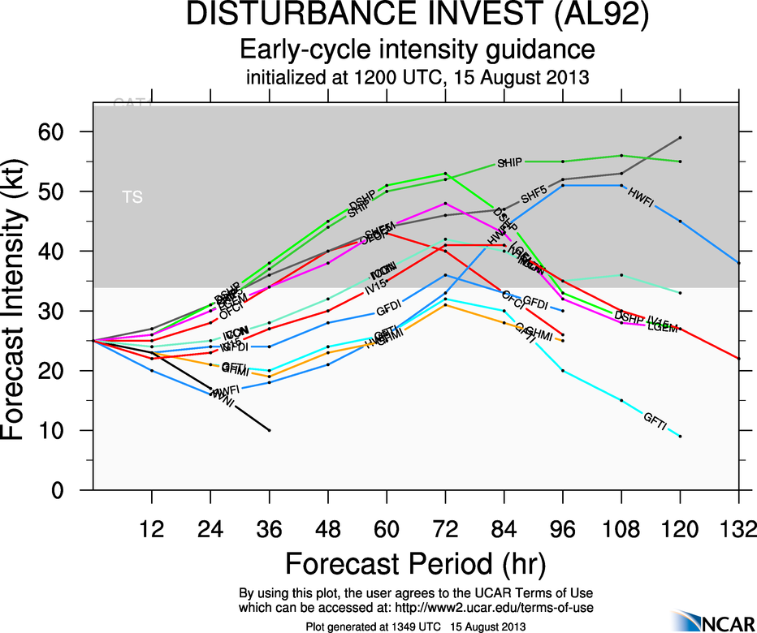

Slide 15
Summary
Anticyclone remains over desert SW / northern Mexico.
Convective outflow expected over extreme southern AZ/NM
Tropical system in the Gulf is not developed by the global models.
Cold front has moved offshore and should be south of EFD for takeoff tomorrow. Showers continue north of the front, but should be south of EFD at takeoff time. Scattered afternoon thunderstorms for arrival.

