Slide 1
Weather discussion
14 August 2013
Jim Bresch NCAR/MMM
and the SEAC4RS Met team
Overview: North American weather has been dominated by an omega-blocking pattern with strong troughs over the northeast and off the west coast. Over the next several days the pattern is expected to de-amplify.
Forecast issues are:
Forecast for Ellington today, Friday and Saturday
Anti-cyclone and U-T flow for NAM and smoke
High cloud
Tropical depression

Slide 2
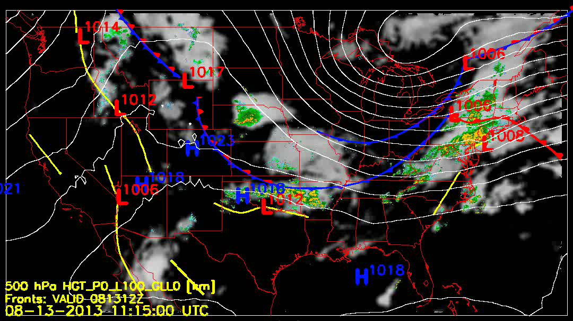

Slide 3
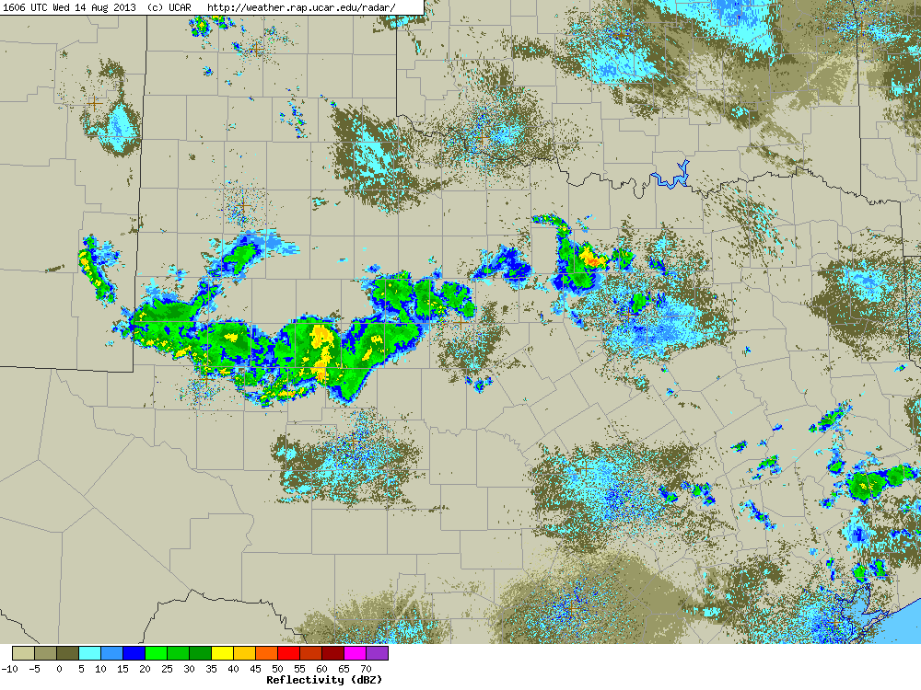

Slide 4
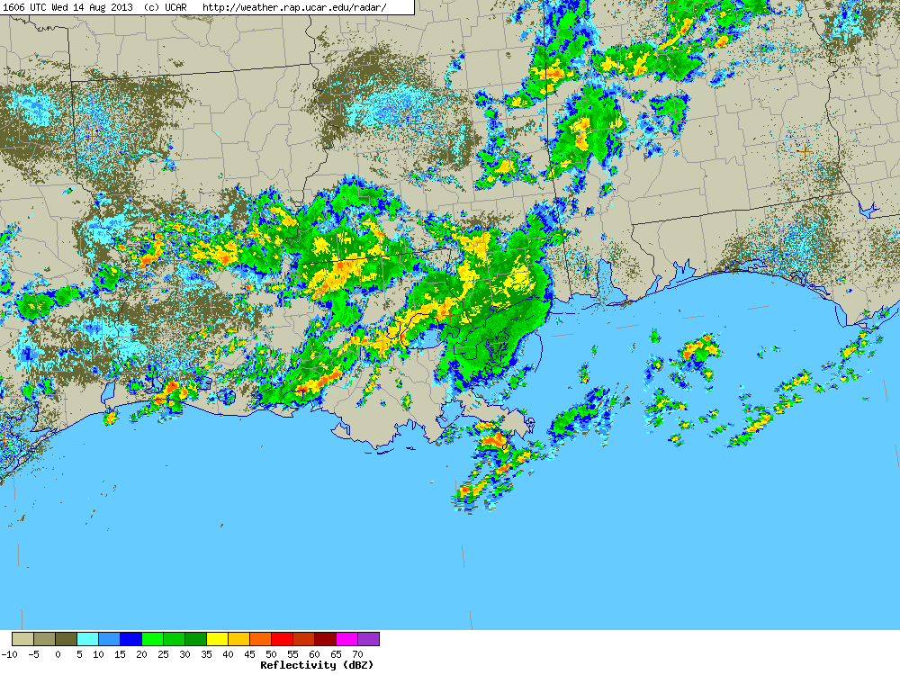

Slide 5
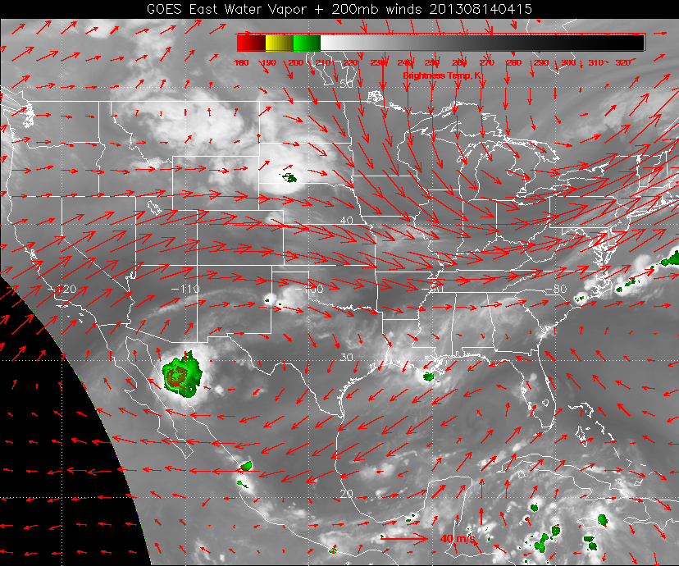

Slide 6
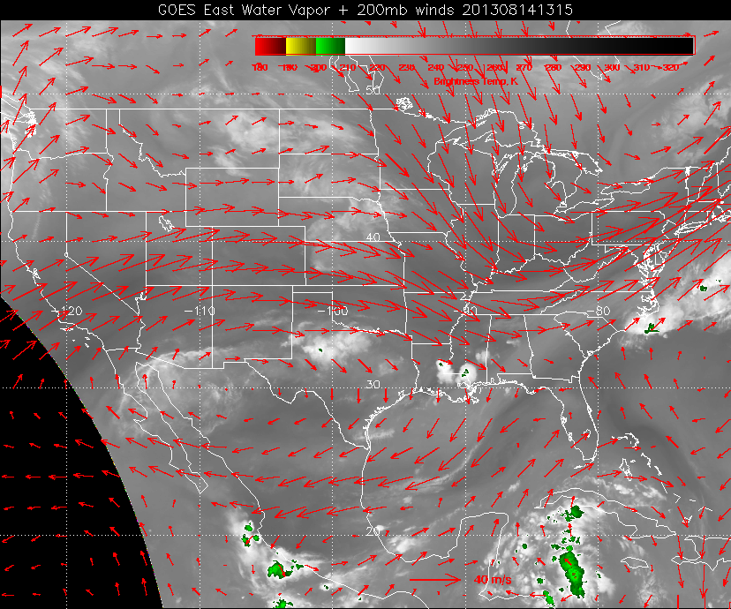

Slide 7
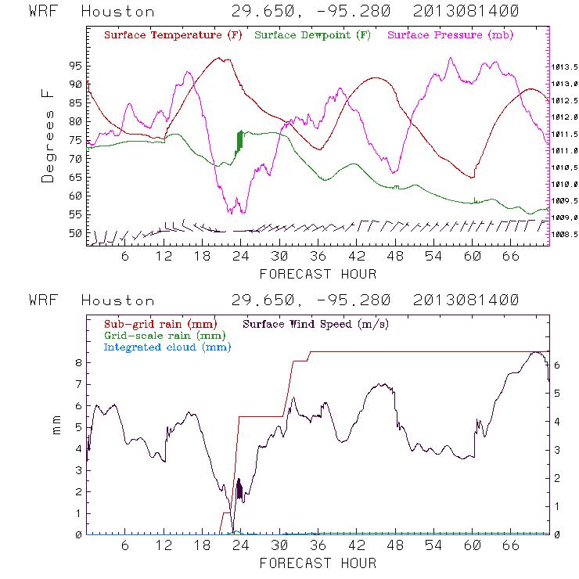
Convective rain beginning near 21z continuing until 00z with more rain after 06z.

Slide 8
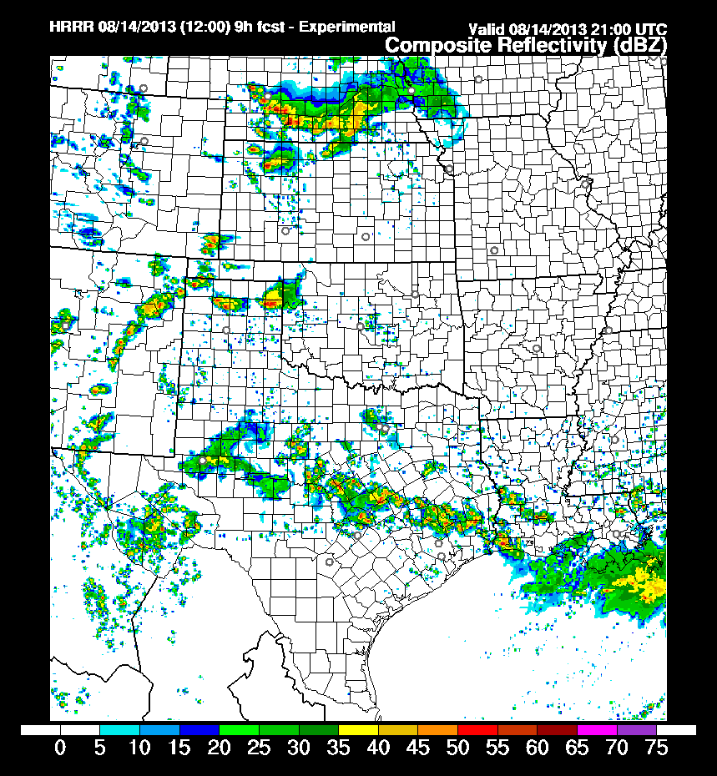

Slide 9
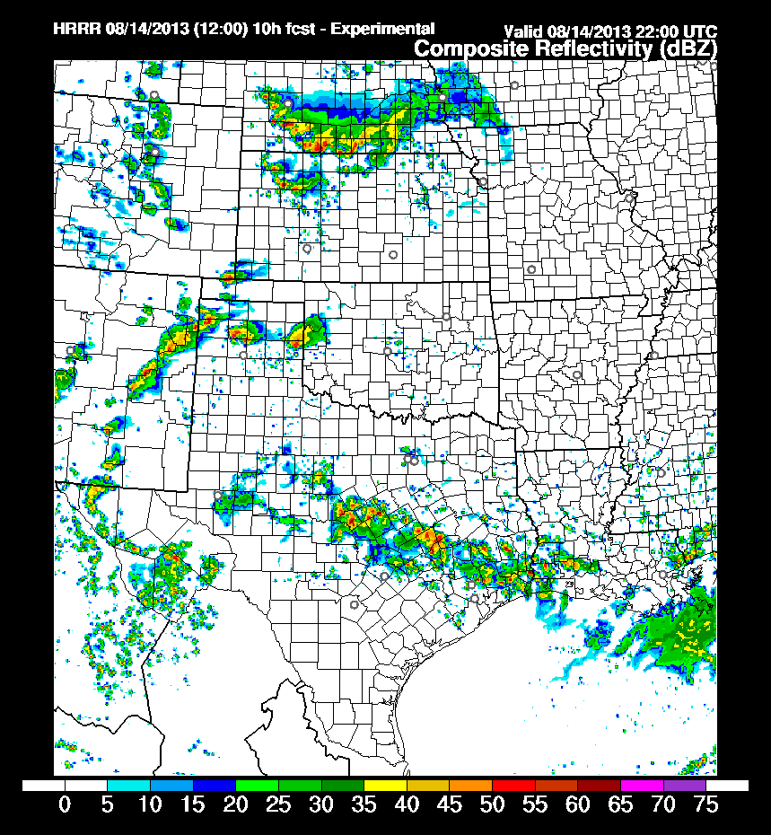

Slide 10
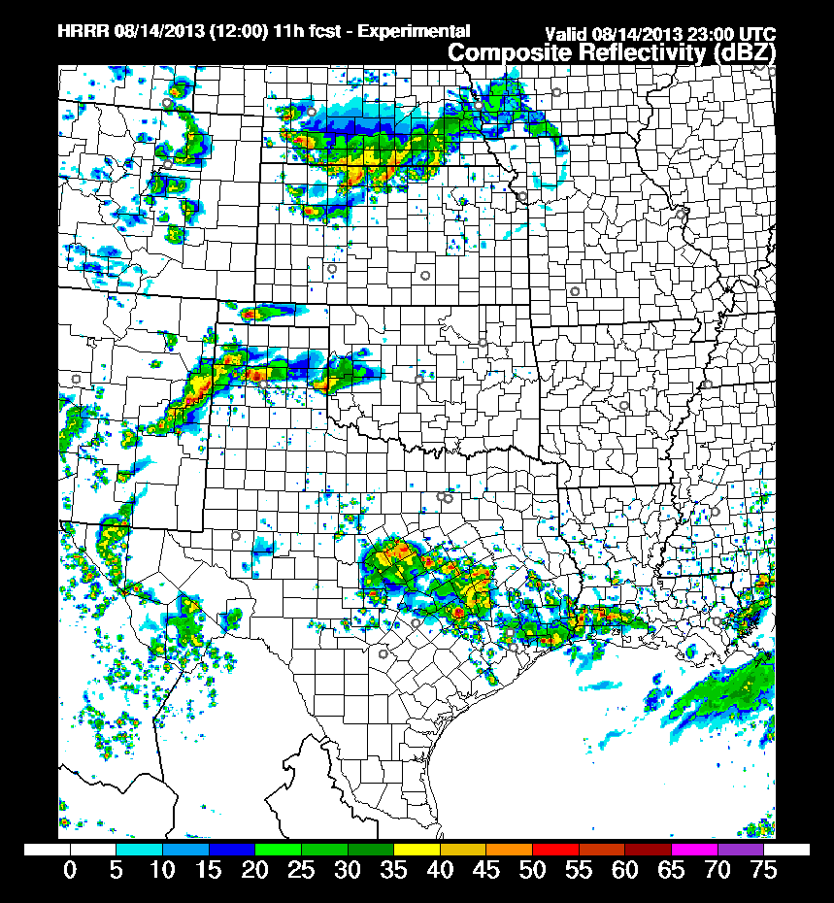

Slide 11
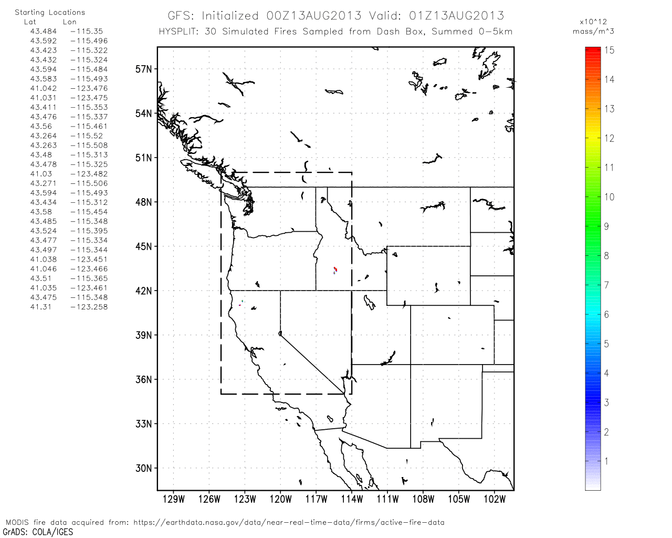
Surface release

Slide 12
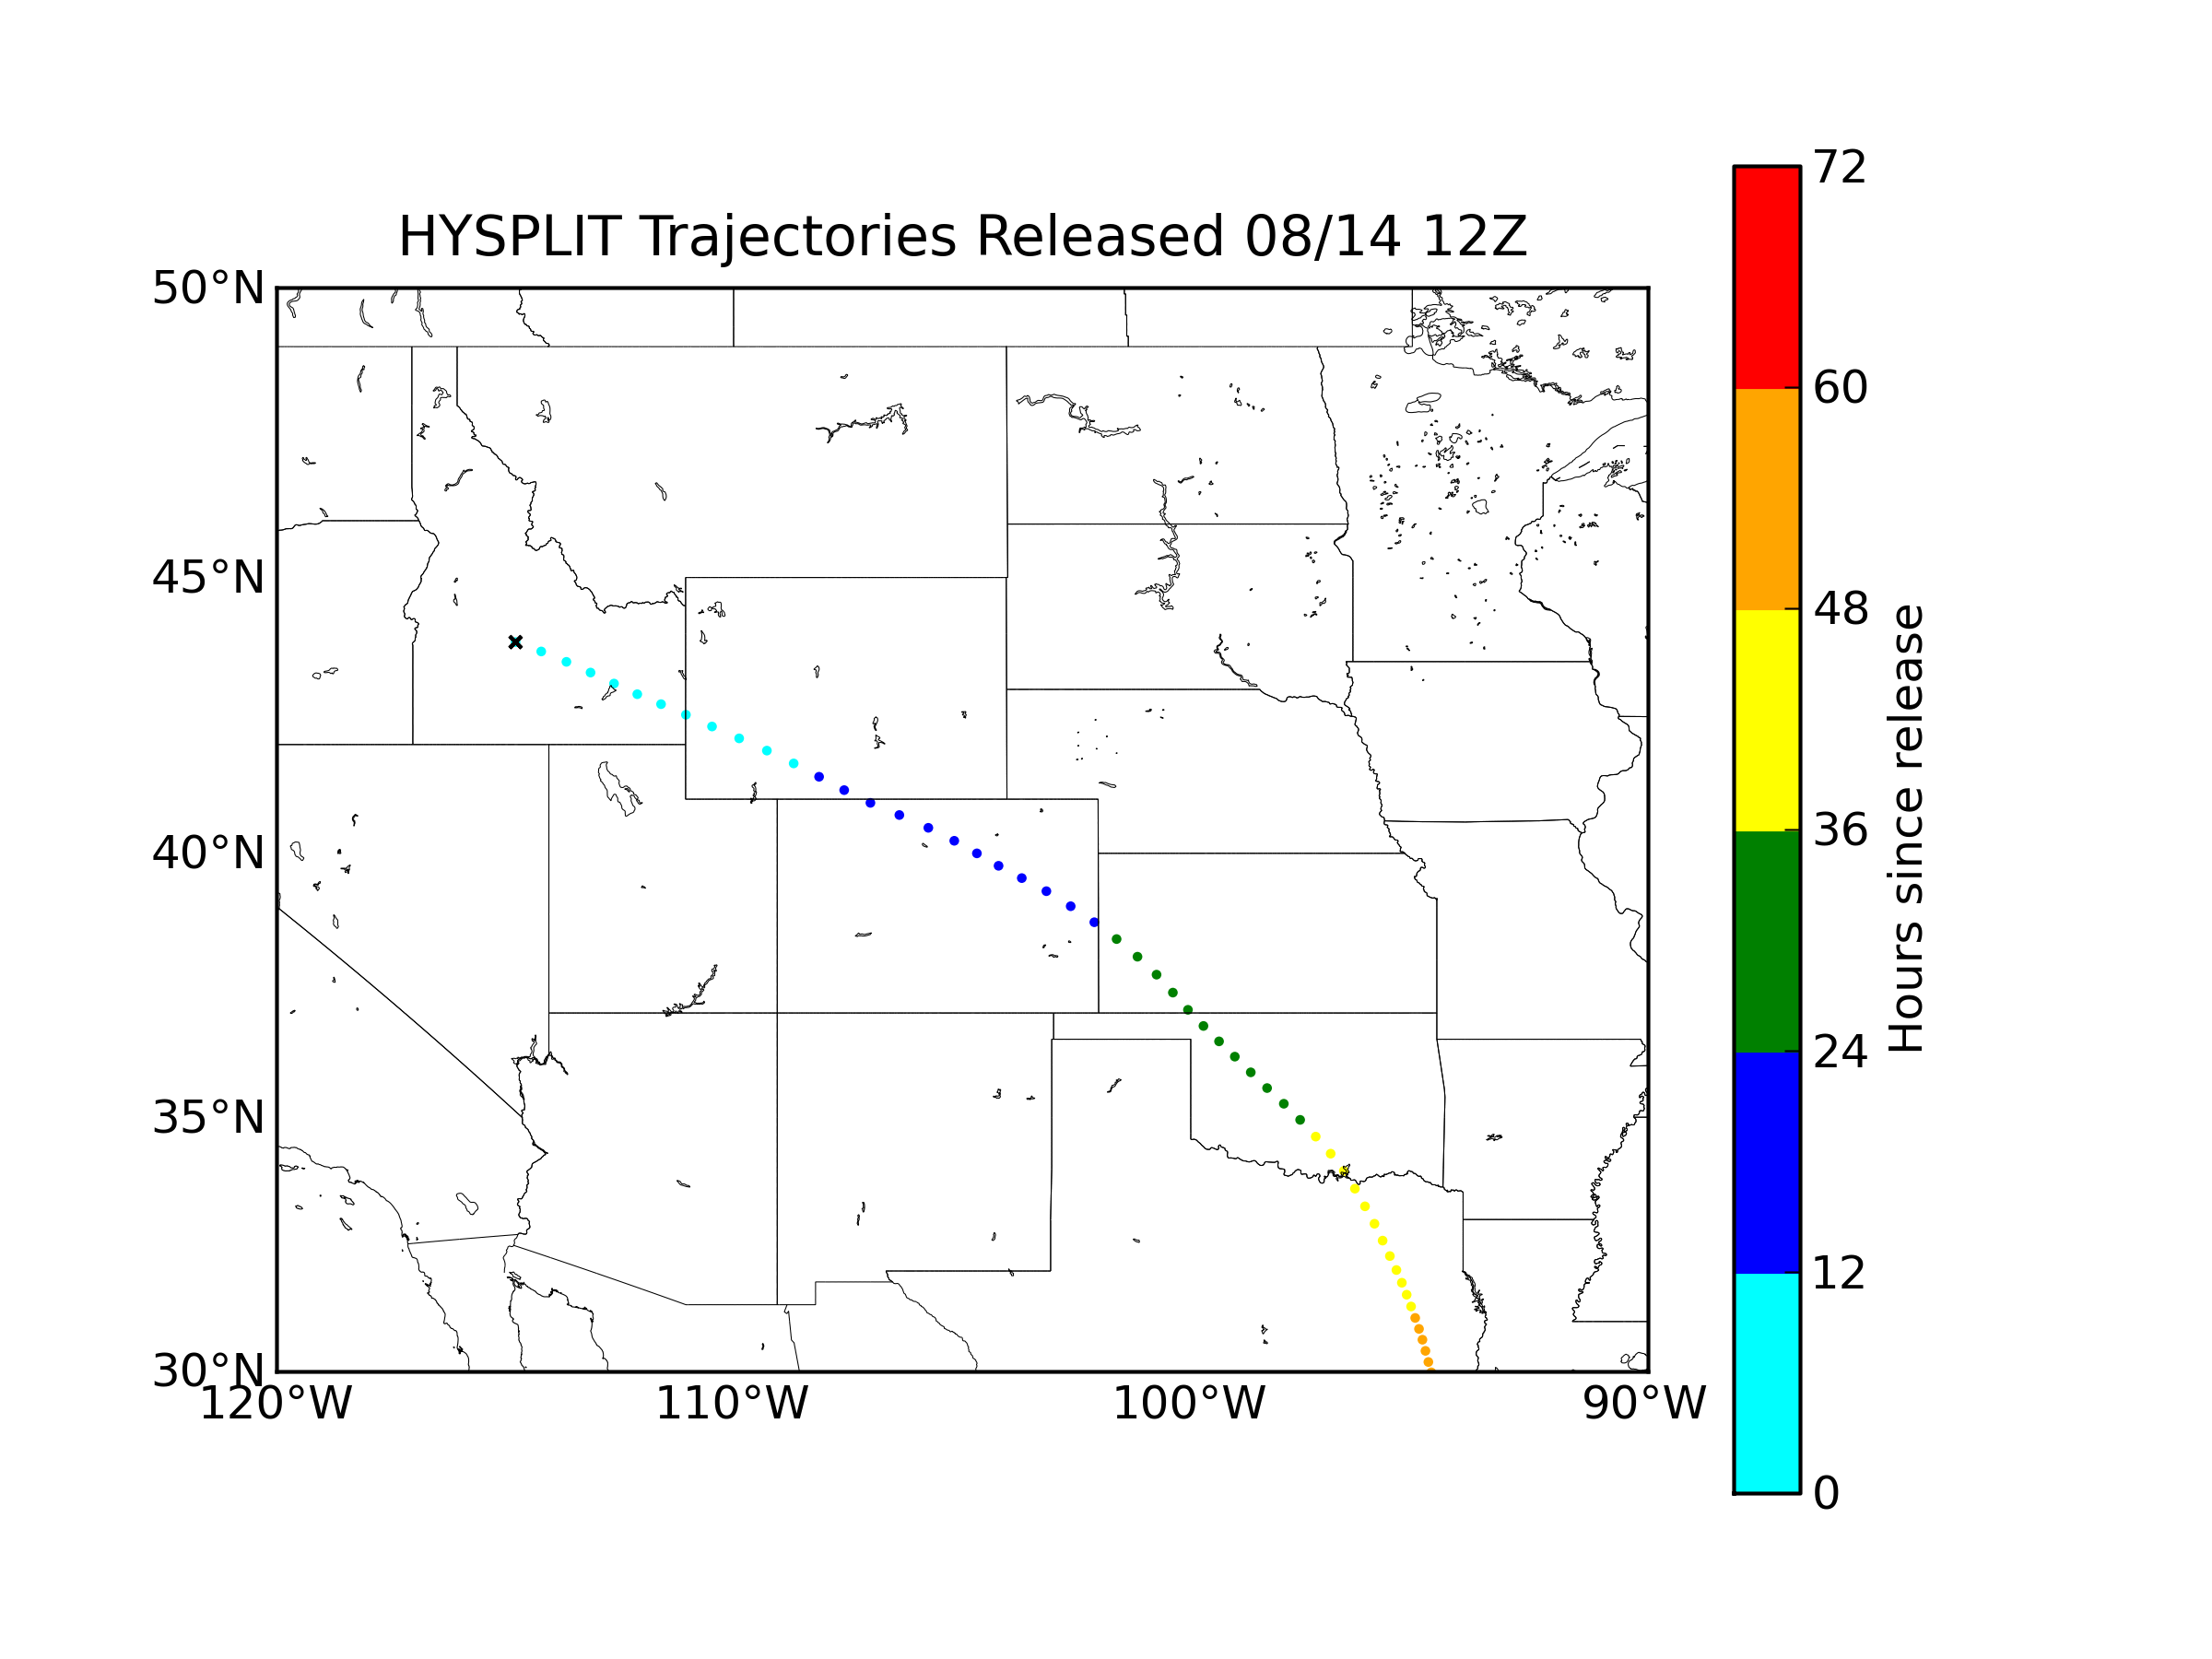
10-km

Slide 13
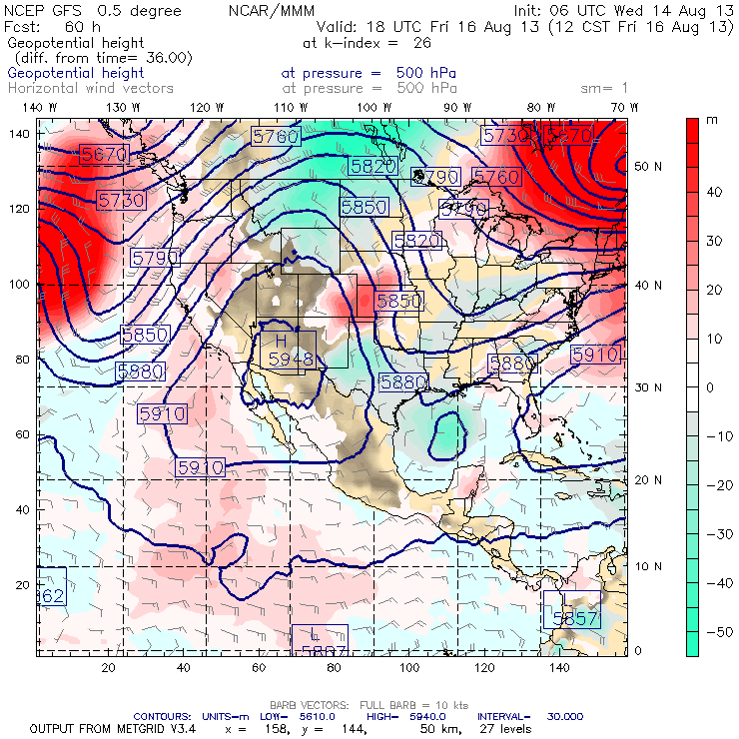
500 hPa chart for 18z Friday.

Slide 14
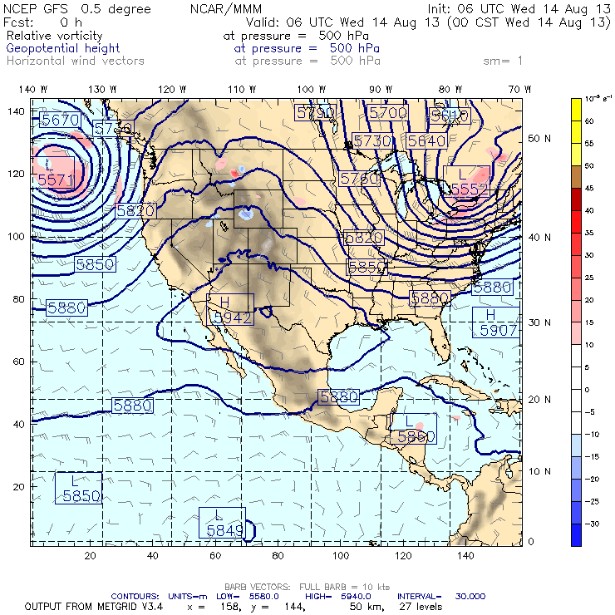
500 hPa animation.

Slide 15
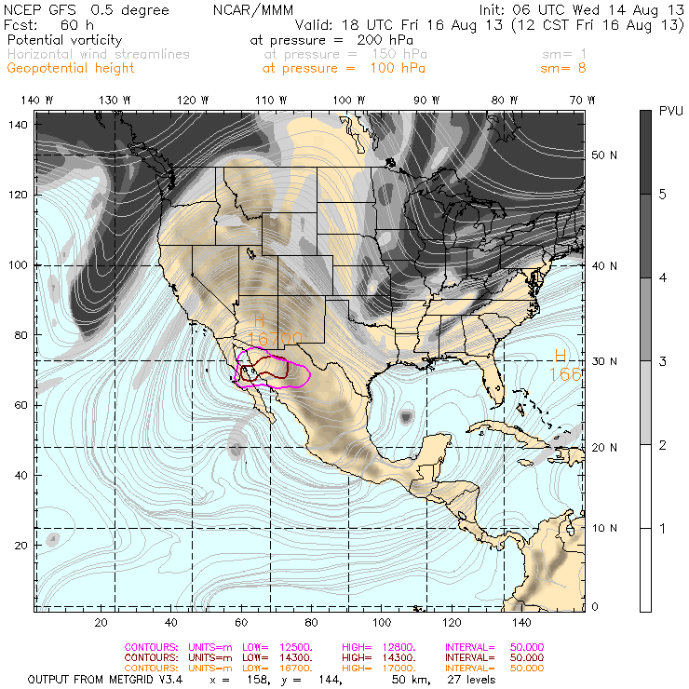

Slide 16
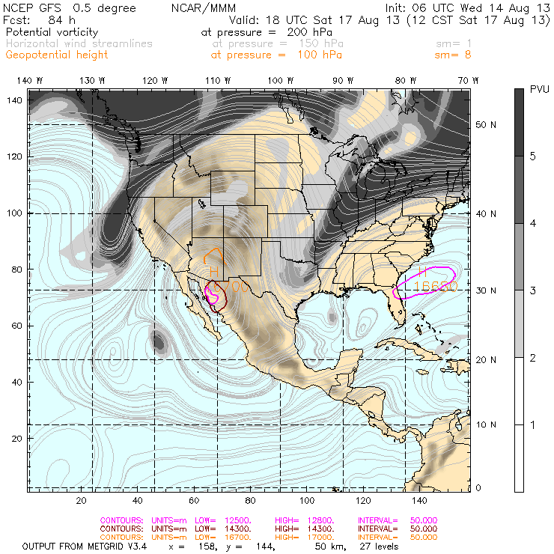

Slide 17
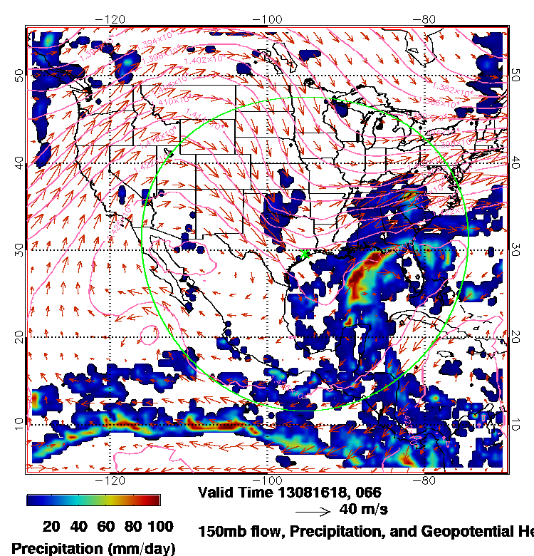
150 hPa for 18z Friday
Decaying MCS over OK/TX.
Anti-cyclone centered over Northern Mexico.
NW flow over Plains.
Disorganized convection in Gulf.

Slide 18
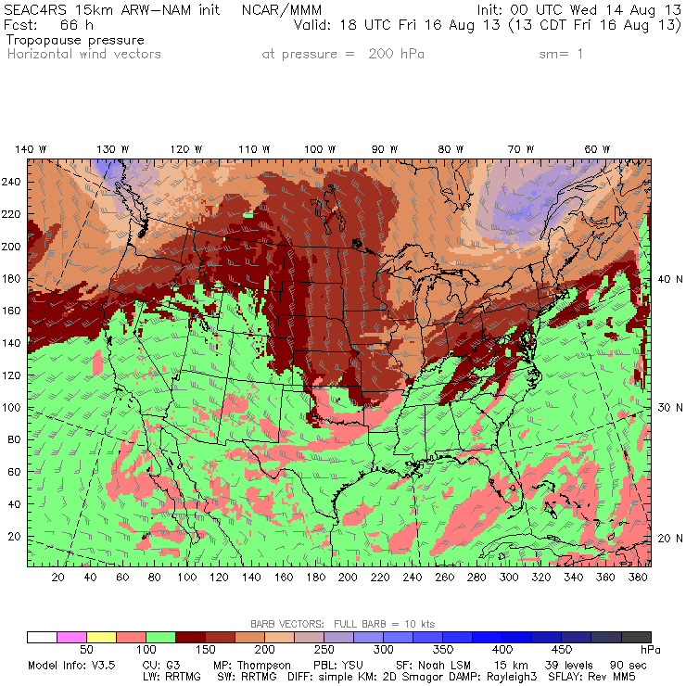

Slide 19
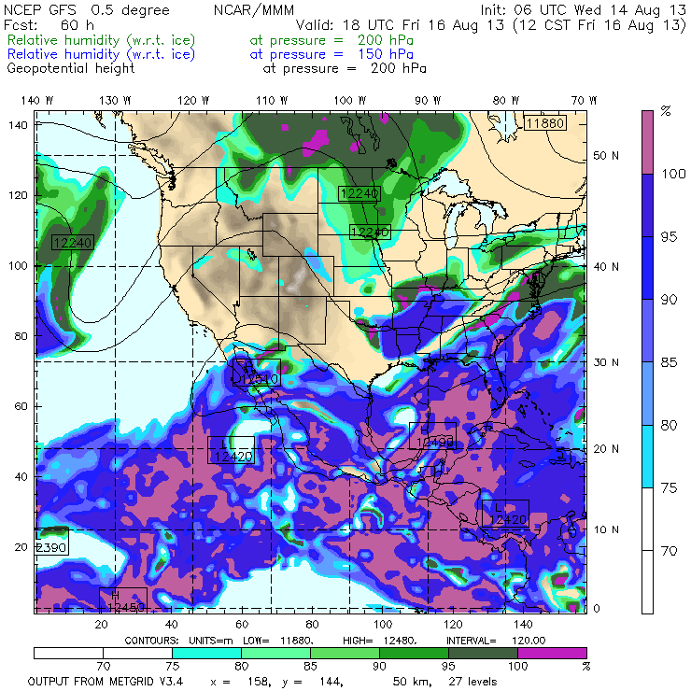
200 / 150 hPa RH_i

Slide 20
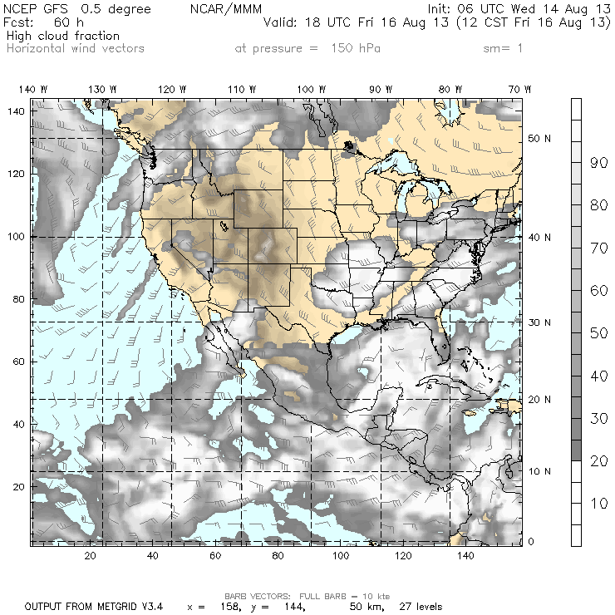
GFS high cloud fraction

Slide 21
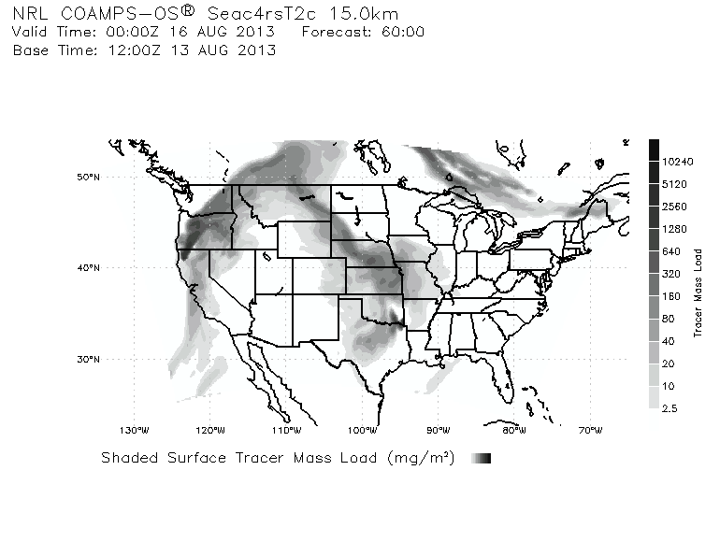
Smoke/Aerosol Forecast
Courtesy: David Peterson, NRL

Slide 22
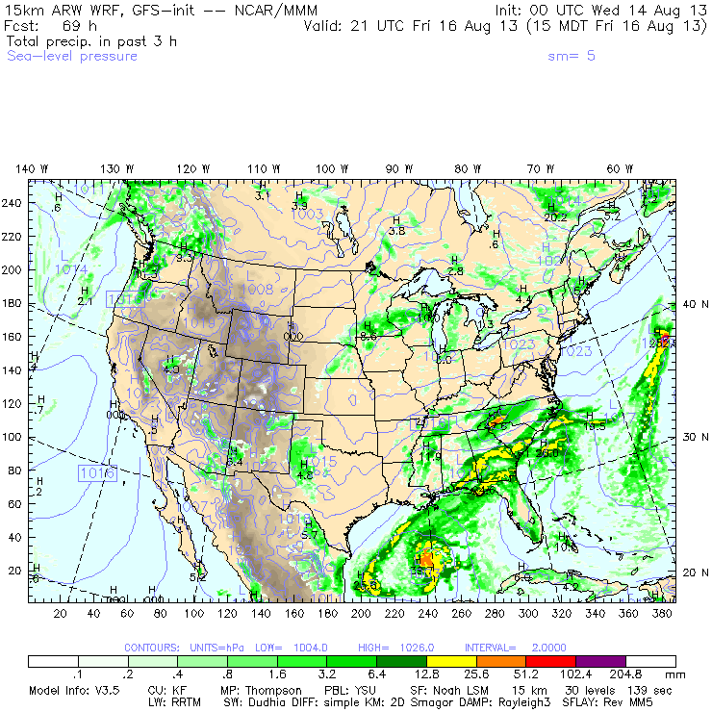
WRF-GFS precip for Friday afternoon

Slide 23
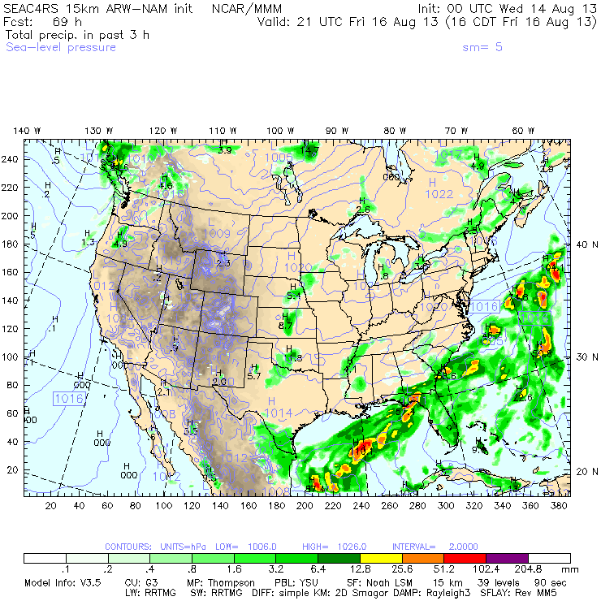
WRF-NAM precip for Friday afternoon

Slide 24
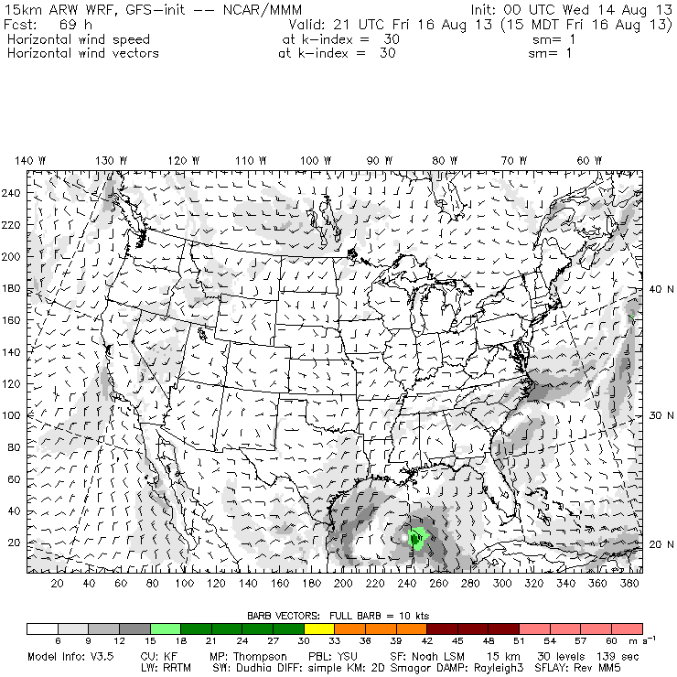
WRF-GFS surface winds for Friday afternoon

Slide 25
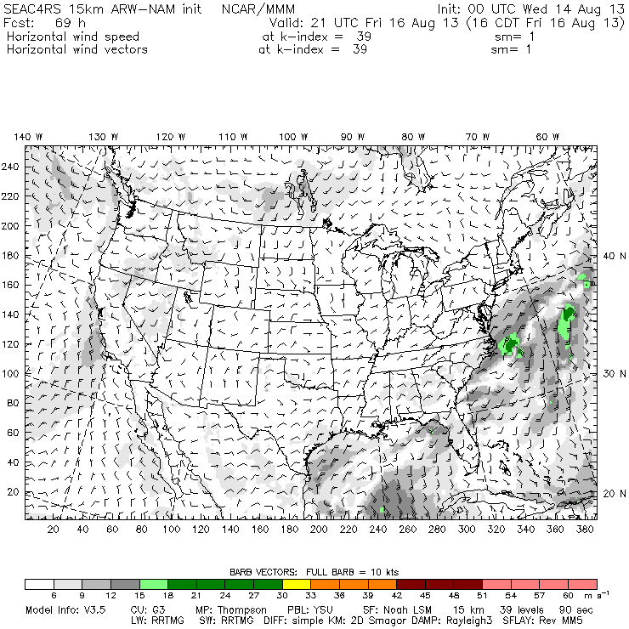
WRF-NAM surface winds for Friday afternoon

Slide 26
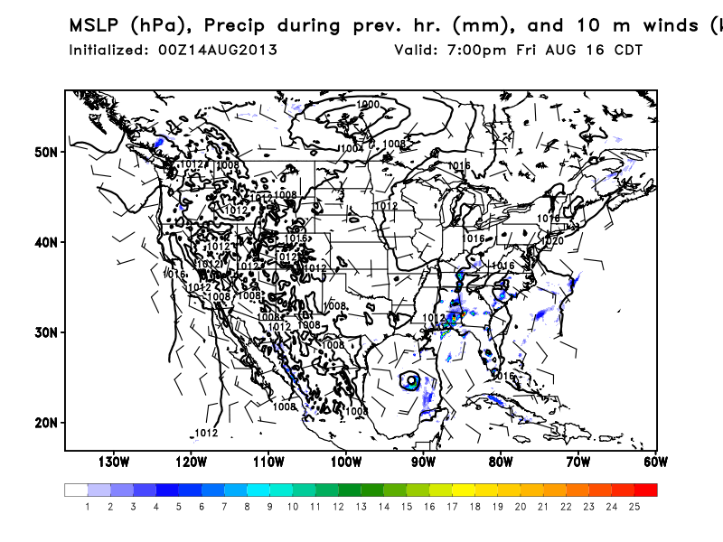
WRF-EC

Slide 27
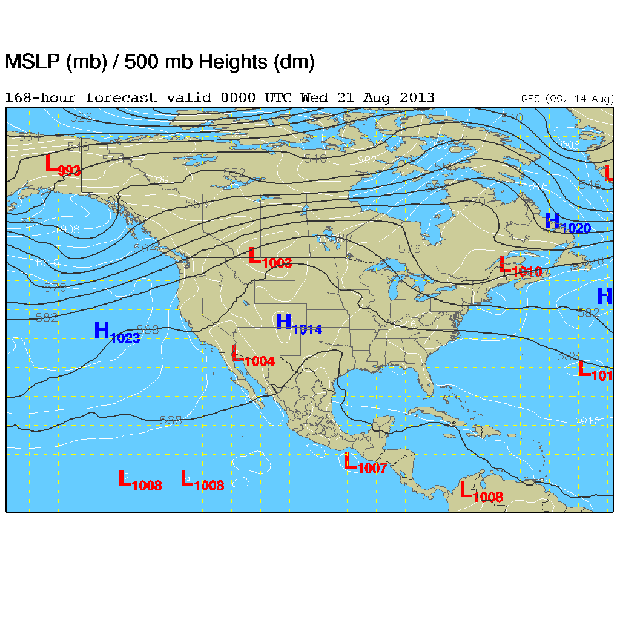
Tuesday, 20 August

Slide 28
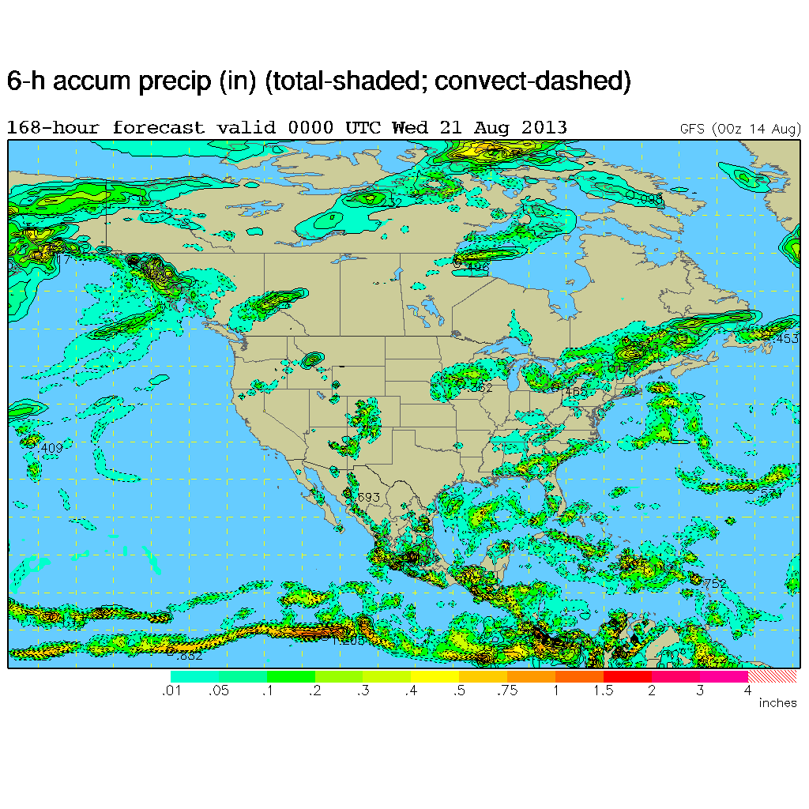
Tuesday, 20 August

Slide 29
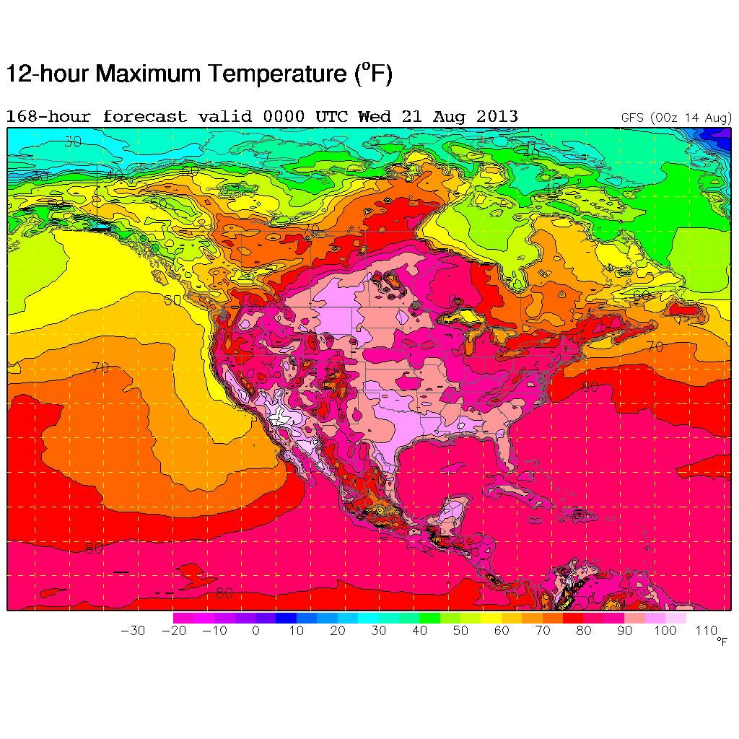
Tuesday, 20 August

Slide 30
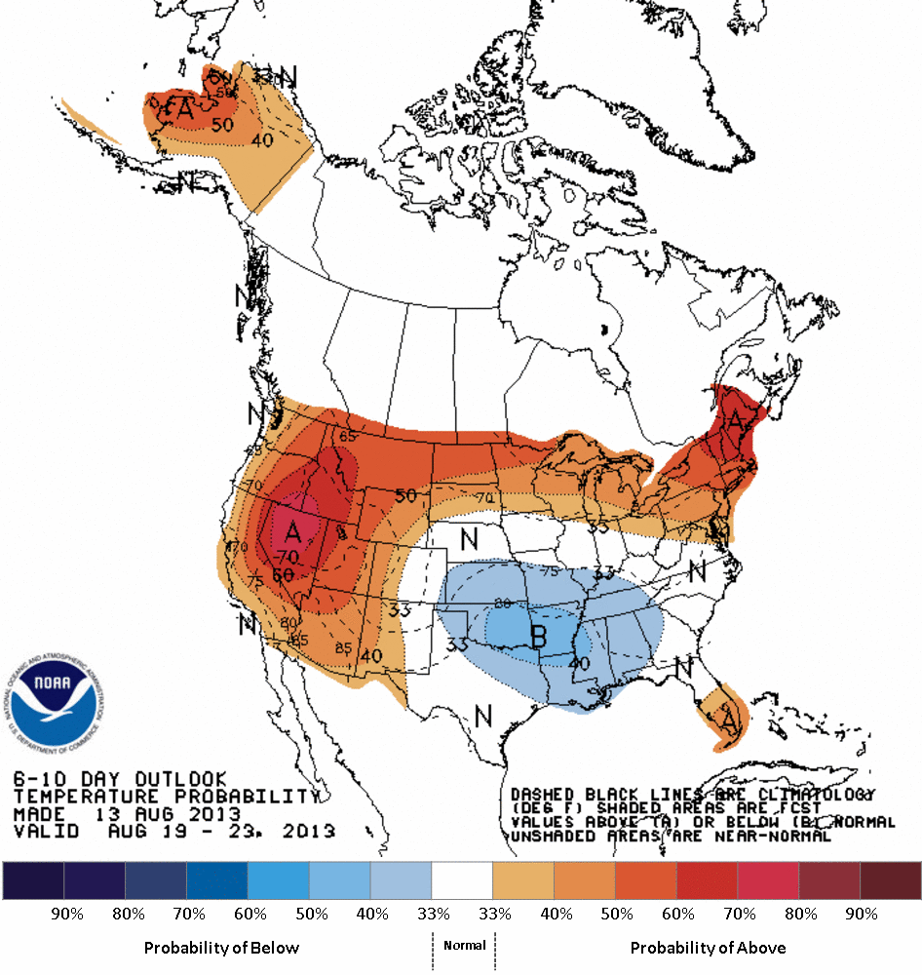
Longer-term outlook
Above normal in the west (with below normal precip) and below normal temperatures in the south-central U.S.

Slide 31
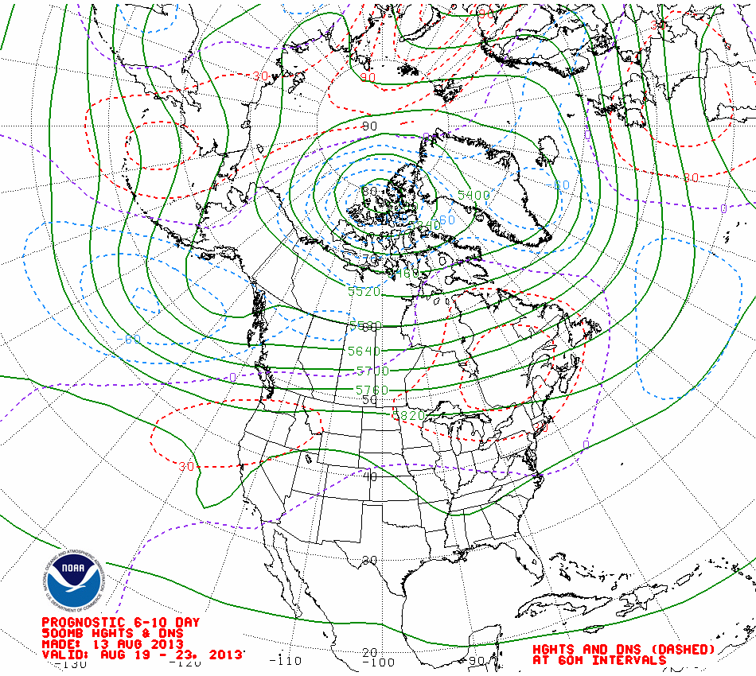
6-10 day 500 hPa height anomaly chart shows ridging in the NW and over Quebec and troughing in the Gulf of Alaska and mid-south U.S.

Slide 32
Summary
Amplified pattern over CONUS is expected to break down.
Anti-cyclone over the southwest drifts north with northwesterly flow across central U.S.
Tropical ``storm” in the Gulf (strongest in GFS model) heads into central Gulf coast by Saturday. WRF-NAM brings surface circulation westward to south of BRO.
Meso-models show no weather issues near EFD on Friday.

