Slide 1
Met Brief, 20130909 Lenny Pfister, Nick Heath, and SEAC4RS met team
Convection location and timing for Wednesday
Conditions in SEUS Wednesday and Friday
“Deep Tropical” conditions Friday -- hurricanes
MCS possibilities Wednesday and Friday

Slide 2
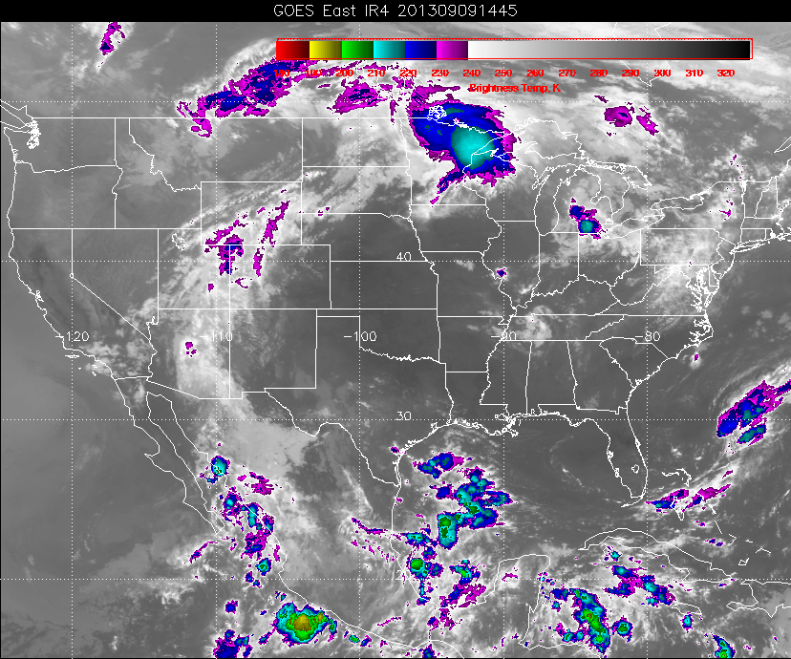
Rain earlier in western TN – ample convection over the Gulf

Slide 3
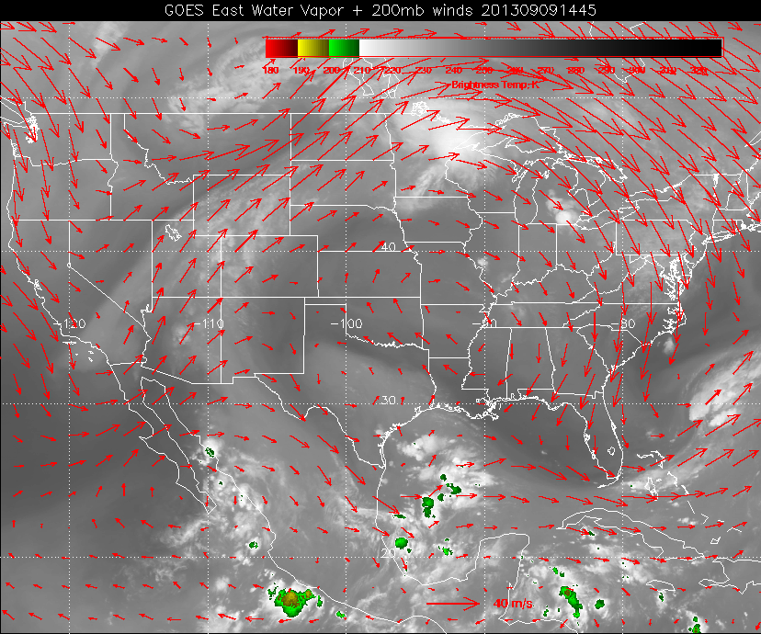
200mb anticyclone over central US (displaced from 500mb anticyclone). Ample monsoon
moisture feeding into convective systems propagating across the northern tier.

Slide 4
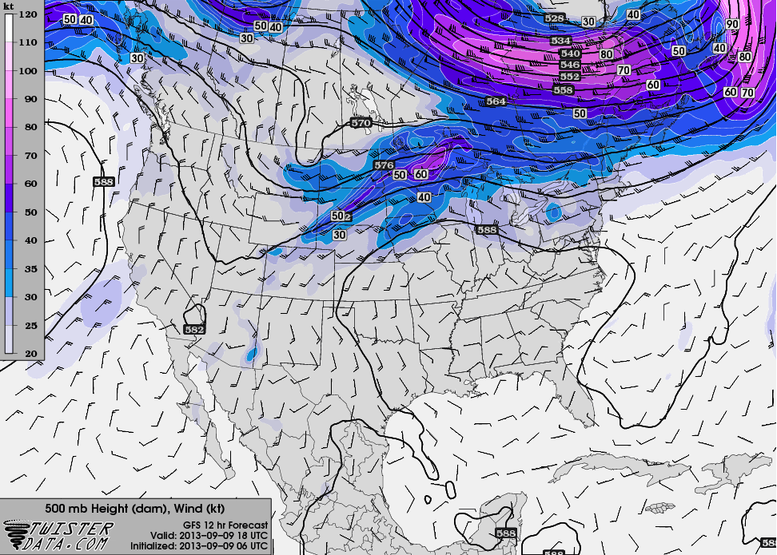

Slide 5
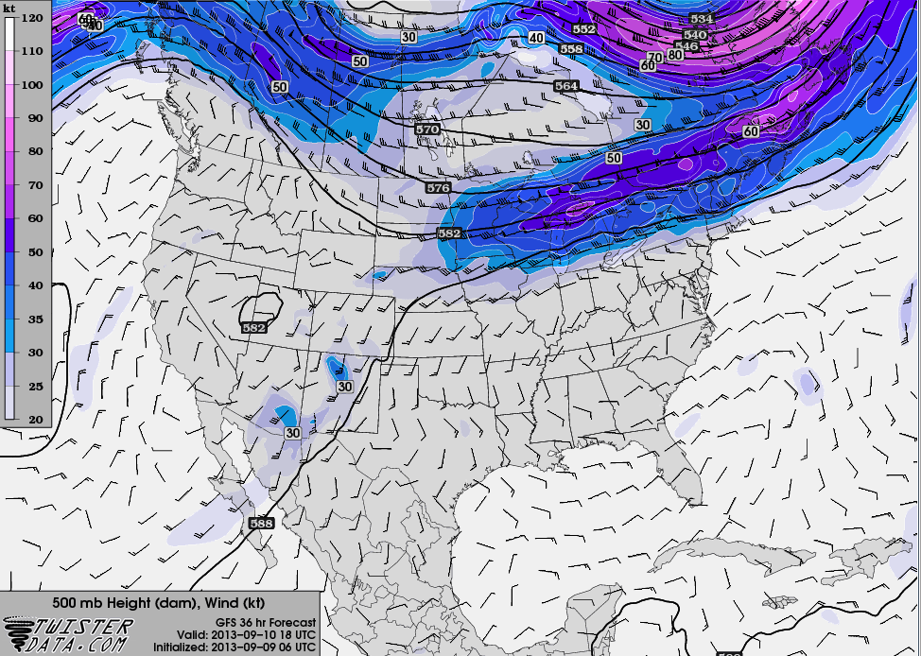

Slide 6
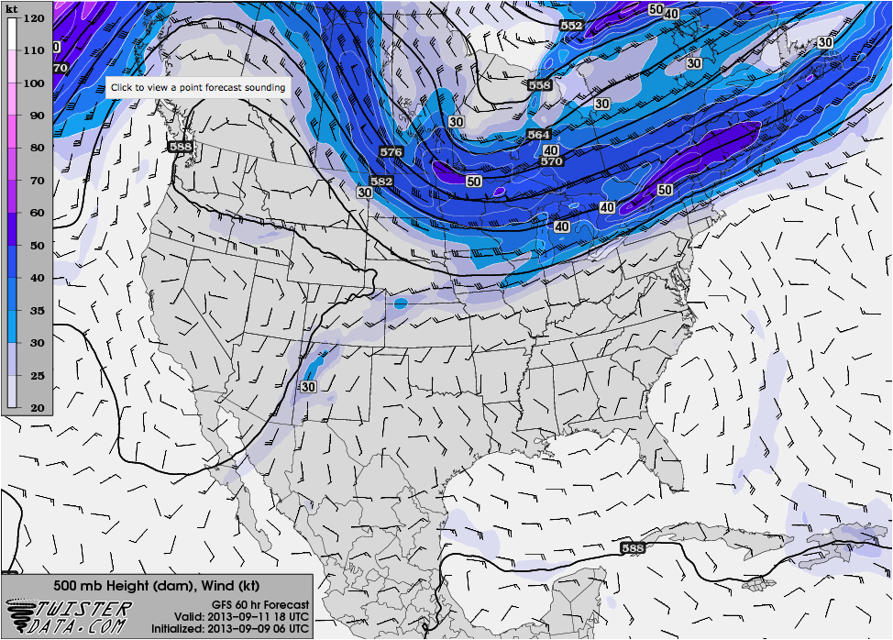

Slide 7
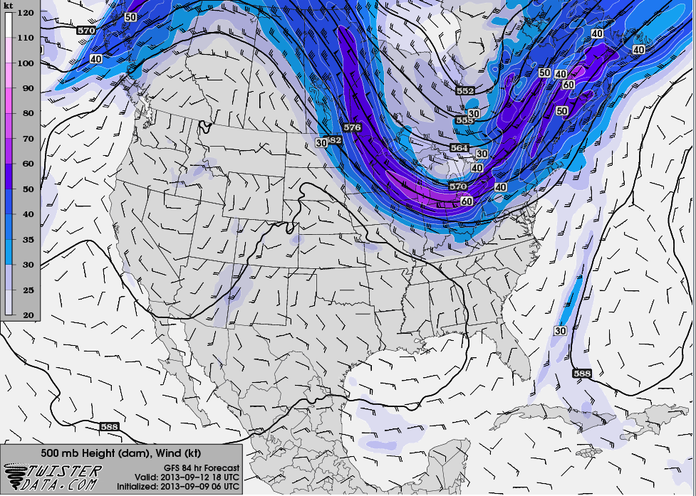

Slide 8
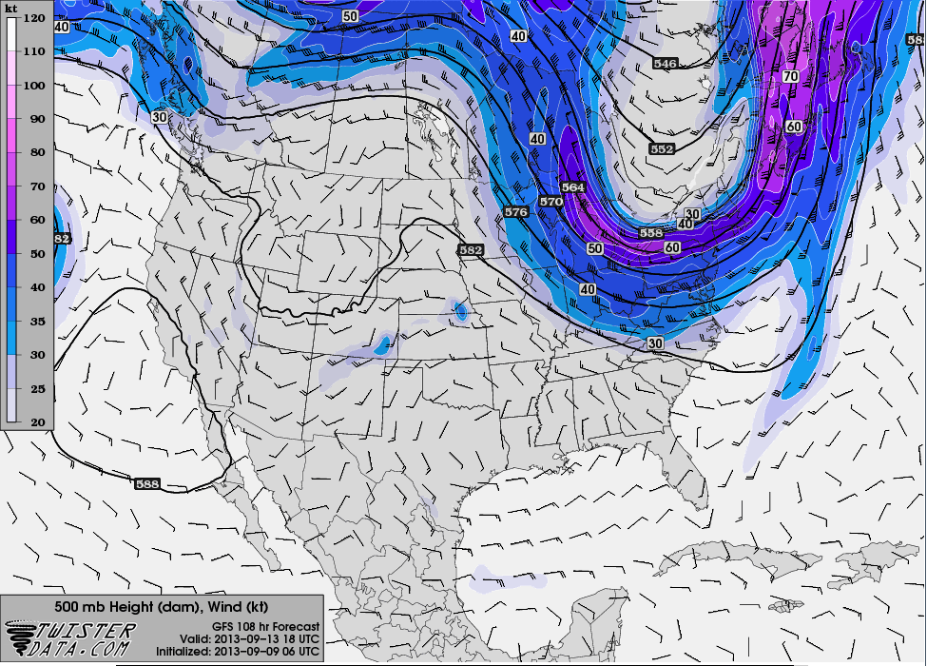

Slide 9
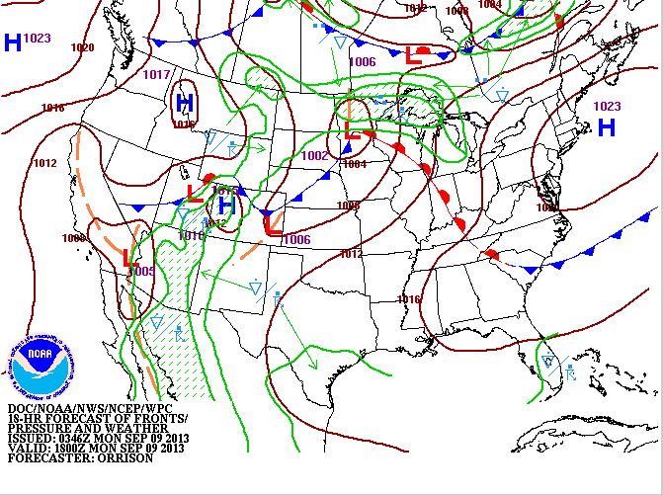

Slide 10
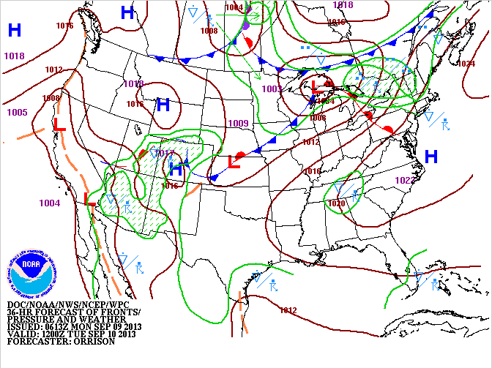

Slide 11
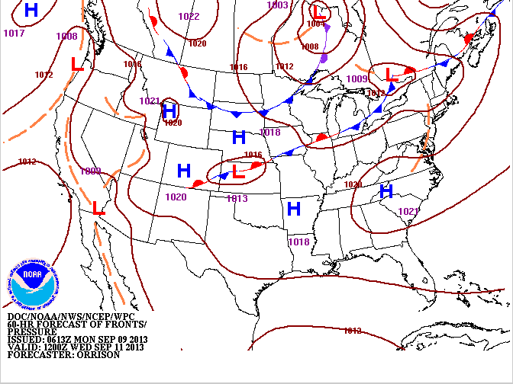

Slide 12
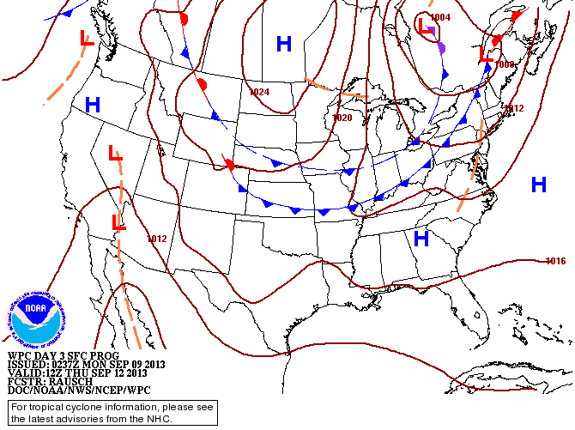

Slide 13
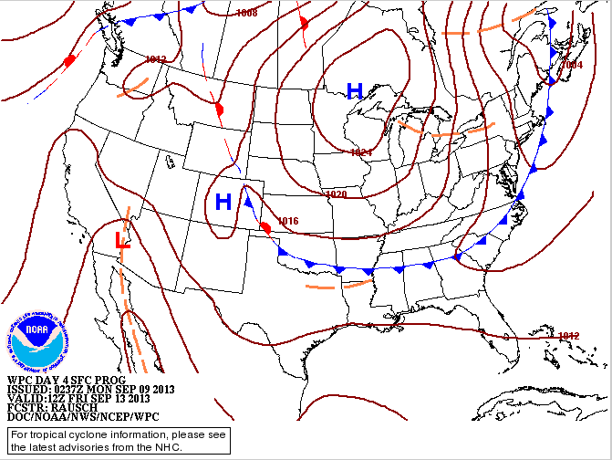

Slide 14
Implications for Wednesday

Slide 15
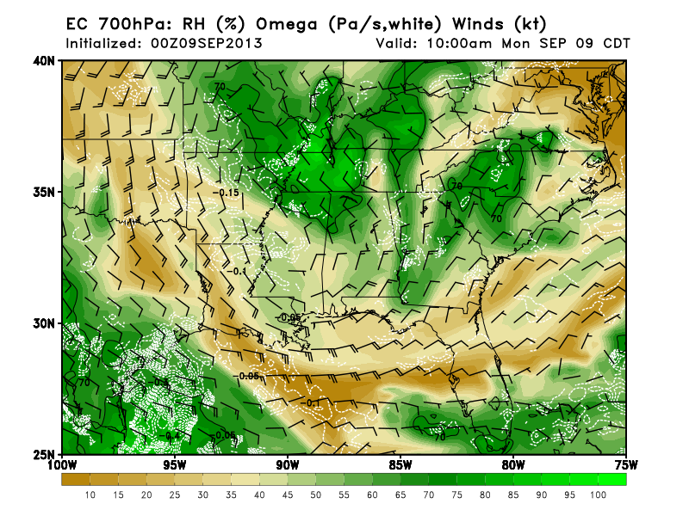
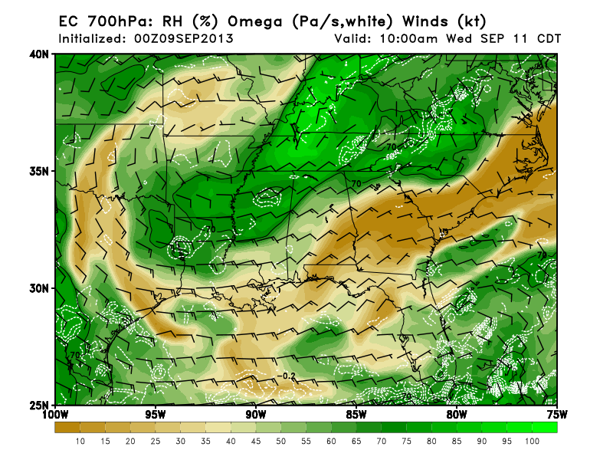
Today
Wednesday
Low level (to 5 kft) moisture is maintained in the Gulf on Wednesday, but mid-level dry
air moves into northern Gulf. In fact, conditions today are clearly drier than yesterday
because of this dry air.

Slide 16
Precip forecasts for Wednesday

Slide 17
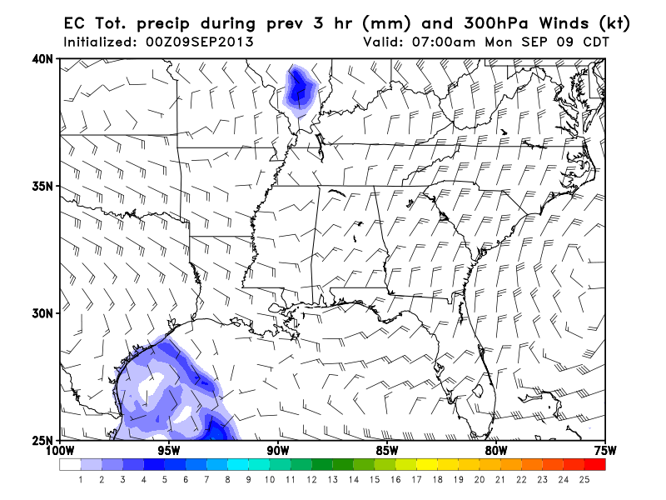
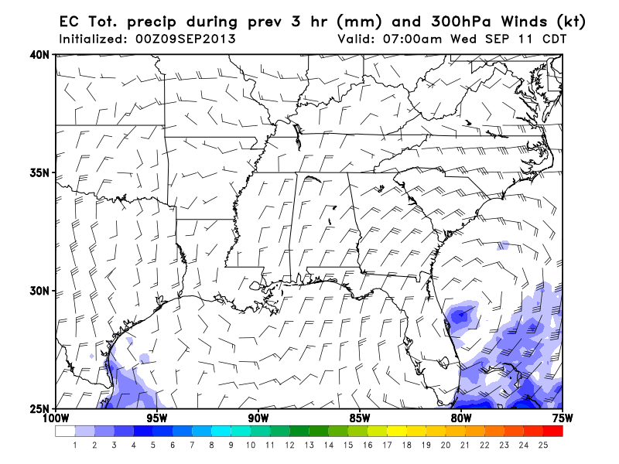
Global models push precip close to
coast, and, most importantly,
further south than today.

Slide 18
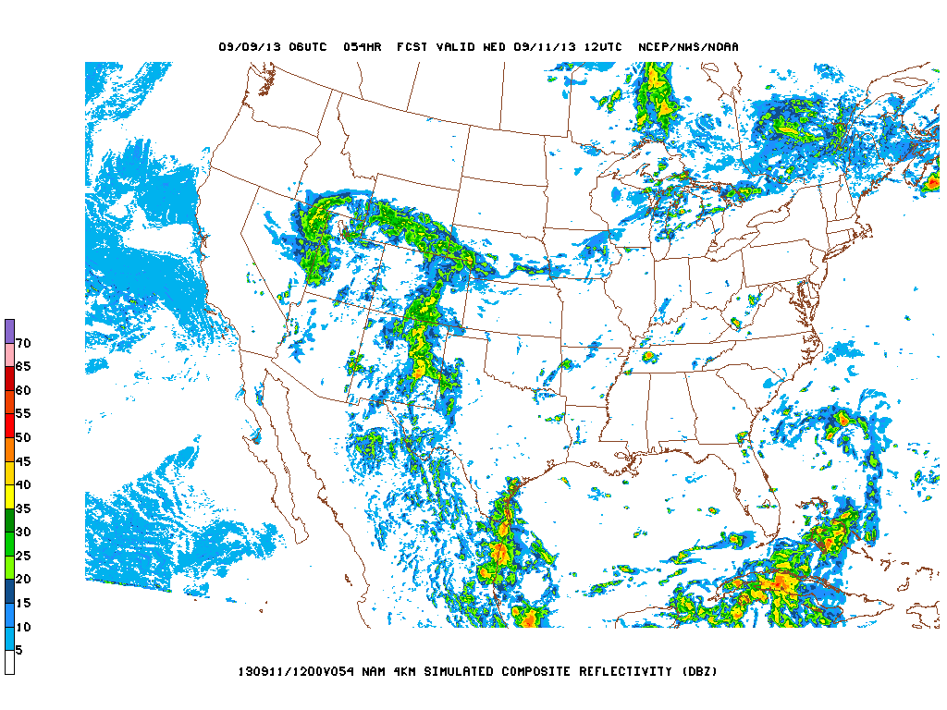
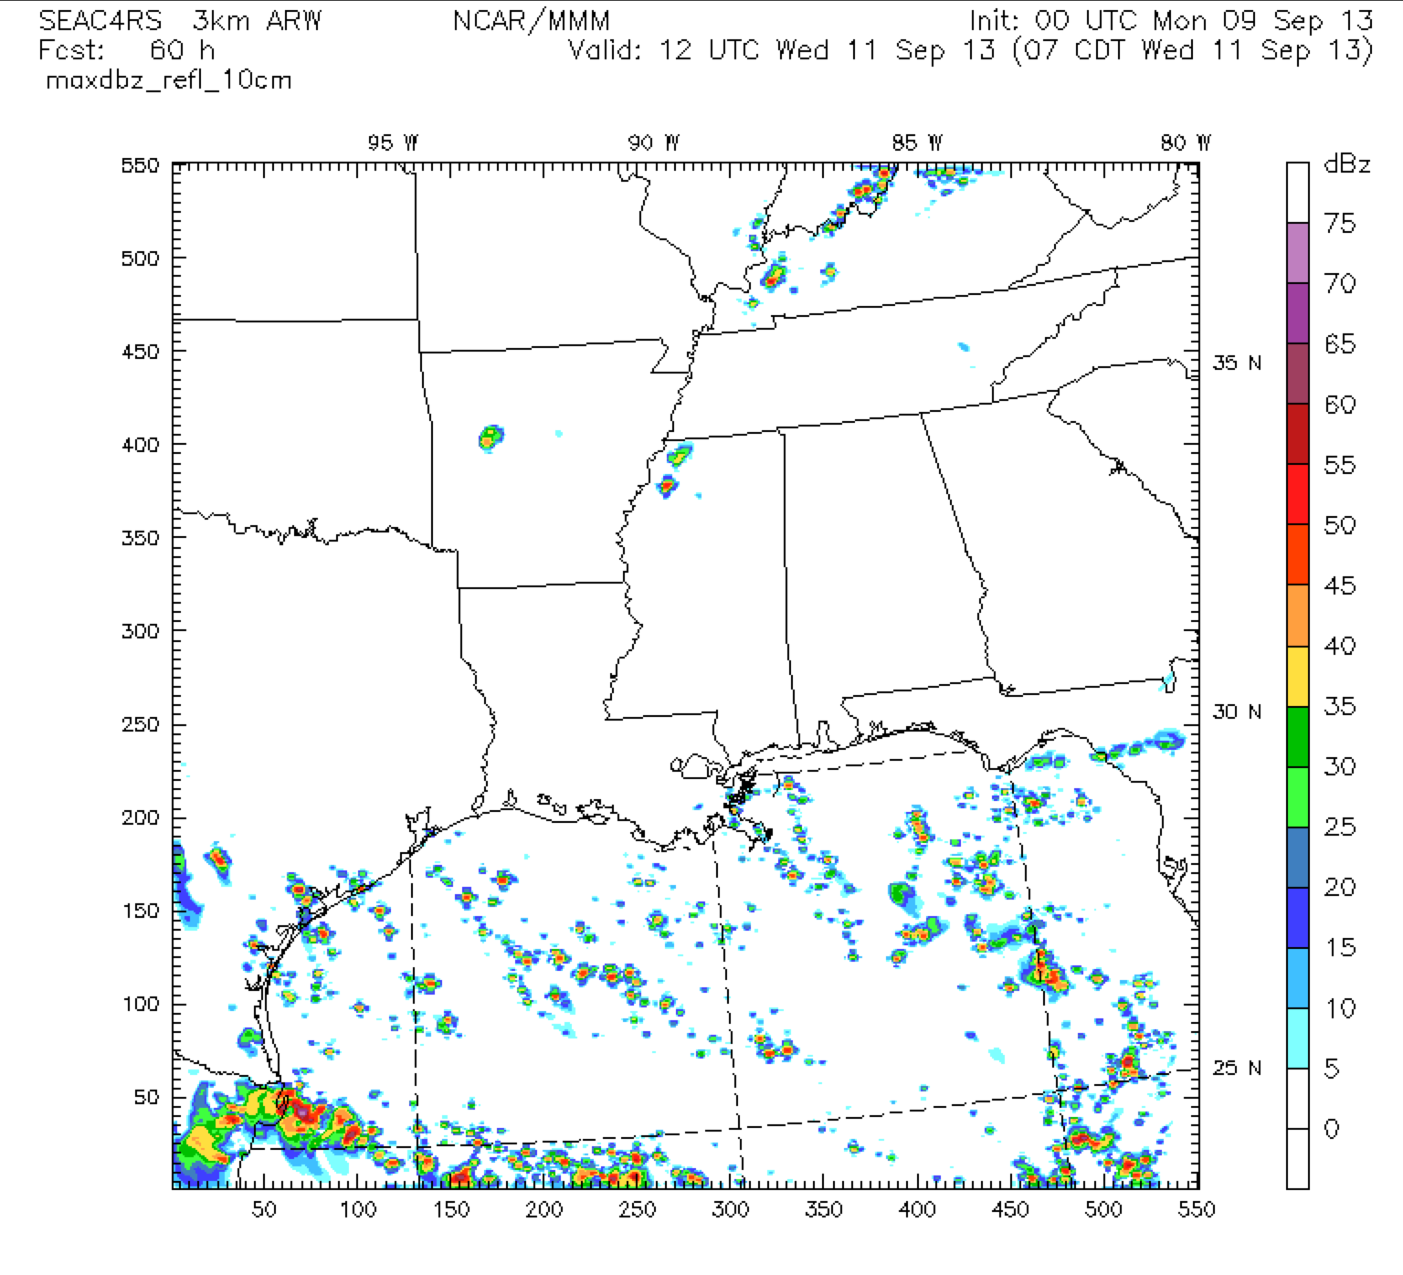
7 AM Wednesday
NAM high-res
NCAR 3 km WRF
NCAR Wrf maintains extensive
precip off our coast.

Slide 19
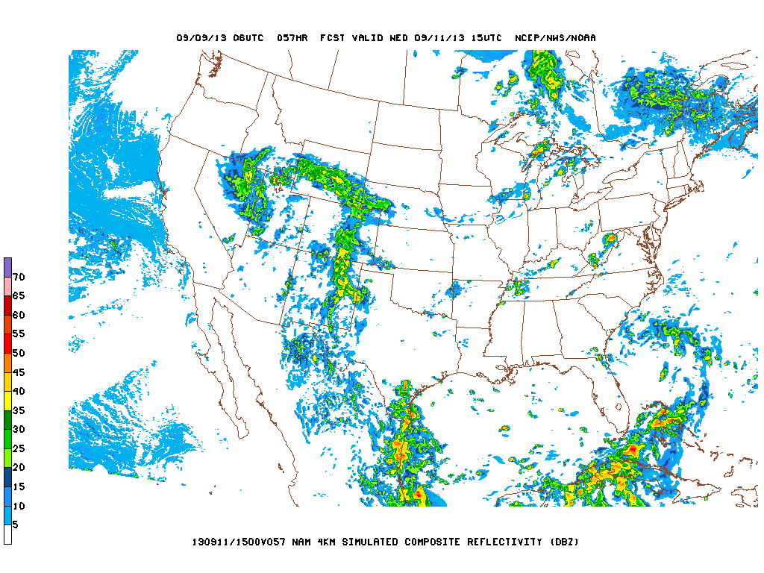
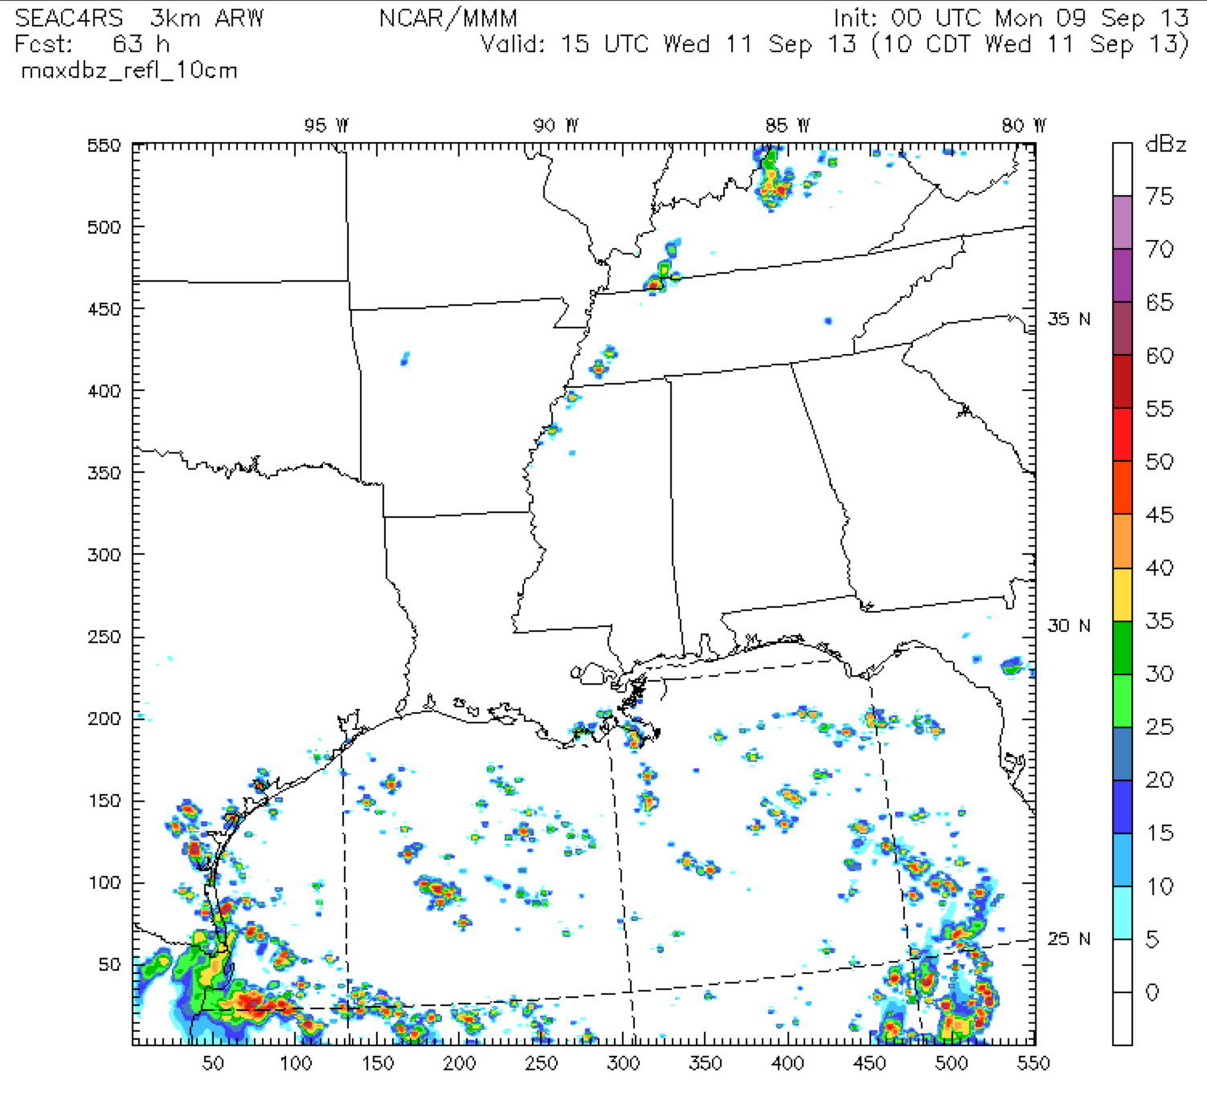
10 AM Wednesday
NAM high-res
NCAR 3 km WRF

Slide 20
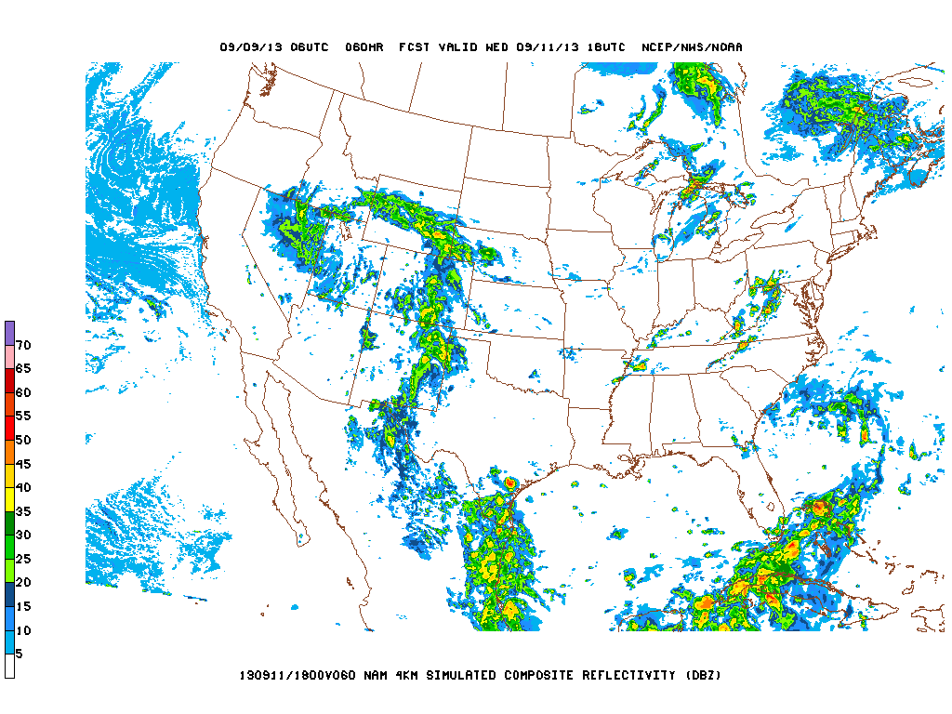
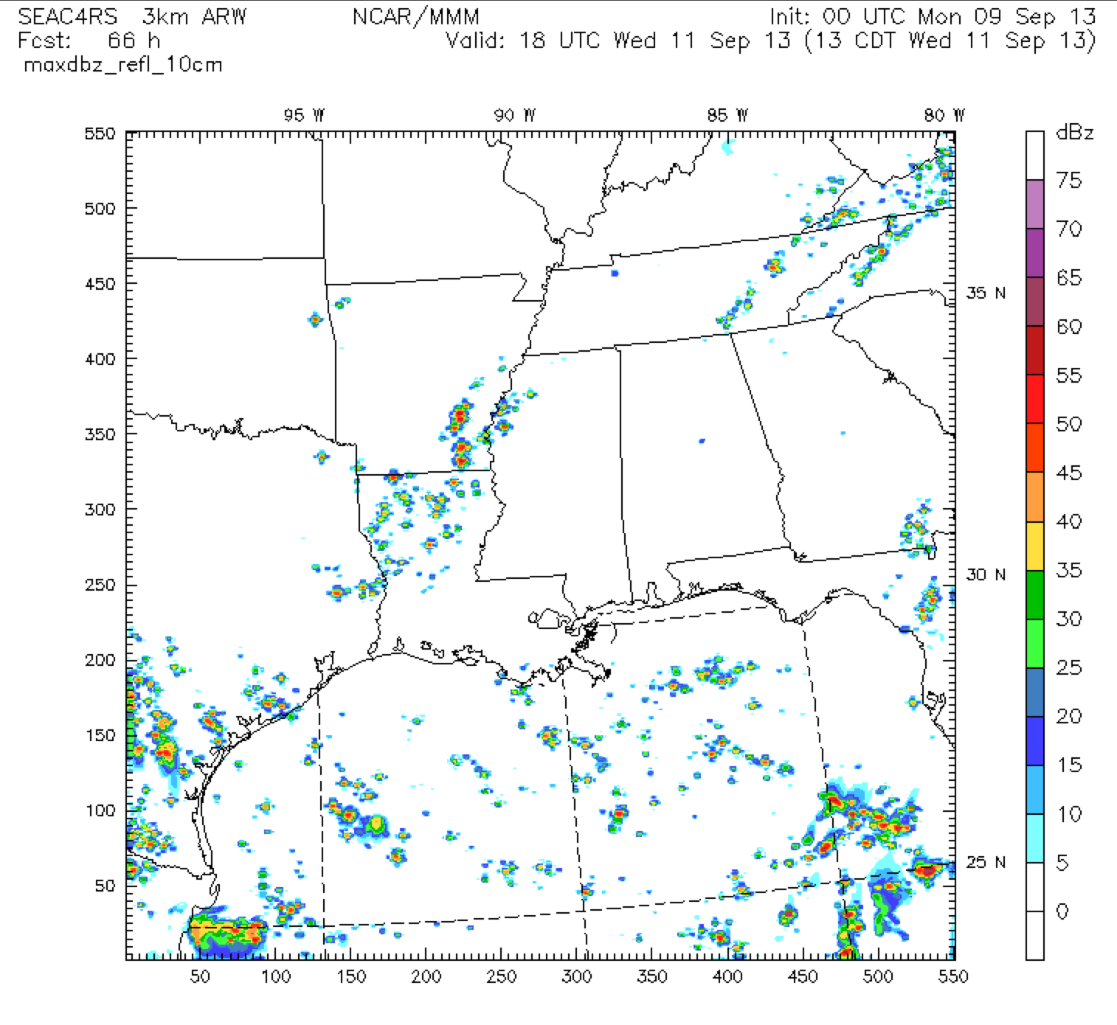
1 PM Wednesday
NAM high-res
NCAR 3 km WRF

Slide 21
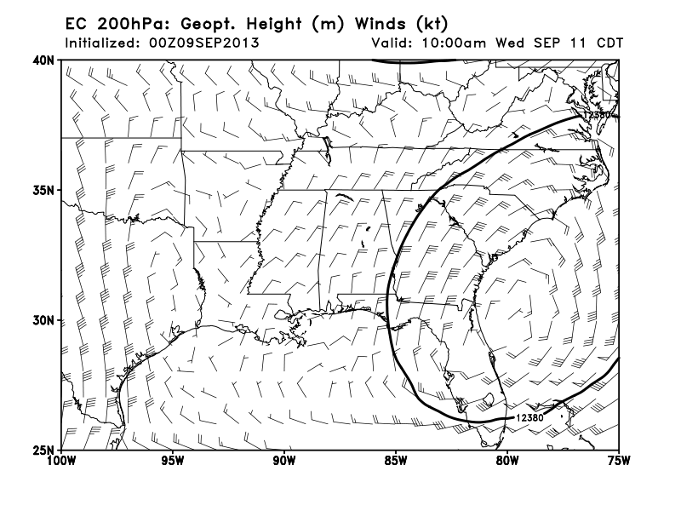
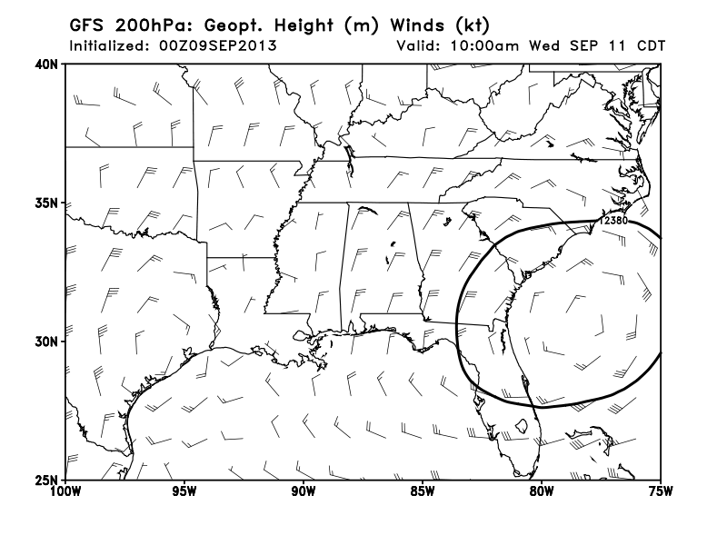
Outflow pattern at top of
convection different for
two models off S TX coast.

Slide 22
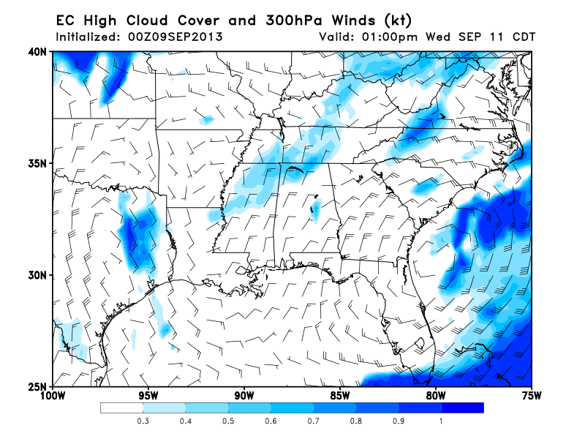
Precip develops in northern MS in the afternoon – scattered T-storms in unstable air
ahead of front, so have high clouds in region

Slide 23
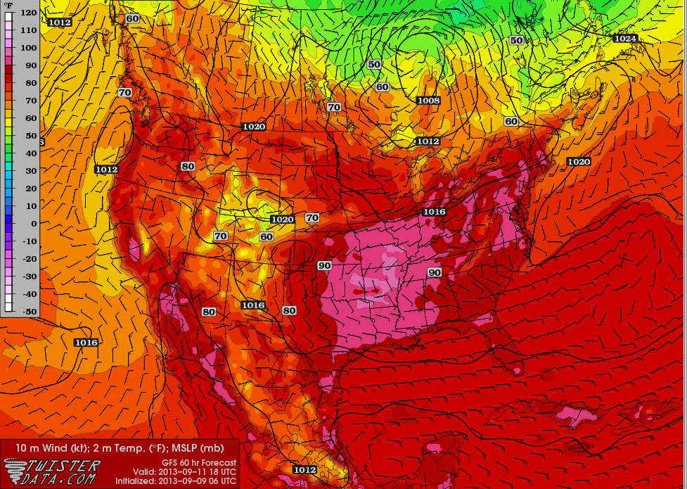
Continued hot in the southeast, with low level winds counterclockwise around high.
Warmest temps to western portion of SEUS.

Slide 24
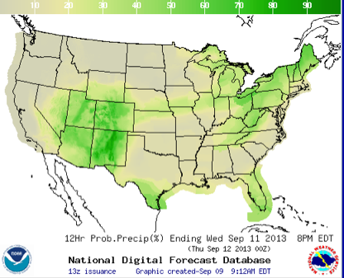
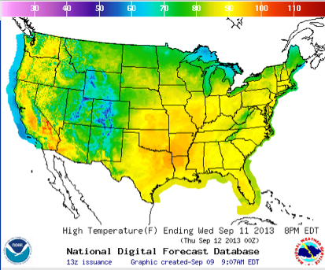
Precip probability
Max Temp

Slide 25
Implications for Friday -- Gulf Surprise!?

Slide 26
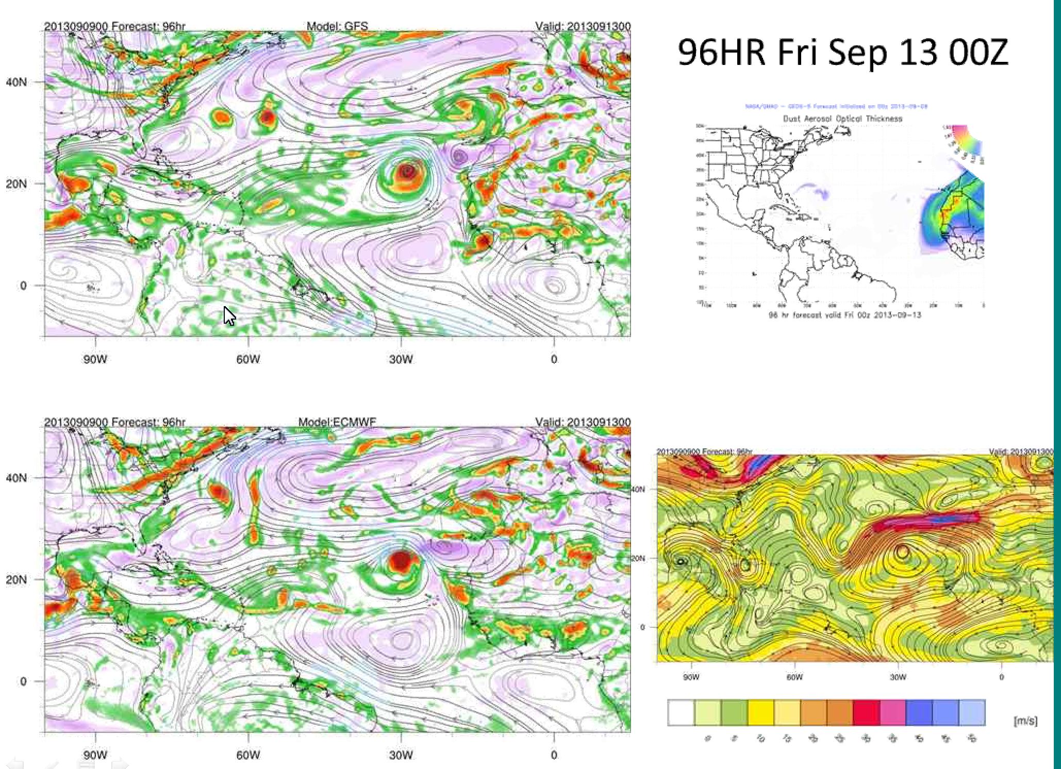
As Jim alluded to yesterday, models predict enhanced 850mb vorticity late Thursday

Slide 27
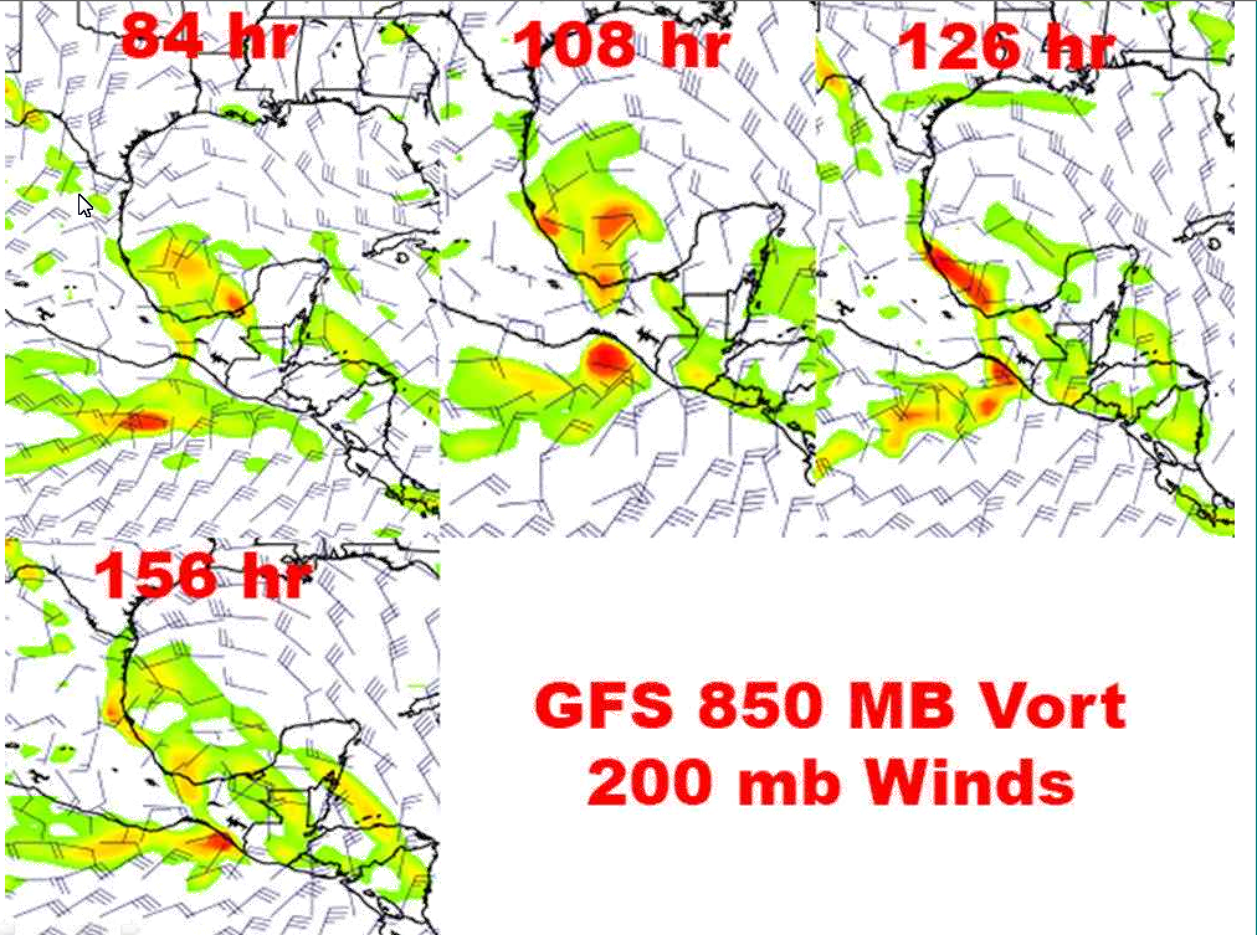
108 Hours (7 AM Friday), looks to be best developed
circulation. HS3 considering a Thursday flight.

Slide 28
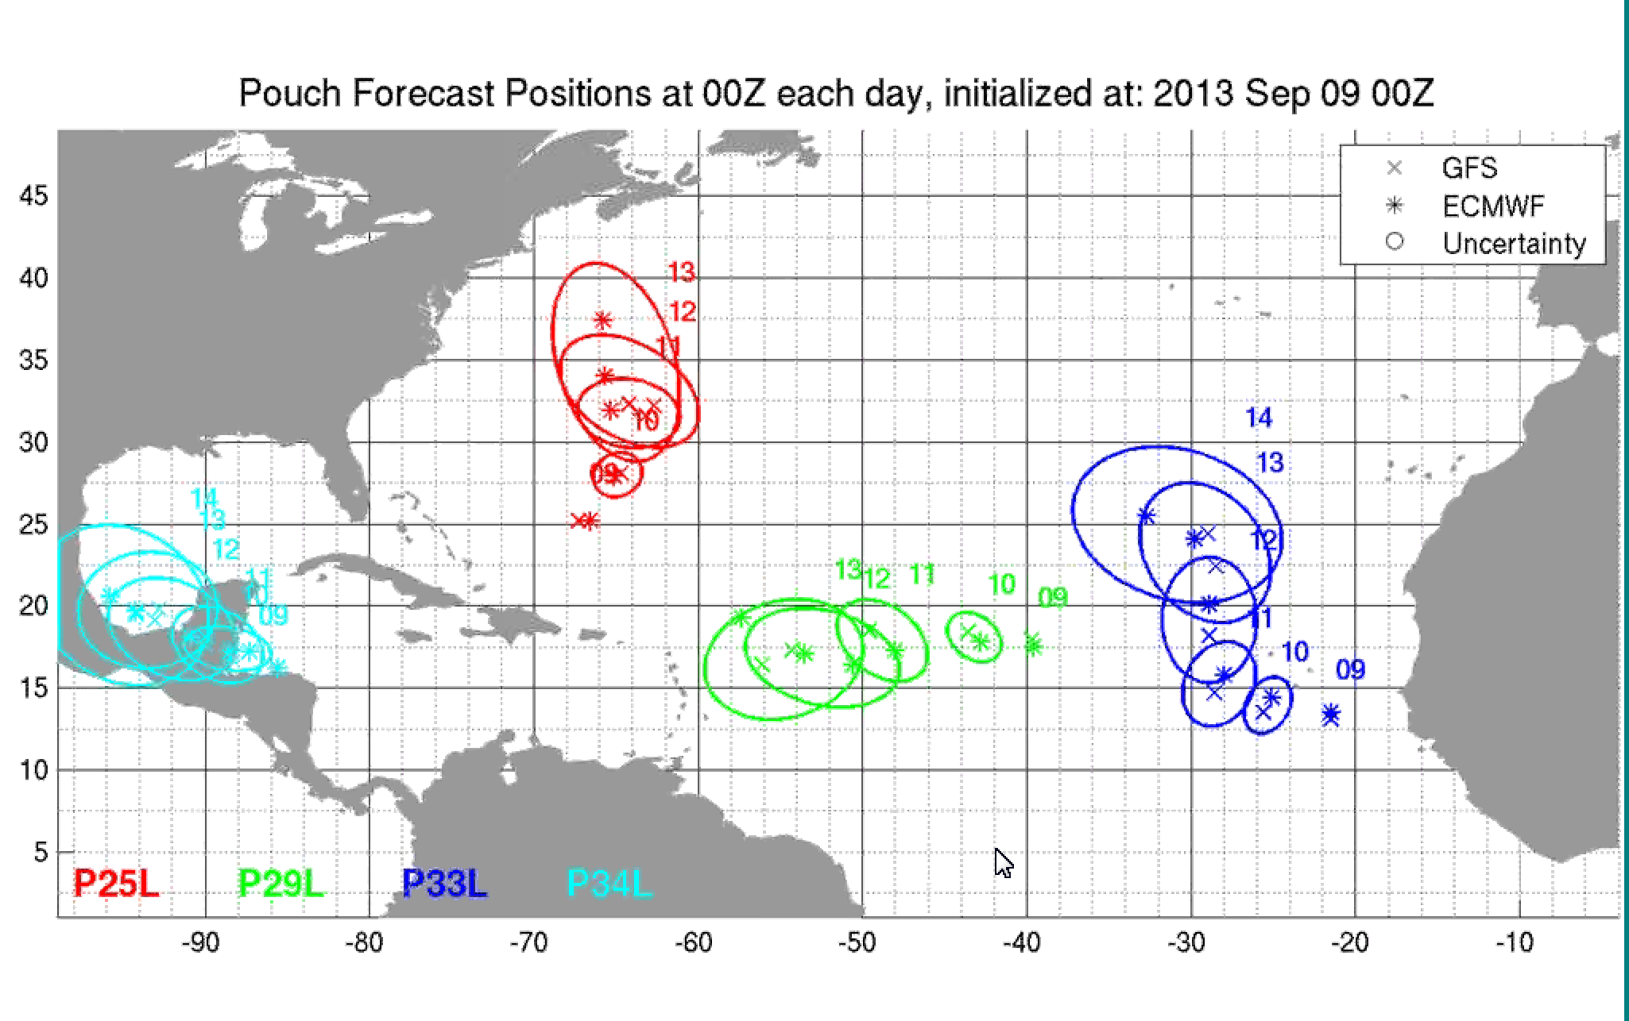

Slide 29
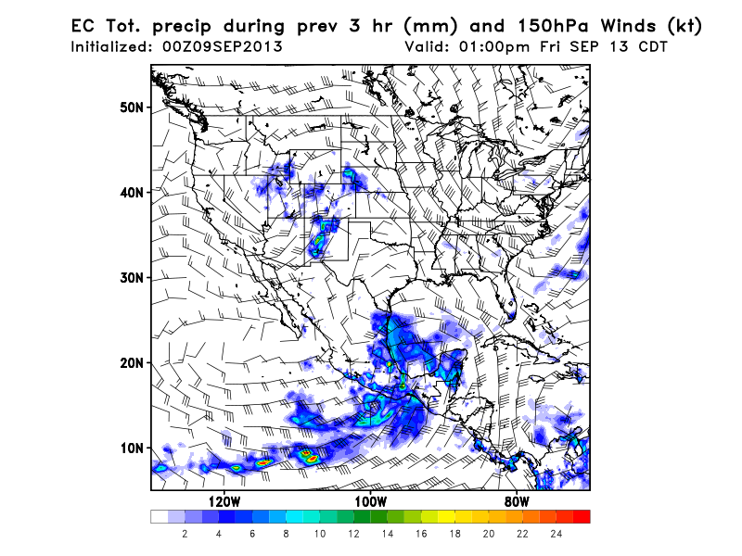
Outflow pattern is mostly south, but could get access to some of that in a Cuba-Yucatan
flight. But best shot for getting idea of what is coming up is to go through the storm.

Slide 30
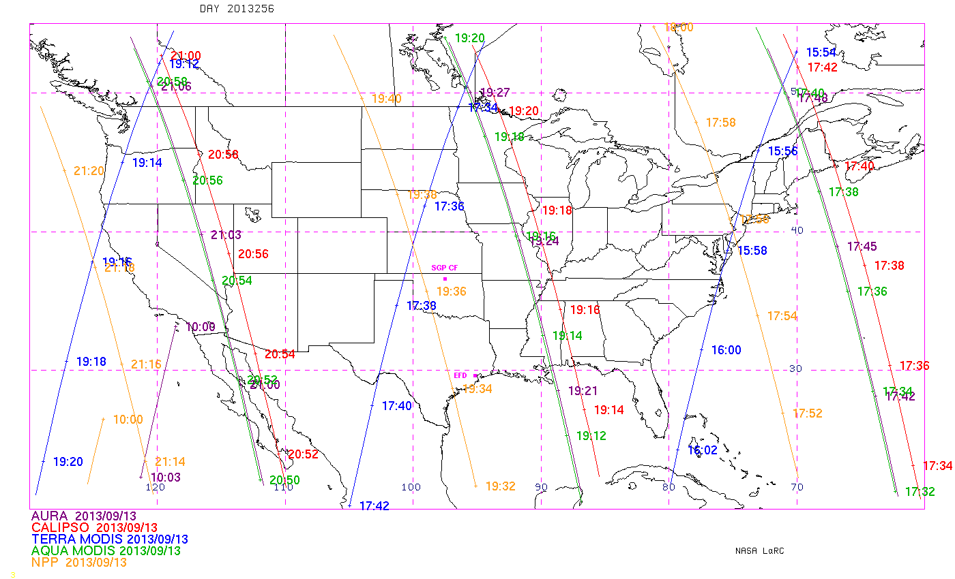
CALIPSO overpass favorable for a yucatan –Cuba flight

Slide 31
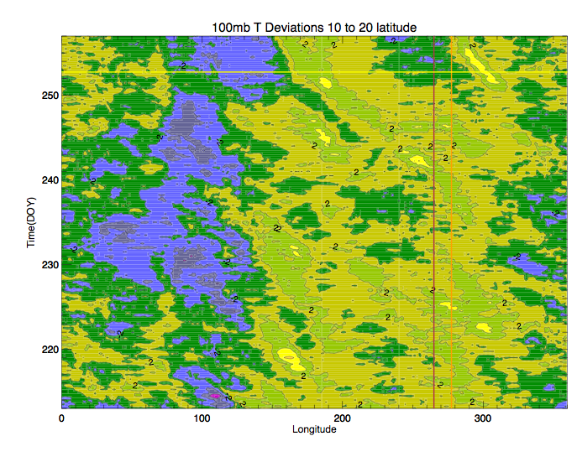
Pfister’s Pforecast
We will be flying between red and yellow line – temperatures progged to cool.
EC convection east of Yucatan progged to be less than normal as pouch goes east into
Gulf of Campeche. DC8 goes to developing storm, ER-2 through the Yucky strait??

Slide 32
Implications for Friday – wx in US

Slide 33
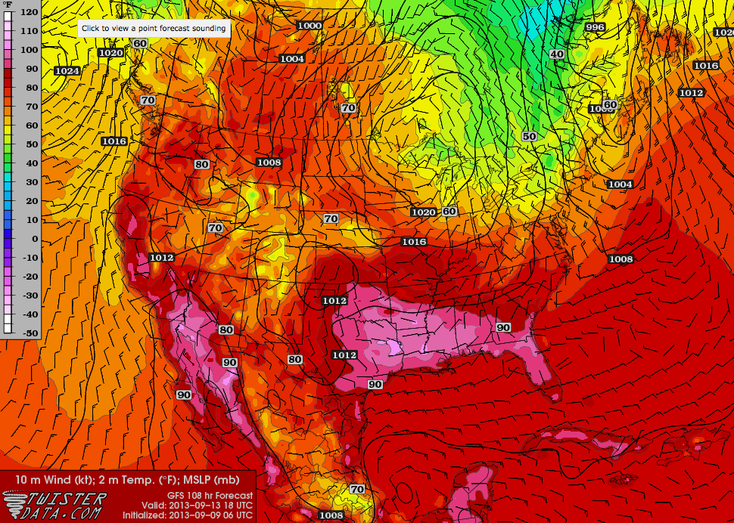
Continued hot in western pocket of SEUS ahead of slowly moving front.

Slide 34
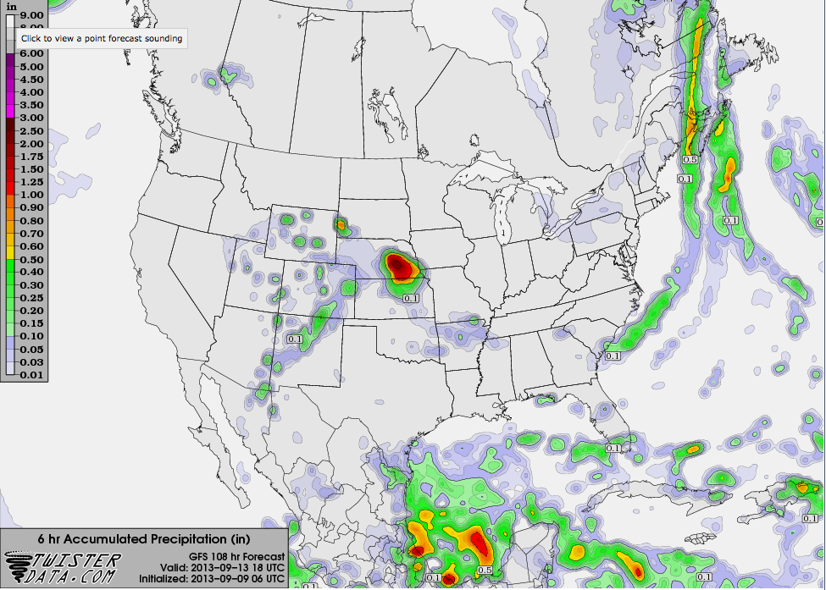
Some precip expected ahead of front – line of instability

Slide 35
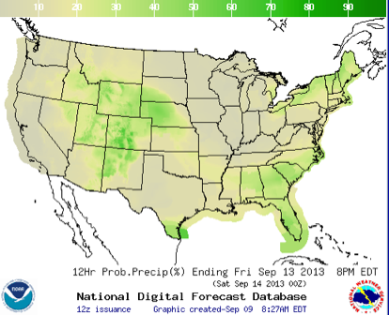
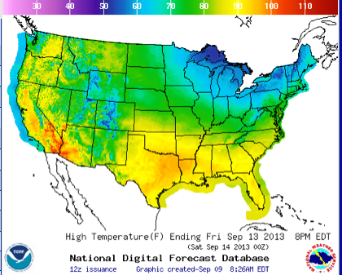

Slide 36
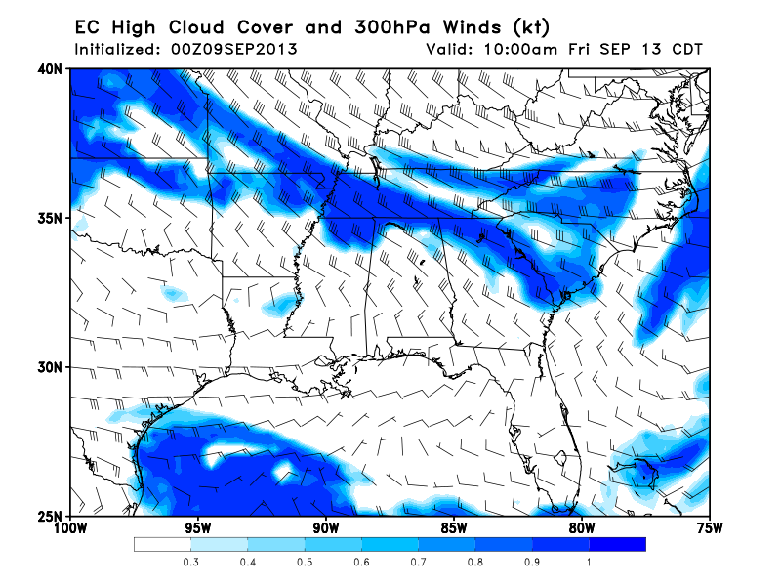
Based on precip probability, proximity of front, and direction of flow, high probability of
severe clear will probably be in TX and southern LA.

