Slide 1
WX Briefing, 201308012 for 8/14 and 8/16
Notes:
Smoke, severe weather over OK, KS associated with digging trough. Note unfavorable pattern for NAM. Note favorable pattern for smoke, More surface charts, Note TC in GMAO model as well. High cloud forecast for
Friday (get RH at high levels??)

Slide 2
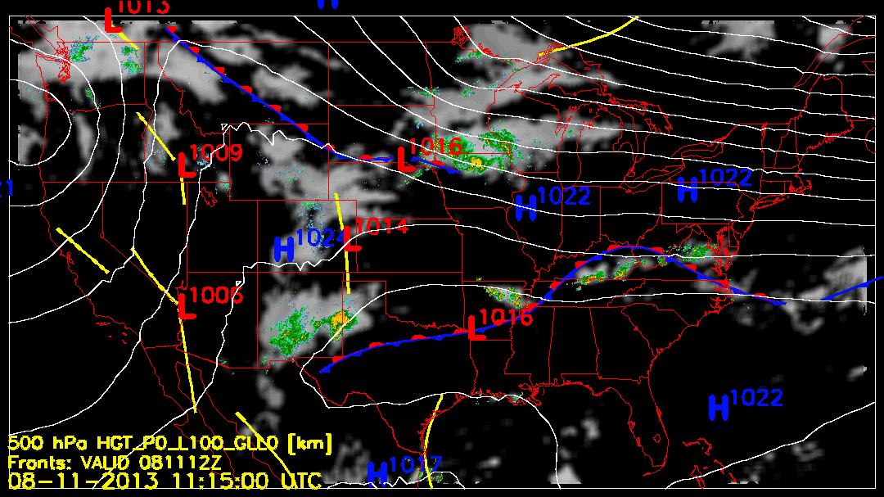
Yesterday’s Weather

Slide 3
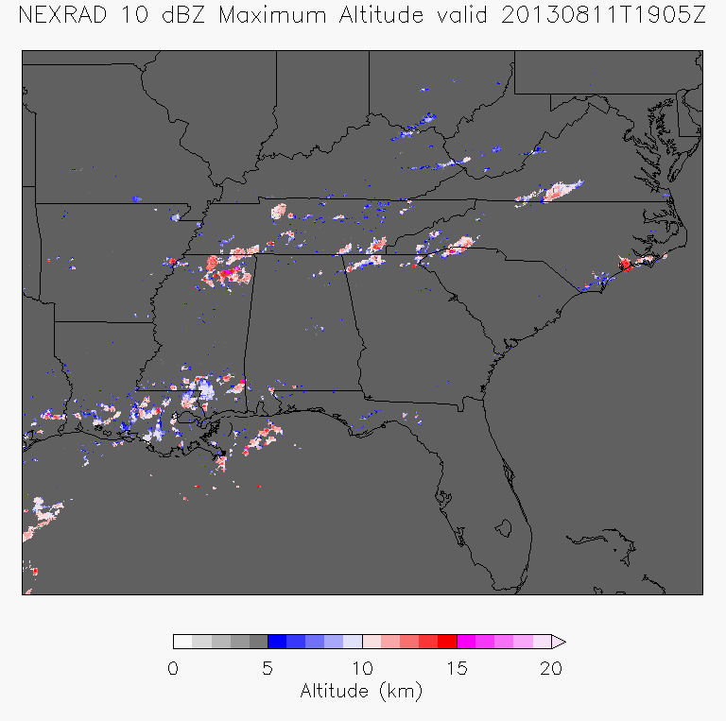
Even the small systems
are reaching to 15-18
km, which is above
the tropopause by
3 km.

Slide 4
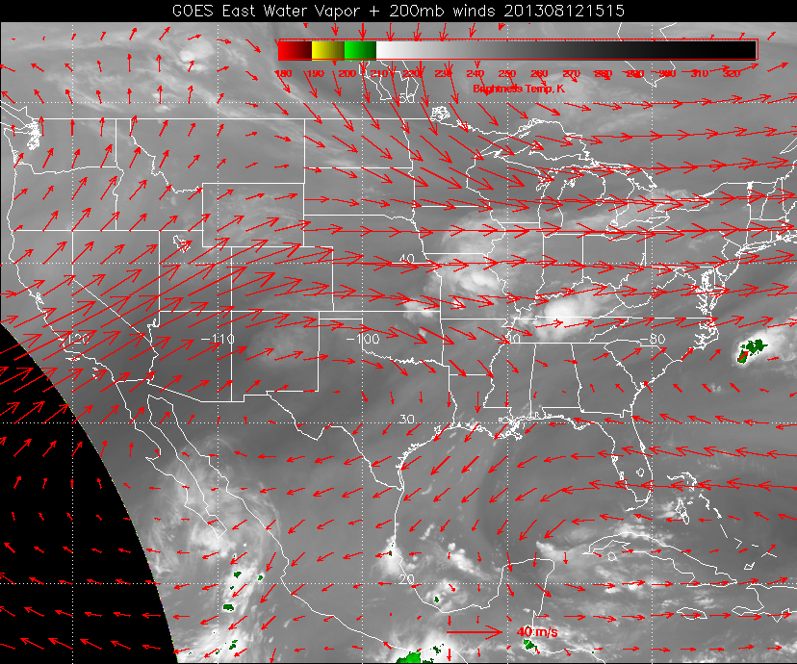
Eastern Gulf is drying out, will continue to do so. MCS over TN, convection over
NO less than expected. Can see small systems in the visible developing.

Slide 5
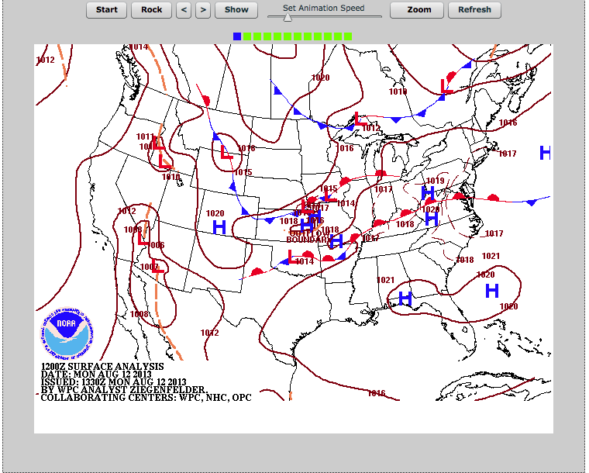
This morning: weak quasistationary front over OK to WV. Moist unstable air to the
south. Another front developing behind it.

Slide 6
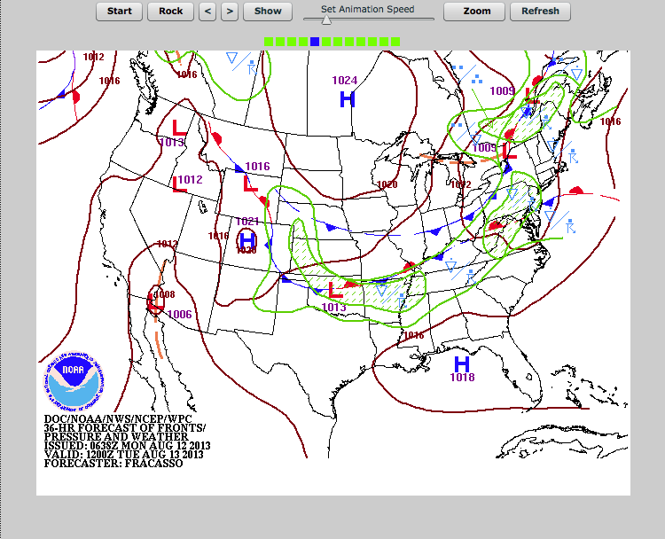
Tuesday: Southward push develops, strong convection to south of the new front.

Slide 7
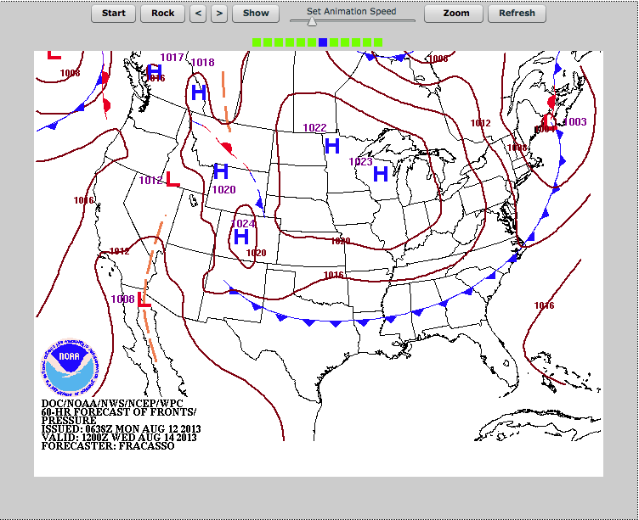
Front moves to central AL/MS by Wednesday morning.

Slide 8
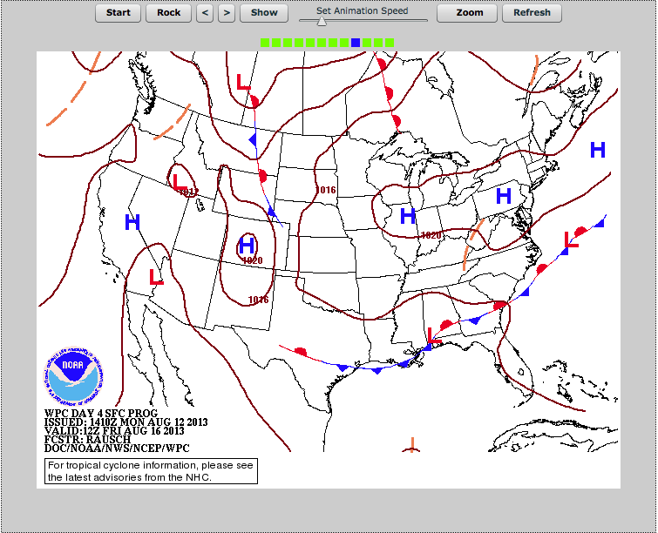
Surface analysis Friday. Depending on strength of front and forcing, could have
T-storms on Friday and Thursday

Slide 9
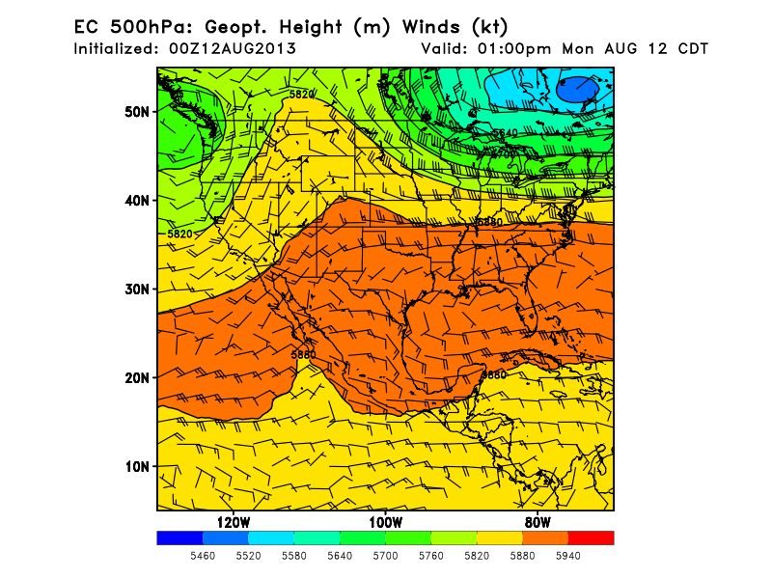
Sequence of daily
maps at 500mb
shows wave
rotating around
Canada low.

Slide 10
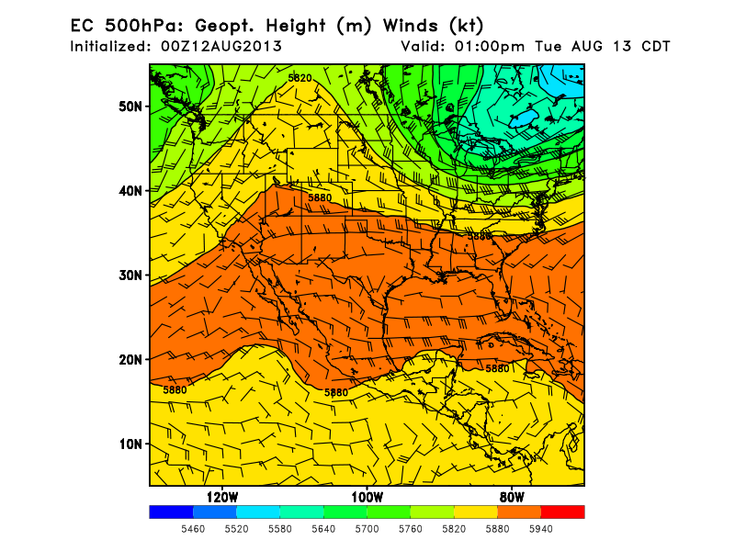

Slide 11
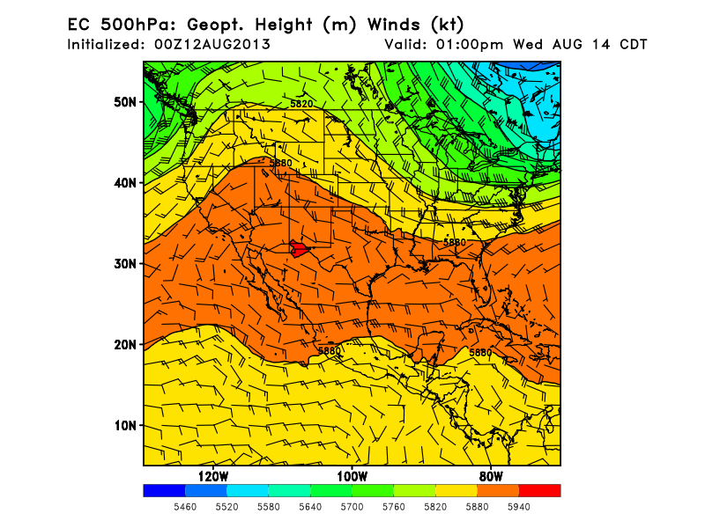
Situation Wednesday
Wave has rotated
around, pushing
front southward

Slide 12
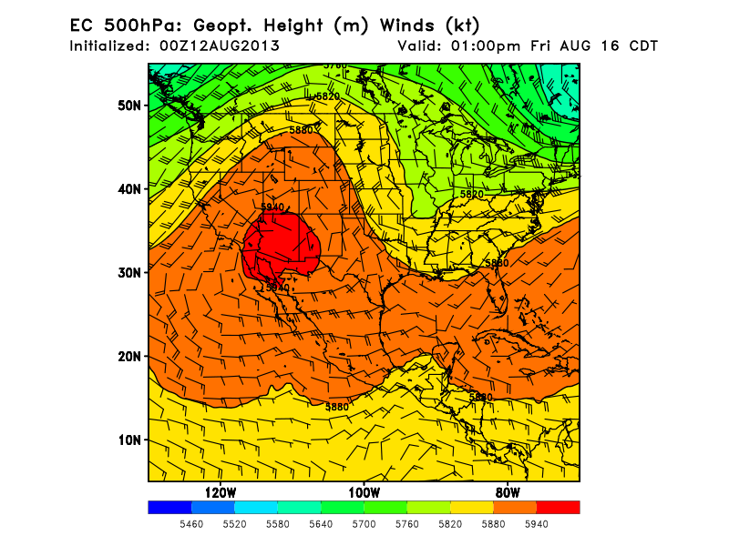
Main low moves
eastward, leaving
a mass of cool
dry air over
northern midwest
Trough and ridge
develop positive
tilt, and amplifies
by Friday. This is
a classic pattern for
the formation of
supercells over OK
and KS

Slide 13
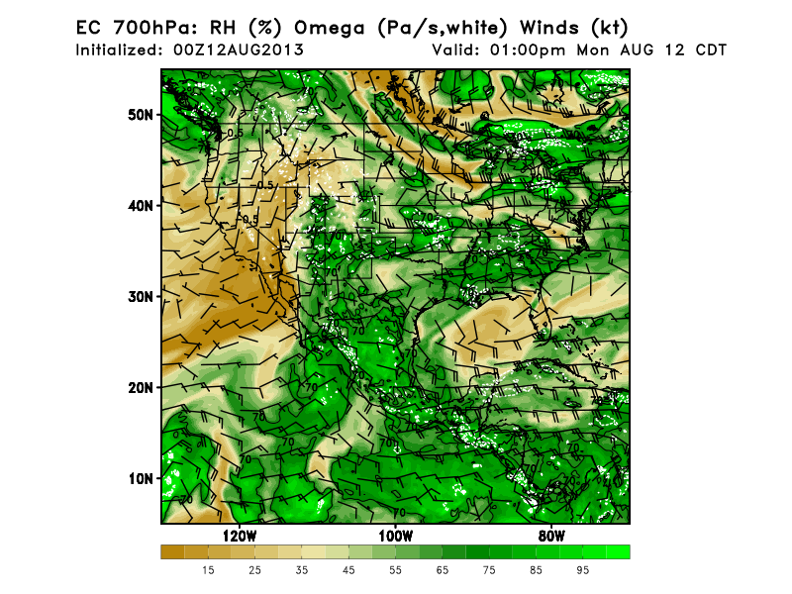
Today: Moist
air over SE,
dry air over
Gulf, note
strings of dry
air starting to
move SEward

Slide 14
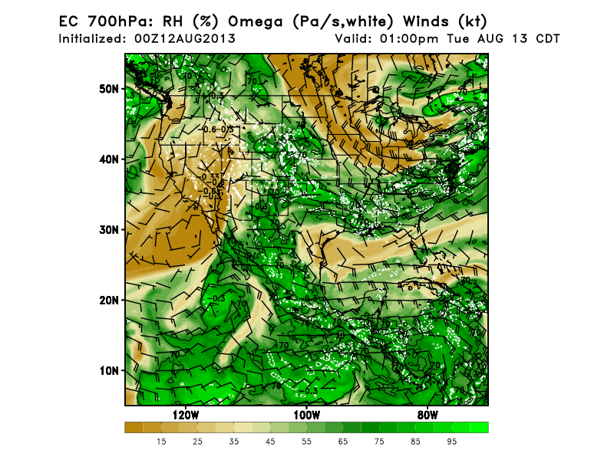

Slide 15
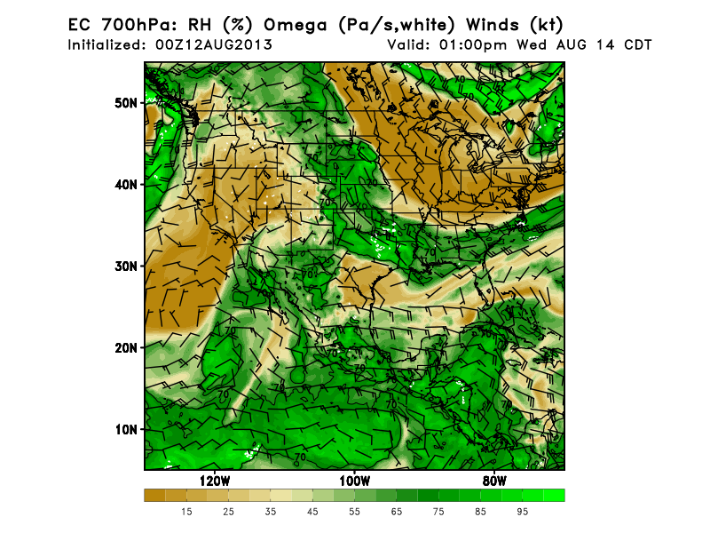
By Wednesday,
cooler drier
air behind front
is down to
northern AL

Slide 16
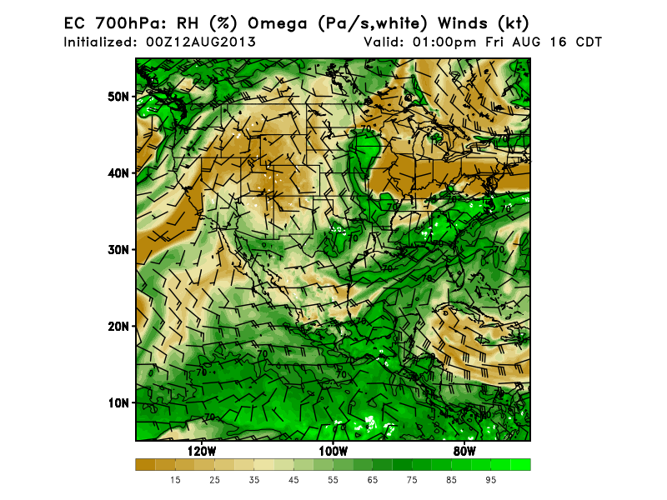
Dry air roughly
stationary, moisture
returns to Gulf,
and precip returns
to FL, which has
been dry since
last Thursday

Slide 17
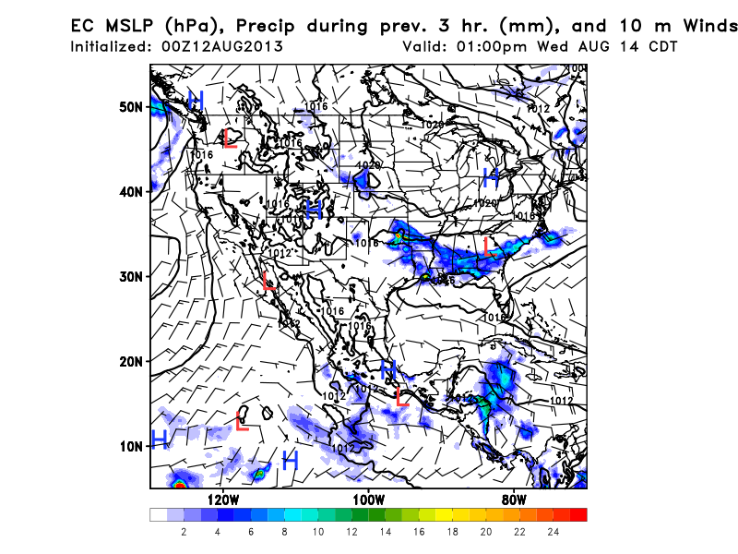
Precip in moist air
ahead of front.Expect
dists to propagate
W-E. Some MCS likely
to develop over OK
AR based on forecast
severe parameters
Run to run consistency
is reasonable; this
is actually more
aggressive than
previous runs.

Slide 18
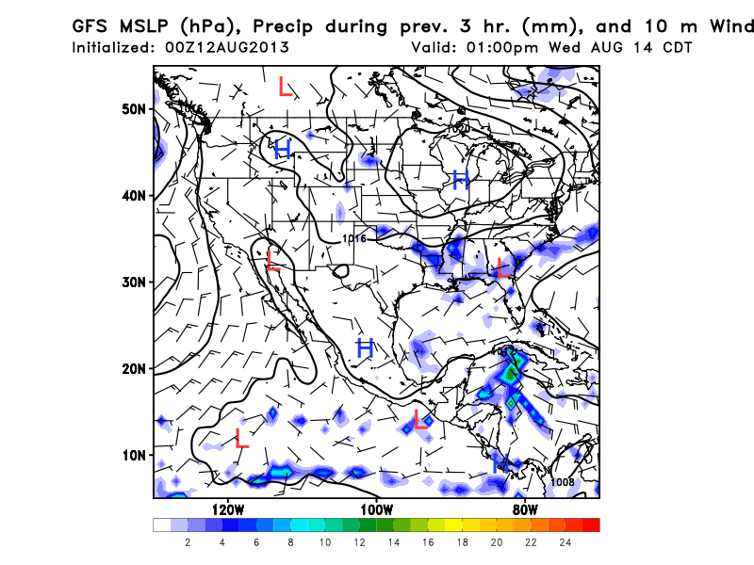
GFS has less well-
defined precip
pattern, with some
CAPE up to and into
southern TN. So,
precip at Huntsville
possible, but most
concentrated well
south.
Note no precip in
central FL since
last Thursday.
40% expected
on Wednesday.
CAPE not impressive

Slide 19
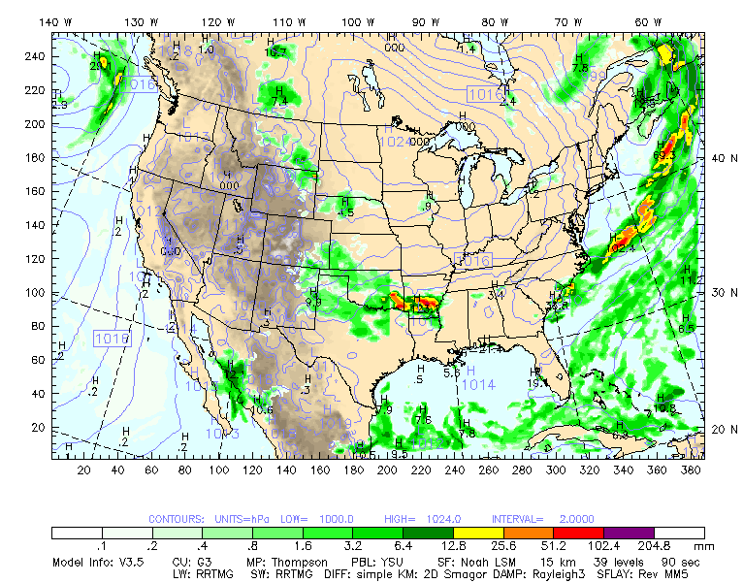
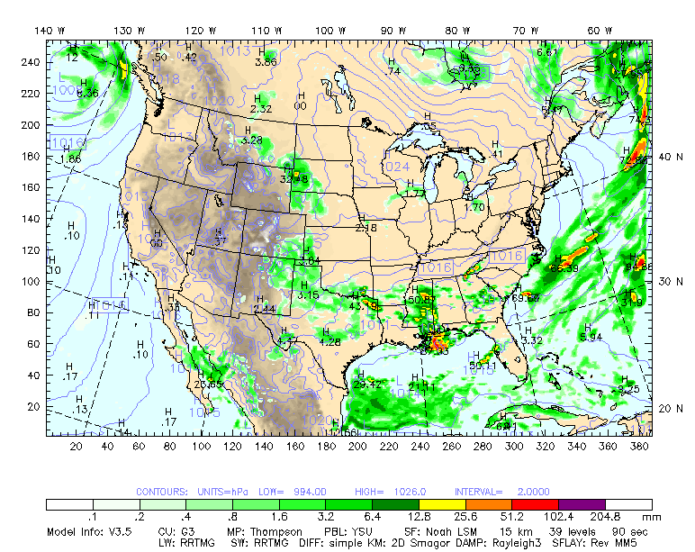
4 AM Wed, right; 1 PM Wed, below
MCS may form over OK/AR and move
eastward into SE US.
Instability and precip clearly focussed
south of line from southern AR to
south of Atlanta
We will see smaller systems also,
but the MCS will reach
the tropopause.
Note that models do not agree
on pattern of precip, though
basic structure is consistent.

Slide 20
High cloud and surface temperature

Slide 21
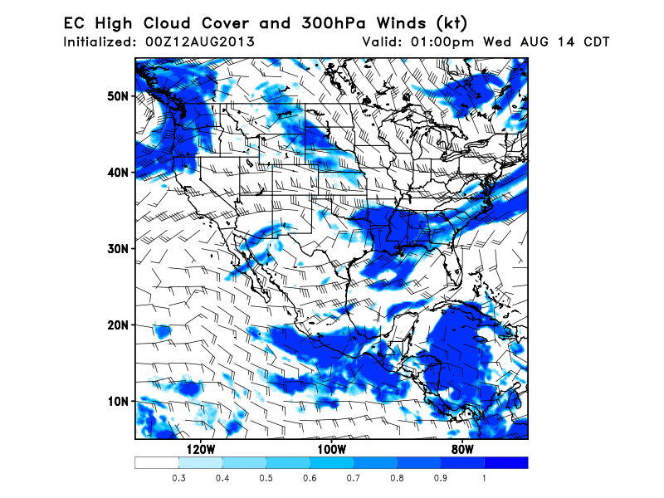

Slide 22
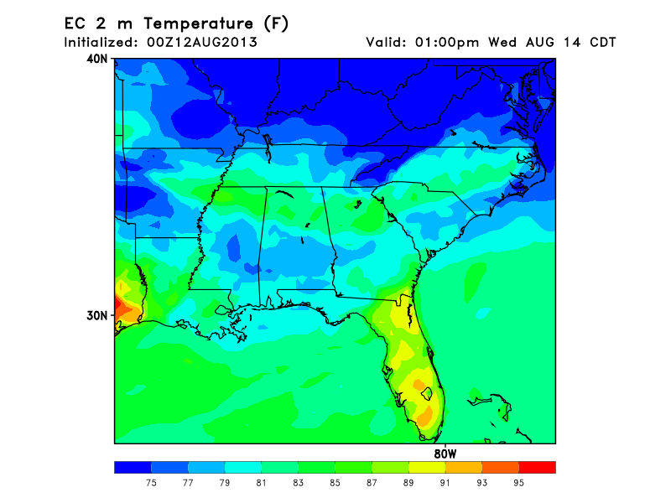
Surface temperature

Slide 23
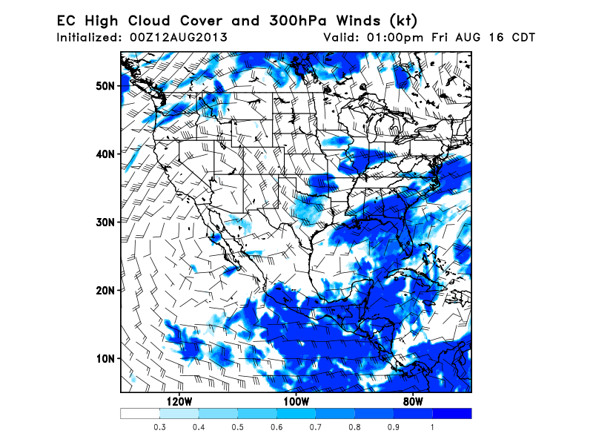

Slide 24
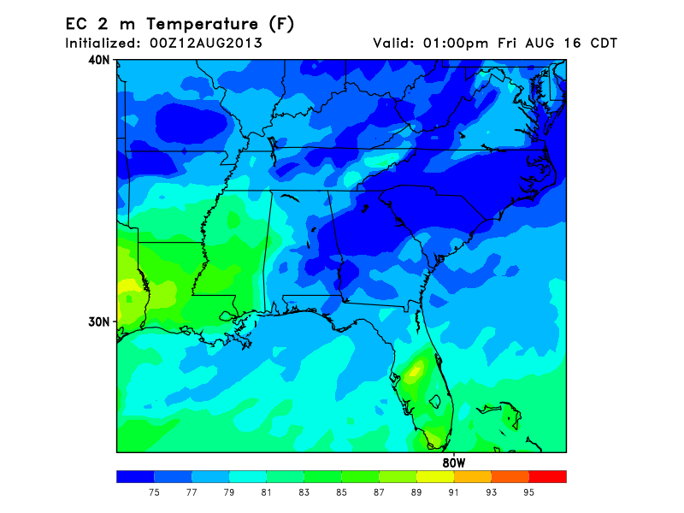

Slide 25
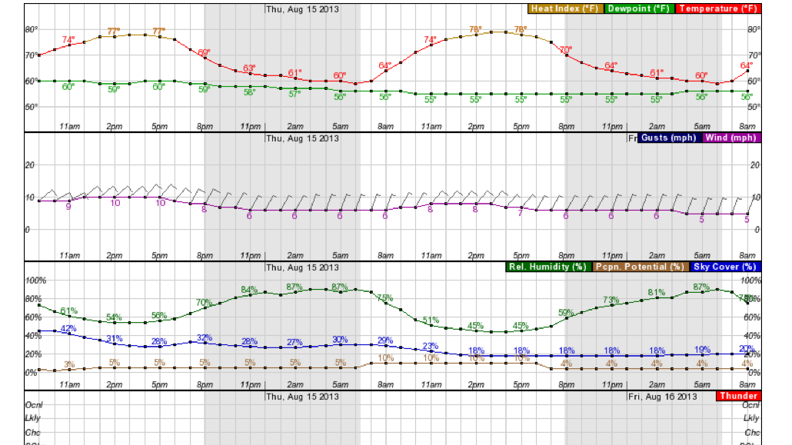
Temperature over the Ozarks. Behind the front on Wednesday, still temps in upper
70s.

Slide 26
Local weather
Ridge over us Wednesday, tropical disturbance has passed, air is dry, good flying wx.
Thursday and Friday, sagging front begins to approaches us. Models differ on progress of this front after Wednesday.
Precip chances depend on timing and strength of front when it gets here. Winds not strong (though direction will be different). At this point, Friday should be deemed flyable.

Slide 27
Anticyclone Notes
Strengthens into the week, but continues to move west over Baja by Friday with strongly amplifying trough
Large-scale models agree with evolution, though circulation strength and precip fields largely differ past 36 hr
Convection should be active in Northern Mexico through Friday

Slide 28
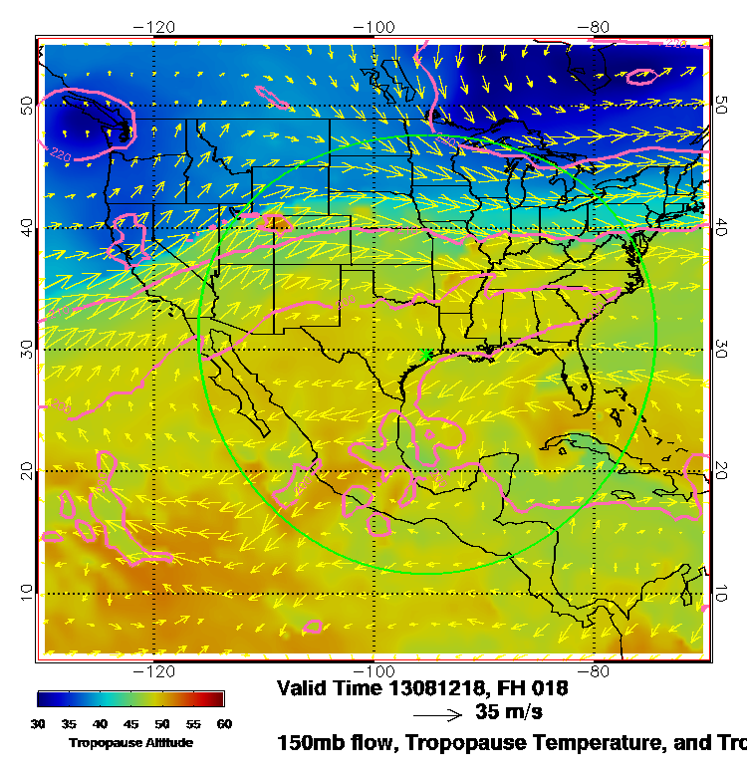
Sequence of trop height and
150 mb wind. Can see
rotating wave. Deep amplific-
ation at this level does not occur
until Friday.

Slide 29
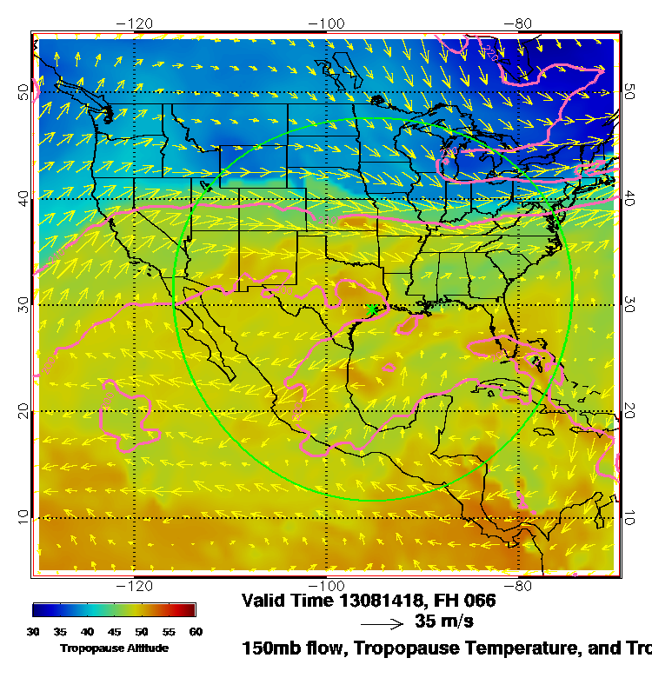
Wednesday

Slide 30
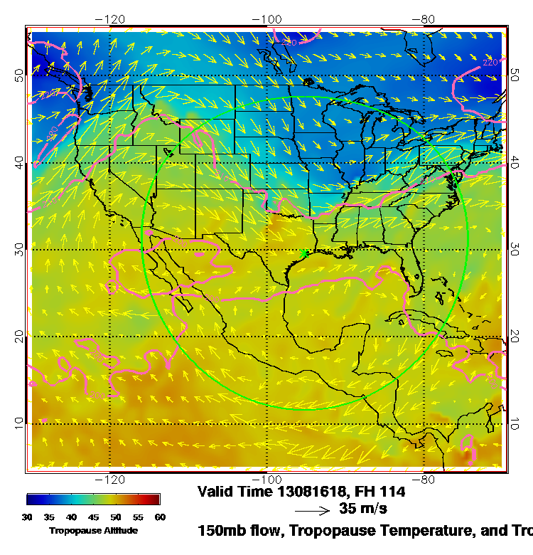
Pronounced anticyclone over
Baja, accompanied by
significant convection over
northwestern Mexico.
Models have been under-
estimating convection in
western US and northern
Mexico the last few days.
Problem is the anticyclone
is too far west

Slide 31
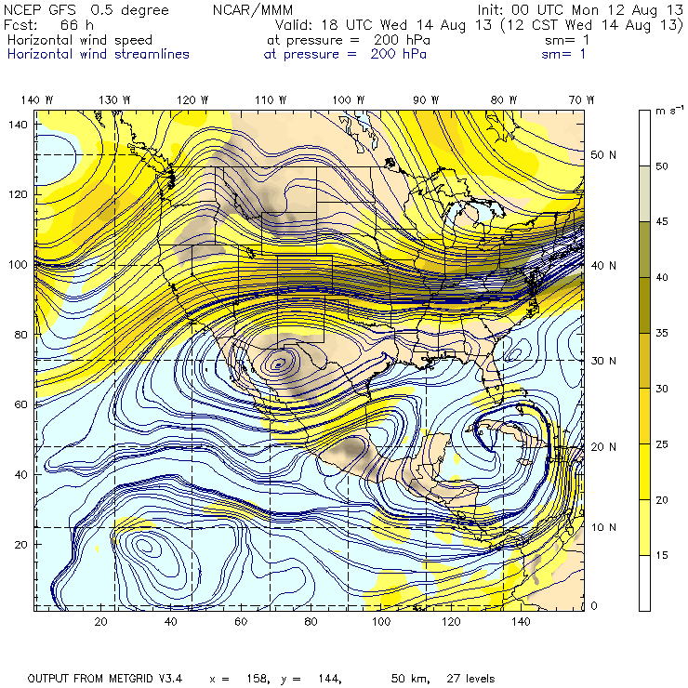
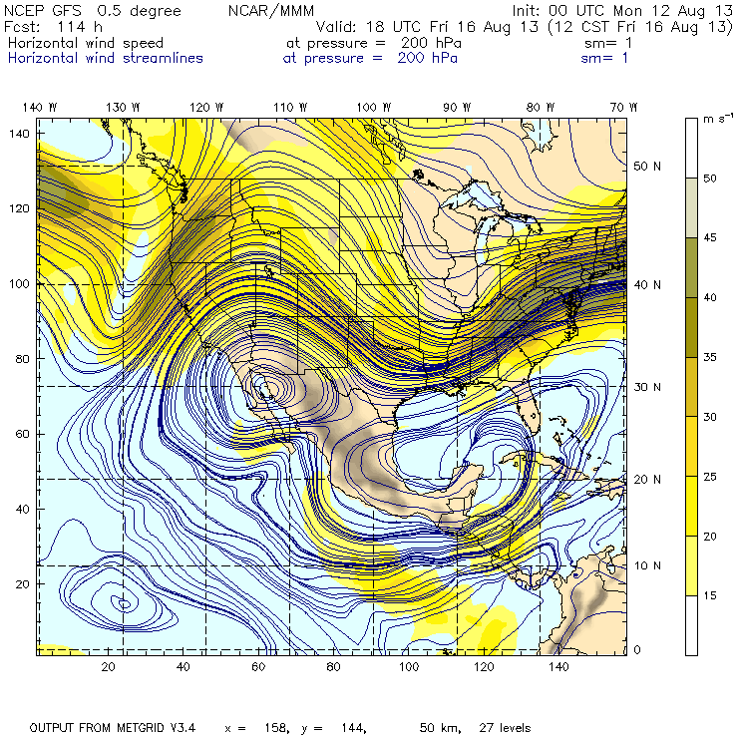
Streamline plot at 200 mb
00Z GFS @ 18Z Wednesday
00Z GFS @ 18Z Friday
Highly Amplified
Westward digging trough moves anticyclone westward. Longer runs do not indicate
any redevelopment (6Z GFS, 180 hours)

Slide 32
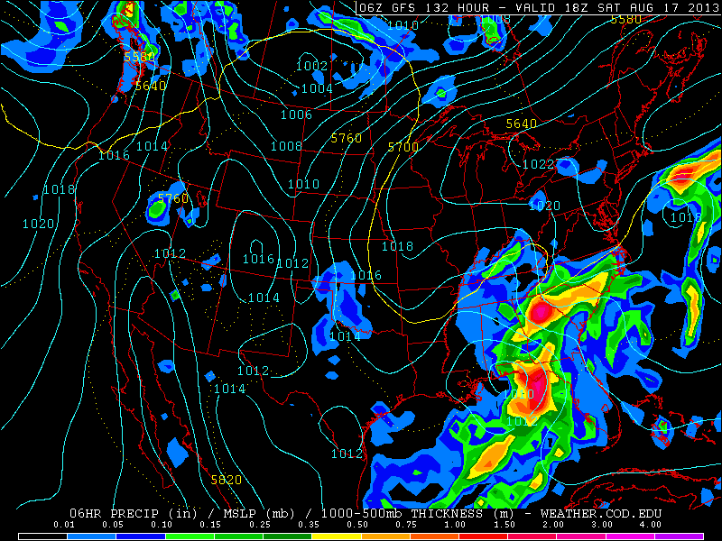
GFS has tropical depression moving into panhandle. Outlier among models, but should
mention this.

Slide 33
WX Briefing, 201308012 for 8/14 and 8/16
Front north of us moves South by Wednesday and strengthens (with strong upper level support) leading to strong convection and/or precip from OK across the SE into the Atlantic.
Dry air associated with high is behind the front, with cooler temps and clear skies.
Gulf drying on Wednesday, remoistening on Friday.
Expect some MCS type convection propagating along the front on Wednesday
Upper air pattern amplifies (trough east, ridge west), and front moves further south by Friday. Favorable pattern for severe weather over OK, KS
Anticyclone strengthens by Friday, but is too far west.
Another attempt by the GFS to generate a TD/TC. But, a tropical wave is expected, which HS3 plans to fly
Notes:
Smoke, severe weather over OK, KS associated with digging trough. Note unfavorable pattern for NAM. Note favorable pattern for smoke, More surface charts, Note TC in GMAO model as well. High cloud forecast for
Friday (get RH at high levels??)

