Slide 1
Weather Brief
Sunday, 11 August 2013
SEAC4RS MET Team

Slide 2
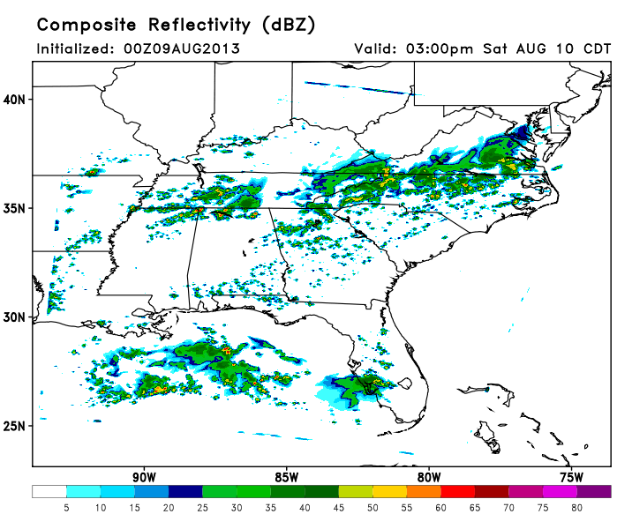
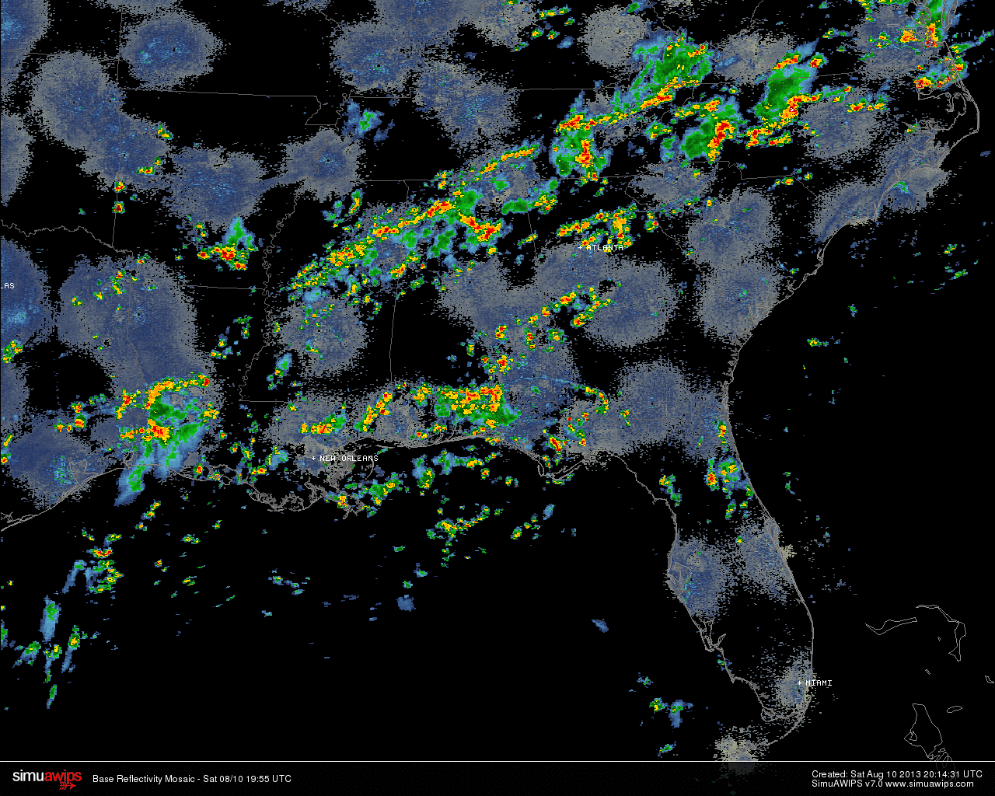
Yesterday’s Convection
3 PM CDT
1.5 day WRF forecast is picking up general features of convection

Slide 3
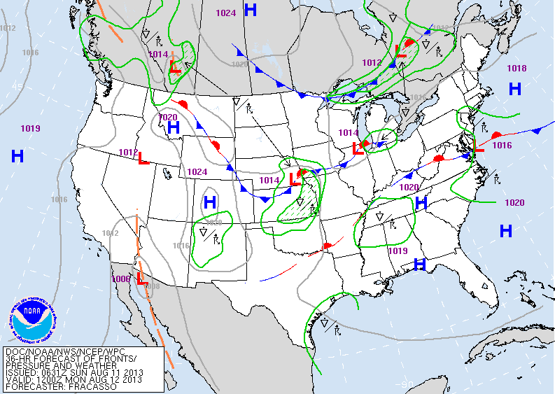
Looking at Monday’s flight
Valid: 7 AM CDT

Slide 4
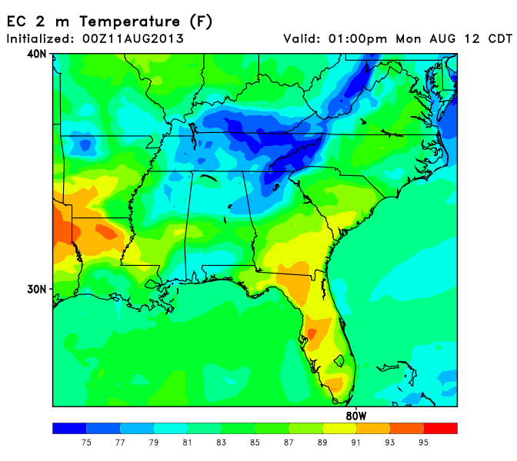
Temperatures in the mid to upper 80s south of the front
Mid 70s north of the front

Slide 5
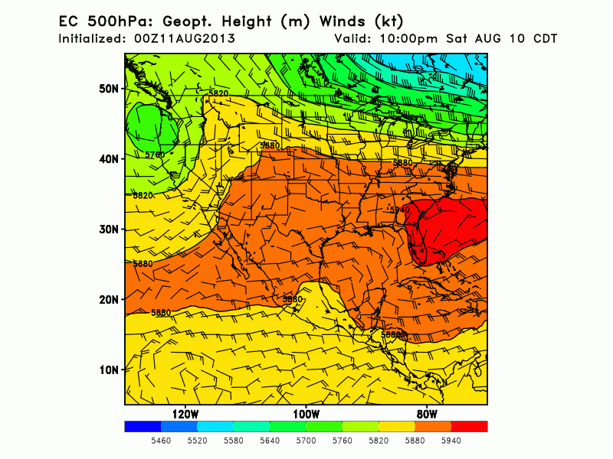
10 PM Sat – 10 PM Mon
Flow amplifies into Monday
Anticyclone slowly develops over SW

Slide 6
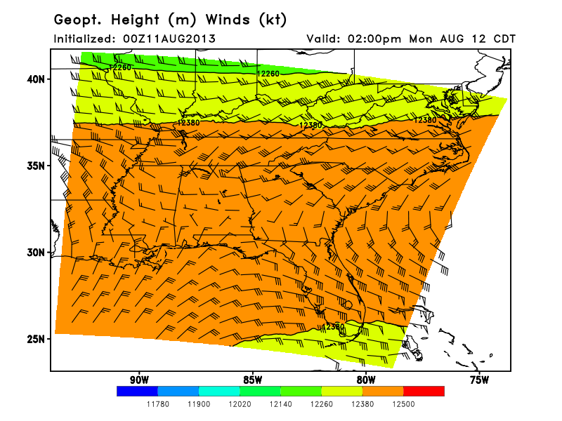
200 hPa
Deformation zone near central/south central AL

Slide 7
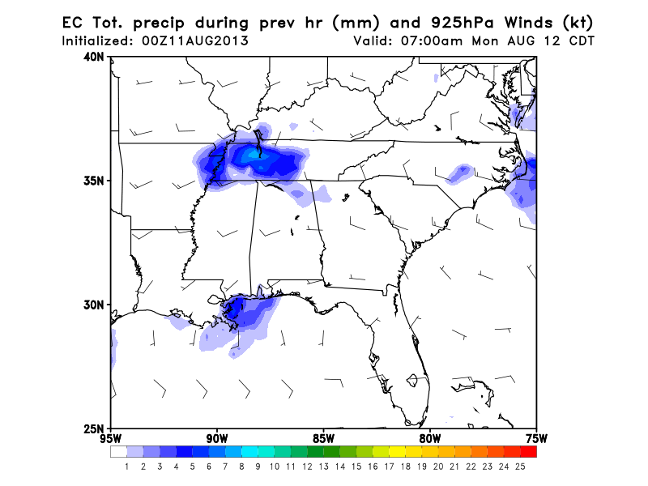
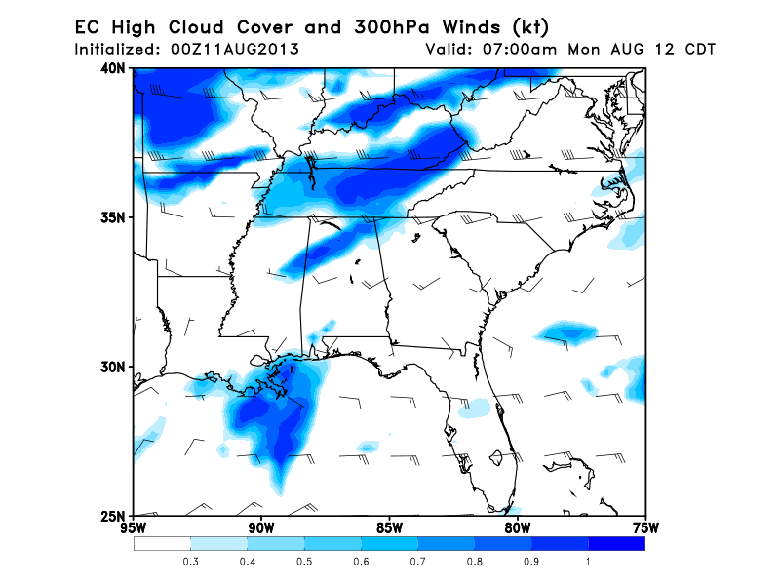
7 AM Monday
Chance of precip and high clouds off the LA coast

Slide 8
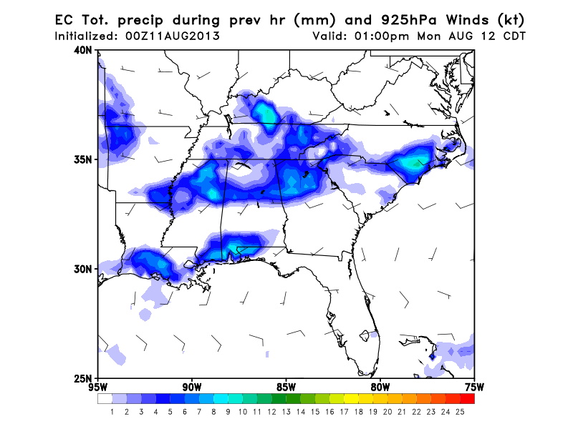
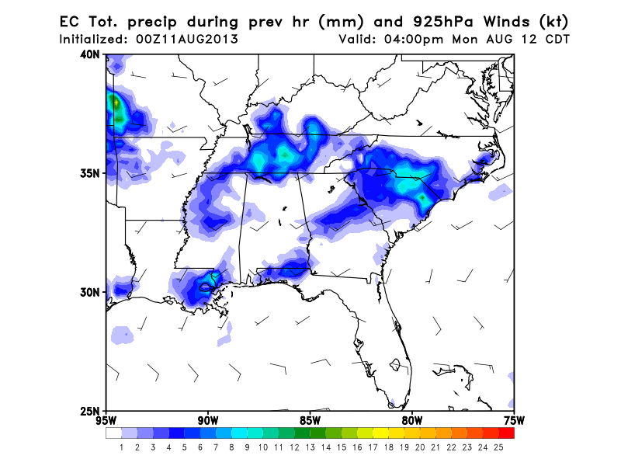
1 PM CDT
4 PM CDT
925 hPa flow from the SW/WSW Monday afternoon
Widespread precip in the afternoon with focus along front

Slide 9
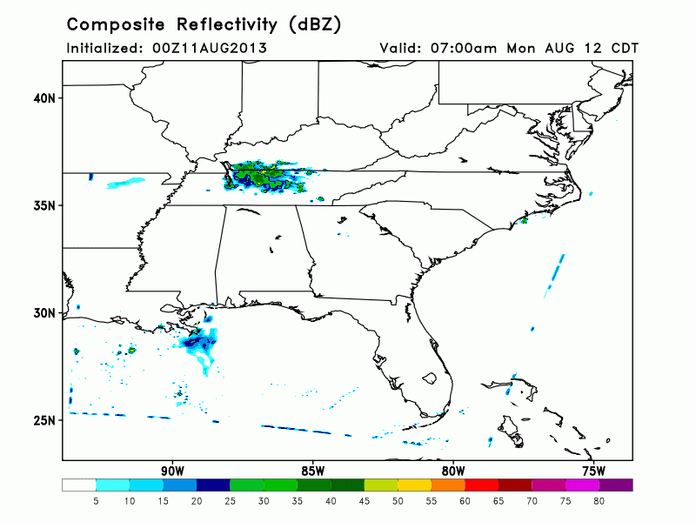
7 AM – 8 PM Monday
MCS development early Monday morning around Tennessee
Could help support earlier convective initiation

Slide 10
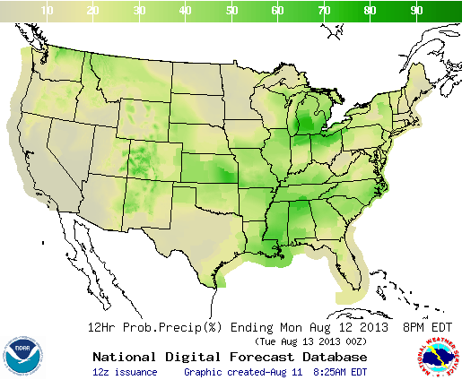
12 h POPs ending 8 PM Monday

Slide 11
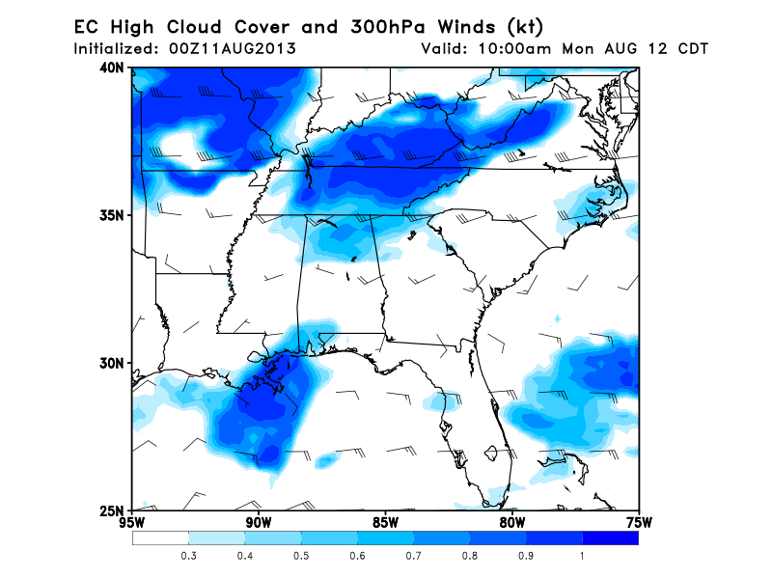
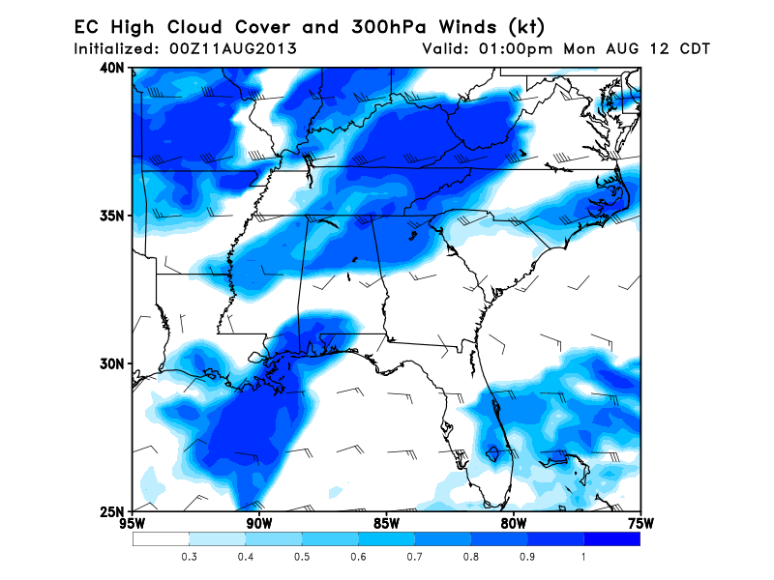
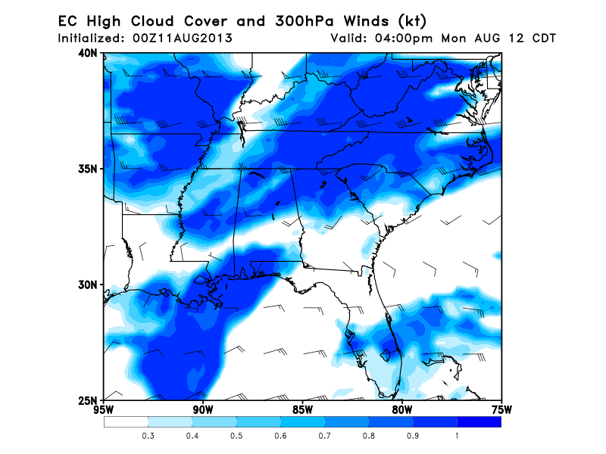
10 AM CDT
1 PM CDT
High clouds become more widespread throughout day
4 PM CDT

Slide 12
Summary
Weak front along Tennessee Valley
Convectively active over AL-MS
Morning convection off SE LA coast
Will require deviations around storms
Exact storm locations cannot be forecast now
Front and precip move south during week

