Slide 1
Weather Briefing
Saturday 10 August
Henry Fuelberg
Nick Heath
Sean Freeman
Lenny Pfister
Jim Bresch

Slide 2
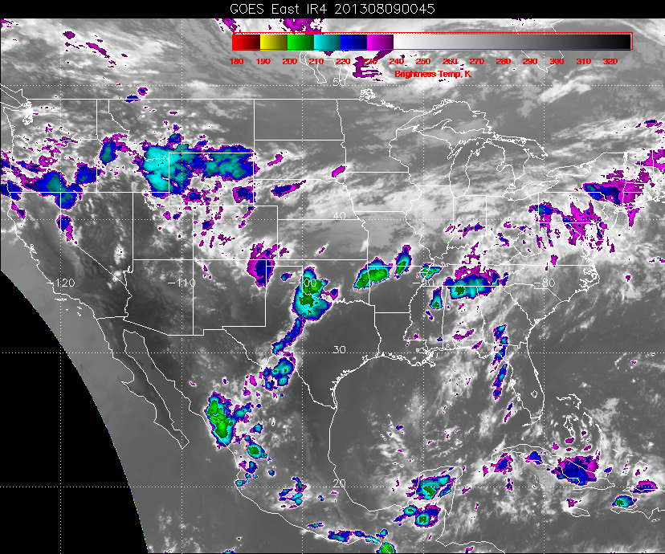

Slide 3
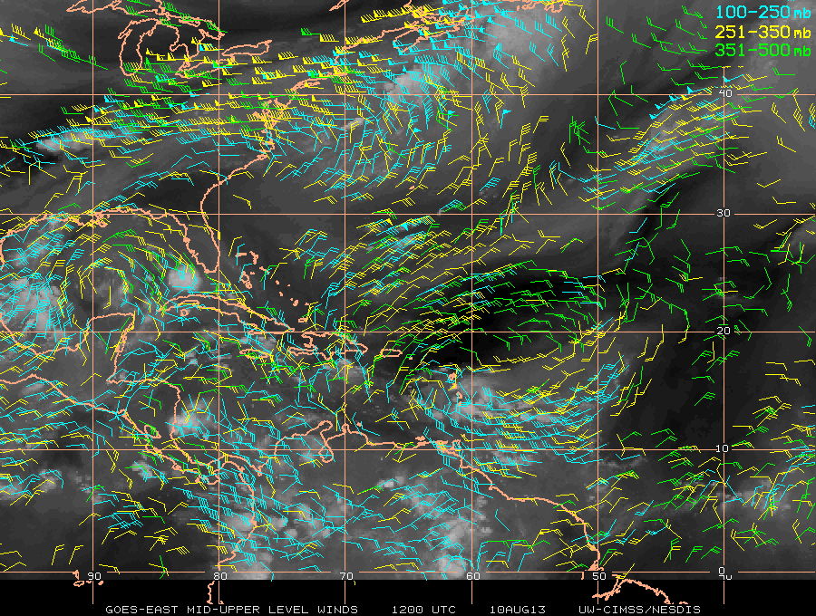
Upper-level winds at 7 AM CDT

Slide 4
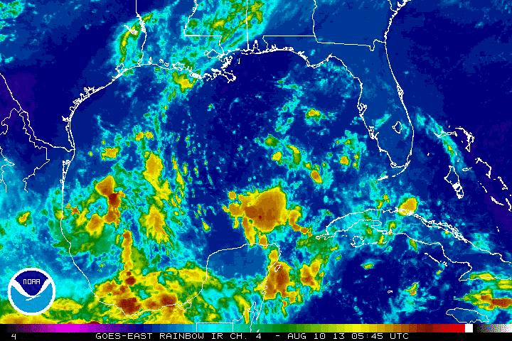

Slide 5
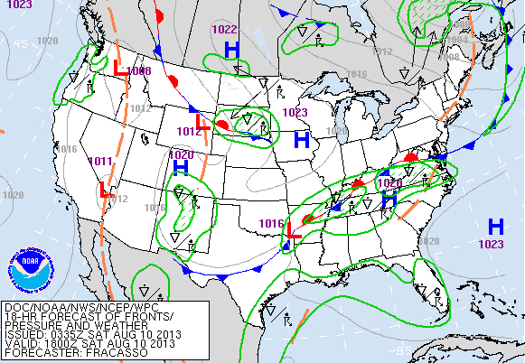
Today 1 PM

Slide 6
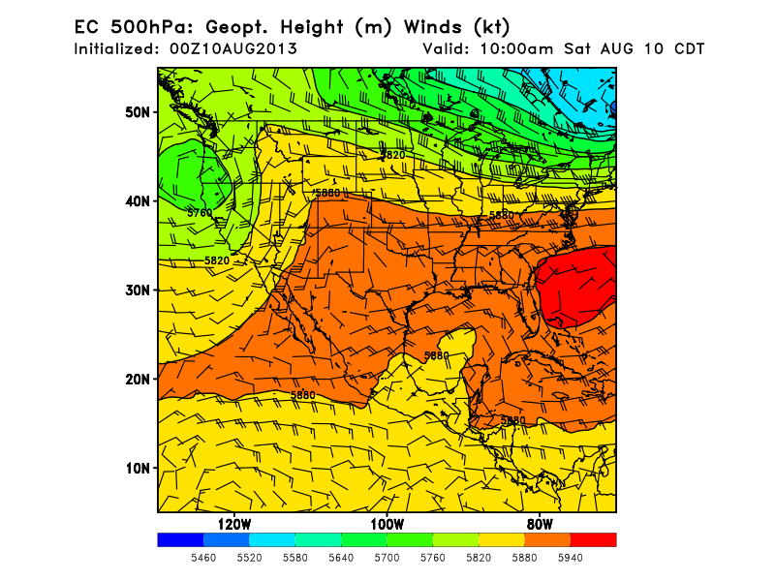
L
H

Slide 7
Monday

Slide 8
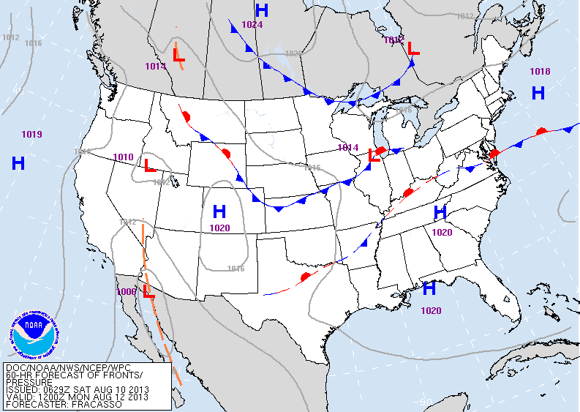

Slide 9
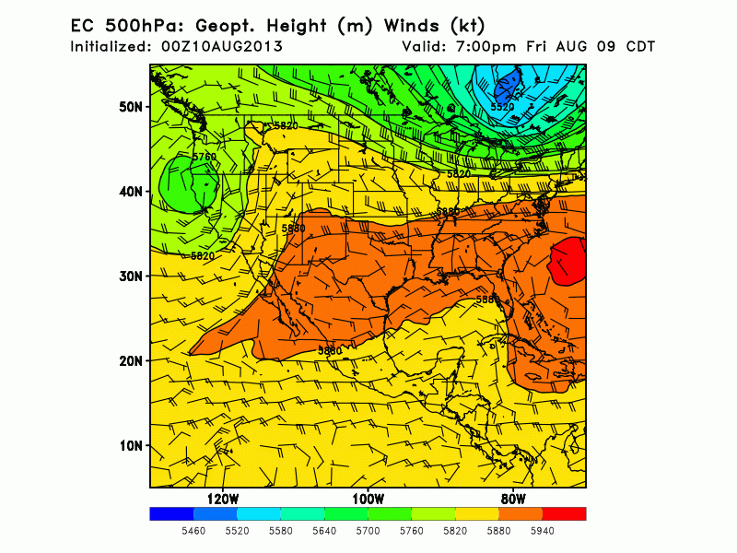
Ridge moves westward over SE USA
Trough begins sinking into Tennessee valley
Shear zone
Sharp ridge to the west

Slide 10
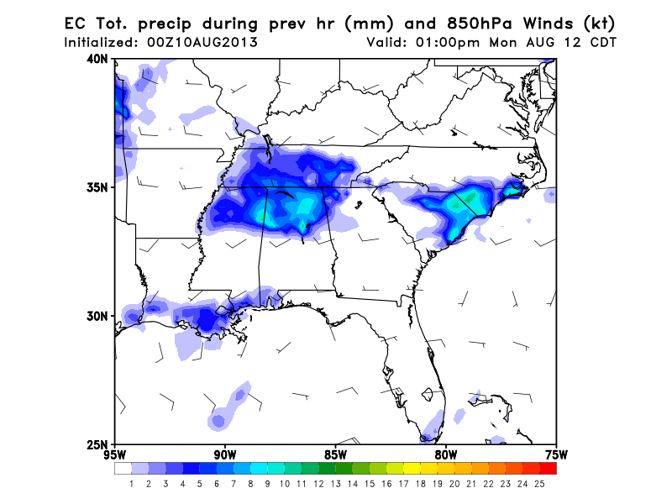
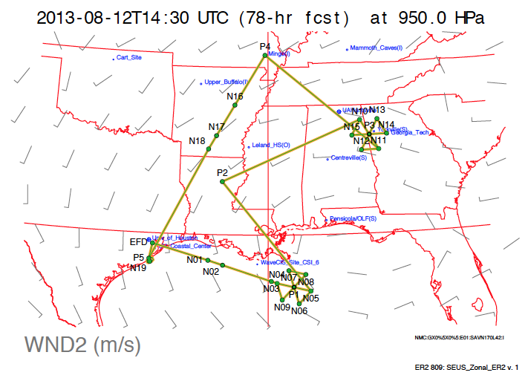
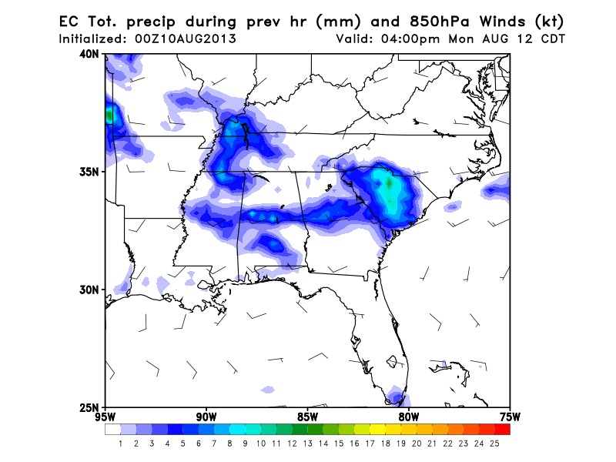
Modify track or timing?

Slide 11
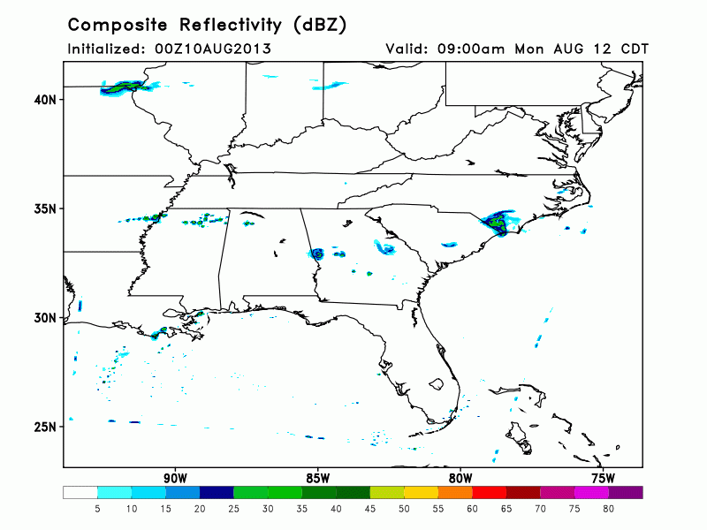
FSU 3.75 km WRF

Slide 12
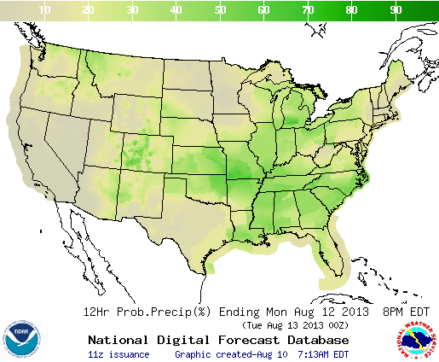
12 h PoP Ending 8 PM Monday

Slide 13
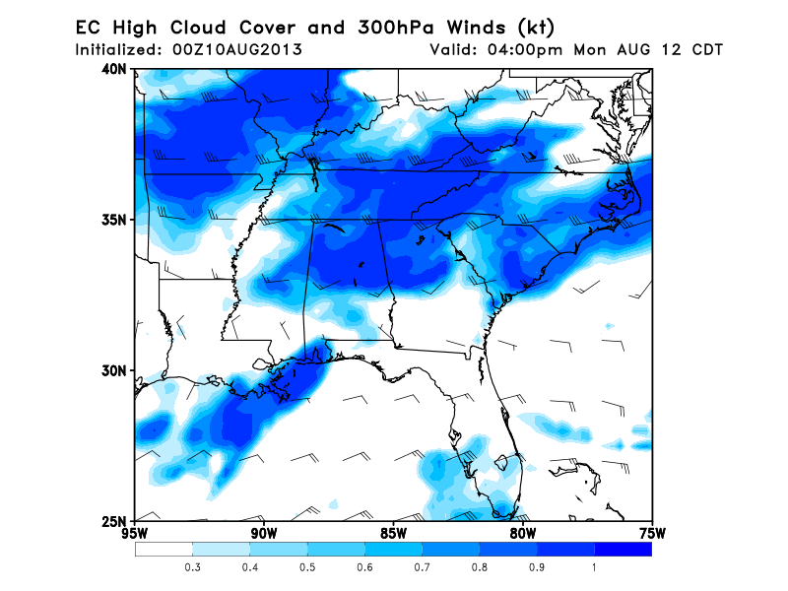

Slide 14
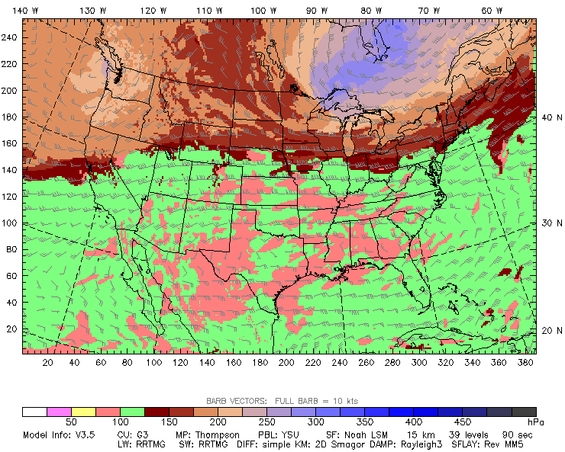
NCAR 15 km WRF (Jim Bresch)
Tropopause Height (mb)

Slide 15
Wednesday

Slide 16
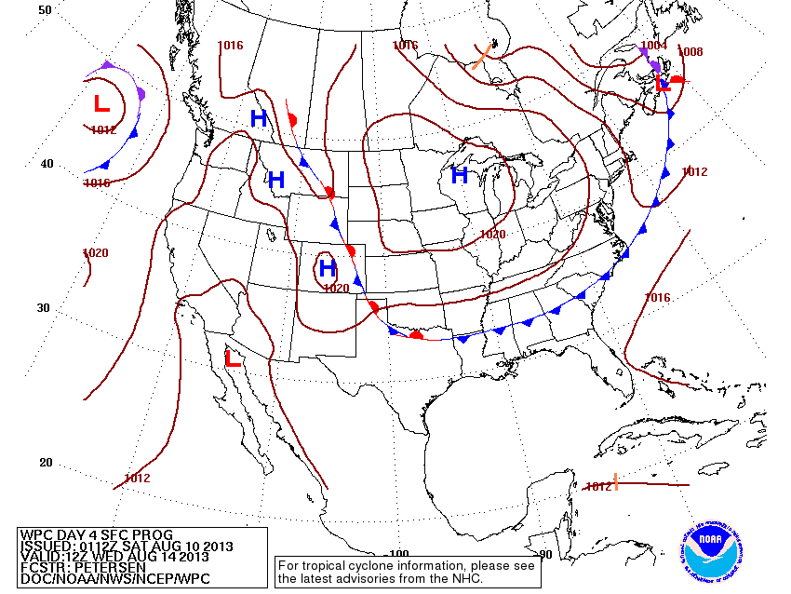

Slide 17
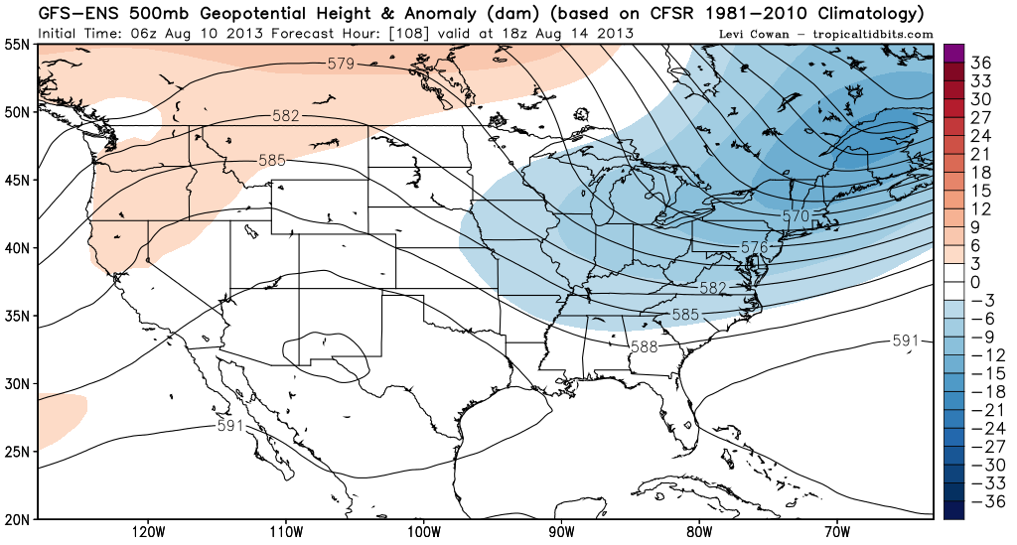
Monsoon high redevelops by Wednesday

Slide 18
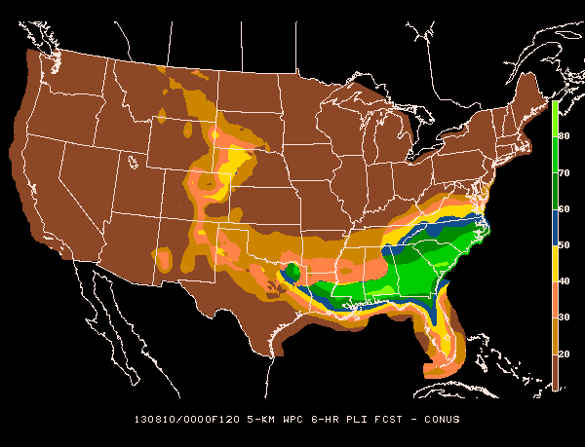
Wednesday 6 h PoPs

Slide 19
Friday

Slide 20
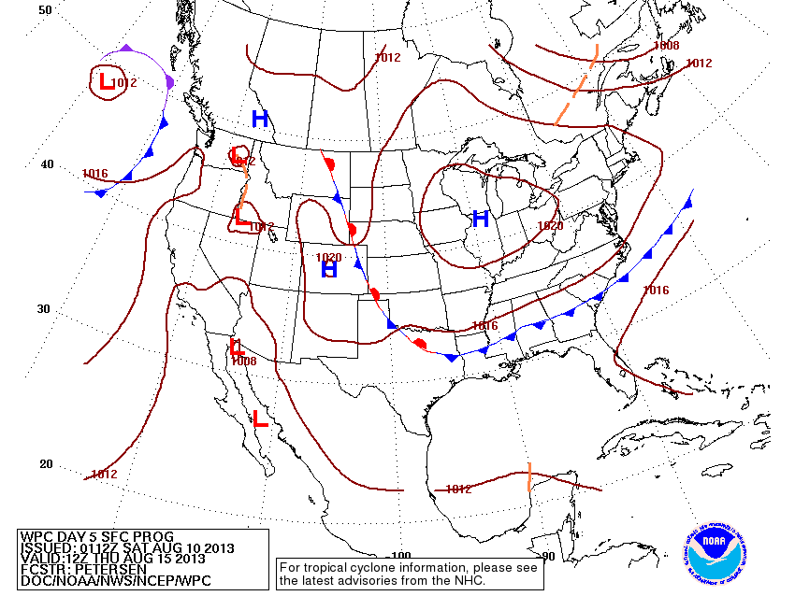

Slide 21
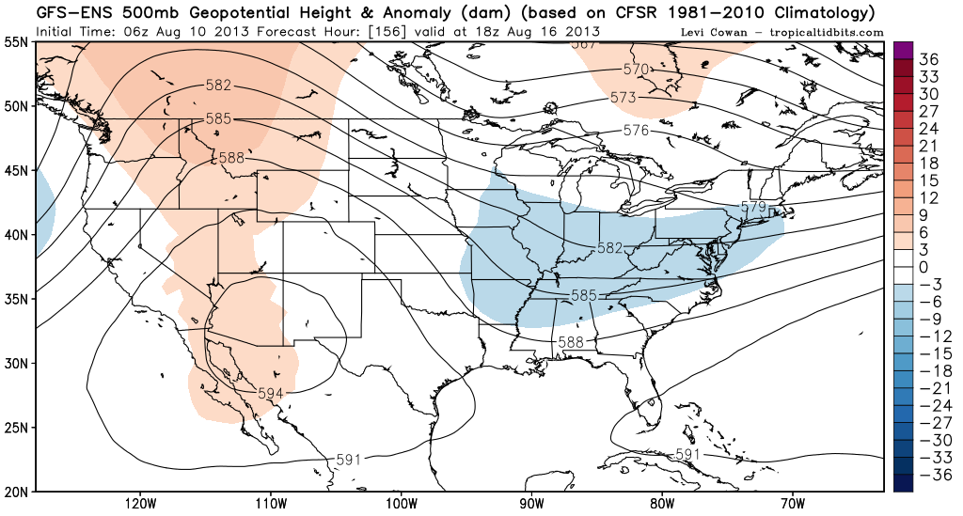
Monsoon high persists
Shortwave prominent over eastern CONUS

Slide 22
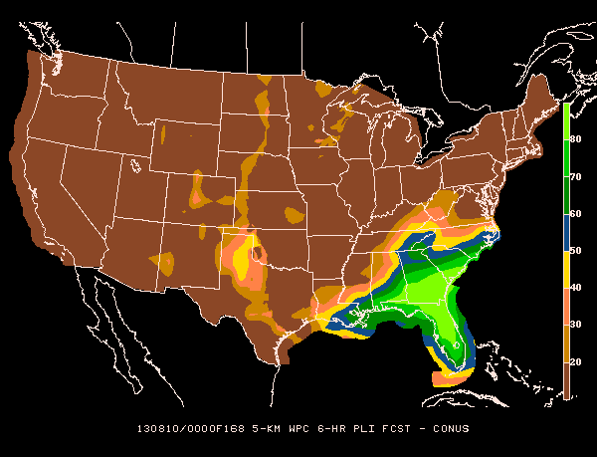
Friday PoPs

Slide 23
Summary
Weak stationary front along Tennessee Valley
Convectively active over AL-MS
Will require deviations around storms
Exact storm locations cannot be forecast now
Front and precip move south during week
Summer anticyclone re-develops later in week
………….without convection over SW U.S.
Possible TC in Gulf late next week ??????

