Slide 1
Briefing, 20130809, 8/12, 8/13
Current quasi-stationary front from TX Panhandle ENEward to Kentucky is expected to sag southward over the SE in the next few days. This front had been nearly E/W prior to yesterday, when convection focus shifted from KS to northern TX/OK.
This is consistent with the impinging upper level Pacific trough and the collapse of the upper level monsoon anticyclone which began yesterday.
Front is expected to move in response to several shortwaves rounding an upper level low over western Ontario.
Models amplify this trough, moving the front across northern AL late Monday into Tuesday. EC model is substantially more aggressive then the GFS in this amplification, and the placement of the trough.
Major precipitation is likely to be focussed on the region of the front in TN, KY, northern AL region over the weekend into Monday, with diurnal systems (peaking late in the day) south of that.
After Monday, as front sags south into AL, will still have active precip along the front Tuesday through MS/AL/GA.
There is a good chance that, with the amplified upper level trough over the east that we will have abnormally cool conditions from late Tuesday to the weekend except over the extreme southern parts of the SE region.

Slide 2
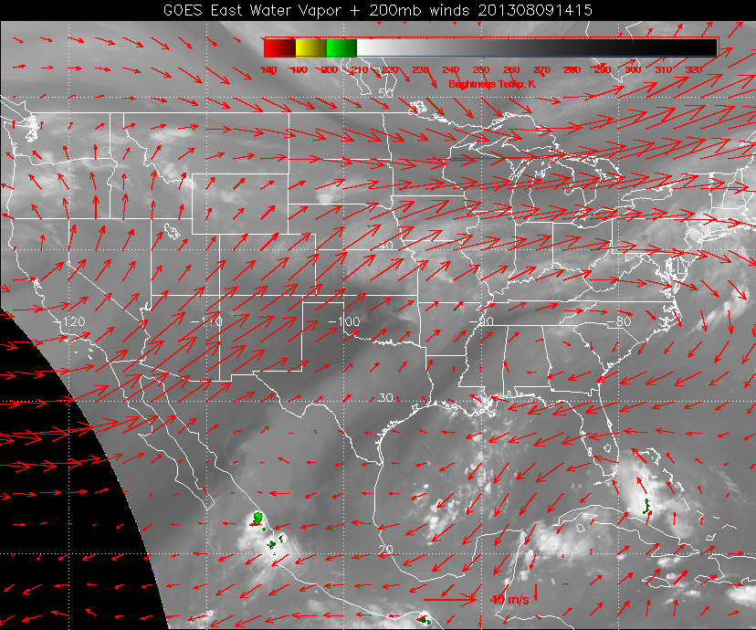
Current wv image this AM shows the dry air penetrating from the Pacific trough, and the position
of stationary front from TX into KY. MCS development last night shifted from its typical position
in KS southward to TX panhandle and OK. Convection in central Gulf is moving westward with
the associated easterly wave bringing rain to EFD by Saturday (diurnal thunderstorms

Slide 3
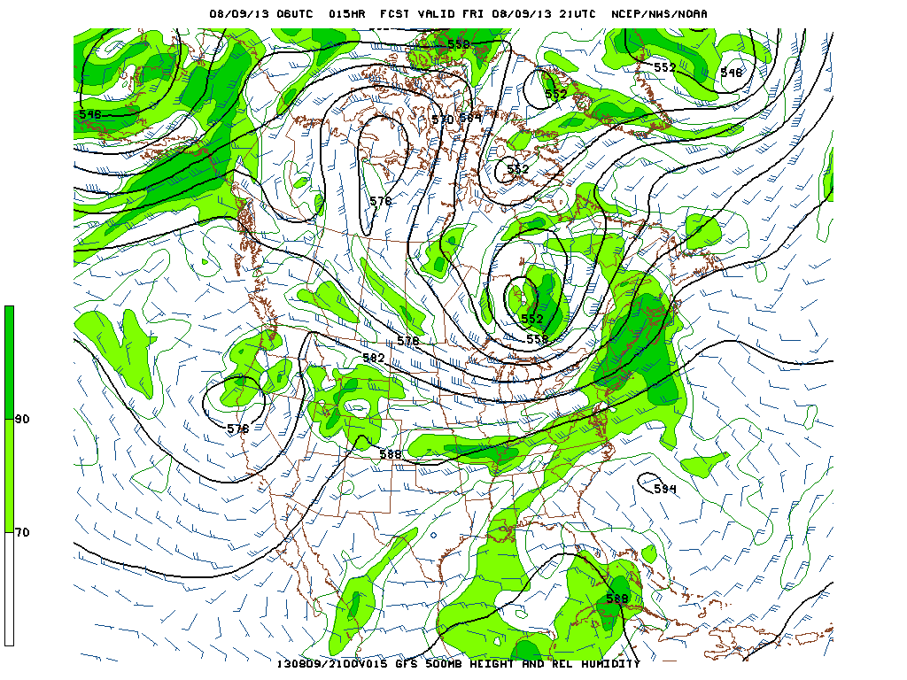
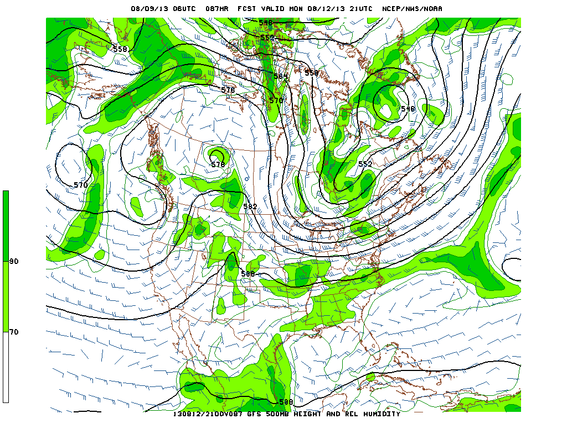
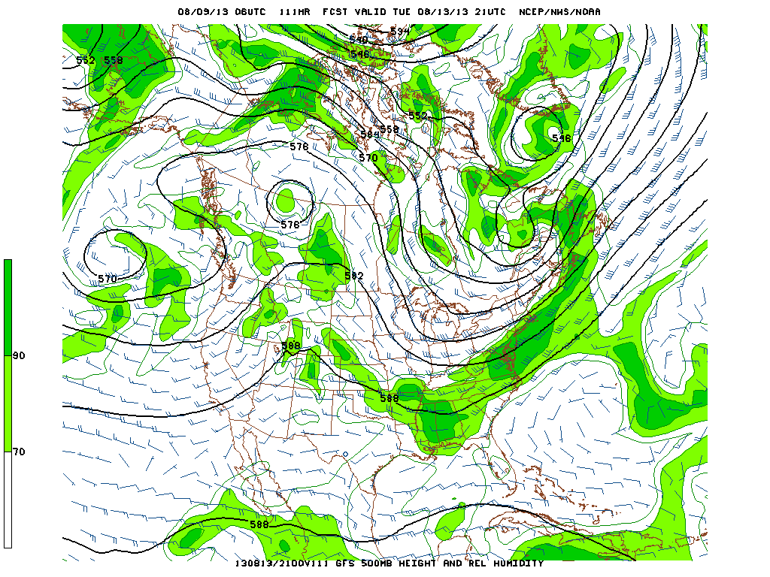
500mb flow today (above), Monday
(above right), and Tuesday (right)
Short waves rotate around the
Amplification clearly occurs between
today (left) and Monday (right above).
Tuesday’s short wave penetrates
deeply into southeast.

Slide 4
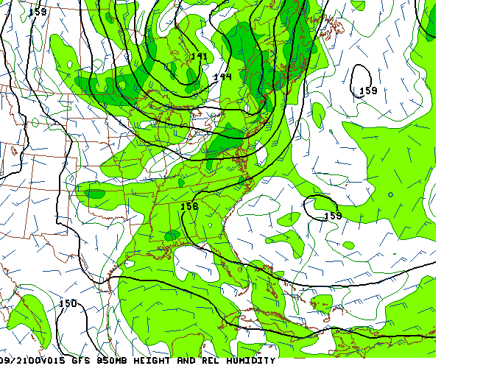
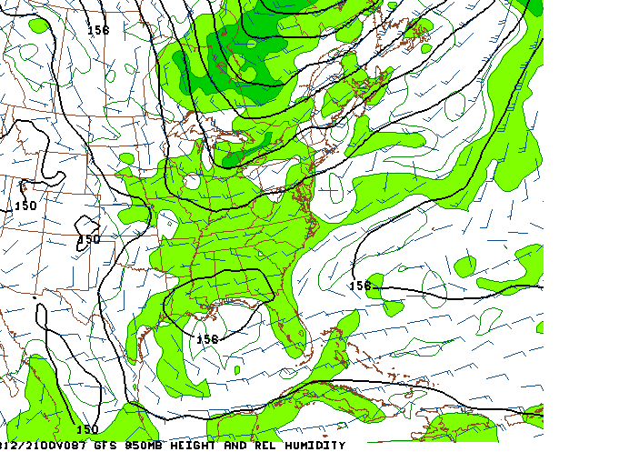
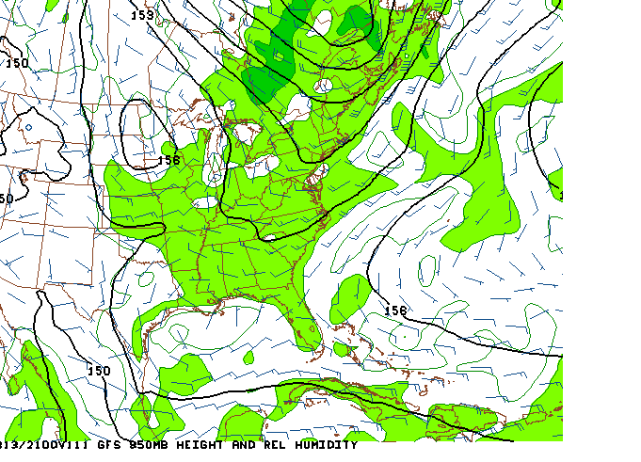
850 mb. Flow trajectories today (above)
and Monday (above right) over SE are clearly
from the Gulf (though more apparent
on Monday). Expect diurnal type pattern
(21-22Z max) on both these days.
Tuesday (right), with front shifting south and
a developing high to the northwest, flow
develops a northwest component.
Still active precip over AL, but maybe
too active, and shifted to the southern part
of the SE US.

Slide 5
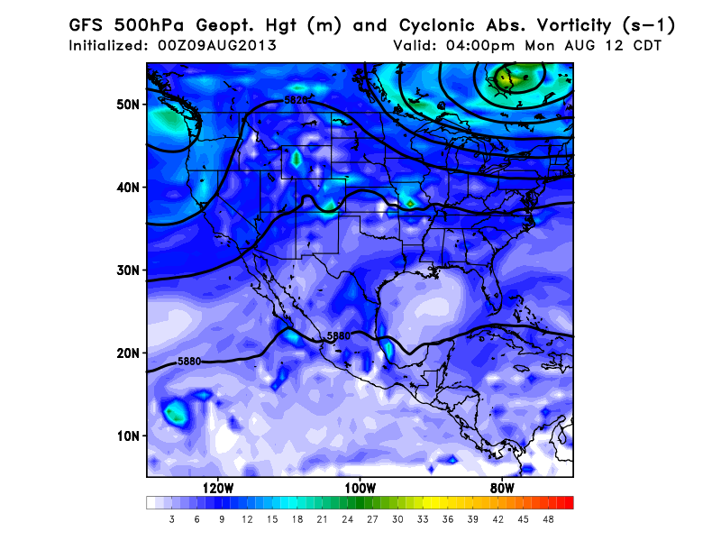
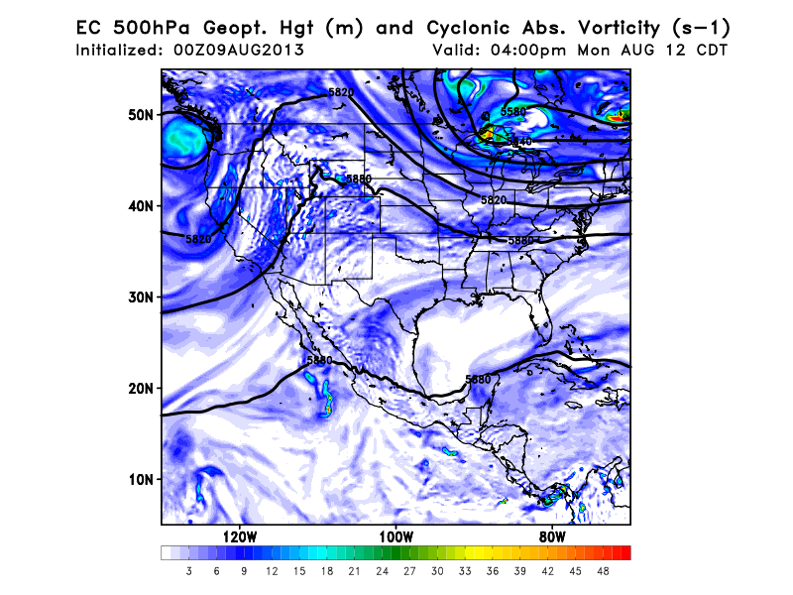
Model comparison
GFS moving Canada low eastward, EC
model holding back

Slide 6
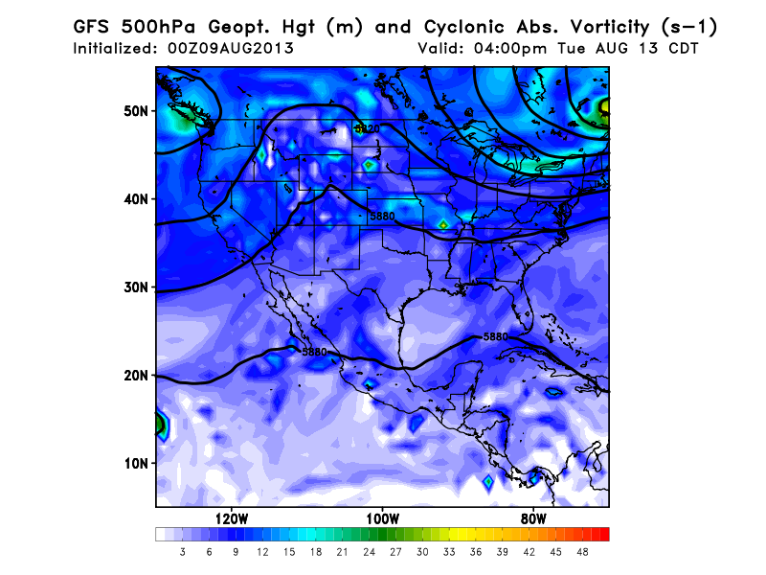
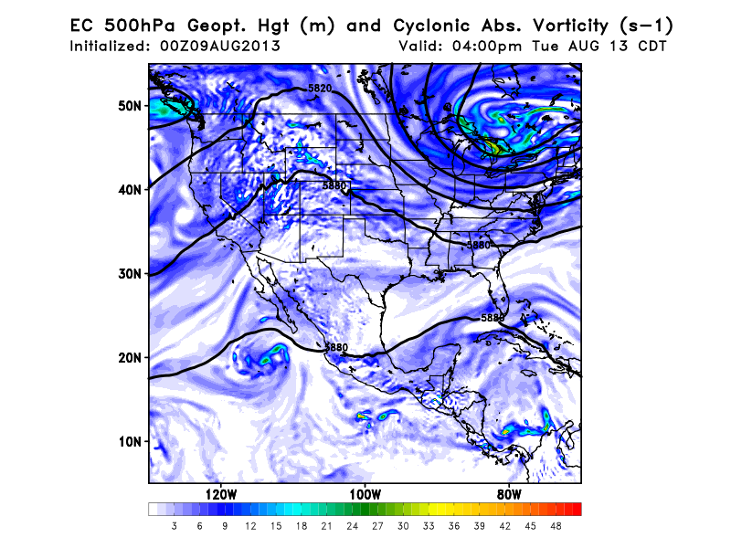
Model Comparison
Models diverge significantly by
Tuesday, with slower movement
of Canada low and greater amplification.
Though both models imply a cooler
drier situation by next Tuesday/Wednesday,
EC model is even more emphatic

Slide 7
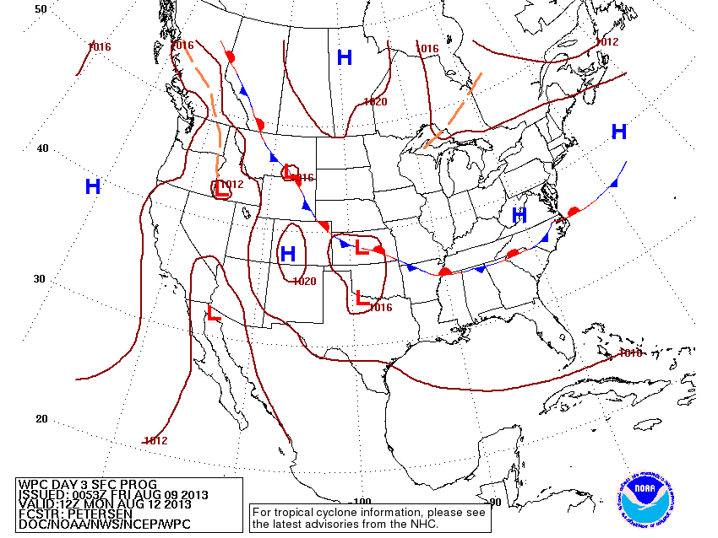
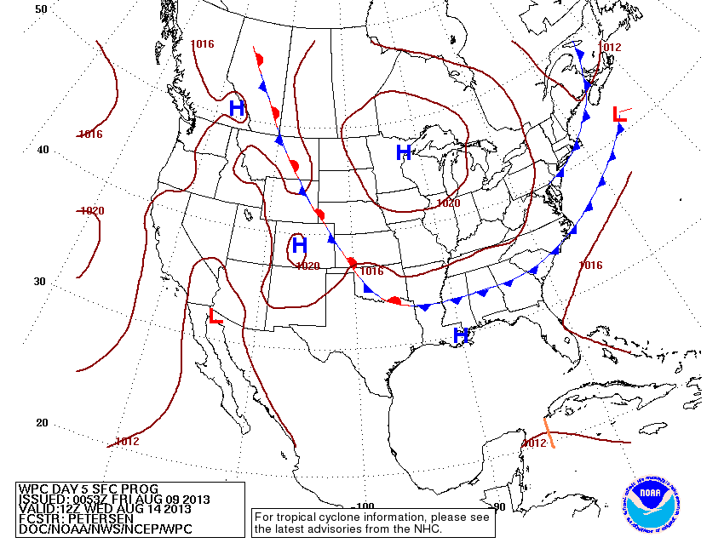
Frontal patterns Monday (left)
and Wednesday (below).
Amplifying upper level trough
brings cooler drier weather
to the northern part of the SE,
especially if the amplified EC
pattern develops. Will still
get active precip in the southern
parts of the region. However,
the diurnal pattern with clear
skies in the morning will not be
present

