Slide 1
Briefing, 20130808, transit flight
Positioning of upper level trough off of west coast similar to yesterday’s progs. Center of anticyclone has slowed its eastward movement slightly per 200mb streamlines (not shown)
Upper level shortwave moves across central TX today, setting off scattered thundershowers along a line from SW OK to Big Bend.
MCSs have developed in SE CO in the afternoon, propagating eastward into KS. Recent runs show MCSs developing further south, though run-to-run differences are large. If so, our trip to Amarillo may encounter T-storms.
Easterly wave continues to progress across the Gulf, reaching us Saturday. Convection today will be south and east of the flight track and is not expected to present a hazard
Ample recent convective influence at 150mb (45kft) and below. Very little at the tropopause because of weaker Mexican convection

Slide 2
Forecast issues for today
Convection north of stationary front across TX panhandle/OK
Convection across central TX
Gulf convection
Trough/anticyclone placement

Slide 3
TX convection
MCS developed over CO/NM late yesterday, in fact line of storms from (-105,20) up into western KS/OK apparent in 5Z image.
At 12Z, convection south of front and in Mexico has died off, see strong convection from Western KS to Missouri/Arkansas border – 0Z and even 6Z models are not getting this.
Rapid Refreshes have run-to-run differences, so north TX convection will be an issue that needs to be watched.

Slide 4
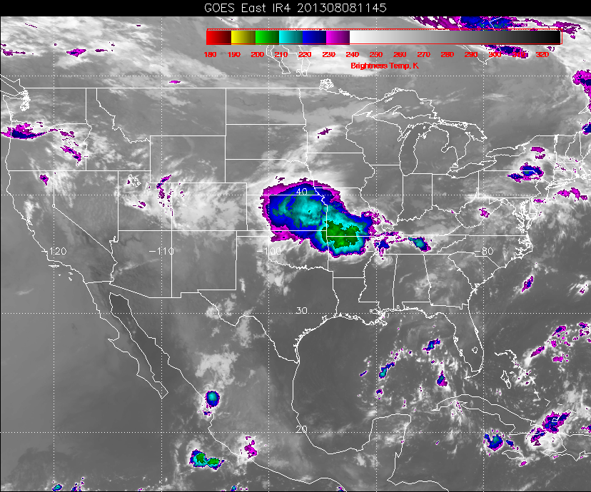
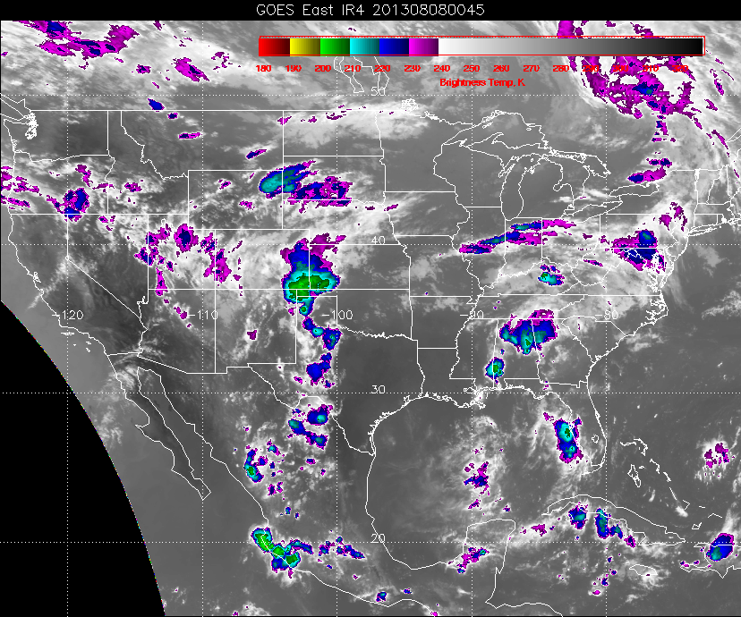
Line of storms – Mexican convection
last night displaced well east of
usual position, and much weaker. Line
extends into TX and lines up with budding
MCS
12Z image (above). MCS has
Propagated eastward. 0Z models
missing development over MO/AS
border.

Slide 5
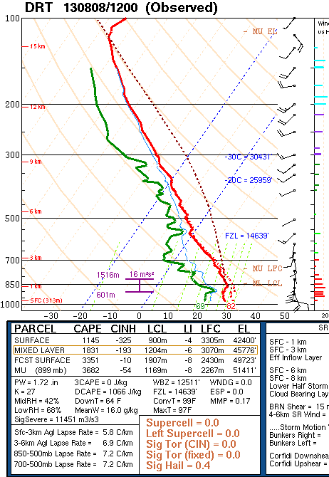
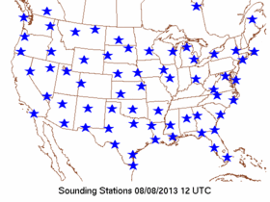
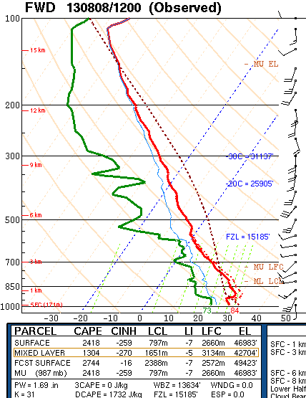

Slide 6
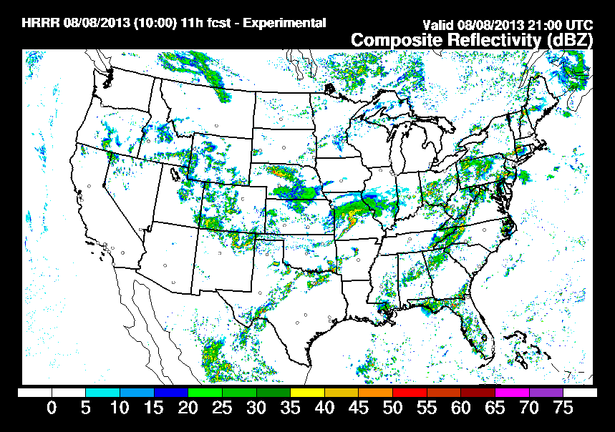
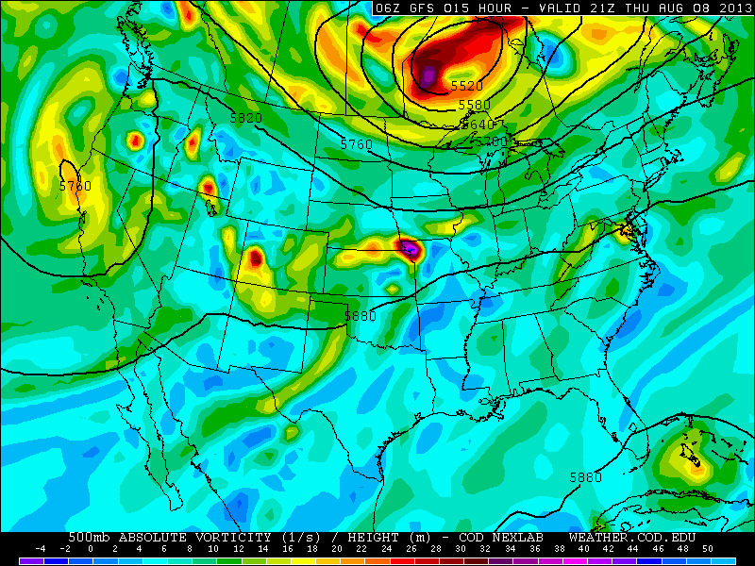
Models show a short wave over
central TX. Also, ample CAPE and
PW values in central TX as well
(previous slide).
Rapid Refresh shows line of convection
developing across TX. Should be scattered,
but will need to be watched as we are crossing
this three times and peaks around 20-22Z
(which is when we are there).

Slide 7
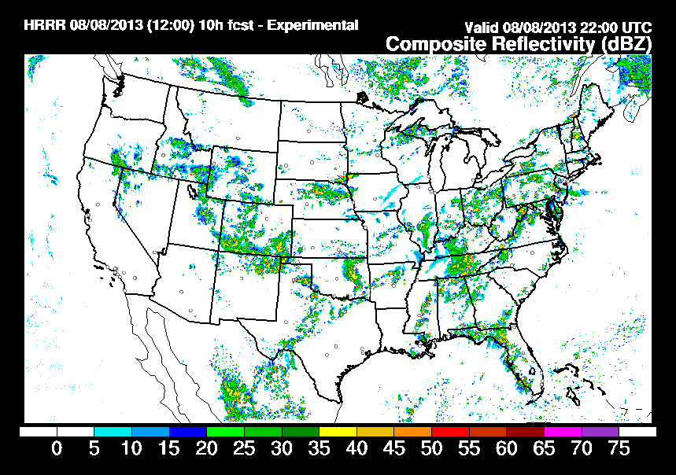
Most recent RUC has significantly more convection over Amarillo. Other versions
of the RUC have even more convection over the TX panhandle and OK.

Slide 8
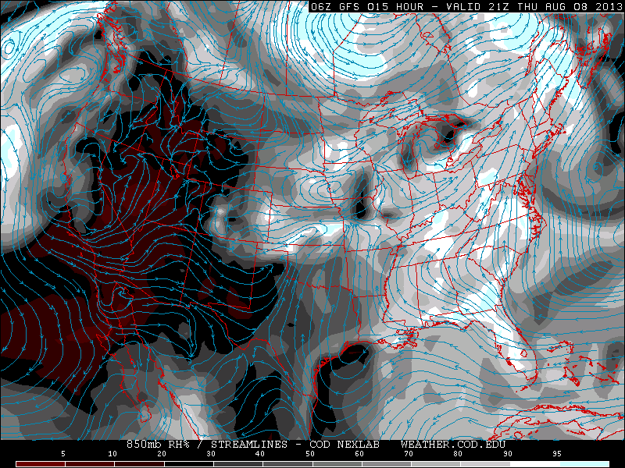
Dry and anticyclonic over our region of the Gulf, so do not
expect developing convection (above, 850mb RH at 4 PM
Houston time. Note convergence line over central TX.

Slide 9
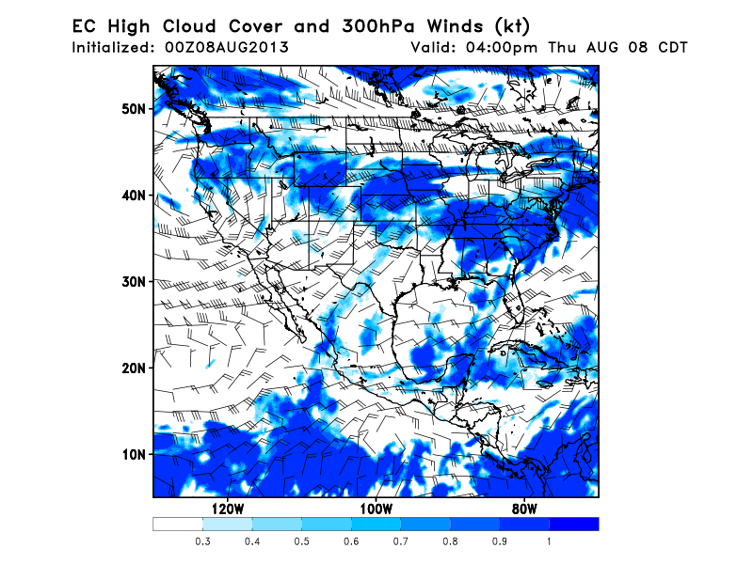
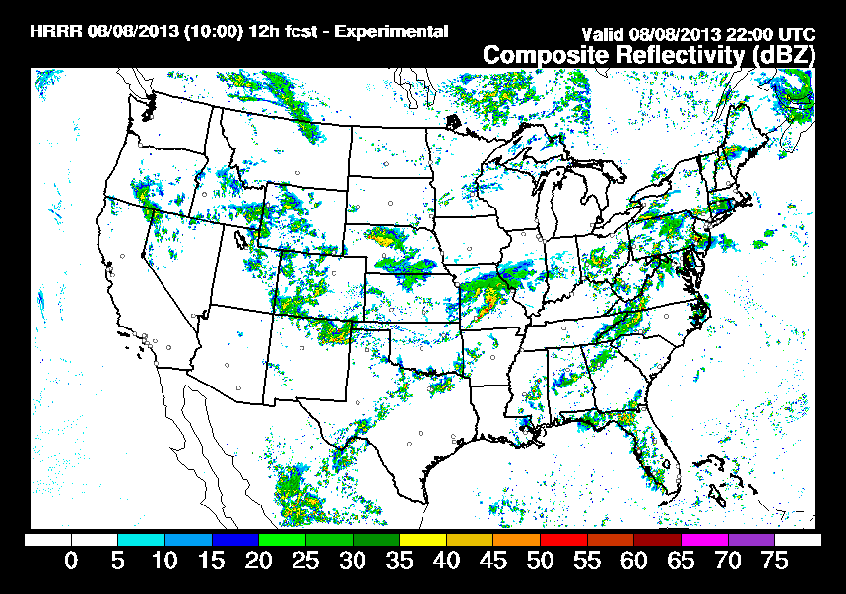
Flight is generally free of high cloud cover, except for line of convection over central TX and cirrus over OK.
Some diurnal convection to the
east of our southward flight
leg over Louisiana. Gulf is free
of convection near landing

Slide 10
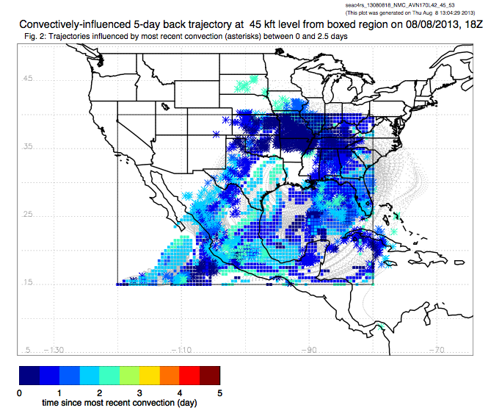
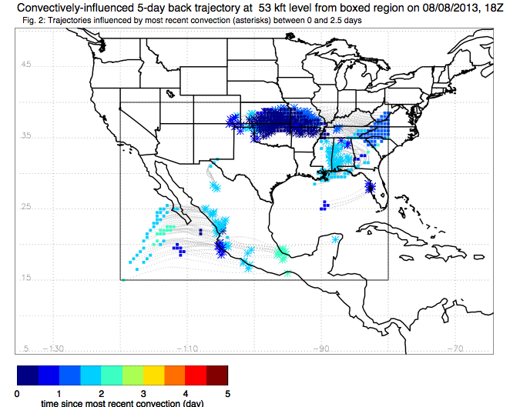
Convective influence at 100mb
(below) and 150mb (left). Ample
recent (2.5 days) convective
influence at 150, much less at
tropopause. Last night’s Mexican
convection has nothing headed
our way at 100mb at all.

Slide 11
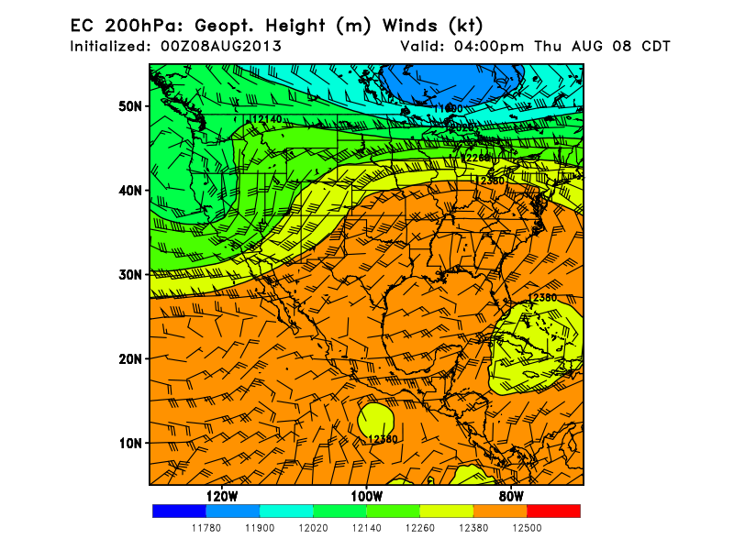
Placement of CA trough and anticyclone are very similar to yesterday’s forecasts.

