Slide 1
Briefing, 20130806a, conditions Tuesday Aug 6
Slight chance of T-storms in South OR this PM, mostly east of the Cascades. Medford office is still skeptical of anything this afternoon, but should note this anyway.
Some high cloud may develop late in the flight. Expect wispy high cloud over rosette region (south end) by 2 PM today, increasing thereafter.
Stratus continues off NORCAL coast today. No clearing off NorCal coast yesterday
Weak cyclonic circulation getting down to surface, expect offshore flow at 850mb in Humboldt, Del Norte cnties and SW OR.

Slide 2
Flight context
Joint ER-2, DC-8, DOE G-1 science flight today, takeoff 10 AM PDT (16Z), 8 hours

Slide 3
Surface wx at Palmdale/Houston
NCEP MOS forecasting winds down the runway at just above 30 knots (gusts) around landing time.
TAF indicates gusts to 30 knots down the runway.
Thursday morning looks good for TO. Houston wx hot but otherwise favorable for landing

Slide 4
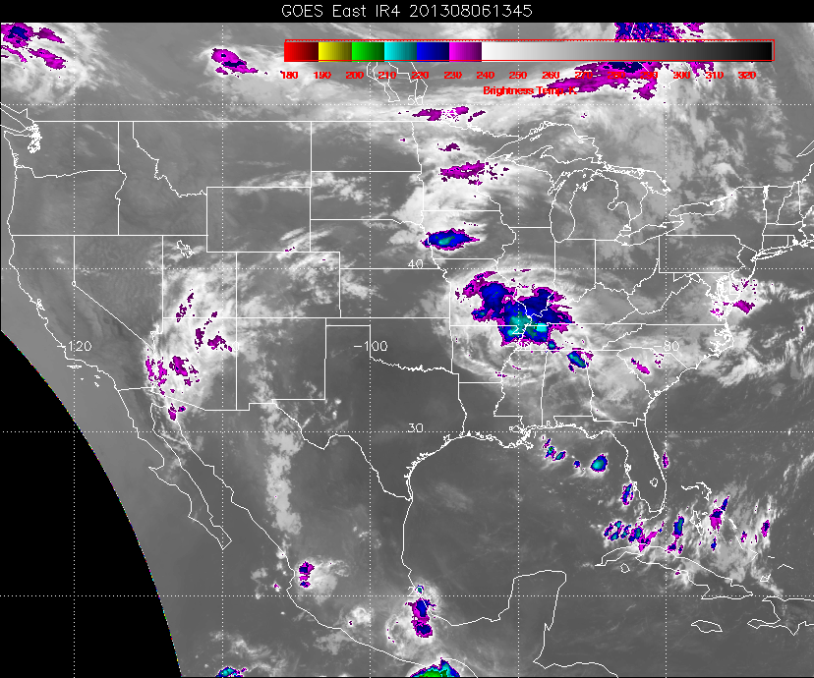
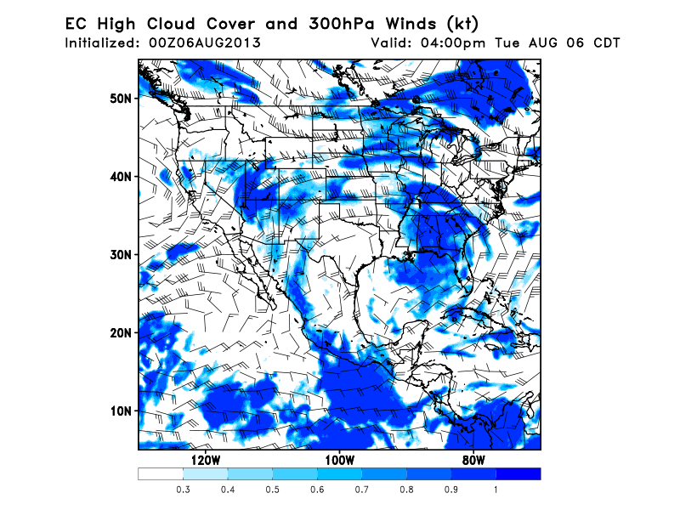
High clouds are issue for today
Upper level cutoff low the NORCAL coast centered near (130,37). Can see wispy high clouds associated with this low on current satellite picture (see below). What looks like a short wave rotating around this low will likely produce some high cloud over NORCAL/OR border just at the coast this afternoon. GFS is less aggressive with this development. We will have high cloud in the region, but it will be thin and wispy. Will go with EC forecast as being the more likely outcome.
EC, Tuesday, 2 PM local

Slide 5
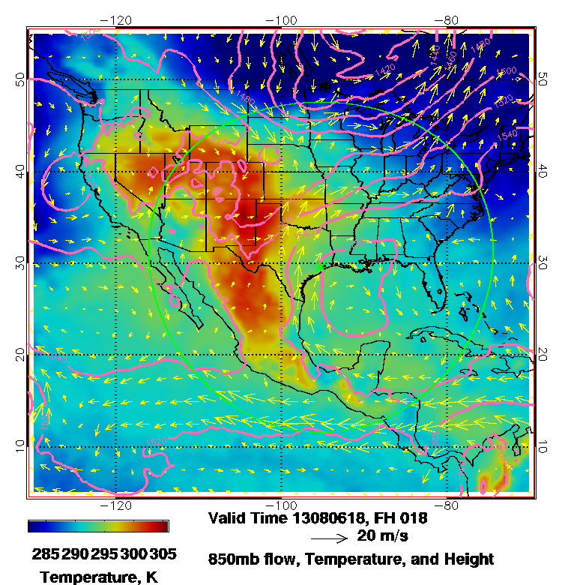
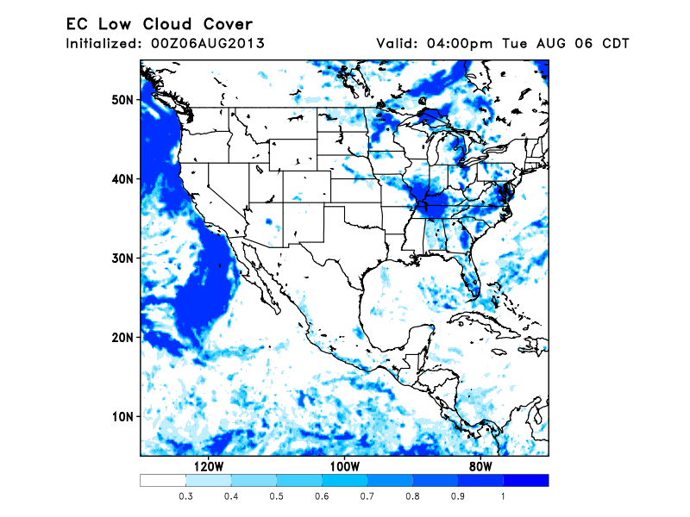
Low Cloud Forecast
Stratus did not clear at all yesterday from NORCAL/OR coast. Eureka office expects some afternoon
clearing today. Circumstances (low level flow) looks similar at 850mb to yesterday. 925mb progged offshore component is stronger at Eureka than yesterday, so there may be more clearing near the coast. Low level 850mb circulation has continued offshore flow in the region of interest. Smoke
will flow offshore and stay above the marine inversion.

Slide 6
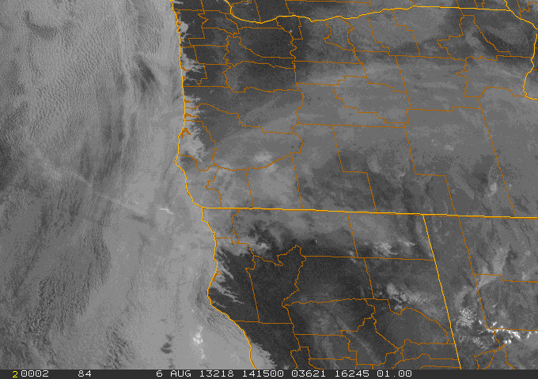
Current satellite image and yesterday’s
Aqua image.

