Slide 1
Briefing, 20130805, conditions Monday/Tuesday Aug 5/6
Chance of some thin cirrus off NORCAL coast today
Models have backed off on the cirrus forecast for the NORCAL coast tomorrow, but chance of cirrus over offshore portions of flight track remains.
Expect stratus off of NORCAL/OR coast both Monday and Tuesday, some local clearing near Eureka associated with offshore circulation and local topography
Weak cyclonic circulation getting down to surface, expect offshore flow at 850mb in Humboldt, Del Norte cnties and SW OR.
Stronger fire development as temperatures increase will give us continued penetration to 700mb in the afternoon, resulting in a plume toward the northeast.

Slide 2
Flight context
DC-8 long test flight Monday (~6 hours)
Joint ER-2, DC-8, DOE G-1 science flight on Tuesday (full length, fire and air quality objectives)
Transit flight Thursday, August 8, both aircraft, NAM objectives

Slide 3
Surface wx at Palmdale
No weather issues through Tuesday. Winds within limits, no T-storms expected.
Deepening marine layer and stronger onshore flow Wed/Thurs. On Wed, winds down runway near 30 knot limit.
Expect wind conditions for TO Thursday to be within limits

Slide 4
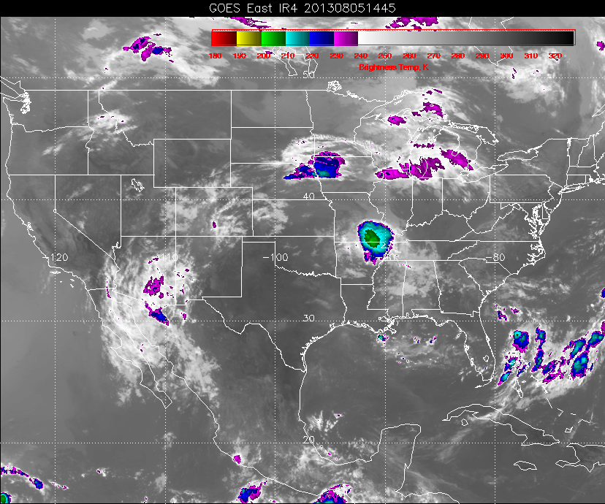
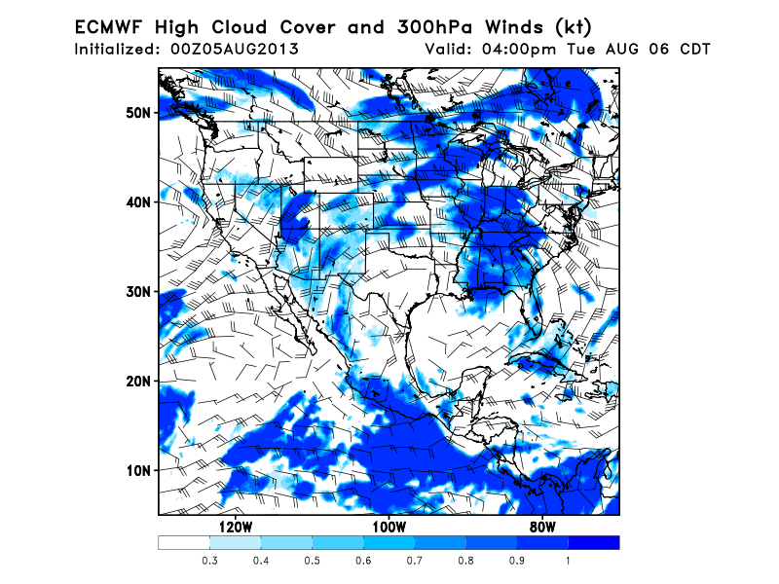
High cloud forecast
Upper level trough off the NORCAL coast centered near (130,36). Can see wispy high clouds associated with this trough on current satellite picture (see below). Trough develops negative tilt, as forecast previously, on Tuesday, but does not move much. Tilt and eastward motion is delayed compared to previous model runs. An upper level weak ridge is in advance of the trough over Norcal/OR, so Medford office has backed off on T-storm chances until Tuesday night.
Possibility of some high clouds over northern CA coast for today’s flight (not shown). Expect it to be
thin and wispy (as seen in current picture). High clouds still possible Tuesday (see below, EC forecast), though recent model forecasts have placed the clouds somewhat offshore, consistent with the slower movement of the trough. GFS has less tilt and lower high cloud chances.
EC, Tuesday, 2 PM local

Slide 5
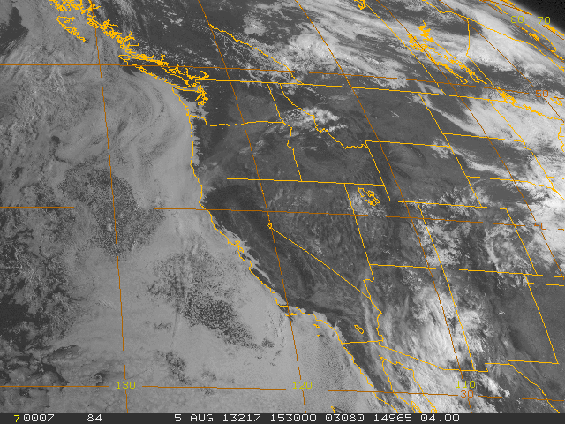
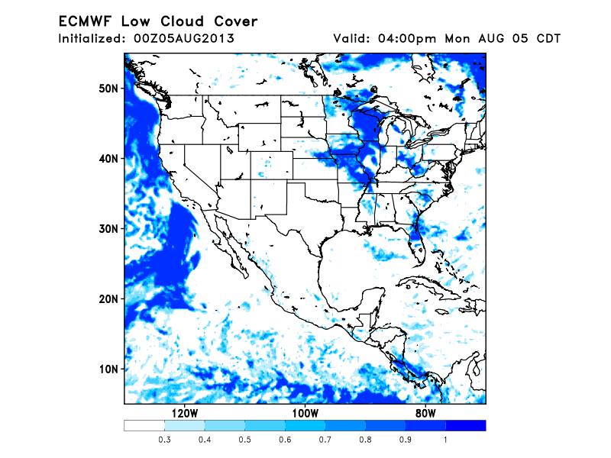
Low Cloud Forecast
Stratus along the entire west coast this morning. No clearing yesterday over Norcal, only
clearing was south of Point Concepcion (LA area). Low level cyclonic circulation centered
near 38N, 126W will keep the waters off NORCAL covered in stratus, except possibly for some
clearing north of Eureka (local). Note the smoke plume extending NEward from SW OR – smoke
has reached near 700mb.
Current visible image (Monday AM)

Slide 6
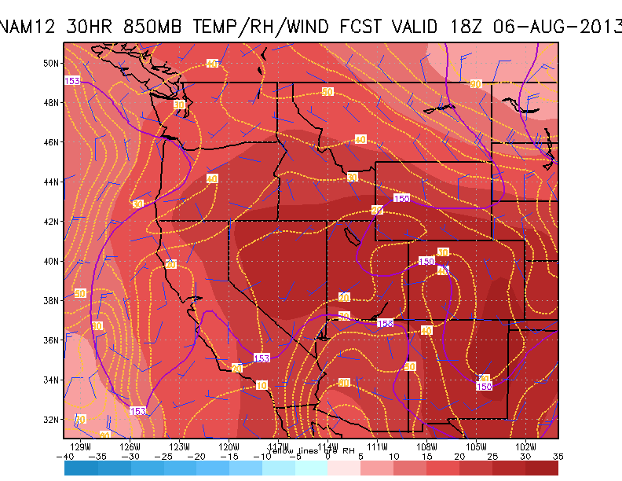
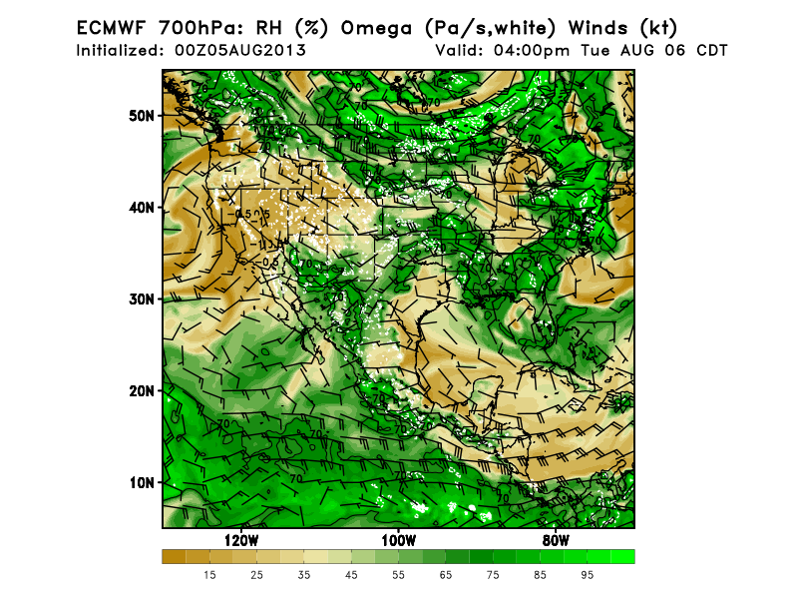
Closed circulation off of Norcal coast at 850mb leads to weak southeasterly
to northeasterly flow tomorrow. Expect smoke over stratus as a result. Circulation
is weak. Smoke plume in previous image is probably a result of late afternoon
fire development and injection. 700mb also has a closed circulation, but fires are
at the eastern edge, so parcels at that level will move northeastward.

Slide 7
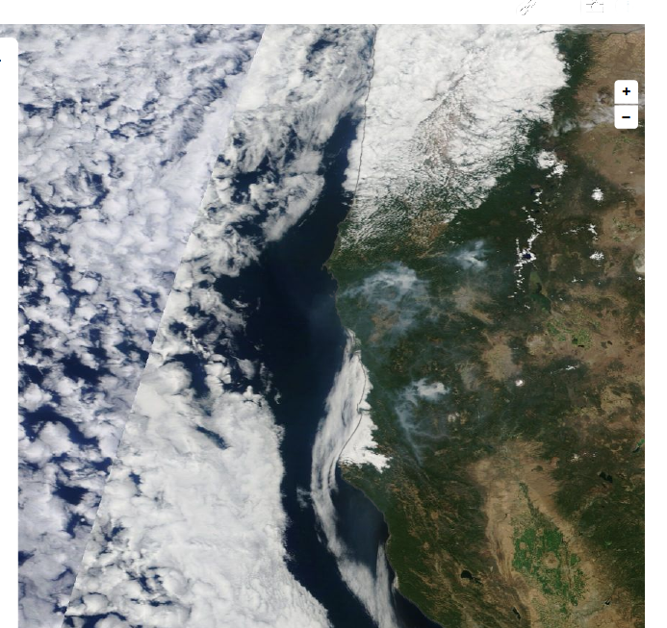
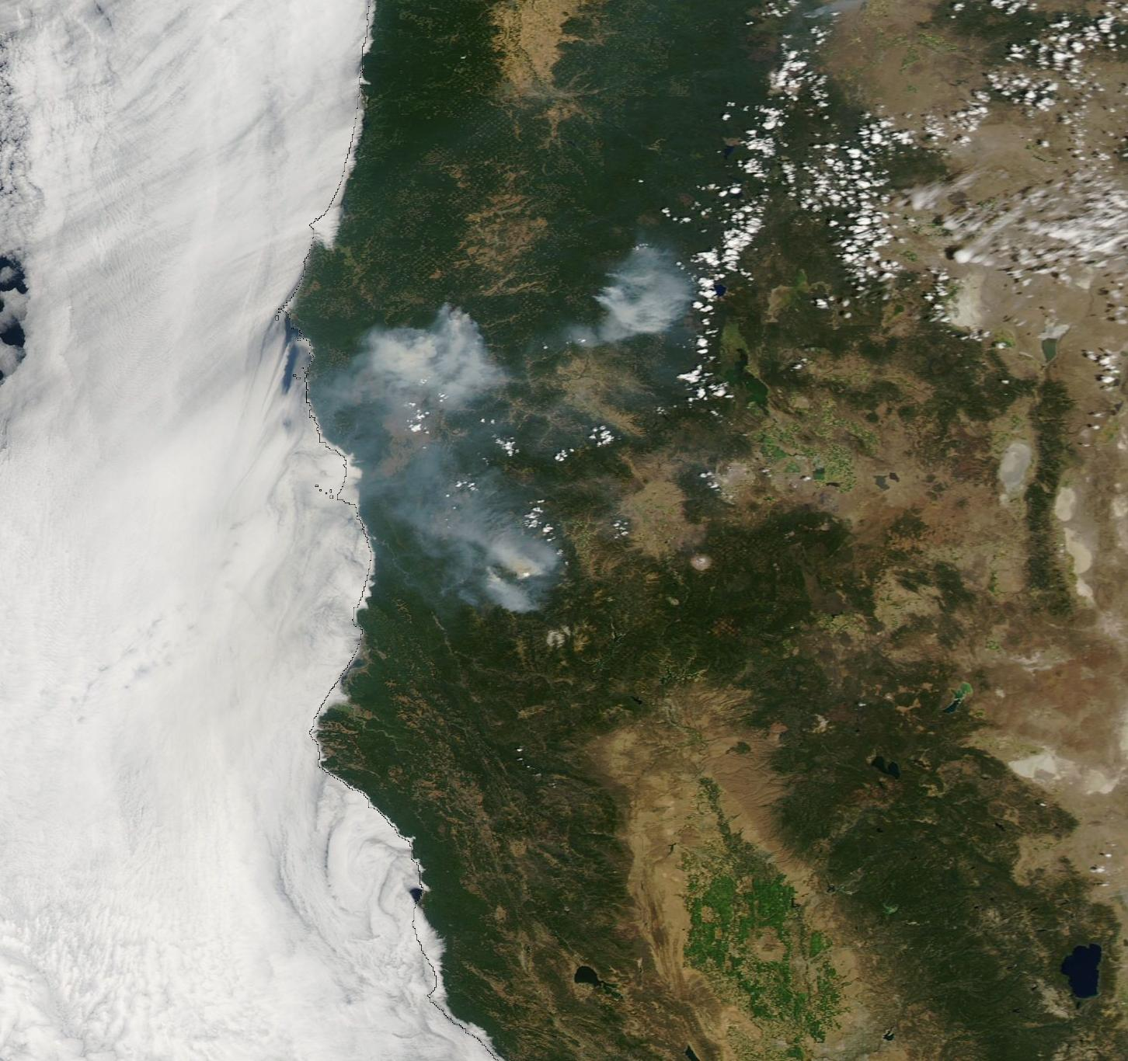
Temperatures have warmed, and will stay warm. Fire development
(apart from suppression efforts) will continue. Fires are stronger now
than on Friday
Sunday PM Aqua (2 PM local) MODIS
Friday Aqua Modis

