Slide 1
Briefing, 20130803
Surface wx through Tuesday(Palmdale)
Cloud conditions and circulation in CA/OR/WA for Monday and Tuesday
Have chance of thin cirrus on Monday and Tuesday over NORCAL, OR. For Tuesday, recommend earlier rather than later takeoff because of developing high cloud.
Expect stratus off of NORCAL/OR coast, minimal inland
Offshore component (weak) circulation at 5kft (850 mb) expected Monday and Tuesday.

Slide 2
Flight context
DC-8 long test flight Monday (~6 hours)
Joint ER-2, DC-8, possibly DOE G-1 science flight on Tuesday (full length, fire and air quality objectives)
Transit flight Thursday, August 8, both aircraft, NAM objectives

Slide 3
Surface wx at Palmdale
No weather issues through Tuesday. Winds within limits, no T-storms expected.

Slide 4
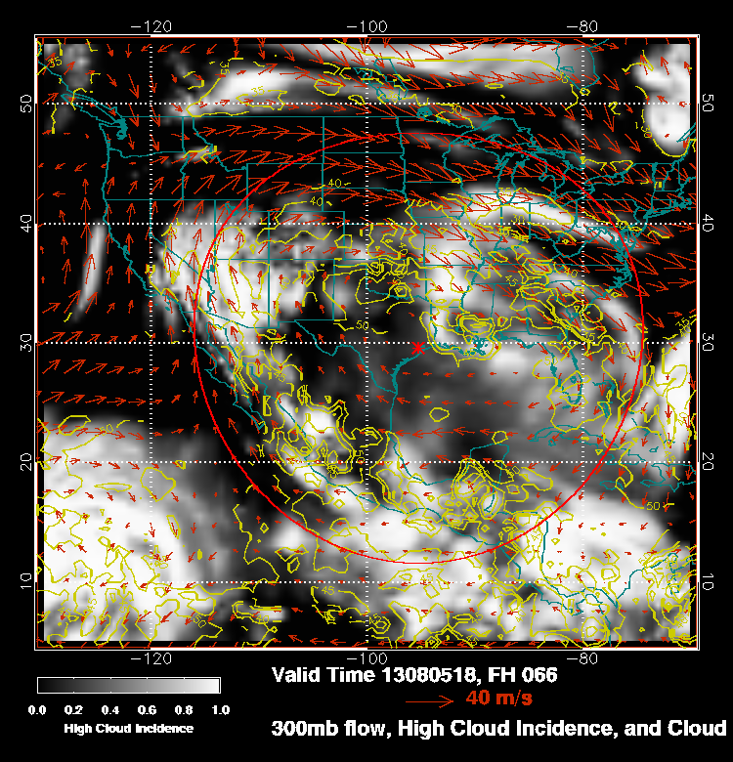
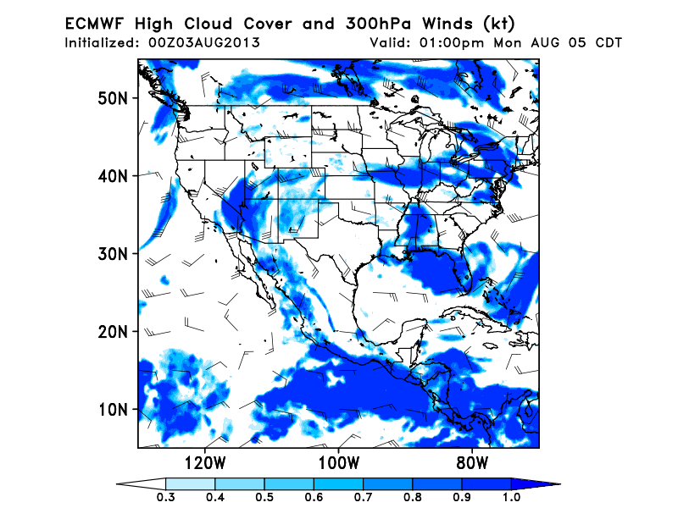
High cloud forecast Monday Tuesday
Upper level trough off the NORCAL coast digs and forms a closed circulation at 500mb by
Sunday. Tilt becomes vertical by Monday, and trough moves VERY slowly shoreward by
Tuesday. Negative tilt develops Tuesday.
Currently wispy cirrus moving around this trough, as forecast by 0Z runs. Some cirrus
forecast of the NORCAL coast by both large scale models on Monday. Should be fairly thin.
GFS, Monday
EC, Monday 11 AM PDT

Slide 5
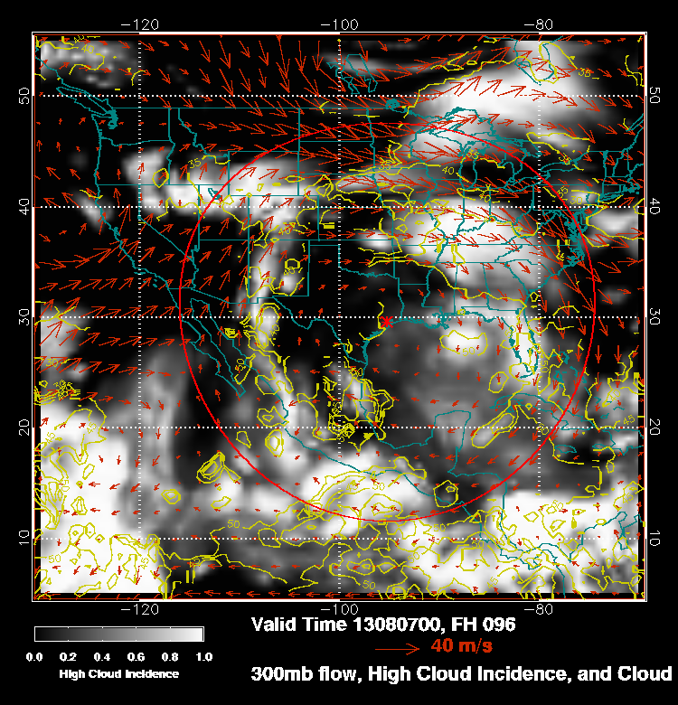
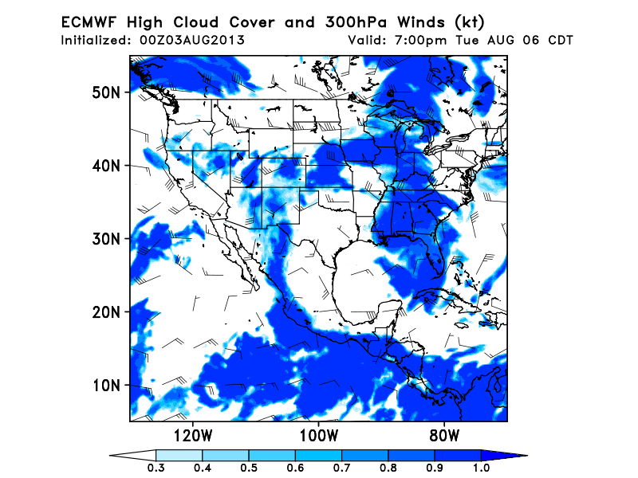
As the trough moves shoreward on Tuesday, high clouds may increase in northern California and southern Oregon. Trough develops negative tilt late Tuesday as it moves shoreward and high clouds increase. EC model has higher cloud amounts. If
this pattern accelerates (these are 96 hour forecasts) could have some high clouds while we are flying. Within the constraints of being at the fires at ~1 PM local, earlier
is better than later.

Slide 6
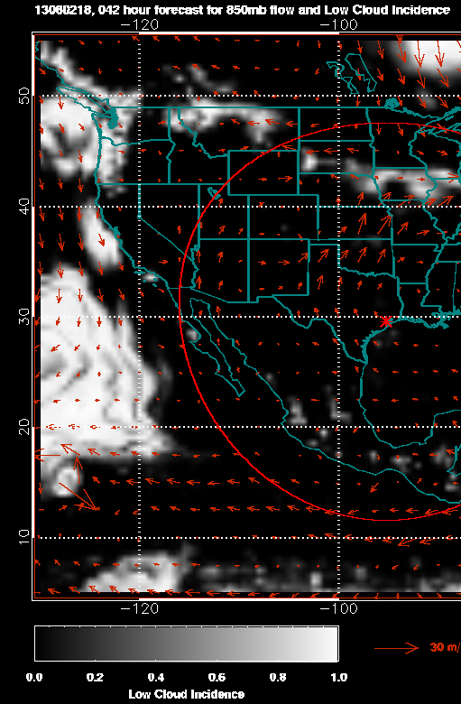
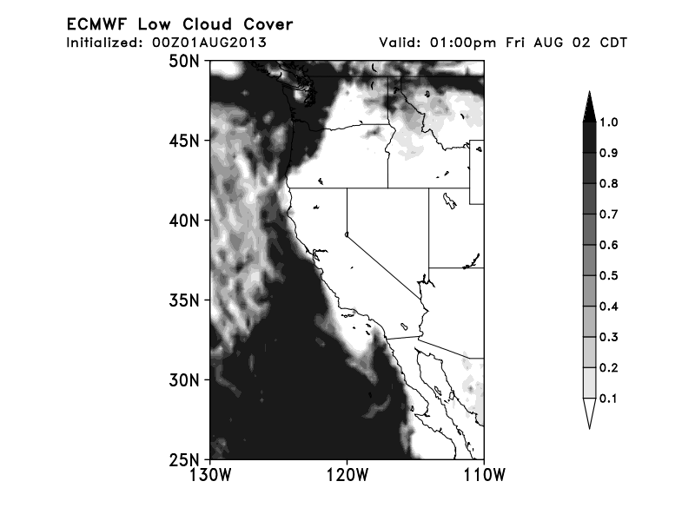
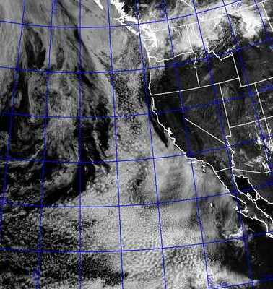
Low cloud forecast verification for Friday
This tells us something we already knew – CA stratus forecasts are tricky!
Valid 11 AM Friday. 42 hour forecasts for EC and GFS. EC model
delays the clearing near the NORCAL coast and misses the failure
to clear south of point Concepcion. GFS is equally “out of phase”
in NORCAL/SOCAL clearing, only much more so.
EC
GFS

Slide 7
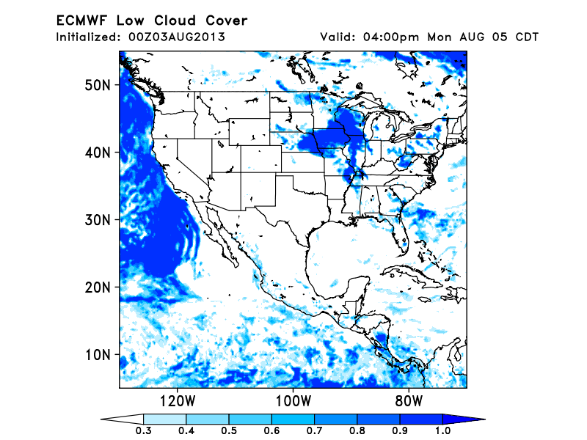
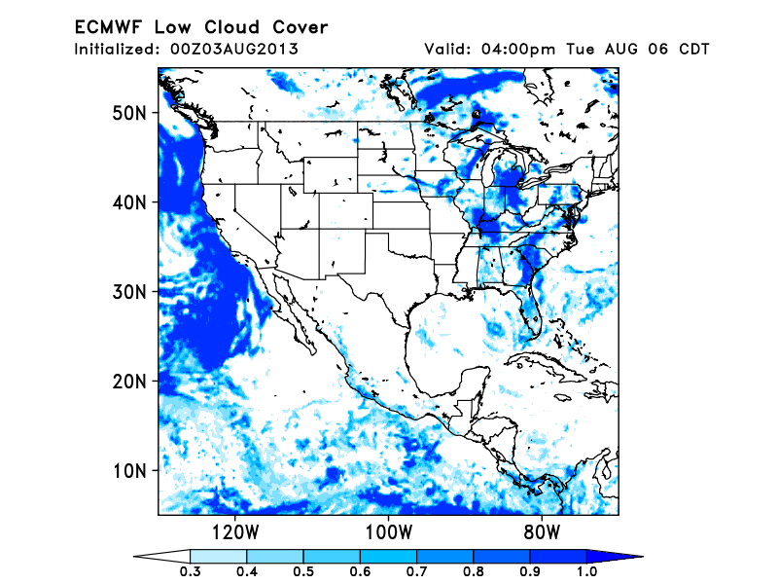
Low cloud forecast
USE EC model, verifies better than GFS so far. Both show ample stratus off
the coast. COAMPS is different for SOCAL, but not for NORCAL and OR.

Slide 8
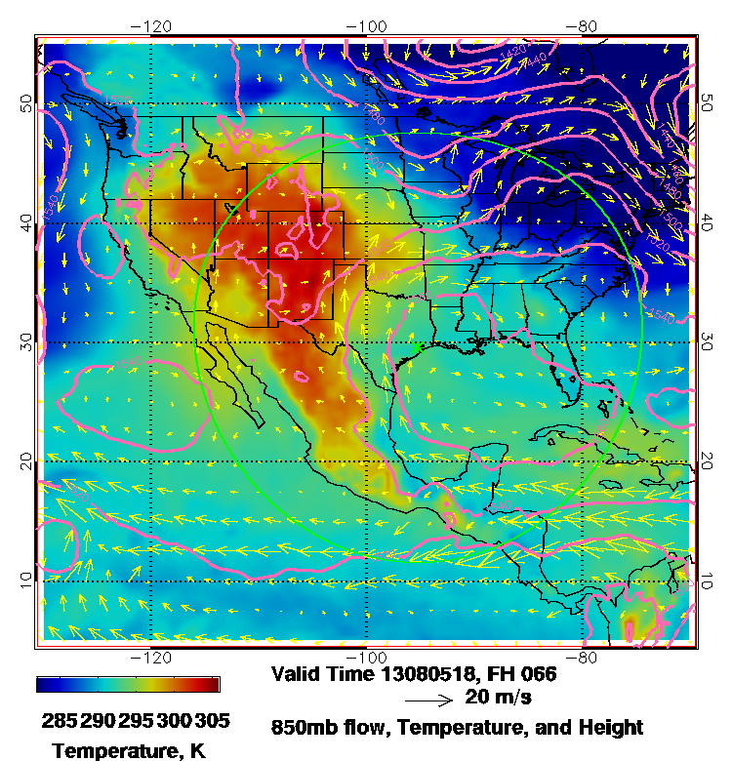
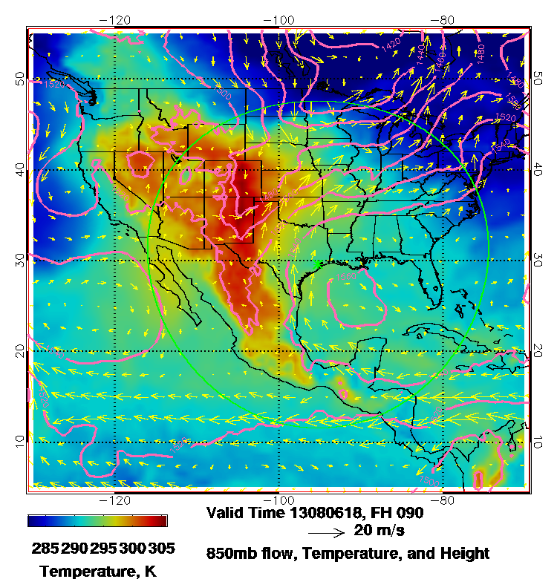
Low level circulation
Both Monday and Tuesday suggest an offshore component over OR. Low level closed
circulation strengthens on Tuesday near (125,39). COAMPS does not show this offshore
low, but still has offshore component over OR. EC does not have offshore low either. If it
develops, could produce hollowing out of low clouds off NORCAL coast (GFS low cloud
forecast not shown).

Slide 9
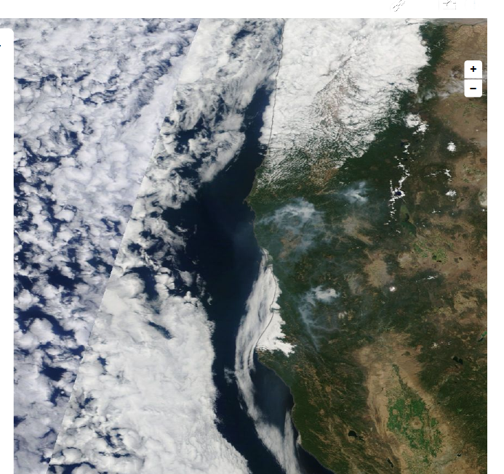
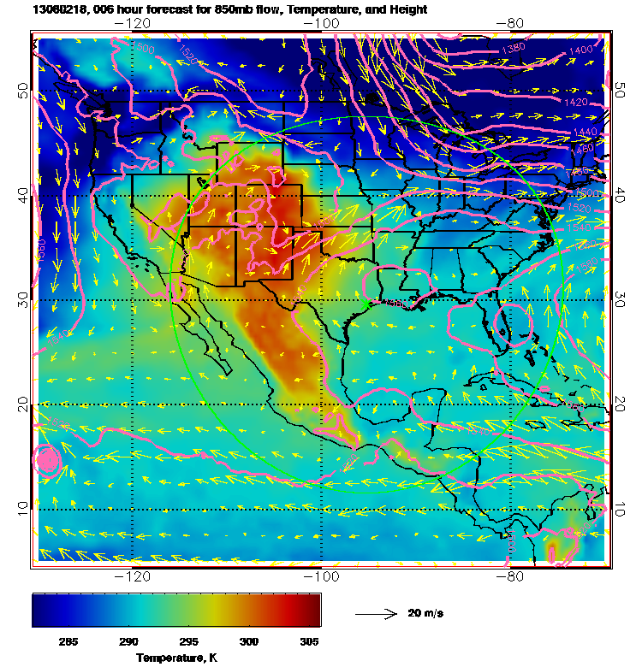
Yesterday’s smoke – can also see yesterday’s offshore 850mb component in GFS.
COAMPS 850 mb offshore component not as apparent.

