Slide 1
Briefing, 20130801
Surface wx through Monday(Palmdale)
Cloud conditions in CA region for Friday and Monday

Slide 2
Flight context
Planning ER-2 test flight today (2-3 hours)
Planning on longer ER-2 test flight Friday
DC-8 test flight Friday
DC-8 test flight Monday
DC-8/ER-2 science flight Tuesday – probably a fire flight, possibly air quality

Slide 3
T/O landing WX, Palmdale
Yesterday’s winds were within limits – maximum gusts down the runway were at 4 PM and were ~20 knots. Peak gusts from the west at 7 PM were also 20 knots, representing a cross wind component of about 11 knots.
Basic pattern of an upper level high over the southwest, and upper level trough off the northwest coast will persist. So, expect moderate to strong onshore wind conditions through the forecast period associated with basic high surface pressure off the coast and a developing thermal trough over the inland desert areas. No rain or T-storms in the forecast. Today and tomorrow winds are forecast to be above average, with 32 knot gusts down the SW runway between 2 and 6 PM (some cross-wind component). TAF has 25 knot gusts from the west after 3 PM, which implies a cross wind component of ~13 knots. As always in the Antelope valley in the summer, earlier is better.
Friday, no T-storms or rain. Max gusts similar in magnitude, but very much down the SW runway, and occurring later (after about 5 PM).
Monday and Tuesday look good, no wx issues

Slide 4
Cloud conditions Friday/Monday
As indicated on previous slide, basic pattern at upper levels is a high over the southwest US, and a trough just off the Pacific coast (next slide). By tomorrow, this trough will move onshore. No significant impact on SoCal stratus for the DC-8 test flight on Friday – expect stratus west of the channel islands (see a following slide). By Monday, a cutoff low develops off the Norcal coast at upper levels, which persists into Tuesday. Low appears dry, so minimal impact on high cloud. Low cloud is enhanced in the forecasts, probably due to thicker marine layer. Cutoff lows, however, are troublesome forecast situations. Monday forecasts will have concomitant uncertainty.
High cloud for Friday. By Friday afternoon, wisps associated with NORCAL trough are gone, and expect clear skies off the NORCAL coast. For our region, there is the real possibility of some high cloud east of Palmdale associated with the monsoon. This could actually be interesting for our region. Both GFS and EC models forecast this, and there is some verification for this morning of the 0Z run (see satellite image, following slide, prog not shown), with scattered to few reported at Needles at 11-12kft. NCAR and FSU WRF models don’t show much tomorrow, and my limited experience is that the large scale models overpredict the high cloud. I think we will see something tomorrow, but it will be limited and wispy -- I still recommend the DC-8 go after stratus west of the channel islands (probably cannot change anything at this stage anyway).
Low cloud for Friday: Slide following sat pic for this morning shows forecast for tomorrow. This is consistent with forecasts done yesterday. Earlier is better for stratus over NorCal. The basic diurnal retreat in Norcal depicted in the forecasts did occur yesterday, though at 4 PM, there was still thin stratus at 41N. Depending on how far the DC-8 can go west, should get some stratus. NCAR WRF model shows significant low cloud all along the coast.
Cloud for Monday: Large scale model high cloud forecasts differ significantly. EC has a surge of monsoon outflow over NV, GFS has much more limited coverage. There will be something there, but it will require use of the lidar to find it and then penetrate – i.e., scattered to few. Low cloud forecast suggests good conditions for stratus all along the coast, with afternoon retreat. Retreat is less than on Friday.

Slide 5
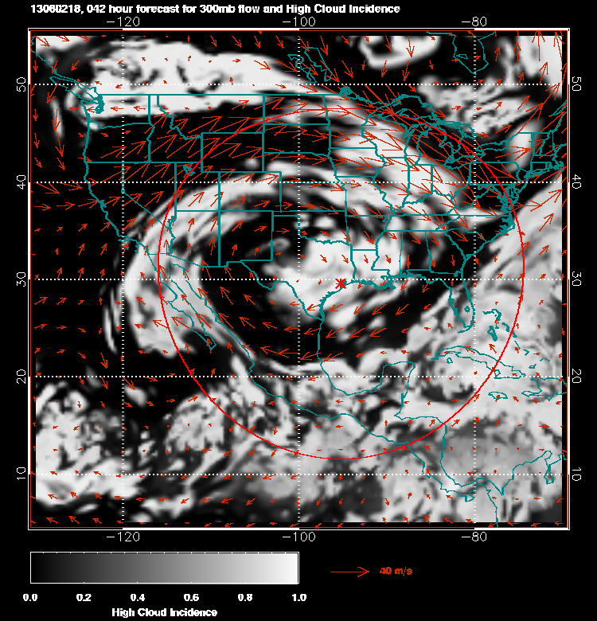
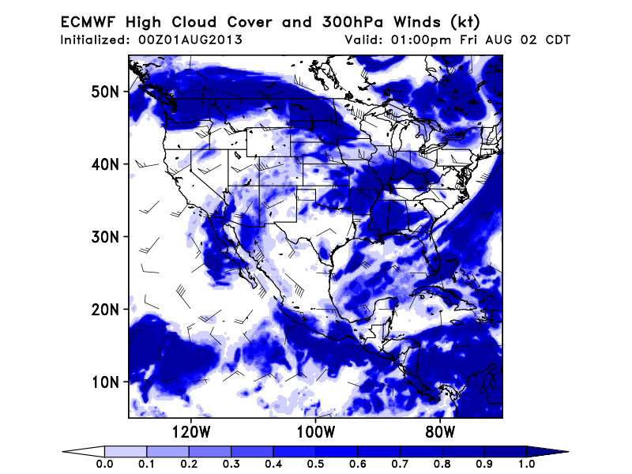
EC forecast high cloud, tomorrow 11AM
GFS high cloud, tomorrow 11 AM PDT
(ARC GFS forecast site, left, FSU site,
above)

Slide 6
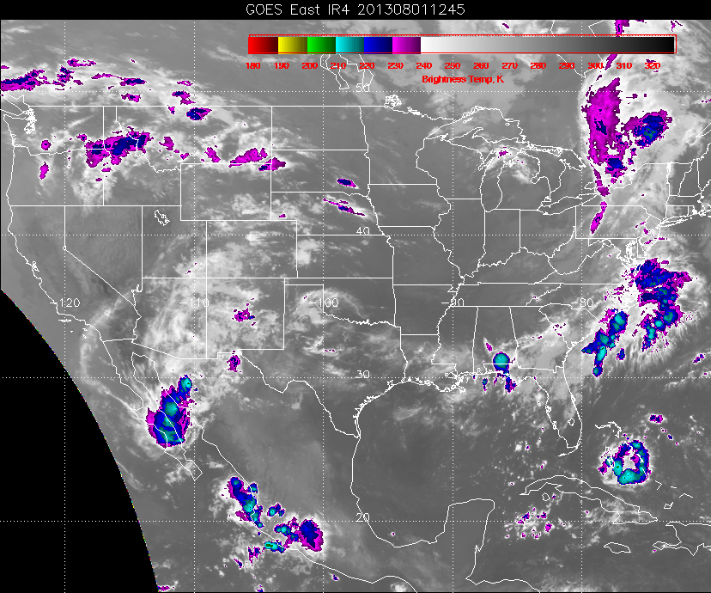
This morning’s IR image. Cloud is thin, roughly consistent with large scale model
Forecast.
ARC satellite imagery, above

Slide 7
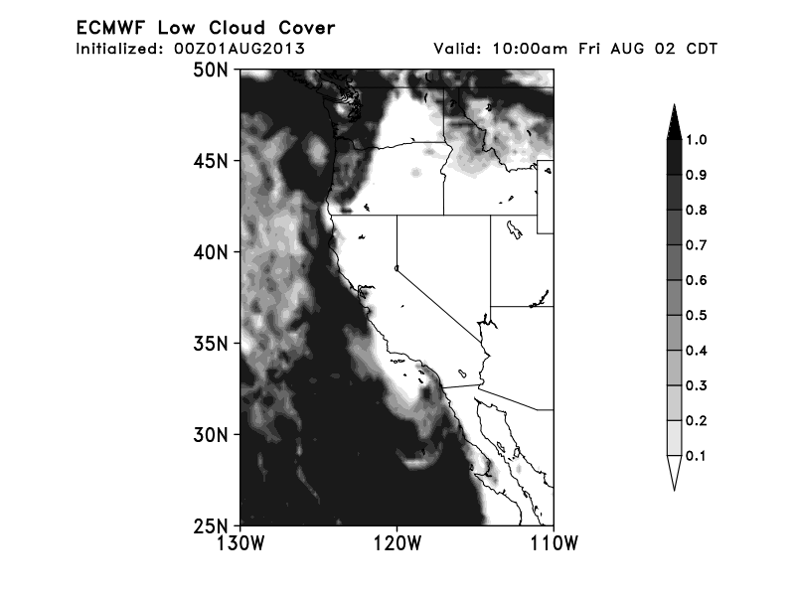
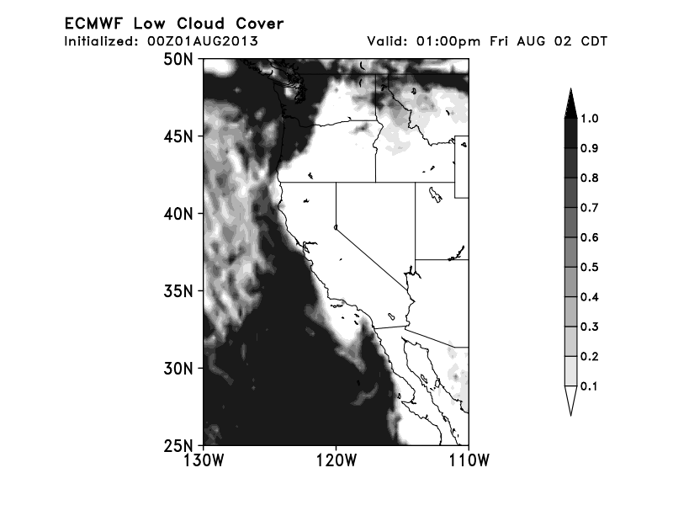
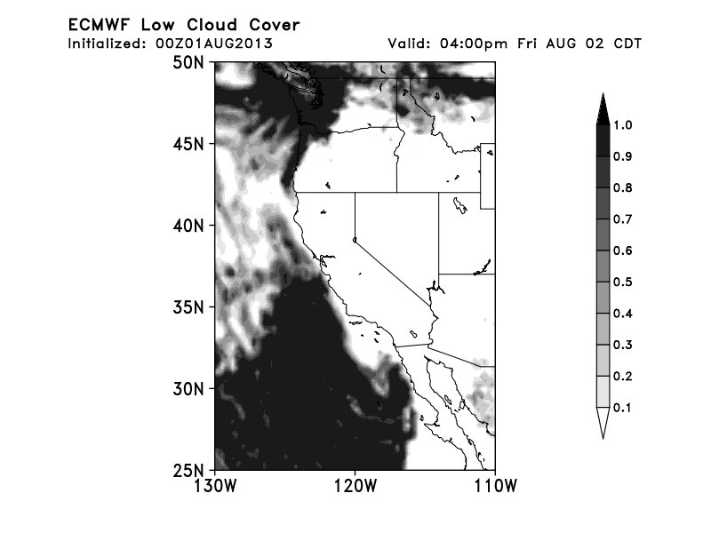
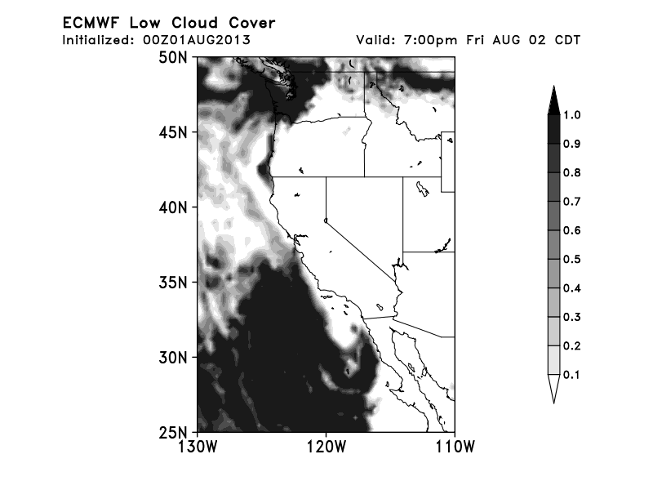
Thanks to Nick Heath (FSU) for these images

Slide 8
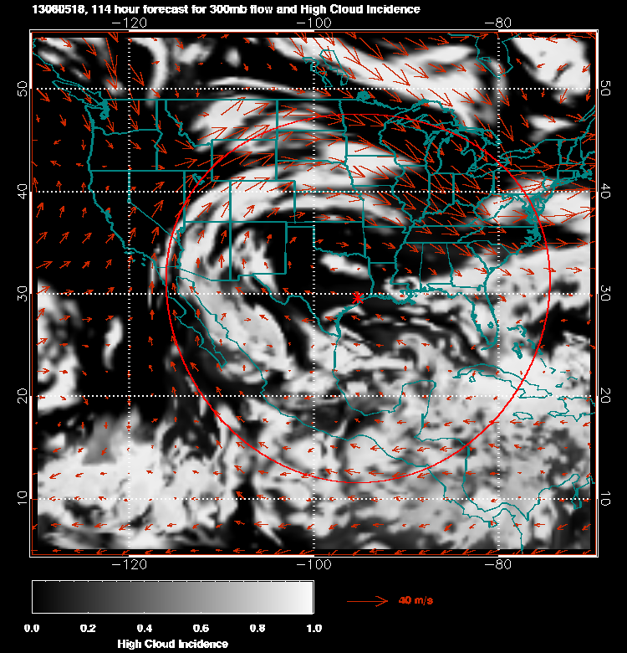
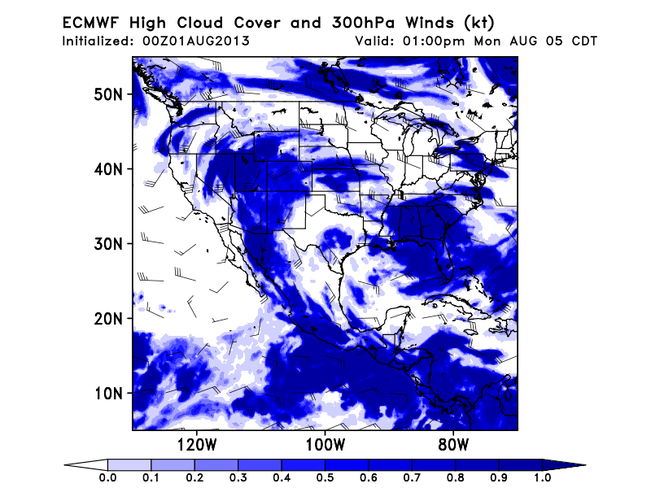
Monday 11 AM forecast for high cloud (left GFS, right EC)

Slide 9
