Slide 1
Briefing, 20130731
Surface wx through Monday(Palmdale)
Cloud conditions in CA region for Friday, Saturday, and Monday

Slide 2
Flight context
Planning ER-2 test flight today (2-3 hours)
Planning on longer ER-2 test flight Thursday
Possible ER-2 only smoke over stratus flight on Saturday
DC-8 test flight Friday
DC-8 test flight Monday
DC-8/ER-2 science flight Tuesday – probably a fire flight
The above subject to change and revision

Slide 3
T/O landing WX, Palmdale
Yesterday’s winds were within limits – maximum gusts down the runway were at 6 PM and were ~26 knots, somewhat higher than forecast.
Basic pattern of an upper level high over the southwest, and upper level trough off the northwest coast will persist. So, expect moderate onshore wind conditions through the forecast period associated with basic high surface pressure off the coast and a developing thermal trough over the inland desert areas. No rain or T-storms in the forecast. Winds will be down the runway, and max winds will tend to occur late in the day (closer to 6 than 3 PM). Current forecast has the biggest threat tomorrow (Thursday), with possible gusts near 30 knots in the very late afternoon (6 PM). Other than that, winds are well within limits, with Saturday particularly benign.

Slide 4
Cloud conditions Friday/Saturday
As indicated on previous slide, basic pattern at upper levels is a high over the southwest US, and a trough just off the Pacific coast (next slide). By Friday, this trough will actually move onshore. No significant impact on SoCal stratus for the DC-8 test flight on Friday – expect stratus west of the channel islands.
Pulses going around this trough will lead to instability and possible T-storms today over southwest Oregon. There are currently radar returns from the Medford/Grants Pass area. Local forecasters indicate that these are likely dry thunderstorms, and may reinforce the existing fires. Red flag conditions persist in all of Southwest Oregon. Thunderstorm probabilities move eastward as the trough moves onshore. Ec model forecasting significant precip on Thursday east of the Cascades in SW Oregon (following slide).
Expect stratus to continue off the SoCal coast. Clearing, as has been happening daily the last few days, will occur at and to the east of the channel islands. A stronger inversion is forecast Friday, so more than the normal amount of stratus will probably be present on that day. In any case, expect stratus west of the channel islands on Friday.
Expect stratus in northern CA on Friday as well (following slide). This will retreat somewhat in the afternoon (a traditional diurnal variation). No high clouds over this region are expected (following slide).
The visible smoke plume from SW Oregon is heading eastward, at least on the visible worldview site. This is consistent with 850 and 700mb winds. Low level winds will continue to be from the north on Saturday (following slide). Stratus off Norcal coast will persist, as surface conditions will not change significantly over the next few days. EC forecast (following slide) shows stratus off Norcal coast in late morning, dissipating somewhat in late afternoon.

Slide 5
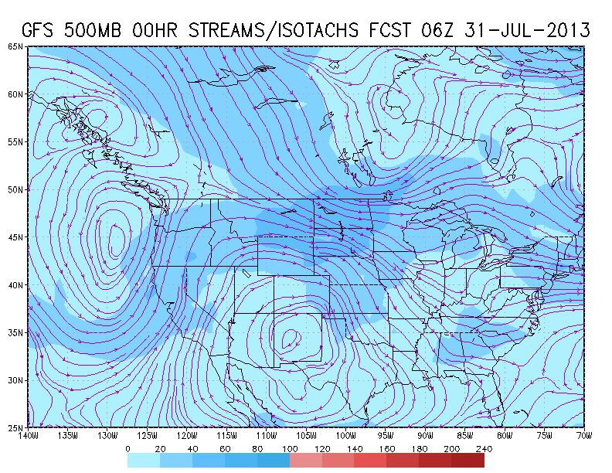
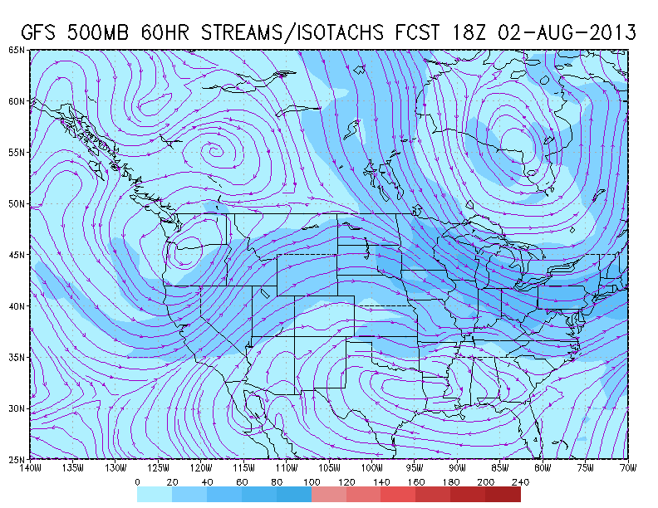
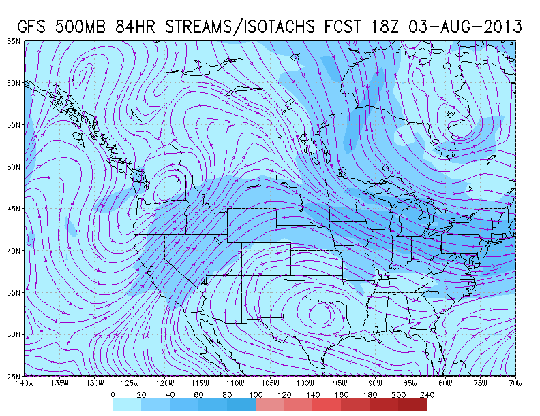
500mb pattern now (above), Friday
(top right), and Saturday (bottom right).
Trough is offshore, disturbances rotate
around it producing some instability
and dry lightning in SW Oregon.

Slide 6
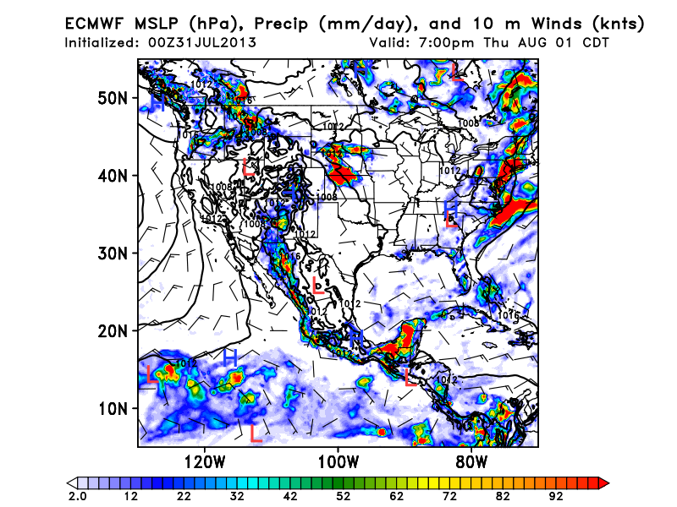
No precip forecast west of Cascades, but expect some precip associated with
trough-induced disturbances east of the cascades in SW Oregon. This precip
will not affect fires currently burning in SW OR.

Slide 7
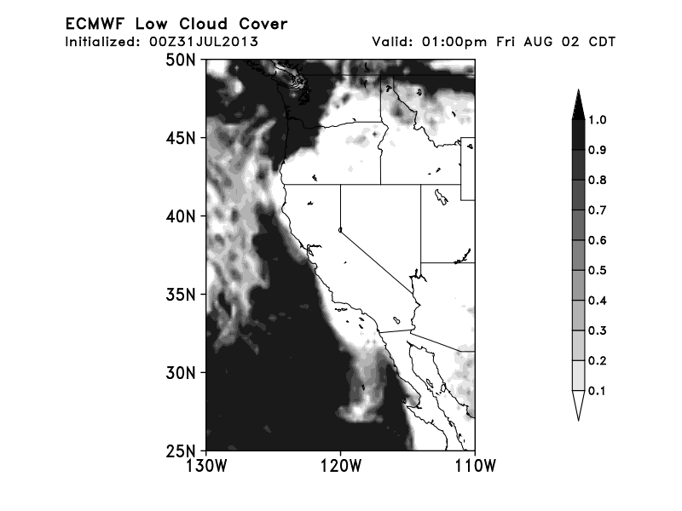
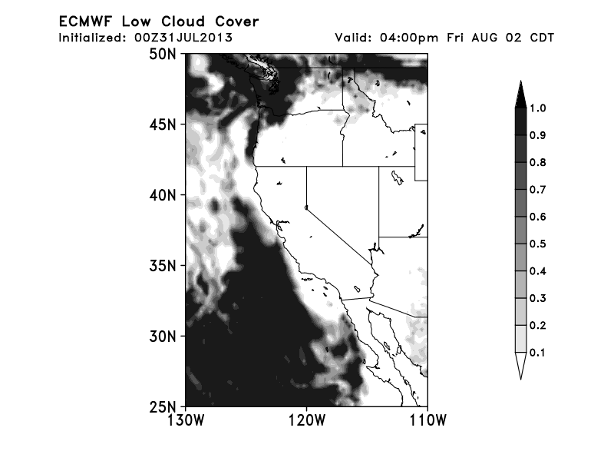
Friday low cloud forecast (PM). Stratus retreating from shore in late afternoon.

Slide 8
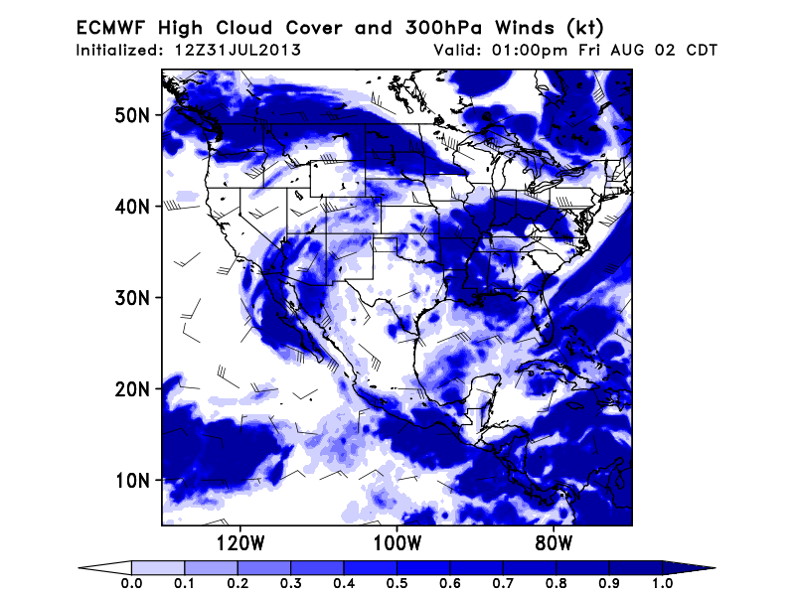
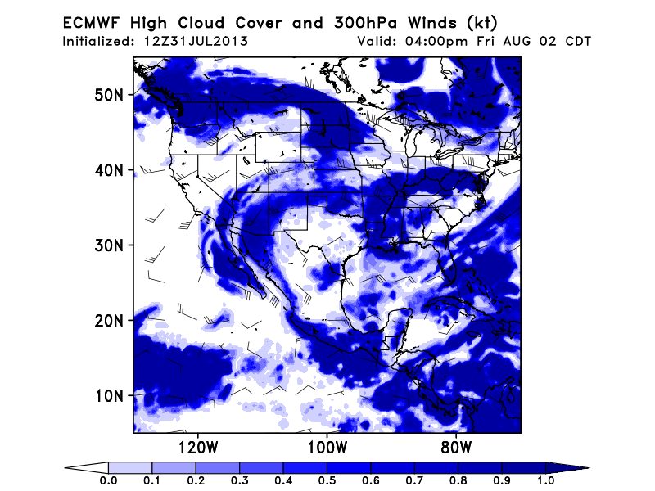
High cloud cover on Friday afternoon. High clouds present over Northern
California today are gone by Friday. High clouds over SE CA are probably
overpredicted.

Slide 9
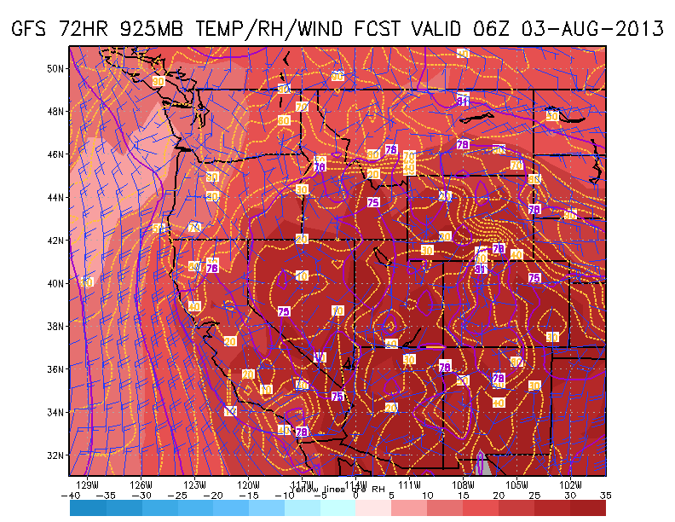
Low level flow continues from the north on Saturday, suggesting
good chance of smoke over Stratus if fires continue.

Slide 10
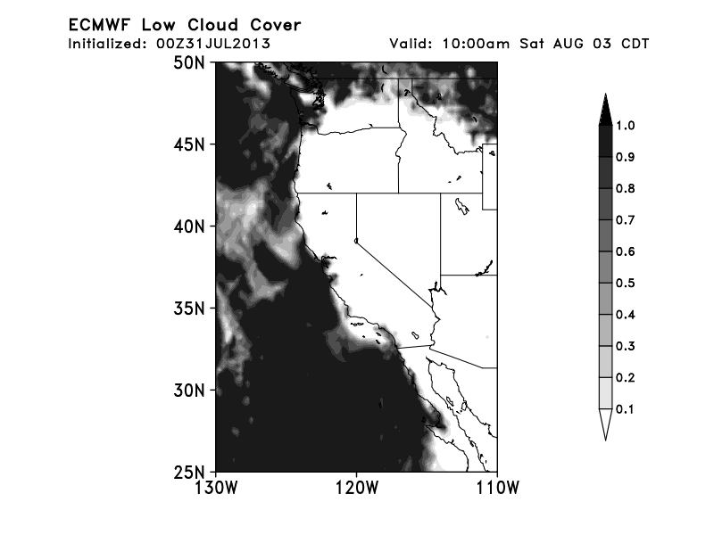
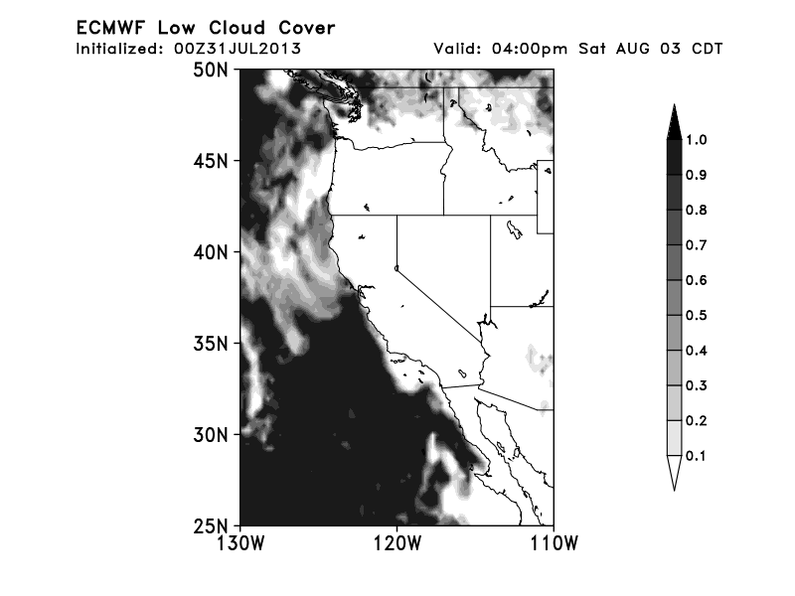
Saturday EC low cloud forecast.

Slide 11
Cloud Conditions Monday
Long range forecast models indicate a developing extended trough to the west of the northern california coast (cutoff at 700mb). The trough is currently off the coast, and has significant mid-level cloud associated with it (next slide). By Monday, the trough moves ashore and becomes extended, but appears dry at upper levels, so mid and upper level clouds would NOT be a suitable target for Monday (following slide).
Forecast situation difficult with these cutoffs, but this will probably enhance the marine layer in northern California. So expect stratus off northern California coast.
So Cal forecasters expect warming and thinner marine layer off the So Cal coast early next week.
No high cloud forecast available, but models keep forecasting surges of high RH at upper levels into our area (next following slide). These seem to be associated with very thin clouds. I don’t recommend pursuing these unless it is obvious.
Basic message on Monday is that stratus in Central and Northern California is your best bet.

Slide 12
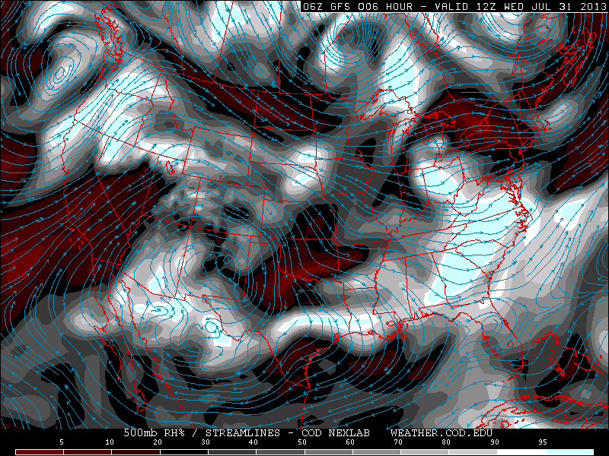
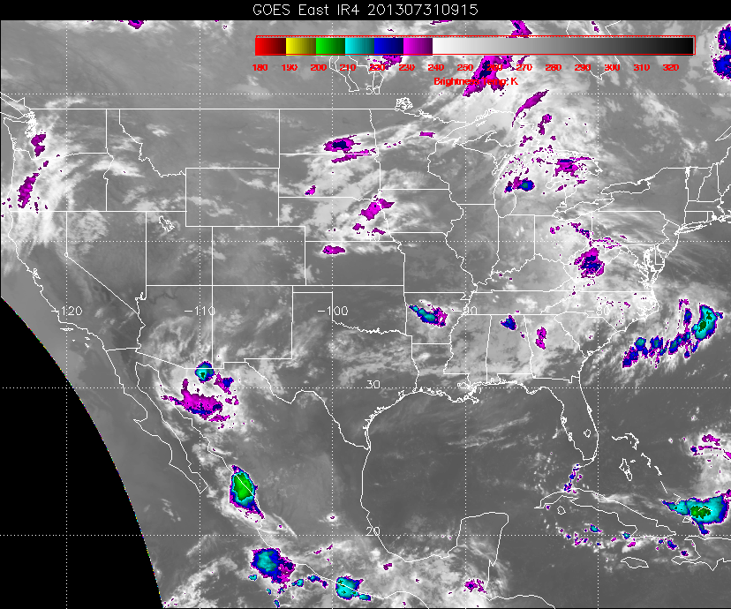

Slide 13
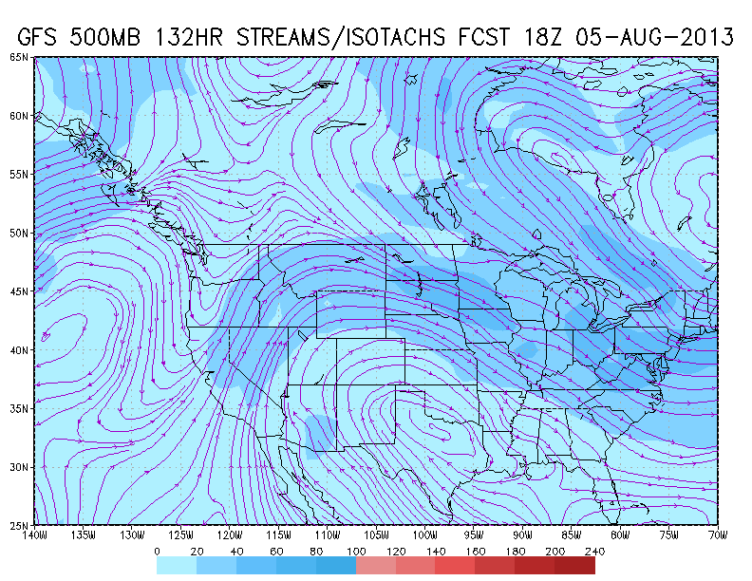
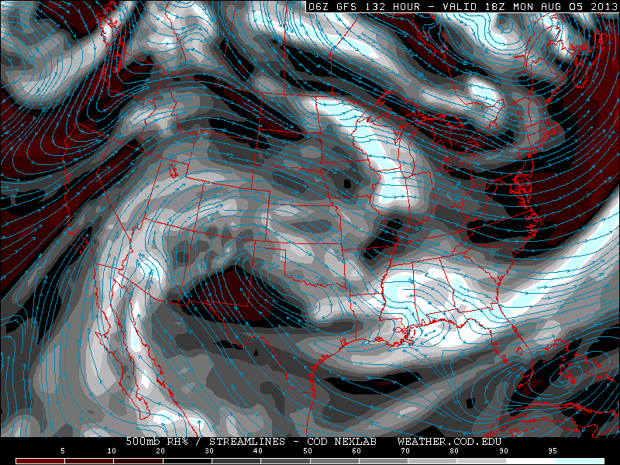
Forecast of extended trough for
Monday. Trough is currently offshore
and has significant moisture and cloud
associated with it (see satellite image,
previous slide). By Monday, trough is
dry, so don’t expect much cloud with
it. Stratus will be present, though

Slide 14
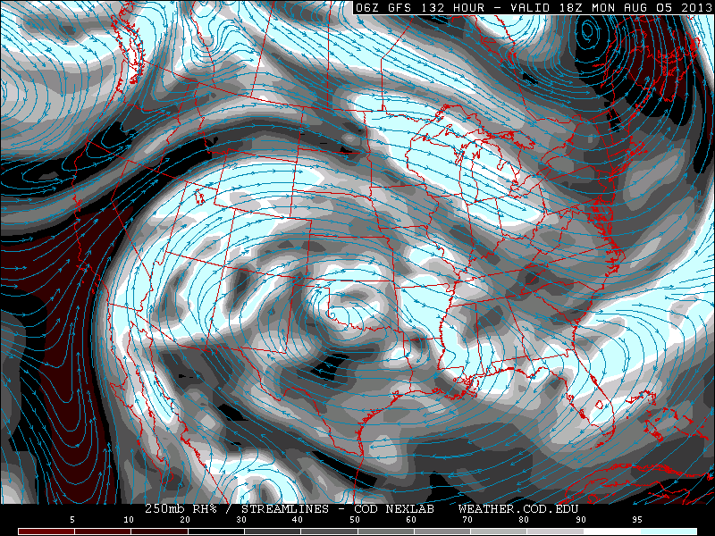
250mb RH for next Monday (above).
Current satellite image (with similar
progged RH values, right, prog not
shown). High RH does not
necessarily mean significant cloud.
Just see some wisps. These are at
25kft (per Edwards report).

