Slide 1
Briefing, 20130730
Surface wx Tues-Fri (Palmdale)
Cloud conditions in CA region
Upper level UTLS flow/convection

Slide 2
T/O landing WX, Palmdale
Yesterday’s winds were within limits – maximum gusts down the runway were at 2 PM and were ~27 knots.
Onshore surface pressure gradient progged to be stronger than yesterday, but max winds will be less, probably due to offshore gradients aloft. Peak gusts will occur later (4-5 PM) at ~20 knots.
Conditions are benign until Friday, when gusts to 27 knots down the runway are forecast. Details dependent on the relative position and strength of the southwest high and trough off the northwest coast – will revisit tomorrow.

Slide 3
Cloud conditions through Friday
Coastal overcast from the Mexican border to well north of San Francisco this morning (Tues, 7/30.
Marine layer thickness in Socal less than yesterday (1200 vs 2000 ft). Got good afternoon clearing yesterday south of point Concepcion (more than I forecast). Expect clearing westward at least to a SSE-NNW line starting at Point Concepcion. Inversion will strengthen tomorrow and Thursday, and expect later and less clearing off the SoCal coast.
Marine Layer continues thicker in central CA. Expect similar conditions to yesterday, where clouds cleared by afternoon sufficiently to produce clear skies under the offshore position of today’s aircraft flight track. This pattern should continue through Thursday.
Tomorrow and Thursday show significant enhancement of high cloud over So Cal and points east. These are consistent overpredictions, but are an indication of monsoon outflow convection. High cloud forecast is less on Friday (tomorrow and Thursday shown on next slide).
Low cloud forecasts based on forecast products at http://graphical.weather.gov/sectors/mtr.php, http://graphical.weather.gov/sectors/sgx.php, http://graphical.weather.gov/sectors/lox.php, and the Monterey and LA forecast discussions.

Slide 4
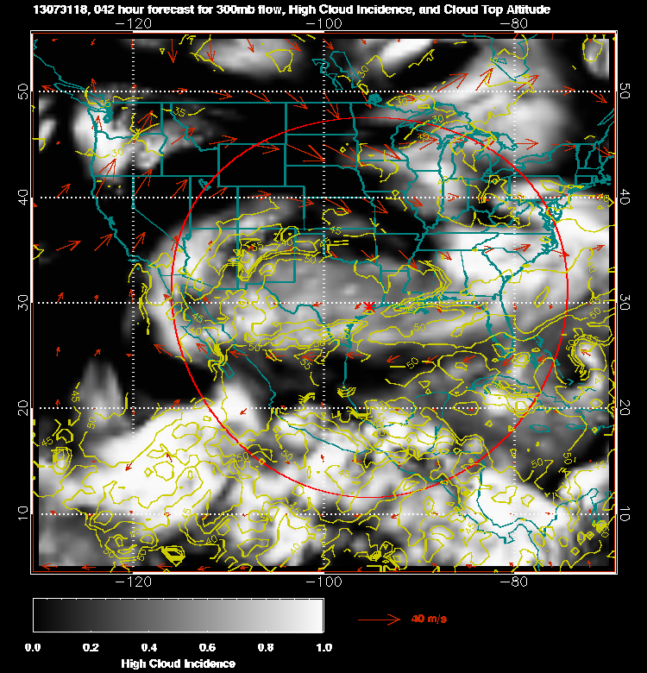
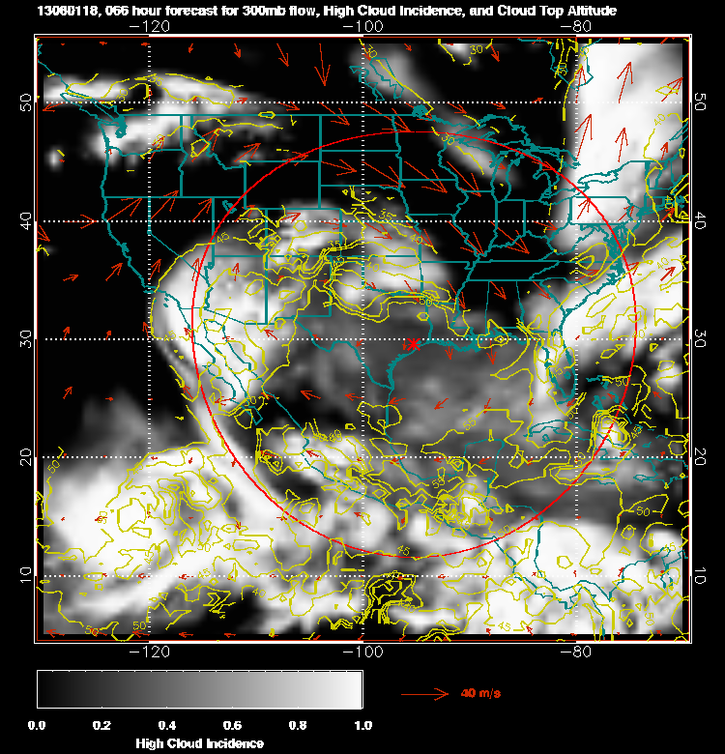
High cloud for tomorrow (left) and Thursday (right). Altitude of tops in kft
Is in yellow. These are high clouds.

Slide 5
Upper level flow/convection
The inability to fly east of 240E (120W) has caused a rethinking of plans for Friday. We are now considering going east to capture outflow from NAM convection in Mexico.
Typically late afternoon convection/evening convection extends north from Mexico well into AZ/NM. Yesterday the AZ/NM component was suppressed, largely due to a wave (could be seen at 700mb) associated with the development of a large MCS currently decaying over OK/KS. See next slide.
The monsoon anticyclone shifts west over the next few days, and expect more convection over NM and AZ. Trajectory models (not shown) suggest ample outflow from deep convection reaching the tropopause should be present. However, will have to be prepared to deal with NM/AZ convective systems depending on how far east we go.

Slide 6
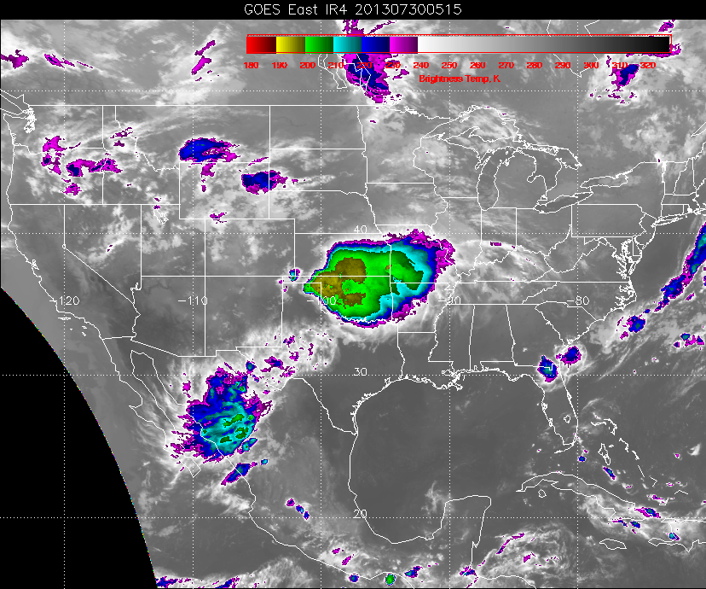
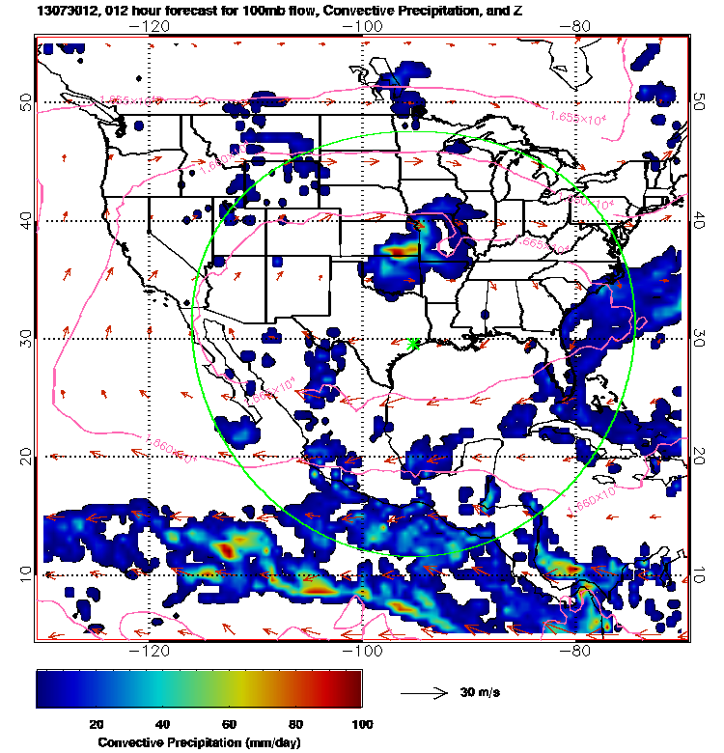
Mexican convection (in decay phase), and amplifying MCS. Note absence of
convection over AZ/NM. Monsoon anticyclone is further east than normal. (Note this
MCS was in the 48 hour forecast)

Slide 7
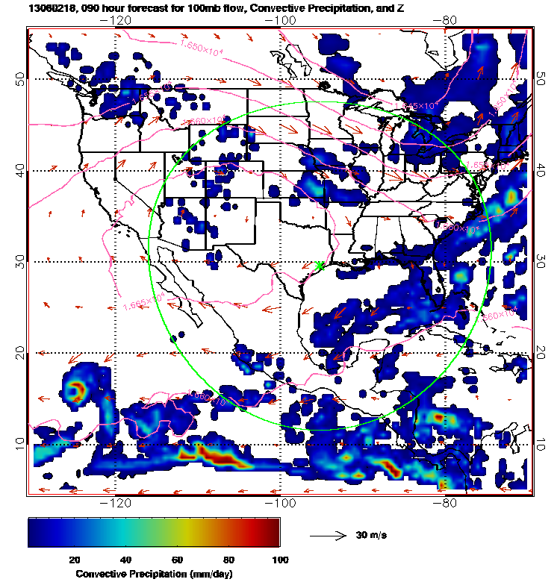
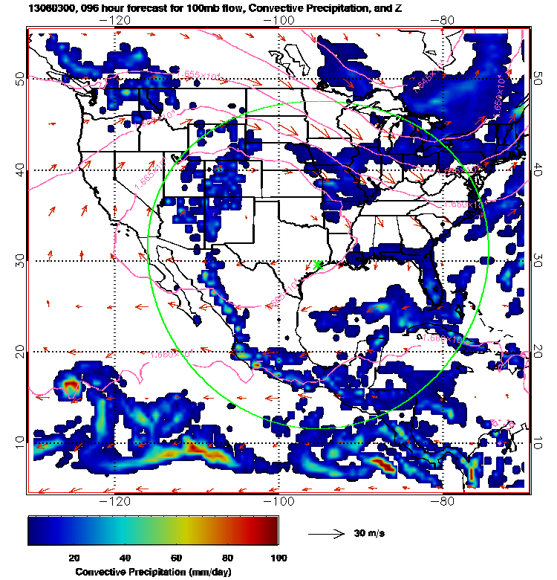
GFS forecast for convection and 100mb winds for 11 AM (left)
And 5 PM (right) on Friday

