Slide 1
Briefing, 20130729
Surface wx Tues-Fri (Palmdale)
Cloud conditions in CA region
Upper level UTLS flow/convection

Slide 2
T/O landing WX, Palmdale
Upper low over Socal leading to deep marine layer and stronger than normal onshore flow today, so expect wind gusts at Palmdale can be barely out of ER-2 limits in the afternoon. High wind period is 2pm – 6 PM. Yesterday had gusts to 31 knots at Palmdale, peaking at 4 PM.
Low moves east after today – peak winds will be less (2-6 PM), and within limits (gusts still in the high 20s).
Based on LA forecast discussion and GFS/NAM forecast winds.
Note that Edwards forecast is more benign than above

Slide 3
Cloud conditions through Friday
Thick stratus layer all the way to the Oregon border today hugging the coast. Goes south to 30N. Very limited clearing expected this afternoon.
As the upper low over Socal coast moves eastward, expect more afternoon clearing south of Point Concepcion. Stratus north of there should be persistent throughout the week, with clearing only near the coast.
Limited clearing 100 nmi off the coast tomorrow south of Point Concepcion, with progressively greater daytime clearing through the week.
Some high clouds forecast for area off Mexican coast. This depends on subtle interaction between anticyclone over southwest and trough off the Pacific coast. It is likely to be very thin stuff. See next slide
Based on forecast products at http://graphical.weather.gov/sectors/mtr.php, http://graphical.weather.gov/sectors/sgx.php, http://graphical.weather.gov/sectors/lox.php, and the Monterey and LA forecast discussions.

Slide 4
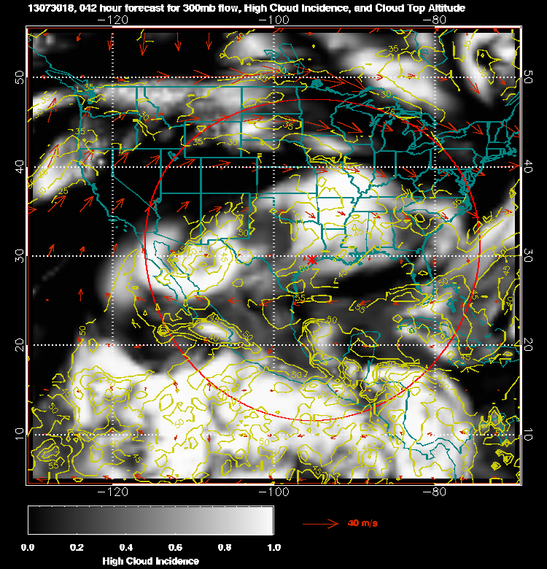
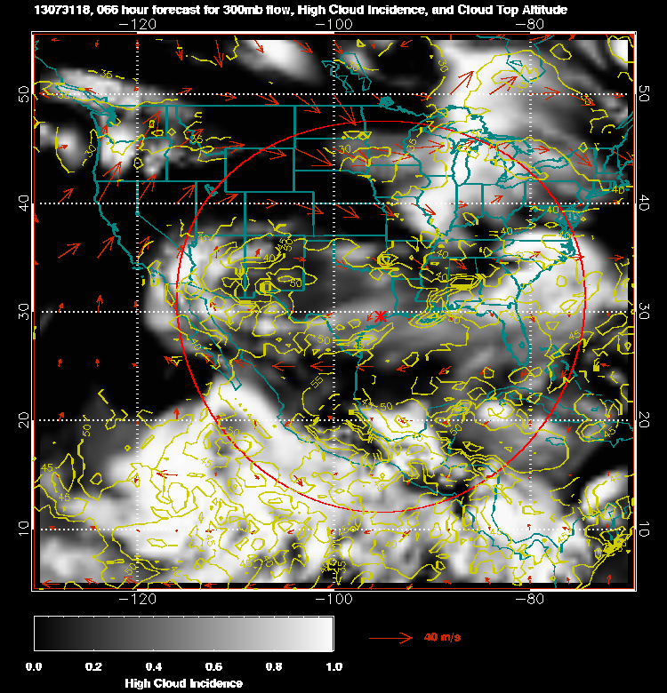
High cloud for tomorrow (left) and Wednesday (right). Altitude of tops in kft
Is in yellow. These are high clouds.

Slide 5
Upper level flow/convection
100mb flow today and tomorrow over Mexico is clearly east to west well into the Pacific. At this level, we should be able to capture outflow from Mexican convection
Comparing the GEOS5 (left) and GFS forecasts, there are differences in the flow. GFS has a more northward component, and is somewhat weaker. There are also differences at 150mb.
Friday’s flight (if west of 120W) will likely be observing convection from Tuesday or Wednesday afternoon, so character of flow is important. LARC trajectories are from GEOS5, ARC from GFS.

Slide 6
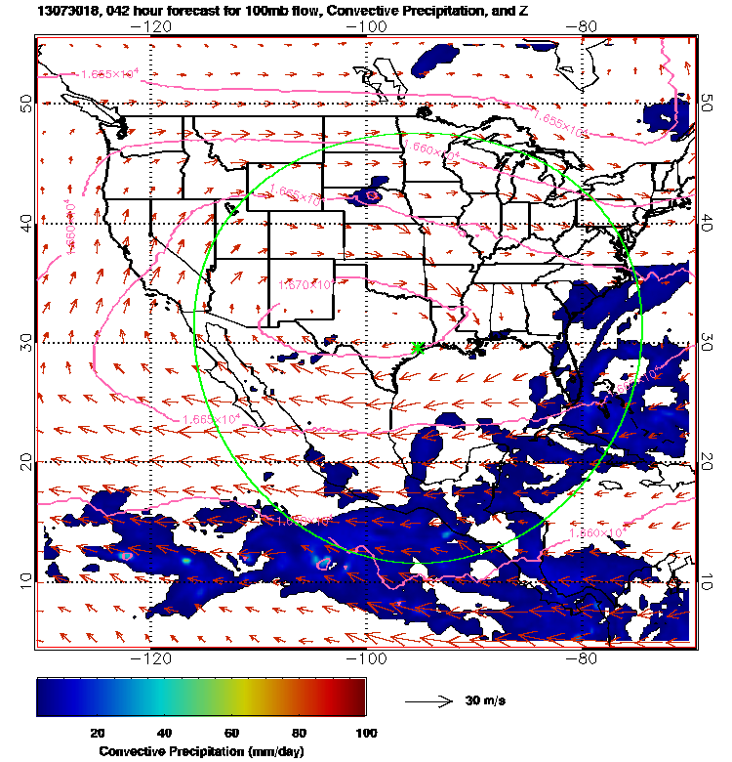
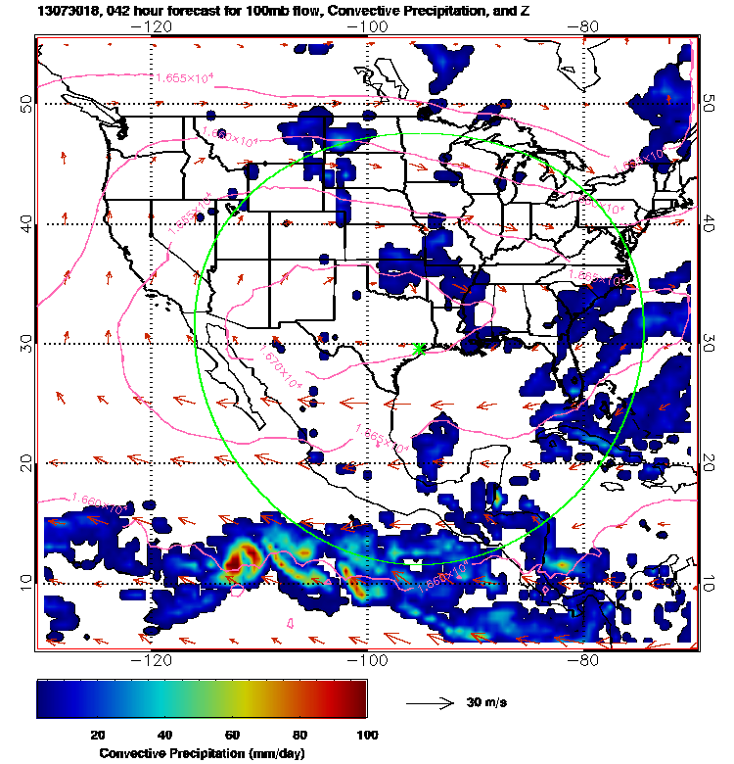
GEOS-5 (left), GFS (right), at noon CDT tomorrow

Slide 7
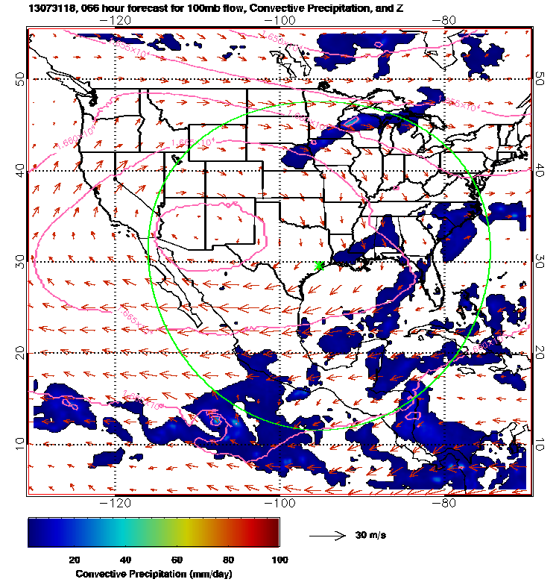
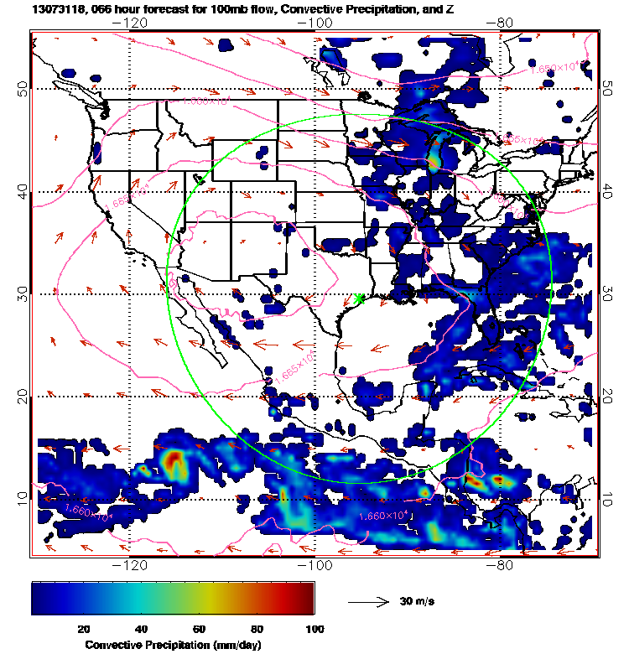
Wednesday noon CDT (100mb).

Slide 8
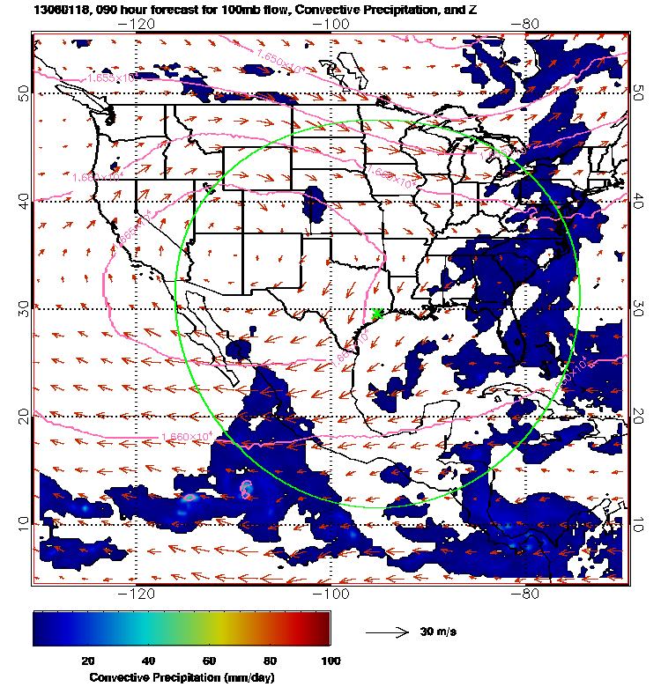
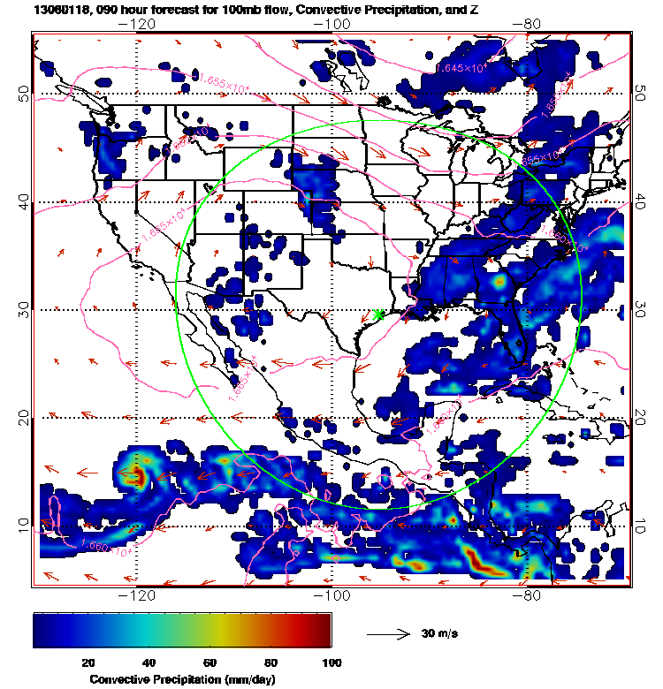
Thursday noon CDT (100mb)

Slide 9
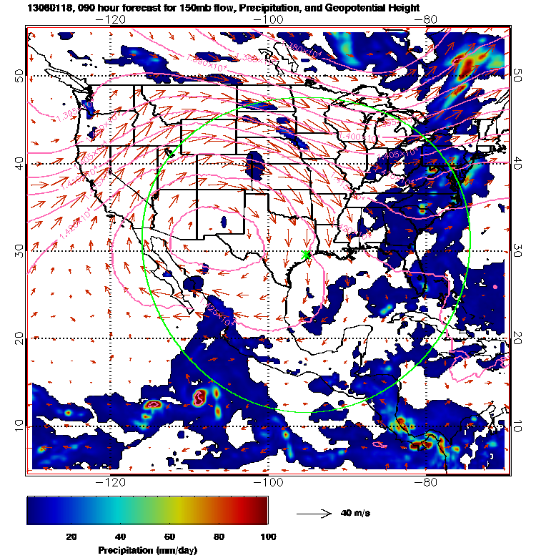
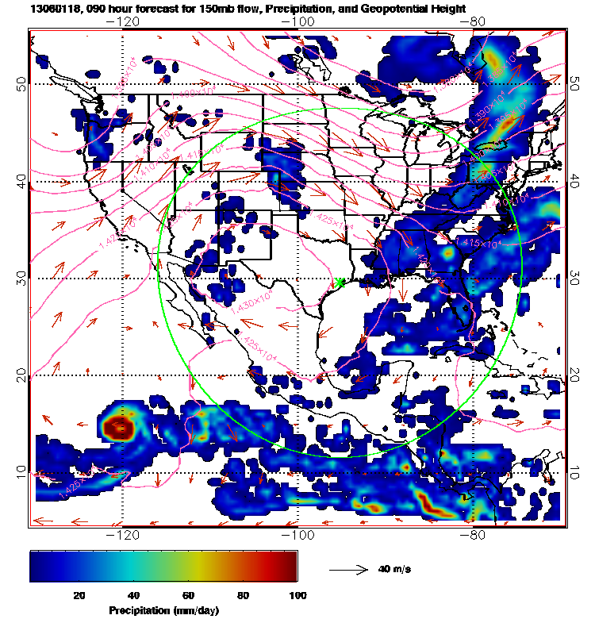
At 150mb, GEOS5 westward flow extends further west
than GFS

