Slide 1
Weather Briefing Saturday, 17 August 2013
Henry Fuelberg
Nick Heath
Sean Freeman &
SEAC4RS MET Team

Slide 2
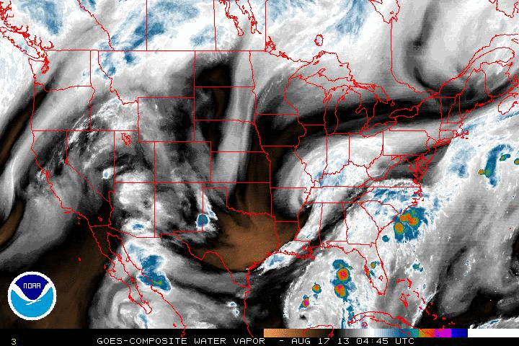
Cooler, drier air being advected into our region behind last night’s shortwave
Ending at 6:45 AM CDT

Slide 3
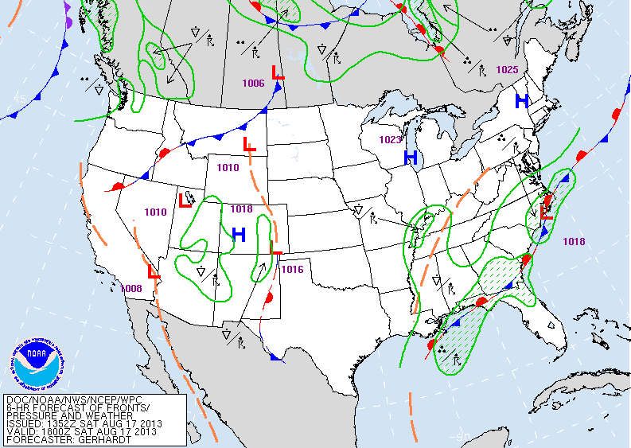
Surface Analysis: 1 PM CDT Today

Slide 4
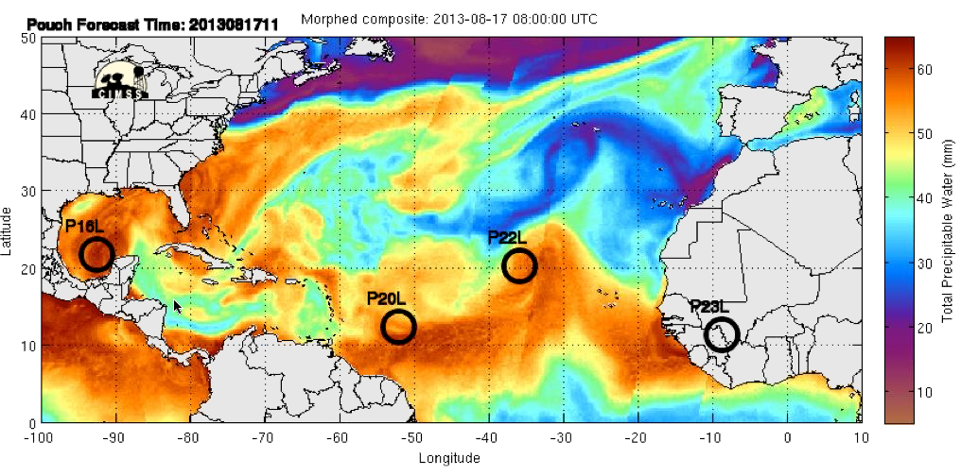
Update on tropical development – precipitable water

Slide 5
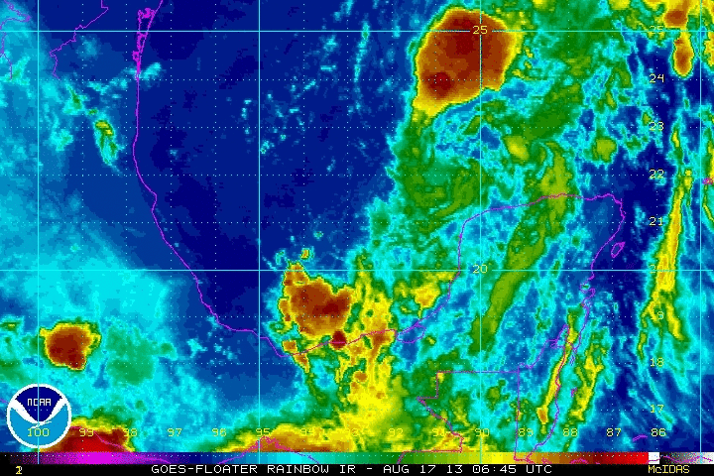
Disturbance in the Gulf
L

Slide 6
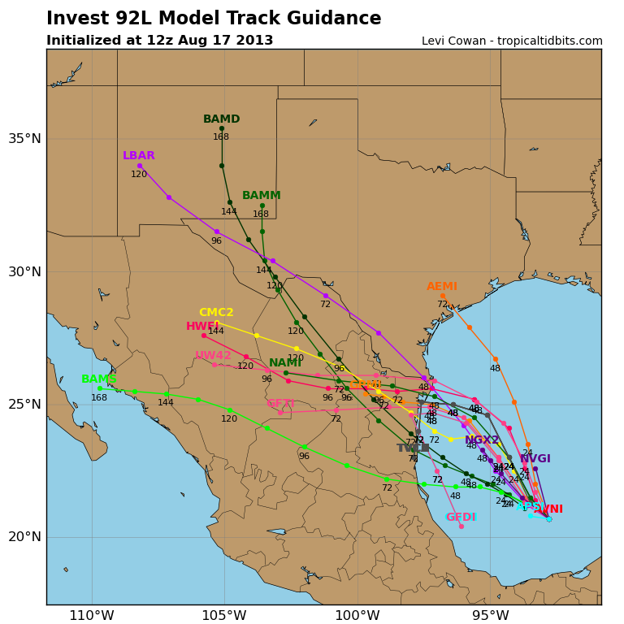
Models are in better agreement on landfall over N. Mexico and S. Texas. Locally, this will impact our rain chances Monday and Tuesday

Slide 7
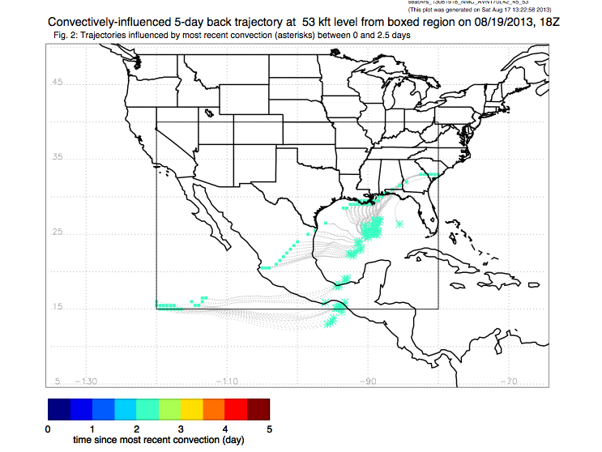
Convectively influenced air being pumped by tropical disturbance

Slide 8
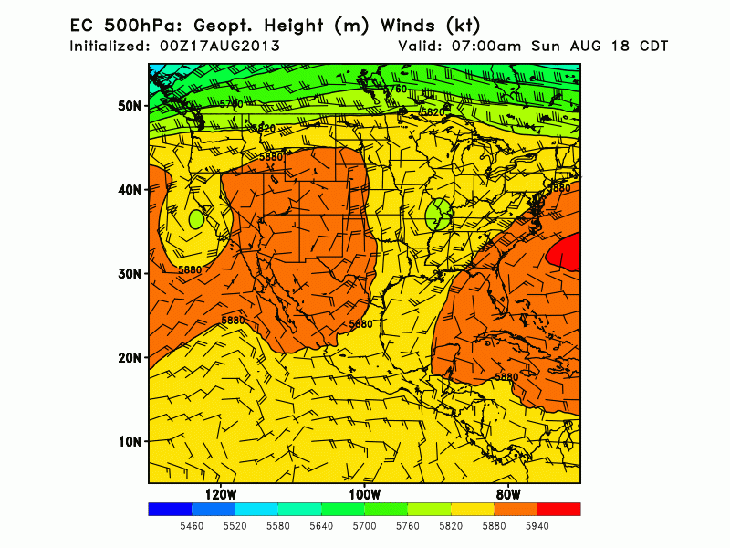
500 mb Flow: Sunday - Wednesday

Slide 9
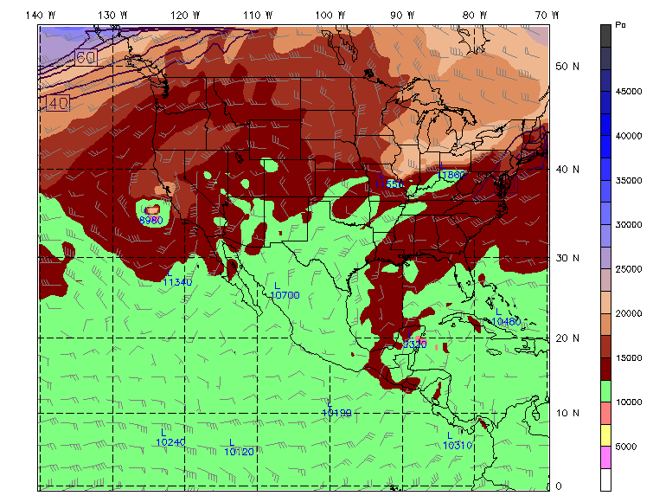
GFS Tropopause pressure at 1PM CDT Monday

Slide 10
Southeast Chemistry

Slide 11
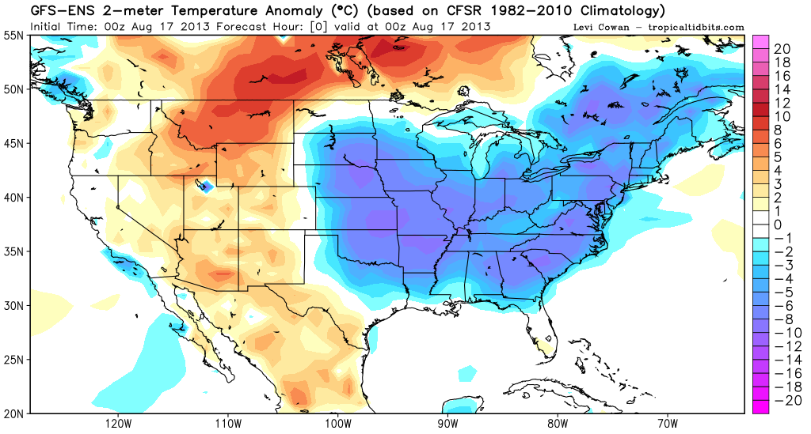
2 m Temperature anomalies valid 7 PM CDT last night – cold an anomalous pattern over eastern CONUS

Slide 12
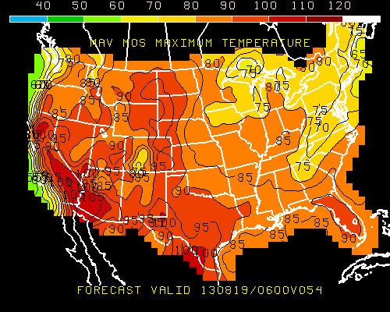
Monday maximum temperatures

Slide 13
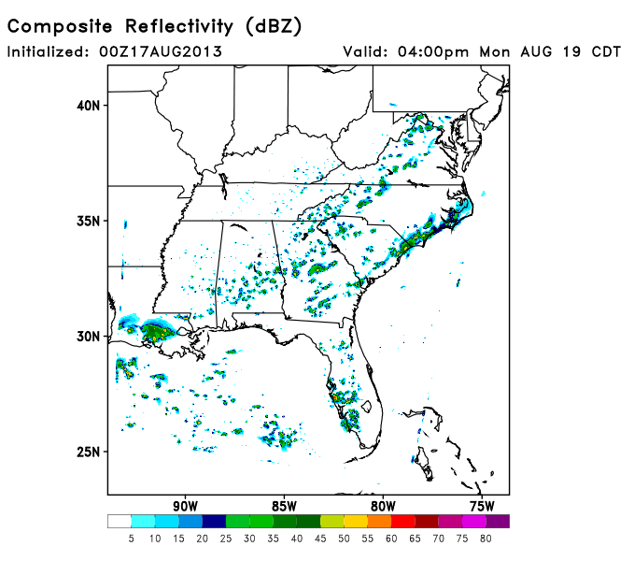
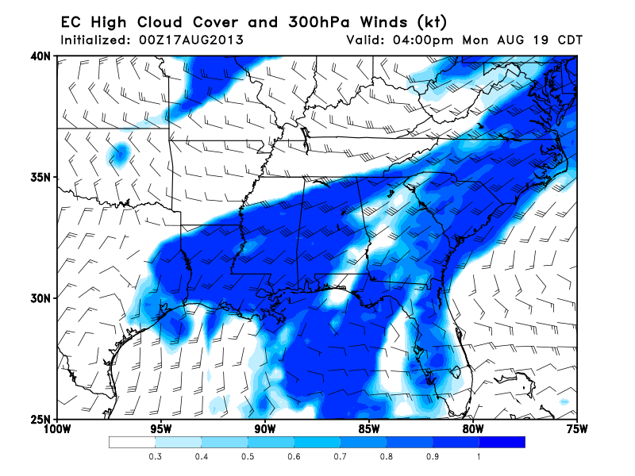
Scattered convection over SE on Monday as tropical moisture lingers around

Slide 14
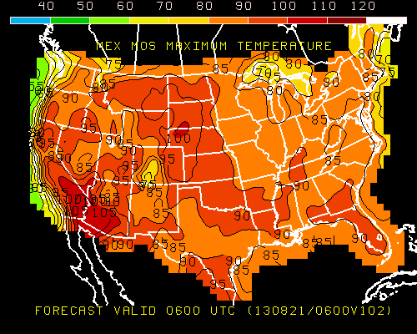
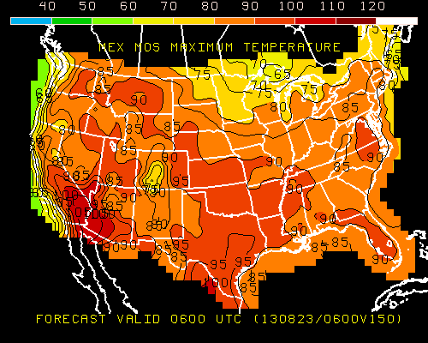
Forecasted Max Temperatures
Wednesday
Friday

Slide 15
Southeast Chemistry
Troughing, scattered convection, and cloud cover will keep temps cooler on Monday
East Coast trough weakens by Wednesday, leading to higher surface temperatures.
Cannot forecast convection that far an advance…however, synoptic conditions indicate a little more active than climo based on high precipitable water values

Slide 16
NAM and Fires

Slide 17
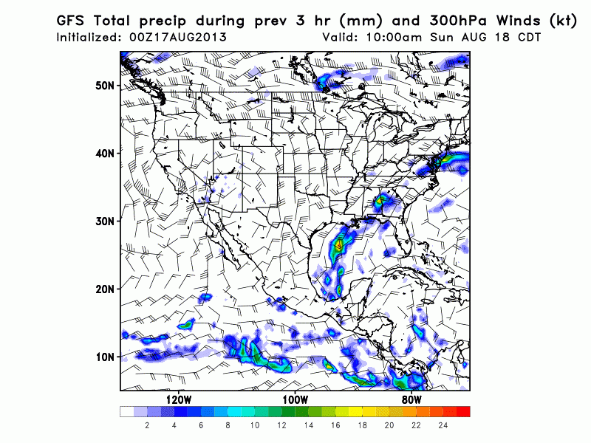
Precip: Sunday - Wednesday

Slide 18
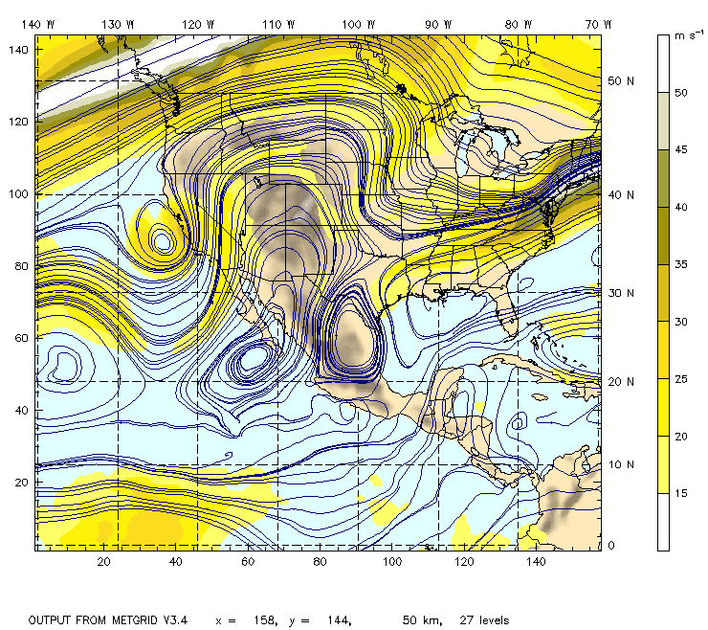
200 mb Streamlines: 1 PM CDT Monday
NCAR GFS

Slide 19
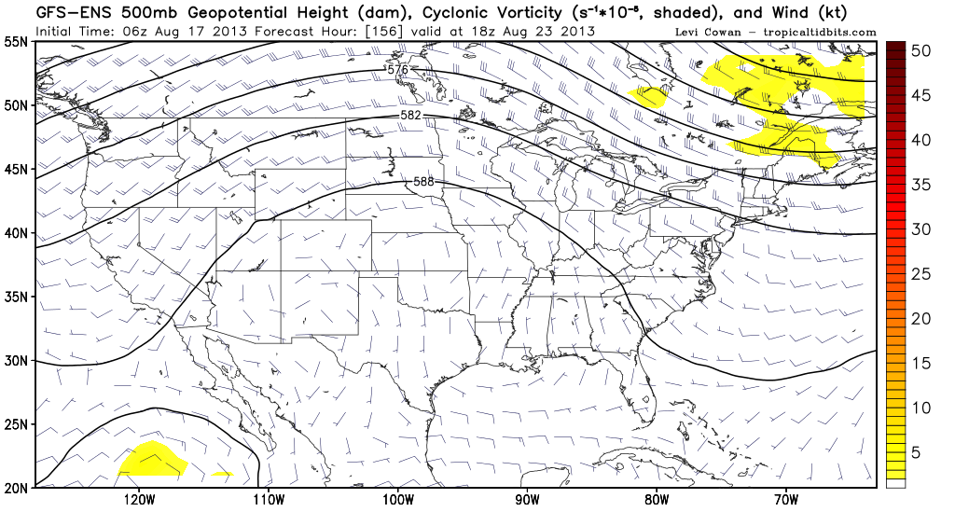
Dreamland → Friday 500 mb

Slide 20
Dreamland → Friday max temp

Slide 21
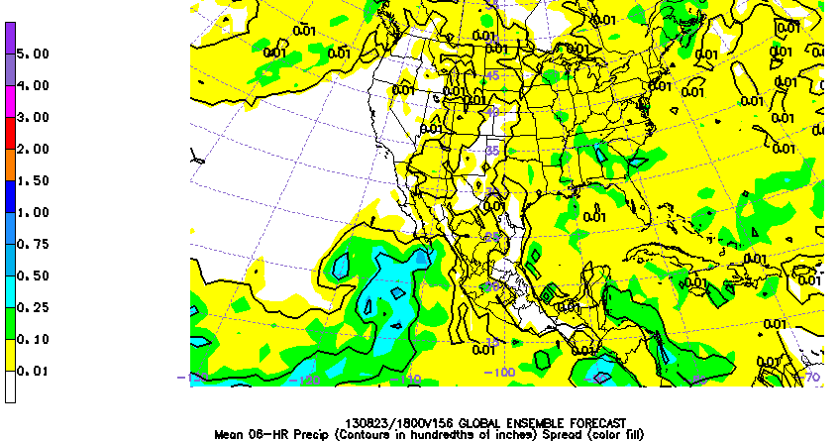
Dreamland → Friday precip

Slide 22
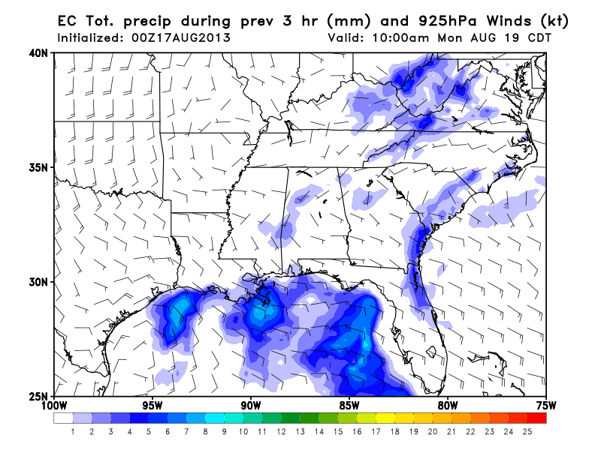
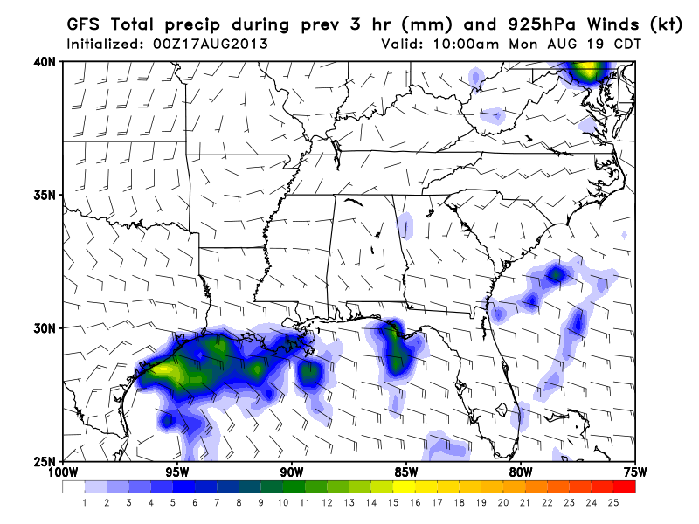
TO and Landing for Monday
NE winds ~15 kt in the morning, veering SE in the afternoon
Good chance (30-40%) of precip in the morning, increasing more in the afternoon
Depends on the track/timing of the tropical wave

Slide 23
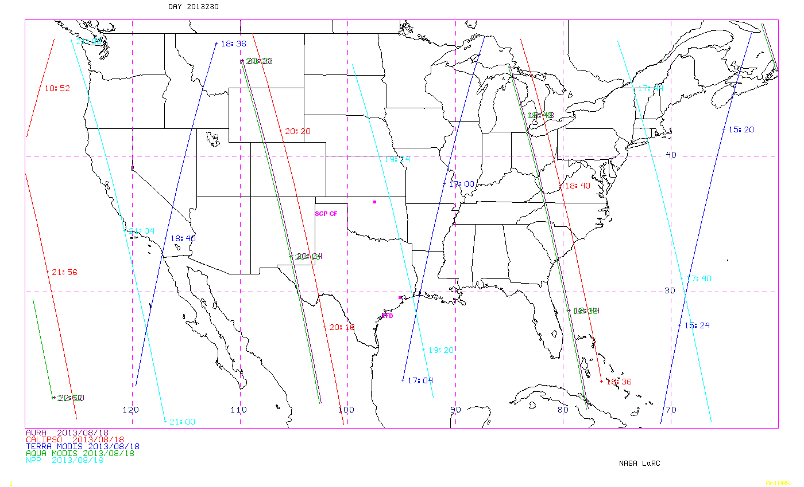

Slide 24
