Slide 1
ER-2 flight tomorrow
Recommend later takeoff. Tropical wave passes late today, with lingering precip
chances tomorrow. That, plus the diurnal cycle of morning coastal convection
indicates we should consider a noon takeoff.
Landing should be good – wave has fully passed and normal diurnal convection
(peaks 2-4) has passed.

Slide 2
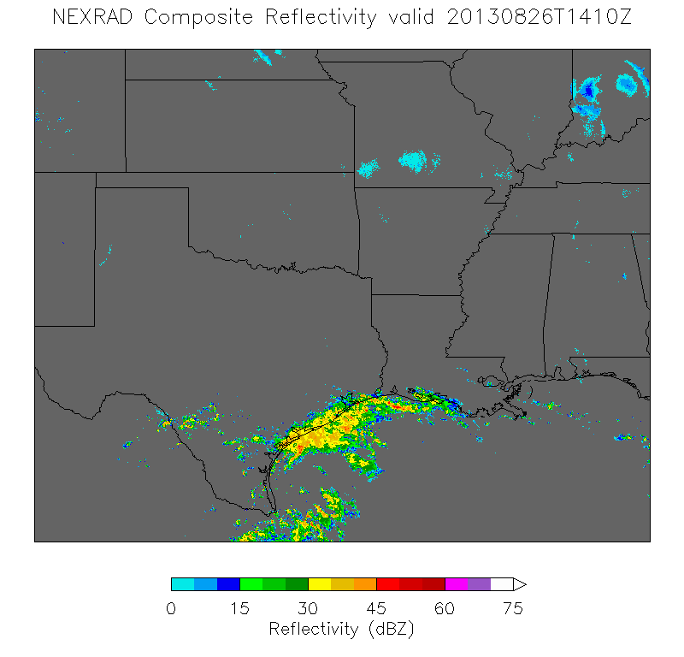

Slide 3
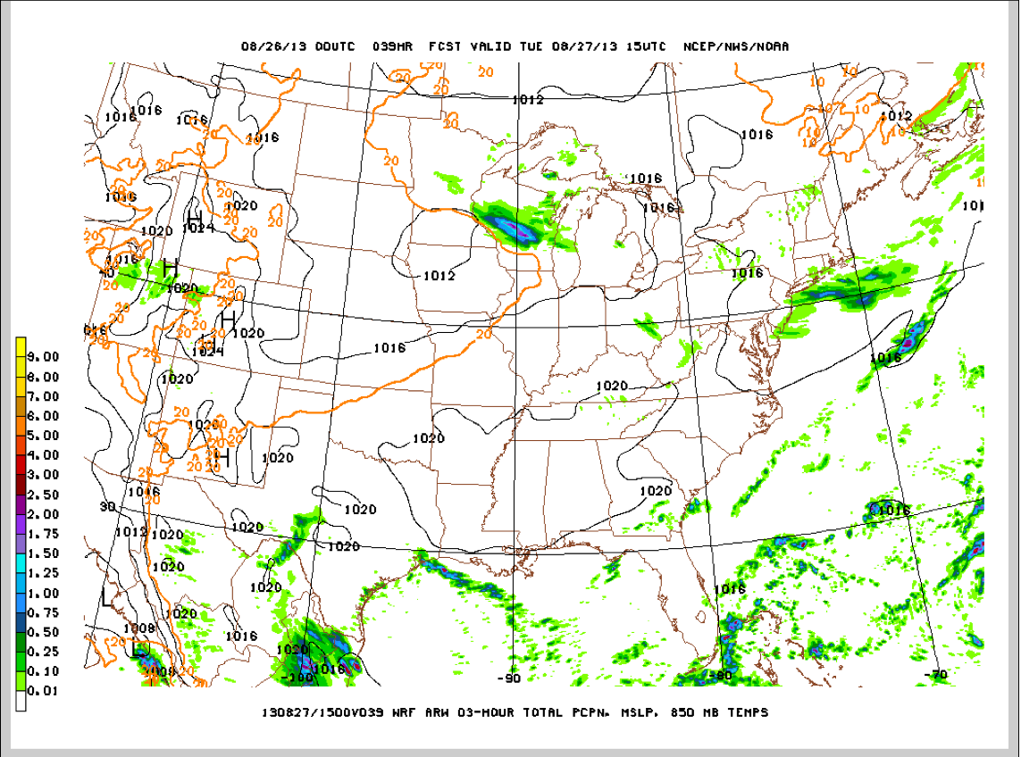
ER-2 flight tomorrow

Slide 4
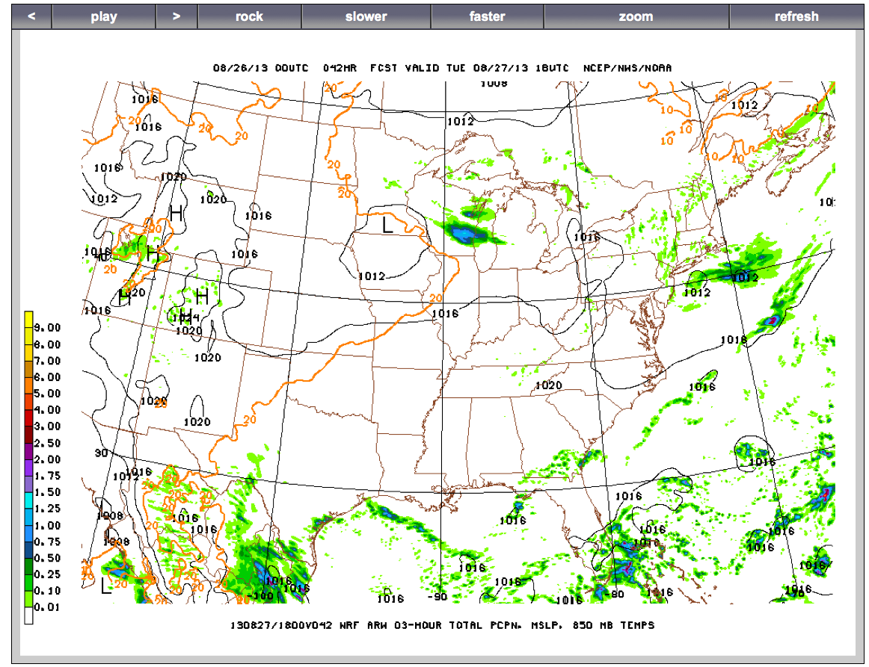

Slide 5
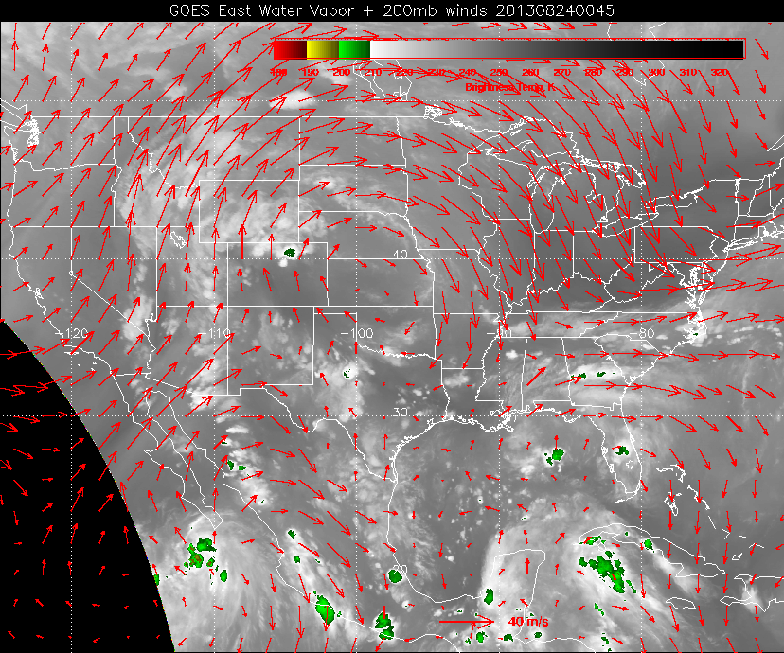

Slide 6
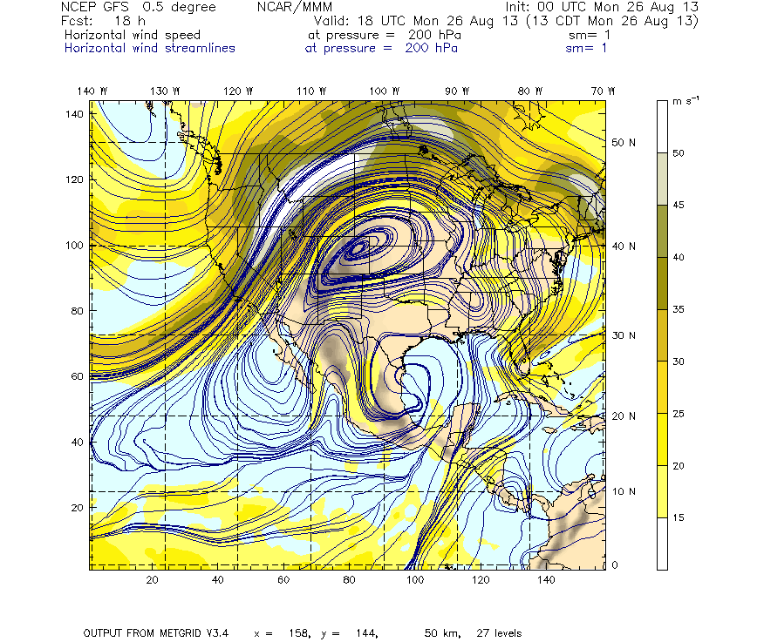
NAM Forecast for today/tomorrow
200mb
Streamlines
today

Slide 7
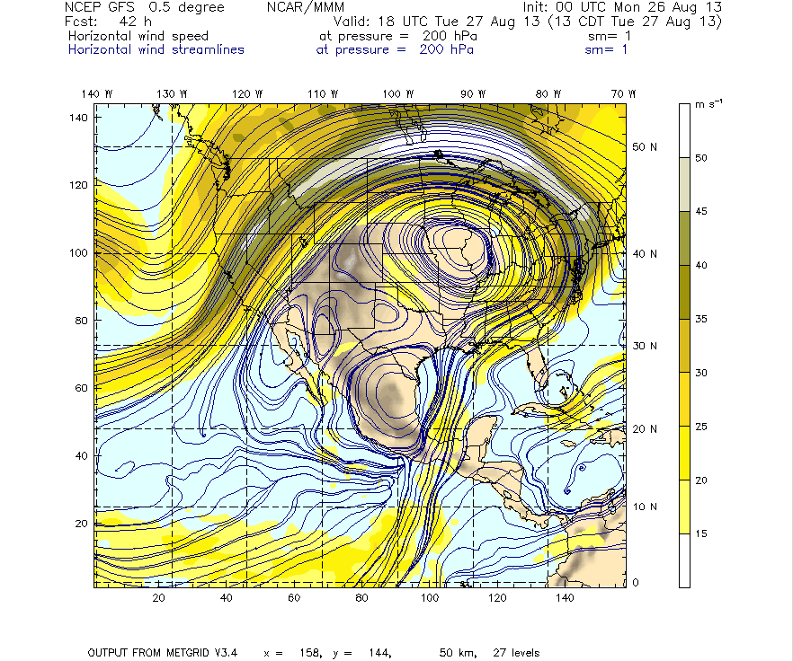
200mb
Streamlines
tomorrow

Slide 8
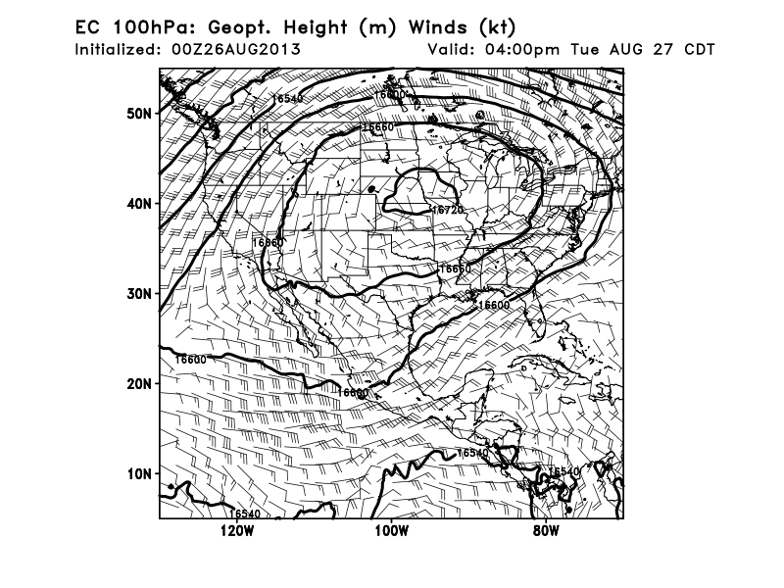

Slide 9
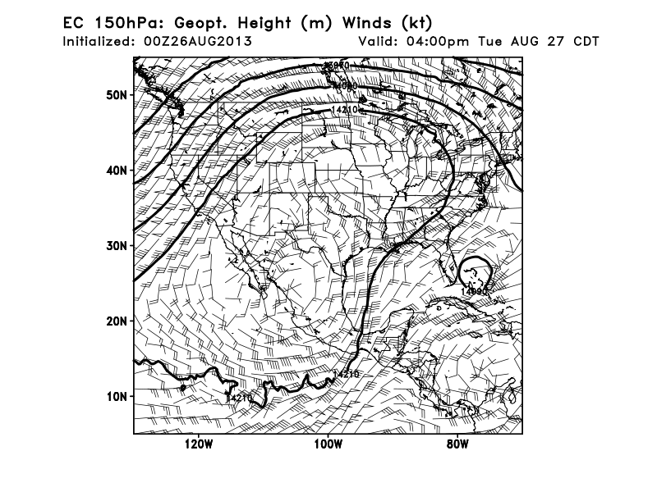

Slide 10
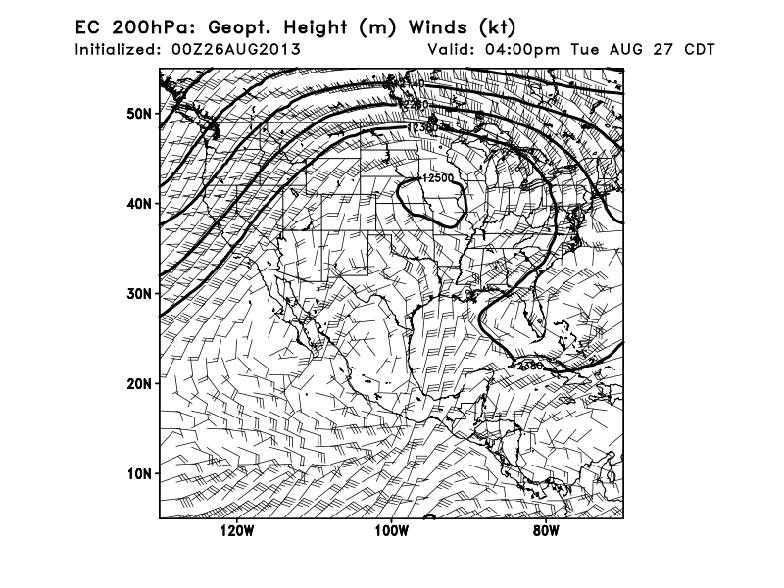

Slide 11
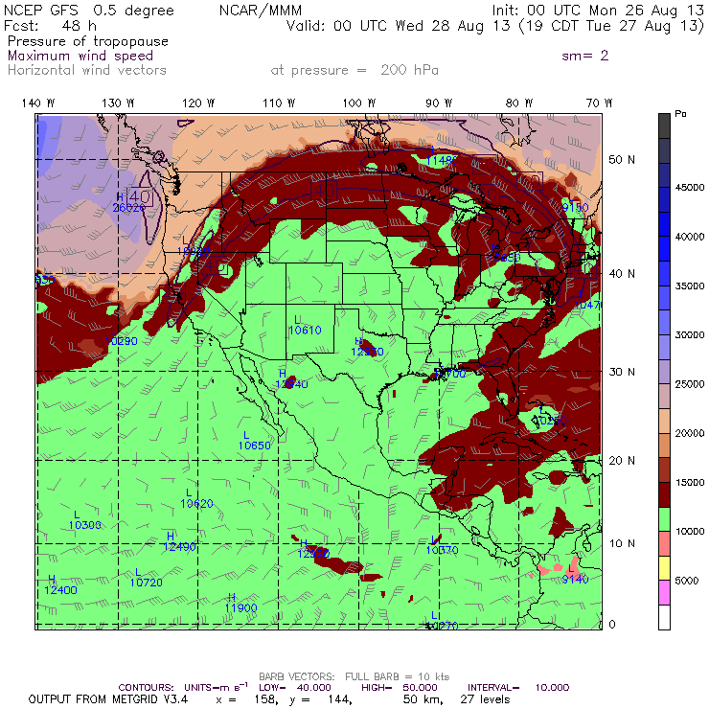

Slide 12
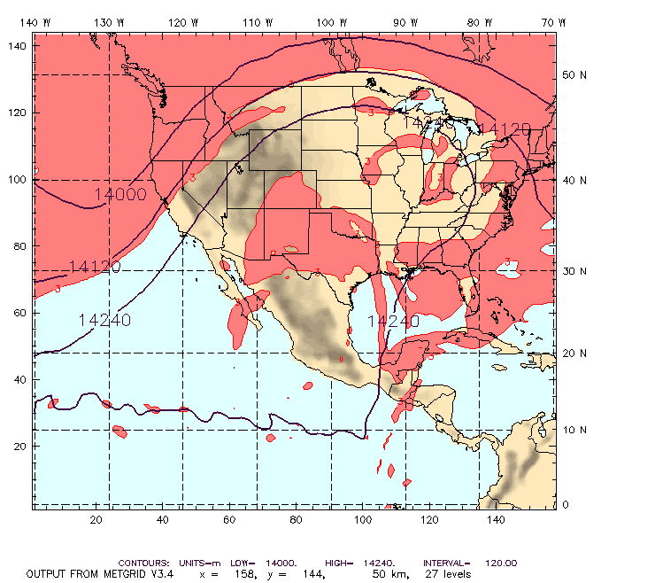
150 hPa PV: Tuesday 18UTC
ExLS Air

Slide 13
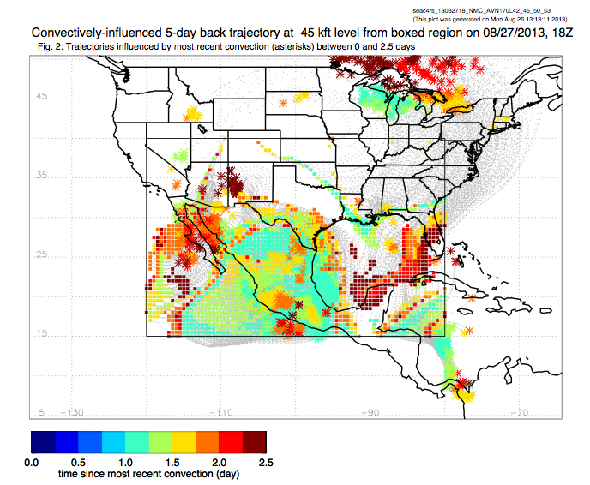

Slide 14
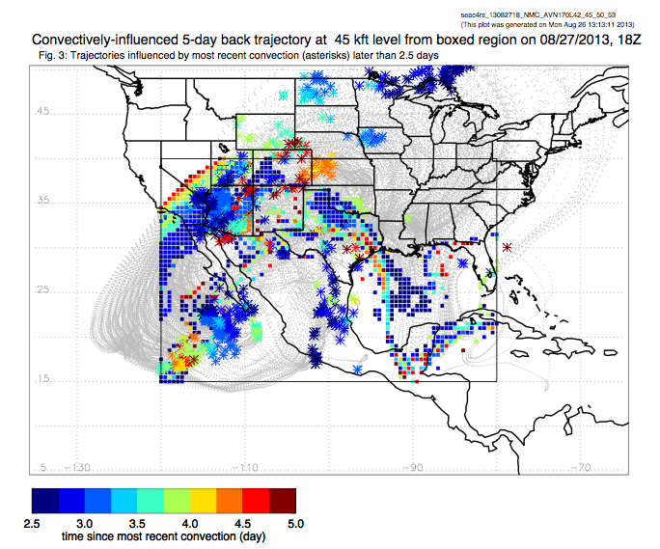

Slide 15
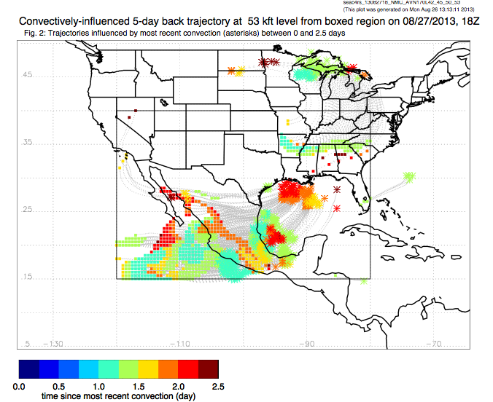

Slide 16
