Slide 1

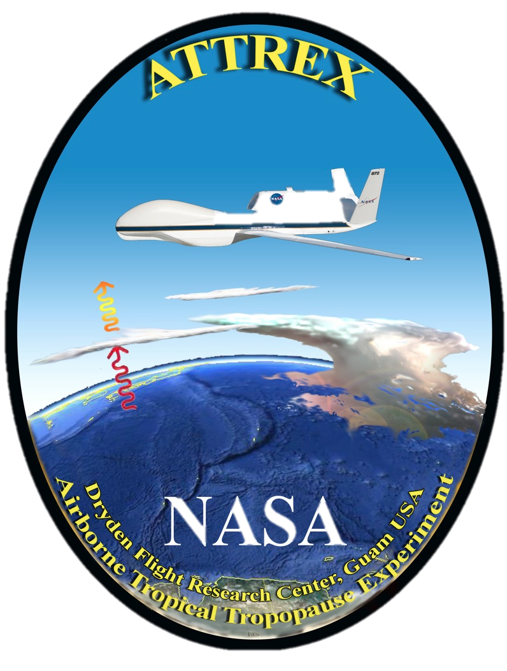
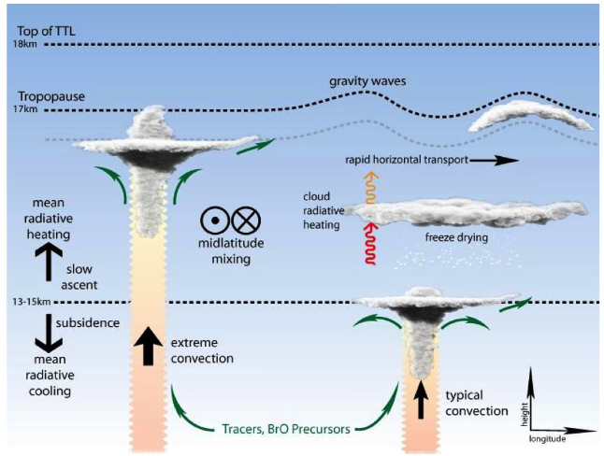
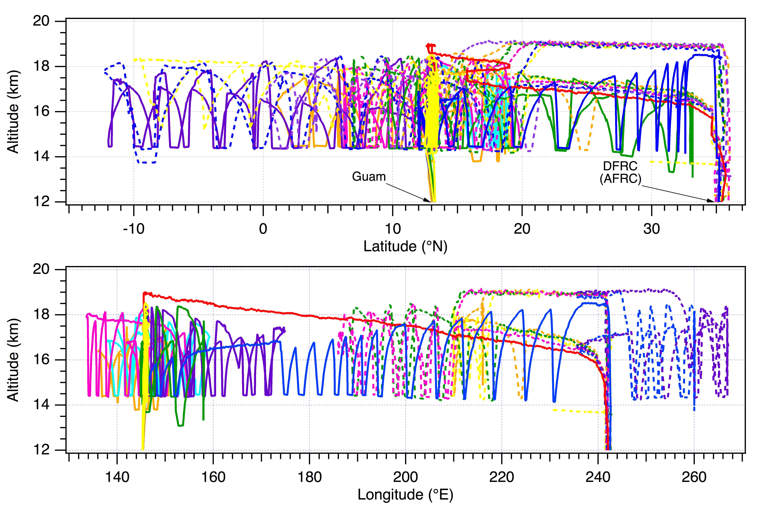
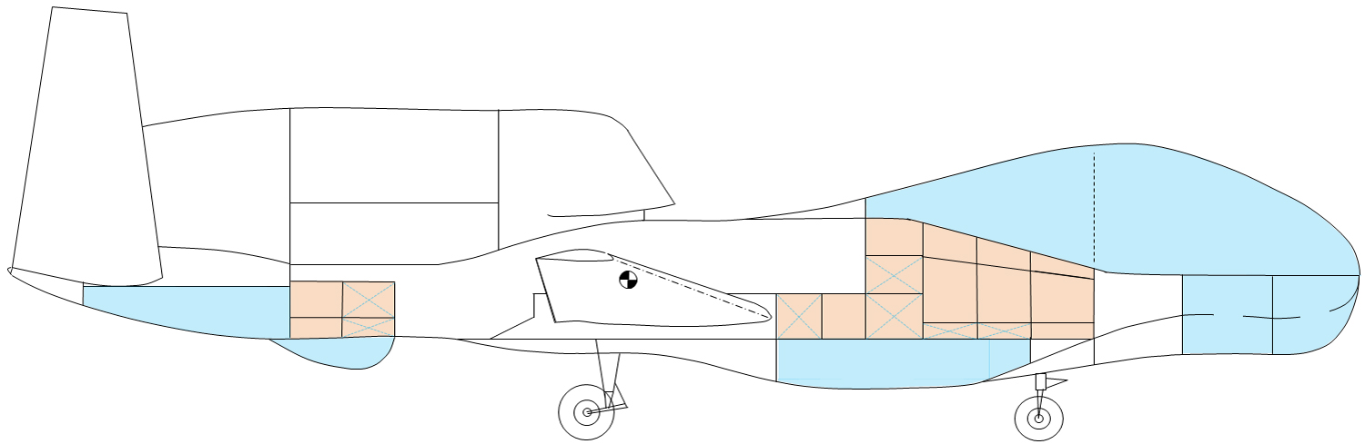
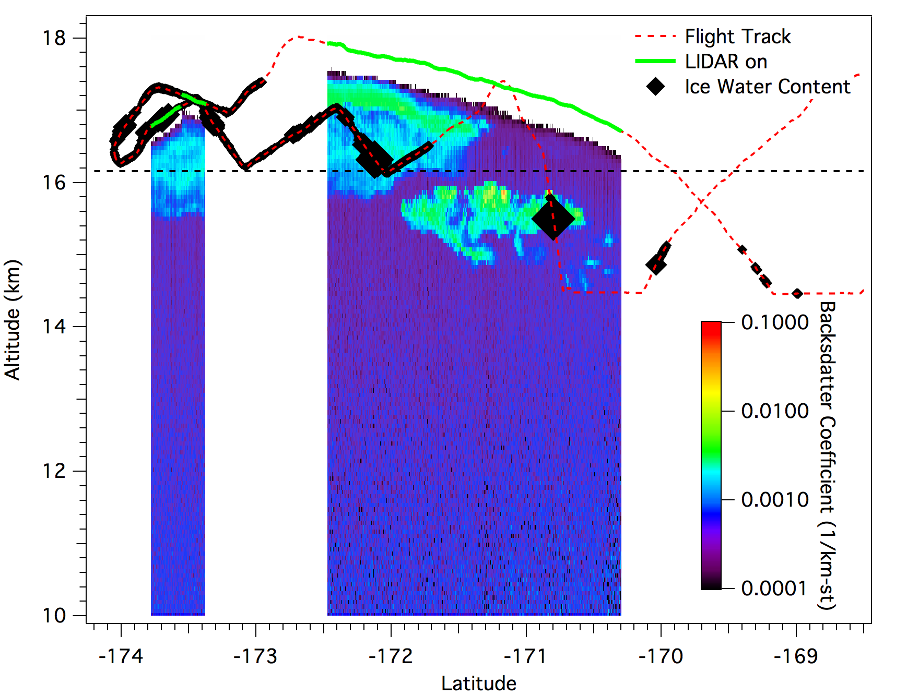
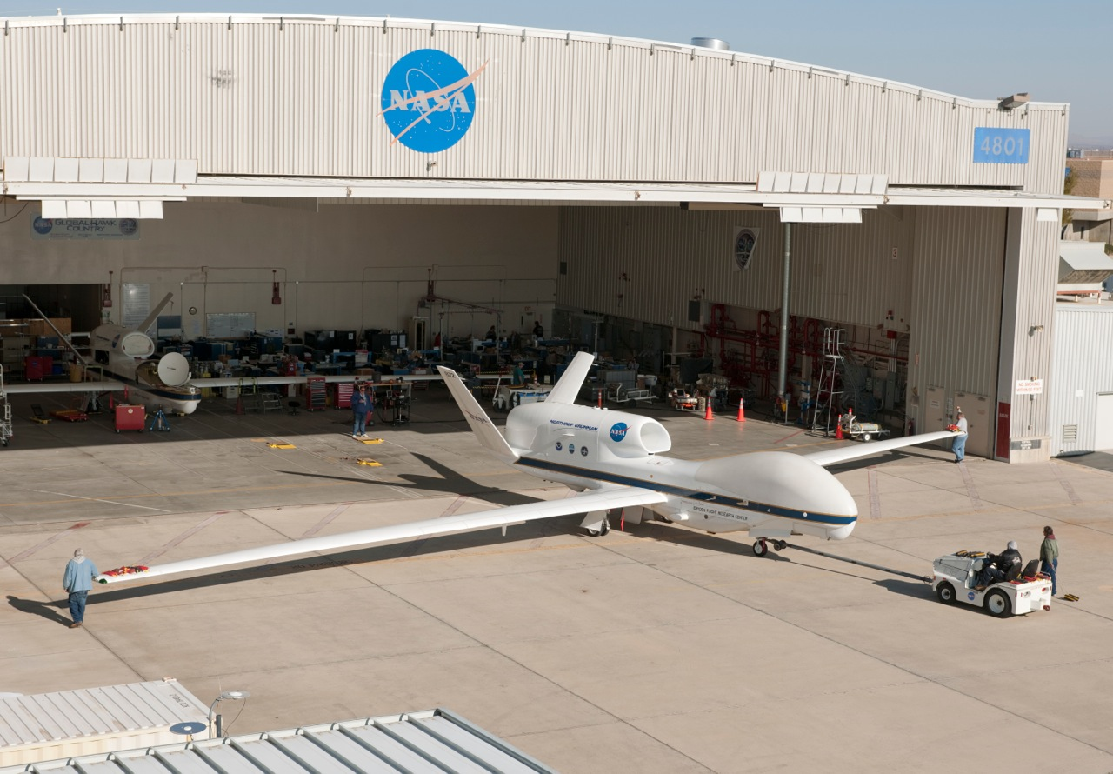
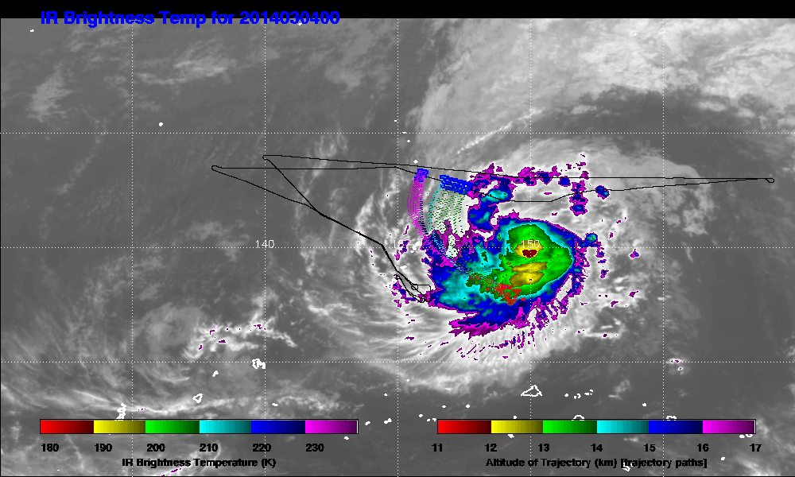
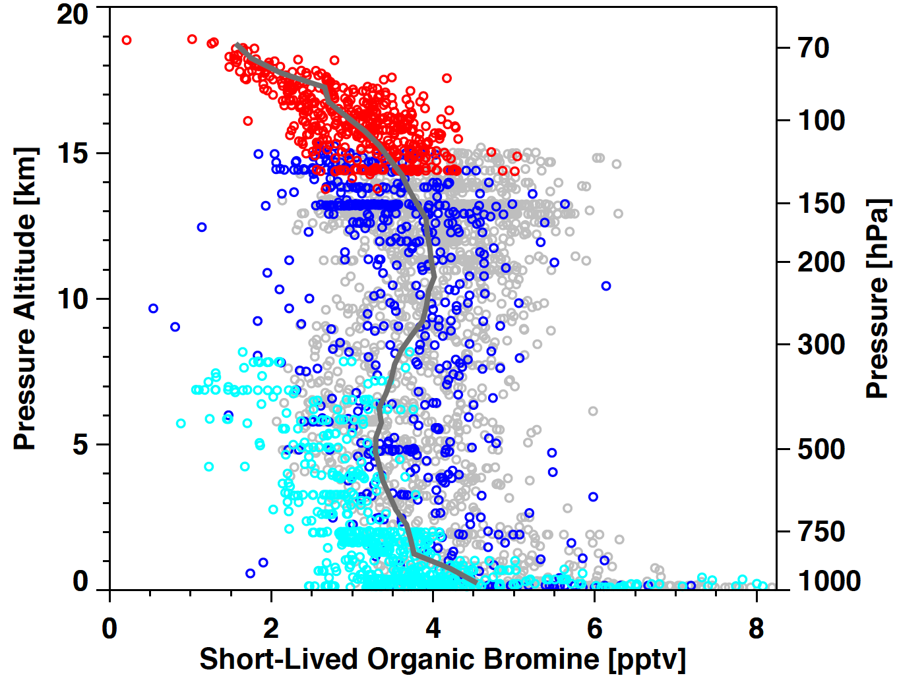
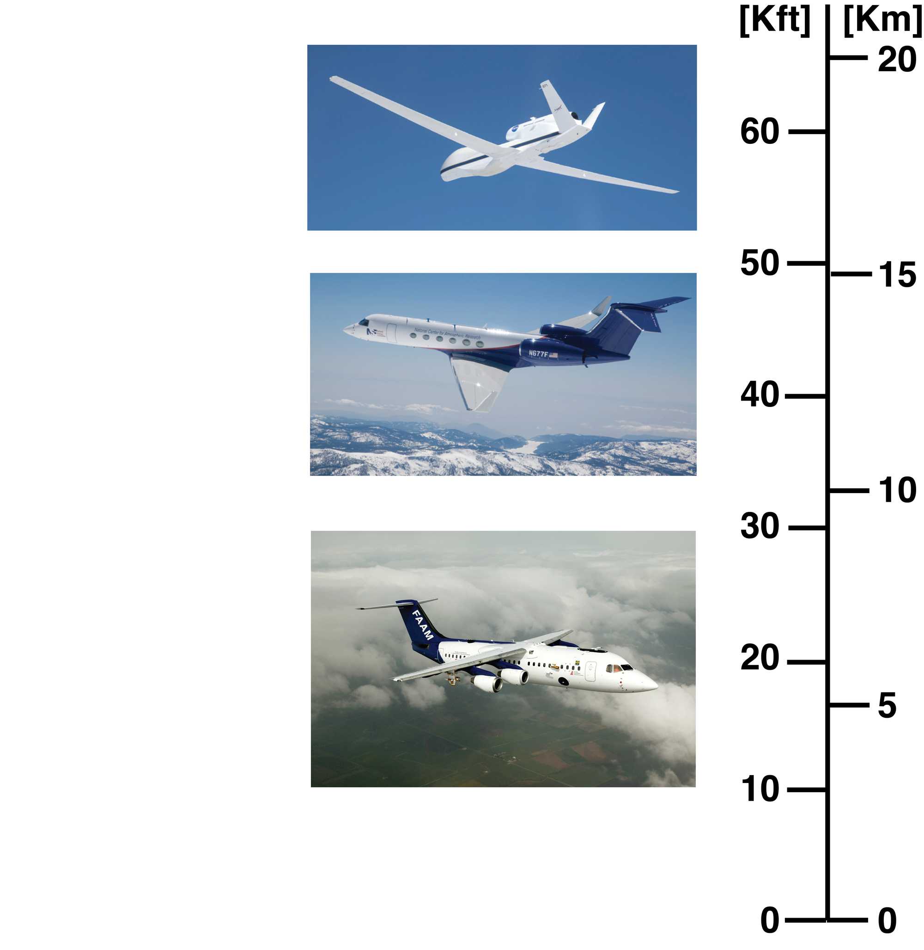
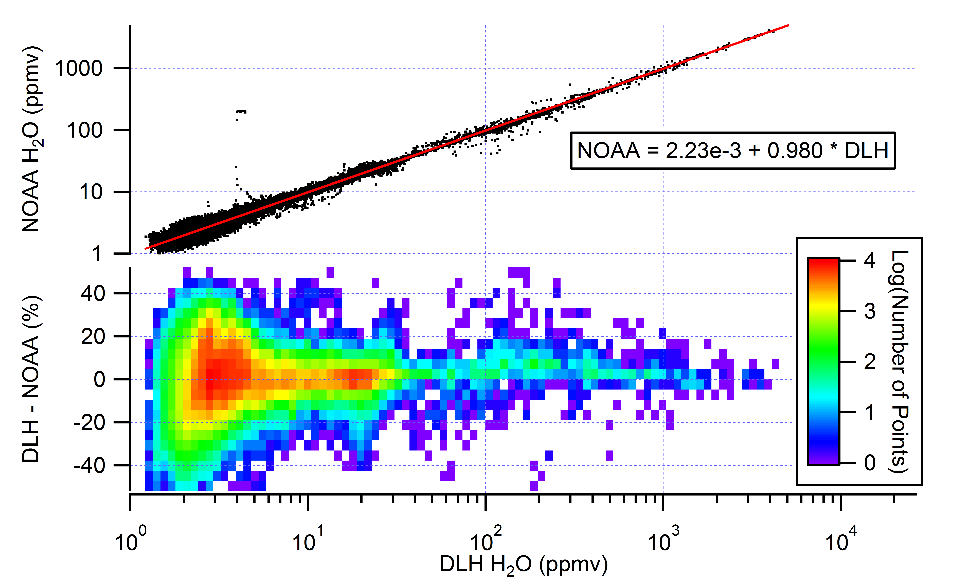
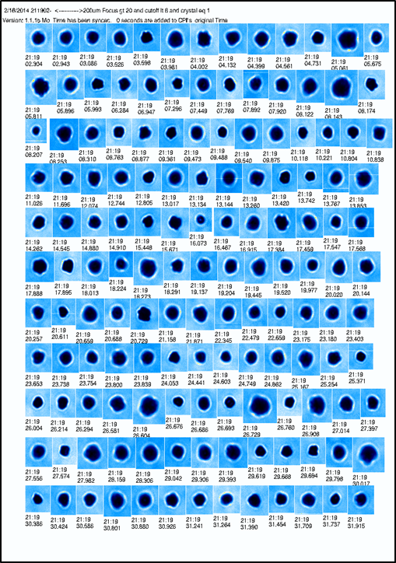
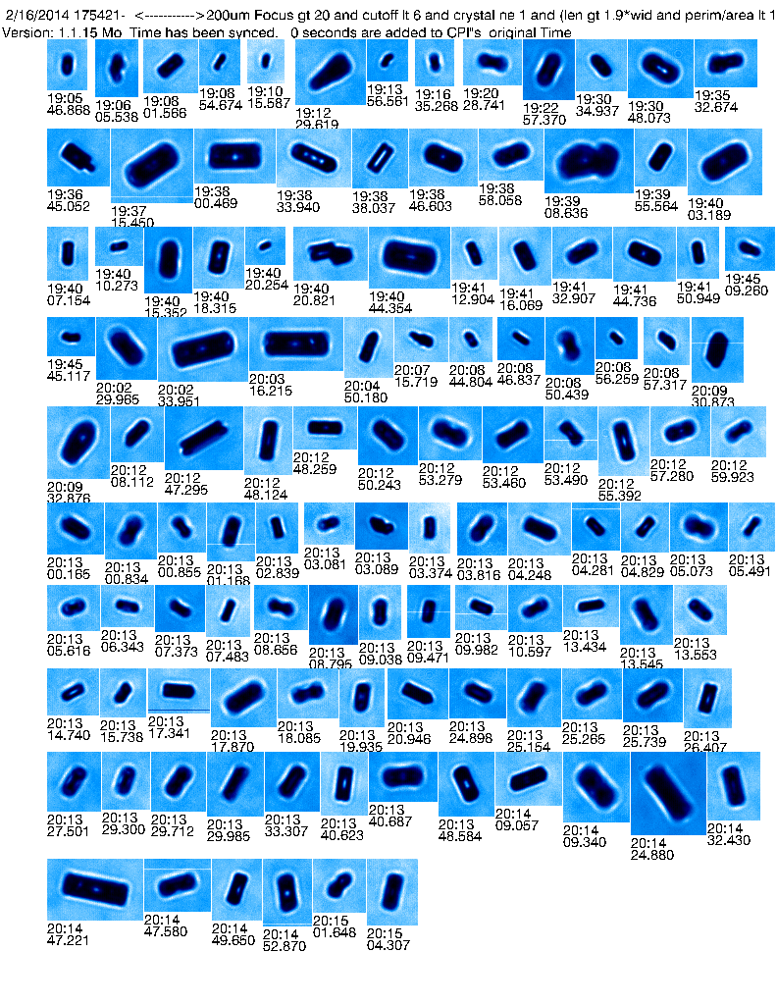
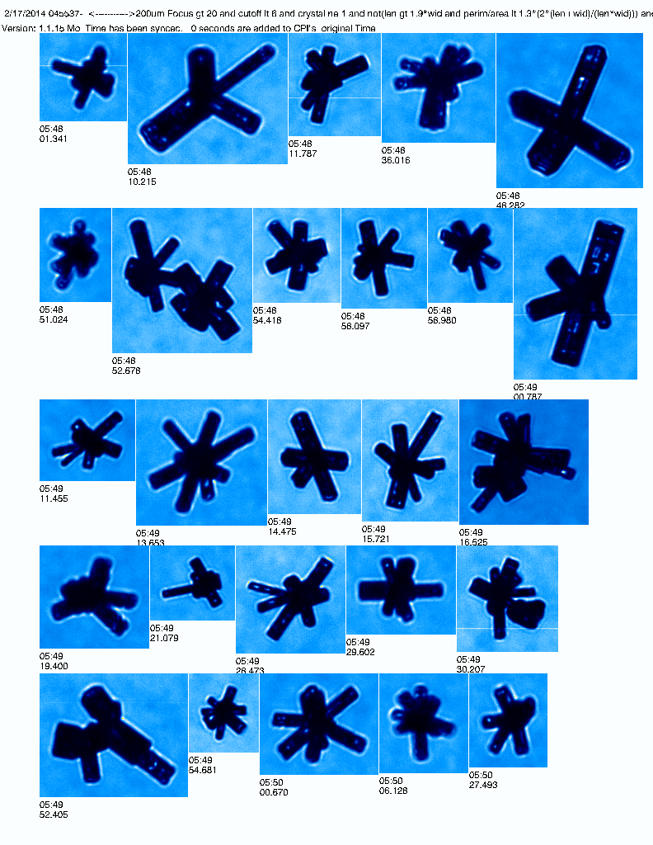
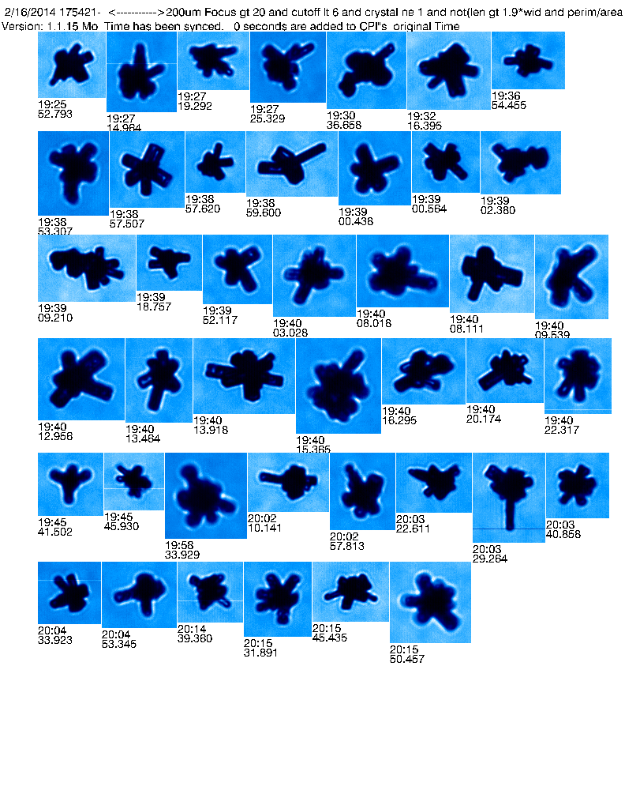
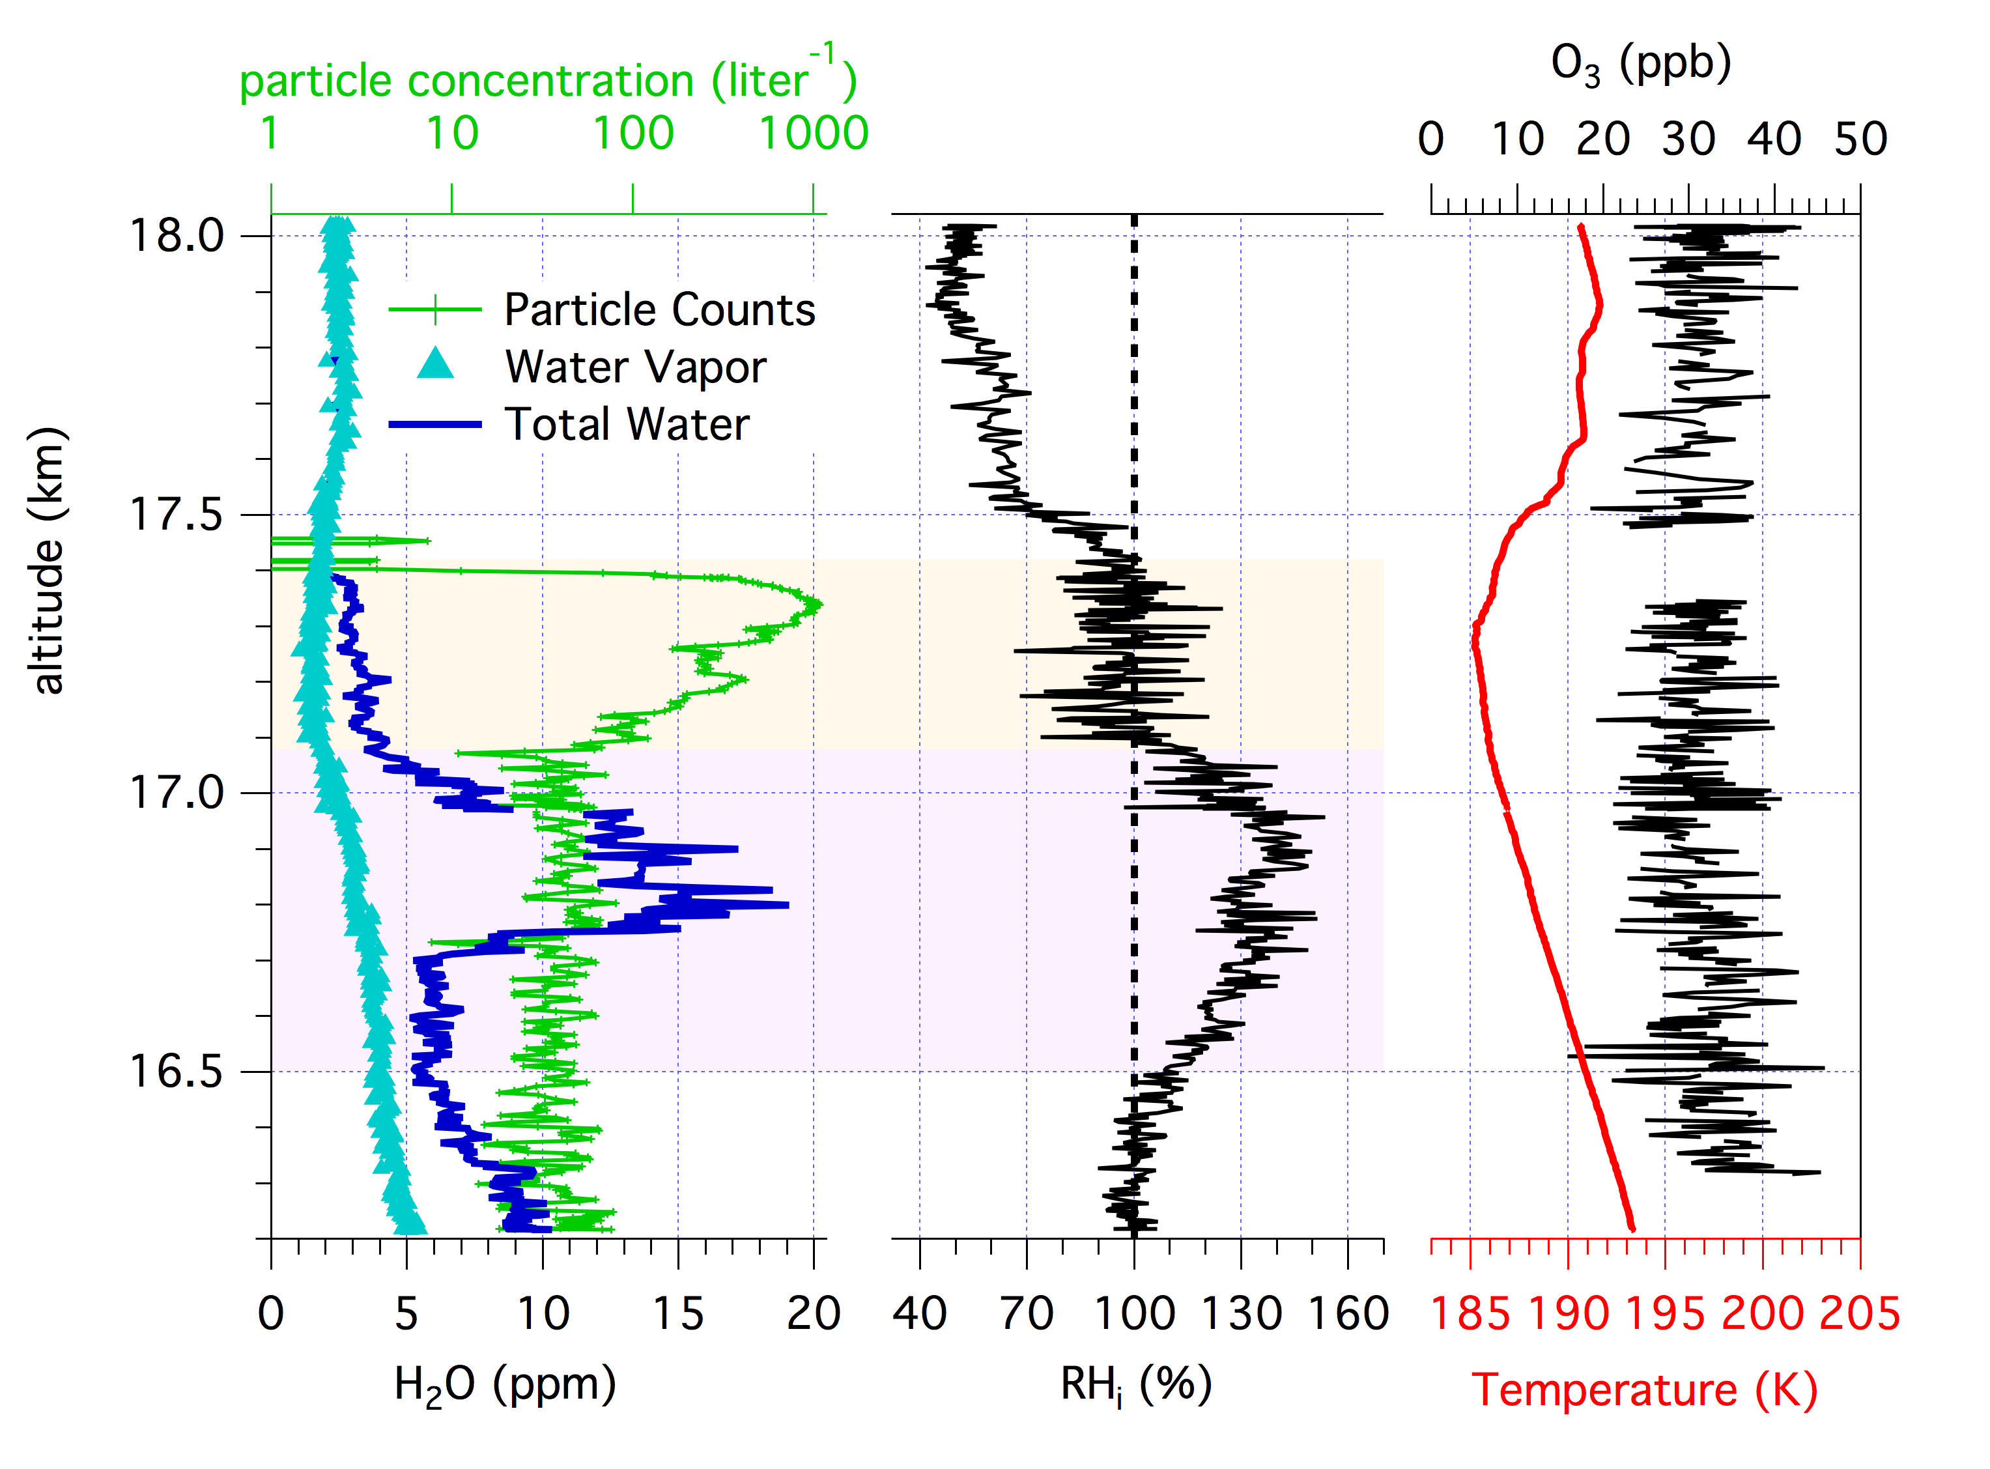
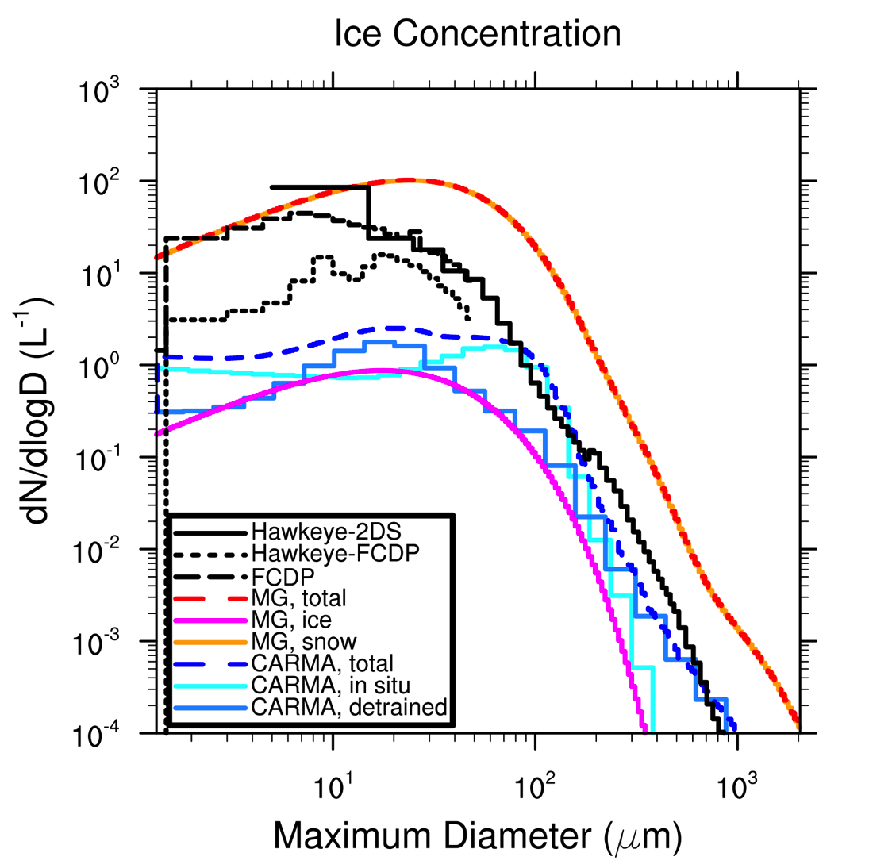
The NASA Airborne Tropical TRopopause EXperiment (ATTREX)
Eric J. Jensen ¹, Leonhard Pfister¹, Troy Thornberry^{2,3}, and the ATTREX Science Team
¹NASA Ames Research Center; ²NOAA Earth System Research Laboratory; ³CIRES, University of Colorado
Motivation for the experiment
Processes in the Tropcail Tropopause Layer (TTL) control the input of trace gases into the stratosphere. The most important of these is water vapor, which is important both for the ozone budget and for climate. The overarching objectives of ATTREX are to improve our understanding of how deep convection, slow ascent, waves, and cloud microphysics control the humidity and chemical composition of air entering the stratosphere.
A critical process in maintaining water vapor in the stratosphere is the formation of thin cirrus sheets near the cold tropical tropopause. The freeze drying process is complicated by convection, horizontal variations in temperature and vertical ascent rates, and the fact that ice crystal nucleation processes at cold temperatures are poorly understood. ATTREX is a five year airborne science experiment focused on understanding TTL processes. This poster reports on some results from the first three ATTREX flight series that took place in October-November, 2011, February-March, 2013, and February–March, 2014.
Oct–Nov 2011, Jan-Feb 2013, and Feb-Mar 2014 Flights
Flight durations ranged from 12 to 26 hours
Cold tropopause regions, convective detrainment, and tracer gradients targeted
Sampling in eastern, central, and western Pacific
Numerous vertical profiles through the TTL (14–19 km)
Aircraft and instrumentation
Radiometers
Temp profiler
Chromatograph
Ozone
NOAA Water
P, T, winds
Whole air sampler
Hawkeye
DLH Water vapor
Mini-DOAS
FCDP Cloud probe
Cloud Lidar
Pressurized compartments
Unpressurized compartments
IR spectrometer
Combination of CPL lidar and in situ measurements provides unprecedented information about TTL cirrus structure and microphysical properties. (Courtesy A. Rollins)
Sampling near Typhoon Faxai east of Guam
Global Hawk Unmanned Air System
15 – 20 km ceiling
25-hour (10,500 nmi) duration
~1,000 lbs payload
ATTREX TTL sampling statistics:
>200 hrs of TTL sampling
~300 TTL vertical profiles
Measurements of TTL, water vapor, clouds, and tracers
NASA Global Hawk
CAM-Chem: Variability and Distribution of Organic Bromine Species
Data access
Hawkey CPI images of TTL ice crystals [P. Lawson, S. Brooks]
WESTERN PACIFIC
EASTERN PACIFIC
Data archive:
espoarchive.nasa.gov/archive/browse/attrex
2011 and 2013 data publicly available
2014 data will be public in early 2015 (contact ATTREX investigators for access now)
Spheroids
Columns
NCAR GV
Halon 2402
Halon 1211
CH₃Br
Rosettes
Budding
Rosettes
Alt (Km)
UK BAe146
Minor VSLBr
CHBr₃
CH₂Br₂
AGU ATTREX presentations
Excellent agreement between DLH [G. Diskin], NOAA H₂O [T. Thornberry, A. Rollins], and frostpoint balloon [D. Hurst].
Coordinated campaigns in Guam provided halogen measurements from the surface to the lower stratosphere [E. Atlas, M. Navaro, CONTRAST and CAST investigators]
Bin 1Km Alt
Mixing ratios (pmol/mol)
Error model and measurements =1sd
Evaluation of global-model halogen simulations using GWAS measurements [M. Navaro, A. Saiz-Lopez, and X. Rodriguez-Lloveras]
Evaluation of global-model cloud parameterizations using Hawkeye data [C. Bardeen]
Hawkey FCDP and 2DS provide full ice crystal size distributions from 1–2000 μm. [P. Lawson, S. Brooks]
Ice crystal number concentrations consistent with measured ice supersaturation [Jensen et al., 2013, PNAS]

