Slide 1
UIOWA, NCAR, GMAO, NRL Chemical forecasts for Aug 21th flights
20 Aug 2013
Compiled by Louisa Emmons, Pablo Saide, Arlindo da Silva, David Peterson
contributions from all groups

Slide 2
Bottom Line Upfront
Fire Observations:
Newer and older smoke was observed on yesterday’s flight!
Large fires continue to burn in the Western CONUS
Small fires have been observed in the SEUS
Key Forecasting Points
Synoptic flow causes some western smoke to be trapped in the central CONUS on Wednesday.
Ridge builds east on Friday, shifting smoke transport to the upper Midwest, and OH Valley
What happens with the western trough and fire weather?
Smoke Predictions:
Western fires: In general, smoke output will be steady or slowly decreasing. However, dry lightning may ignite new fires.
SEUS: A few small fire are possible each day, but large-scale smoke transport is not expected.

Slide 3
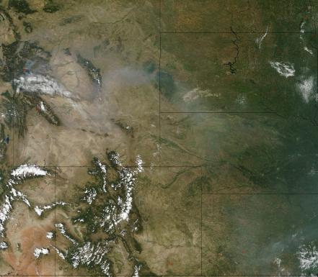
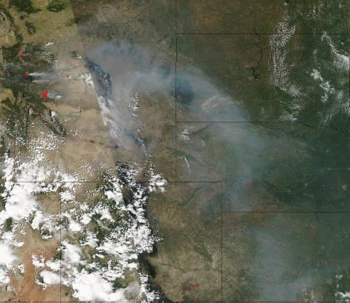
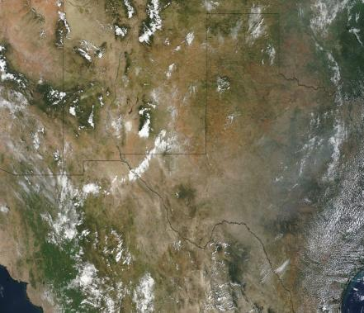
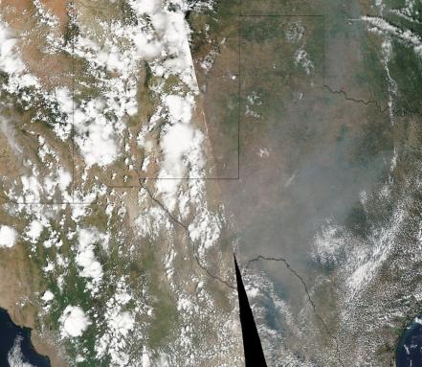
Terra MODIS Late Morning
8/19
Aqua MODIS Early Afternoon
8/19
Extreme Station
Extreme Station
Downwind Station
Downwind Station

Slide 4
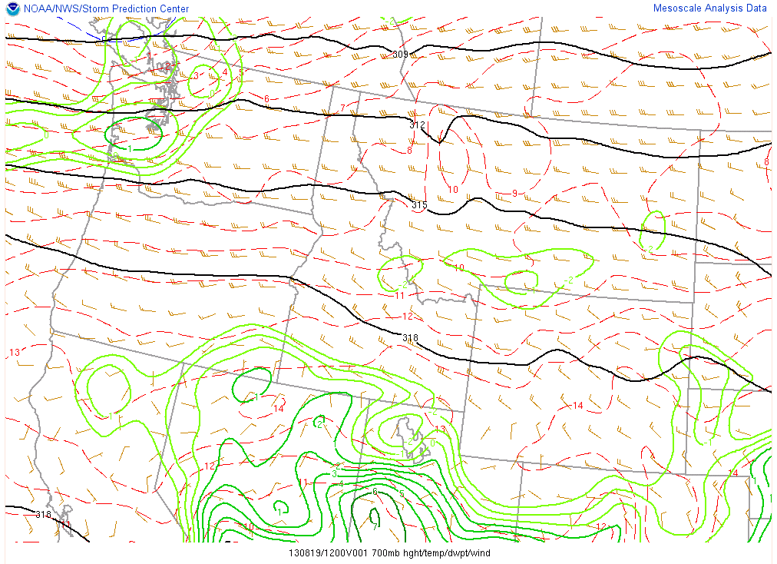
700 hPa, 1200 UTC
At 12Z, the 700 hPa winds were westerly in NE Wyoming
Primary Station NE WY, Recent Smoke

Slide 5
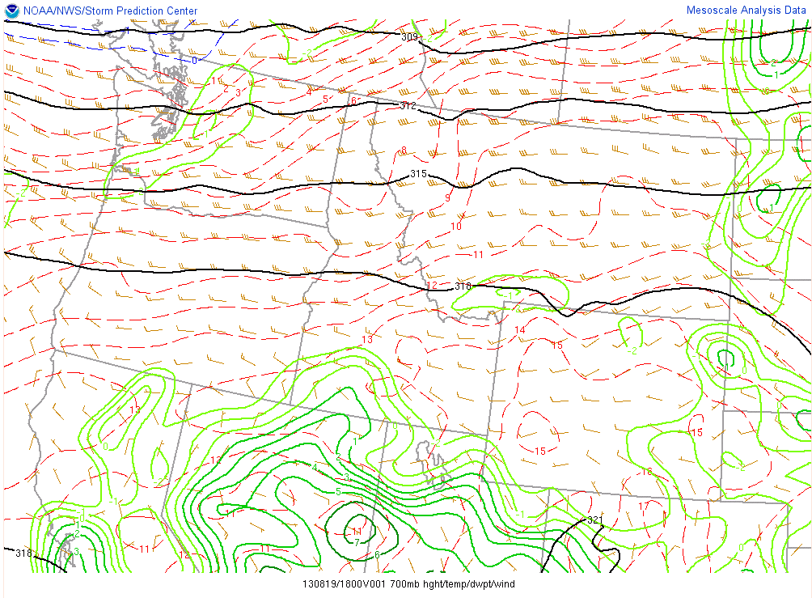
700 hPa, 1800 UTC
By 18Z, the 700 hPa winds shifted to the SW in NE Wyoming
The smoke plume moved farther north!
Primary Station NE WY, Recent Smoke

Slide 6
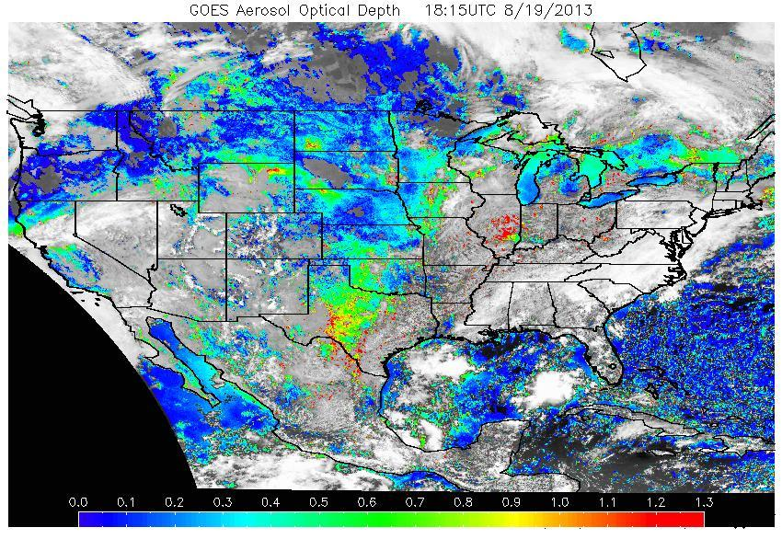
AOD, 1800 UTC

Slide 7
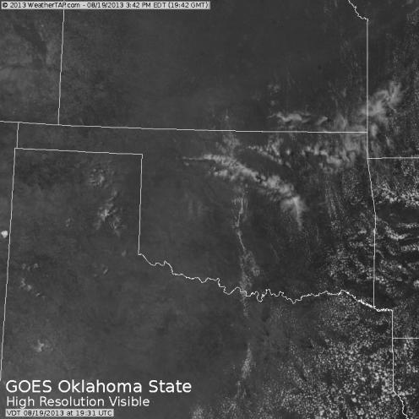
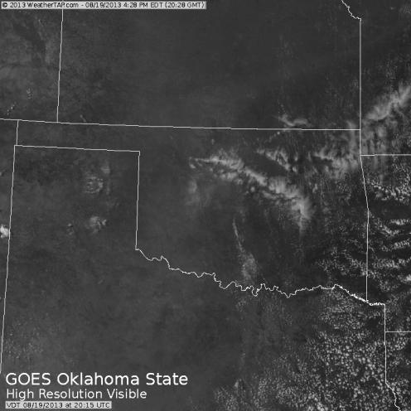
Downwind Station, KS/OK, Aged Smoke
As the flight reached the downwind station, a large axis of smoke was located along a weak boundary extending from the TX Panhandle to western MO. The site was located at the intersection of the smoke axis and a general region of aged smoke. It was also cloud free.
8/19, 19:42 Z
8/19, 20:28 Z
Smoke axis on boundary
Smoke axis on boundary
Downwind Station
Downwind Station

Slide 8
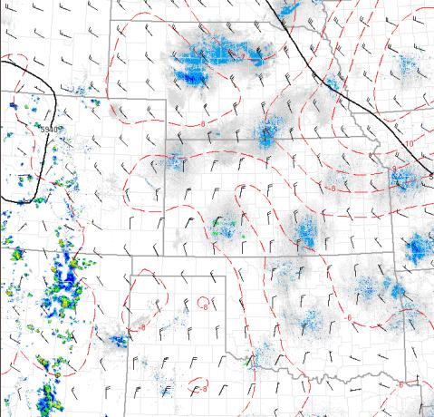
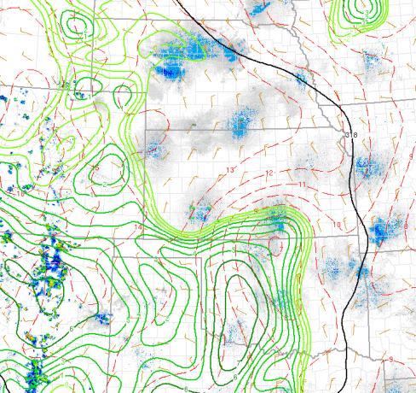
Upper-Air, 2000 UTC
500 hPa, 8/19, 20Z
700 hPa, 8/19, 20Z

Slide 9
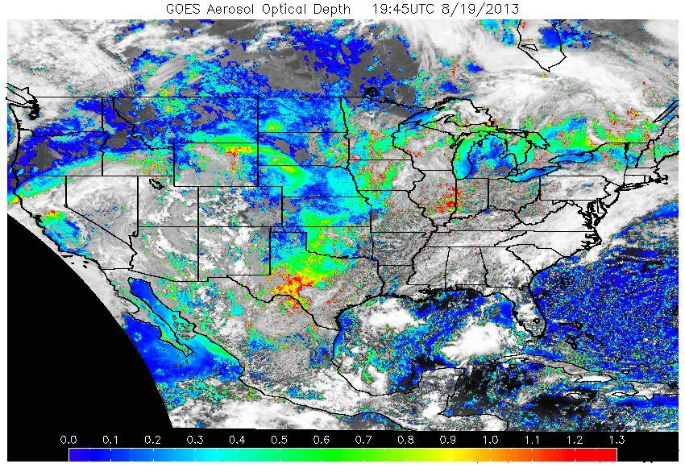
AOD, 2000 UTC

Slide 10
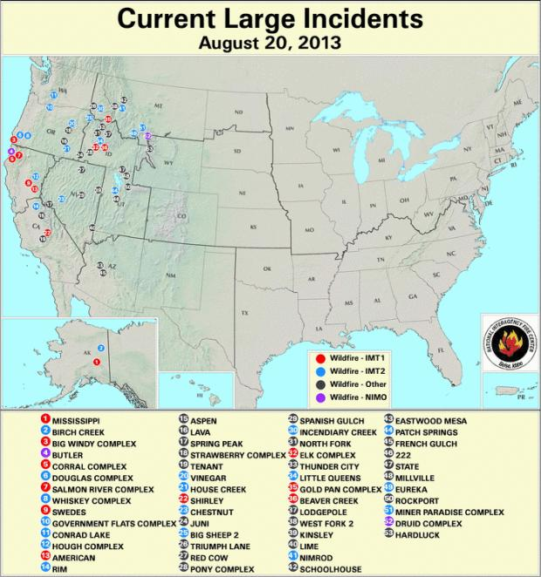
Current Fire Activity
Several ongoing large fires and recent pyroconvection
Many new fires!
Large-scale smoke transport is still occurring…

Slide 11
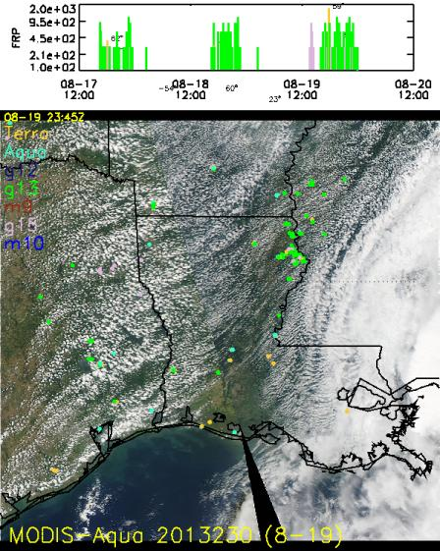
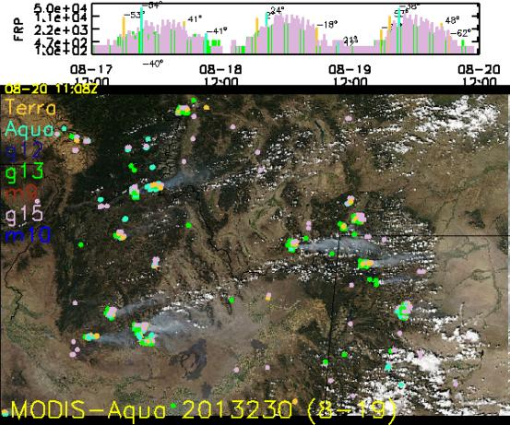
Satellite Fire Timeline
ID/WY fires are still burning strong
Western trough will move in this week. Reduced fire danger? More dry lightning?
A few fires observed daily in the SEUS

Slide 12
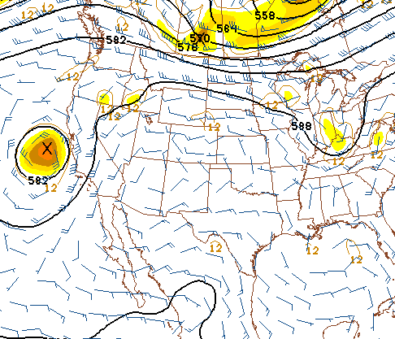
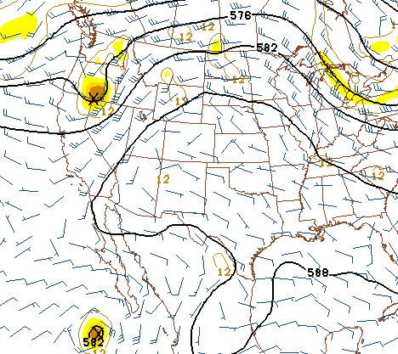
Upper-Air Forecast
GFS 500 hPa, 18Z Wed. 8/21
GFS 500 hPa, 18Z Fri. 8/23

Slide 13
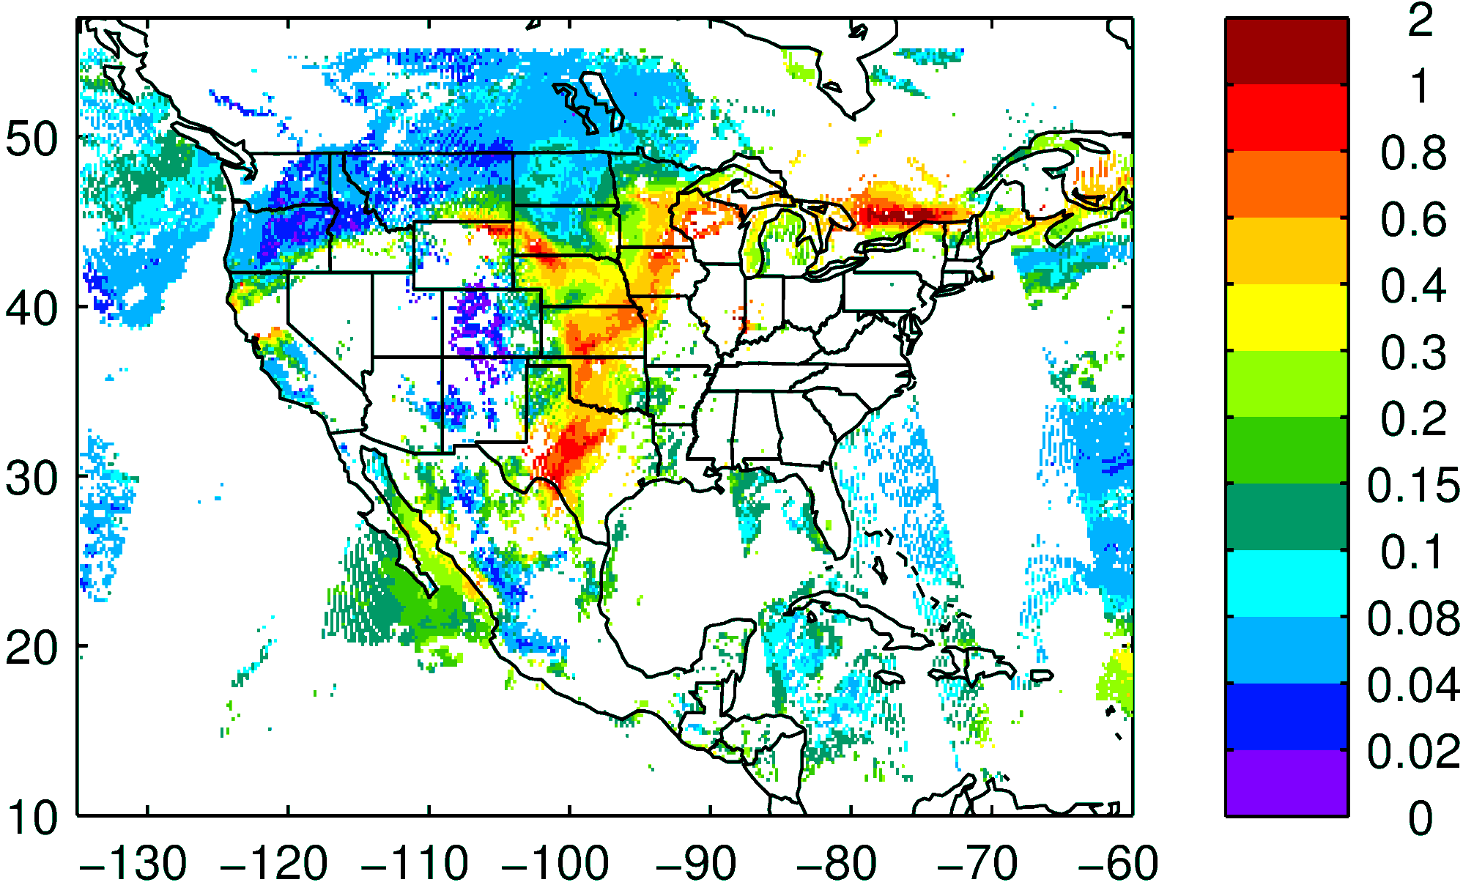
NASA NNR AOD composite yesterday

Slide 14
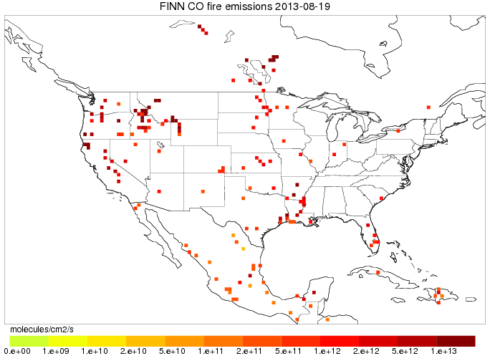
Fires: locations
FINN today

Slide 15
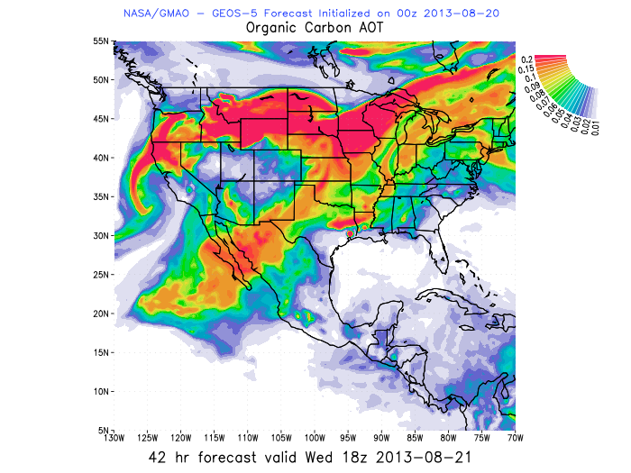
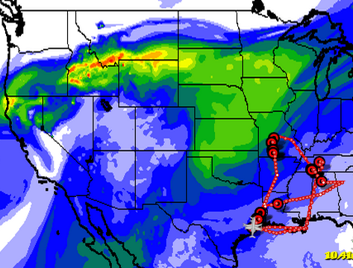
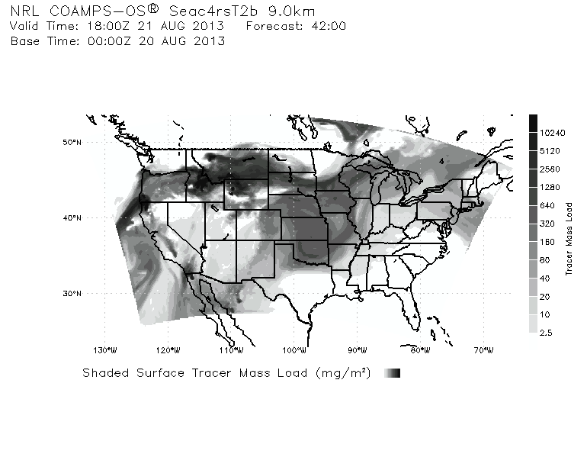

WRF-Chem AOD 18 UTC Aug 21st
GEOS5 OC AOD 18 UTC
COAMPS TRACER COLUMN 18 UTC

Slide 16
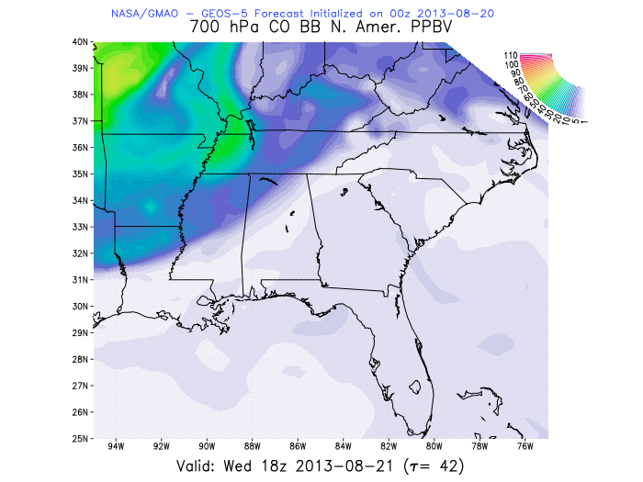
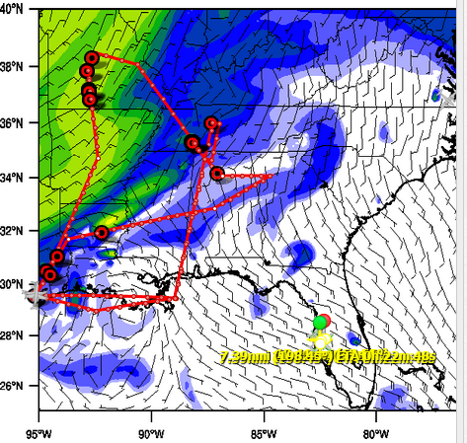

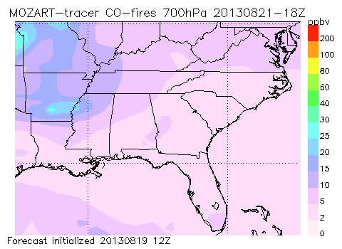
CO fire 700mb 18 UTC
CO 700mb 18 UTC GEOS5
UIOWA
AOD 18 UTC

Slide 17
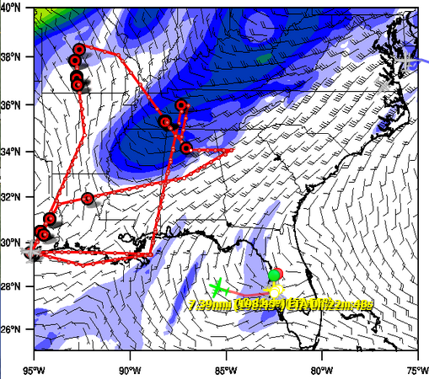
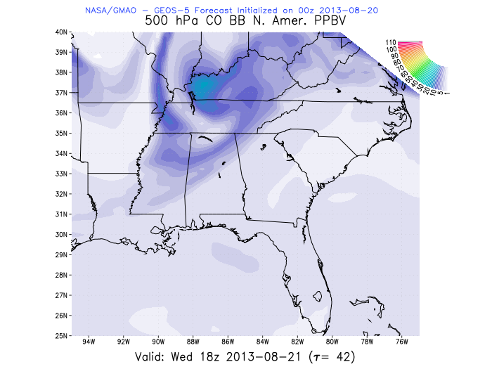
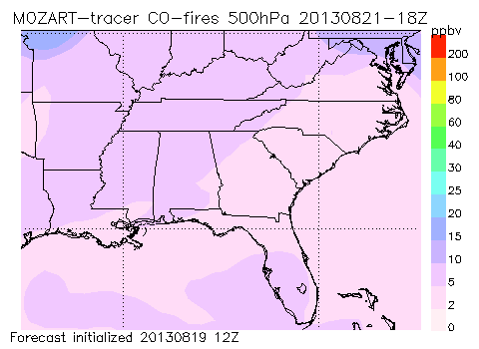
CO fire 500mb 18 UTC
CO 500mb 18 UTC GEOS5
Consistency at 500mb
AOD 18 UTC

Slide 18
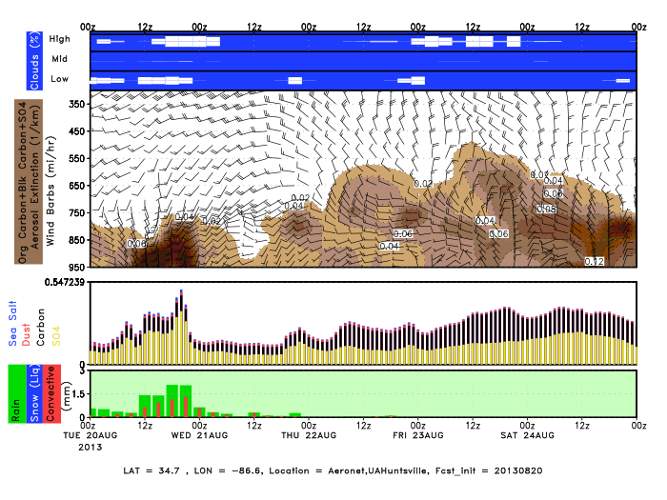
GEOS5 Huntsville AERONET

Slide 19
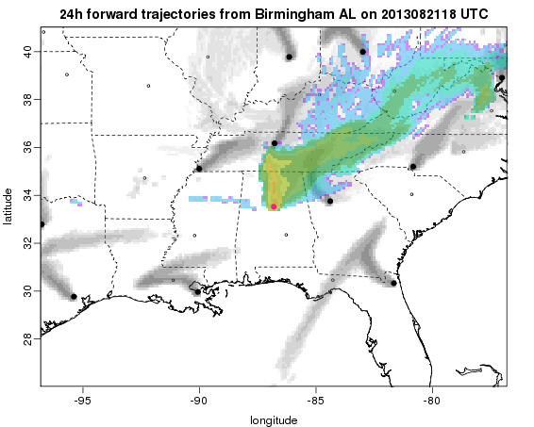
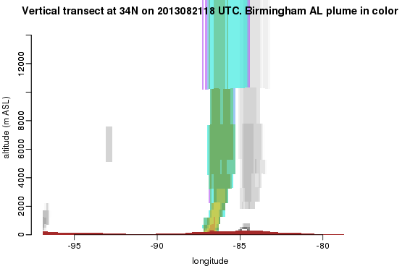
Flexpart forward trajectories – Wed 8/21
Birmingham and Atlanta plumes carried northward
34N cross-section
plume lofted through troposphere

Slide 20
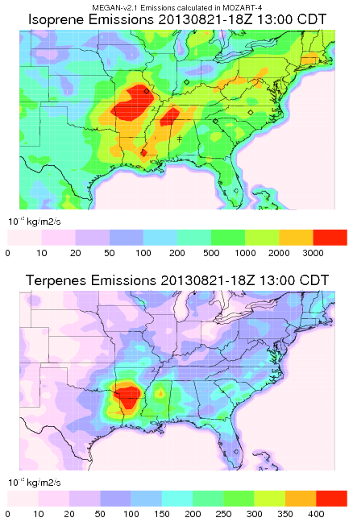
MEGAN Biogenic Emissions
Isoprene emissions peak at 18-19Z
Southern MO has higher isoprene/terpenes ratio than AL or sourthern Ark.

Slide 21
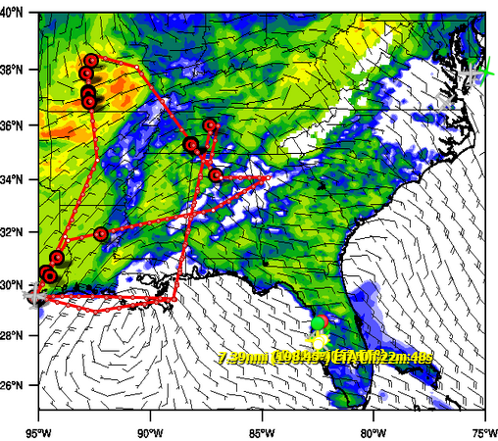

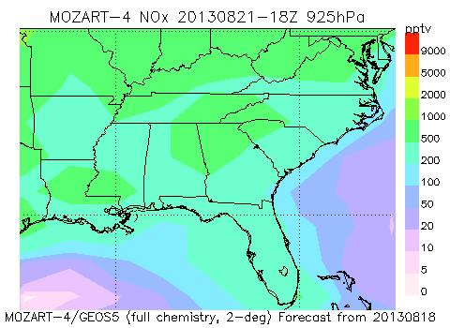
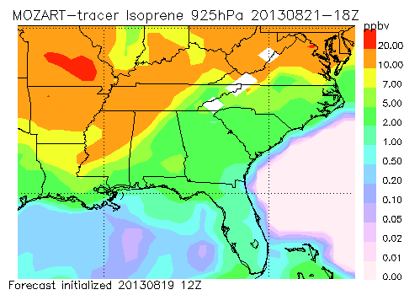
Isoprene 925mb 18UTC
Wed 8/21
925 hPa

Slide 22
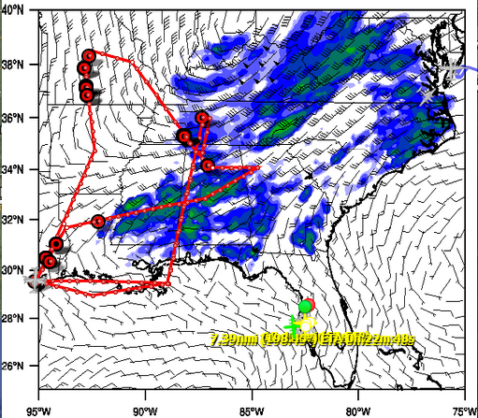
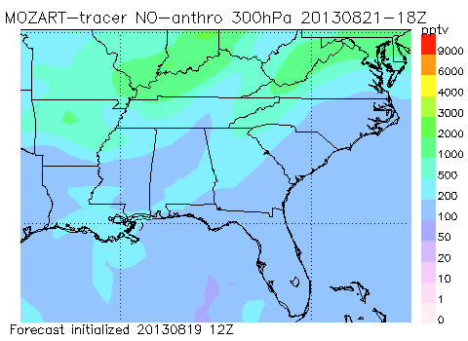
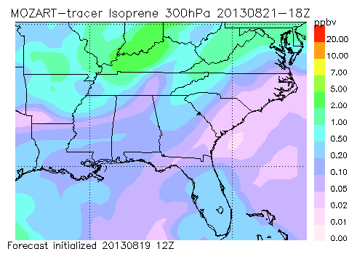
Wed 8/21
300 hPa
Some convectively lifted isoprene

Slide 23
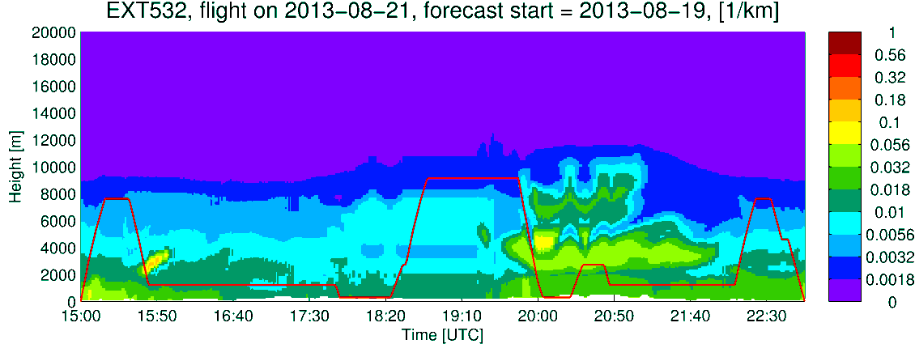
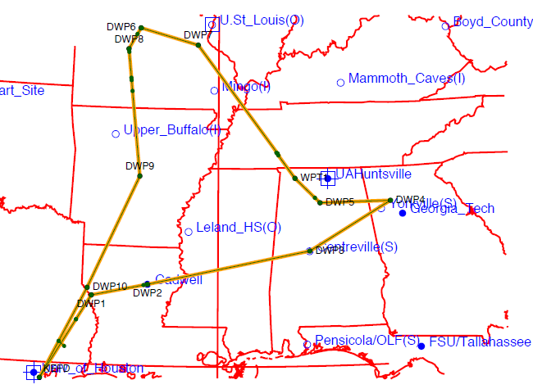
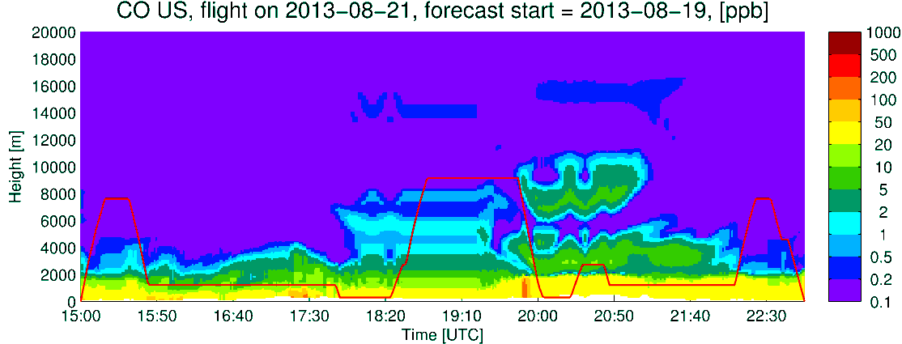
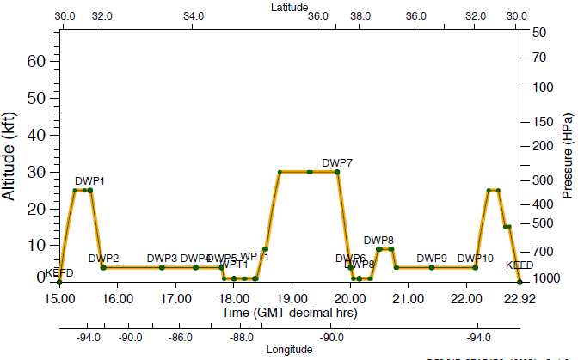
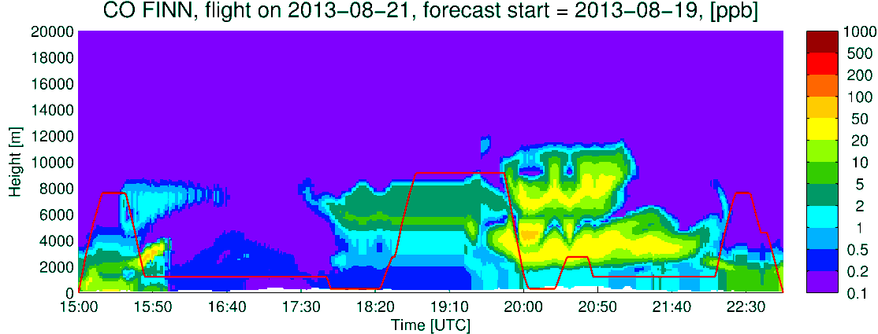
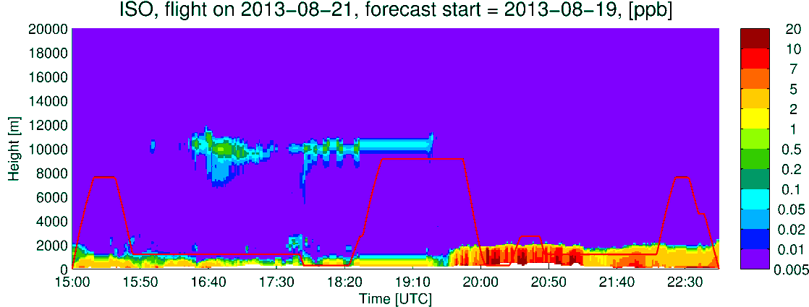
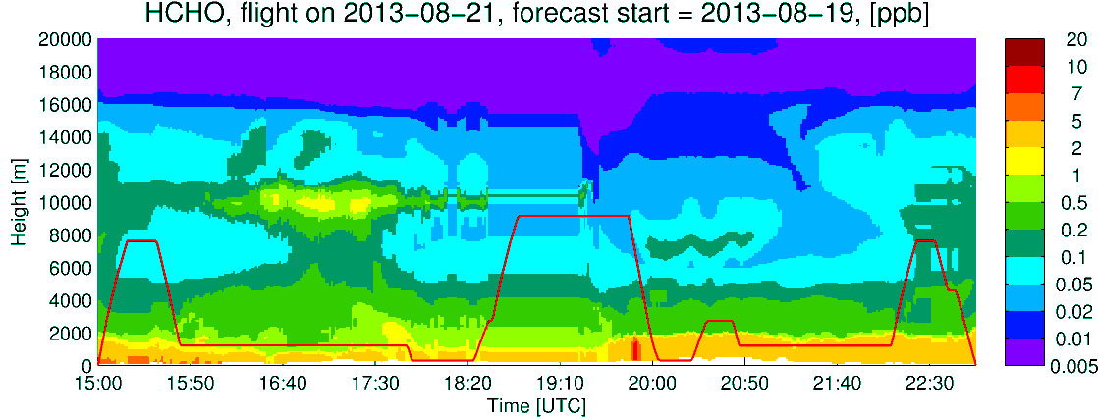
UIOWA DC-8
Extinction
CO US Anthro
CO Fire
Formaldehyde
Isoprene

Slide 24
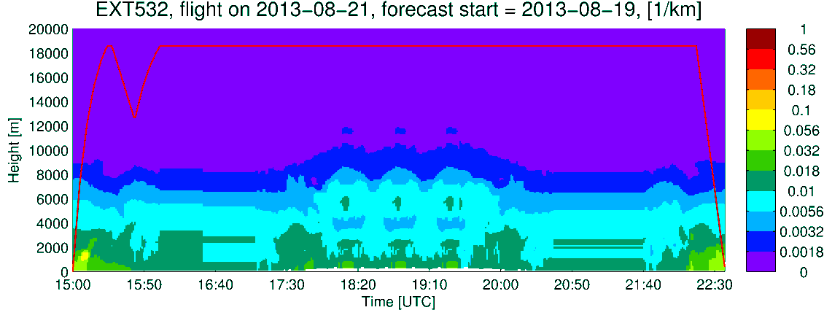
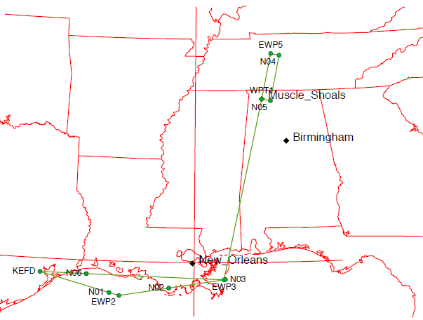
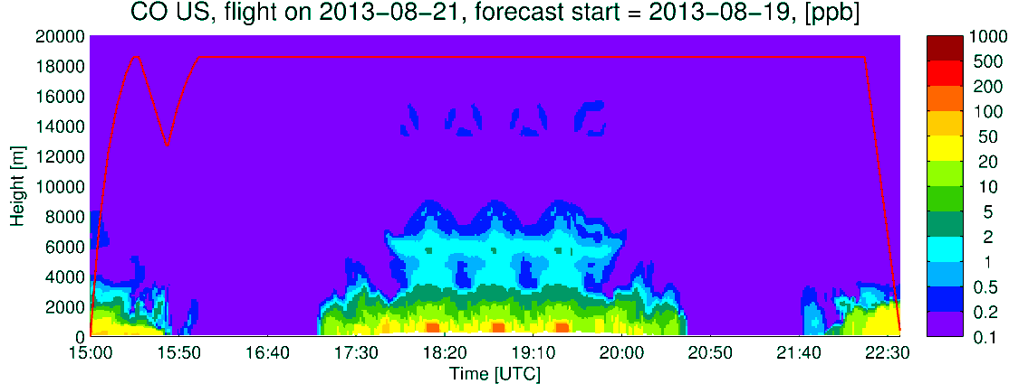
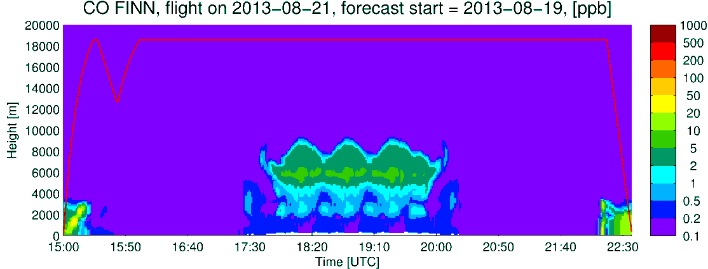
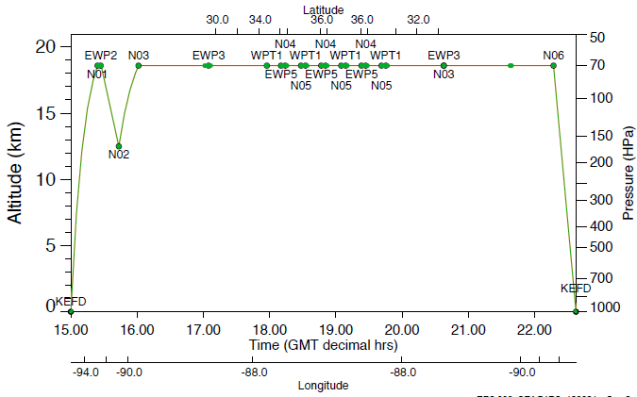

UIOWA ER2
Extinction
CO US Anthro
CO fires
Q_CLOUD
CO total

Slide 25



GEOS5 ER2
Tot Extinction
OC Extinction
SO4 Extinction
Q_CLOUD
Q_CLOUD
Q_CLOUD

Slide 26

Aug 21st Satellite overpass

Slide 27

Friday

