Slide 1
UIOWA, NCAR, GMAO, NRL Chemical forecasts for Aug 19th flights
18 Aug 2013
Compiled by Mary Barth and Pablo Saide, Arlindo da Silva, contributions from all groups

Slide 2
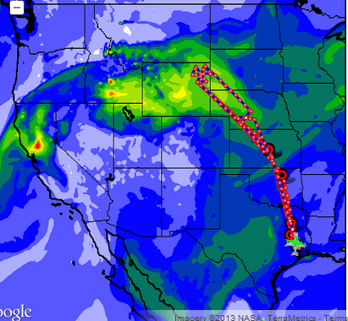
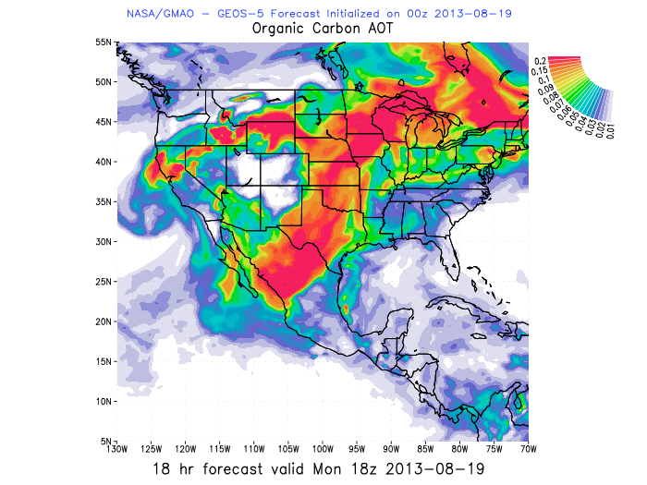
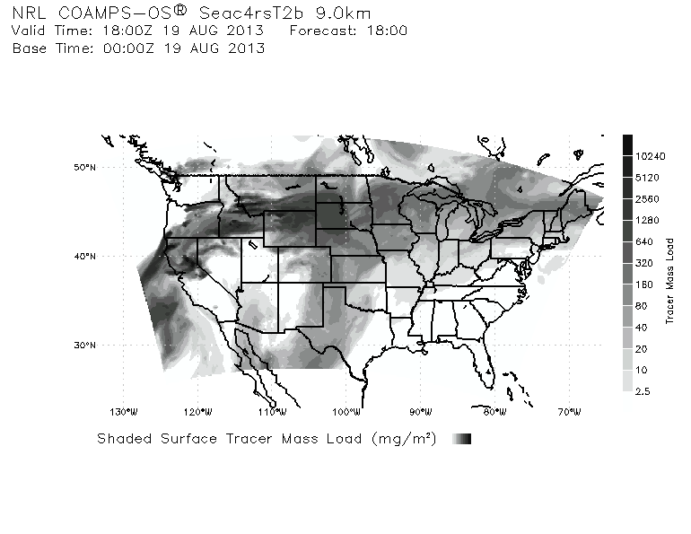

WRF-Chem AOD 18 UTC Aug 19th
GEOS5 OC AOD 18 UTC
COAMPS TRACER COLUMN 18 UTC

Slide 3
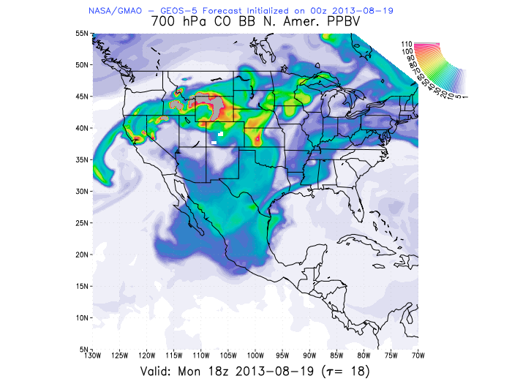
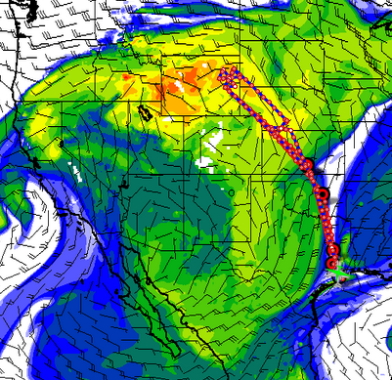

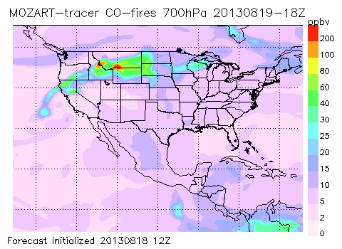
CO fire 700mb 18 UTC
CO fire 700mb 18 UTC GEOS5
Smoke intercepting the flight track over Oklahoma
AOD 18 UTC

Slide 4
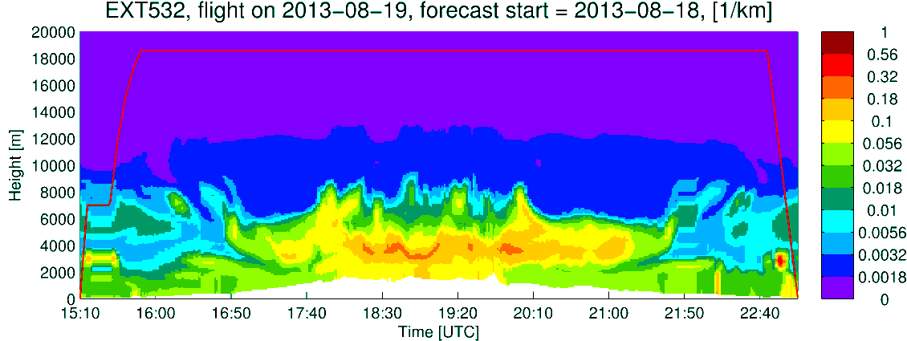
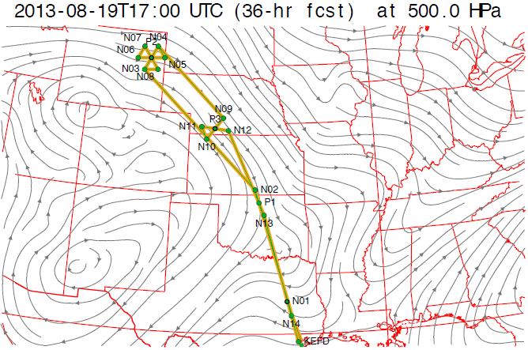
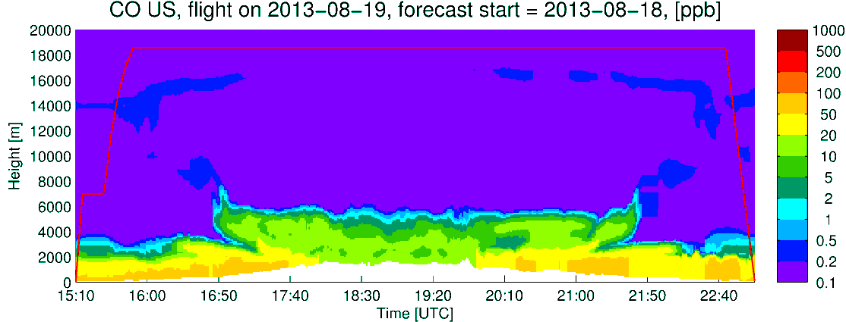
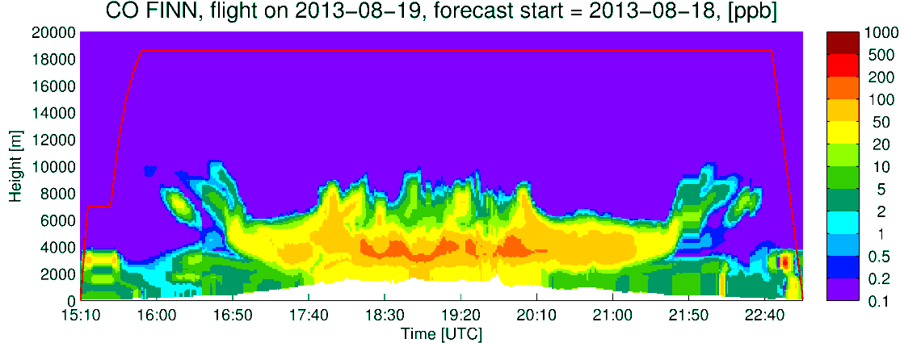
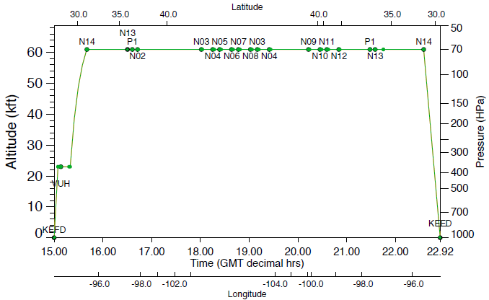
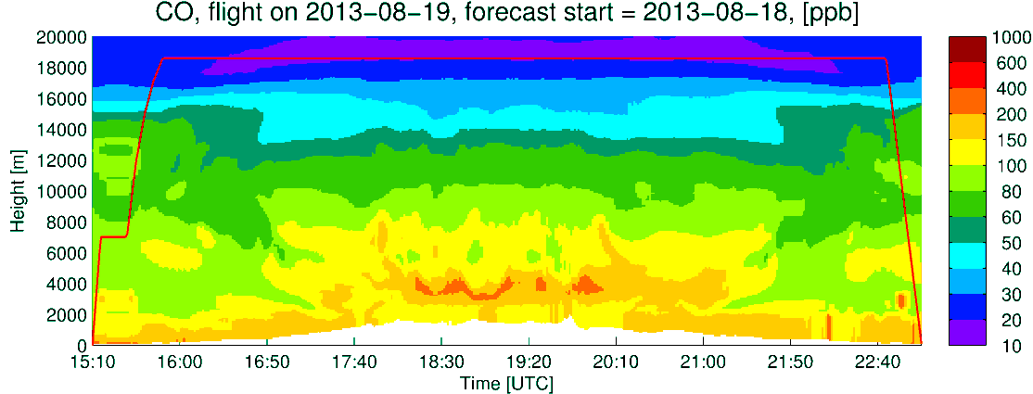
ER2 PRIMARY PLAN
Extinction
CO US Anthro
CO Fires
CO total
CLOUDS

Slide 5
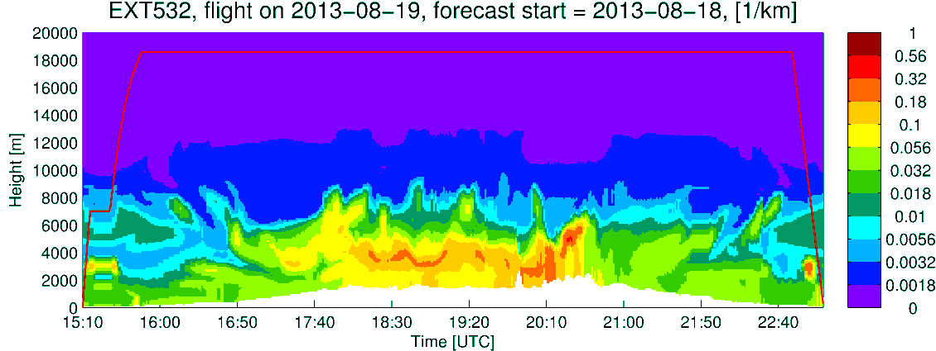
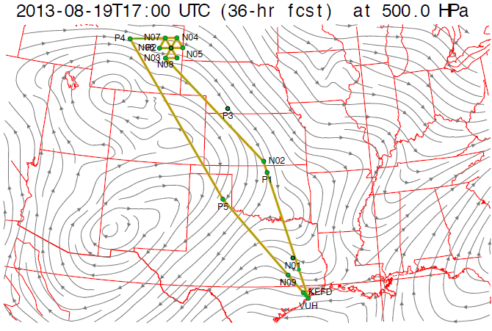
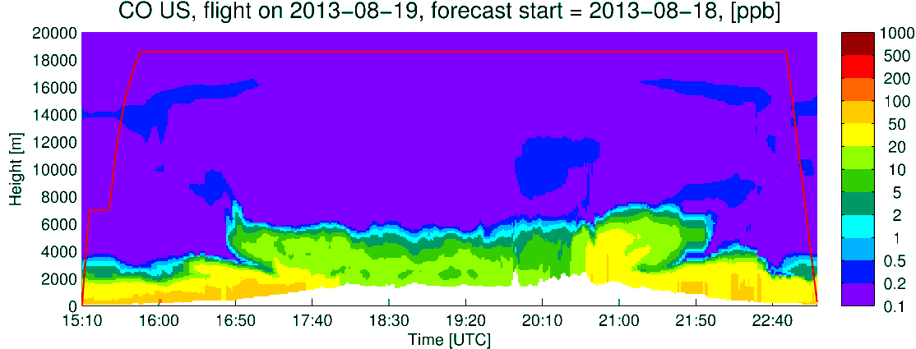
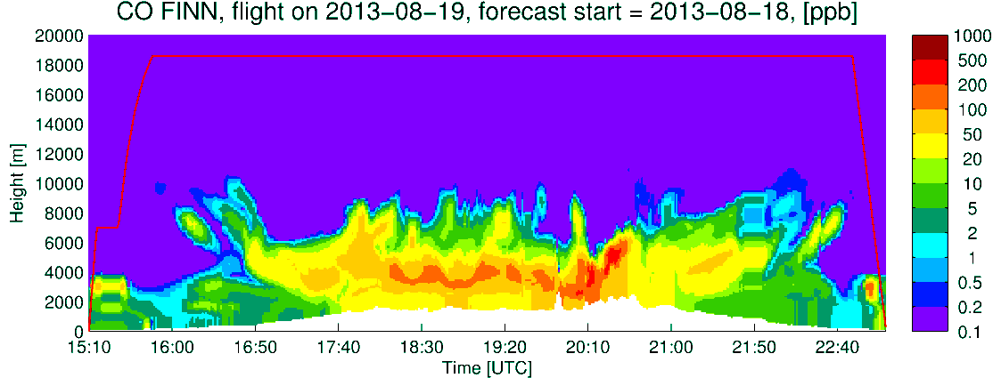
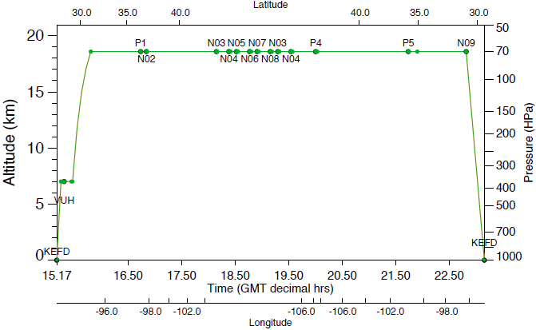
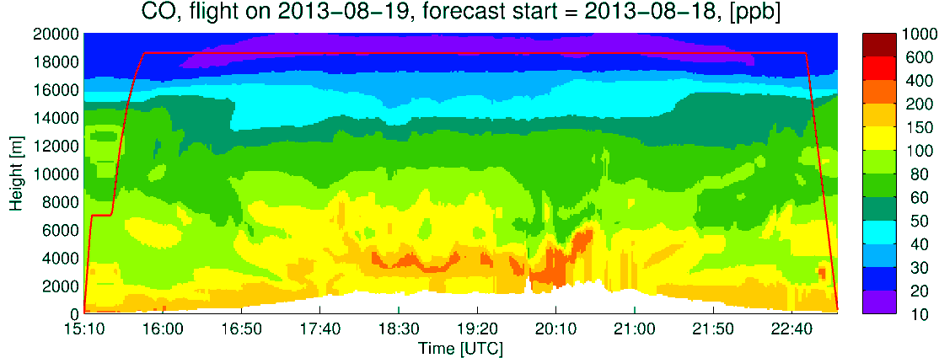
ER2 ALTERNATE PLAN
Extinction
CO US Anthro
CO Fires
CO total
CLOUDS

