Slide 1
UIOWA, NCAR, GMAO, NRL Chemical forecasts for Aug 19th flights
18 Aug 2013
Compiled by Mary Barth and Pablo Saide, Arlindo da Silva, contributions from all groups

Slide 2
smoke

Slide 3
Bottom Line Upfront
Fire Observations:
  Large fires continue to burn in ID, WY, UT and MT
  The primary focus is still Idaho!
Key Forecasting Points (Monday 8/19)
  Fire weather conditions remain favorable for fire growth
  Synoptic flow (e.g. at 500 hPa) becomes zonal along the Canadian border, but smaller ridge remains in SW CONUS.
  Smoke may take two paths, affecting both the Upper Midwest and the High Plains
  Nocturnal convection in the upper Midwest produces high clouds over portions of IA, MO, and possibly KS
Smoke Predictions (Monday 8/19 and beyond):
  Western fires: High smoke concentrations, higher altitude injections, and large-scale transport will continue through Monday!
  A pattern change may alter the smoke transport direction later in the week!

Slide 4
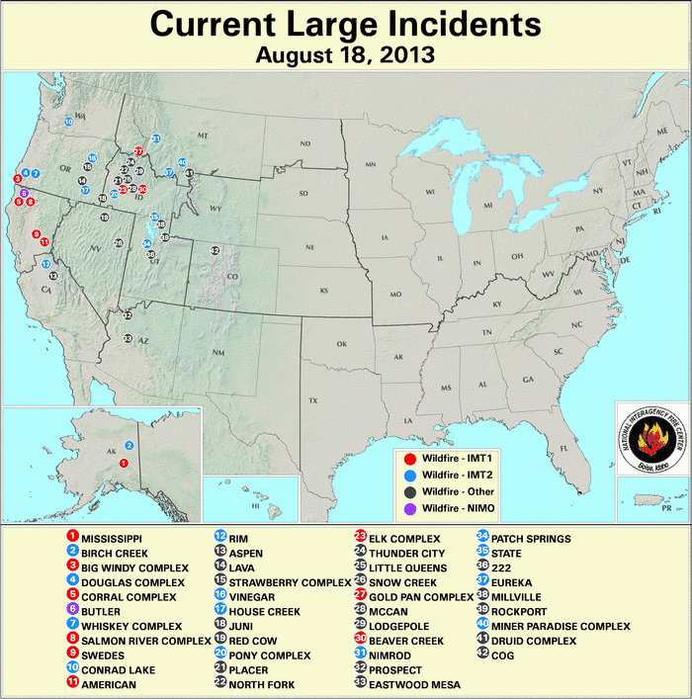
Current Fire Activity
Several ongoing large fires and recent pyroconvection
Many new fires!
Large-scale smoke transport is still occurring…

Slide 5
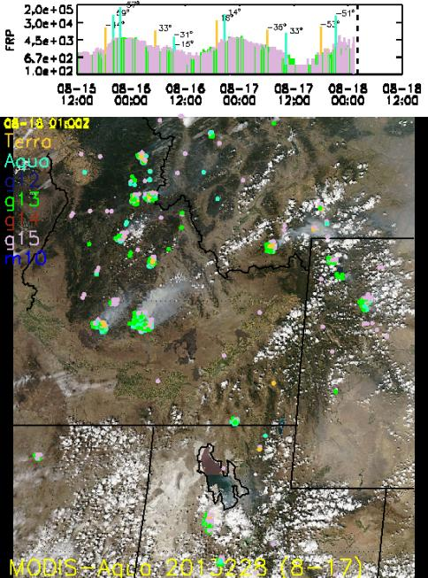
Satellite Fire Timeline
Backdrop is Saturday’s MODIS-Aqua image
Idaho complexes are still going strong
UT fires not detected for nearly 24-hrs, but ground reports indicate they are still burning
Northern fires picking up
Saturday had slightly less fire detections than Friday
There were also more clouds in the region
Still lots of smoke being released!

Slide 6
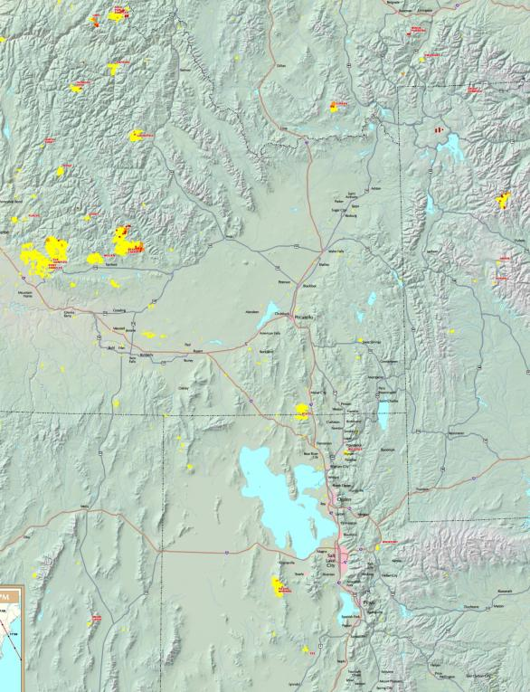
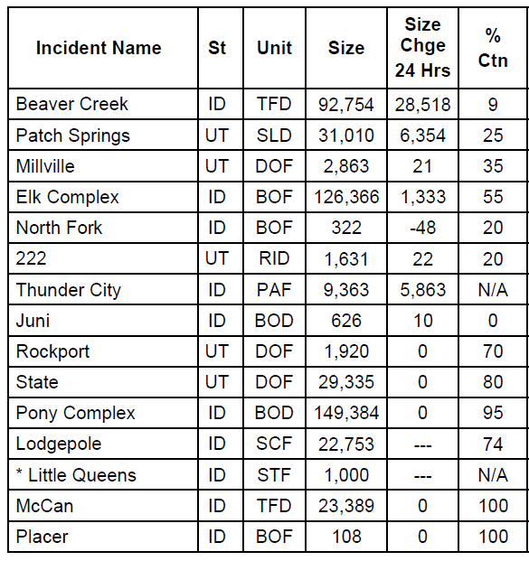
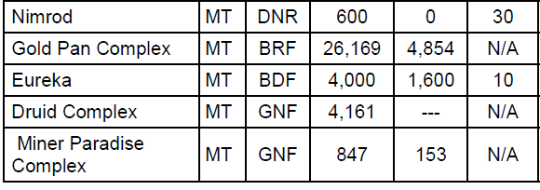
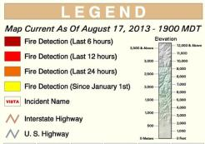
Current Fires
Past 24 hrs:
Primary smoke producers
Still burning?

Slide 7
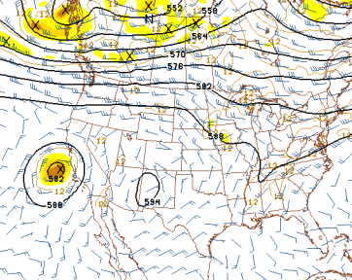
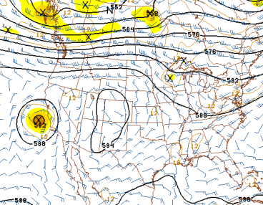
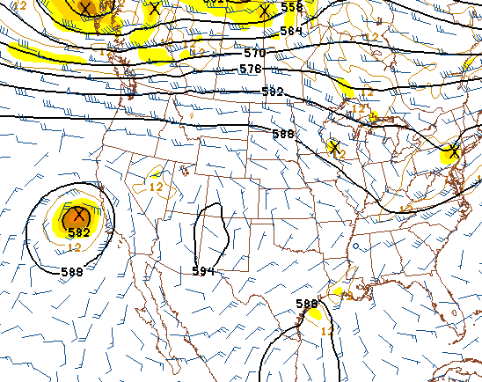
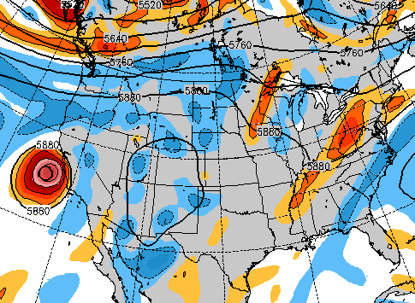
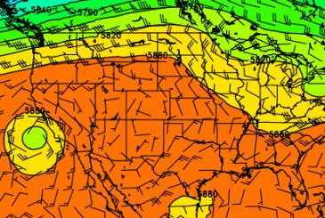
Upper-Air Forecast (500 hPa)
NAM 500 hPa, 18Z, 8/19
GFS 500 hPa, 18Z, 8/19
4 models now show general agreement
Zonal flow develops along the Canadian border
Shortwave moves into MN. Leftover debris clouds?
Smaller ridge remains in the western CONUS
Smoke will take two paths (see next slide)
Similar at 700 hPa!
Some sort of tropical disturbance near the TX Gulf Coast?
NAVGEM 500 hPa, 18Z, 8/19
EC 500 hPa, 18Z, 8/19

Slide 8
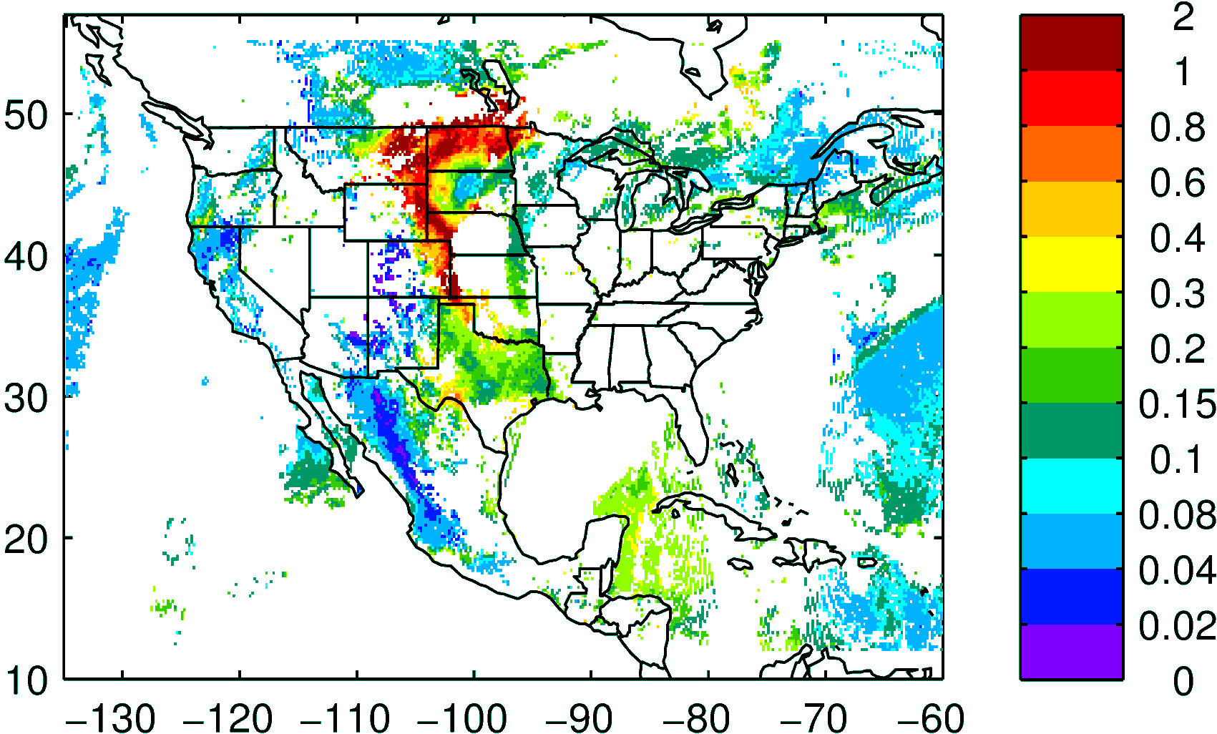
NASA NNR AOD composite yesterday

Slide 9
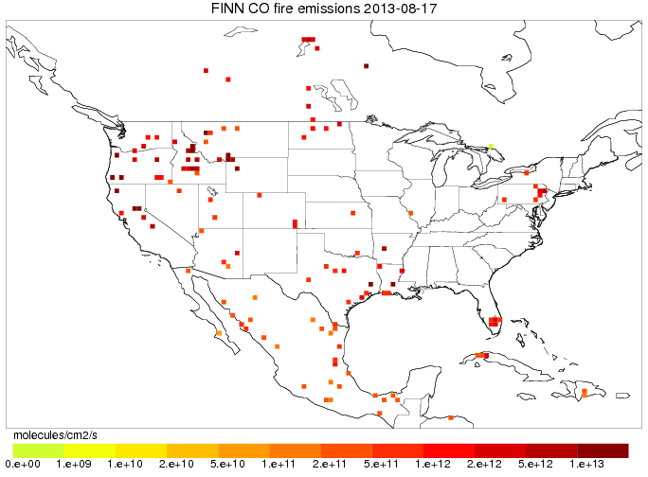
Fires: locations
FINN today

Slide 10
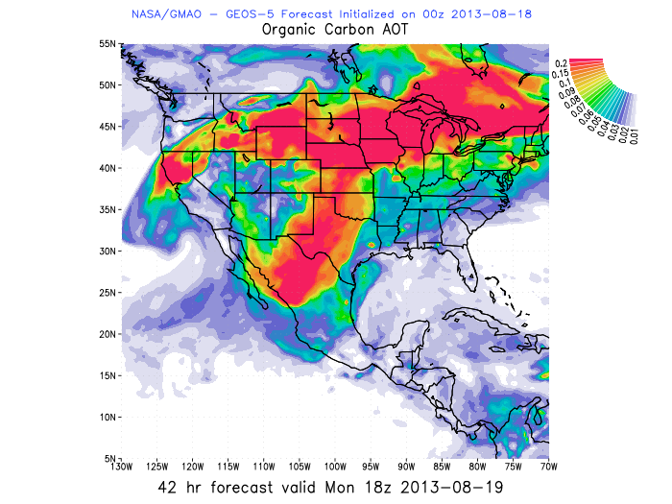
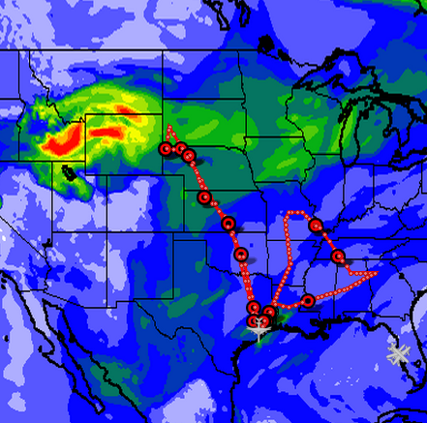
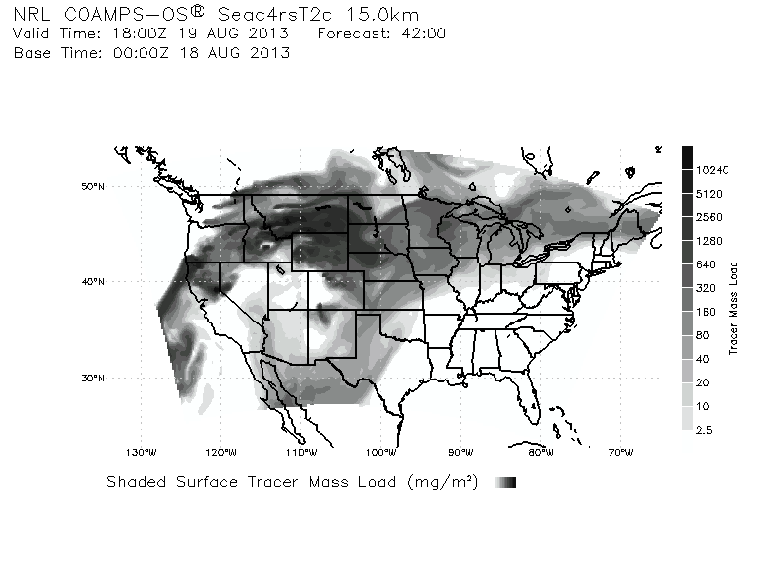

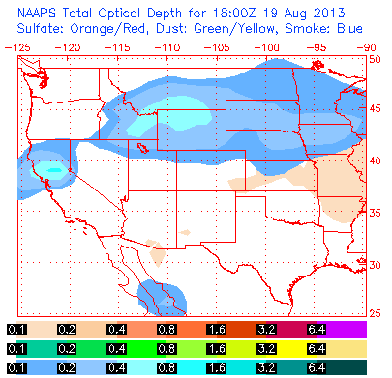
WRF-Chem AOD 18 UTC Aug 19th
GEOS5 OC AOD 18 UTC
COAMPS TRACER COLUMN 18 UTC

Slide 11
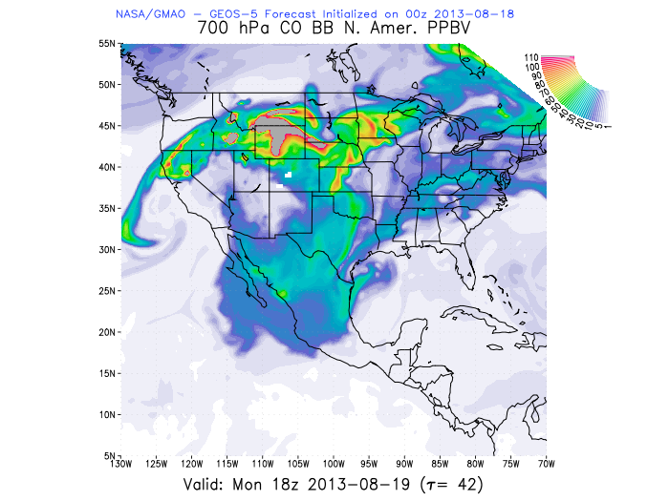
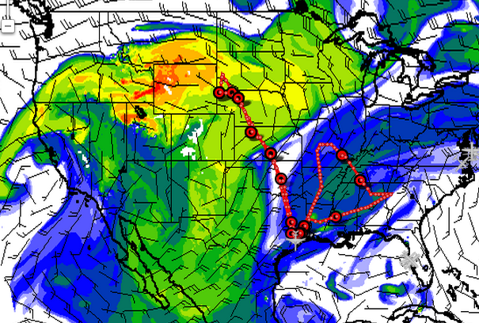

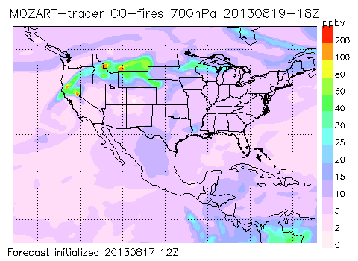
CO fire 700mb 18 UTC
CO fire 700mb 18 UTC GEOS5
Smoke intercepting the flight track over Kansas
Might intercept before if flight go west
AOD 18 UTC

Slide 12
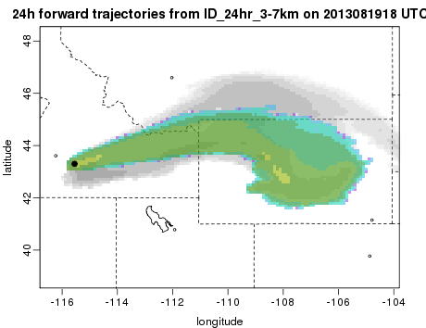
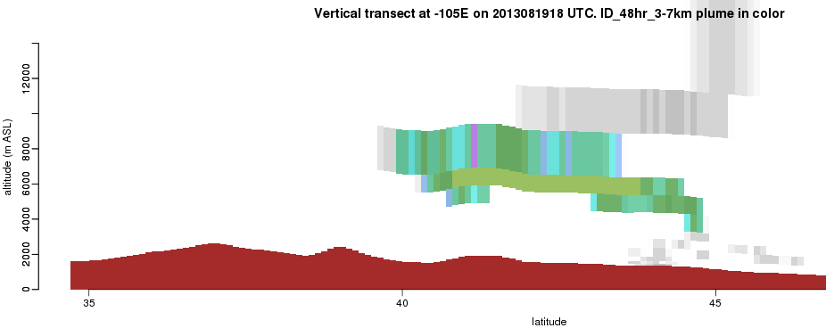
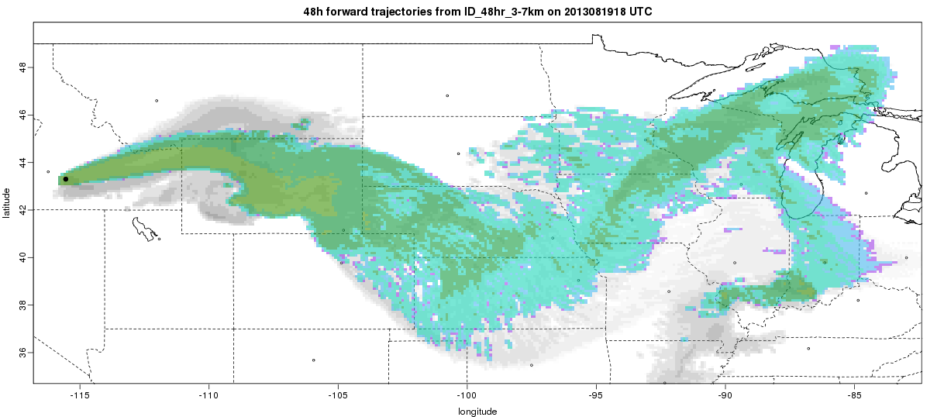
Flexpart Trajectories from Idaho fires – mostly going eastward between 5-10 km altitudes
24 hr trajectory injected at 3-7 km, ending 08-19 1800UTC
48 hr trajectory injected at 3-7 km, ending 08-19 1800 UTC at 105W
48 hr trajectory injected at 3-7 km, ending 08-19 1800UTC

Slide 13
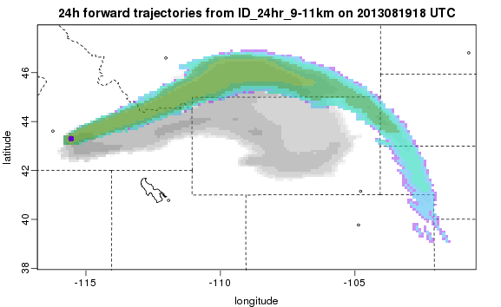
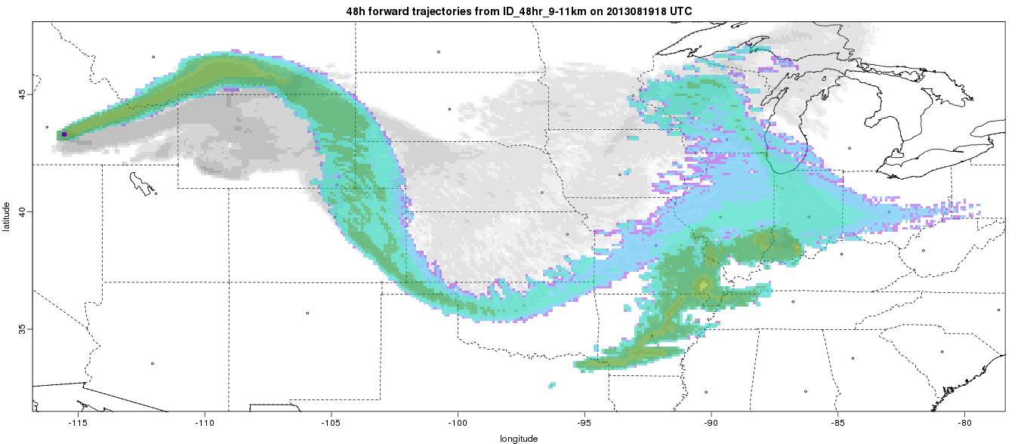
Flexpart trajectories released 9-11km altitude ending 08-19 1800 UTC
24 hr trajectory injected at 9-11 km, ending 08-19 1800UTC
48 hr trajectory injected at 9-11 km, ending 08-19 1800UTC

Slide 14
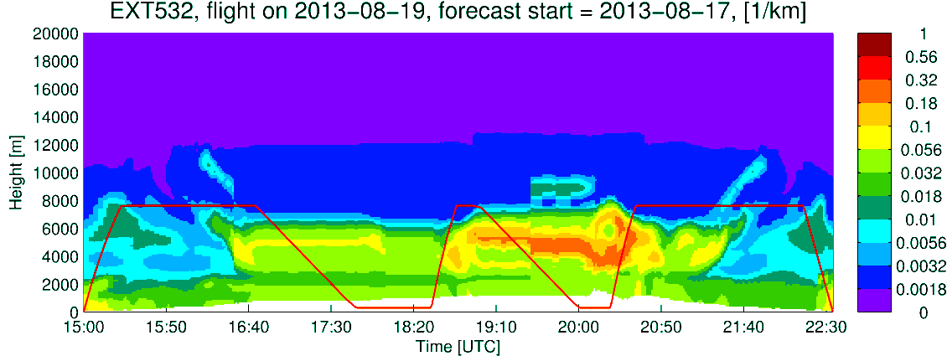
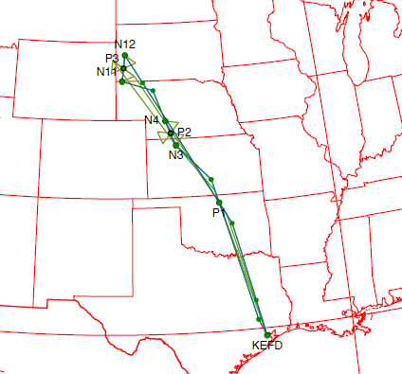
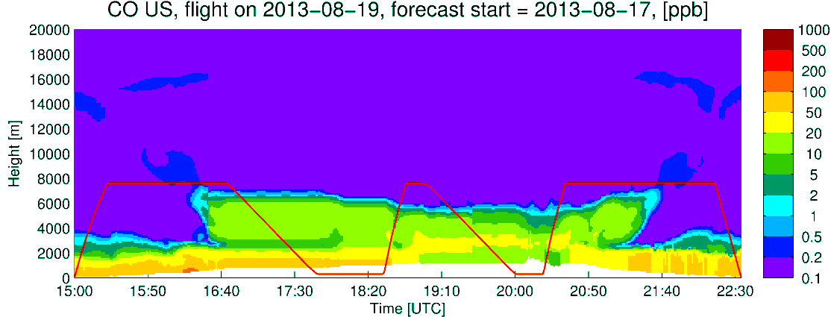
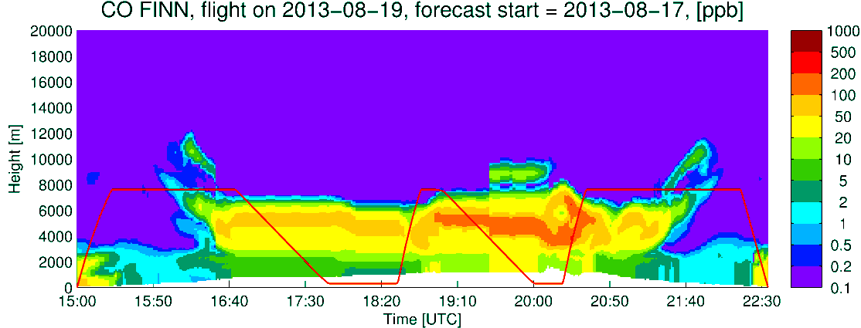
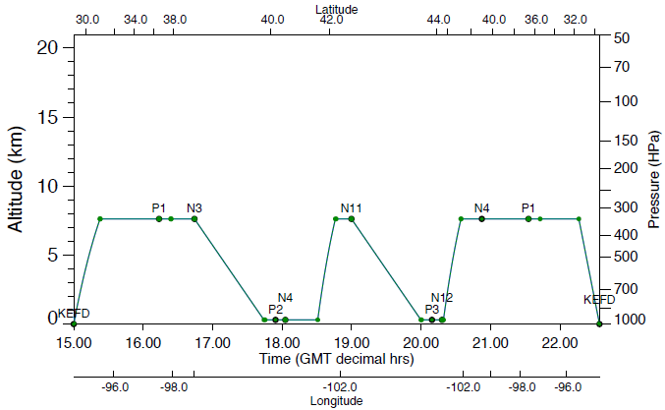
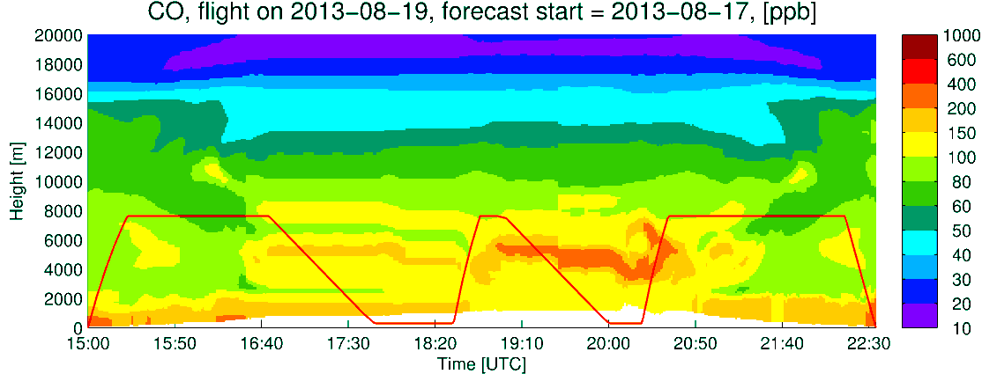
DC-8
Extinction
CO US Anthro
CO Fires
Q_CLOUD
CO total

Slide 15
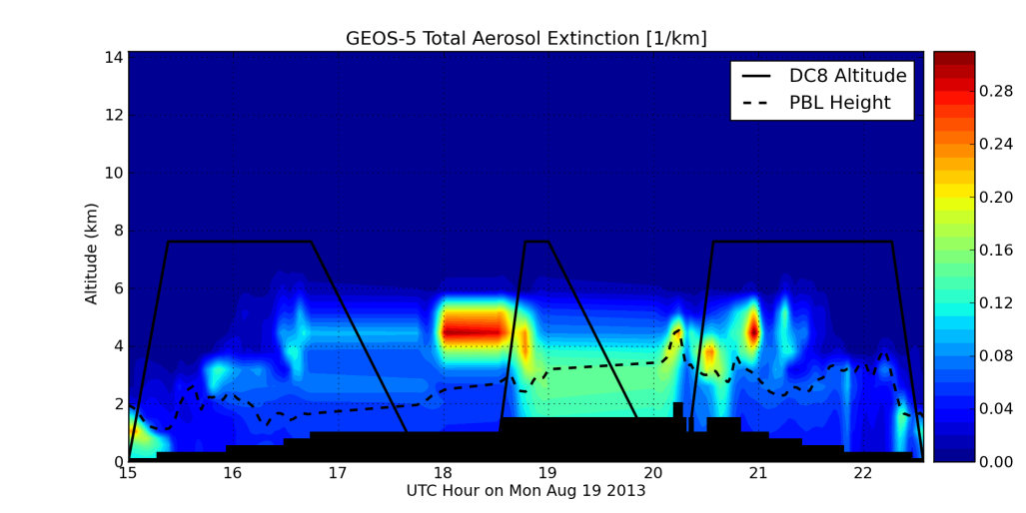
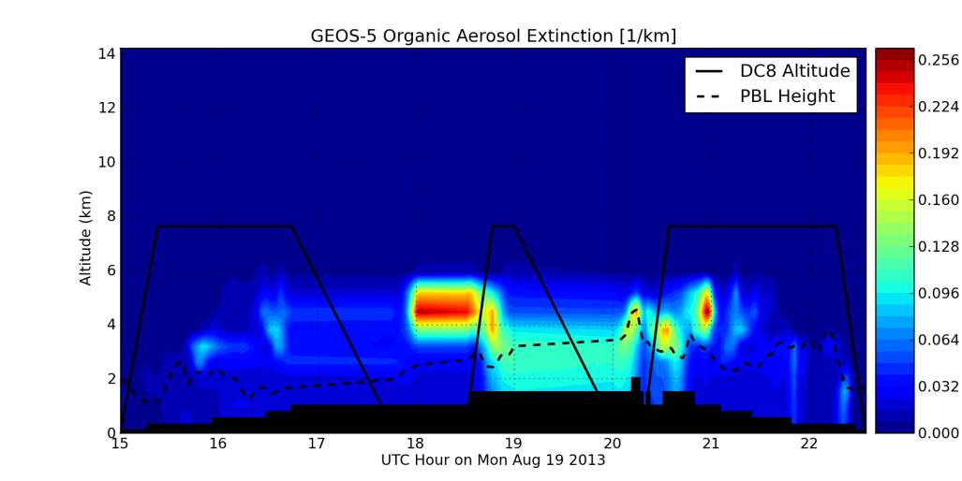
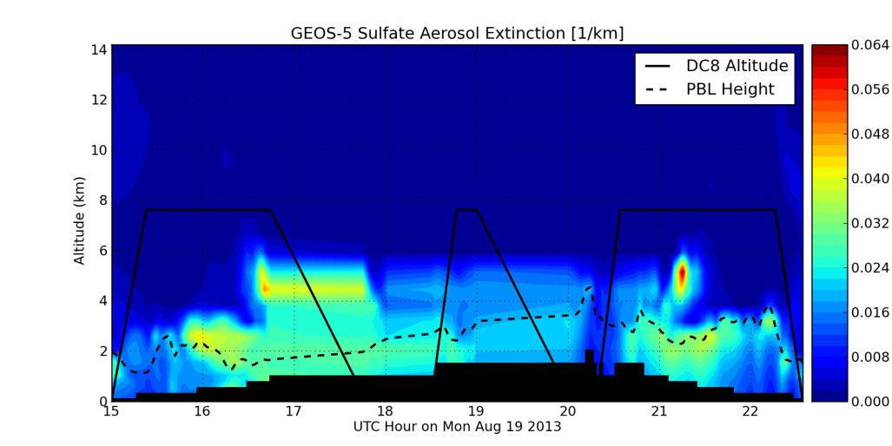
DC-8
Tot Extinction
OC Extinction
SO4 Extinction
Q_CLOUD

Slide 16
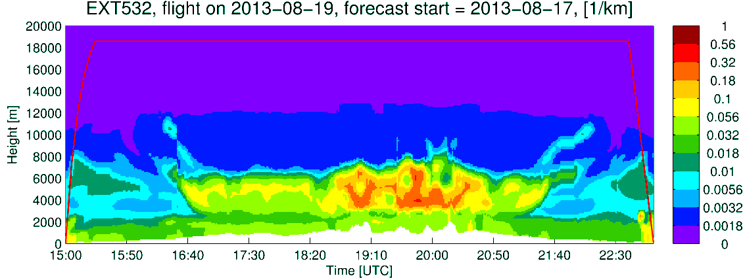
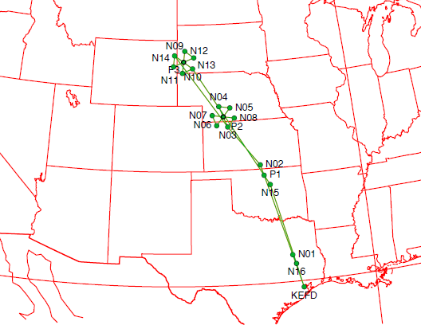
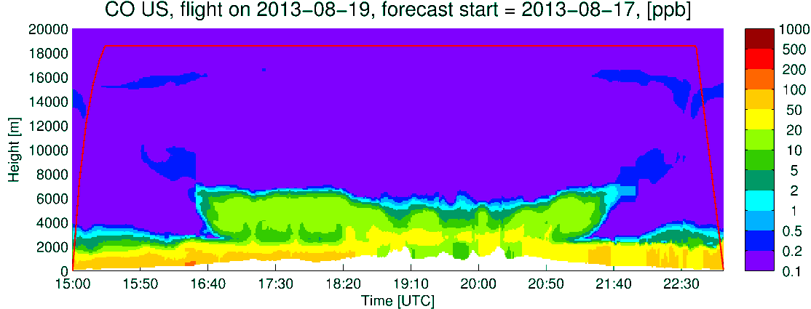
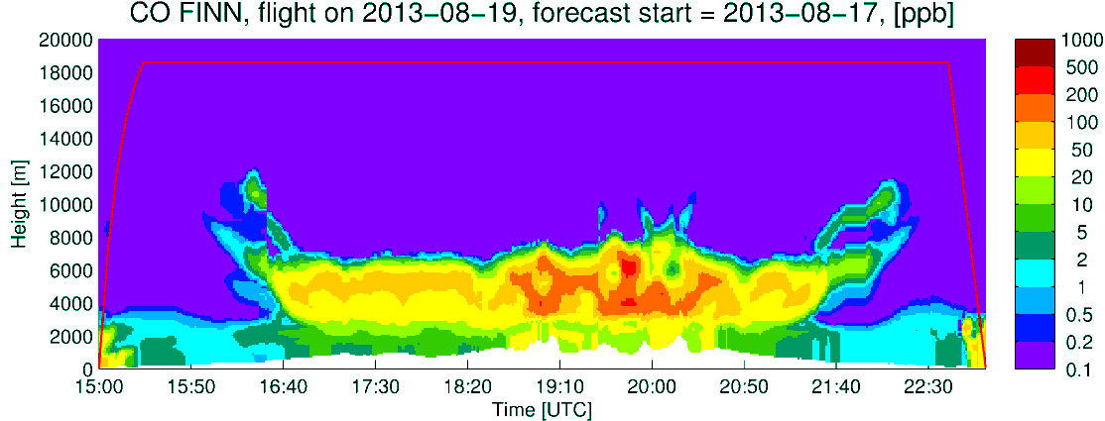
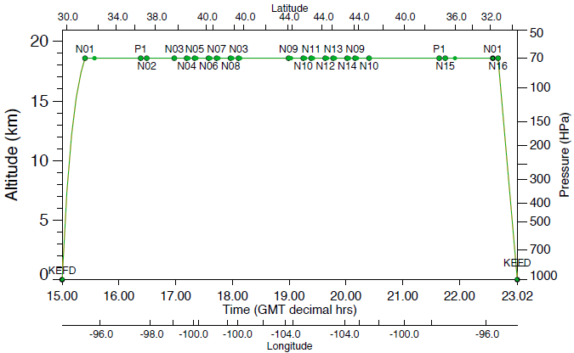
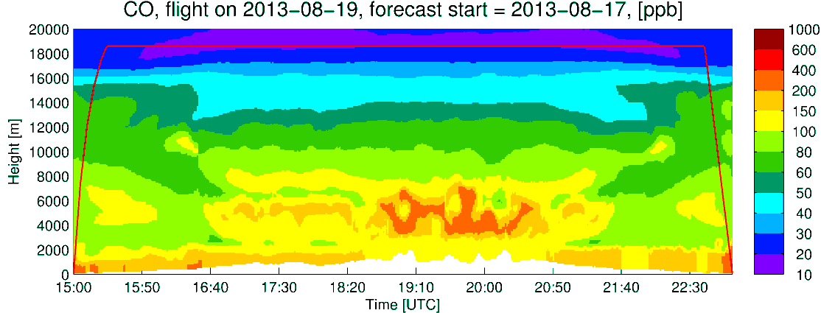
ER2
Extinction
CO US Anthro
CO Fires
CO total
CLOUDS

Slide 17
SE US CHEMISTRY

Slide 18
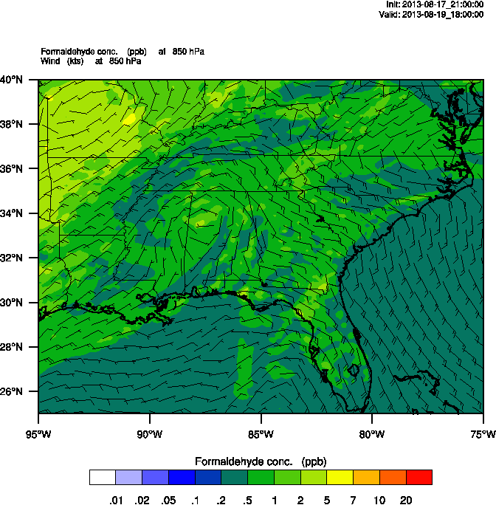
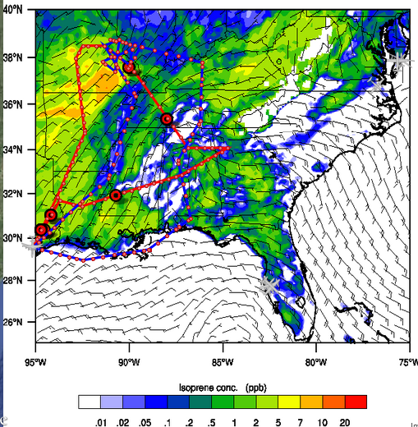
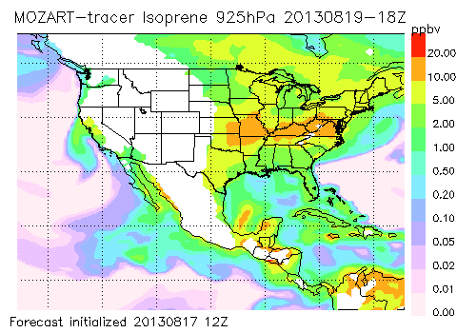
HCHO 925mb 18UTC
Isoprene occurring throughout SE US
WRF-Chem in AR-MO is 5-10 ppbv at 925 mb MOZART tracer over 10 ppbv
Isoprene 925mb 18UTC
Monday 8/19 at 18Z

Slide 19
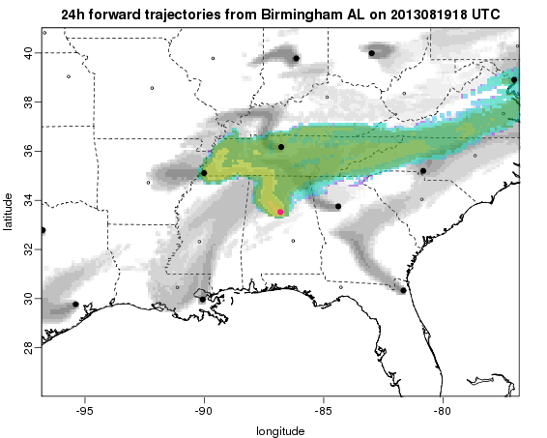
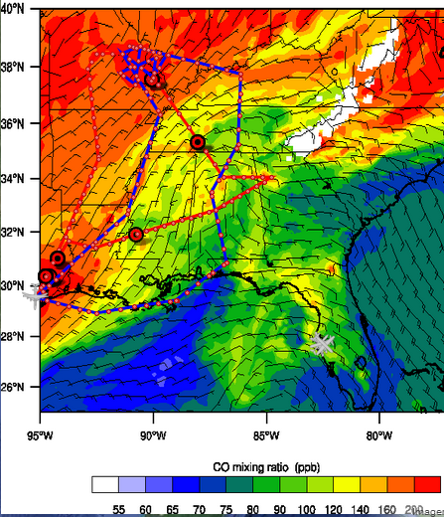
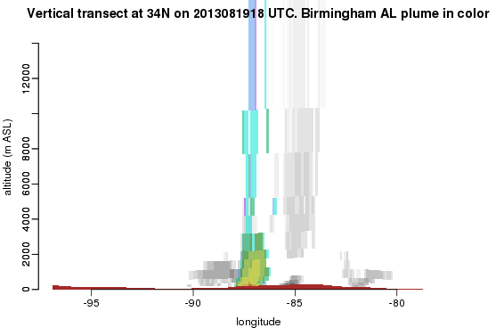
Birmingham plume
CO 925mb 18UTC

Slide 20
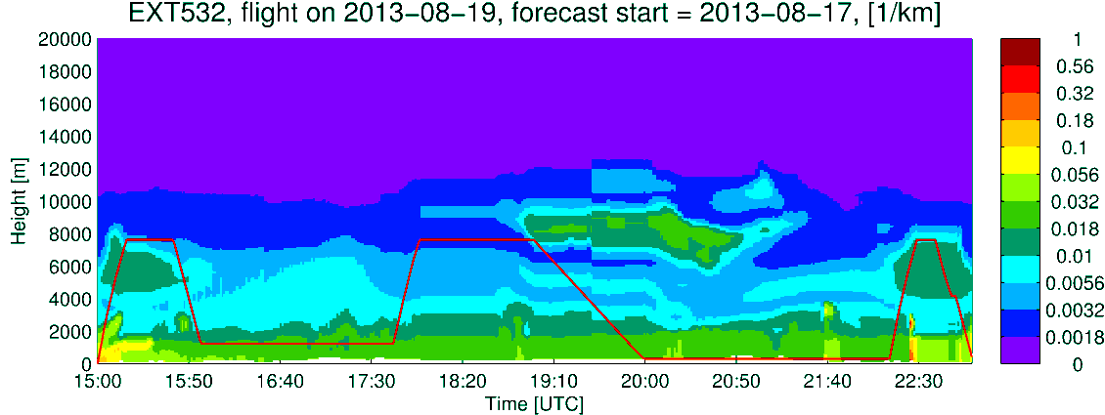
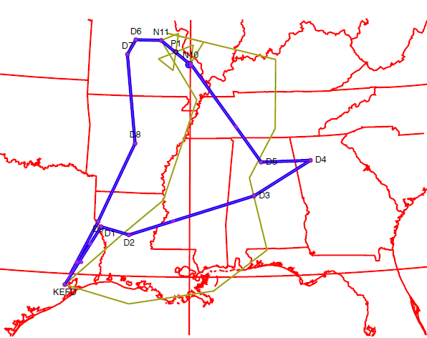
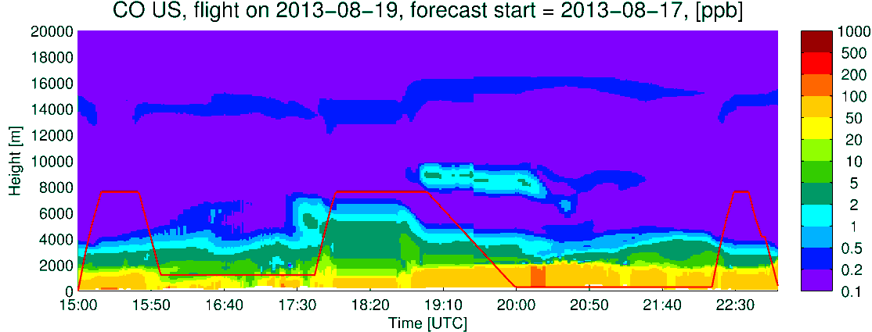
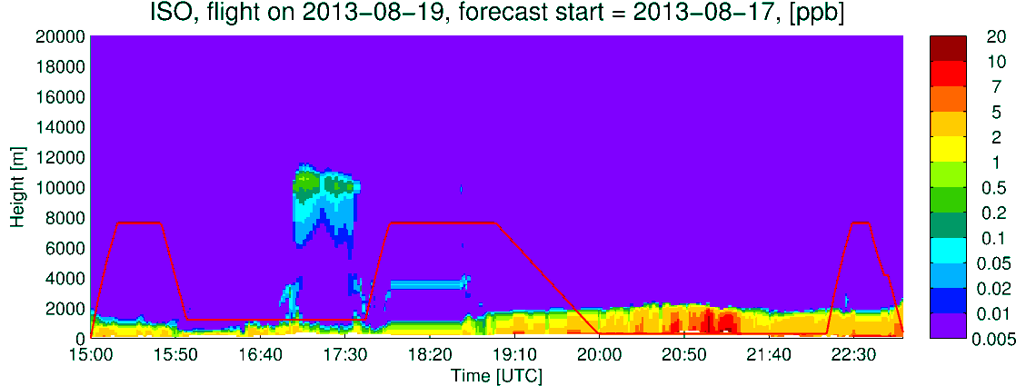


DC-8
Extinction
CO US Anthro
Isoprene
Q_CLOUD
Formaldehyde

Slide 21



DC-8
Tot Extinction
OC Extinction
SO4 Extinction
Q_CLOUD

Slide 22






ER2
Extinction
CO US Anthro
CO fires
Q_CLOUD
CO total

