Slide 1
UIOWA, NCAR, GMAO, NRL Chemical forecasts for Aug 16th flights
16 Aug 2013
Compiled by Mary Barth and Pablo Saide, Arlindo da Silva, David Peterson, contributions from all groups

Slide 2
smoke

Slide 3
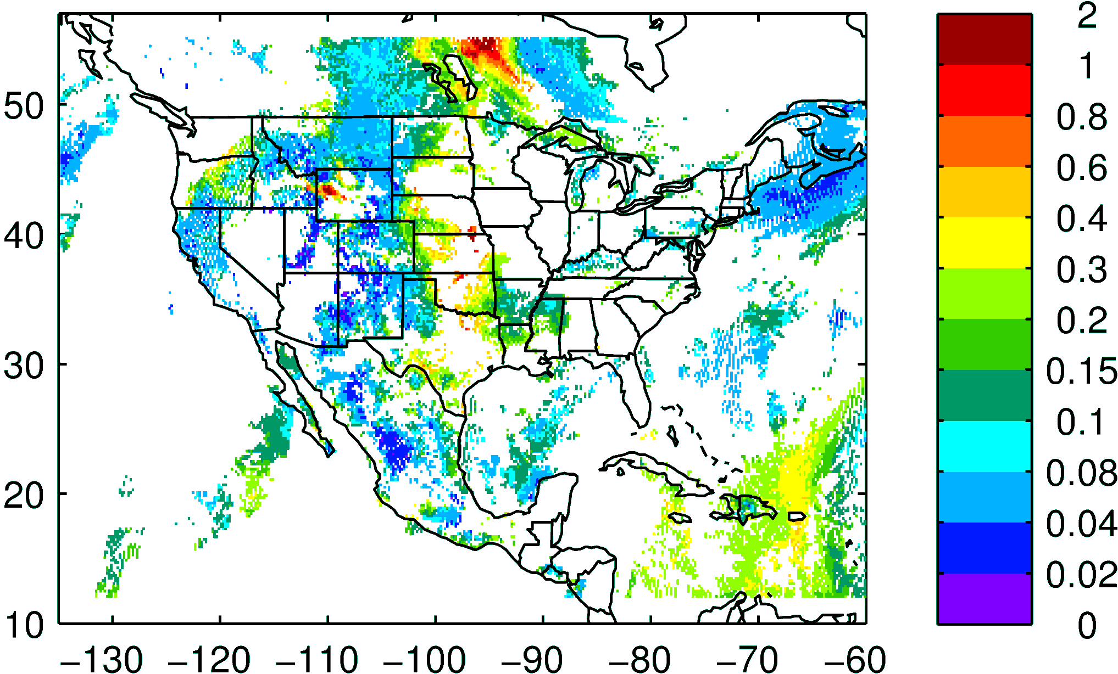
NASA NNR AOD composite yesterday

Slide 4
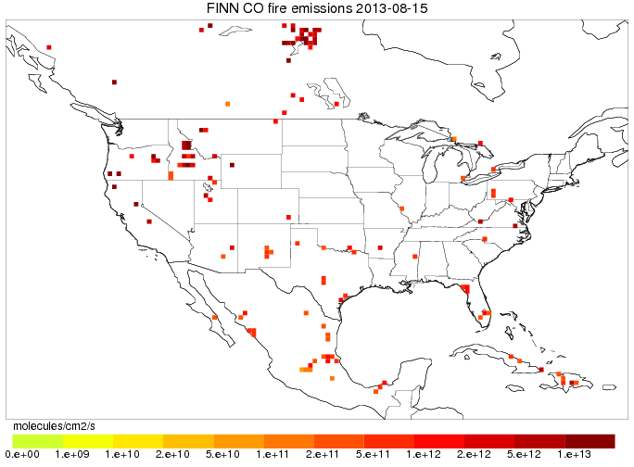
FINN fires today

Slide 5
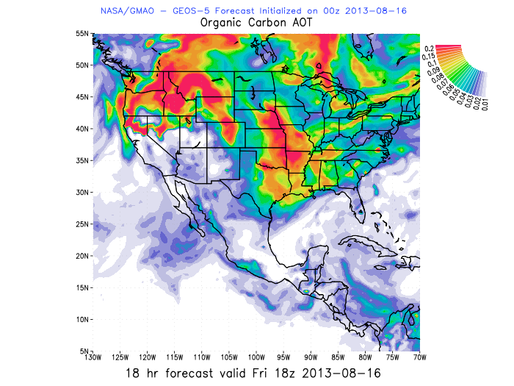
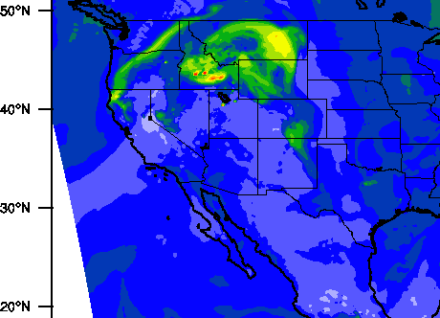
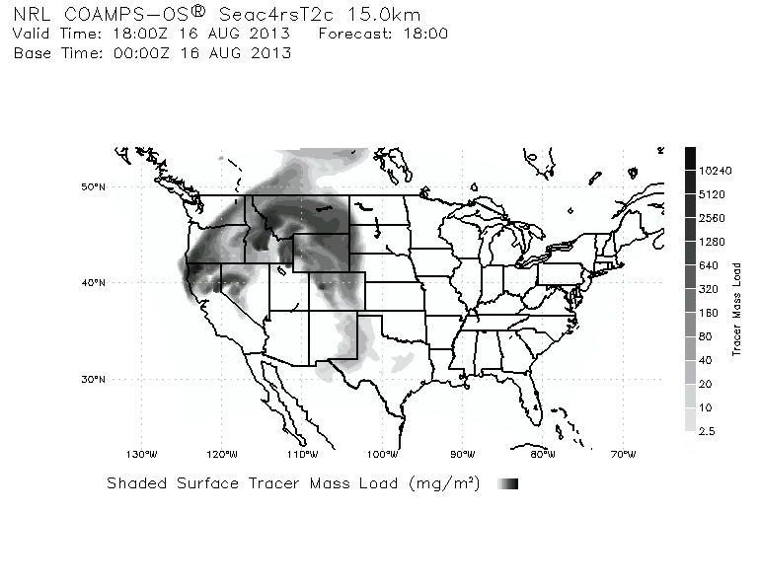

Idaho fire smoke is coming to SEUS
Tracers and AOD showing Idaho fire influence on a streamer
GMAO – GEOS5 forecast has high AOD assimilated
WRF-Chem assimilates AOD but it did not get the high AOD product
WRF-Chem AOD 18 UTC Aug 16th
GEOS5 OC AOD 18 UTC
Models agree in location of the fresh plume
UIOWA WRF-Chem now running with QFED2, AOD increased
COAMPS TRACER COLUMN 18 UTC

Slide 6
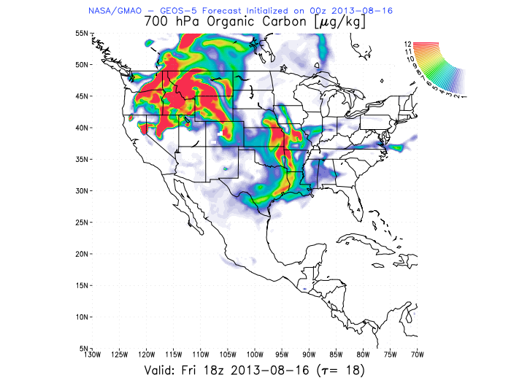
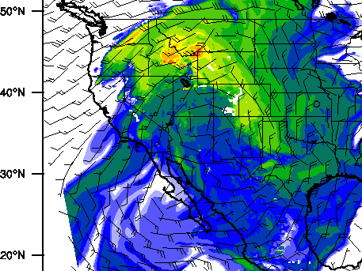

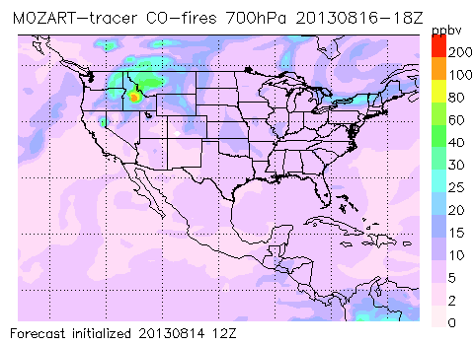
CO fire 700mb 18 UTC
CO fire 700mb 18 UTC GEOS5
Idaho/California fire smoke intercepting the flight track
Models are consistent
AOD 18 UTC

Slide 7
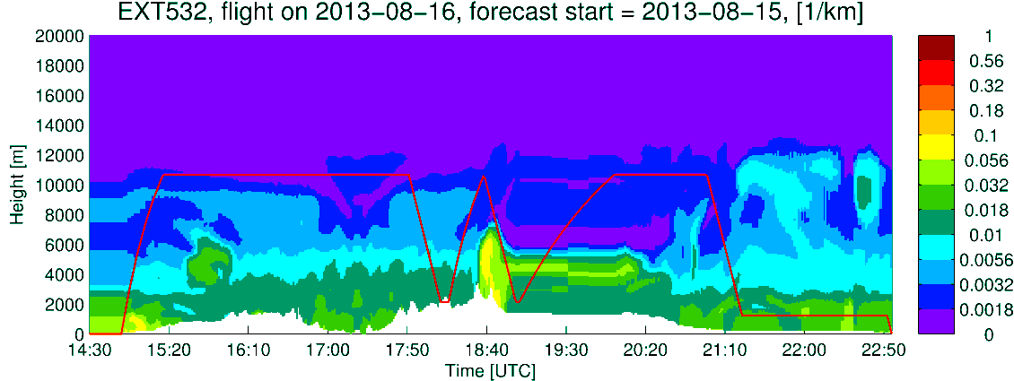
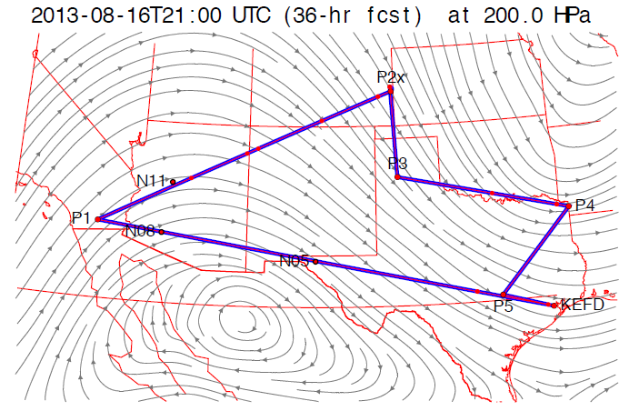
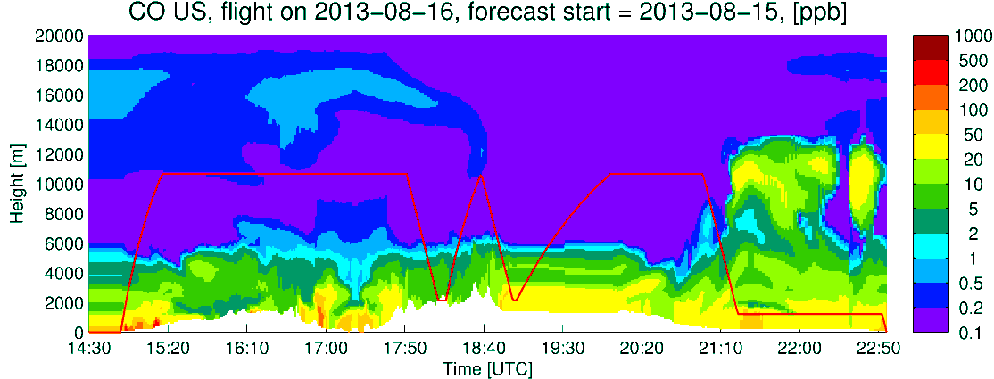
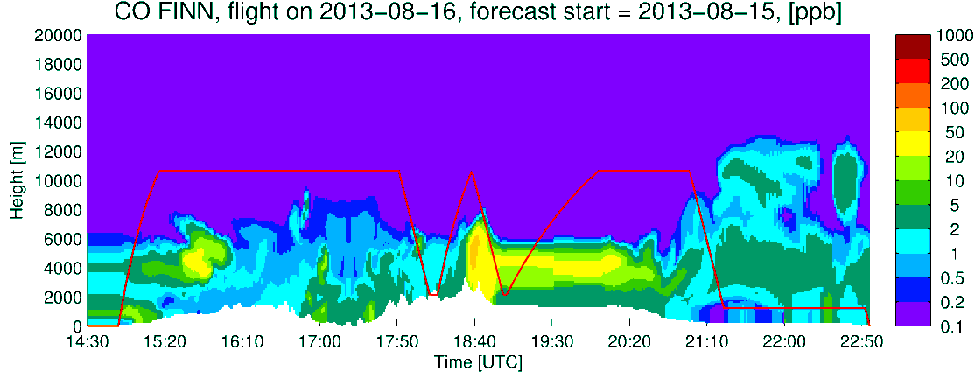
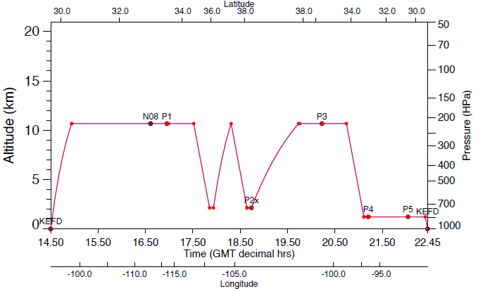
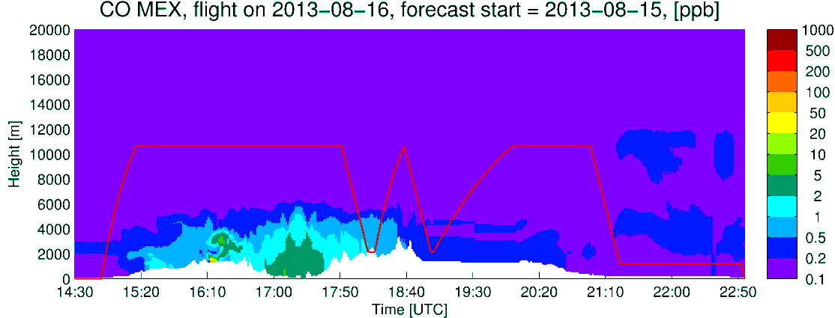
DC-8
Extinction
CO US Anthro
CO Fires
Q_CLOUD
CO Mexico

Slide 8
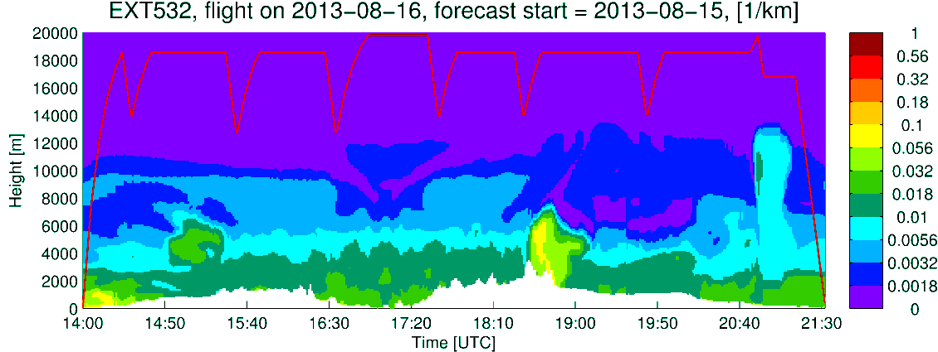
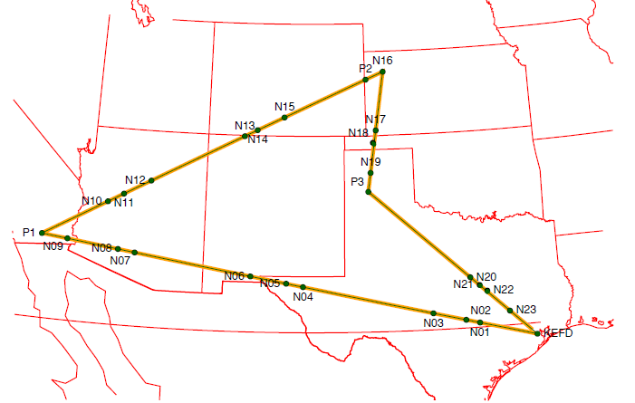
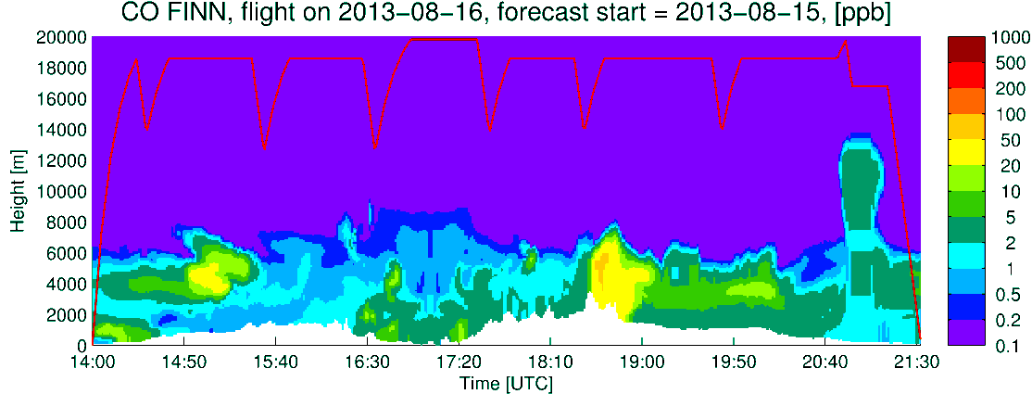
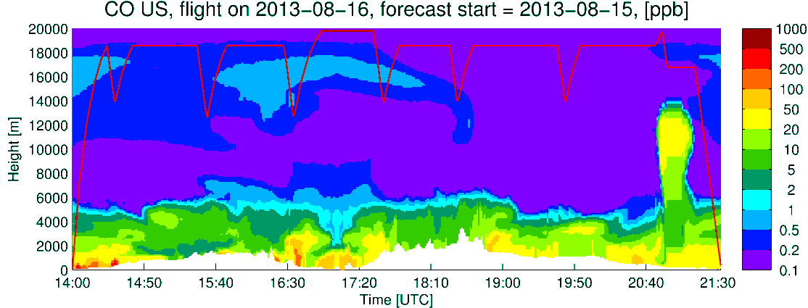
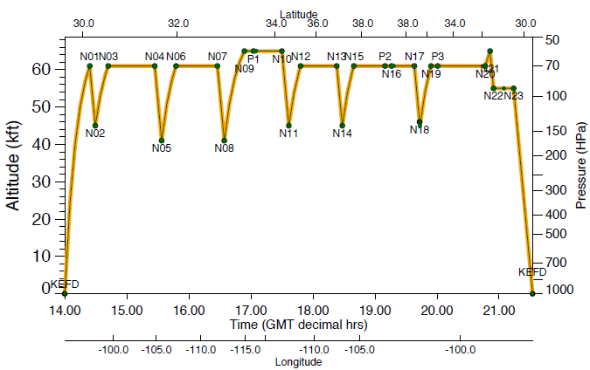
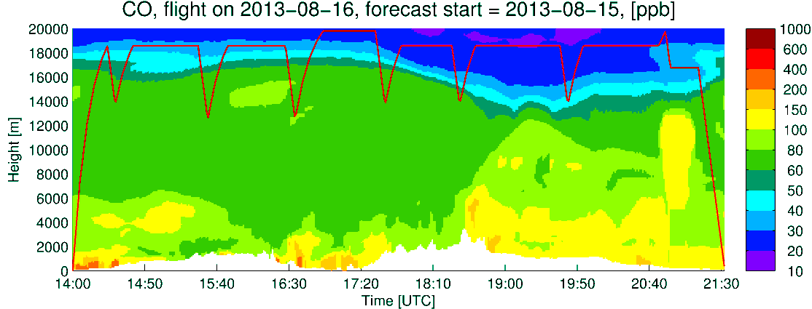
Extinction
ER2
CO Fires
CO US Anthro
CO total
CLOUDS

