Slide 1
UIOWA, NCAR, GMAO, NRL Chemical forecasts for Aug 16th flights
15 Aug 2013
Compiled by Mary Barth and Pablo Saide, Arlindo da Silva, David Peterson, contributions from all groups

Slide 2
smoke

Slide 3
Bottom Line Upfront
Fire Observations:
Large fires continue to burn in ID, WY, UT and MT
The primary focus is Idaho!
Key Forecasting Points (Friday 8/16):
Fire weather conditions remain favorable for fire growth
Synoptic flow (e.g. at 500 hPa) becomes more northerly, funneling smoke farther west through the High Plains/Front Range
There may be less smoke near the primary Oklahoma target region!
Morning MCS will impact Oklahoma, producing widespread cloud cover before 18Z
Smoke Predictions (Friday 8/16):
Western fires: High smoke concentrations, higher altitude injections, and large-scale transport will continue through Friday!
Smoke output will begin to decrease over the weekend!

Slide 4
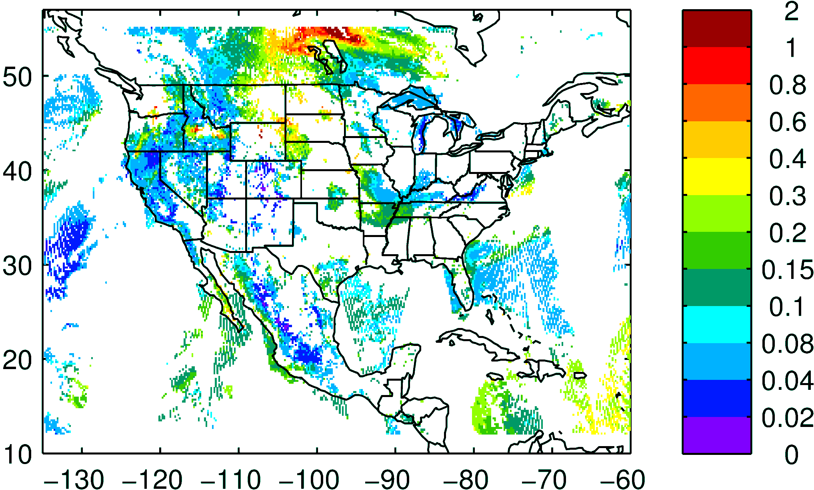
NASA NNR AOD composite yesterday

Slide 5
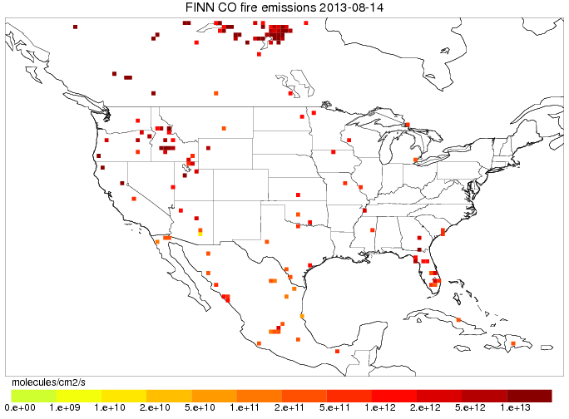
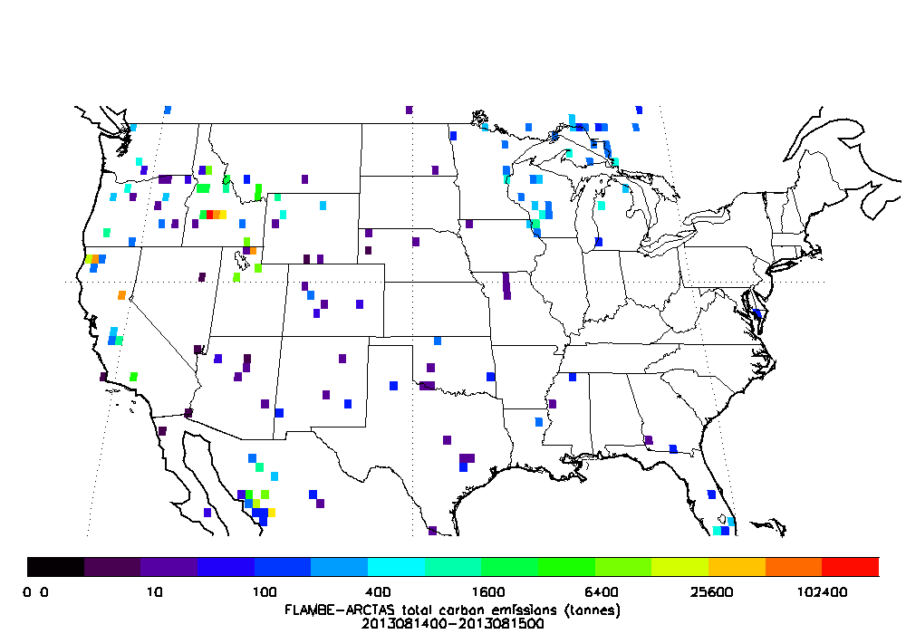
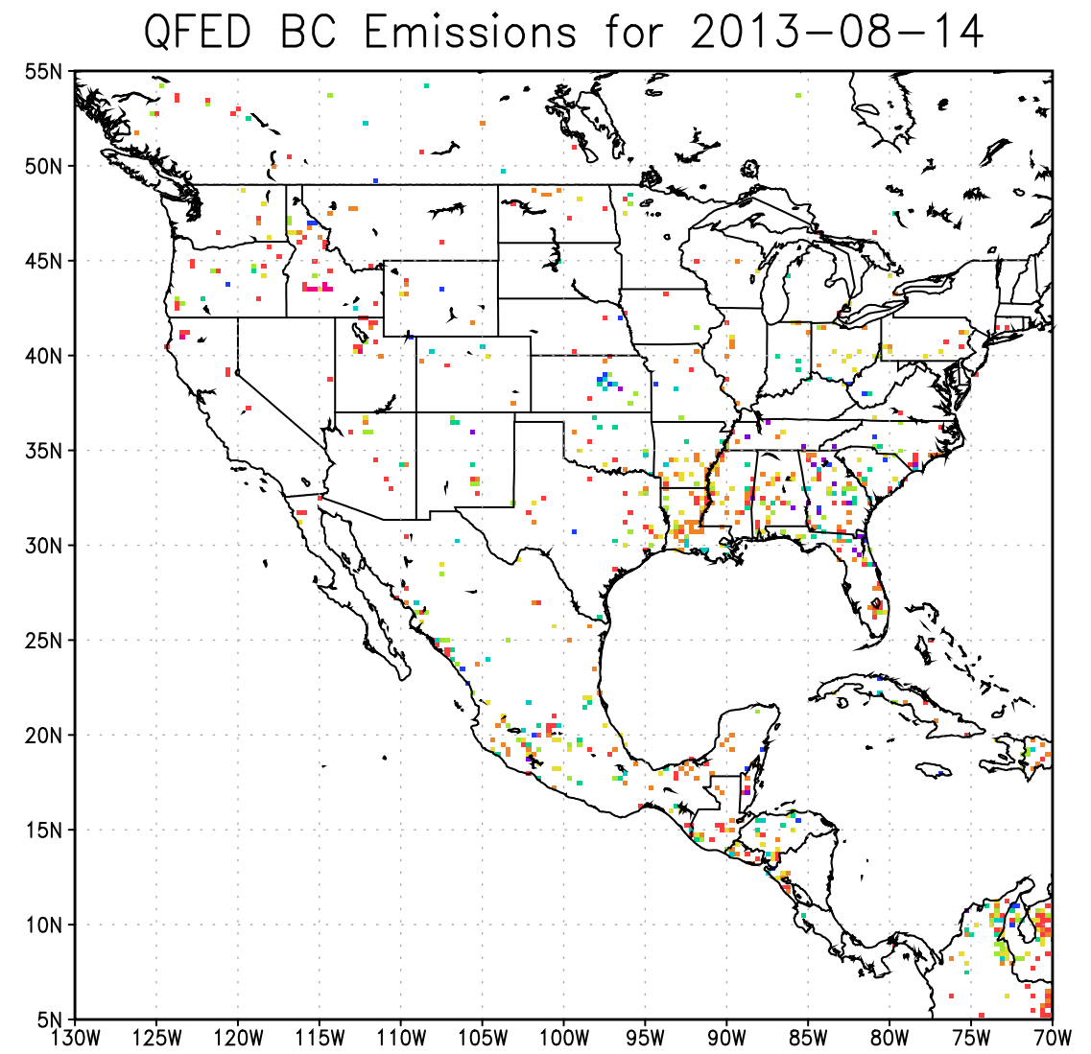
Fires: locations
FLAMBE today
FINN today
QFED2 today

Slide 6
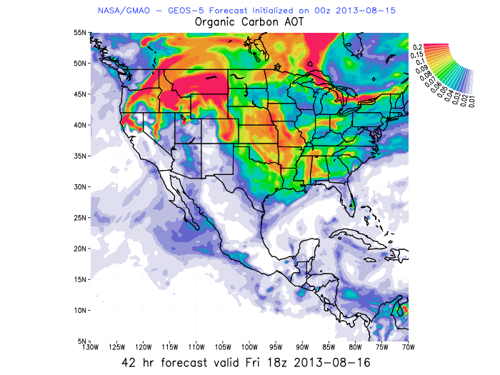
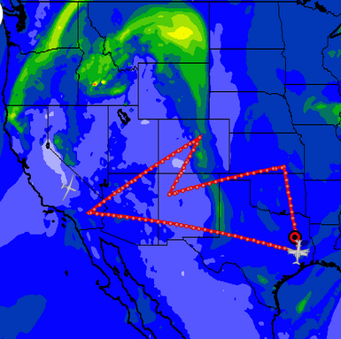

WRF-Chem AOD 18 UTC Aug 16th
Idaho fire smoke is coming to SEUS
Tracers and AOD showing Idaho fire influence on a streamer
GMAO – GEOS5 forecast has high AOD assimilated
WRF-Chem assimilates AOD but it did not get the high AOD product
GEOS5 OC AOD 18 UTC
UIOWA WRF-Chem now running with QFED2, AOD increased

Slide 7
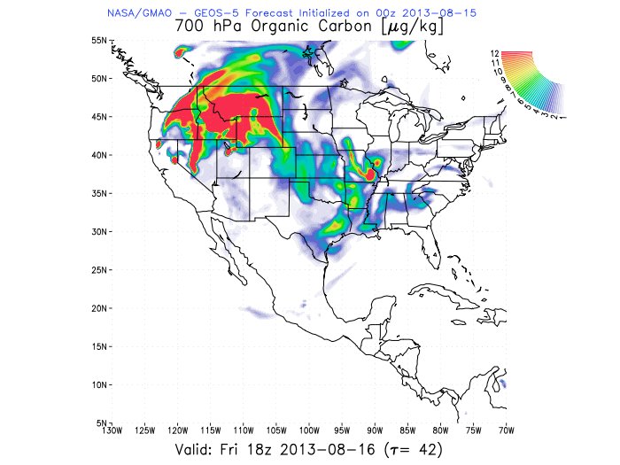
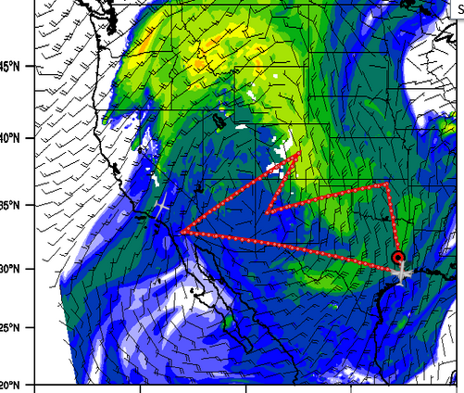

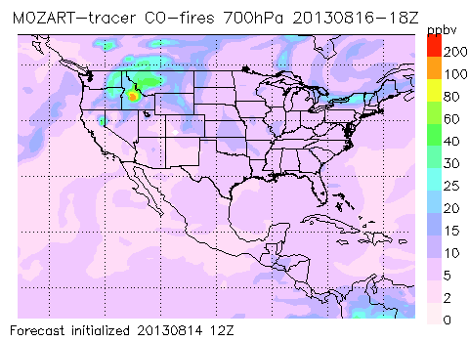
CO fire 700mb 18 UTC
CO fire 700mb 18 UTC GEOS5
Idaho/California fire smoke intercepting the flight track
Models are consistent
AOD 18 UTC

Slide 8
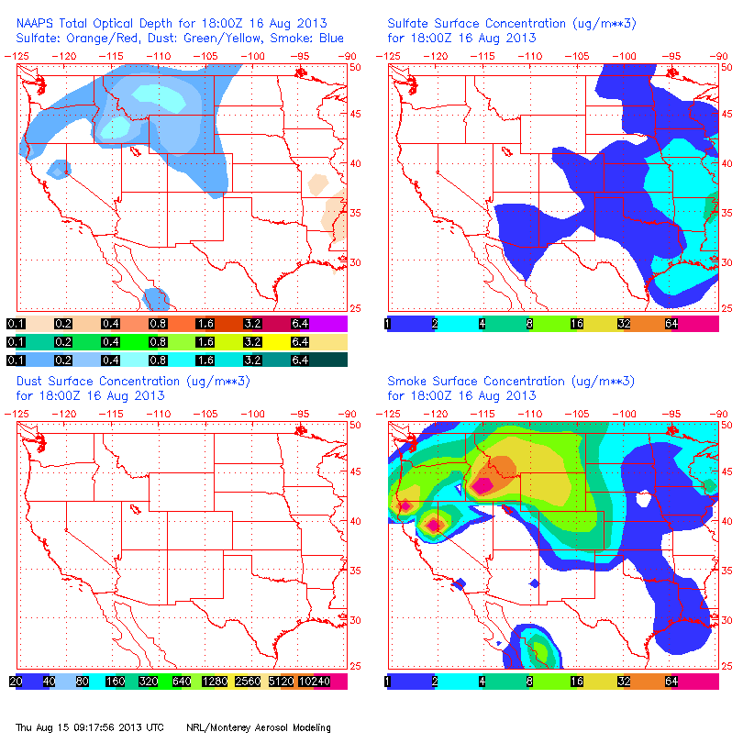
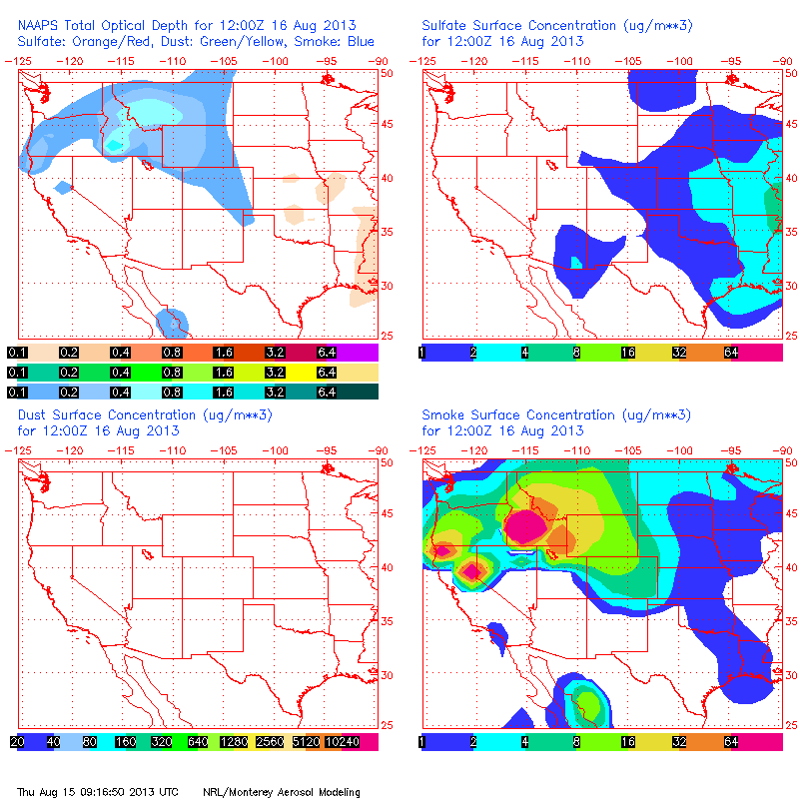
NAAPS Smoke/Aerosol Forecast
8/16, 12Z 8/16, 18Z
Large smoke concentrations are forecast from the Idaho source region, arcing to the ENE through MT, then to the SSE across the High Plains/Front Range
Primary smoke transport region has shifted west!

Slide 9
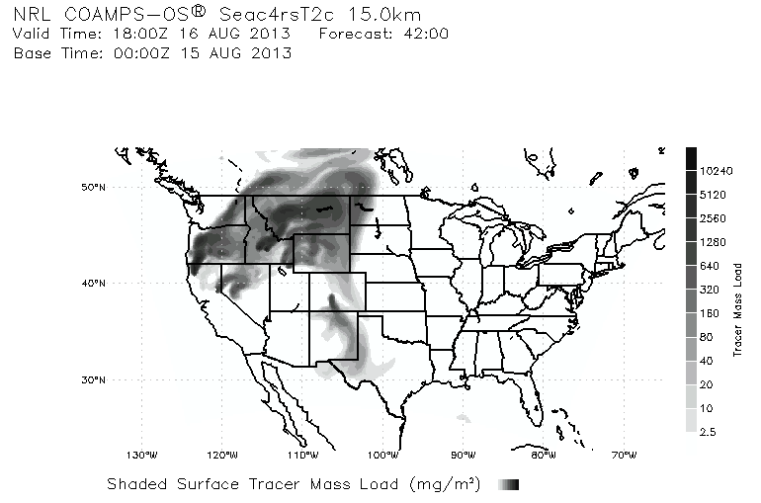
Smoke/Aerosol Forecast

Slide 10
North american monsoon

Slide 11
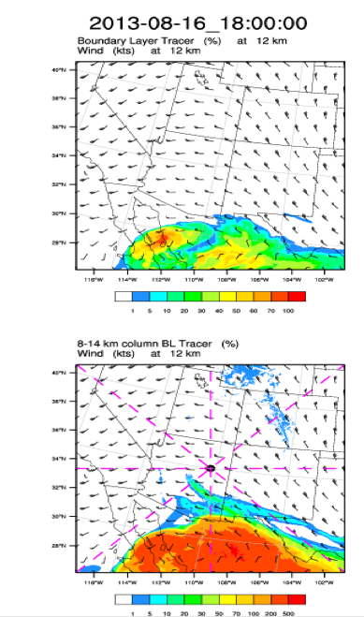
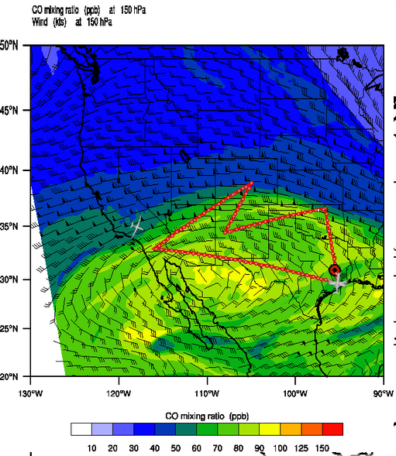
PBL tracer air is mostly confined to Mexico at 1800 UTC Friday 18 August

Slide 12
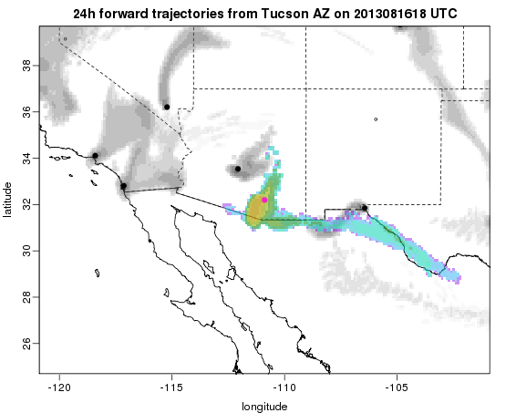
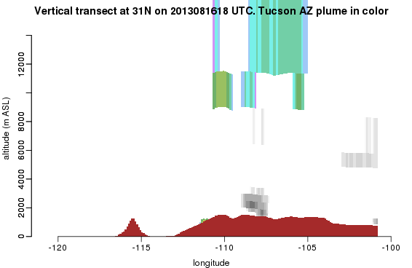
Flexpart shows Tucson air being lofted to above 12 km

Slide 13
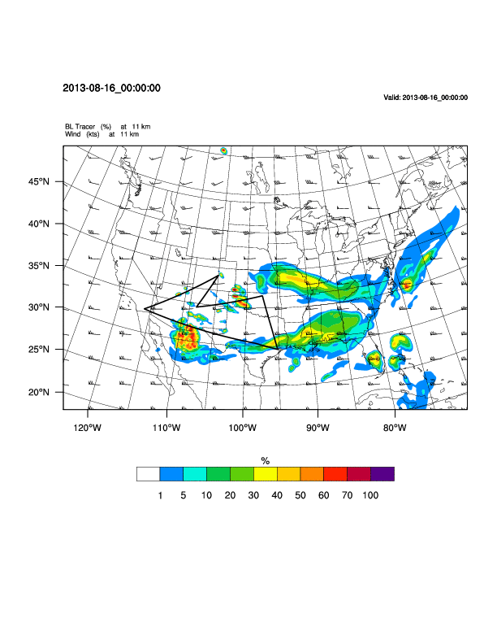
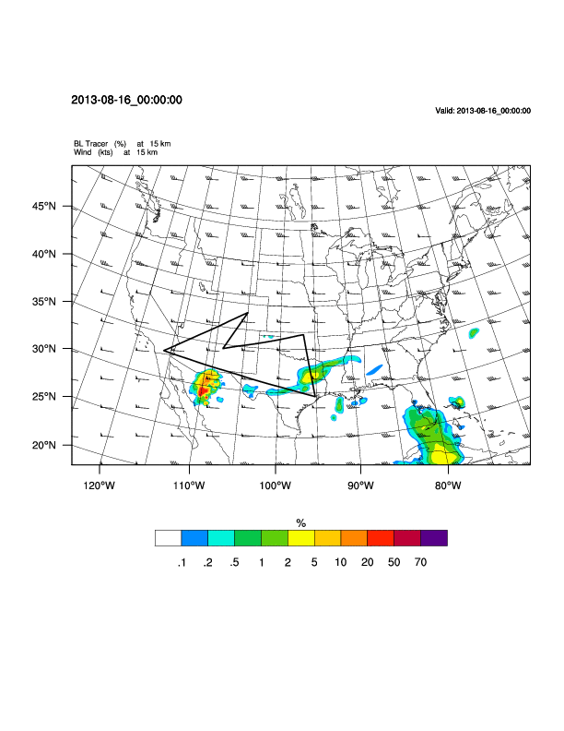
PBL tracer air is mostly confined to Mexico at 1800 UTC Friday 18 August
11 km
15 km

Slide 14
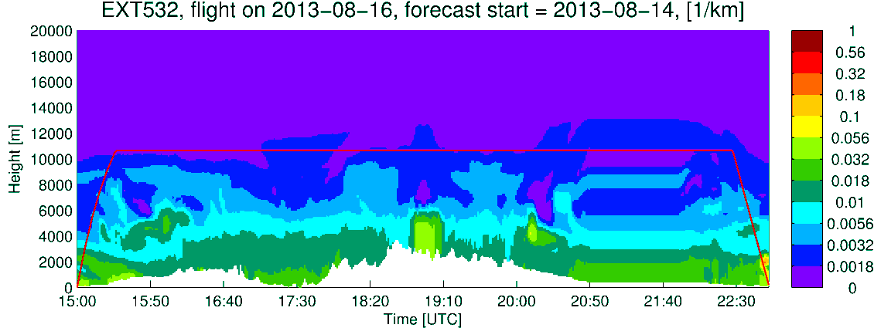
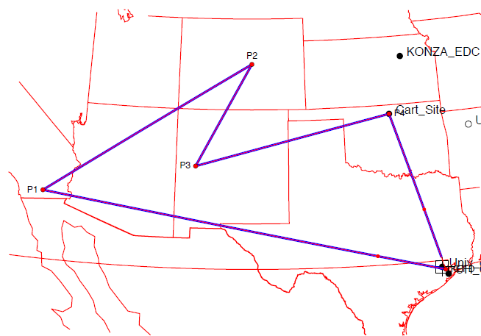
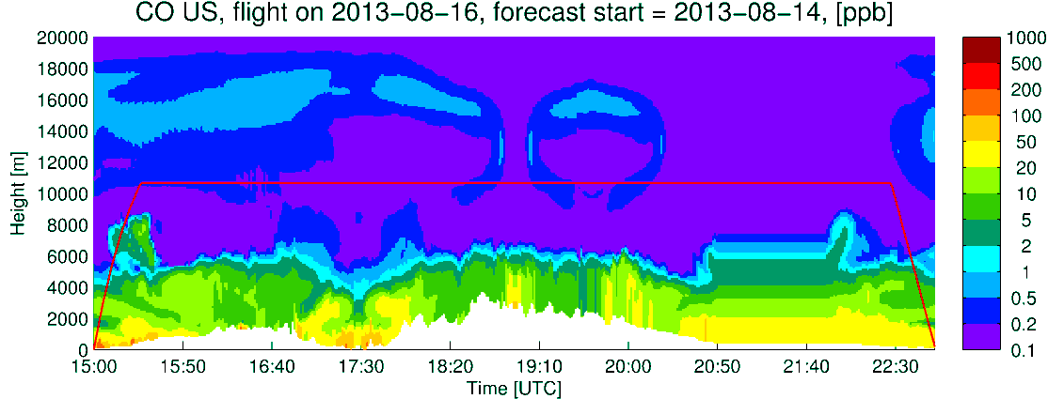
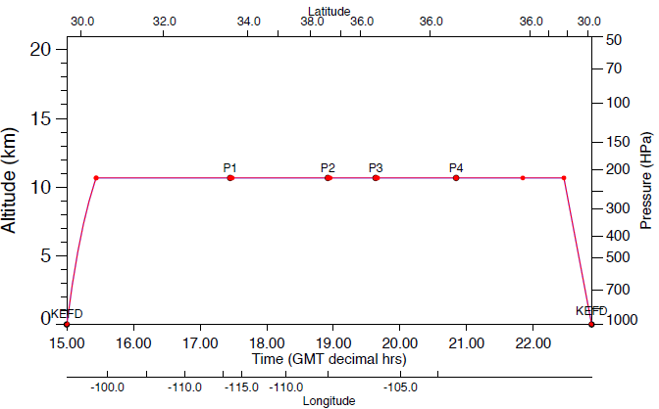
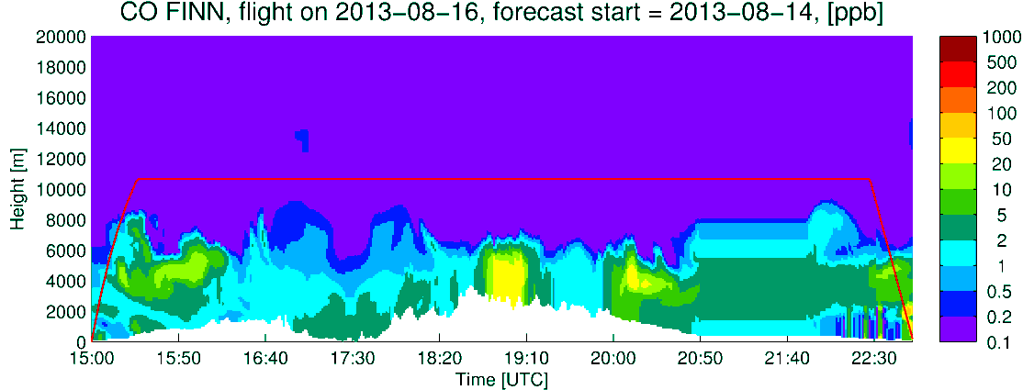
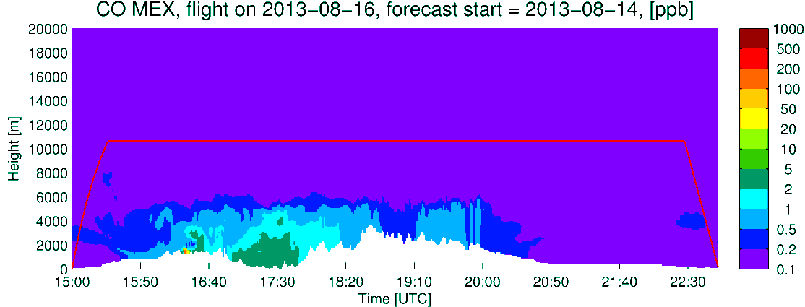
DC-8
Extinction
CO US Anthro
CO Fires
Q_CLOUD
CO Mexico

Slide 15
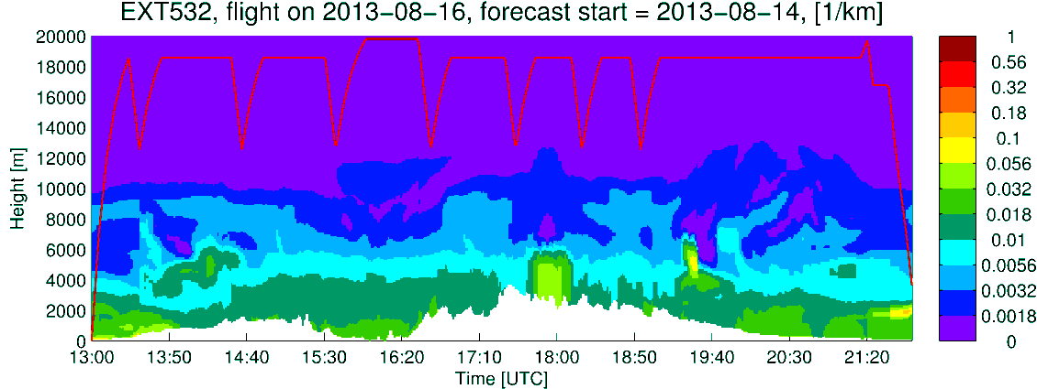
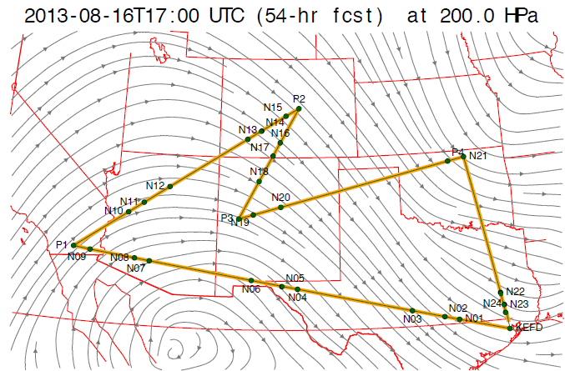
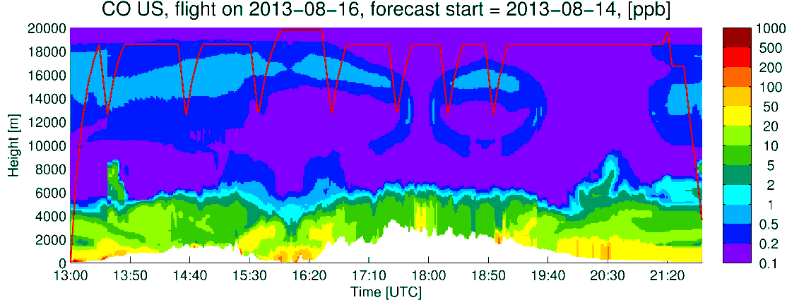
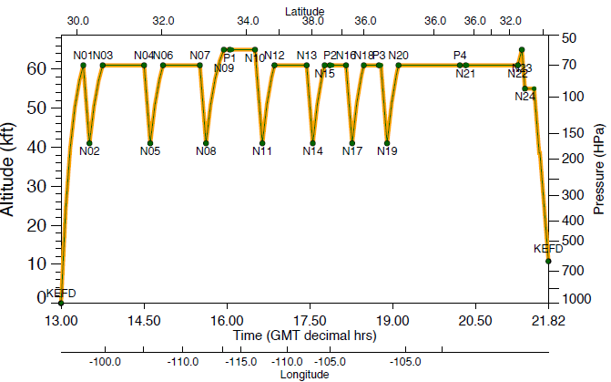
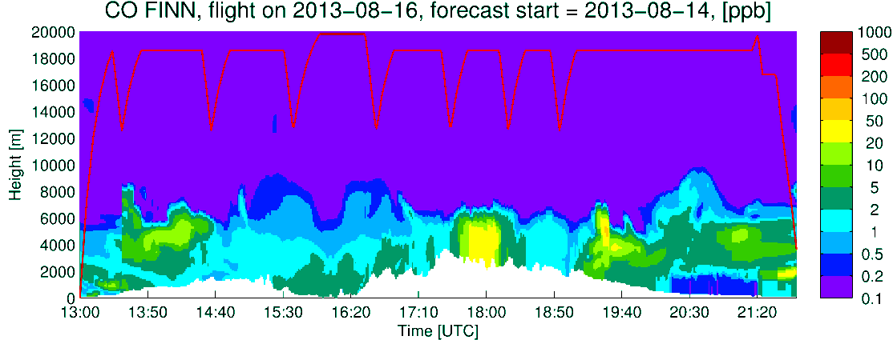
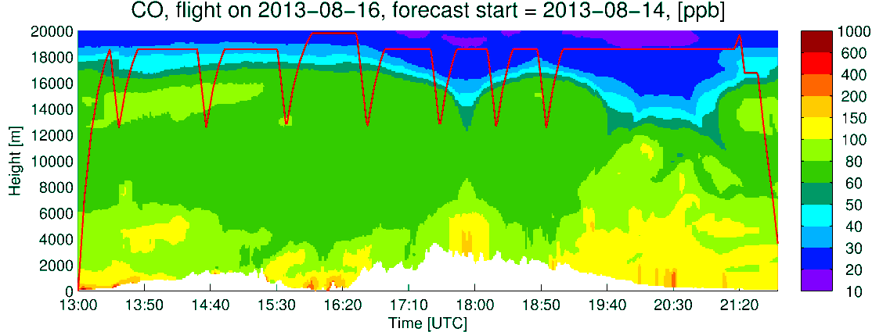
Extinction
ER2
CO US Anthro
CO Fires
CO total
CLOUDS

Slide 16
Long-term outlook

Slide 17
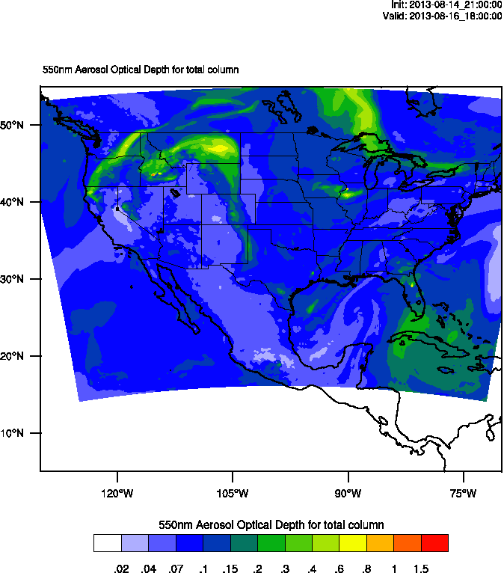
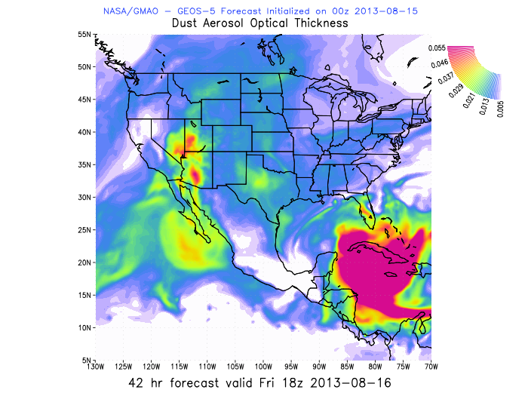
Dust coming in again
AOD 18 UTC

Slide 18
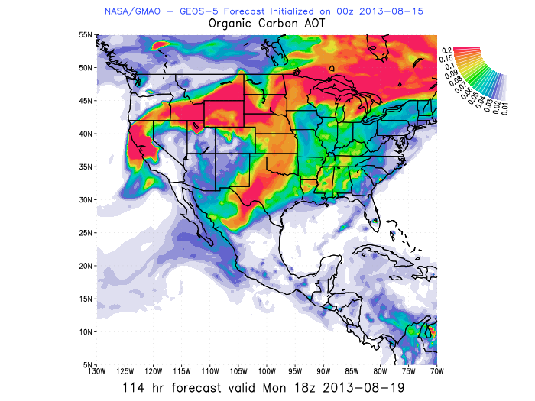
Smoke for Monday

Slide 19
Summary
Plenty of smoke in west
NAM convective outflow is limited
Outlook shows more dust coming from Sahara

