Slide 1
UIOWA, NCAR, GMAO, NRL Chemical forecasts for Aug 14th flights
13 Aug 2013
Compiled by Mary Barth and Pablo Saide, Arlindo da Silva, David Peterson
, contributions from all groups

Slide 2
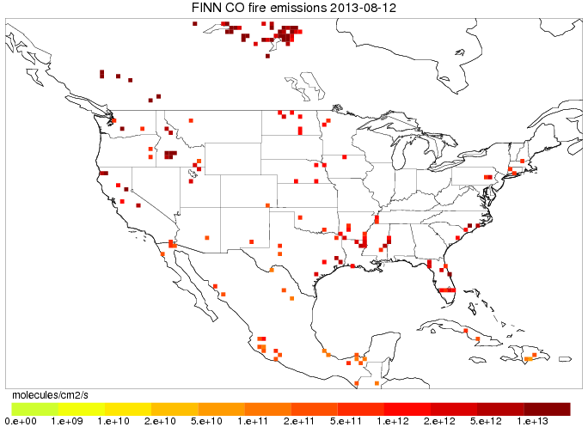
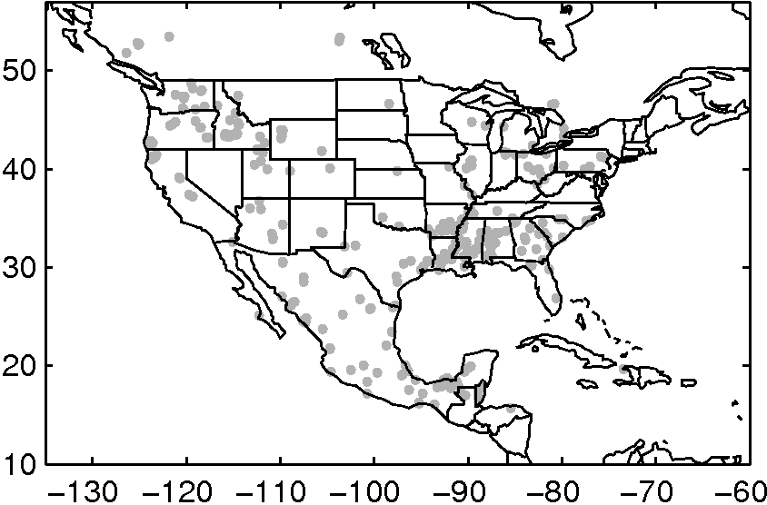
Fires: locations and CO-fire tracers
FINN
QFED2 LOCATIONS

Slide 3
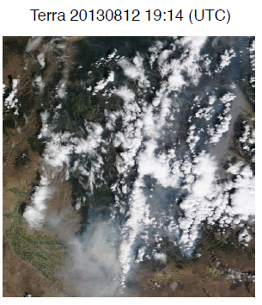
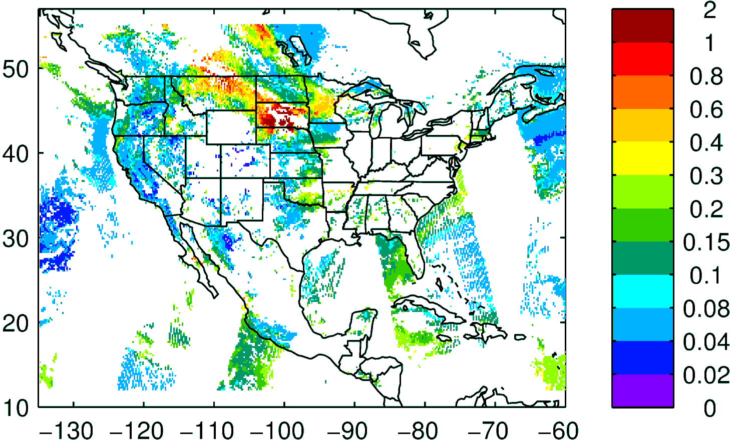
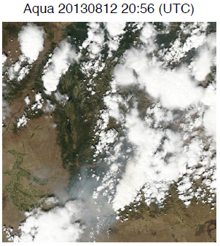
NASA NNR AOD composite yesterday

Slide 4
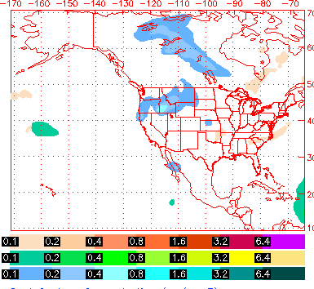
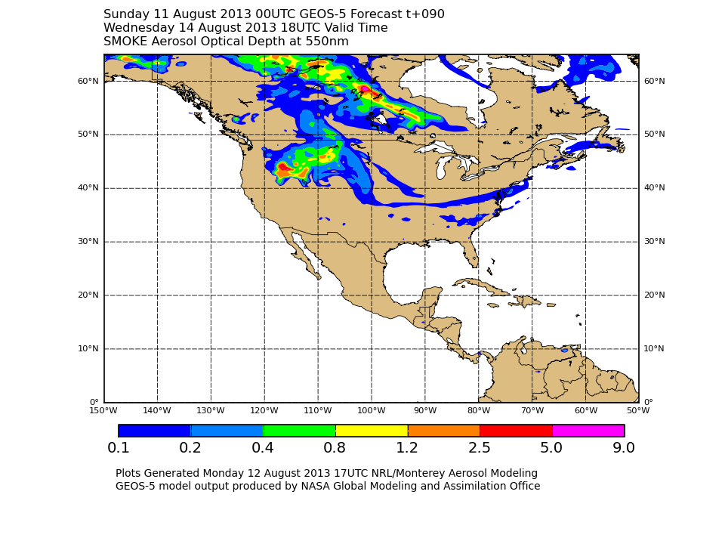
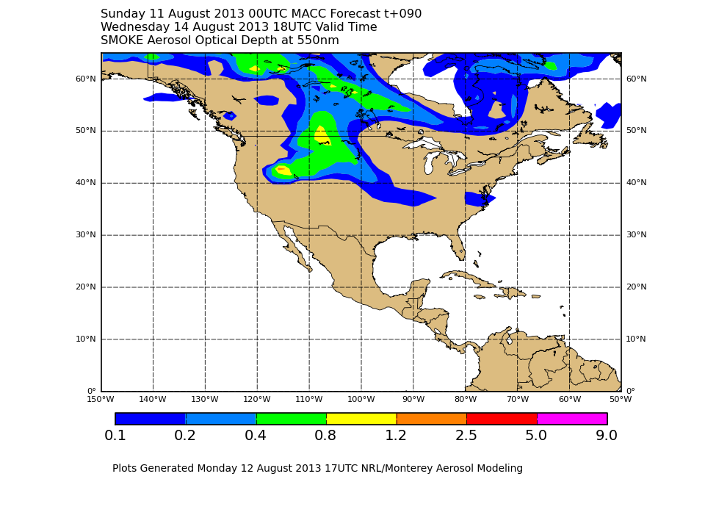
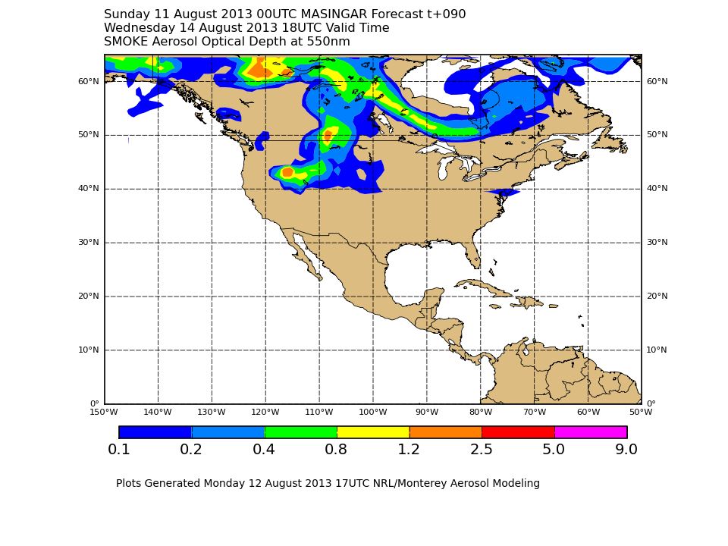
NAAPS AOD
GEOS-5 SMOKE AOD
MACC SMOKE AOD
MASSINGAR SMOKE AOD

Slide 5
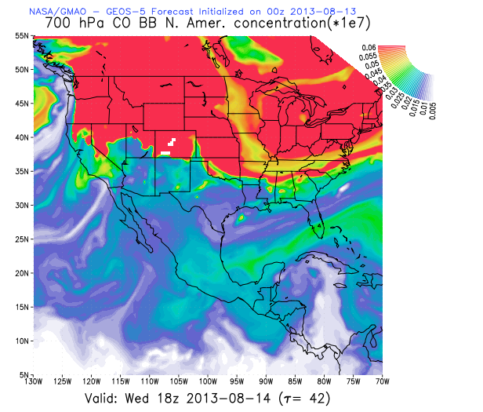
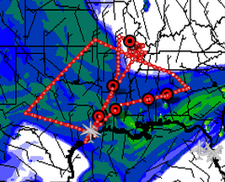

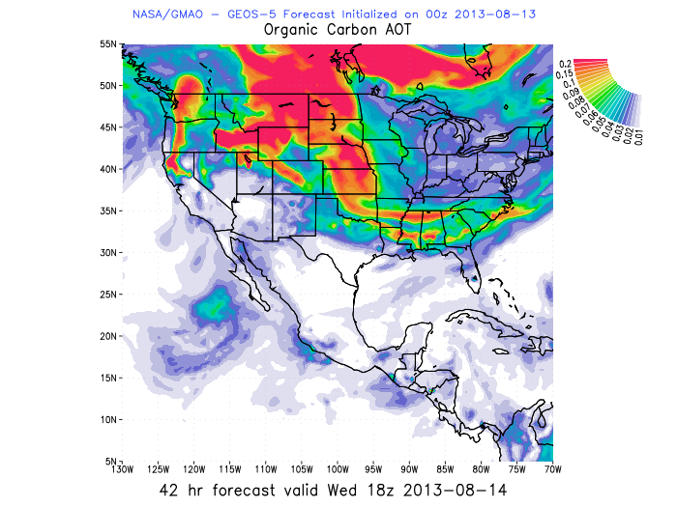
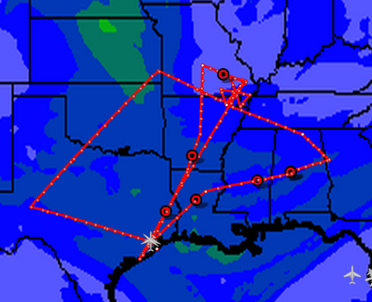

CO fire 700mb BB 18 UTC
WRF-Chem
CO fire 700mb BB 18 UTC
GMAO-GEOS5
Idaho fire smoke is coming to SEUS
Tracers and AOD showing Idaho fire influence on a streamer
GMAO – GEOS5 forecast has high AOD assimilated
WRF-Chem assimilates AOD but it did not get the high AOD product
Organic Carbon AOD 18 UTC
AOD 18 UTC

Slide 6
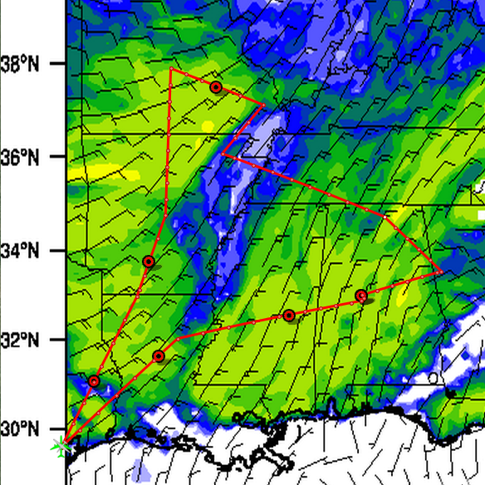

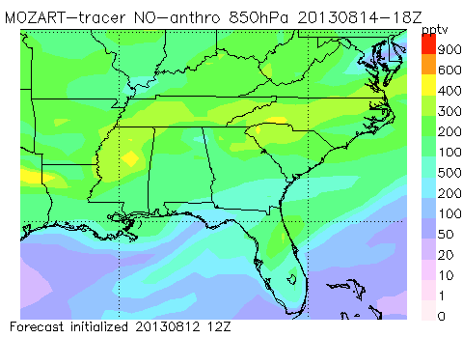
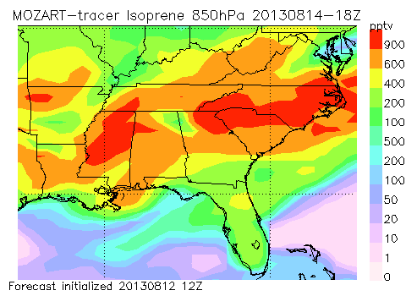
Isoprene 925mb 18 UTC
WRF-Chem
Isoprene tracer for midday Wednesday is >5 ppb at 925mb and >1ppb at 850mb over Mississippi and Ozarks; less isoprene in AL
Anthropogenic NO tracer has same pattern
MOZART 0.5deg Anthro-NOx tracer (2-day lifetime)
MOZART 0.5deg Isoprene tracer (2-day lifetime)

Slide 7
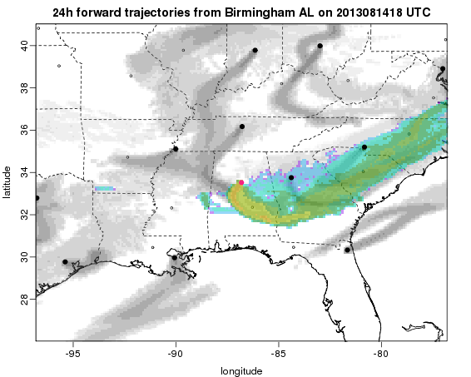
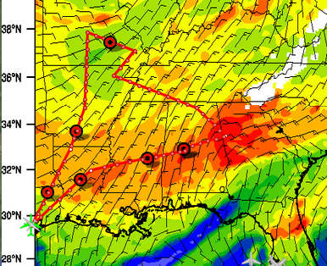
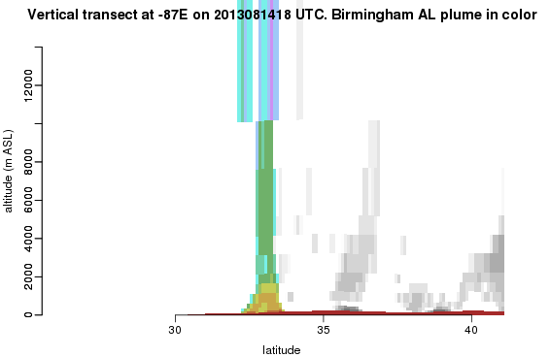

Flexpart trajectory from Birmingham
Birmingham plume is going southward then eastward (same with Atlanta)
- some of the plume gets lofted
WRF-Chem
Total CO 925mb 18 UTC
Centreville
Atlanta plume
Birmingham plume

Slide 8
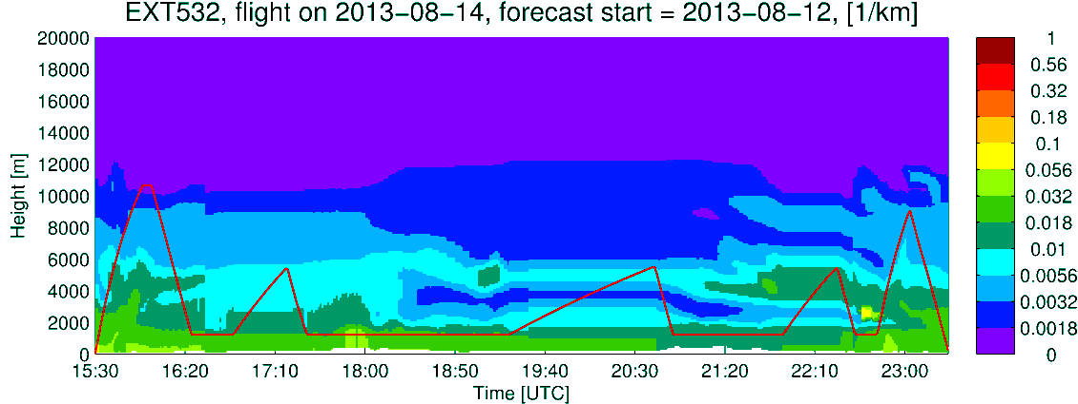
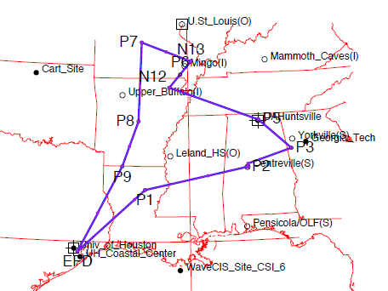
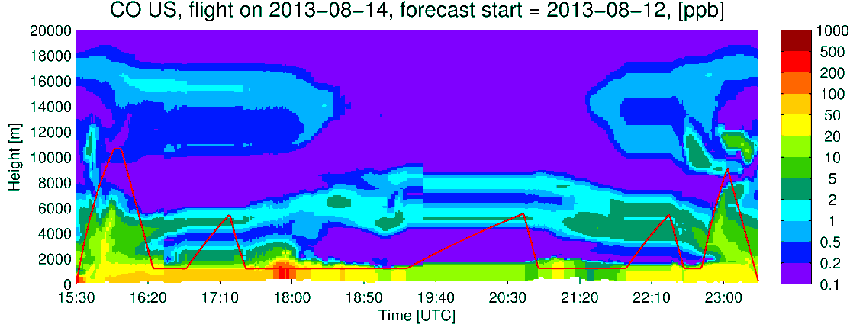
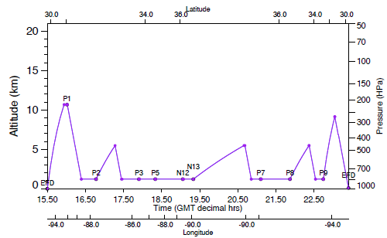
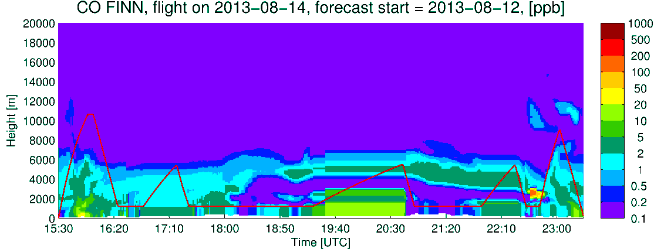
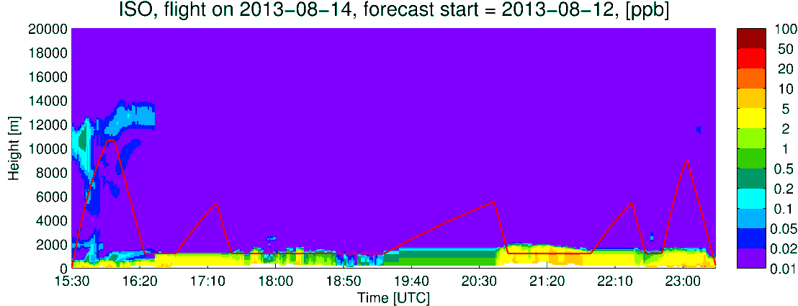
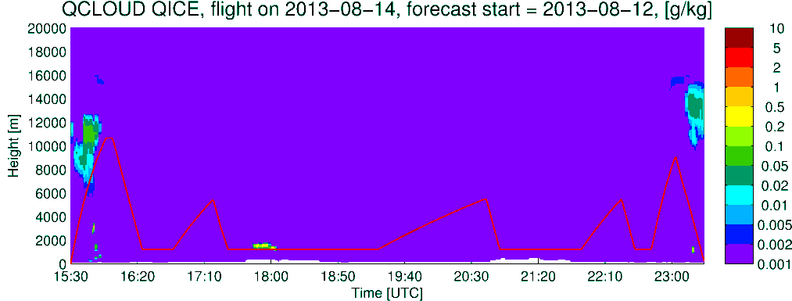
DC-8
Extinction
CO US Anthro
CO Fires
Isoprene
Q_CLOUD

Slide 9
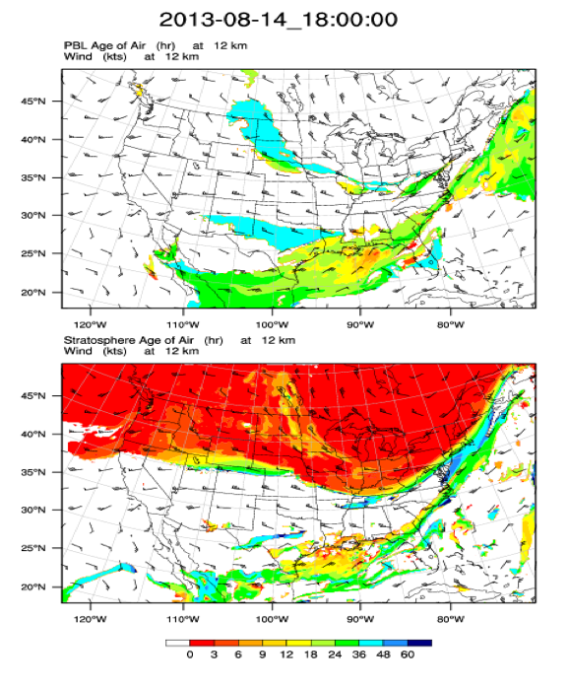
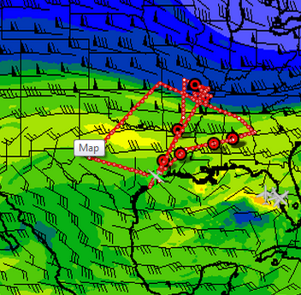

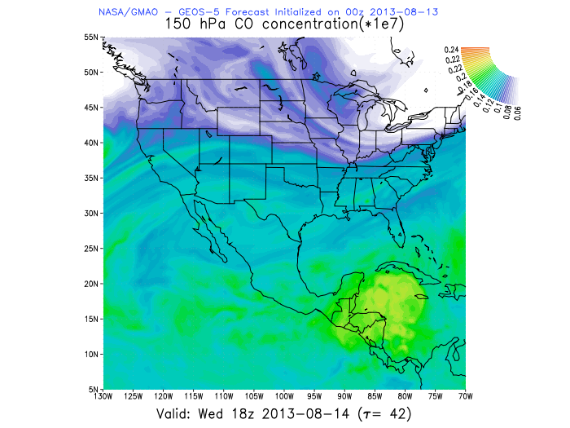
North American Monsoon
Age of WRF PBL tracer at 12 km
Total CO 150mb 18 UTC
WRF-Chem
> 36 hours old
< 18 hours old
> 90 ppb CO
Age of WRF Stratosphere tracer at 12 km
NASA/GMAO – GEOS5

Slide 10
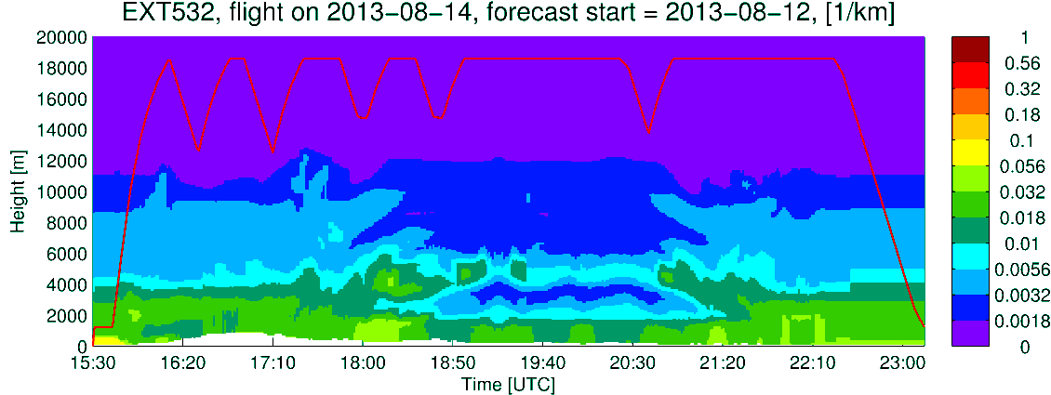
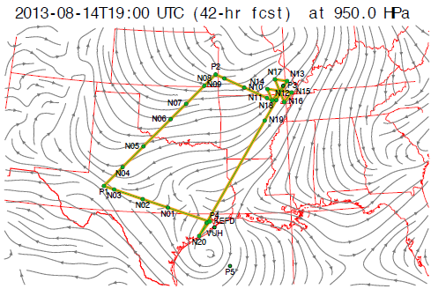
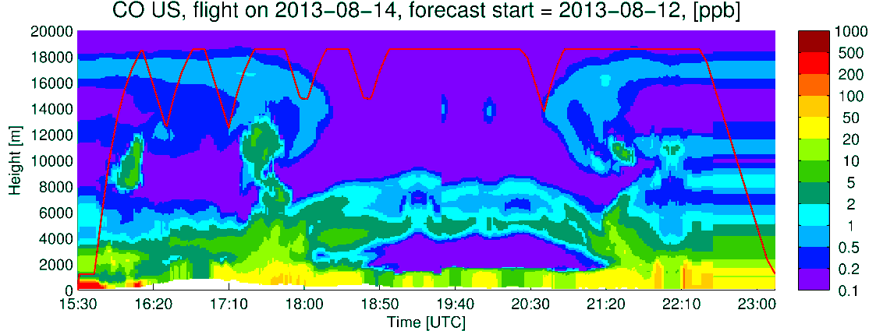
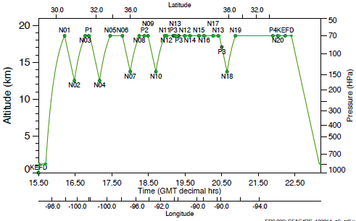
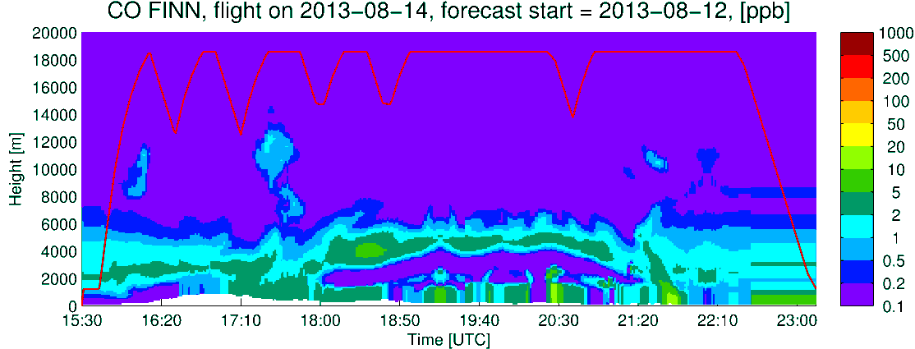
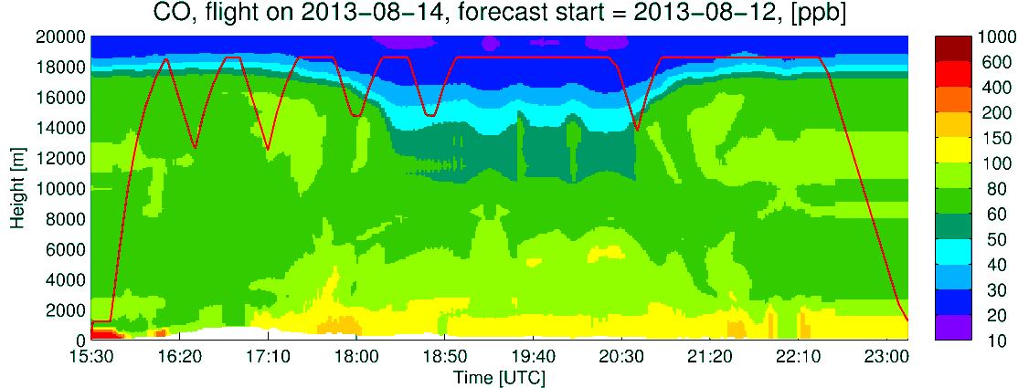
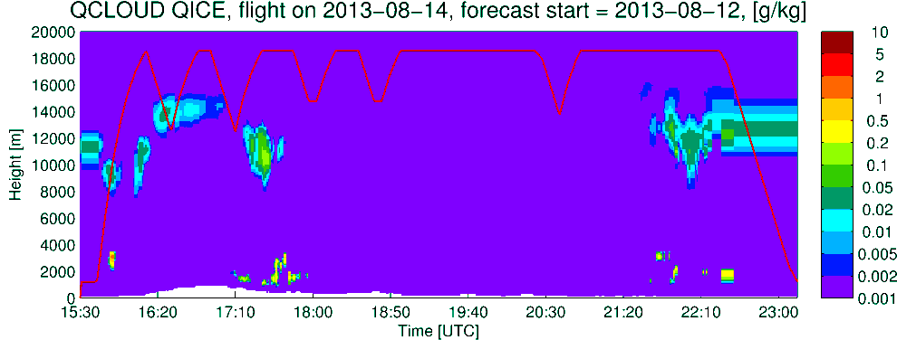
Extinction
ER2
CO US Anthro
CO Fires
CO total
Q_CLOUD

Slide 11
Summary
Urban plumes are south of cities
High isoprene seen throughout region except over Mingo Aeronet site
Likely smoke streamer near TN-AL border
PBL air in upper troposphere over east Texas

