Slide 1


Flight Planning Smoke Outlook SEAC4RS 2013
Prepared: 08/05/2013
2100 hours PDT (04:00Z, 8/6)
Forecast period: Tuesday (8/6)
David Peterson
Marine Meteorology Division
Naval Research Lab - Monterey, CA

Slide 2
Bottom Line Upfront
Fire Observations:
7-8 fires in SW Oregon and Northern California, several are still growing in size
Aspen fire is still burning in the Sierra (Fresno County)
Key Forecasting Points (Tuesday 8/6):
Oregon/California fire activity is expected to persist
Favorable fire weather conditions for growth
Potential for off-shore smoke transport is increasing!
Low clouds likely present over land in SW Oregon in the morning hours
Stratus deck likely to persist through early afternoon!
Little change in the meteorological conditions from the previous forecast
Slight chance of isolated convection near the end of the flight in north CA/OR
Smoke Predictions (Tuesday 8/6):
SW Oregon/N California: lower concentrations before ~18Z, increasing throughout the afternoon hours
Sierra Nevada: Aspen fire smoke will still be present

Slide 3
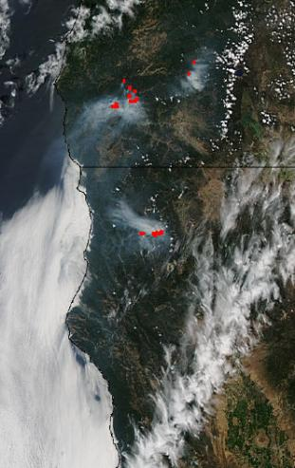
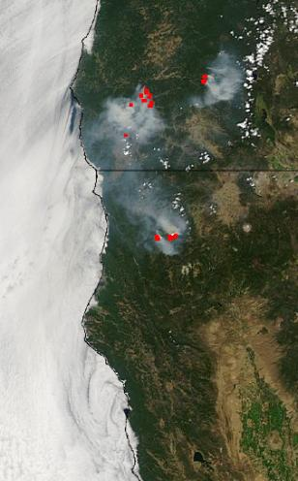
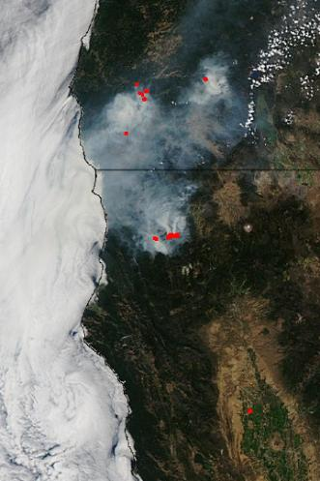
Fire Trends (Past 48 hrs)
Aqua MODIS: ~1430 PDT Saturday
Fires reinvigorated, and smoke is present over stratus!
Aqua MODIS: ~1430 PDT Sunday
Similar fire/smoke setup as Saturday, but more stratus!
Aqua MODIS: ~1430 PDT Monday
Similar fire/smoke setup as Sunday…
Smoke and stratus
Smoke &
stratus
Smoke &
stratus

Slide 4
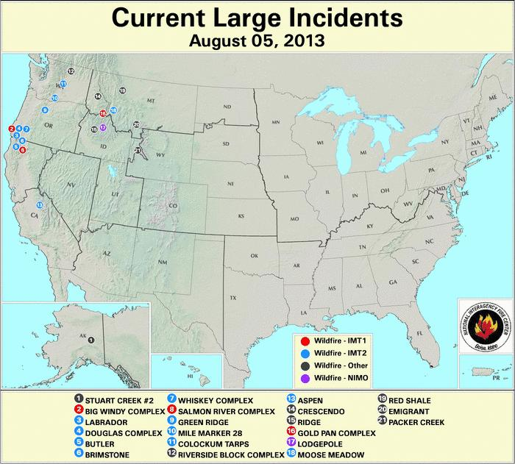
Current Fire Activity

Slide 5
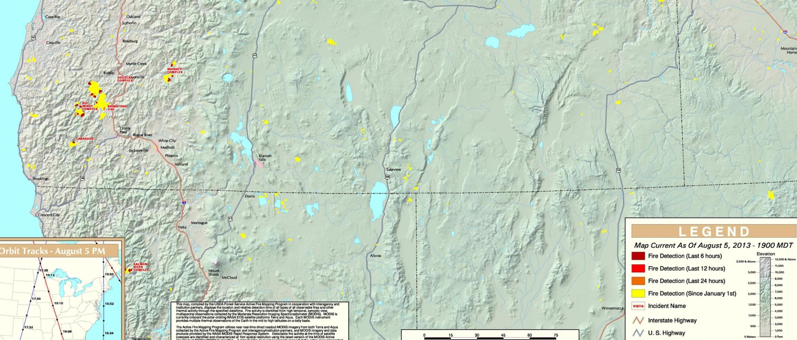
Fire Trends (Past 24 hrs, OR)
Fires grew again on Monday! At least 4 are still active and producing smoke!
At least 3 of the fires were started by lightning in remote regions
Two of the fires are now partially contained
Name | St. | Size (Acres) | 24-hr Increase | Contained?
Big Windy Complex | OR | 7499 | 22% | Expected Sep. 1st
Whisky Complex | OR | 6245 | 12% | 25%
Labrador | OR | 2020 | 0% | unknown
Brimstone | OR | 2372 | 3% | 80%
Douglas Complex | OR | ? | ? | ?

Slide 6
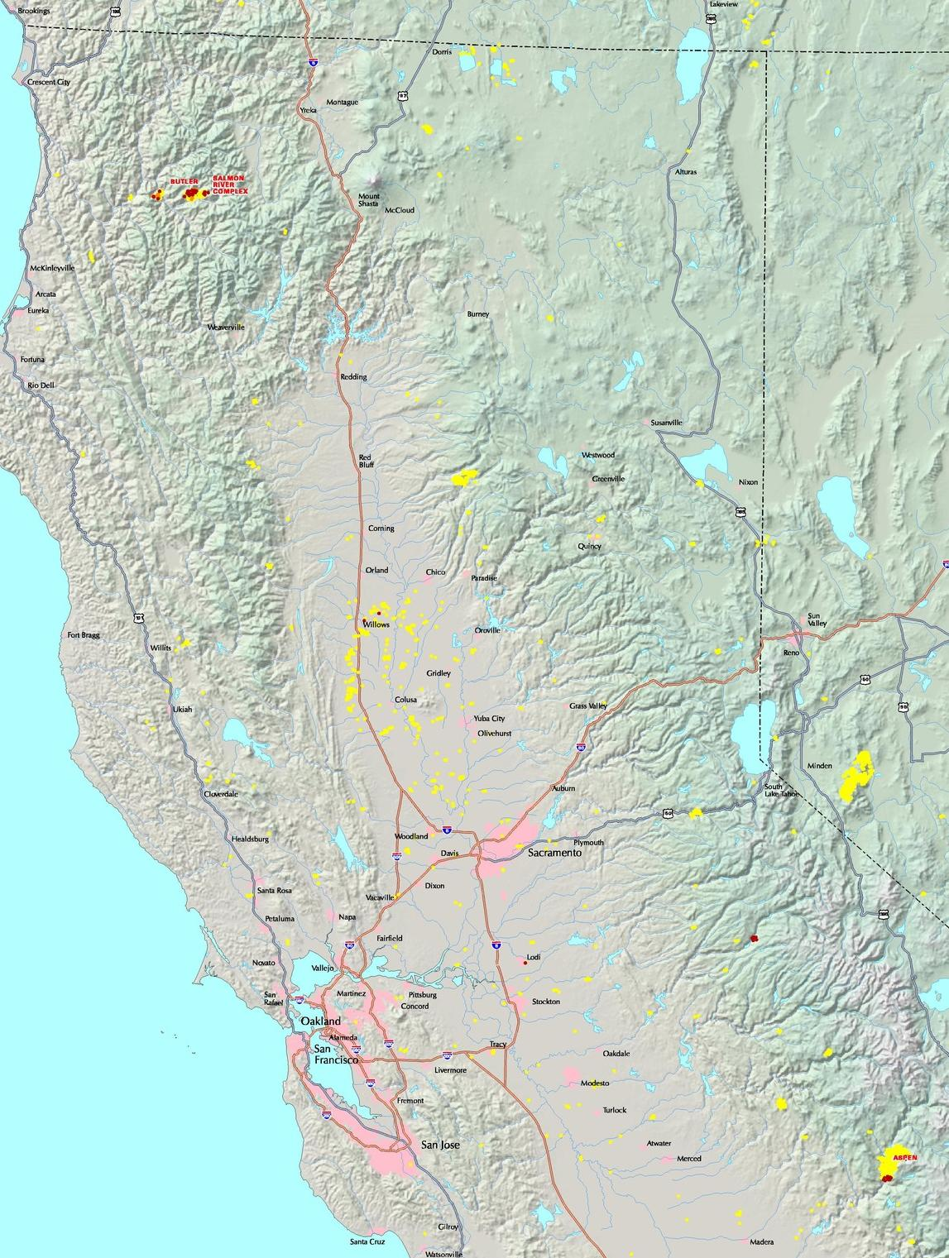
Fire Trends (Past 24 hrs, CA)
Aspen Fire continues to burn, but is partially contained
Expect steady or decreasing smoke output
Dance fire in northern CA is now contained, no MODIS fire pixels
The Butler and Salmon River fires are growing and producing lots of smoke!
Name | St. | Size (Acres) | 24-hr Increase | Contained?
Aspen | CA | 20252 | 7% | 60%
Dance | CA | 577 | 0% | 100%
Butler | CA | 1500 | 59% | 3%
Salmon River | CA | 3547 | 77% | 5%

Slide 7
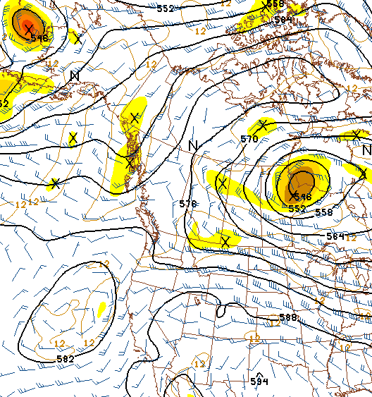
Synoptic Pattern
8/6/13, 0000Z
The previously observed Rex Blocking Pattern (high over low) is beginning to break down
The expected cutoff low has now formed off the coast of Northern CA!
Location of low is about what we expected
Primary forecast issues:
Lifting from upper level low can yield a higher but uniform deck.
Possibility of occasional higher clouds traversing the region
Isolated convection Tuesday afternoon?
H
L

Slide 8
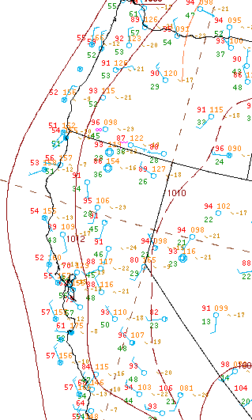
Surface Conditions
8/6/13, 0122Z
Oregon and Northern California Fires:
Cloud cover is typical in the morning hours.
Since Thursday, clouds (over land) burned off each afternoon. Fire weather conditions were more favorable (lower RH/higher temps) each day (Saturday-Monday).
Tuesday (8/6)…
Some clouds in the morning, then clearing, warming, and drying in the afternoon

Slide 9
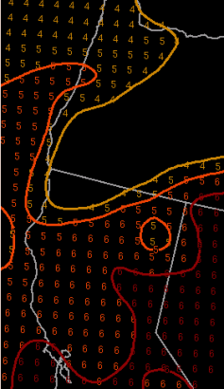
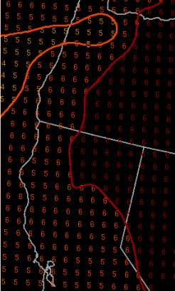
Fire Weather Conditions
Overall, moderate to high fire danger in SW Oregon and Northern CA on Monday, depending on elevation
Fire danger consistently moderate to high in the Sierra
Tuesday (8/6)…
Expect the fire danger to generally increase during the afternoon hours in SW Oregon and North CA!
Persistence is probably a good forecast.
The big issue is the potential impacts from the cutoff low (located offshore)
Slight chance of convection/dry lightning on Tuesday!
Haines Index
1-2: low fire danger
3-4: moderate fire danger
5-6: high fire danger
High-Elevation Haines
Mid-Elevation Haines

Slide 10
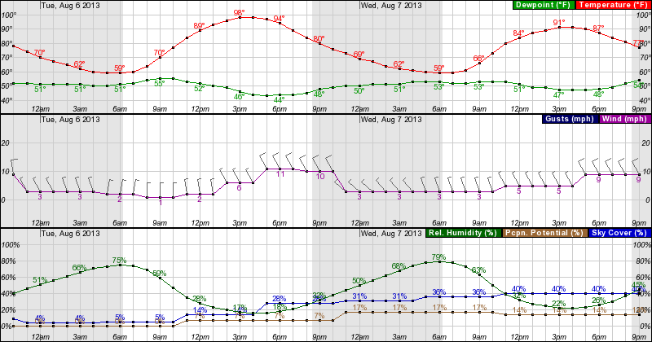
Weather Forecast: Surface
Tuesday 0000 – Wednesday 2100 PDT, near Grants Pass, OR
Fire weather conditions continue to be favorable for fire growth in the afternoon hours. Inland highs persist in the 80s and 90s.
Low RH in the afternoon, wind speed will vary with terrain
Persistent northerly wind direction, becoming NNW by evening!

Slide 11
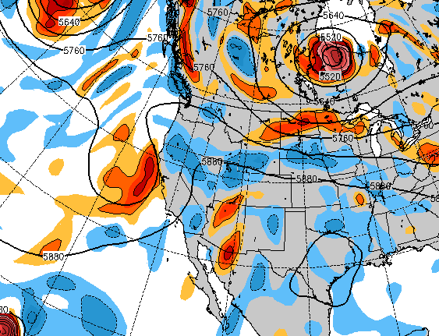
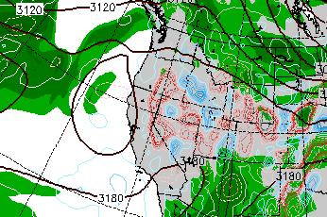
Weather Forecast: Upper Air
NAVGEM 500 mb heights/vorticity, Tuesday 18Z
Tuesday (8/6):
Most models show an upper-level low near the cost of CA/OR
Perhaps a negative tilt?
The low now reaches below 700 mb
A small amount of elevated monsoonal moisture and CAPE may reach the study region by tomorrow afternoon, but the main influx will be after the flight on Wed.-Thurs.
NAVGEM 700 mb heights/RH, Weds. 00Z

Slide 12
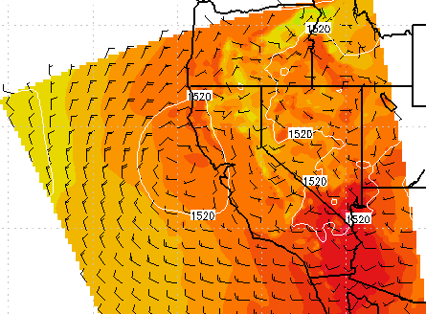

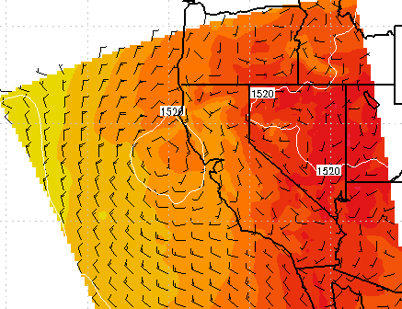
Weather Forecast: 850 mb
COAMPS 850 mb, Tues. 12Z
Tuesday (8/6):
COAMPS, GFS, NAM, and NAVGEM continue to show cyclonic flow near the OR/CA coast on Tuesday
Convergence near the coast at 18Z
Weak offshore flow seems likely
There is a good chance of off-shore smoke transport during the flight!
COAMPS 850 mb, Tues. 18Z

Slide 13
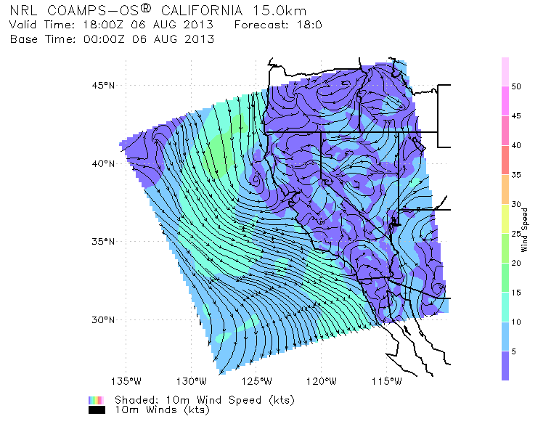
Winds and Stratus (Near-Surface)
COAMPS 10m winds, Tues. 18Z
Tuesday (8/6):
Coastal winds are expected around 5-15 kts.
Marine stratus will likely persist into the late morning and early afternoon in the study region

Slide 14
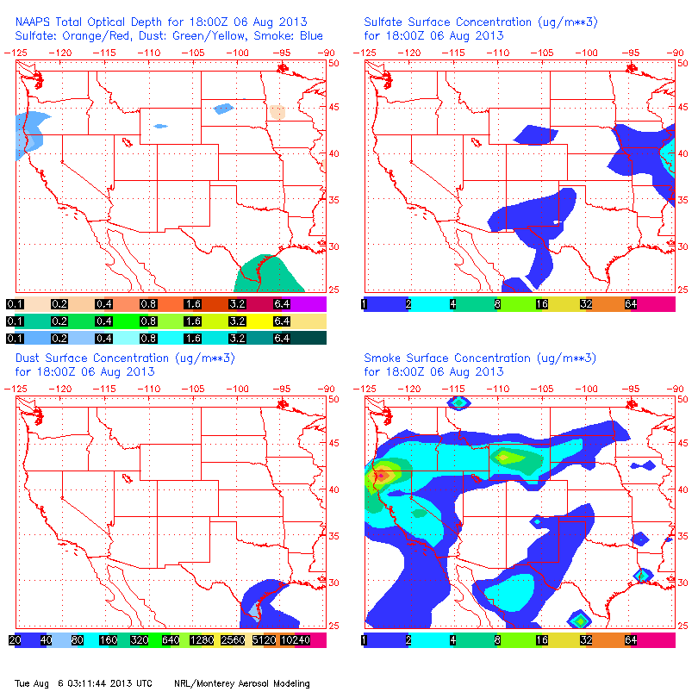
NAAPS Smoke/Aerosol Forecast
Smoke increases from late morning to evening in SW Oregon/North CA!
Smoke will be present for Tuesday’s flight!

Slide 15
Summary
Fires and smoke will generally persist on Tuesday.
Steady fire growth is likely during the afternoon hours, but explosive growth is not expected.
Low cloud cover will be present in SW Oregon during the early morning hours, marine layer should persist offshore
Smoke transport over stratus still seems likely!
Chance for convection is still there, but it will be isolated

