Slide 1


Flight Planning Smoke Outlook SEAC4RS 2013
08/04/2013
1800 hours PDT, 01:00Z (Updated 0530 PDT, 12:30Z)
Forecast period: Monday (8/5) - Tuesday (8/6)
David Peterson
Marine Meteorology Division
Naval Research Lab - Monterey, CA

Slide 2
Bottom Line Upfront
Fire Observations:
7-8 fires in SW Oregon and Northern California, 3-4 in Idaho/Montana
Several newer fires in northern CA!
Aspen fire is still burning in the Sierra (Fresno County)
Key Forecasting Points (Tuesday 8/6):
Oregon/California fire activity is expected to persist, but some fires may be contained
Potential for off-shore smoke transport is increasing!
Low clouds likely present over land in SW Oregon in the morning hours
Stratus deck now looks more likely to persist through early afternoon!
Best time to sample Oregon fires is 10AM-5PM PDT (17Z-00Z), when fire activity is building, but broken cloud cover is still present. Earlier is better for smoke over clouds, later is better for a well defined plume.
Smoke Predictions (Saturday 8/3 - Tuesday 8/6):
SW Oregon/N California: low concentrations before ~18Z, increasing throughout the afternoon hours each day.
Sierra Nevada: Aspen fire smoke output will slowly decrease through the period
Idaho/Montana: possible backup option, but smoke output will slowly decrease

Slide 3
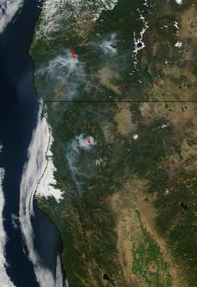
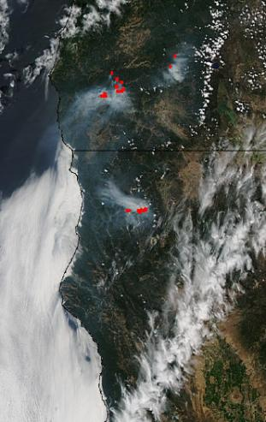
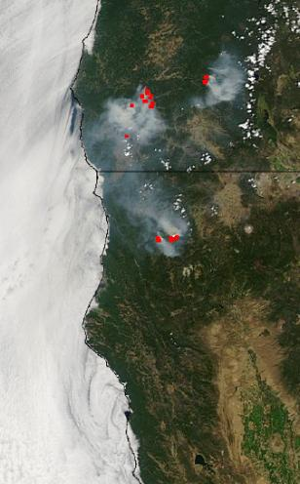
Fire Trends (Past 48 hrs)
Terra MODIS: ~1130 PDT Fri.
As expected, Oregon clouds broke earlier on Friday and marine layer mixed out
Aqua MODIS: ~1430 PDT Saturday
Fires reinvigorated, and smoke is present over stratus!
Aqua MODIS: ~1430 PDT Sunday
Similar fire/smoke setup as Saturday, but more stratus!
Smoke and stratus
Smoke &
stratus
Smoke
Smoke
Smoke was near the coast!

Slide 4
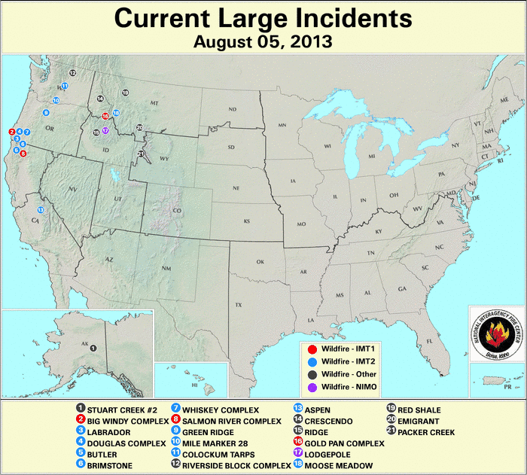
Current Fire Activity

Slide 5
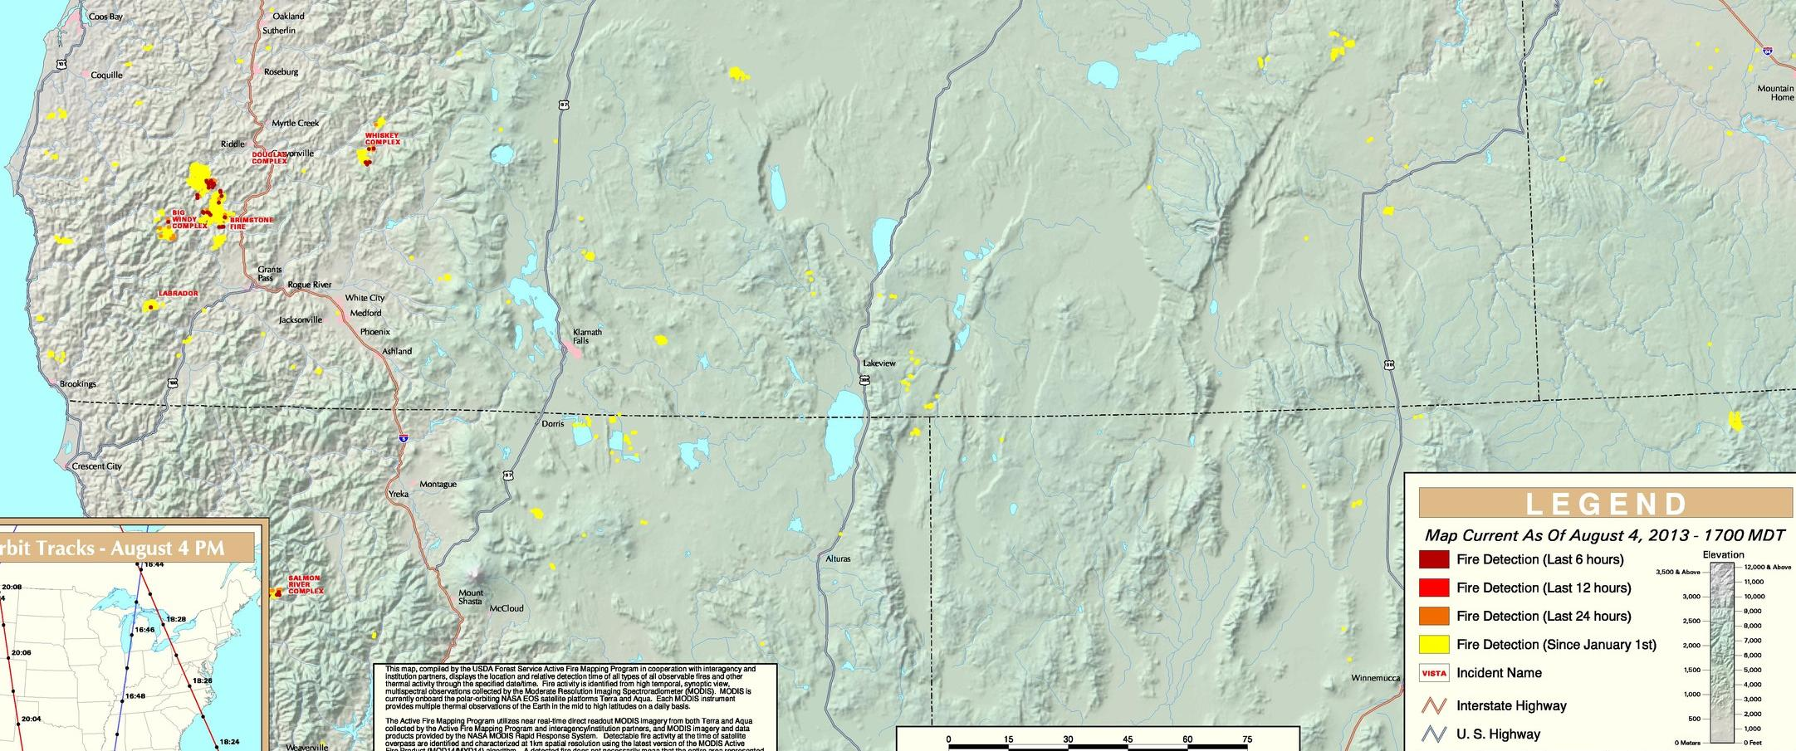
Fire Trends (Past 24 hrs, OR)
Fires grew again Friday - Sunday! At least 4 are still active and producing smoke!
At least 3 of the fires were started by lightning in remote regions
Two of the fires are now partially contained
Name | St. | Size (Acres) | 24-hr Increase | Contained?
Big Windy Complex | OR | 7499 | 22% | Expected Sep. 1st
Whisky Complex | OR | 6245 | 12% | 25%
Labrador | OR | 2020 | 0% | unknown
Brimstone | OR | 2372 | 3% | 80%
Douglas Complex | OR | ? | ? | ?

Slide 6
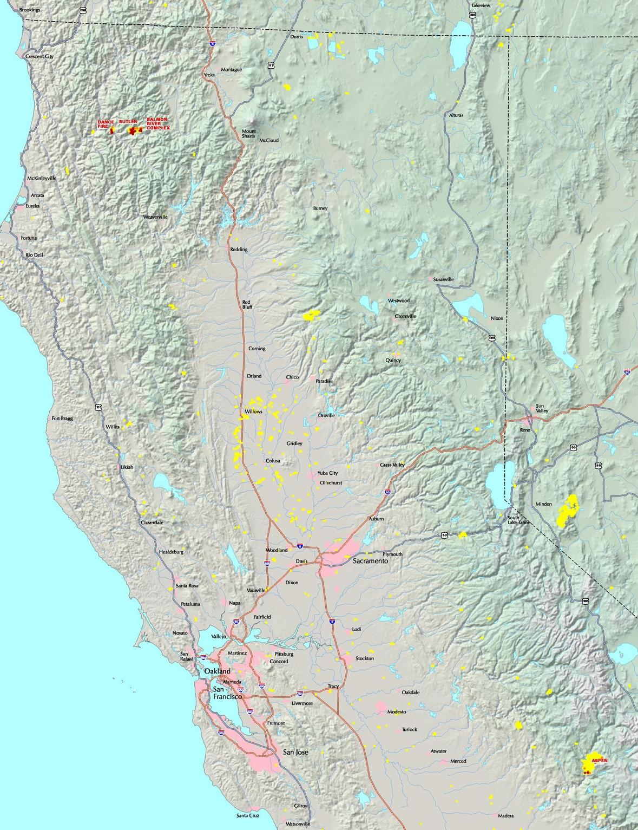
Fire Trends (Past 24 hrs, CA)
Aspen Fire continues to burn, but is partially contained
Expect steady or decreasing smoke output
Dance fire in northern CA is now contained
The newer Butler and Salmon River fires are producing lots of smoke!
Name | St. | Size (Acres) | 24-hr Increase | Contained?
Aspen | CA | 20252 | 7% | 60%
Dance | CA | 577 | 0% | 100%
Butler | CA | 1500 | 59% | 3%
Salmon River | CA | 3547 | 77% | 5%

Slide 7
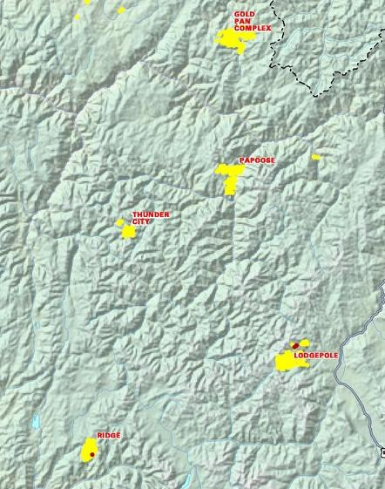
Fire Trends (Past 24 hrs, ID/MT)
Idaho is a potential backup option…
2-3 large fires are burning, but they are at least partially contained.
A few smaller fires exist, but they are nearly extinguished.
OR/CA fires seem like a better option?
Name | St. | Size (Acres) | 24-hr Increase | Contained?
Ridge | ID | 5270 | ? | 48%
Lodgepole | ID | 20325 | <1% | 40%
Gold Pan | ID | ? | ? | ?
Moose Meadow | MT | 3500 | 0% | 60%

Slide 8
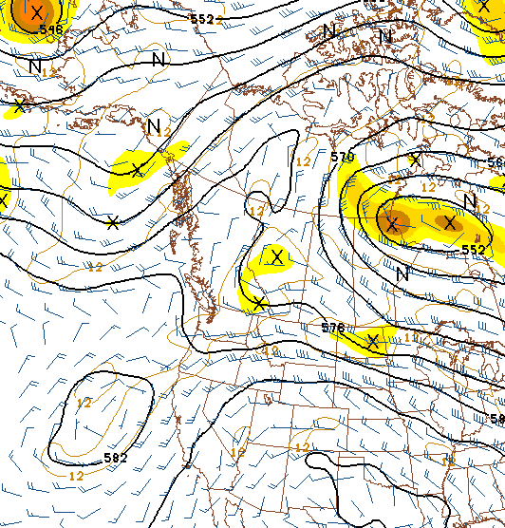
Synoptic Pattern
8/5/13, 0600Z
A Rex Blocking Pattern (high over low) is currently in place, and becoming sheared!
The trough will continue to become stretched (or sheared) during the forecast period.
NAM, GFS, and NAVGEM now show the expected closed low off the coast of OR/CA.
Primary forecast issues:
Lifting from upper level low can yield a higher but uniform deck.
Possibility of occasional higher clouds traversing the region
If the low stays well offshore, conditions will be better for status
Possible erratic upper-level winds near the end of the forecast period
Isolated convection Tuesday afternoon?
H
L

Slide 9
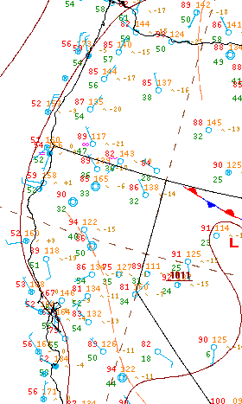
Surface Conditions
8/4/13, 21:00Z
Oregon and Northern California Fires:
Cloud cover is typical over in the morning hours.
Since Thursday, clouds (over land) burned off each afternoon. Fire weather conditions were more favorable on Friday (lower RH/dew points), and even better on Saturday-Sunday.
The potential for dry lightning has diminished across the region, at least for now.
Monday (8/5) –Tuesday (8/6)…
Cloudy in the morning, then clearing, warming, and drying in the afternoon
Upper-level SW flow is likely to develop by Monday afternoon due to the upper-level low located offshore
Some monsoonal moisture many be advected into the area
Potential for elevated convection and dry lightning increases again on Tuesday!

Slide 10
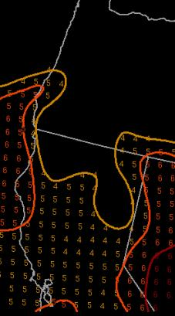
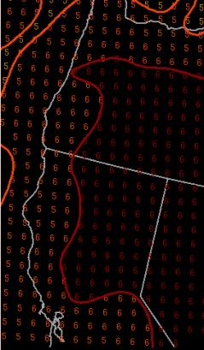
Fire Weather Conditions
Overall, moderate to high fire danger in SW Oregon and Northern CA on Saturday and Sunday afternoon
Fire danger consistently moderate to high in the Sierra
Monday (8/5) –Tuesday (8/6)…
Expect the fire danger to generally increase during the afternoon hours in SW Oregon and North CA!
Persistence is probably a good forecast.
The big issue is the potential impacts from a cutoff low (located offshore) later in the period!
More favorable dry lightning conditions?
Increased instability/CAPE?
Haines Index
1-2: low fire danger
3-4: moderate fire danger
5-6: high fire danger
High-Elevation Haines
Mid-Elevation Haines

Slide 11
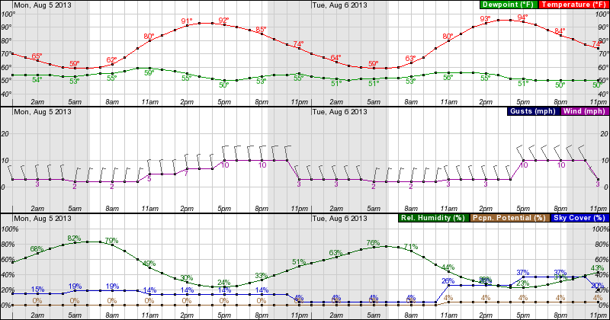
Weather Forecast: Surface
Monday 0000 – Tuesday 2300 PDT, near Grants Pass, OR
Fire weather conditions are generally favorable for fire growth in the afternoon hours each day. Inland highs persist in the 80s and 90s.
Low RH in the afternoon, wind speed will vary with terrain
Persistent northerly wind direction!

Slide 12
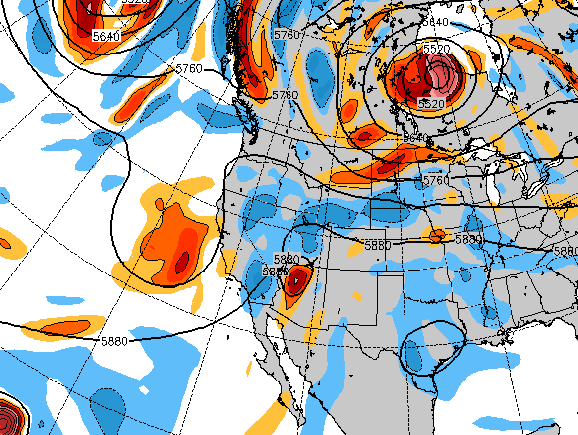
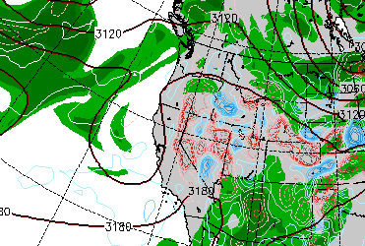
Weather Forecast: Upper Air
NAVGEM 500 mb heights/vorticity, Tuesday 18Z
Tuesday (8/6):
Most models show an upper-level low (cutoff) near the cost of CA/OR
The formation of the cutoff is delaying a bit in some runs.
The low now reaches below 700 mb
Some monsoonal moisture appears to reach Oregon via southerly flow
Enhanced rising motion is present by evening
There is a slight chance for elevated convection and dry lightning! It will be isolated.
NAVGEM 700 mb heights/RH, Weds. 00Z

Slide 13
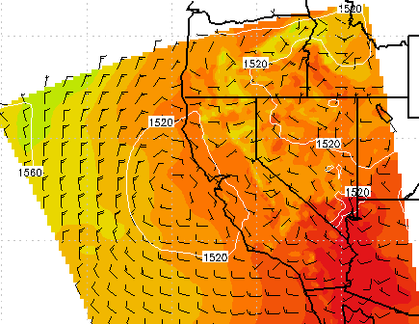
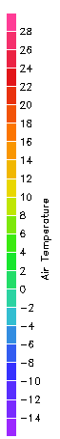
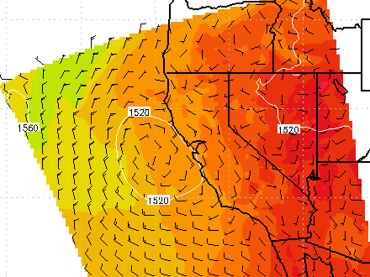
Weather Forecast: 850 mb
COAMPS 850 mb, Tues. 12Z
Tuesday (8/6):
COAMPS, GFS, NAM, and NAVGEM develop cyclonic flow off the OR/CA coast by 12Z Tuesday
Convergence near the coast at 18Z
Weak offshore flow seems possible
There is an increasing chance of off-shore smoke transport near the CA/OR border!
The exact position of the low will be critically important!
COAMPS 850 mb, Tues. 18Z

Slide 14
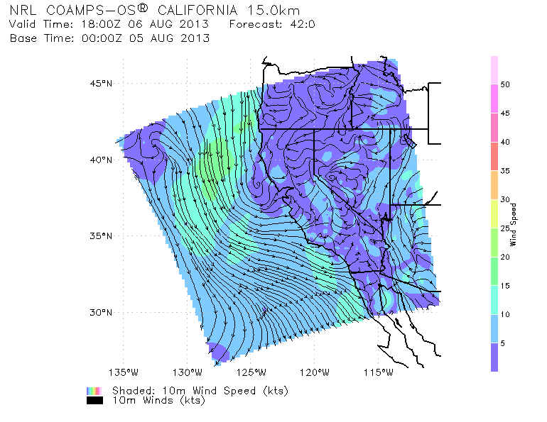
Winds and Stratus (Near-Surface)
COAMPS 10m winds, Tues. 18Z
Tuesday (8/6):
Coastal winds are expected around 5-15 kts.
Weaker winds than the previous runs
Marine stratus may persist into the late morning hours
NAVGEM and GFS also have relatively weak winds on Tuesday

Slide 15
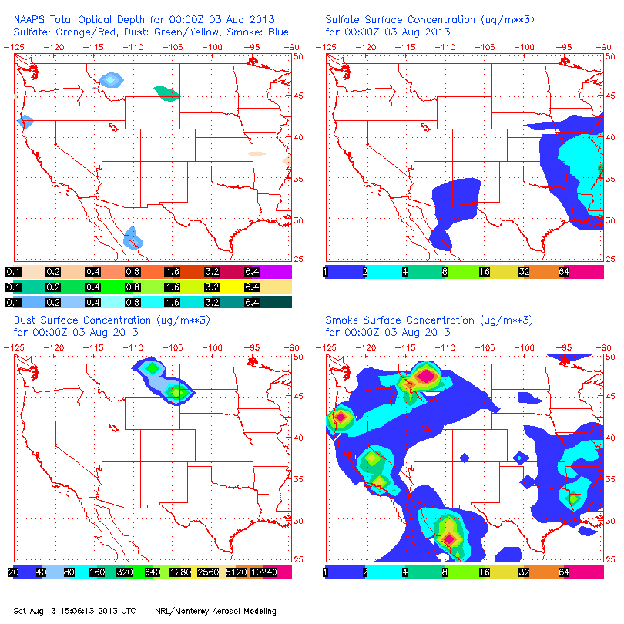
NAAPS Smoke/Aerosol Forecast
Smoke increases from late morning to evening in SW Oregon/North CA each day!
Smoke concentrations generally persist near the Aspen Fire (CA).
Idaho smoke output seems too high!
While this seems to indicate smoke will be present through Tuesday, other factors may impact the forecast…
Containment of older fires
Potential for new ignitions
Major changes in weather conditions, which seems unlikely at this time
View slideshow for loop!!!

Slide 16
Summary
Fires and smoke will generally persist through Tuesday.
Steady fire growth is likely during the afternoon hours, but explosive growth is not expected.
Low cloud cover will be present in SW Oregon during the morning hours each day, marine layer should persist offshore
850 mb winds may shift to the NNE on Tuesday due to an off-shore (cut-off) cyclone.
Large scale smoke transport over open ocean seems more likely!
Chance for convection increases through the forecast period

