Slide 1


Flight Planning Smoke/Aerosol Outlook
SEAC4RS 2013
Prepared: 08/19/2013
0800 hours CDT (13:00Z)
Forecast period: Wednesday (8/21)
David Peterson
Marine Meteorology Division
Naval Research Lab - Monterey, CA

Slide 2
Bottom Line Upfront
Fire Observations:
  Large fires continue to burn in the Western CONUS
  Small fires have been observed in the SEUS
Key Forecasting Points (Wednesday 8/21)
  Synoptic flow (e.g. at 500 hPa) becomes zonal along the Canadian border, but an upper-level low may develop in over the OH Valley.
  Smoke may be transported quickly to the east, but may also be trapped in the central CONUS
Smoke Predictions (Wednesday 8/21):
  Western fires: both new and older smoke will still be present on Wednesday!
  SEUS: A few small fire are possible each day, but large-scale smoke transport is not expected.

Slide 3
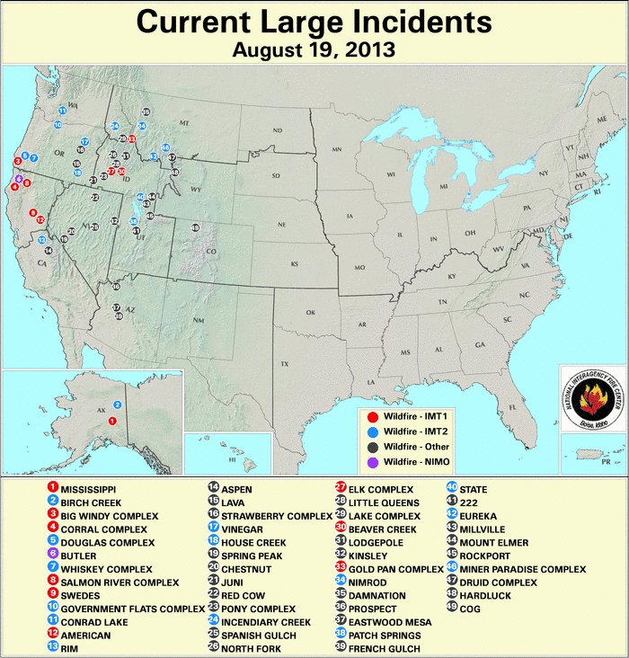
Current Fire Activity
Several ongoing large fires and recent pyroconvection
Many new fires!
Large-scale smoke transport is still occurring…
A few small fires have been observed in the SEUS..

Slide 4
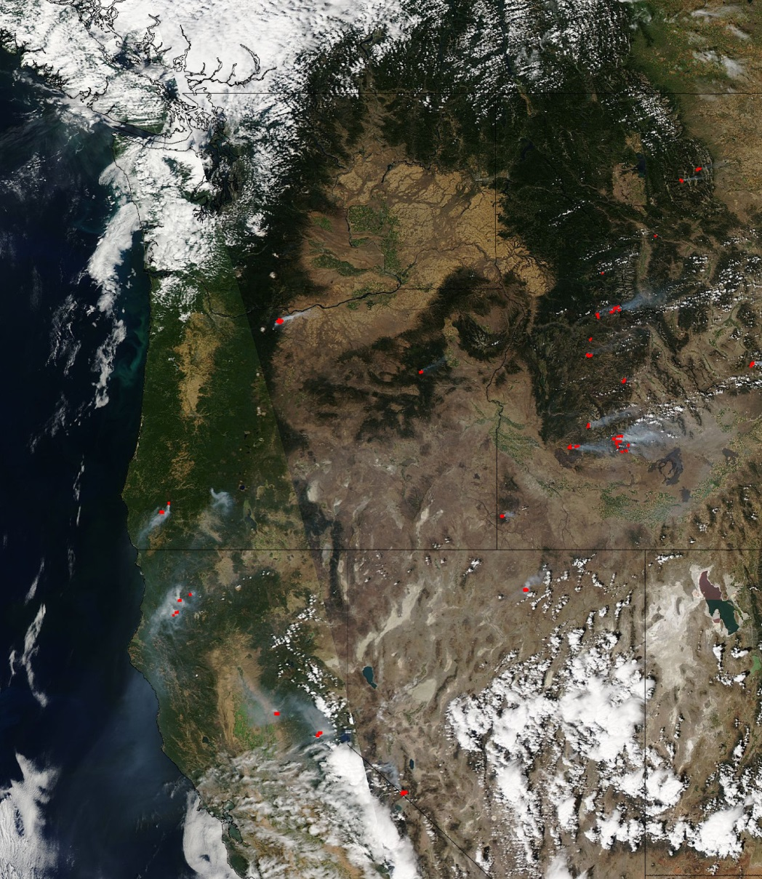
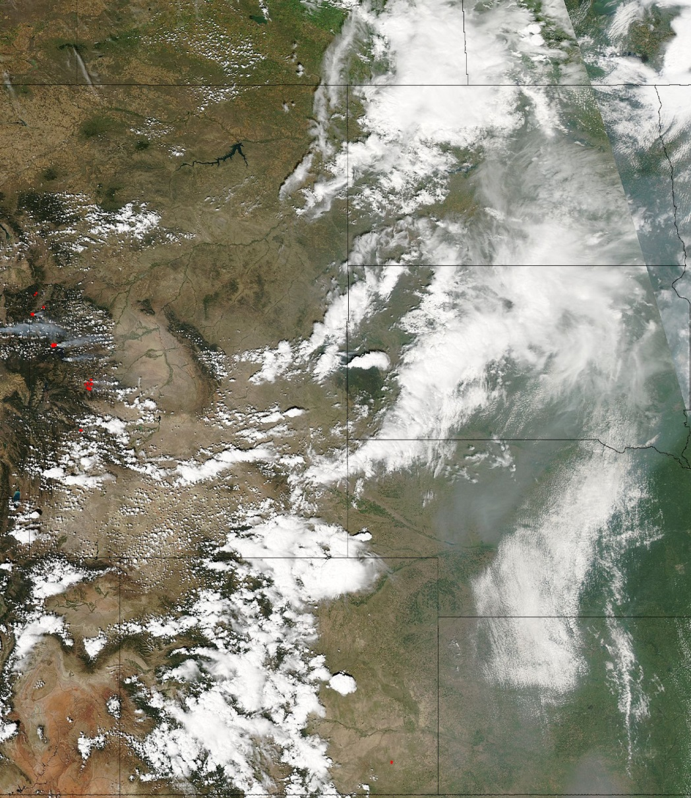
Aqua MODIS Sunday (8/18)
Smoke

Slide 5
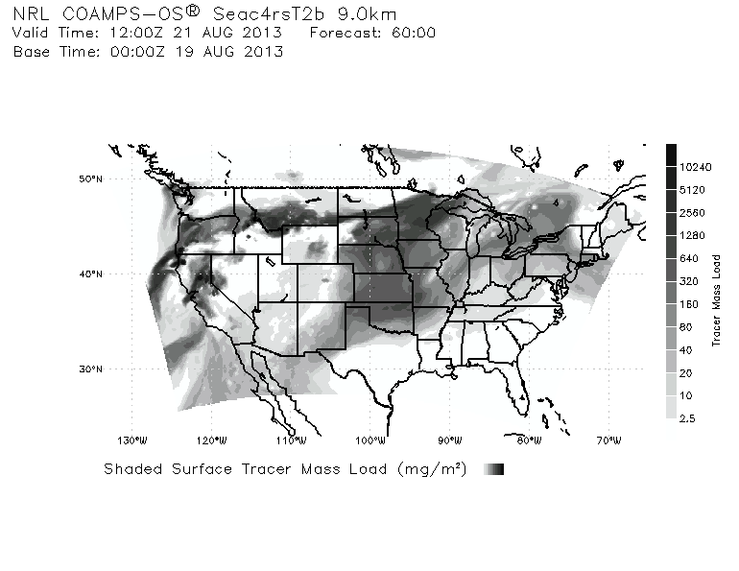
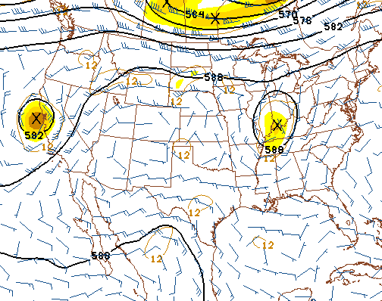
Smoke Forecast
Some models are developing an upper-level low over the OH Valley.
More smoke trapped in the central CONUS?
NAM 500 hPa, 18Z, 8/21

Slide 6
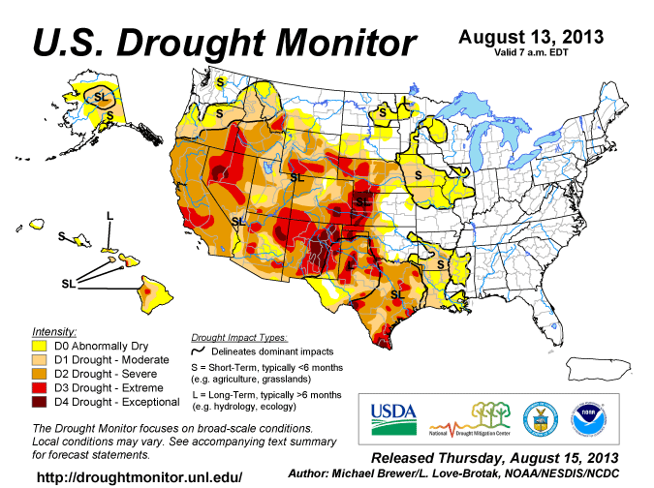
Drought Conditions

Slide 7
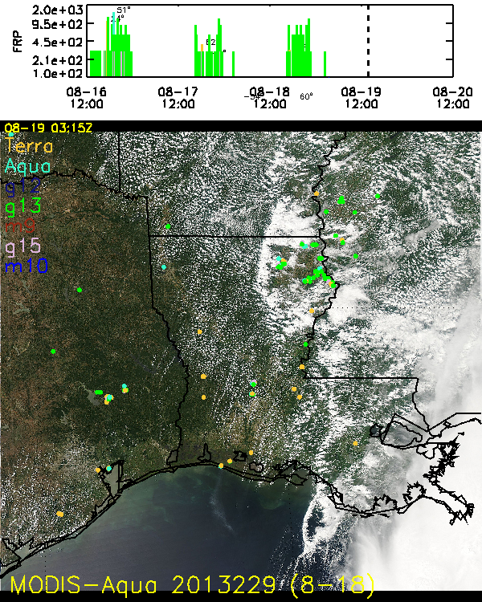
SEUS Satellite Fire Timeline
Backdrop is Sunday’s MODIS-Aqua image
A few small fires each day
Observed better by GOES
Short duration fires
Nothing at night
Occasional cloud cover obscures fire observations!
Very little smoke output!

Slide 8
Summary
Large fires will still be burning in the western CONUS
Small fires are possible in MS, AR, LA, and TX
Much of the western smoke will be transported quickly to the east in zonal flow.
Older smoke (and some new smoke) may be trapped in the Central CONUS due to a developing upper-level low?

