Slide 1


Flight Planning Smoke/Aerosol Outlook
SEAC4RS 2013
Prepared: 08/19/2013
0800 hours CDT (13:00Z)
Forecast period: Monday (8/19)
David Peterson
Marine Meteorology Division
Naval Research Lab - Monterey, CA

Slide 2
Bottom Line Upfront
Fire Observations:
  Large fires continue to burn in ID, WY, UT, NV, and MT
  The primary focus is still Idaho!
Key Forecasting Points (Monday 8/19)
  Smoke is likely to be present in the flight plan region!
  High clouds east of the flight path this morning, but keeping an eye on WY this afternoon.
Smoke Predictions (Monday 8/19 and beyond):
  Western fires: High smoke concentrations, higher altitude injections, and large-scale transport will continue through Monday!
  A pattern change may alter the smoke transport direction later in the week!

Slide 3
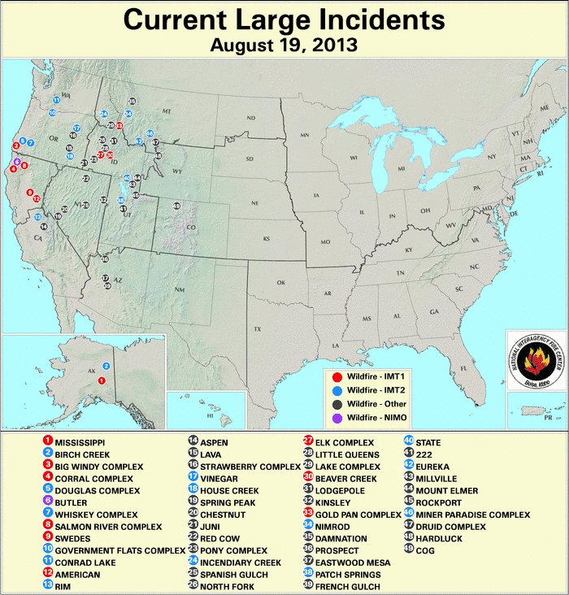
Current Fire Activity
Several ongoing large fires and recent pyroconvection
Many new fires!
Large-scale smoke transport is still occurring…

Slide 4
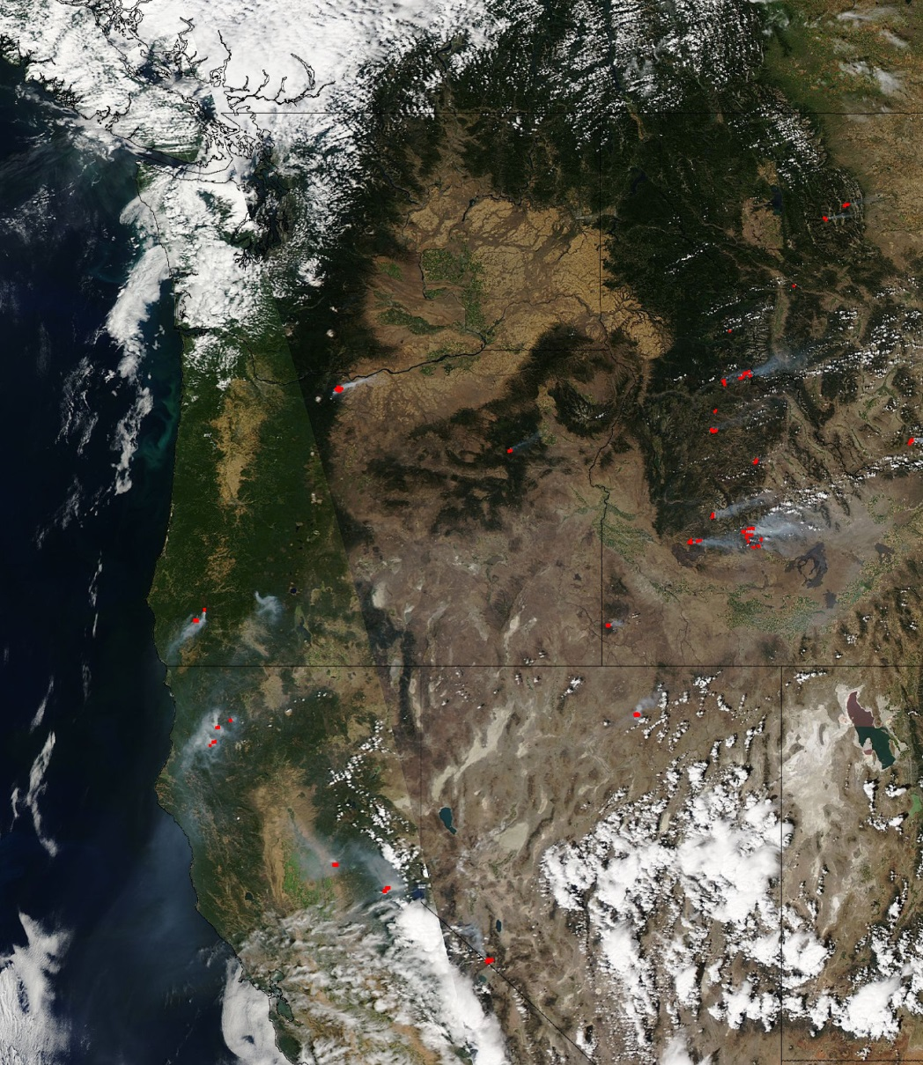
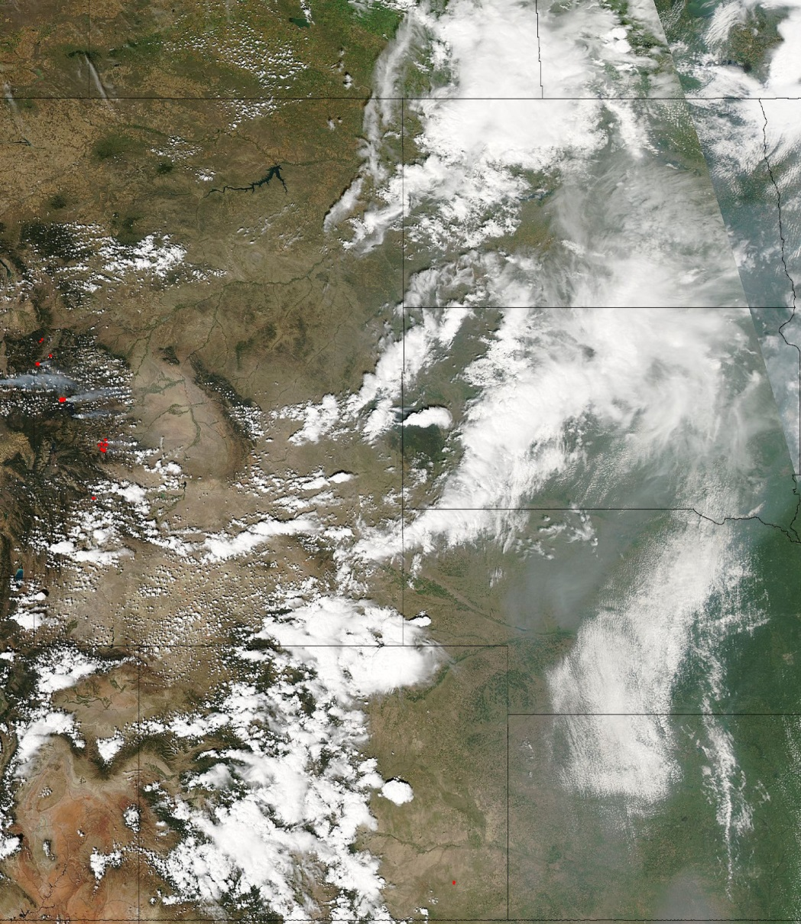
Aqua MODIS Sunday (8/18)
Smoke

Slide 5
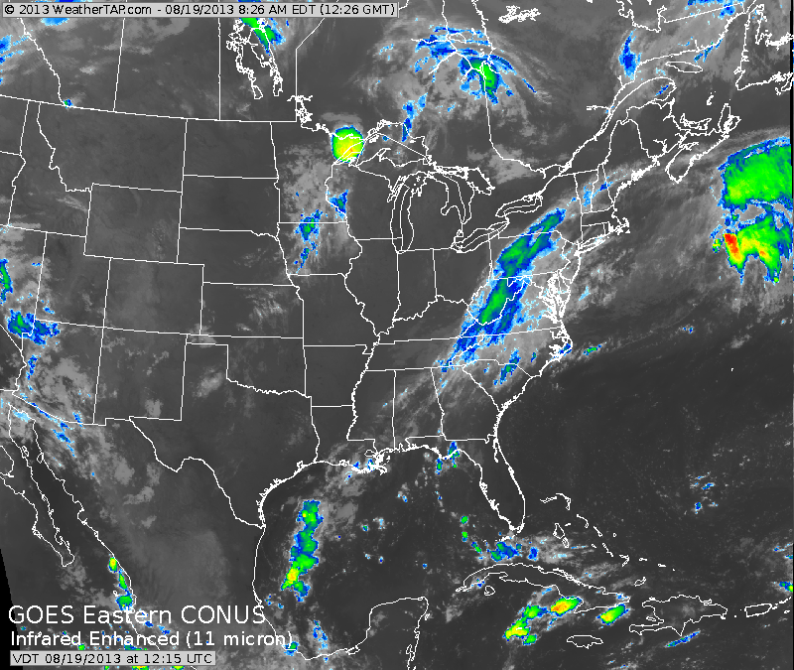
Current Cloud Cover

Slide 6
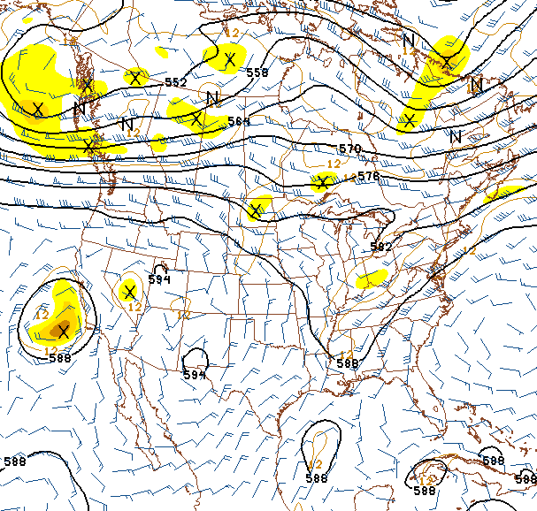
Current Synoptic Pattern
500 hPa, 8/19/13, 0600Z
Primary forecast issues:
  Zonal flow sends thick smoke into WY, NE, and SD
  Some smoke may still be transported down the Front Range
  High clouds east of flight path this morning
Shortwave
Smoke transport
Tropical Wave

Slide 7
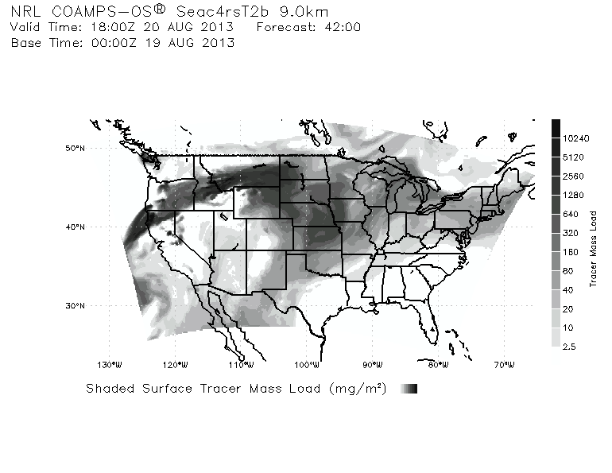
Smoke/Aerosol Forecast

