Slide 1


Flight Planning Smoke/Aerosol Outlook SEAC4RS 2013
Prepared: 08/18/2013
0800 hours CDT (13:00Z)
Forecast period: Monday (8/19)
David Peterson
Marine Meteorology Division
Naval Research Lab - Monterey, CA

Slide 2
Bottom Line Upfront
Fire Observations:
Large fires continue to burn in ID, WY, UT and MT
The primary focus is still Idaho!
Key Forecasting Points (Monday 8/19)
Fire weather conditions remain favorable for fire growth
Synoptic flow (e.g. at 500 hPa) becomes zonal along the Canadian border, but smaller ridge remains in SW CONUS.
Smoke may take two paths, affecting both the Upper Midwest and the High Plains
Nocturnal convection in the upper Midwest produces high clouds over portions of IA, MO, and possibly KS
Smoke Predictions (Monday 8/19 and beyond):
Western fires: High smoke concentrations, higher altitude injections, and large-scale transport will continue through Monday!
A pattern change may alter the smoke transport direction later in the week!

Slide 3
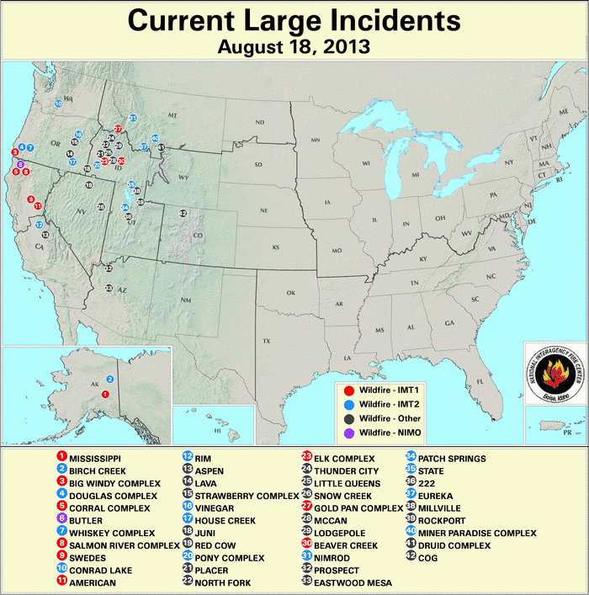
Current Fire Activity
Several ongoing large fires and recent pyroconvection
Many new fires!
Large-scale smoke transport is still occurring…

Slide 4
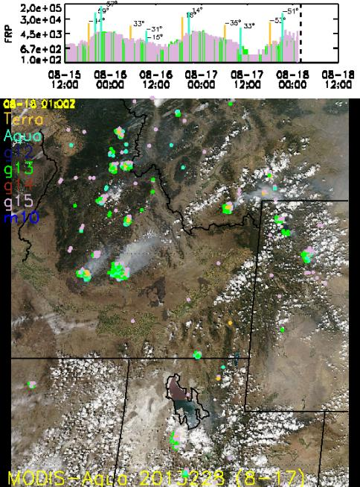
Satellite Fire Timeline
Backdrop is Saturday’s MODIS-Aqua image
Idaho complexes are still going strong
UT fires not detected for nearly 24-hrs, but ground reports indicate they are still burning
Northern fires picking up
Saturday had slightly less fire detections than Friday
There were also more clouds in the region
Still lots of smoke being released!

Slide 5
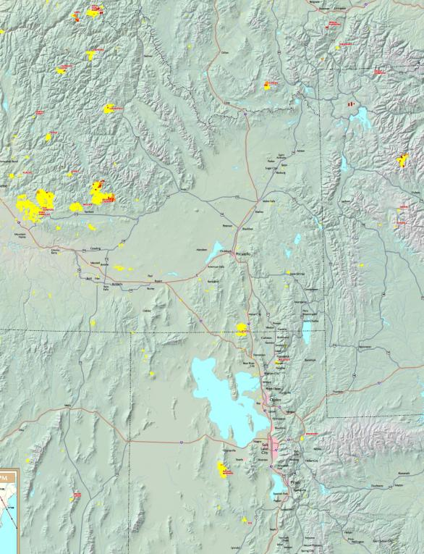
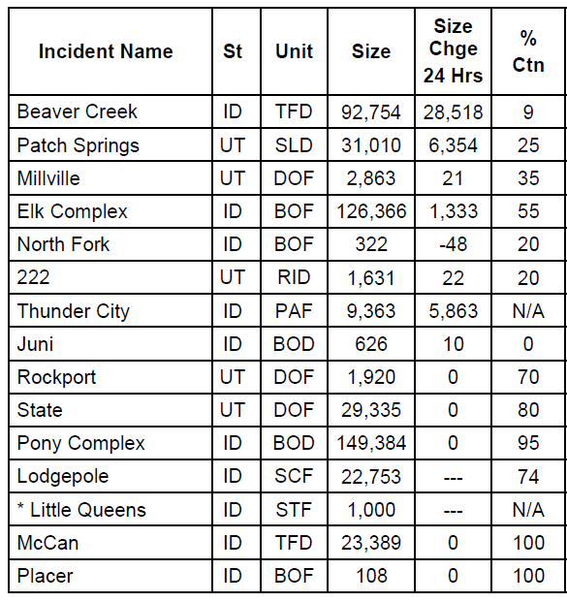
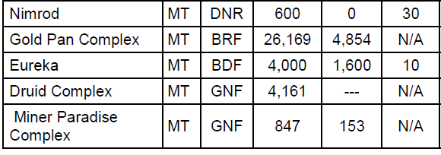
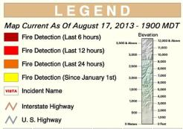
Current Fires
Past 24 hrs:
Primary smoke producers
Still burning?

Slide 6
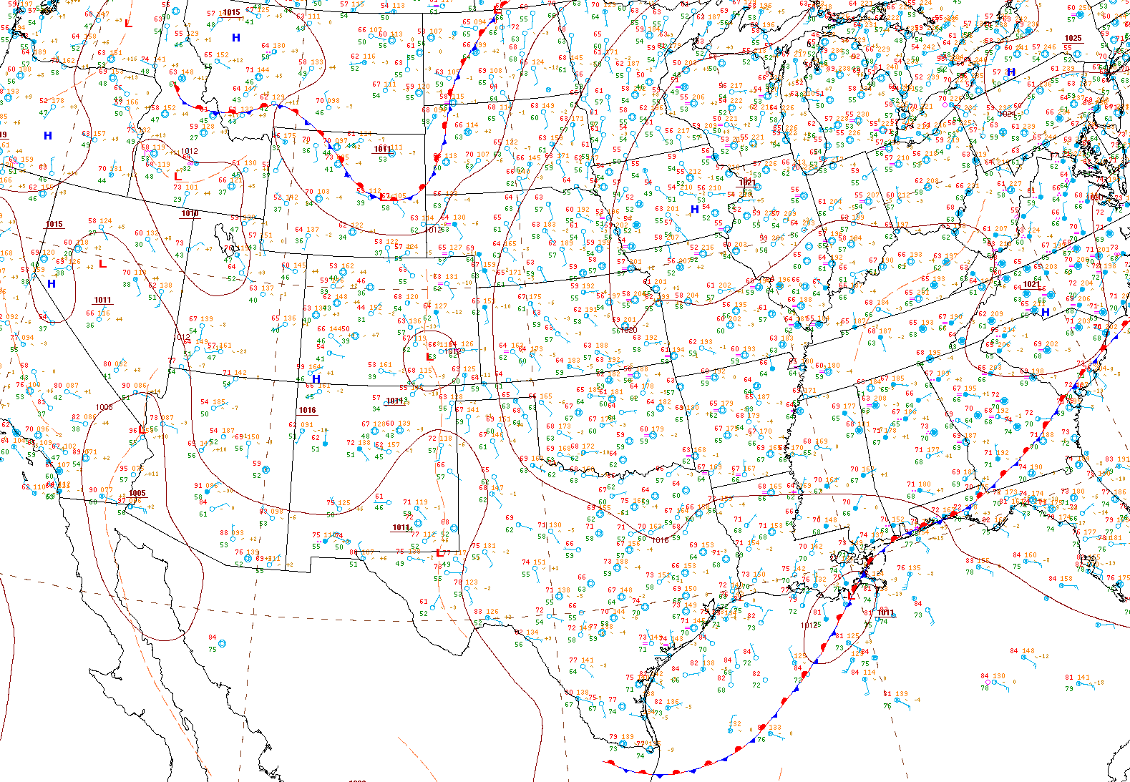
Current Surface Conditions
8/18/13, 1025Z
Developing Wave
Isolated Convection
Wind shift…
Hot and Dry
Unseasonably Cool
Key Points
Developing wave in the Dakotas
Surface wind shift in ID
Region with fires is still hot and dry, despite a West Coast trough
Heavy rain in AL, GA, SC and north FL
Heavy Rain

Slide 7
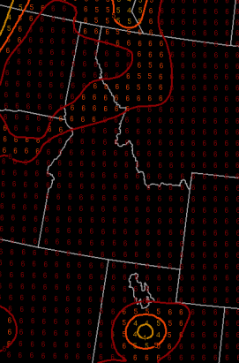
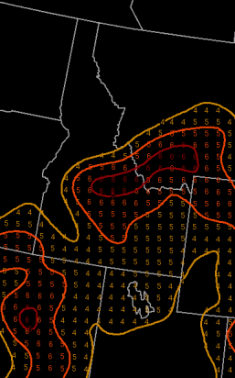
Fire Weather Conditions
Currently: high fire danger in ID, UT, WY, and MT.
Fire weather conditions reached their peak on Friday (8/16), but danger is still high.
A great deal of smoke is still being released!
Sunday – Monday (8/18 - 8/19):
Expect fire danger to decrease slightly, but still remain favorable for growth.
The Pacific trough may increase cloud cover/convection potential over the next few days
Haines Index
1-2: low fire danger
3-4: moderate fire danger
5-6: high fire danger
Mid-Elevation
High-Elevation

Slide 8
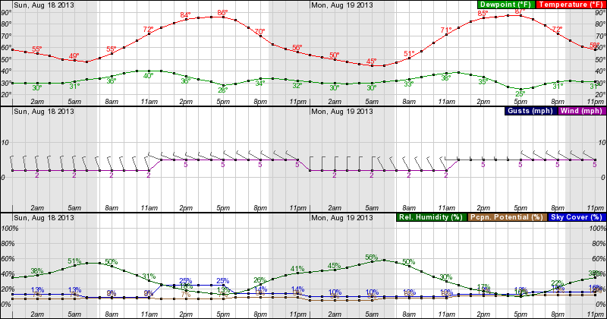
Forecast: Near the Idaho Fires
Sunday 0000 – Monday 2300 MDT, near the Beaver Creek Fire, east of Boise
Fire weather conditions will be favorable for fire growth in the afternoon hours each day. Inland highs decrease slightly, but RH values are still < 20%.
Wind direction will shift to the W, then the NW by Monday
Wind speed will vary with terrain

Slide 9
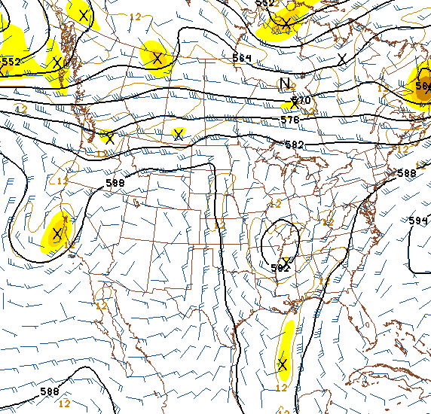
Current Synoptic Pattern
500 hPa, 8/18/13, 0600Z
Primary forecast issues:
Highly amplified pattern is starting to break down
What happens to the smoke?
Zonal flow along the Canadian border
Imbedded shortwaves and convection potential
Easterly tropical wave near the Yucatan, moving WNW
Potential for tropical development?
Shortwaves
Smoke transport
Potential tropical cyclone development?
Tropical Wave

Slide 10
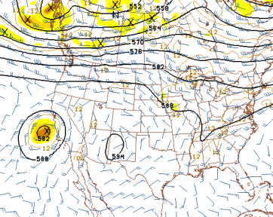
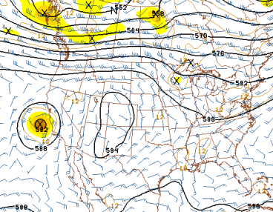
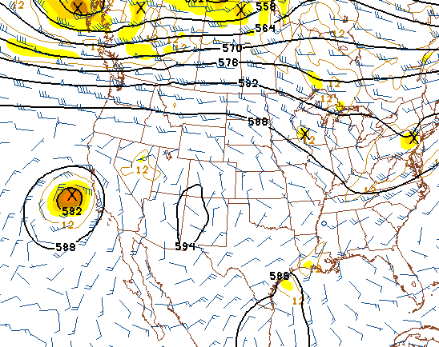
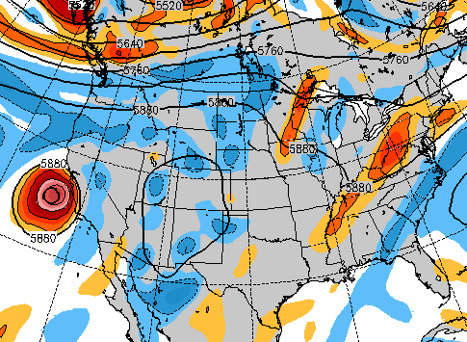
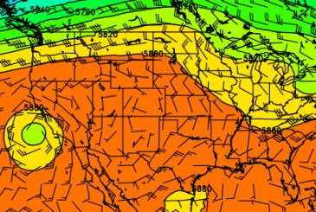
Upper-Air Forecast (500 hPa)
NAM 500 hPa, 18Z, 8/19
GFS 500 hPa, 18Z, 8/19
4 models now show general agreement
Zonal flow develops along the Canadian border
Shortwave moves into MN. Leftover debris clouds?
Smaller ridge remains in the western CONUS
Smoke will take two paths (see next slide)
Similar at 700 hPa!
Some sort of tropical disturbance near the TX Gulf Coast?
NAVGEM 500 hPa, 18Z, 8/19
EC 500 hPa, 18Z, 8/19

Slide 11
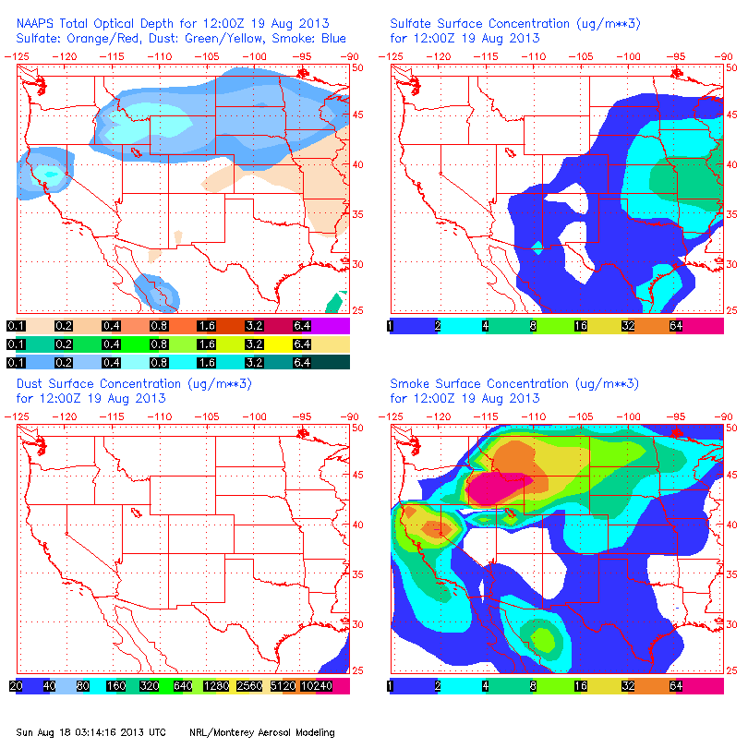
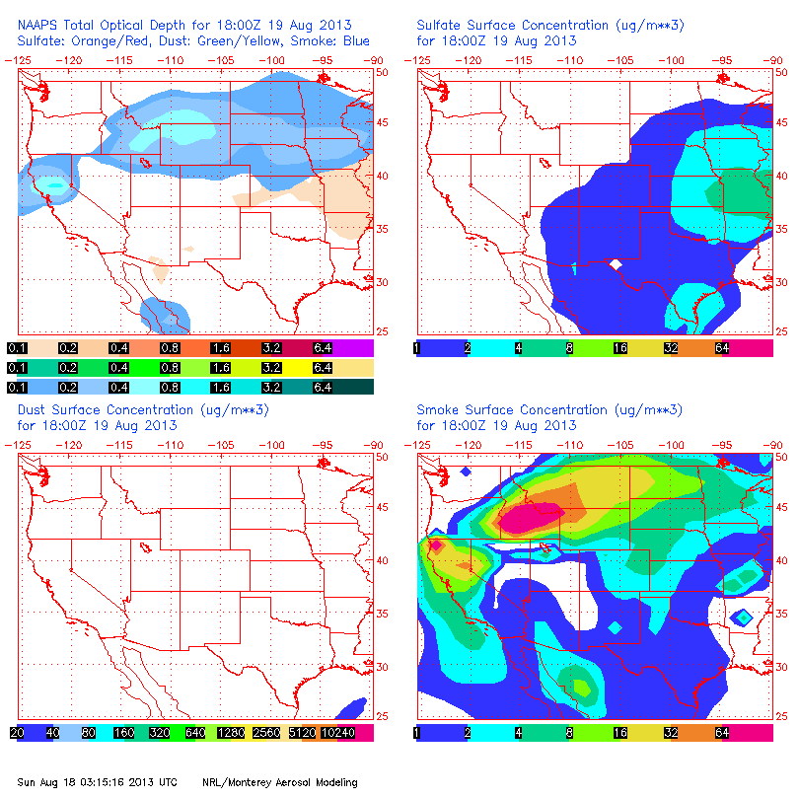
NAAPS Smoke/Aerosol Forecast
8/19, 12Z 8/19, 18Z
By Monday, a large quantity of smoke will be advected to the ESE by increasingly zonal flow, reaching into the upper Midwest/Plains.
While reduced in size, the synoptic ridge will still occupy the SW CONUS.
Therefore, some smoke will still be pulled to the south over the High Plains, around the ridge.
It is expected that a mix if new and older smoke will be present at several layers, primarily between 700 and 500 hPa.

Slide 12
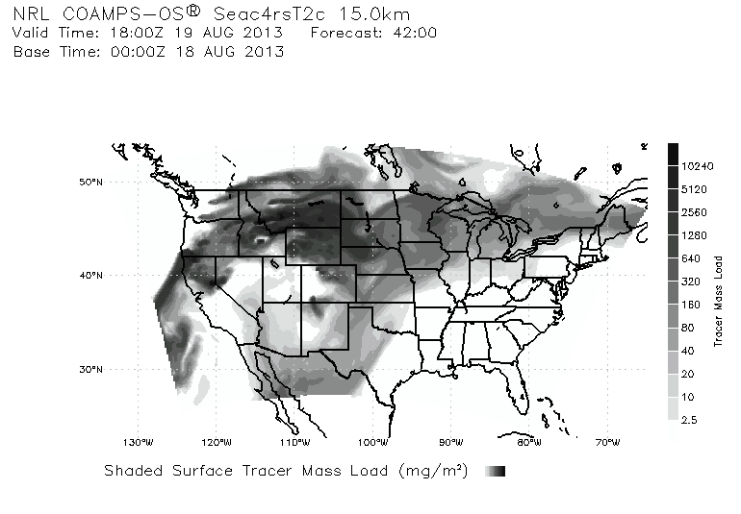
Smoke/Aerosol Forecast

Slide 13
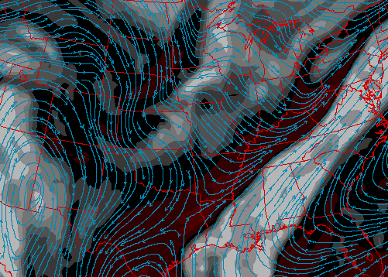
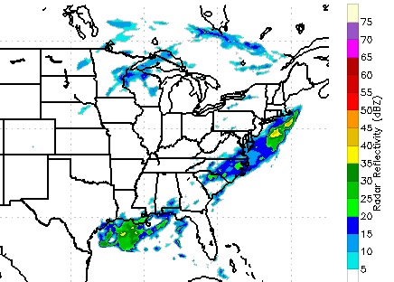
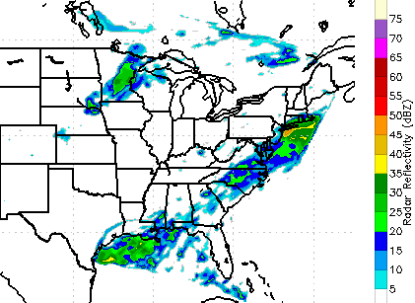
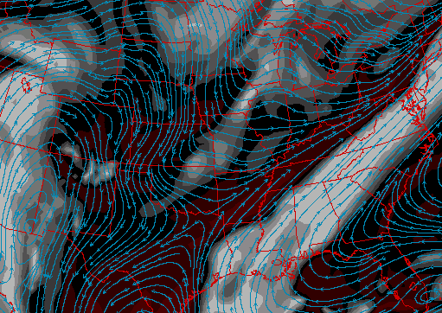
Convection and High Clouds
NAM 250 hPa RH, 12Z, 8/19
All models suggest that scattered convection or even an MCS will develop near the Canadian Border overnight.
By Monday morning, convection weakens over the Upper MS Valley.
Leftover high clouds affect portions of IA, MO and possibly even KS
COAMPS Simulated Reflectivity, 09Z, 8/19
NAM 250 hPa RH, 18Z, 8/19

Slide 14
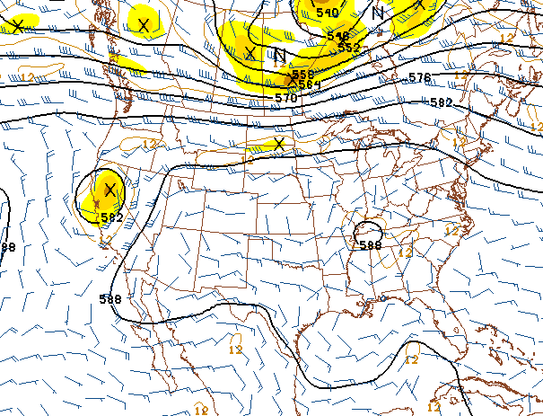
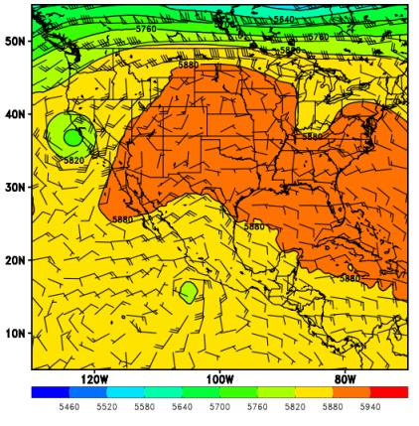
Wednesday (8/21)
The long-range forecast suggests that favorable smoke transport will be gone by Wednesday (8/21)
The ridge may finally move/build eastward, allowing warmer conditions to return to the SEUS
GFS 500 hPa, 12Z, 8/21
EC 500 hPa, 12Z, 8/21

Slide 15
Summary
Large fires will still be burning in the western CONUS, especially in Idaho
Fire weather conditions will remain favorable for growth
Large-scale smoke transport will likely continue, but may take two paths:
Into the upper Midwest due to zonal flow near the Canadian border
Into the Plains due to the persistent (but smaller) ridge in the SW CONUS
Nocturnal convection in the Upper Midwest may produce high clouds in IA, MO, and possibly eastern KS.
What impact (if any) will come from the tropics?

