Slide 1


Flight Planning Smoke/Aerosol Outlook SEAC4RS 2013
Prepared: 08/17/2013
0800 hours CDT (13:00Z)
Forecast period: Monday (8/19)
David Peterson
Marine Meteorology Division
Naval Research Lab - Monterey, CA

Slide 2
Bottom Line Upfront
Fire Observations:
Large fires continue to burn in ID, WY, UT and MT
The primary focus is still Idaho!
Key Forecasting Points (Monday 8/19)
Fire weather conditions remain favorable for fire growth
Synoptic flow (e.g. at 500 hPa) becomes zonal along the Canadian border, but smaller ridge remains in SW CONUS.
Smoke may take two paths, affecting both the Upper Midwest and the High Plains
Smoke Predictions (Monday 8/19 and beyond):
Western fires: High smoke concentrations, higher altitude injections, and large-scale transport will continue through Monday!
A pattern change may alter the smoke transport direction later in the week!

Slide 3
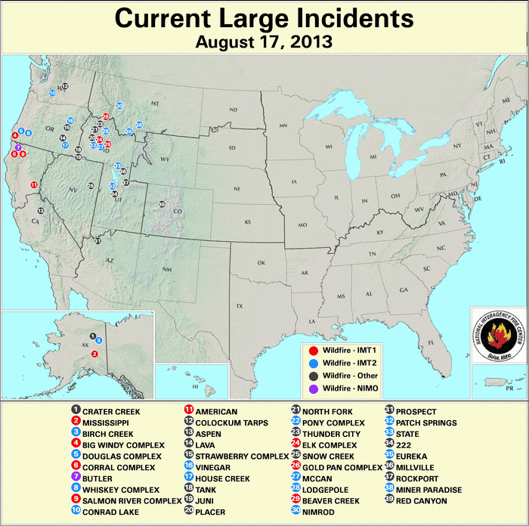
Current Fire Activity
Several ongoing large fires and recent pyroconvection
Many new fires!
Large-scale smoke transport is still occurring…

Slide 4
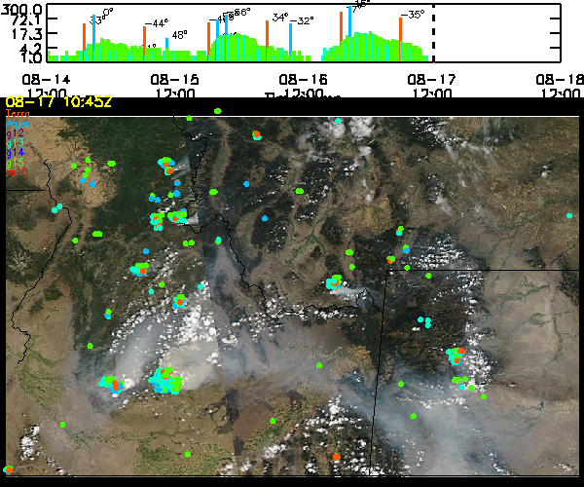
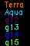
Satellite Fire Timeline- Idaho
Backdrop is Friday’s MODIS-Terra image
Southern complexes still going strong
Northern fires picking up
Friday was biggest day yet in satellite fires (GOES slightly higher than Thursday, MODIS significantly higher)
Did the fires burn overnight Friday?

Slide 5
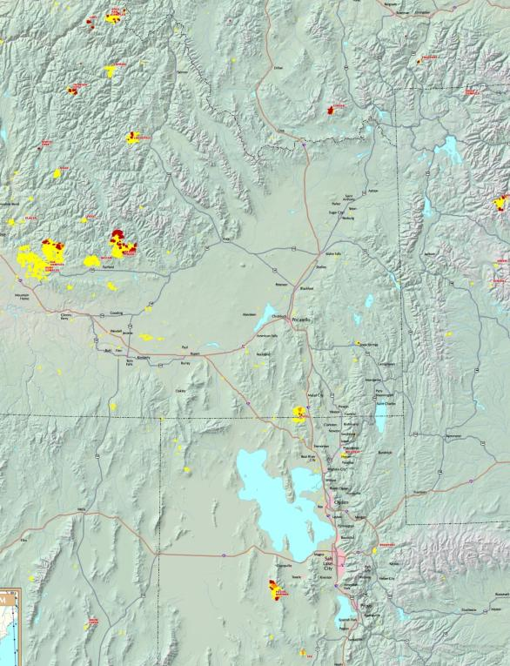
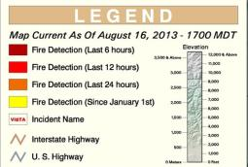
Current Fires
Past 24 hrs (Some of the Largest):
Name | St. | Size (Acres) | 24-hr Incr. | Contained?
Pony Complex | ID | 149384 | 1% | 90%, Expd 8/24
Elk | ID | 125033 | 7% | 50%, Expd 8/31
Beaver Creek | ID | 64236 | 43% | 6%
Lodgepole | ID | 22753 | ? | 74%
Ridge | ID | 5315 | ? | Expd 9/30
Gold Pan | ID | 21315 | 18% | unkown
Mccan | ID | 23389 | ? | 70%
Patch Springs | UT | 24656 | 76% | 20%, Expd 8/25
State | UT | 29335 | 15% | 70%. Expd 8/19
Eureka | MT | 2400 | 140% | 5%
Primary smoke producers

Slide 6
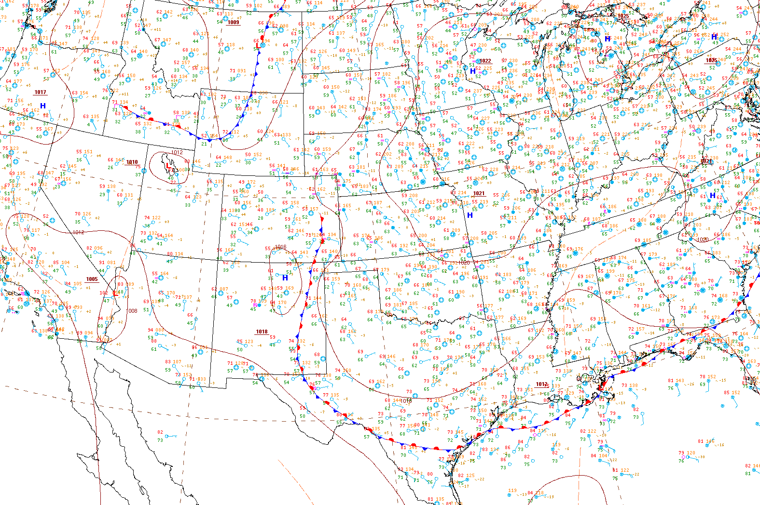
Current Surface Conditions
8/17/13, 1027Z
Wind shift…
Unseasonably Cool
Hot and Dry
Upslope Flow
Isolated Convection
Key Points
Surface (largely stationary) frontal boundary still bisects the region, but the pattern is slowly changing
Surface wind shift in ID
Region with fires is still hot and dry, despite a West Coast trough
Scattered Convection

Slide 7
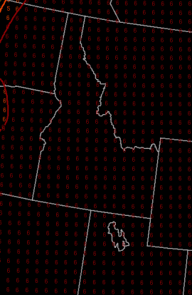
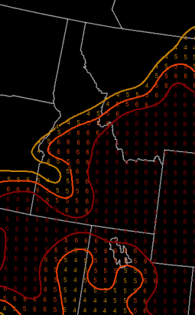
Fire Weather Conditions
Currently: very high fire danger in ID, UT, and MT.
Fire weather conditions have reached their peak on Friday (8/16).
A great deal of smoke was likely released!
Saturday – Monday (8/17 - 8/19):
Expect fire danger to decrease slightly, but still remain favorable for growth.
The developing Pacific trough will not suppress fires as much as originally expected!
Haines Index
1-2: low fire danger
3-4: moderate fire danger
5-6: high fire danger
Mid-Elevation
High-Elevation

Slide 8
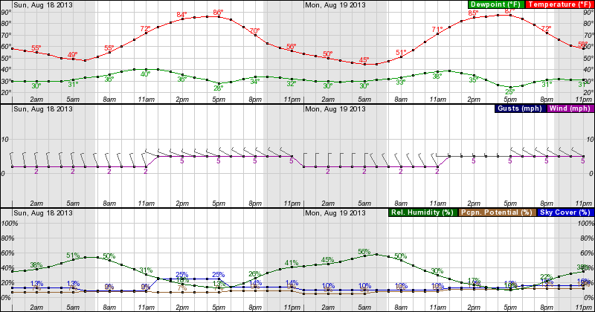
Forecast: Near the Idaho Fires
Sunday 0000 – Monday 2300 MDT, near the Beaver Creek Fire, east of Boise
Fire weather conditions will be favorable for fire growth in the afternoon hours each day. Inland highs decrease slightly, but RH values are still < 20%.
Wind direction will shift to the W, then the NW by Monday
Wind speed will vary with terrain

Slide 9
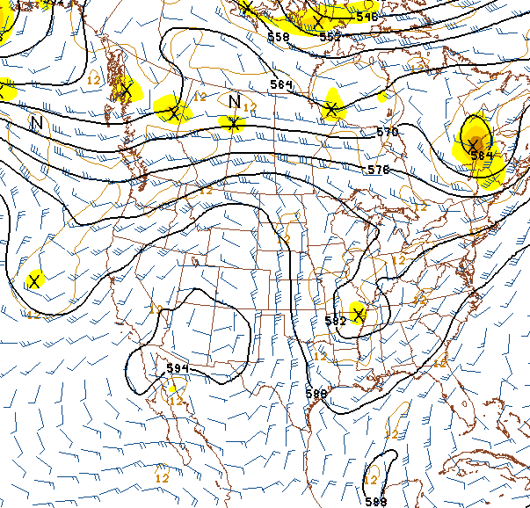
Current Synoptic Pattern
500 hPa, 8/17/13, 0600Z
Primary forecast issues:
Highly amplified pattern, unusual for August
Western smoke transported to the NE, then sharply SSE between ridge and trough
When will the western ridge begin to flatten?
Easterly tropical wave near the Yucatan, moving WNW
Potential for tropical development!
Smoke transport
Potential tropical cyclone development?
Tropical Wave

Slide 10
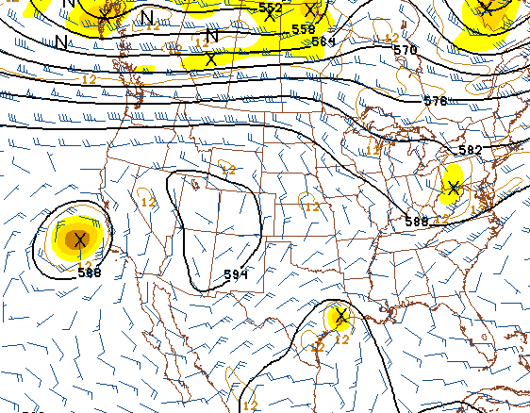
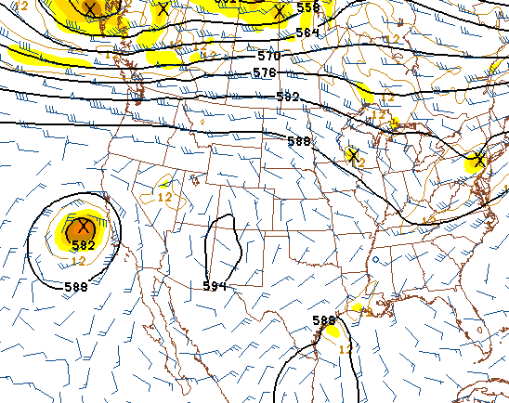
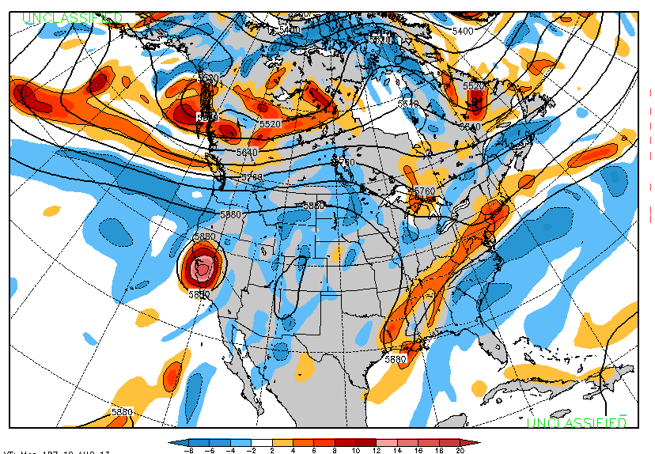
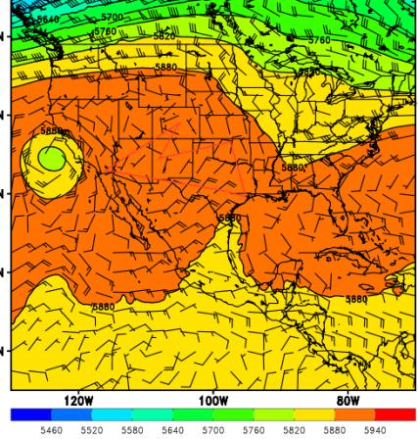
Upper-Air Forecast (500 hPa)
NAM 500 hPa, 18Z, 8/19
GFS 500 hPa, 18Z, 8/19
4 models now show general agreement
Zonal flow develops along the Canadian border
MCS potential shifts into the Upper Midwest/OH Valley
Smaller ridge remains in the western CONUS
Smoke will take two paths (see next slide)
Similar at 700 hPa!
Some sort of tropical disturbance near the TX Gulf Coast?
NAVGEM 500 hPa, 18Z, 8/19
EC 500 hPa, 18Z, 8/19

Slide 11
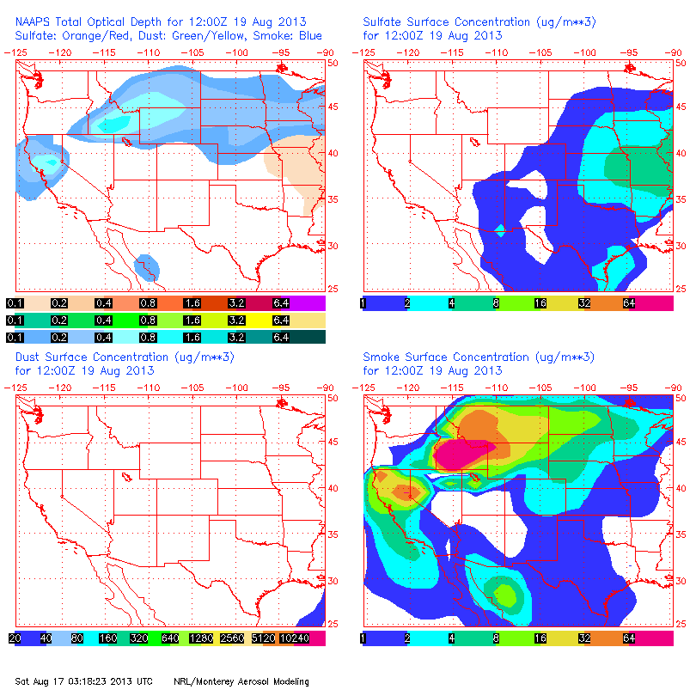
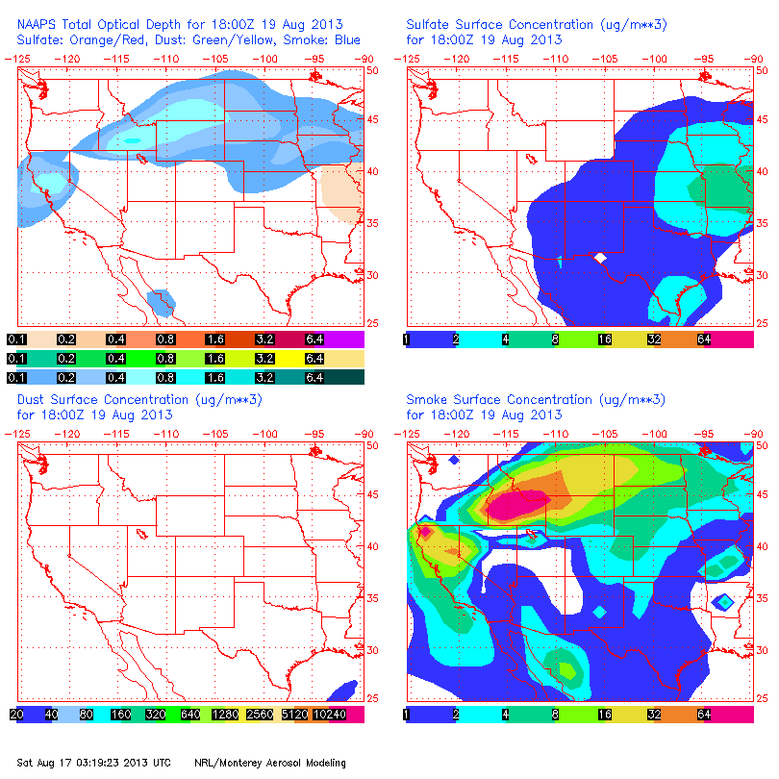
NAAPS Smoke/Aerosol Forecast
8/19, 12Z 8/19, 18Z
By Monday, a large quantity of smoke will be advected to the ESE by increasingly zonal flow, reaching into the upper Midwest/Plains.
While reduced in size, the synoptic ridge will still occupy the SW CONUS.
Therefore, some smoke will still be pulled to the south over the High Plains, around the ridge.
It is expected that a mix if new and older smoke will be present at several layers, primarily between 700 and 500 hPa.

Slide 12
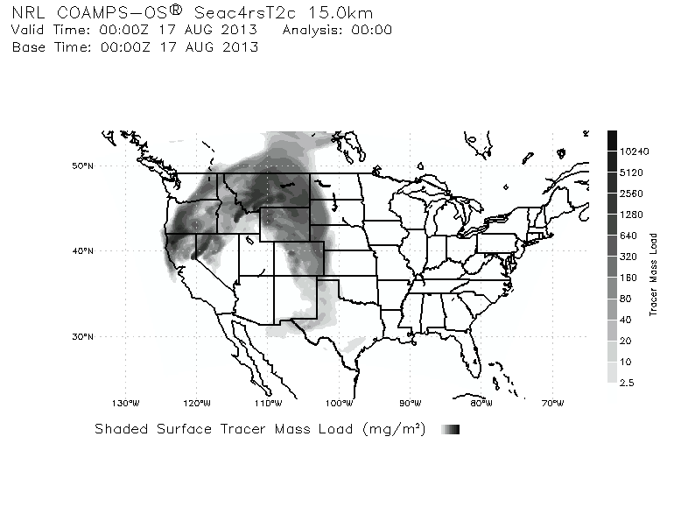
Smoke/Aerosol Forecast
View slide for animation!!!

Slide 13
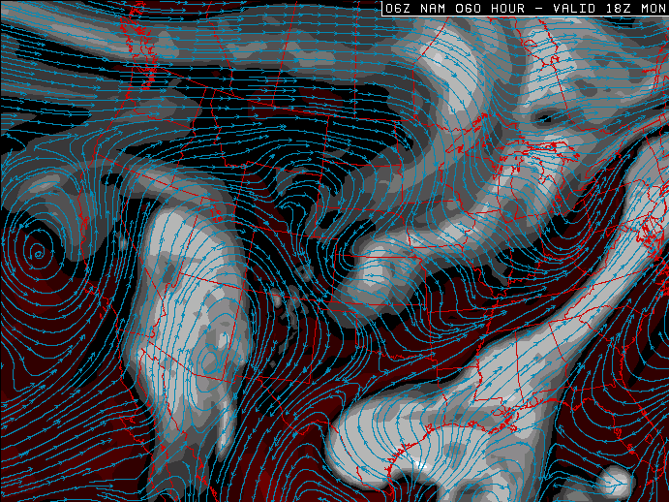
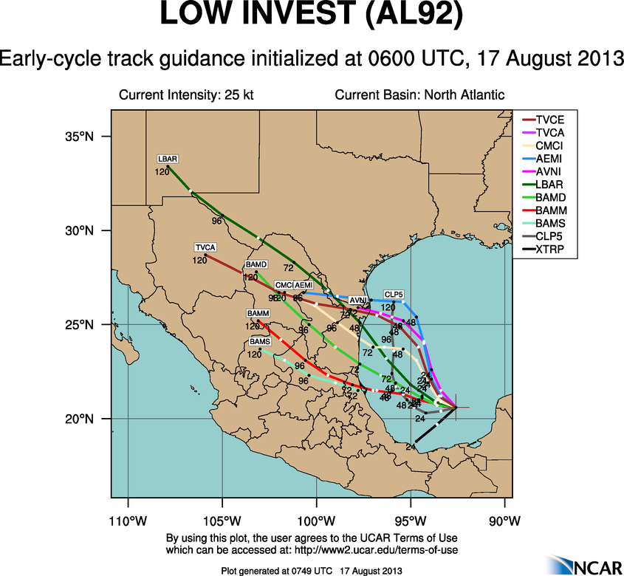
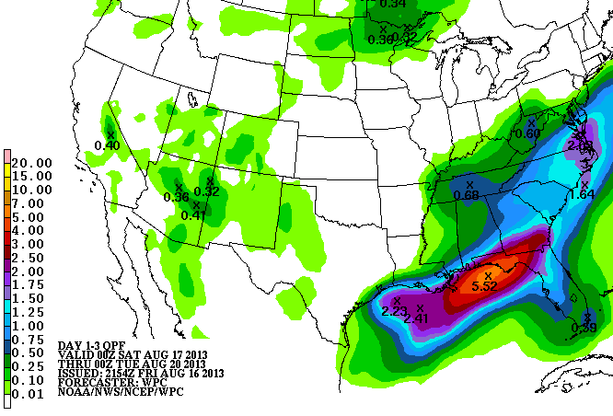
Convection, Clouds, and Tropic Trouble
NAM 250 hPa RH, 18Z, 8/19
Convection shifts to the Eastern CONUS, Gulf Coast, and the Upper Midwest
What happens with the tropical wave?
?
Precip. 00Z 8/17 – 00Z 8/20

Slide 14
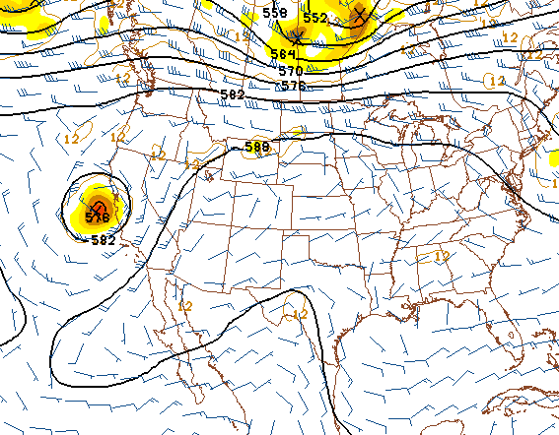
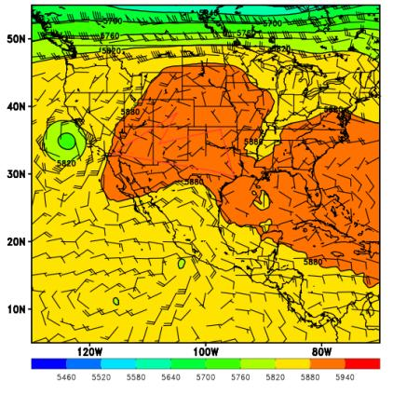
Wednesday (8/21)
The long-range forecast suggests that favorable smoke transport will be gone by Wednesday (8/21)
The ridge may finally move/build eastward, allowing warmer conditions to return to the SEUS
GFS 500 hPa, 12Z, 8/21
EC 500 hPa, 12Z, 8/21

Slide 15
Summary
Large fires will still be burning in the western CONUS, especially in Idaho
Fire weather conditions will remain favorable for growth
Convection potential will decrease the central CONUS
Large-scale smoke transport will likely continue, but may take two paths:
Into the upper Midwest due to zonal flow near the Canadian border
Into the Plains due to the persistent (but smaller) ridge in the SW CONUS
What impact (if any) will come from the tropics?

