Slide 1


Flight Planning Smoke/Aerosol Outlook SEAC4RS 2013
Prepared: 08/15/2013
0800 hours CDT (13:00Z)
Forecast period: Friday (8/16)
David Peterson
Marine Meteorology Division
Naval Research Lab - Monterey, CA

Slide 2
Bottom Line Upfront
Fire Observations:
Large fires continue to burn in ID, WY, UT and MT
The primary focus is Idaho!
Key Forecasting Points (Friday 8/16):
Fire weather conditions remain favorable for fire growth
Synoptic flow (e.g. at 500 hPa) becomes more northerly, funneling smoke farther west through the High Plains/Front Range
There may be less smoke near the primary Oklahoma target region!
Morning MCS will impact Oklahoma, producing widespread cloud cover before 18Z
Smoke Predictions (Friday 8/16):
Western fires: High smoke concentrations, higher altitude injections, and large-scale transport will continue through Friday!
Smoke output will begin to decrease over the weekend!

Slide 3
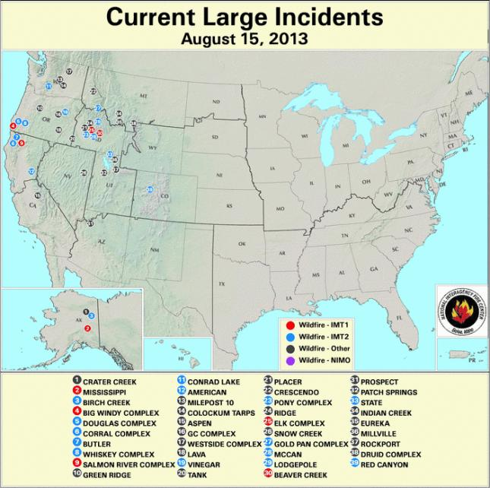
Current Fire Activity
Several large fires and recent pyroconvection
Large-scale smoke transport is occurring…
New fire in Colorado, “Red Canyon”
390 acres, smoke was observed!
Detected by GOES, not MODIS
39N, 107W

Slide 4
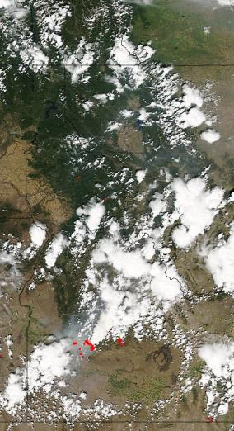
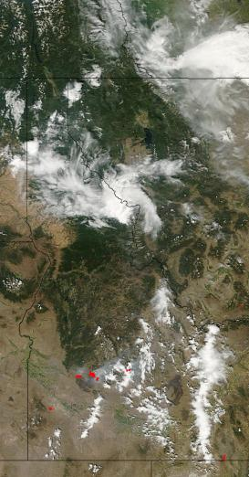
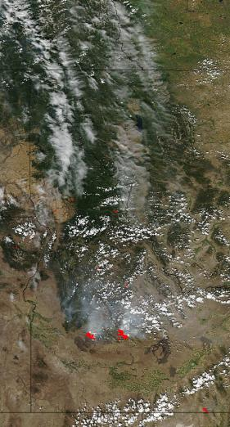
Idaho Fire Observations (Past 48 Hrs)
Aqua MODIS: ~1430 MDT Monday (8/12)
Large fires present
Aqua MODIS: ~1430 MDT Tuesday (8/13)
Large fires present, less smoke
Aqua MODIS: ~1430 MDT Wednesday (8/14)
Large fires present, more smoke

Slide 5
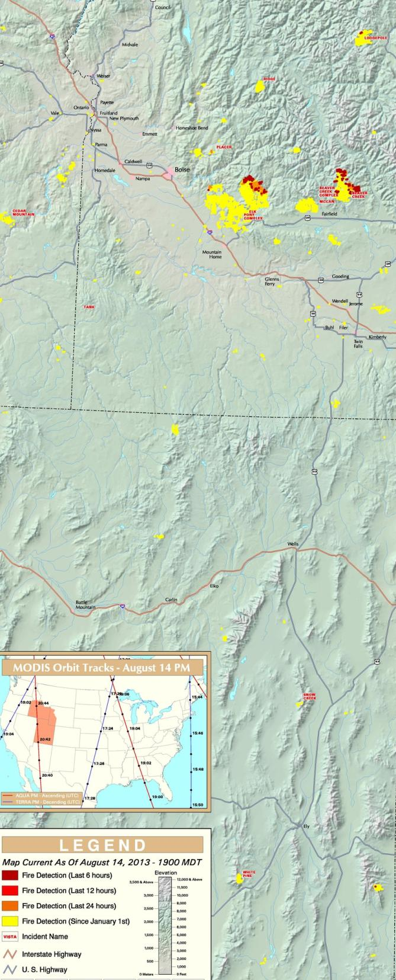
The Idaho Fires
Past 24 hrs:
Several ongoing large fires, a few new ignitions may have occurred
While there has been some containment, fires are still growing!
Name | Size (Acres) | 24-hr Increase | Contained?
Pony Complex | 147806 | 3% | 50%, Expected 8/18
Elk | 111977 | 14% | 25%, Expected 10/1
Beaver Creek | 38789 | 20% | 11%
Mccan | 23389 | ? | 60%

Slide 6
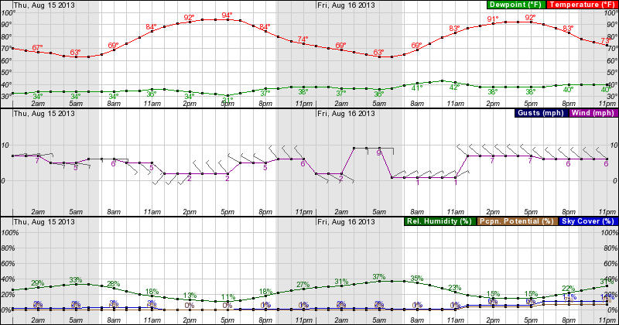
Forecast: Near the Idaho Fires
Thursday 0000 – Friday 2300 MDT, near the Elk Fire, NE of Boise
Fire weather conditions will be favorable for fire growth (possibly explosive) in the afternoon hours each day. Inland highs persist in the 80s and 90s, with RH values < 20%.
Wind speed and direction will vary with terrain!

Slide 7
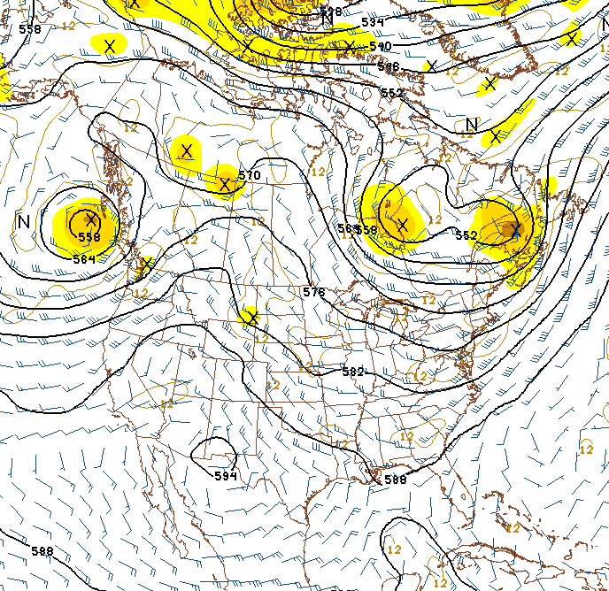
Synoptic Pattern
500 hPa, 8/15/13, 0600Z
Primary forecast issues:
Highly amplified pattern, unusual for August
Western smoke will be transported to the NE, then SSE between ridge and trough
Potential for convection in the Plains
Easterly tropical wave near the Yucatan, moving WNW
Potential for tropical development!
Smoke transport
Potential tropical cyclone development?
Tropical Wave

Slide 8
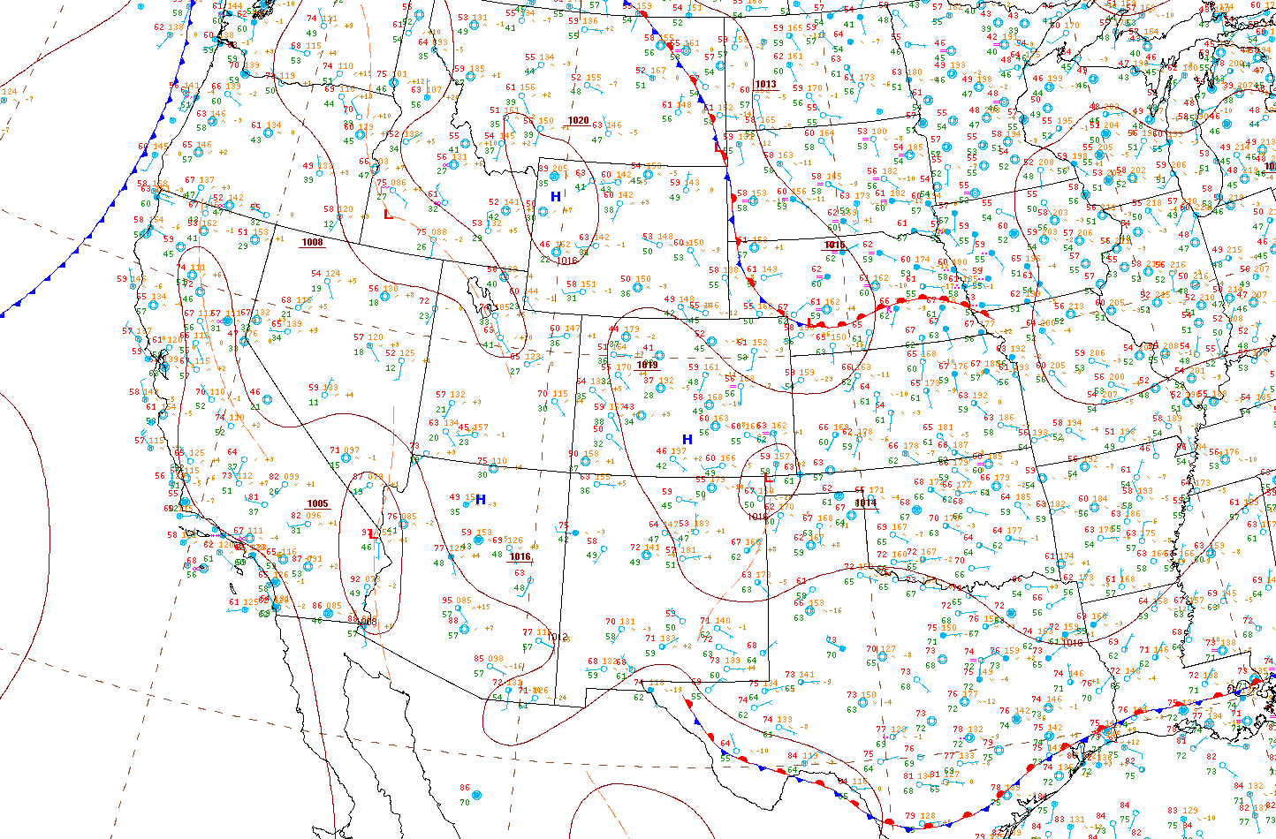
Surface Conditions
8/15/13, 1022Z
Developing Wave
Unseasonably Cool
Hot and Dry
Key Points
Surface (largely stationary) frontal boundary currently bisects the region and serves as a focal point for convection
Region with fires is hot and dry
Upper-level shortwave will drive an MCS along the boundary!
Scattered Convection

Slide 9
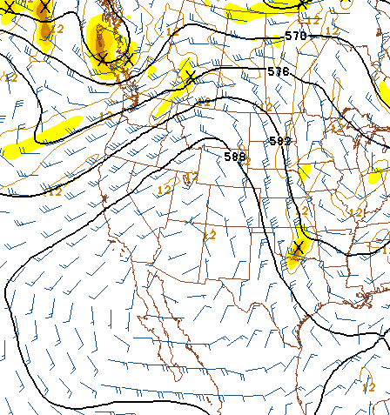
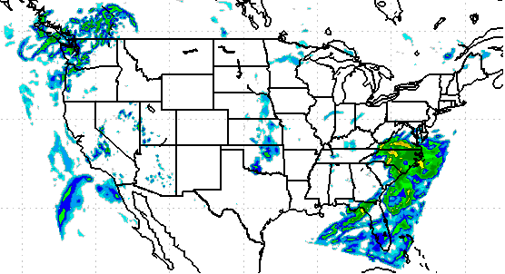
General Forecast
Friday (8/16):
Morning MCS somewhere in Oklahoma
Synoptic ridge becomes pinched, resulting in almost northerly flow at 500 hPa
Smoke may be pushed into west-central TX!
GFS 500 hPa Heights/Vorticity, 18Z, 8/16
COAMPS Simulated Reflectivity, 15Z, 8/16
Transport

Slide 10
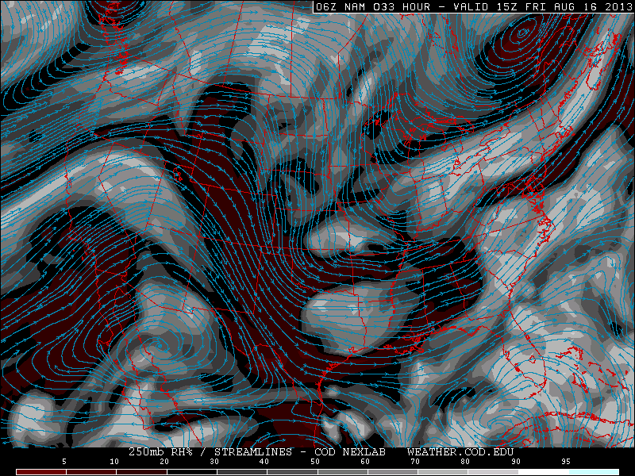
High Cloud Forecast
NAM 250 hPa RH, 15Z, 8/16

Slide 11
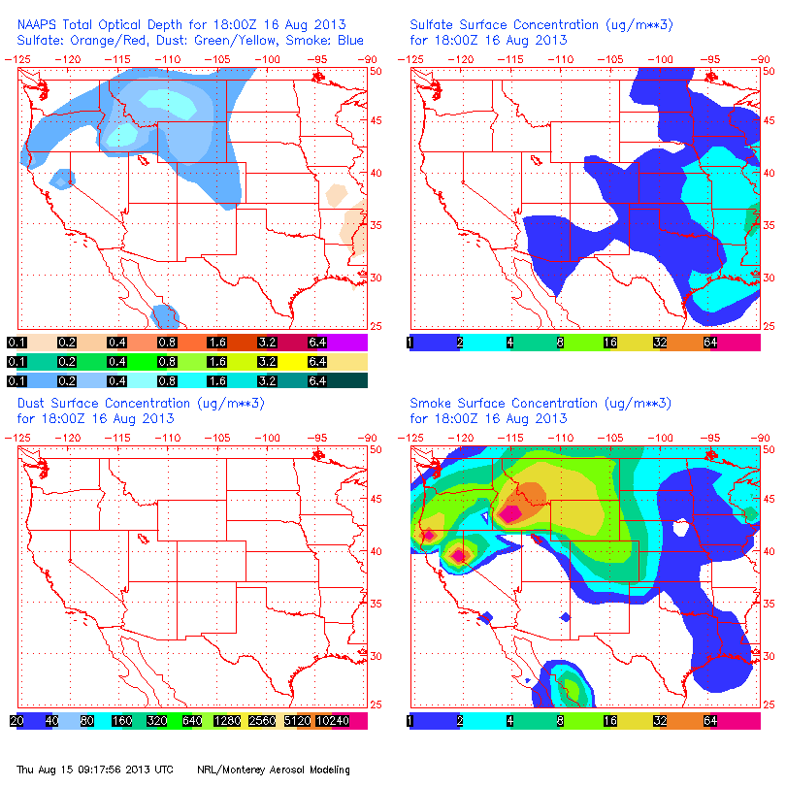
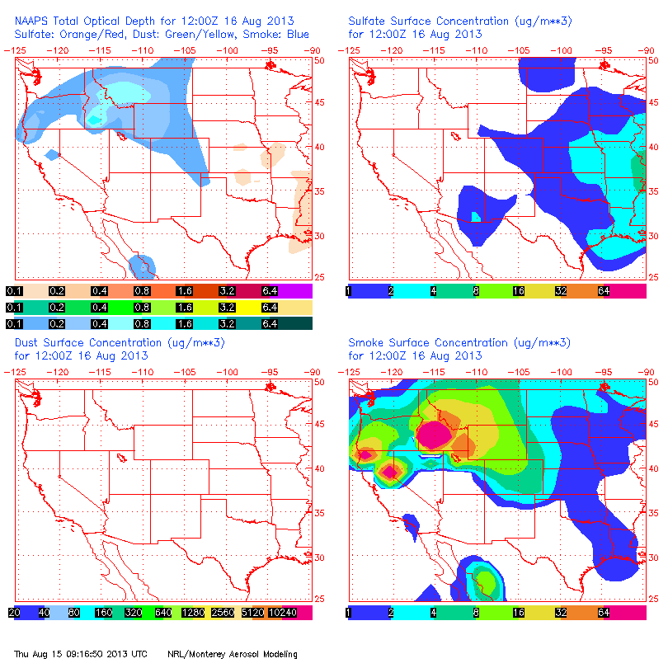
NAAPS Smoke/Aerosol Forecast
8/16, 12Z 8/16, 18Z
Large smoke concentrations are forecast from the Idaho source region, arcing to the ENE through MT, then to the SSE across the High Plains/Front Range
Primary smoke transport region has shifted west!

Slide 12
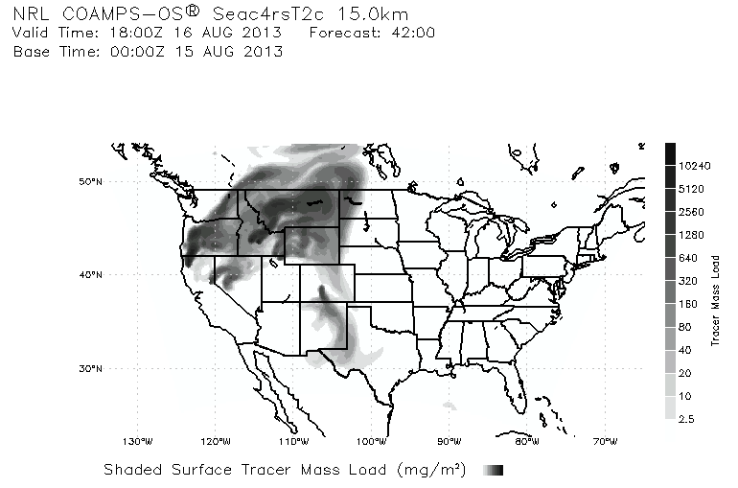
Smoke/Aerosol Forecast

Slide 13
Summary
Large fires will still be burning in Idaho
Fire weather conditions will be favorable for growth
Morning MCS will spread cloud cover over eastern OK
Large-scale smoke transport will likely continue, arching to the ENE over the synoptic ridge and then to the SSE into the southern High Plains
Smoke may be observed in western OK, northern TX and portions of CO, west of the primary OK target!

