Slide 1


Flight Planning Smoke/Aerosol Outlook
SEAC4RS 2013
Prepared: 08/11/2013
1900 hours PDT (02:00Z)
Forecast period: Monday (8/12)
David Peterson
Marine Meteorology Division
Naval Research Lab - Monterey, CA

Slide 2
Bottom Line Upfront
Fire Observations:
  A few small fires have been detected by MODIS in TX, AR, and LA
  Large fires continue to burn in WY, ID, and MT
Key Forecasting Points (Monday 8/12):
  Near-stationary surface frontal boundary in SE CONUS, with plenty of instability/moisture
  Convection is likely along a surface boundary, mainly in southern TN and northern AL, MS, and GA.
  Convection also possible near the coast of TX and LA
Smoke Predictions (Monday 8/12):
  SE CONUS: minor smoke concentrations are possible in TX, AR, and LA, but numerous, large fire events are not likely
  Western fires: fire evolution/smoke transport potential will be monitored. Smoke transport into portions of the Midwest/SE CONUS is becoming more likely!

Slide 3
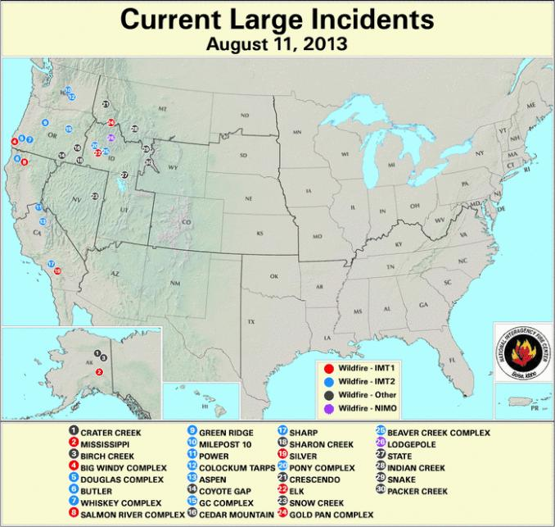
Current Fire Activity
Recent pyroconvection
Smoke Transport???
Something to watch!
A few fires have been detected, but no large incident reports

Slide 4
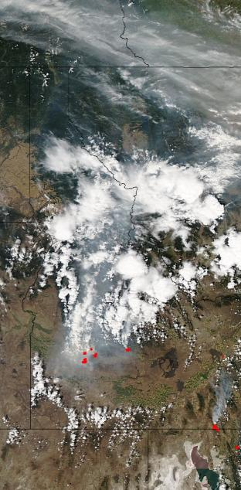
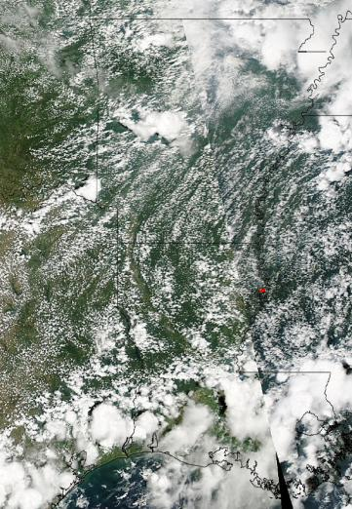
Fire Observations
Aqua MODIS: ~1330 CDT Sunday (8/11)
Few fires today
Aqua MODIS: ~1430 MDT Sunday (8/11)
Several large fire complexes in southern Idaho.
Lots of smoke, transported a great distance
Smoke from Canada coming into MT?
Smoke from Canada?
increased moisture reduces fire danger

Slide 5
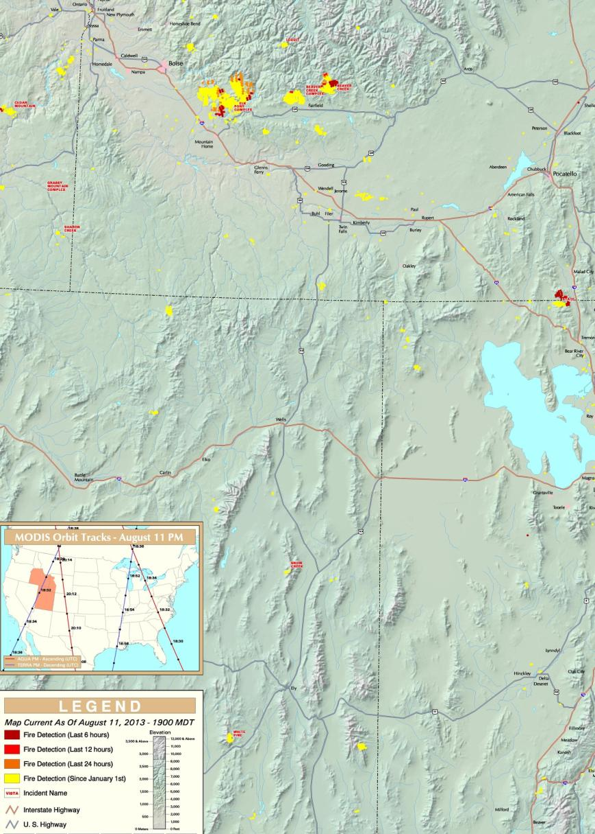
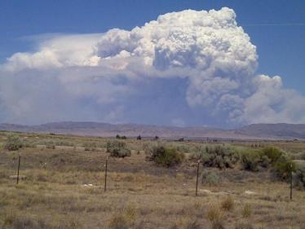
Idaho Fires are Impressive!
Past 24 hrs:
  Several large fires
  Sizes ranging from 15000 -50000 acres
  15-85% growth in the past day
  Pyroconvection has been observed!
  High-altitude injections are occurring!
Photo from I-84 taken Saturday afternoon

Slide 6
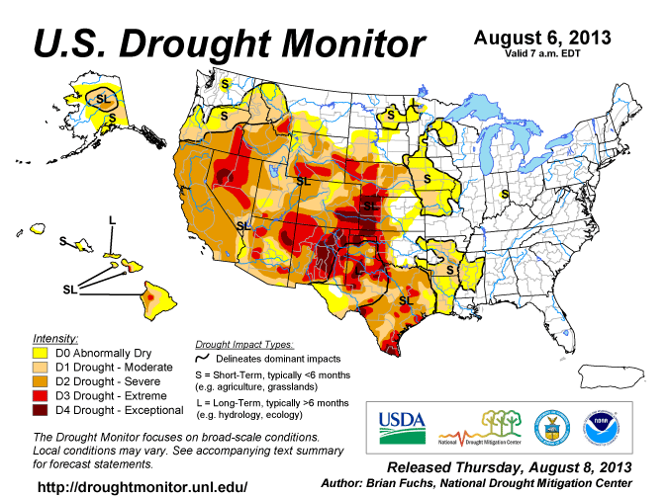
Current Drought Conditions
In recent weeks, drought conditions have developed in eastern TX, and portions of AR and LA…

Slide 7
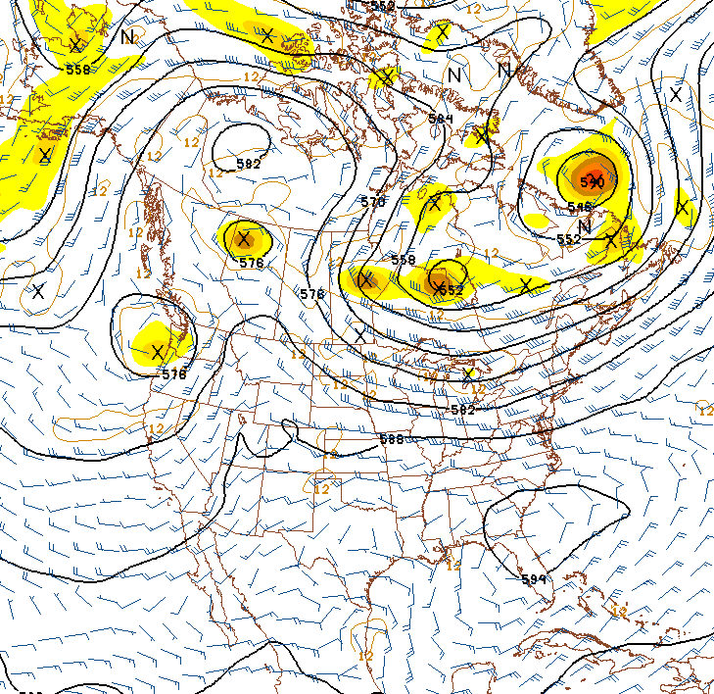
Synoptic Pattern
8/10/13, 1800Z
Primary forecast issues:
  Western blocking pattern is beginning to break down
  Easterly tropical wave now over Mexico
  Little large-scale dynamical forcing in the SE CONUS.
  Convection will be largely instability driven, which is typical for August.
  Typical Bermuda High pattern is trying to reform, but still weak
  Occasional shortwaves provide a lifting mechanism near the edge of the high, and above a surface frontal boundary
H
L
Bermuda
High
Tropical Wave

Slide 8
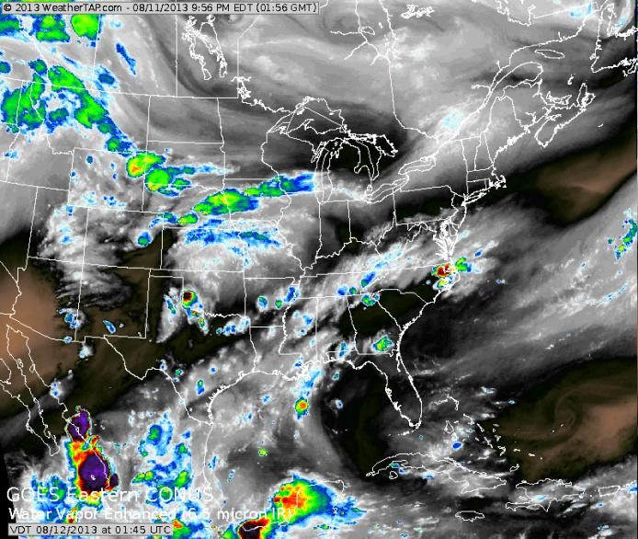
Synoptic Pattern
Midwestern convection associated with the digging large-scale trough
Convection along southern surface boundary
Easterly tropical wave

Slide 9
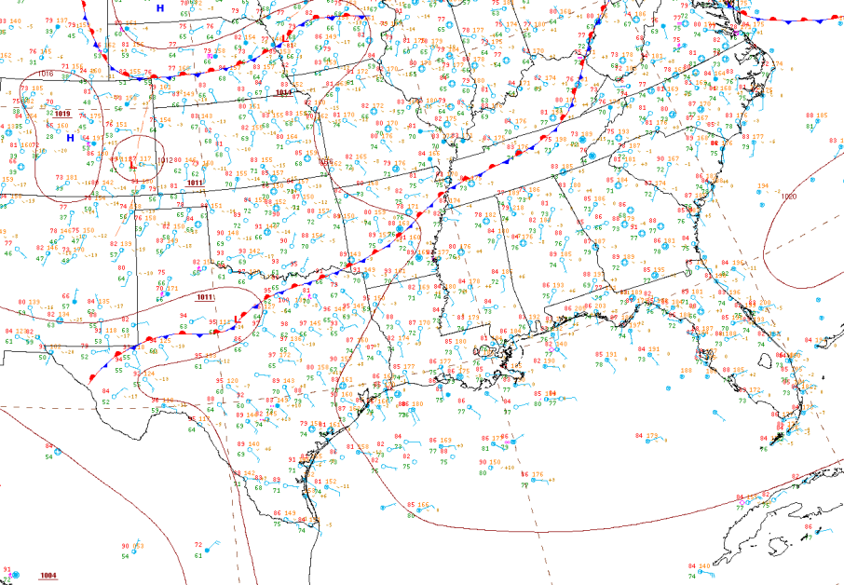
Surface Conditions
Key Points
Surface (largely stationary) frontal boundary will bisect the region and serve as a focal point for convection
The front will slowly sag to the SSE
8/11/13, 0125Z

Slide 10
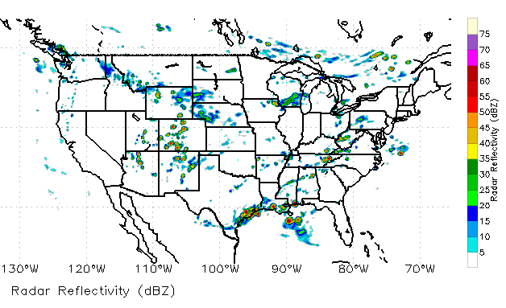
Convection/Rainfall Forecast
Monday (8/12):
Near-stationary frontal boundary will be the primary focus
Convection will develop along the front, mainly near the southern TN border
Convection also likely along the TX/LA coast and offshore
COAMPS Simulated Reflectivity (21Z, 8/12)

Slide 11
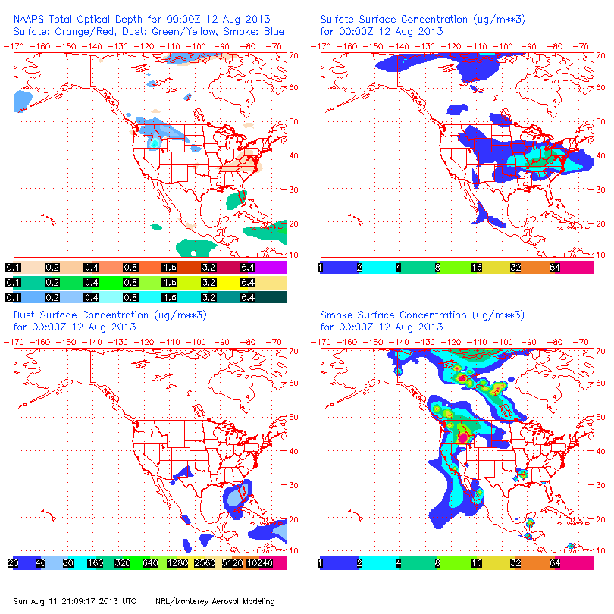
NAAPS Smoke/Aerosol Forecast
View slideshow for loop!!!
Some smoke may be present in the TX/LA/AR region!
Smoke concentrations are still high in the western CONUS and Canada
  Potential for ESE transport must be monitored!
  Some smoke will likely reach the study region during the week!
Sulfates are generally high in the southern Midwest and Mid Atlantic
  High concentrations extend into the SE CONUS on Monday 8/12!

Slide 12
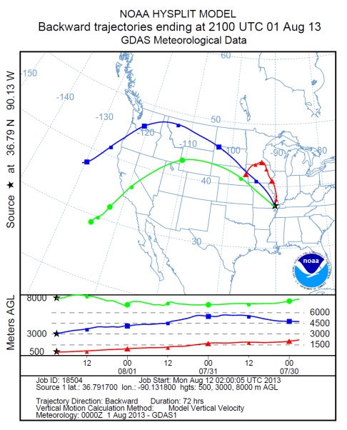
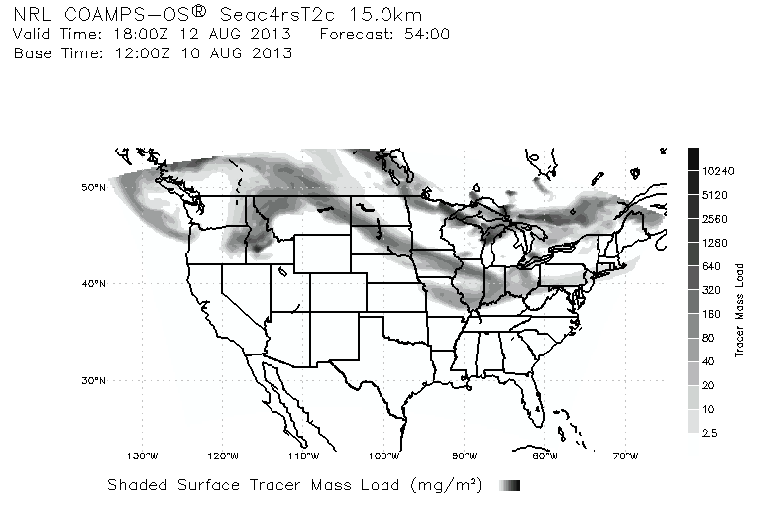
Smoke/Aerosol Forecast
Smoke may already be reaching the Midwest!

Slide 13
Summary
Fire and smoke observations are possible in portions of TX, AR, and LA
Some fire growth/ignition is possible during the afternoon hours Monday, but explosive growth is not expected.
Convection is likely along a surface boundary, extending across the southern border of TN
Transport of western US/Canadian smoke must be monitored in the coming days! It all depends on the evolution of the synoptic trough!

