Slide 1


Flight Planning Smoke/Aerosol Outlook
SEAC4RS 2013
Prepared: 08/10/2013
1500 hours PDT (22:00Z)
Forecast period: Monday (8/12)
David Peterson
Marine Meteorology Division
Naval Research Lab - Monterey, CA

Slide 2
Bottom Line Upfront
Fire Observations:
  A few small fires have been detected by MODIS in TX, AR, and LA
  Large fires continue to burn in WY, ID, and MT
Key Forecasting Points (Monday 8/12):
  Near-stationary surface frontal boundary in SE CONUS, with plenty of instability/moisture
  Convection is likely along a surface boundary, extending across the southern border of TN!
  Easterly tropical wave moves into northern Mexico/South TX
  Fire weather conditions becoming favorable in portions of AR, LA, and TX!
Smoke Predictions (Monday 8/12):
  SE CONUS: minor smoke concentrations are possible in TX, AR, and LA, but numerous, large fire events are not likely
  Western fires: fire evolution/smoke transport potential will be monitored, but smoke is unlikely to reach the SE CONUS study region

Slide 3
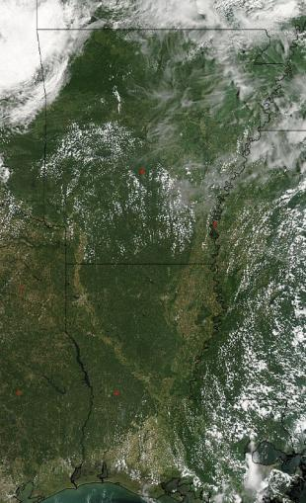
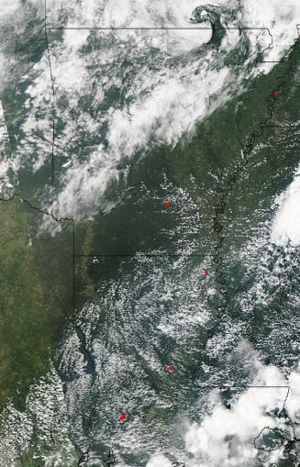
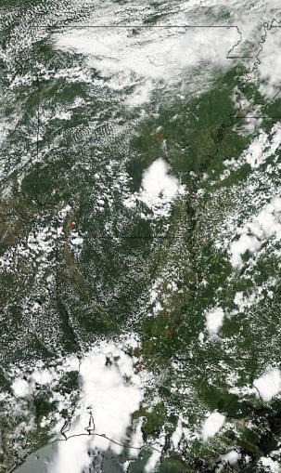
Fire Trends (Past 48 hrs)
Aqua MODIS: ~1330 CDT Thursday (8/8)
Several small fires are present
Aqua MODIS: ~1330 CDT Friday (8/9)
Several small fires are present
Aqua MODIS: ~1330 CDT Saturday (8/10)
Several small fires are present
Smoke
increased moisture temporarily reduces fire danger

Slide 4
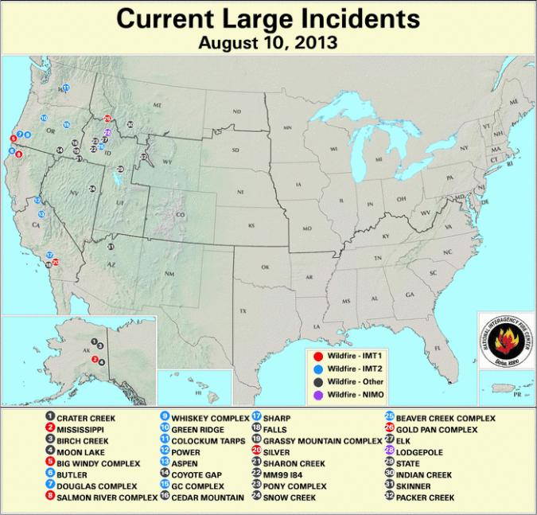
Current Fire Activity
Recent pyroconvection
Smoke Transport???
Something to watch!
A few fires have been detected, but no large incident reports

Slide 5
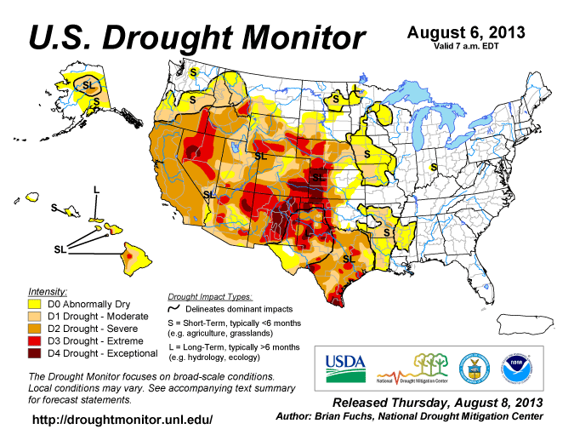
Current Drought Conditions
In recent weeks, drought conditions have developed in eastern TX, and portions of AR and LA…

Slide 6
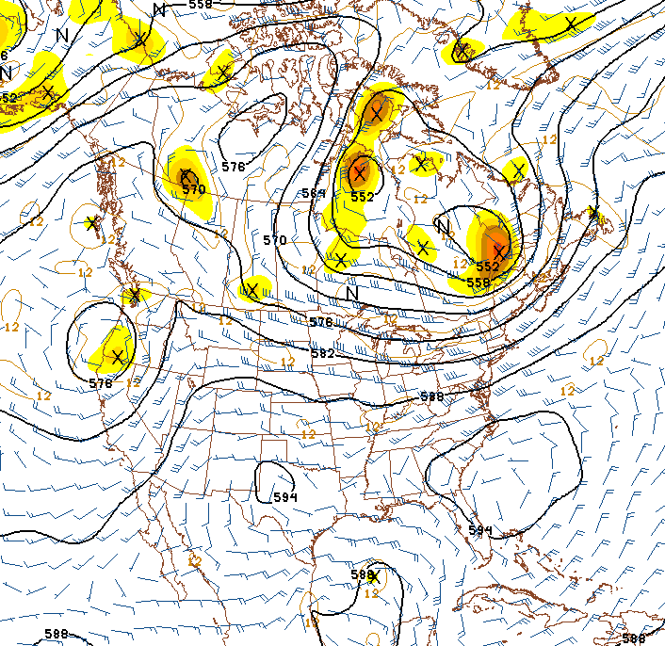
Synoptic Pattern
8/10/13, 1800Z
Primary forecast issues:
  Western blocking pattern (high over low) is still in place
  Easterly tropical wave in the Western Gulf/Bay of Campeche
  Little large-scale dynamical forcing in the SE CONUS.
  Convection will be largely instability driven, which is typical for August.
  Typical Bermuda High pattern is trying to reform, but still weak
  Occasional shortwaves provide a lifting mechanism near the edge of the monsoonal/Bermuda highs, and above a surface frontal boundary
H
L
Monsoonal
High
Bermuda
High
Tropical Wave

Slide 7
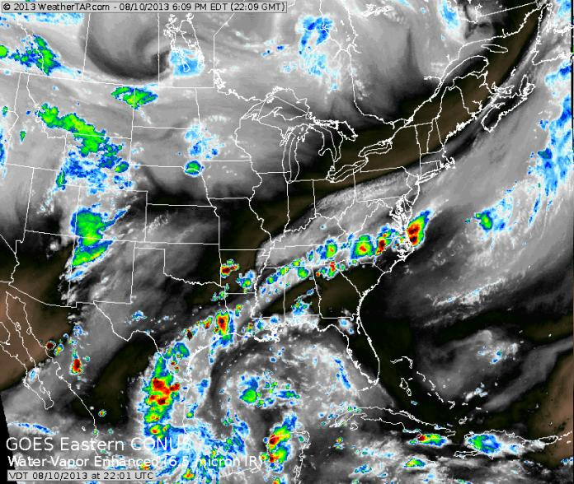
Synoptic Pattern
Convection along surface boundary
Easterly tropical wave

Slide 8
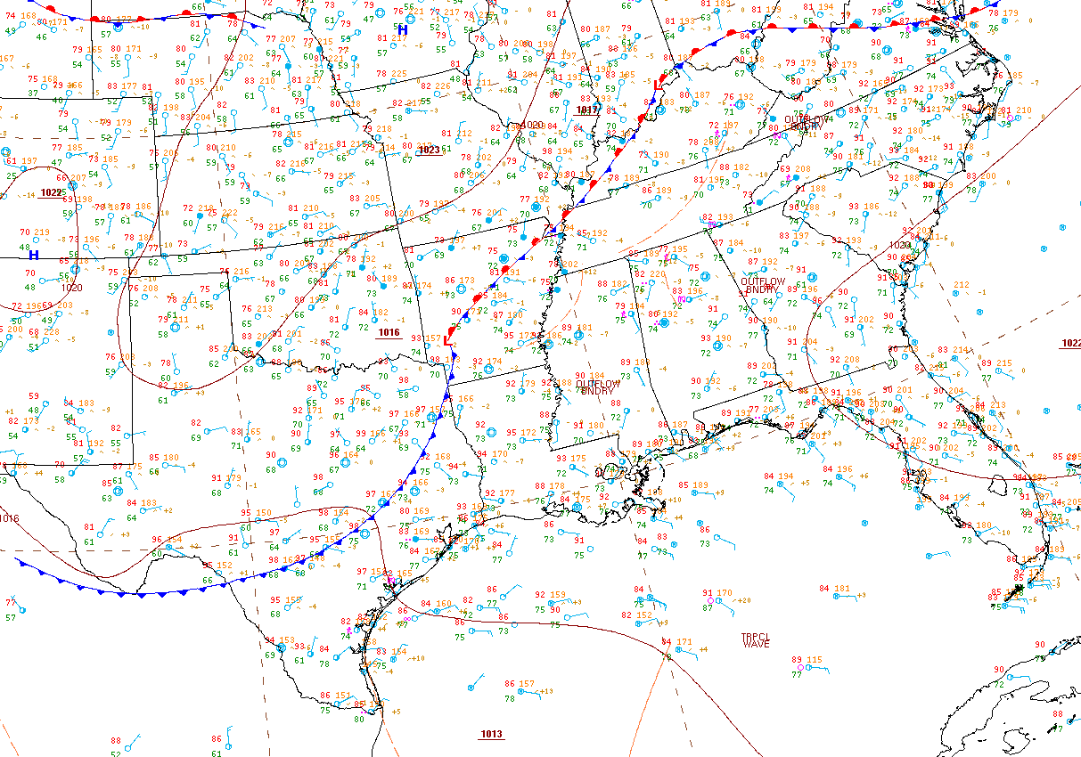
Surface Conditions
Key Points
Surface (largely stationary) frontal boundary will bisect the region and serve as a focal point for convection
The front will slowly sag to the SSE over the coming days
Scattered convection currently in TX will become less prevalent over the next 48 hrs.
8/10/13, 1917Z

Slide 9
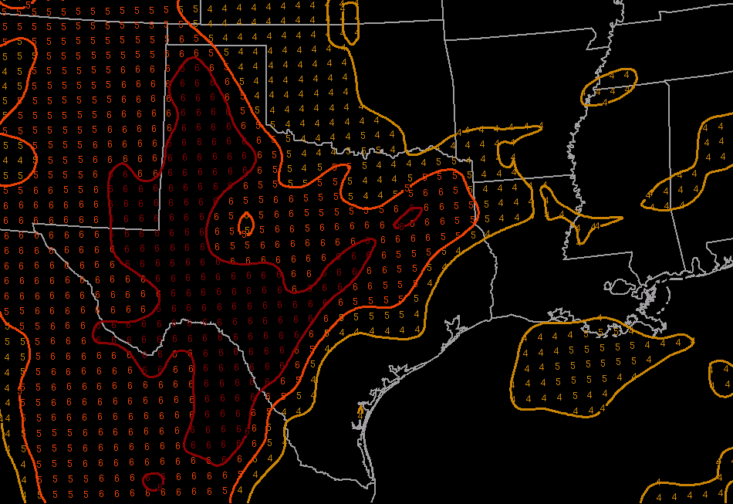
Fire Weather Conditions
Overall, moderate danger in TX and portions of AR/LA.
Fire danger has temporarily decreased due to increased moisture and scattered convection
Monday (8/12):
Expect fire weather conditions to become more favorable in large portions of TX and LA!
Fire danger will be lower…
  In Eastern OK and northern AR as a result of increased rainfall chances along the front
  In south TX due to the tropical wave influence
Haines Index
1-2: low fire danger
3-4: moderate fire danger
5-6: high fire danger
Low-Elevation Haines Index

Slide 10
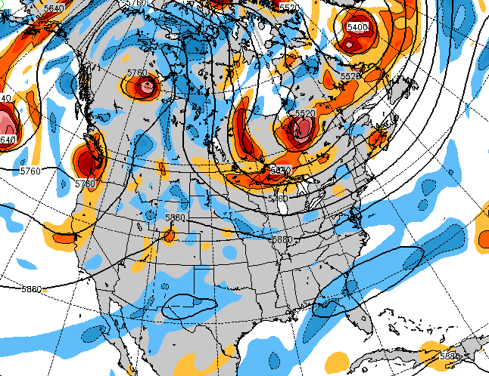
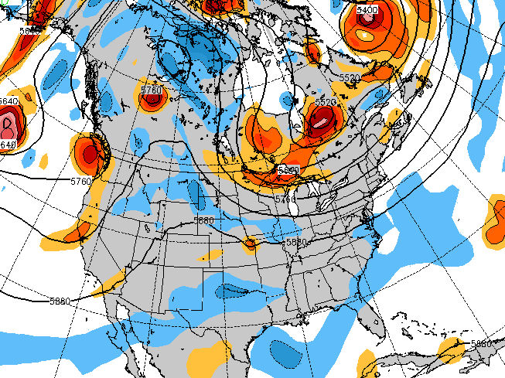
Weather Forecast: Upper Air
NAVGEM 500 mb heights/vorticity, 8/12, 18Z
Monday (8/12):
Both NAVGEM and the GFS show the long-wave pattern becoming highly amplified
  Ridge in the west, trough in the east
Easterly tropical wave moves into northern Mexico and dissipates
Potential shortwave activity must be monitored because it can enhance convection
GFS 500 mb heights/vorticity, 8/12, 18Z

Slide 11
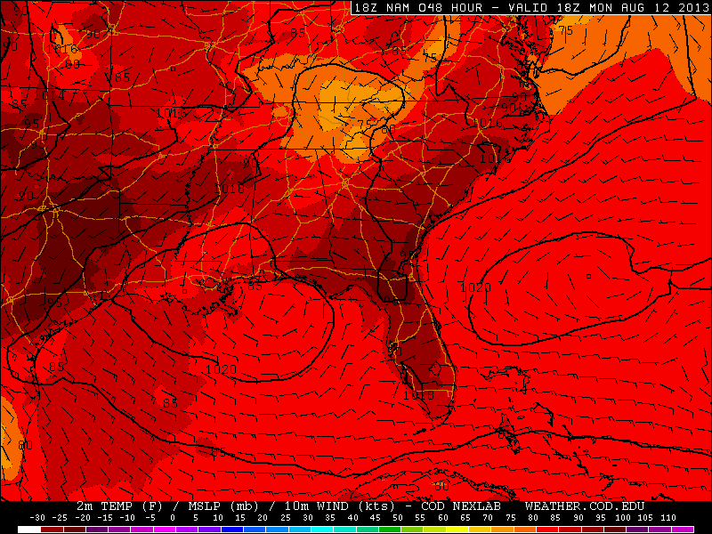
Weather Forecast: Surface
NAM sfc Temp, pressure, wind, 8/12, 18Z
Monday (8/12):
NAM, GFS and NAVGEM show surface boundary from AR to southern TN
  Convection development likely in the afternoon!
High pressure over northern Gulf
Plenty of low-level moisture and instability!
H
H
H

Slide 12
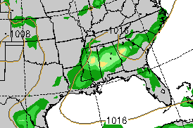
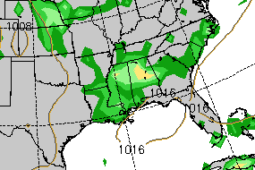
Convection/Rainfall Forecast
NAVGEM 6-hr Precipitation, 00Z 8/13
GFS 6-hr Precipitation, 00Z 8/13
By 00Z (7 PM CDT) on Monday, NAVGEM and GFS have the precip axis from northern MS to GA. This is different from the NAM, which has the precip axis from AR to TN. The southern border of TN and northern MS/AL seem to have a high chance for convection.

Slide 13
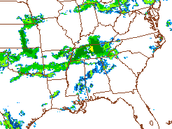
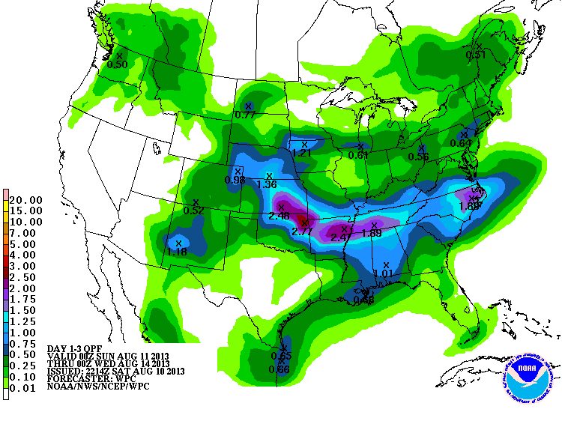
Convection/Rainfall Forecast
3-Day Precip. (8/11 – 8/14), NAM sim. reflectivity (18Z, 8/12)
Monday (8/12):
Near-stationary frontal boundary will be the primary focus
Convection will develop along the front, mainly along the southern TN border
Very little rainfall forecast in the region of interest for fires!

Slide 14
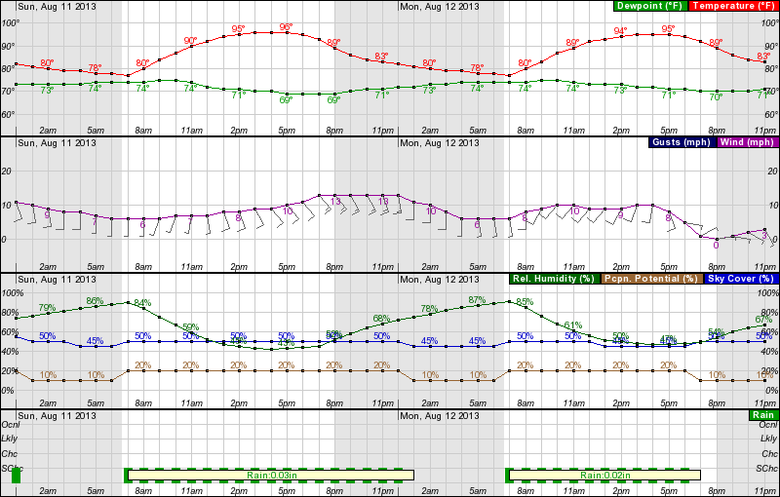
Forecast: Region of Higher Fire Danger
Sunday 0000 – Monday 2300 CDT, near Shreveport, LA
Frontal influences fail to reach northern LA. Low rain chances and persistently hot weather will allow the fire danger to remain relatively high on Monday
  Relatively low RH in the afternoon, wind speed consistently southerly

Slide 15
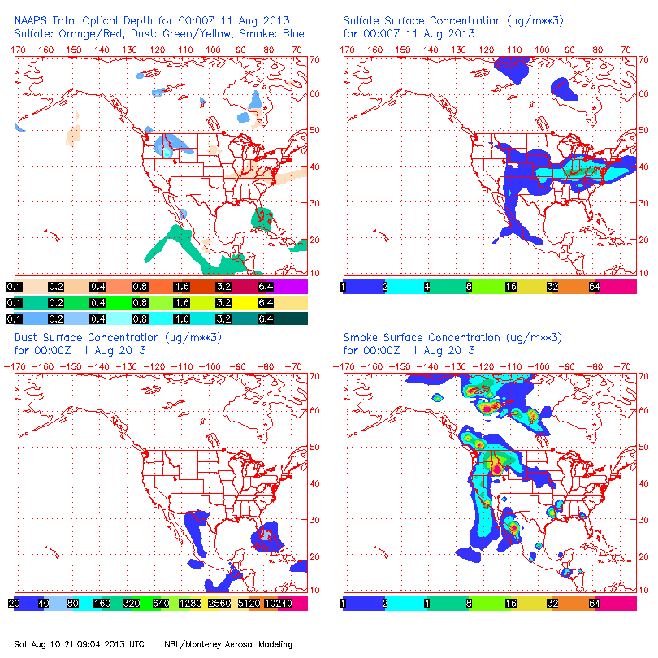
NAAPS Smoke/Aerosol Forecast
View slideshow for loop!!!
Some smoke may be present in the TX/LA/AR region!
Smoke concentrations are still high in the western CONUS
  Potential for ESE transport must be monitored!
Dust concentrations decrease during the forecast period
Sulfates are generally high in the southern Midwest and Mid Atlantic
  High concentrations extend into the SE CONUS on Monday 8/12!

Slide 16
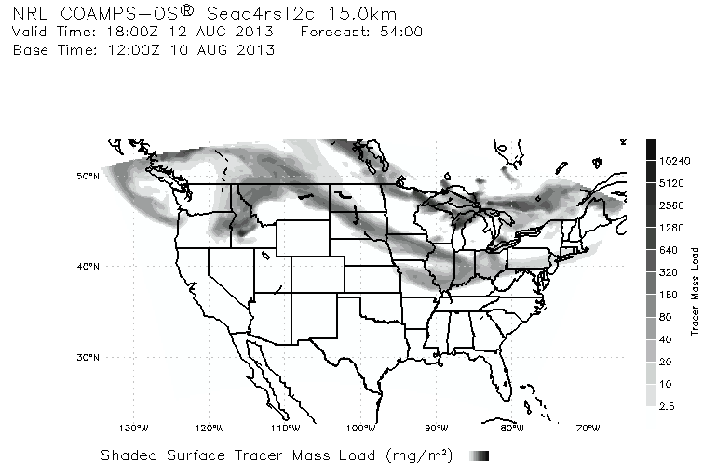
Smoke/Aerosol Forecast
Smoke from the western CONUS and boreal Canada may reach the Midwest by Monday!

Slide 17
Summary
Fire and smoke observations are possible in portions of TX, AR, and LA
Some fire growth/ignition is possible during the afternoon hours Monday, but explosive growth is not expected.
Convection is likely along a surface boundary, extending across the southern border of TN

