Slide 1


Flight Planning Smoke/Aerosol Outlook SEAC4RS 2013
Prepared: 08/08/2013
1400 hours PDT (21:00Z)
Forecast period: Thursday (8/8) - Monday (8/12)
David Peterson
Marine Meteorology Division
Naval Research Lab - Monterey, CA

Slide 2
Bottom Line Upfront
Fire Observations:
A few small fires have been detected by MODIS in TX, AR, and LA
Large fires continue to burn in WY, ID, and MT
Key Forecasting Points (Thursday 8/8 – Monday 8/12):
Near-stationary surface frontal boundary in SE CONUS, with plenty of instability/moisture
Convection is likely along a line from Arkansas to the Carolinas!
Easterly tropical wave moves into northern Mexico/South TX
Fire weather conditions remain favorable in portions of AR, LA, and TX!
Smoke Predictions (Monday 8/12):
SE CONUS: minor smoke concentrations are possible in TX, AR, and LA, but numerous, large fire events are not likely
Western fires: fire evolution/smoke transport potential will be monitored, but smoke is unlikely to reach the SE CONUS study region

Slide 3
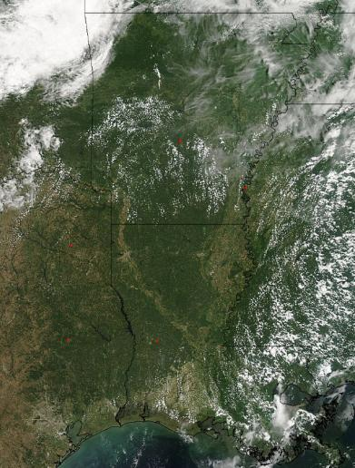
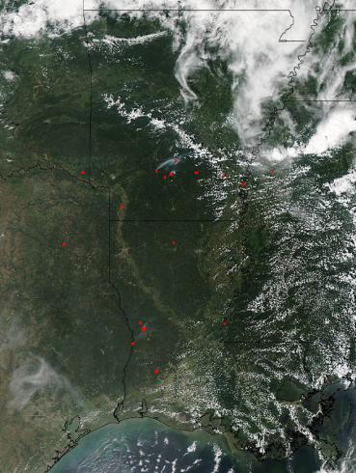
Fire Trends (Past 24 hrs)
Aqua MODIS: ~1330 CDT Wednesday (8/7)
Several small fires are present in the drought stricken regions of AR and LA
Aqua MODIS: ~1330 CDT Thursday (8/8)
Several small fires are present, but less than Wednesday
Smoke

Slide 4
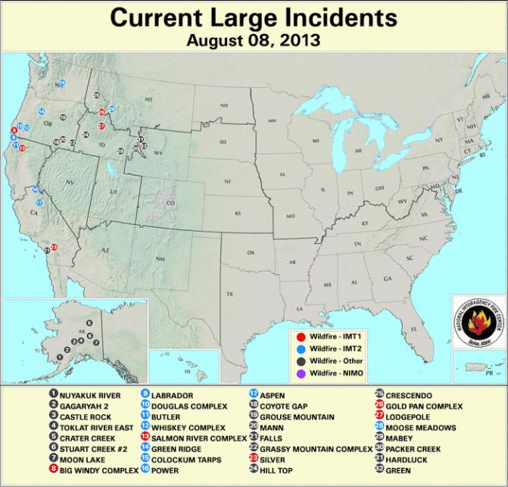
Current Fire Activity
Smoke Transport???
Something to watch!
A few fires have been detected, but no large incident reports

Slide 5
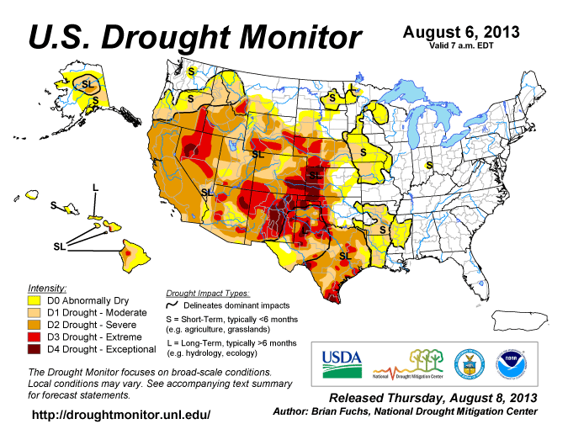
Current Drought Conditions
In recent weeks, drought conditions have developed in eastern TX, and portions of AR and LA…

Slide 6
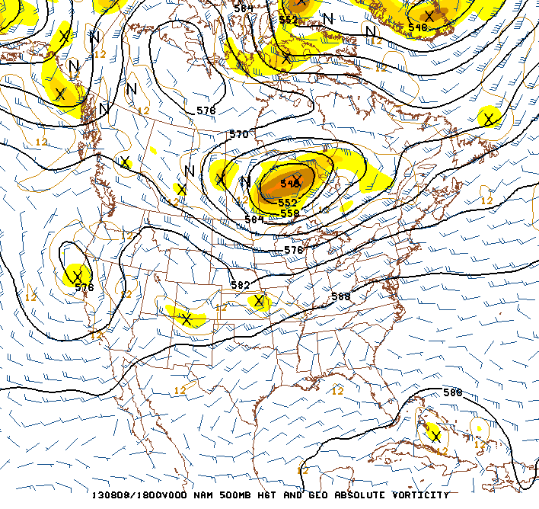
Synoptic Pattern
8/8/13, 1800Z
Primary forecast issues:
Western blocking pattern (high over low) is still in place
Easterly tropical wave in the Caribbean
Little large-scale dynamical forcing in the SE CONUS.
Convection will be largely instability driven, which is typical for August.
Occasional shortwaves provide a lifting mechanism near the edge of the monsoonal high, and above a surface frontal boundary
H
L
Monsoonal
High
Tropical Wave

Slide 7
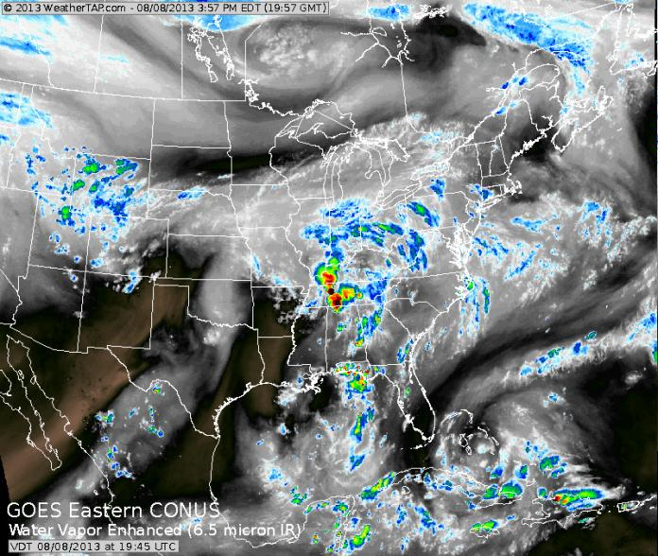
Synoptic Pattern
Shortwaves
Easterly tropical wave

Slide 8
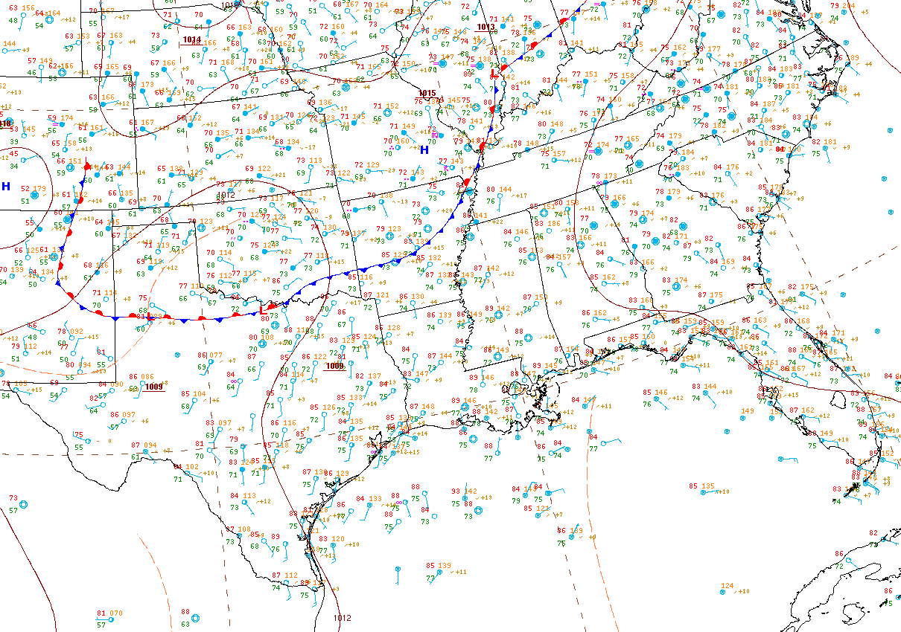
Surface Conditions
Key Points
Surface (largely stationary) frontal boundary will bisect the region in the coming days and serve as a focal point for convection
The front will slowly sag to the ESE over the coming days
8/8/13, 1500Z

Slide 9
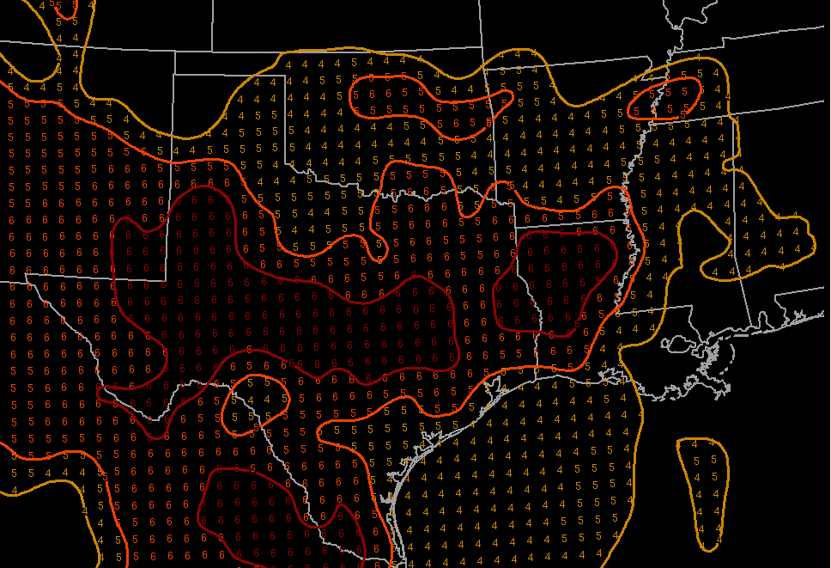
Fire Weather Conditions
Overall, moderate to high fire danger TX, OK, and portions of AR/LA.
Thursday (8/8) - Monday (8/12):
Expect favorable fire weather conditions in large portions of TX and LA!
Persistence is probably a good forecast.
Fire danger may decrease…
In Eastern OK and AR as a result of increased rainfall chances along the approaching front
In south TX due to the approaching tropical wave
Haines Index
1-2: low fire danger
3-4: moderate fire danger
5-6: high fire danger
Low-Elevation Haines Index

Slide 10
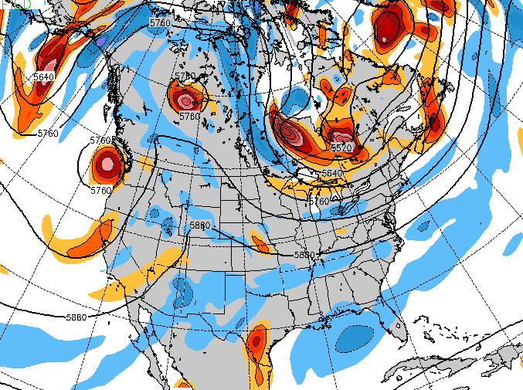
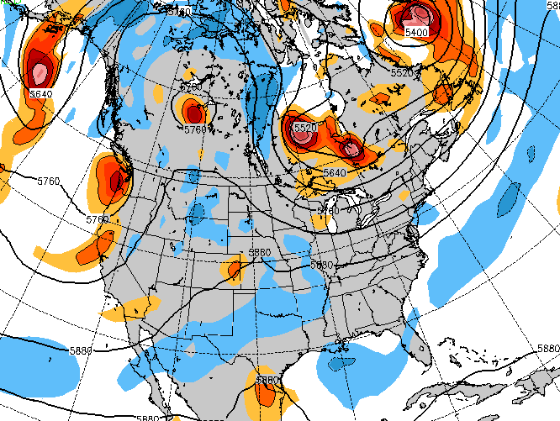
Weather Forecast: Upper Air
NAVGEM 500 mb heights/vorticity, 8/12, 12Z
Tuesday (8/6):
Both NAVGEM and the GFS show the long-wave pattern becoming highly amplified
Ridge in the west, trough in the east
Easterly tropical wave moves into northern Mexico and south TX
Shortwaves continue to traverse the region from KS into the TN valley
GFS 500 mb heights/vorticity, 8/12, 12Z

Slide 11
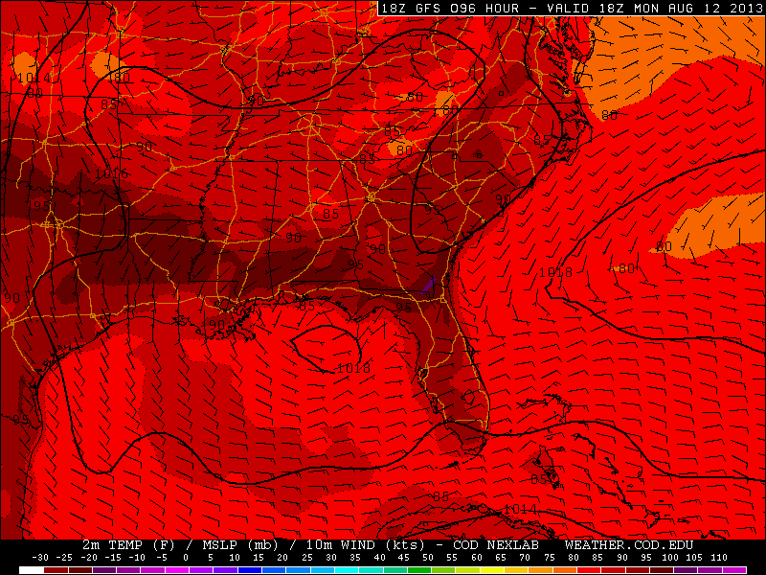
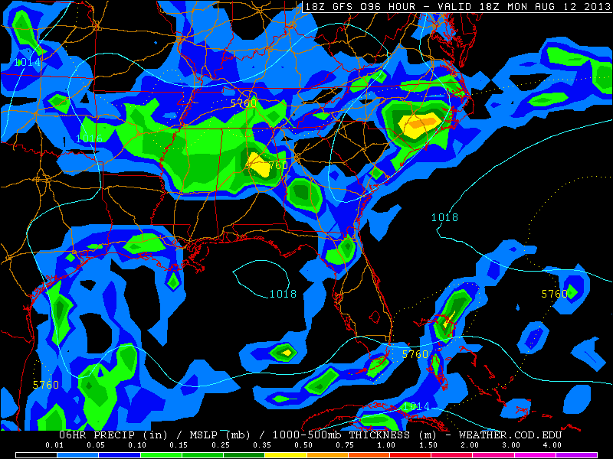
Weather Forecast: Surface
GFS sfc Temp, pressure, wind, precip, 8/12, 18Z
Monday (8/12):
GFS and NAVGEM show surface boundary extending from AR to NC/SC
Convection development likely in the afternoon!
High pressure over northern Gulf
Plenty of low-level moisture and instability!
H

Slide 12
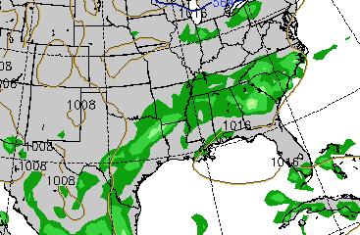
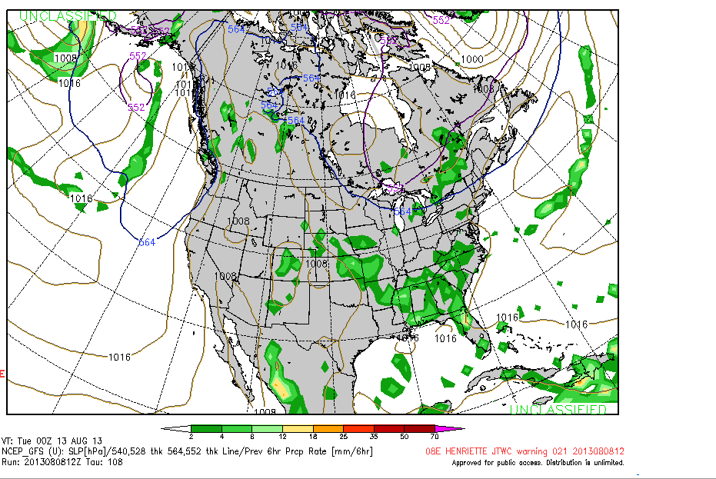
Convection/Rainfall Forecast
NAVGEM Precipitation, 00Z 8/13
GFS Precipitation, 00Z 8/13
By 00Z (7 PM CDT) on Monday, NAVGEM and GFS have the precip axis from AR to SC, but the GFS brings the precip closer to the Gulf Coast. The biggest discrepancy is the potential for precip in TX. NAVGEM has rain and the GFS is dry. This will be closely monitored in subsequent updates.

Slide 13
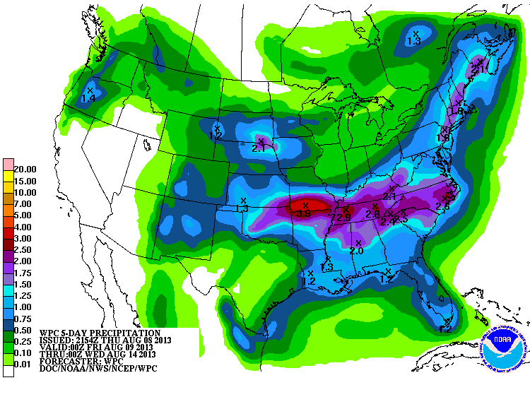
Convection/Rainfall Forecast
Monday (8/12):
Still too early to make a detailed convection forecast
Near-stationary frontal boundary will be the primary focus
Convection will develop each day along the front, extending from eastern OK to the Carolinas
In general, very little rainfall forecast in the region of interest for fires!
5-Day Precipitation (8/9 – 8/14)

Slide 14
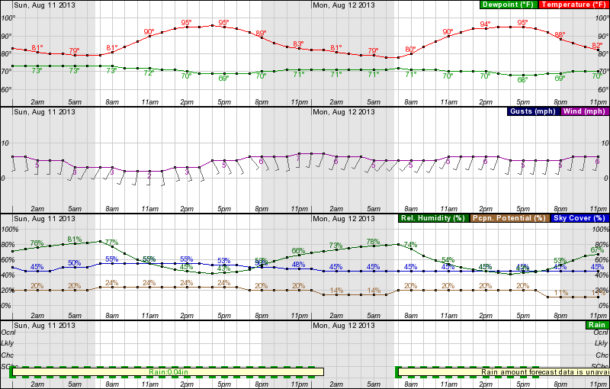
Forecast: Region of Higher Fire Danger
Sunday 0000 – Monday 2300 CDT, near Shreveport, LA
Frontal influences fail to reach northern LA. Low rain chances and persistently hot weather will allow the fire danger to remain relatively high
Relatively low RH in the afternoon, wind speed consistently southerly

Slide 15
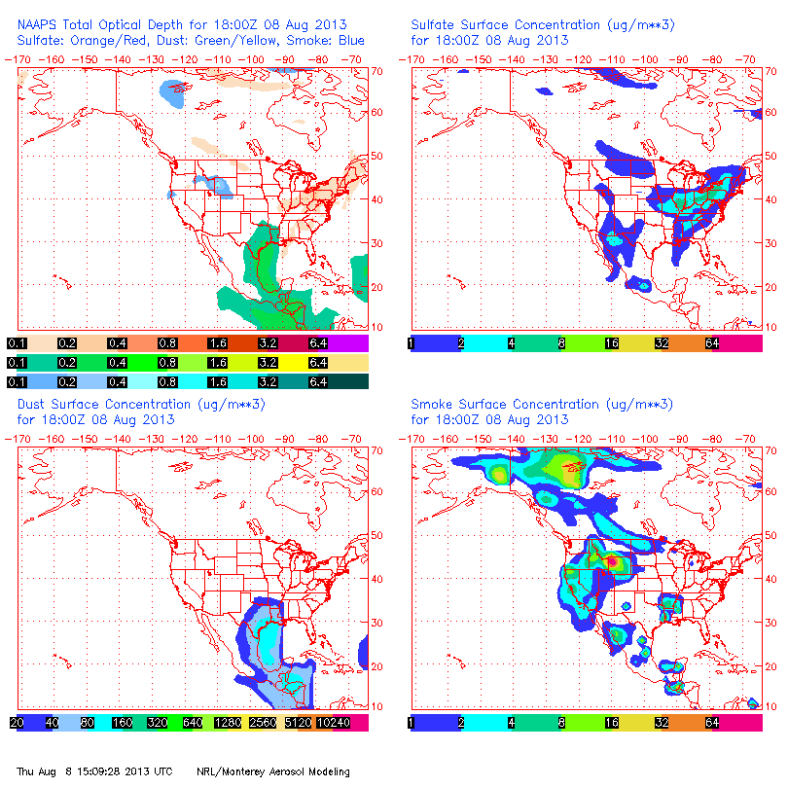
NAAPS Smoke/Aerosol Forecast
View slideshow for loop!!!
Some smoke may be present in the TX/LA/AR region!
Smoke concentrations are still high in the western CONUS
Potential for ESE transport must be monitored!
Dust concentrations decrease during the forecast period
Sulfates are generally high in the southern Midwest and Mid Atlantic
High concentrations extend into the SE CONUS on Monday 8/6!

Slide 16
Summary
Fire and smoke observations are possible in portions of TX, AR, and LA
Some fire growth/ignition is possible during the afternoon hours, but explosive growth is not expected.
Convection is likely along a surface boundary, extending from AR to the Carolinas

