Slide 1


Weather Briefing Sunday, August 18
Henry Fuelberg
Nick Heath
SEAC4RS Met Team

Slide 2
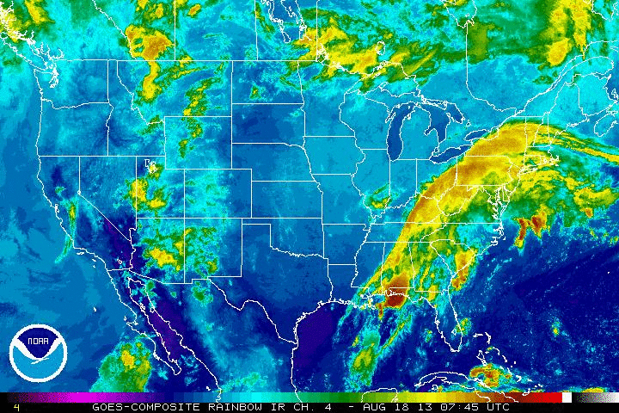
2:45 AM – 9:45 AM CDT

Slide 3
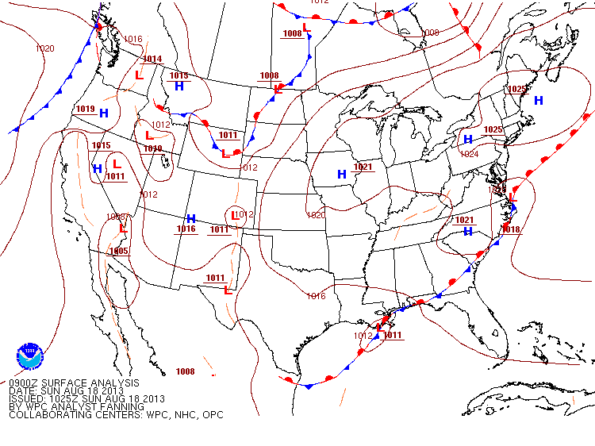
Surface Today

Slide 4
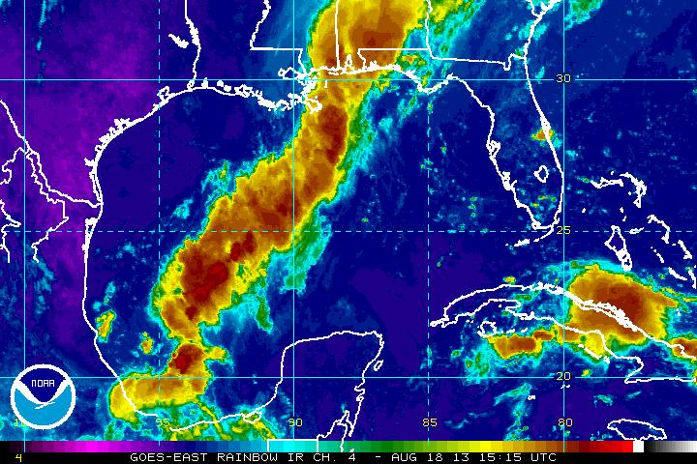
Tropical system is dead – 10:15 AM

Slide 5
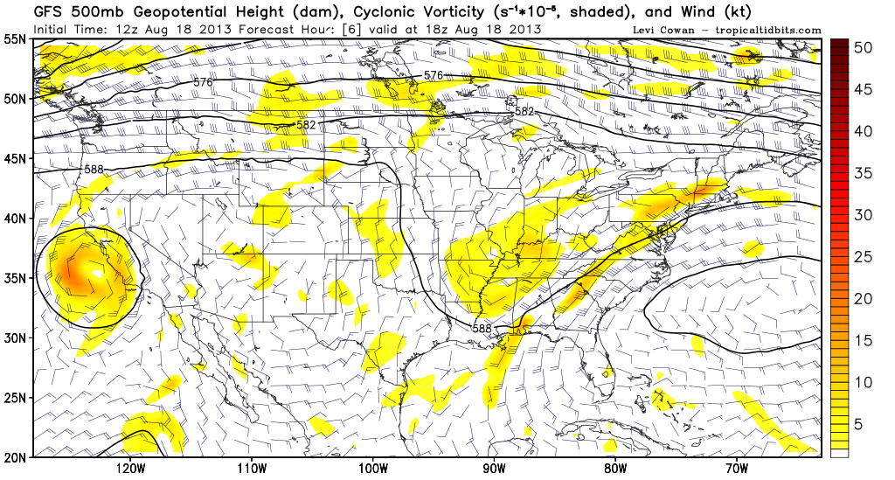
500 mb Flow: 1 PM Sunday

Slide 6
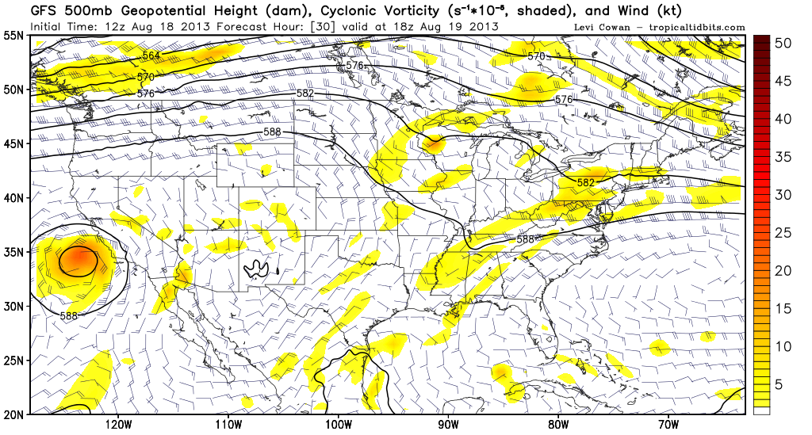
Looking ahead to Monday…1 PM CDT

Slide 7
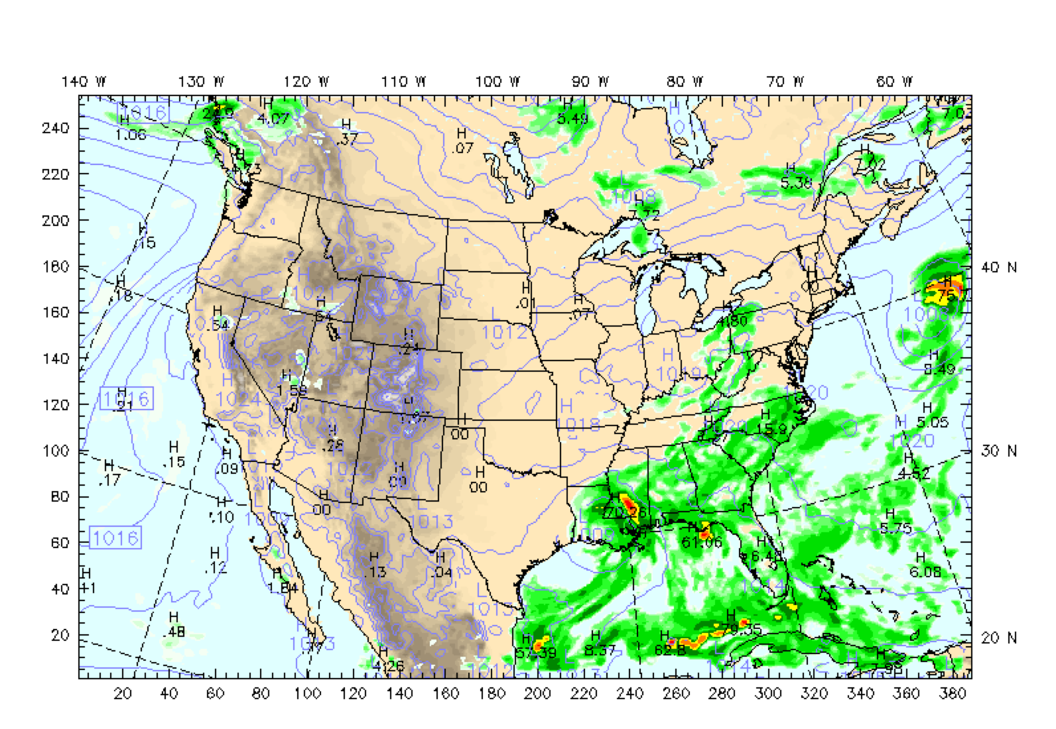
Surface forecast
Monday 1 PM CDT
NCAR 15 km WRF

Slide 8
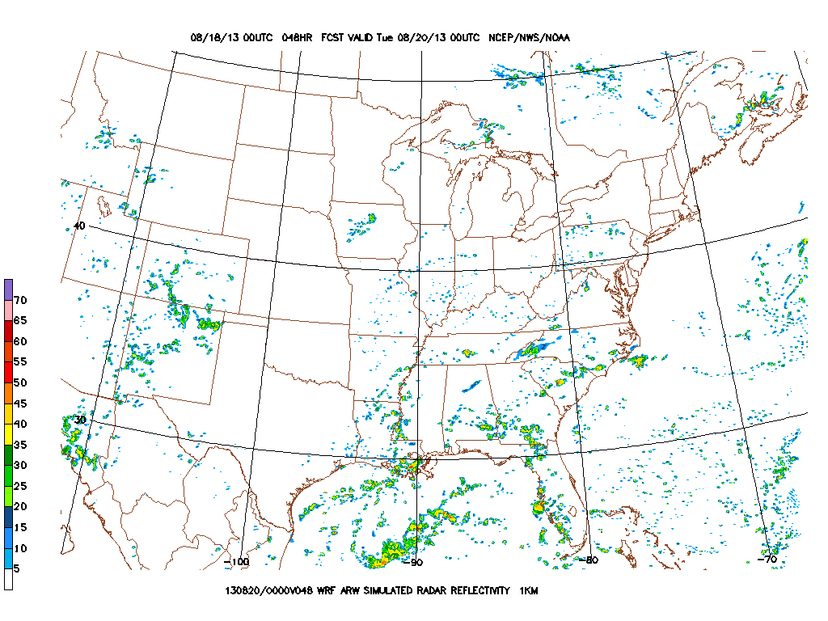
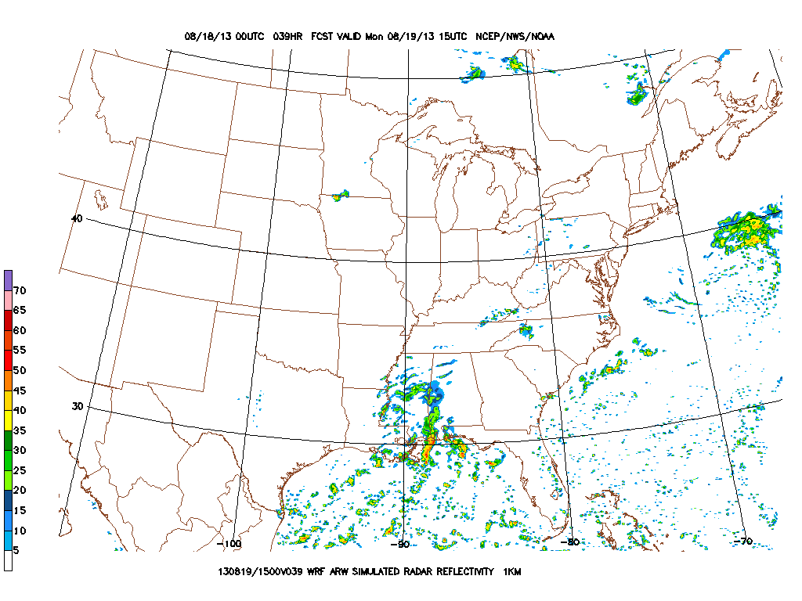
NCEP 4 km WRF-ARW
10 AM Monday
7 PM Monday

Slide 9
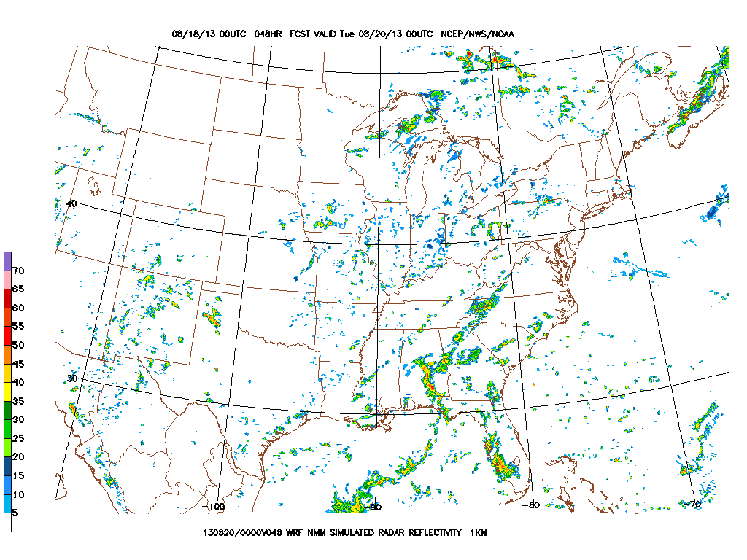
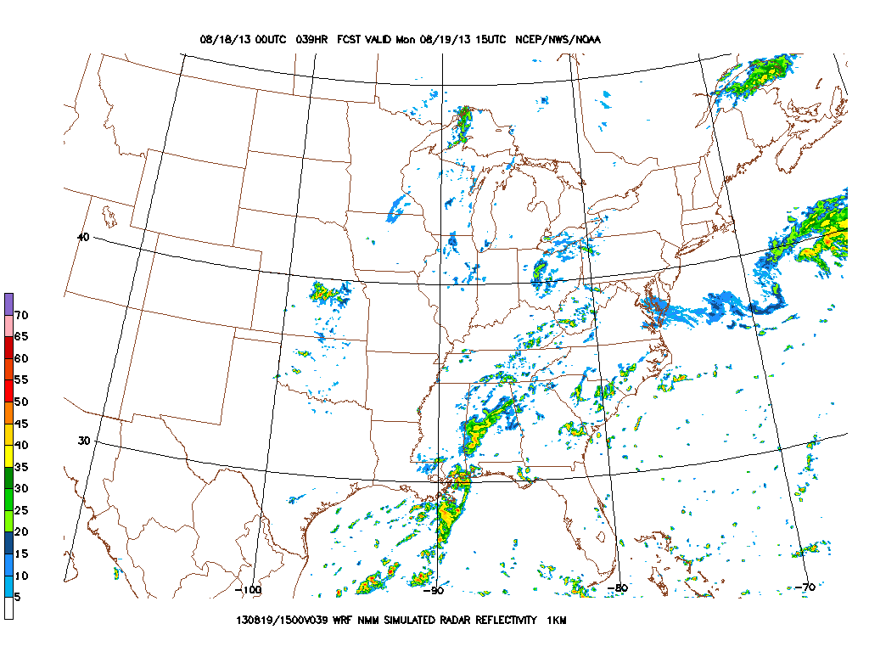
NCEP 4 km WRF-NMM
10 AM Monday
7 PM Monday

Slide 10
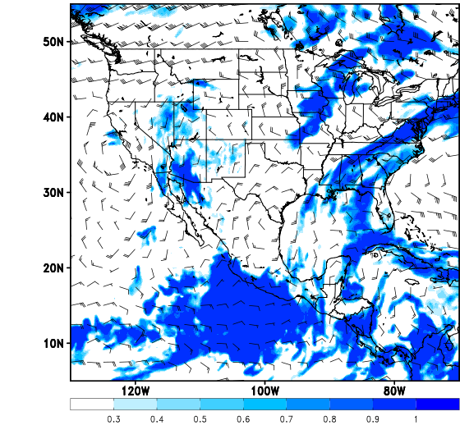
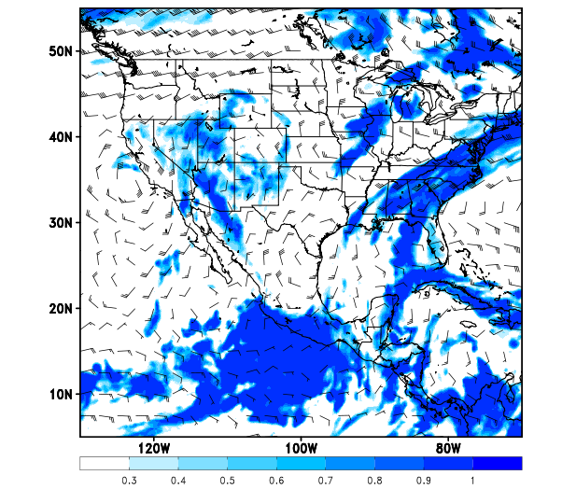
ECMWF High Cloud Cover
1 PM Monday
4 PM Monday

Slide 11
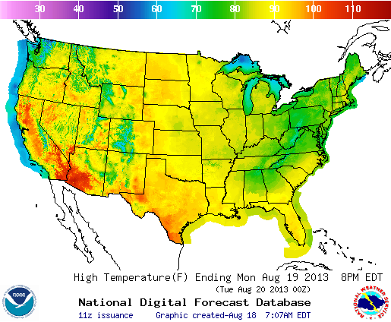
Max Temperatures Monday

Slide 12
Takeoff and Landing
Slow moisture advection leads to only remote chance of precip for takeoff
Isolated to scattered showers in the afternoon
East to southeast winds < 10 kt

Slide 13
Wednesday & Friday

Slide 14
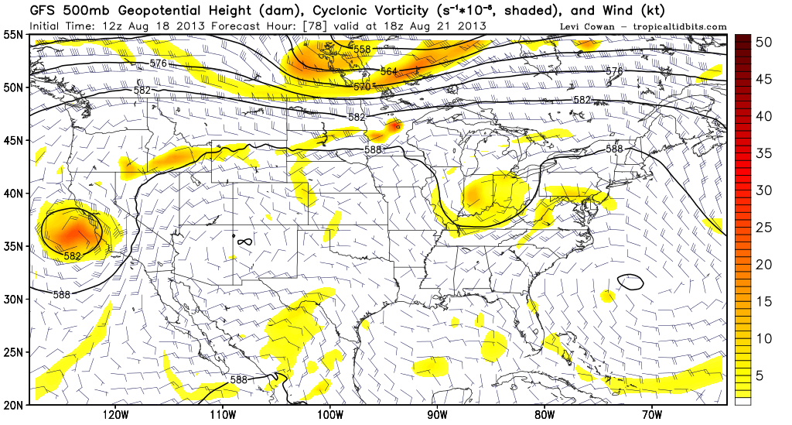
500 hPa 1 PM Wednesday

Slide 15
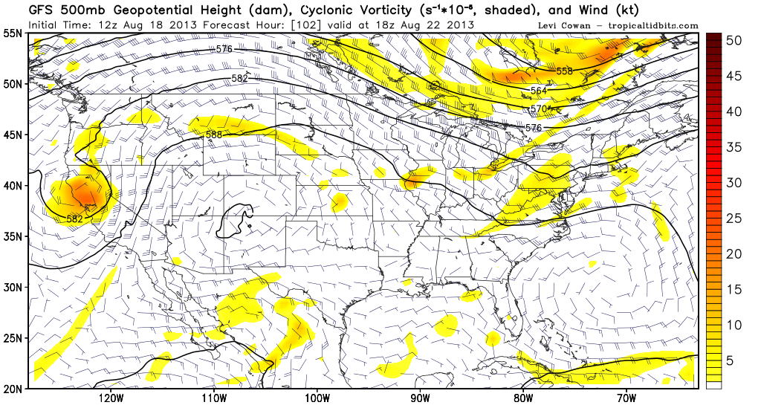
500 hPa 1 PM Thursday

Slide 16
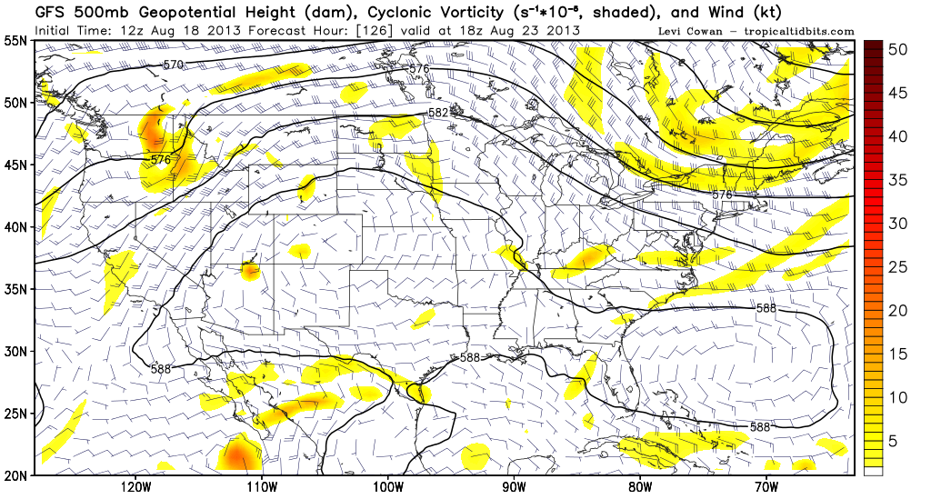
500 hPa 1 PM Friday

Slide 17
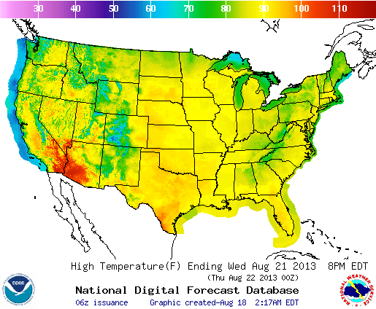
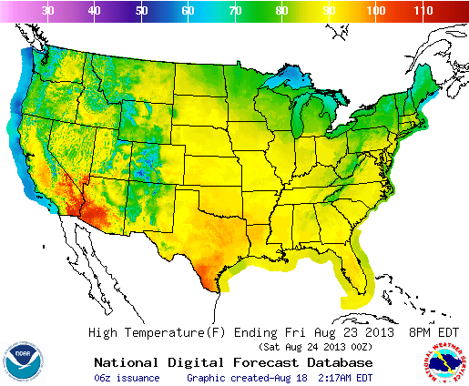
Monday
Maximum Temperatures
Wednesday
Friday

Slide 18
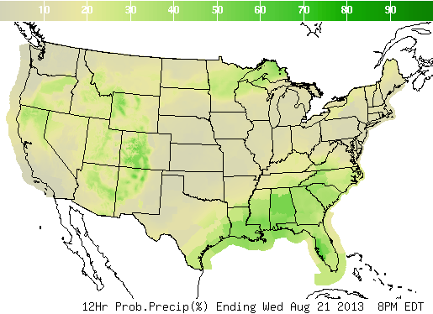
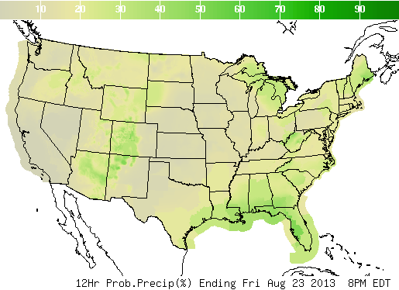
Probability of precipitation
Wednesday
Friday

