Slide 1
Dust plume update
UIOWA model

Slide 2
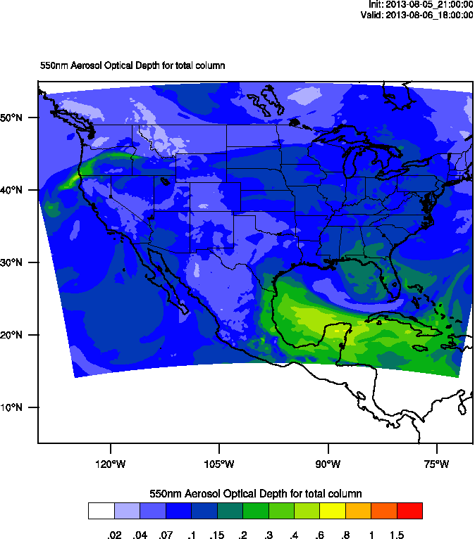
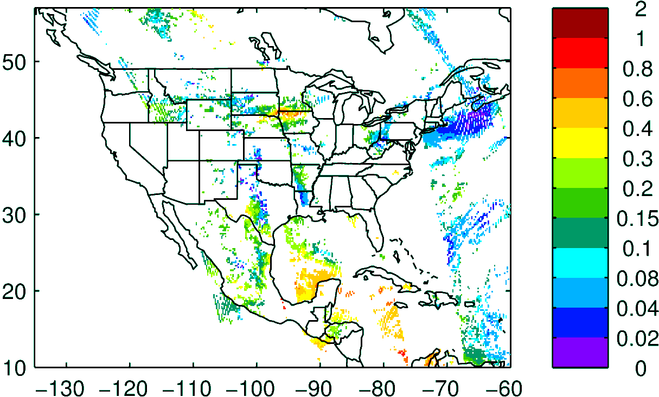
Today’s plume was well forecasted, location and magnitude
(check different color scales)
Today’s forecast AOD 18 UTC
Aqua AOD (NRL)

Slide 3
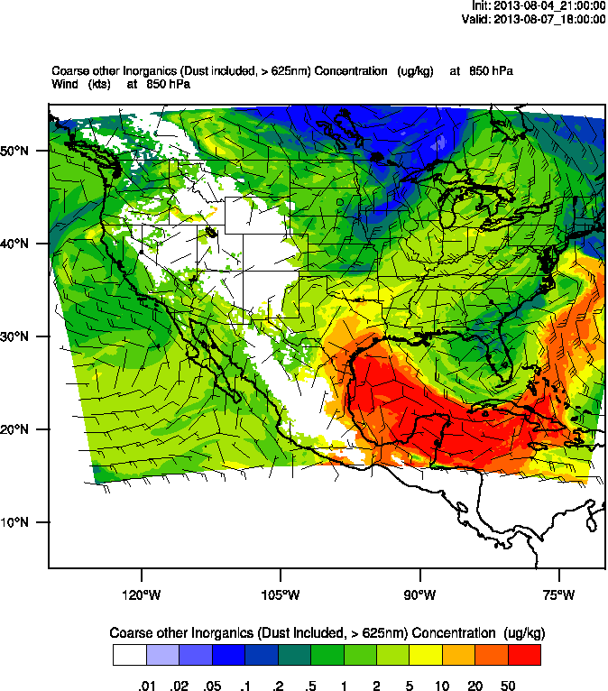
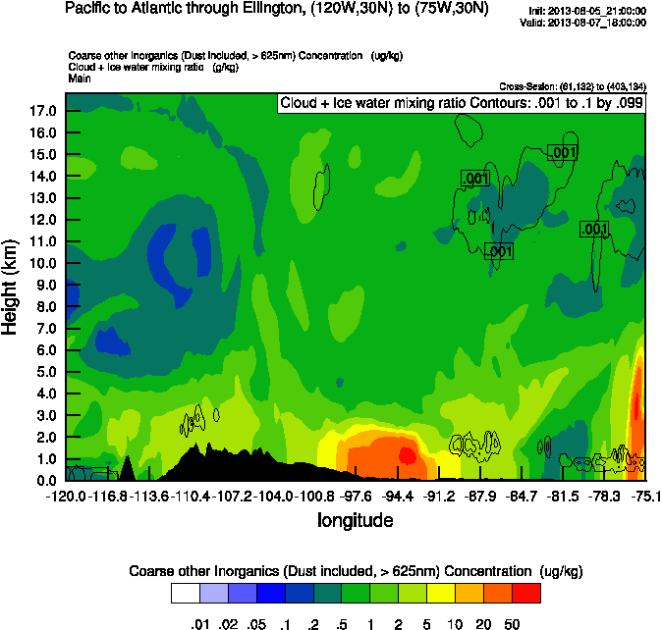
By local noon on Wednesday (Aug 9th) we should be able to see the plume in Ellington!
Ellington

